Slide 1


Report from the
Europe Representative to the RSC
EURIG Annual Meeting, 2024
Ahava Cohen
ahava.cohen@nli.org.il Ahava.cohen@rdatoolkit.org
Notes:
Spanish translation work is underway.
Move from a 4-release per year calendar to a 3-release one. Also each release will rollout over 2-3 weeks, beginning with the update to the official English version. Translation updates would publish over the following days.
We will implement this new schedule in the 2025 calendar year, with releases in February, June, and October.

Slide 2
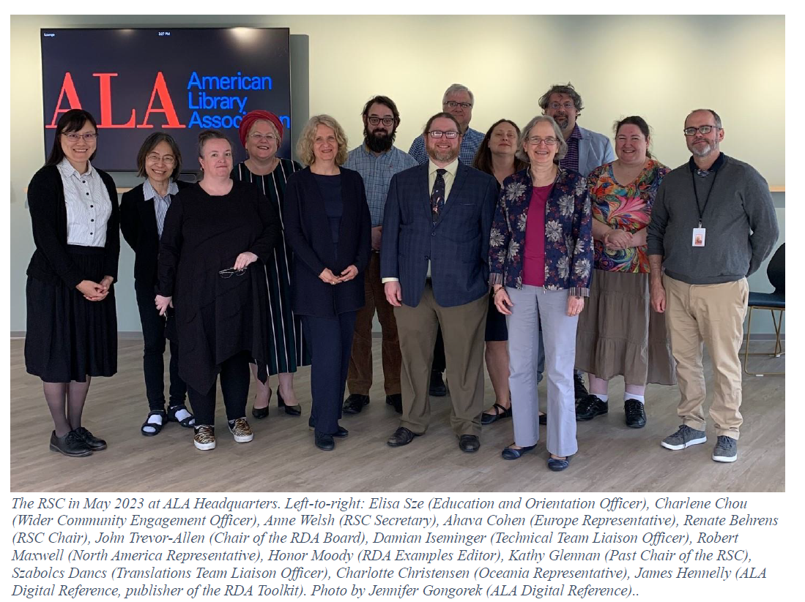
Meetings
2 in person meetings (joint RSC/RDA board meeting in Chicago in May, RSC meeting in Vienna in October)
3 asynchronous meetings (July, January, April)
All asynchronous
meetings had public
sessions
Going forward, every
third or fourth year
will see all meetings
asynchronous

Slide 3
RSC Membership
Kathy Glennan completed her term as RSC Past Chair
Jessica Grzegorski succeeded Honor Moody as Examples Editor for a three year term (December 2026)
Education and Orientation Officer became permanent role
Terms ending within the next 12 months:
  EURIG representative Ahava Cohen (December 2024)
  Technical Team Liaison Officer Damian Iseminger (December 2024)
  Translations Team Liaison Officer Szabolcs Dancs (December 2024)
  ORDAC representative Charlotte Christensen (February 2025)

Slide 4
Official RSC
Fast Tracks
Proposals
Community Resources
Operations Documents
Working Groups

Slide 5
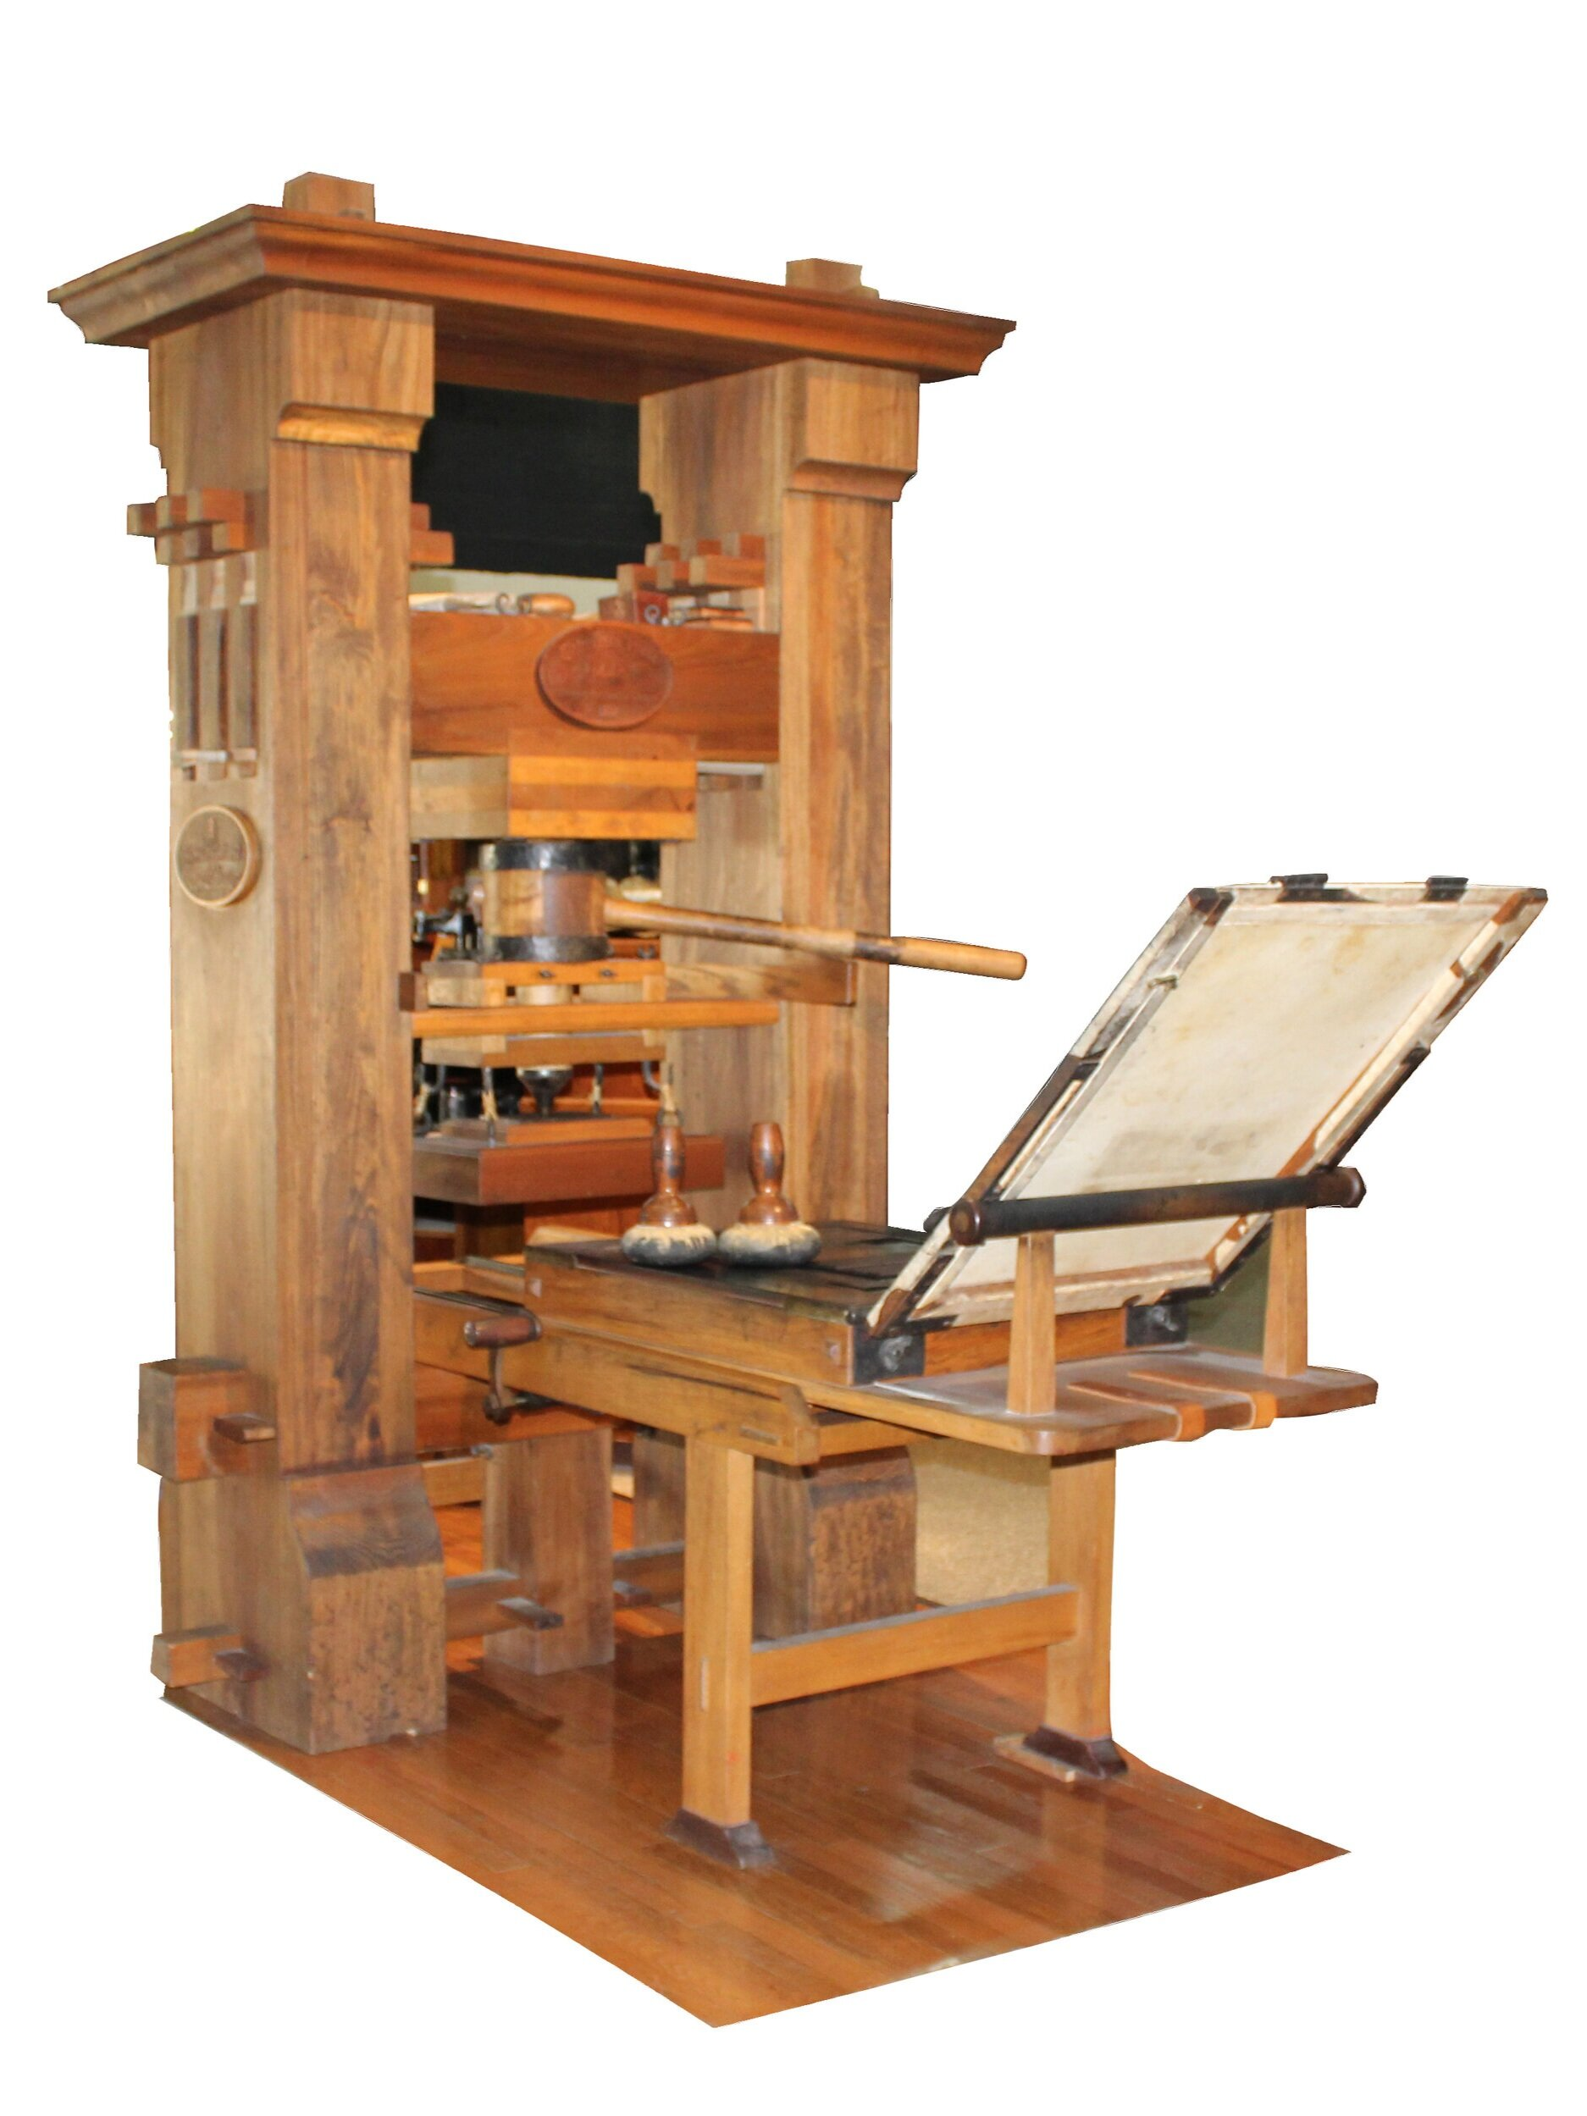
Fast Tracks
  Source:
  Translation WG: 2
  RSC Secretary: 2
  Technical WG: 3

Slide 6
Proposals - 2023
Proposal to Revise Term of Rank or Honour or Office
  Approved at October meeting with minor wordsmithing
Religious Titles
  Approved at July meeting – deleted material into CR
Jurisdictions, Governments, and Courts in RDA
  3 of 7 recommendations approved at May meeting
Revision of Corporate Body: jurisdiction governed and Place: jurisdiction governed of
  Approved at October meeting
Preferred names and official languages of corporate bodies, governments, and places in RDA
  Approved at July meeting, implementation to follow implementation of Jurisdiction proposals
Notes:
All proposals are available on the RSC website.
Decided in Jan that all Proposals will have impact statements (how does this affect day-to-day cataloging?)

Slide 7
Proposals
Dual-language naming of Corporate Body and Place
  Discussed at April meeting – requires more study
Revision of element hierarchy for appellations of work groups
  Approved at April meeting
Revise Name of Corporate Body
  Sent to Secretary for placement on future agenda
Notes:
All proposals are available on the RSC website.
Decided in Jan that all Proposals will have impact statements (how does this affect day-to-day cataloging?)

Slide 8
Community Resources
Incremental preparation for implementation
Policies and Procedures
for Updating RDA Content
https://www.rdatoolkit.org/sites/default/files/rsc/RSC_Operations_4_2024.pdf
Guidelines for Discussion Papers,
Proposals, and Responses to Them
https://www.rdatoolkit.org/sites/default/files/rsc/RSC-Operations_5_2024.pdf

Slide 9
Working Groups
Extent Working Group
Official Languages Working Group ☑
Place/Jurisdiction Working Group ☑
Religions in RDA Working Group

Slide 10
Working Groups
Standing Working Groups
Examples Working Group
Technical Working Group
Translations Working Group
Task and Finish Working Groups
Extent Working Group
Religions in RDA Working Group
Joint RDA Board and RSC Working Group on Artificial Intelligence
SES Working Group – Discussed at July meeting
Archives Working Group – Discussed at April meeting

Slide 11
Editorial Committee – 2024
Mélanie Roche - Bibliothèque nationale de France | June 2023 - June 2026
Heloise Lecomte - ABES | January 2023 – January 2026
Hannes Lowagie - KBR Royal Library of Belgium | June 2022 – June 2025
Thurstan Young – British Library | June 2022 – June 2025
Christian Aliverti | Ex officio – RDA Board IR
Jenny Wright - BDS (Bibliographic Data Services Ltd.) | Ex officio – RSC Chair
Ahava Cohen | Ex officio – EdCo Chair
Liv D’Amelio | Ex officio
Szabolcs Dancs | Ex officio
Szabina Ilácsa | Ex officio
Notes:
Looking for 1 or 2 new members
At this point, former members are kept on our basecamp space. If it ever came down to a vote – they are not voting members. But their input, if they should offer it, is still welcome.

Slide 12
Translations
Full translations:
Arabic
Catalan
Finnish
French
Hungarian
Italian
Norwegian
Spanish
Partial translations:
Danish
Dutch
Estonian
German
Greek
Hebrew
Latvian
Portuguese
Slovenian
Swedish
Turkish
Chinese
Vietnamese
Notes:
Looking for 1 or 2 new members
At this point, former members are kept on our basecamp space. If it ever came down to a vote – they are not voting members. But their input, if they should offer it, is still welcome.

Slide 13
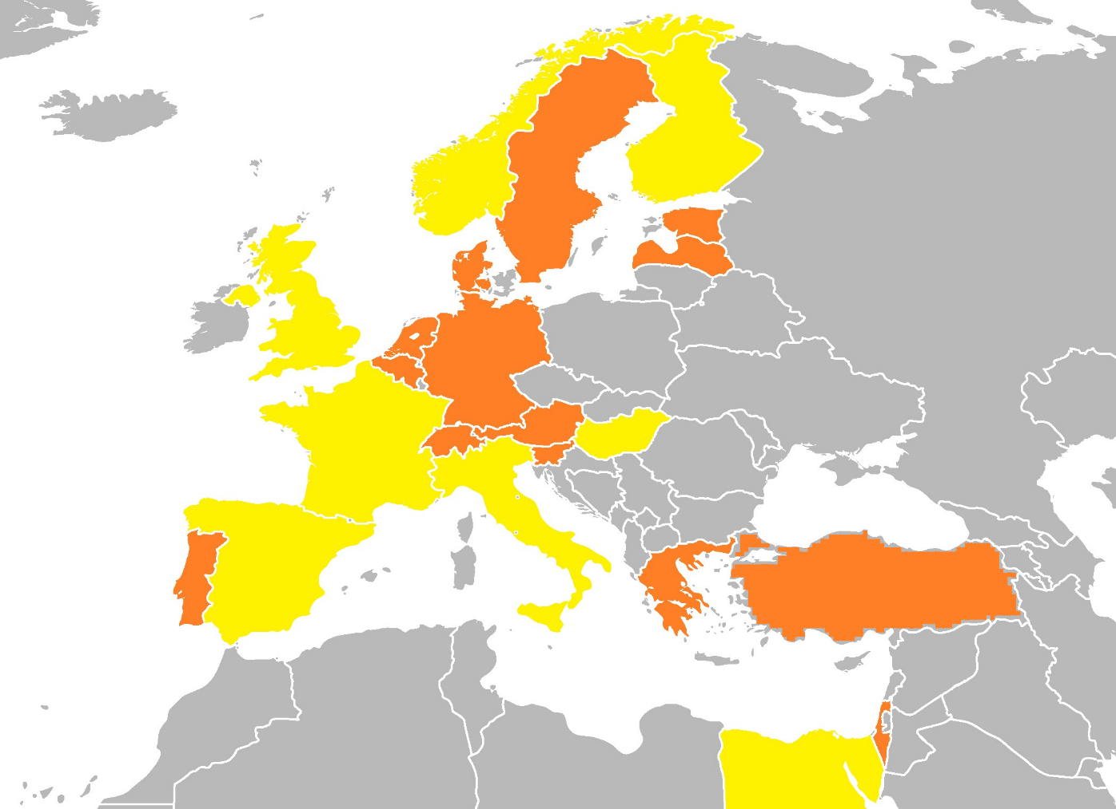


In Europe
Source of status information:
RDA Translation Statuses (last updated: May 2024) – you can find it on Googe Drive
Please, update it when necessary!
Full
Translations:
(8)
Partial translations:
(13)
?
Notes:
From slide deck for RDA Translators’ Meeting 2024, by Szabolcs Dancs
This is an updated map of the European status of RDA translations. There are several languages, mainly in the eastern part, for example the North Slavic languages, the post-Yugoslav countries, which are not yet covered. We continued to correspond with Romanian colleagues who expressed their interest in the implementation of RDA, but the progress is quite slow due to resource problems.
Full translations: 8
Partial translations: 13
As I mentioned, before. The table of language statuses was used as source, I registered status changes here. You can check it if you want to have a landscape of RDA translations. In general, I would like to ask you to provide updates when necessary, so that I can provide fresh information on translations during the RSC meetings and other occasions.

Slide 14


Questions? Comments?
Fast Track/Proposal ideas?

Slide 15
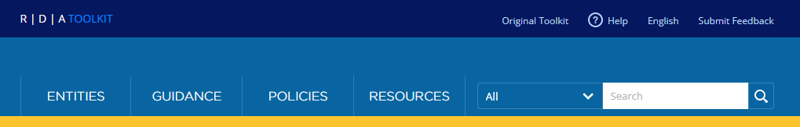
Ahava Cohen
National Library of Israel
Europe Representative to the RSC
ahava.cohen@nli.org.il Ahava.cohen@rdatoolkit.org
Twitter: @AhavaCohen

