Slide 1
Preparing RDA Training
A Perspective from the PCC
Notes:
Hi everyone. Thank you for inviting me to present on preparing RDA training, a perspective from the Program for Cooperative Cataloging (PCC).

Slide 2
RDA Copyright
©2010-2026 - American Library Association, Canadian Federation of Library Associations, and CILIP: Chartered Institute of Library and Information Professionals.
Screen images from the RDA Toolkit (www.rdatoolkit.org) used by permission of the Copyright Holders for RDA (American Library Association, Canadian Federation of Library Associations, and CILIP: Chartered Institute of Library and Information Professionals).

Slide 3
About Me
Head of Metadata Services, University of California, Berkeley
Member, SCT LRM Training Task Group (2018-2020)
Chair, SCT RDA Training Task Group: Monographs (2020-present)
Co-Chair/Chair, PCC RDA Communications Committee (2021-present)
Co-Chair, PCC Task Group to Test the Official RDA Toolkit (2022-2023)
Chair, PCC RDA Implementation Task Group (2023-present)
American Library Association Representative, North American RDA Committee (NARDAC) (2026-present)
Notes:
I am Adam Baron, Head of Metadata Services at the University of California, Berkeley in the United States.
I have been involved in the Program for Cooperative Cataloging’s efforts to implement official RDA since 2018, when I helped develop training on IFLA LRM. Over the past 6 years, I’ve taken on more leadership roles by serving as chair or co-chair of groups working on training, communications, testing, and implementation.
This past January, I was appointed as one of two representatives from the American Library Association to serve on the North American RDA Committee (NARDAC).

Slide 4
Outline
Introduction to PCC and RDA
What is IFLA/LRM? Training
Phase 1: PCC Introductory RDA Training
Changes from Original RDA for Monographs: Report
ALA RDA Preconference Workshop 2025
ALA RDA Preconference Workshop 2026
Phase 2: PCC RDA in Practice Training
Notes:
My presentation today is based on my experiences over the past 8 years and provides some insights into the behind-the-scenes work to prepare RDA training for PCC.

Slide 5
Introduction to PCC and RDA
Notes:
Before discussing PCC’s RDA training, I’m going to provide a brief introduction to PCC and RDA to provide some context for our training.

Slide 6
Program for Cooperative Cataloging (PCC)
An international cooperative organization of libraries coordinated by the Library of Congress
Goal: to build and share standardized, high-quality bibliographic and authority records using common standards
Advantages: helps libraries reduce duplicate work, lower costs, and speed up access to collections
Notes:
For those of you not familiar with PCC, the Program for Cooperative Cataloging is an international cooperative organization of libraries coordinated by the Library of Congress.
Its goal is to build and share standardized, high-quality bibliographic and authority records using common standards.
By using common standards, the program helps libraries reduce duplicate work, lower costs, and speed up access to collections.
To ensure a common understanding and application, documentation and training are essential to PCC’s work.

Slide 7
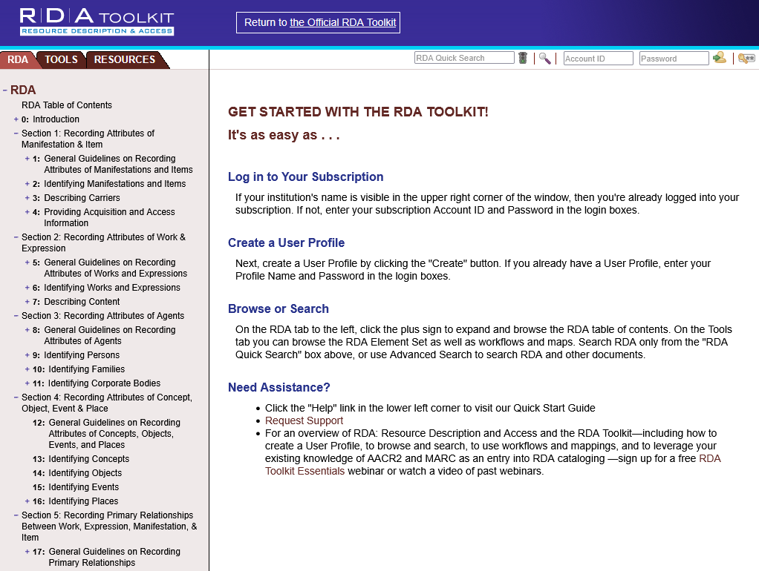
Original RDA Toolkit
https://original.rdatoolkit.org/
Released in 2010
Aligned with IFLA conceptual models:
  FRBR: Functional Requirements for Bibliographic Records
  FRAD: Functional Records for Authority Data
  FRSAD: Functional Requirements for Subject Authority Data
Notes:
Since 2013, PCC records were contributed using the original RDA Toolkit.
The original RDA Toolkit was released in 2010 and is available at original.rdatoolkit.org until May 2027. The original RDA Toolkit is aligned with the IFLA conceptual models Functional Requirements for Bibliographic Records (FRBR), Functional Requirements for Authority Data (FRAD), and Functional Requirements for Subject Authority Data (FRSAD).

Slide 8
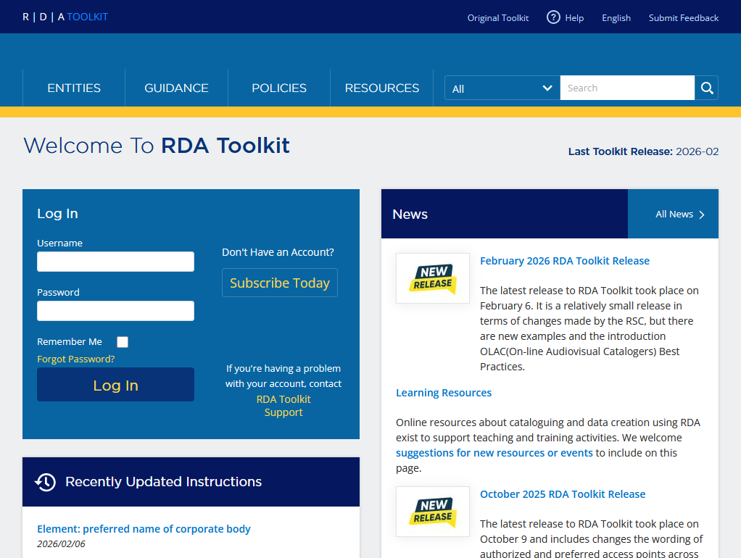
Official RDA Toolkit
https://access.rdatoolkit.org/
Released in 2020
Aligned with IFLA conceptual model: IFLA Library Reference Model (LRM)
Optimized for linked data environment
Expanded internationalization
Notes:
The official RDA Toolkit is available at access.rdatoolkit.org and was released in 2020 following the completion of the RDA Toolkit Restructure and Redesign (3R) Project.
During the 3R Project, RDA was brought into alignment with the IFLA Library Reference Model (LRM), which is the consolidation of the separate conceptual models FRBR, FRAD, and FRSAD. Official RDA’s alignment with IFLA LRM resulted in new RDA entities and elements, as well as the new modeling of aggregates, among other changes.
Official RDA is also optimized for linked data environments; however, it remains compatible with technologies used in current library systems, including MARC 21.
Internationalization and expanding RDA to an international audience has been a key focus of the RDA Board and the RDA Steering Committee and was a significant factor in some of the changes from original RDA to official RDA.

Slide 9
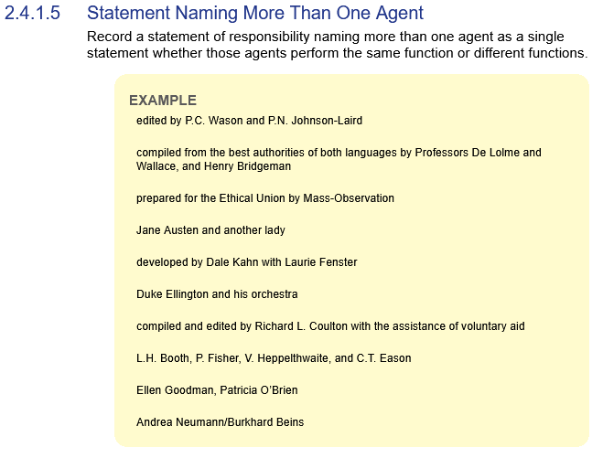
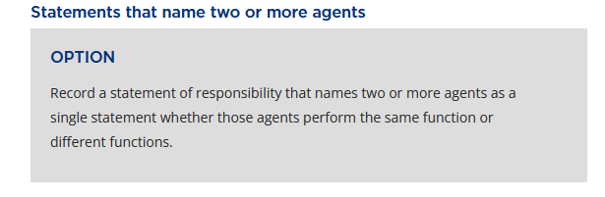
Instructions versus Options
Original RDA provides instructions.
Official RDA provides options.
Notes:
One change from original RDA to official RDA to support internationalization was that instructions became options. Optional instructions in RDA provide choices for creating well-formed RDA data that supports the needs of a local application or cataloging community.
In this example, the instruction remains largely unchanged; however, as an option, cataloging communities can decide to apply the option or not apply the option based on their particular use cases.

Slide 10
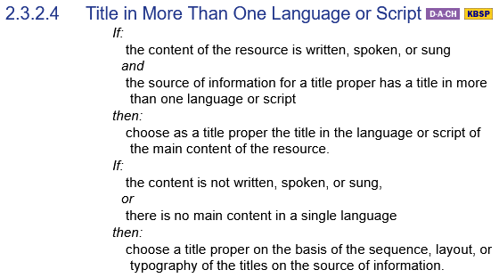
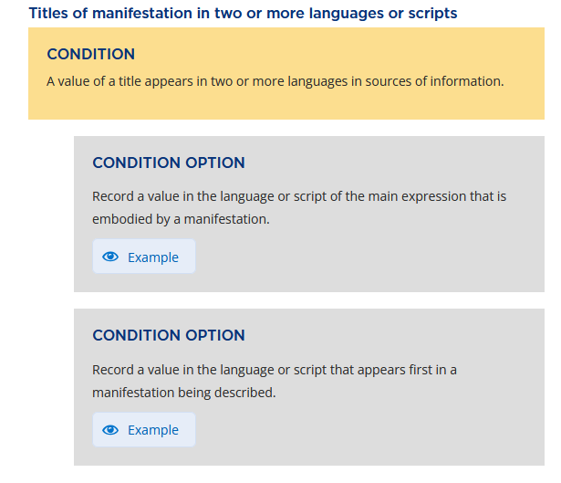
Conditions and Condition Options
Original RDA has conditional instructions.
Official RDA has conditions and condition options.
Notes:
Some options in RDA are applied conditionally.
Unlike conditional instructions in original RDA that may have started with an “If” statement, conditional instructions in official RDA display in yellow Condition boxes. All conditions in the Condition box must be met before considering which of the following Condition Options to apply.

Slide 11
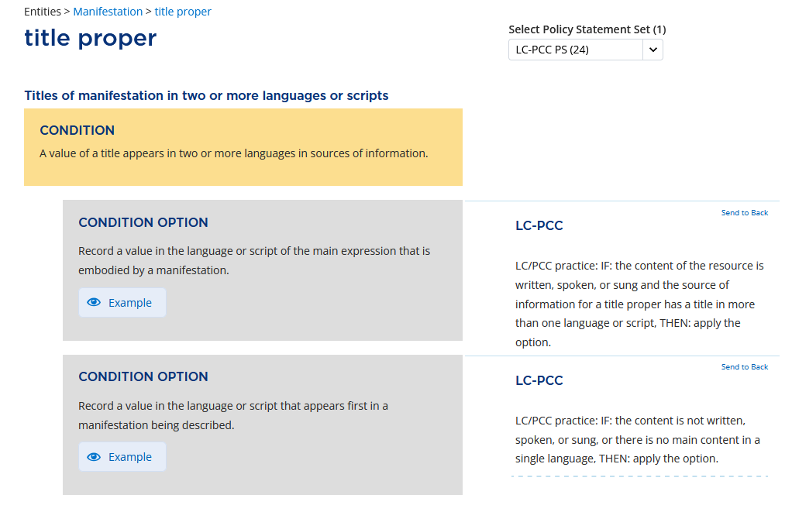
Policy Statements
Identify the options a cataloging community has decided to apply or not apply
Display in the right column alongside the RDA instructions
Policy Statements
Notes:
With so many options in official RDA, cataloging communities may create policy statements to identify which options they have decided to apply or not apply.
The policy statements display in the right column, making them easy to view alongside the RDA instructions.

Slide 12
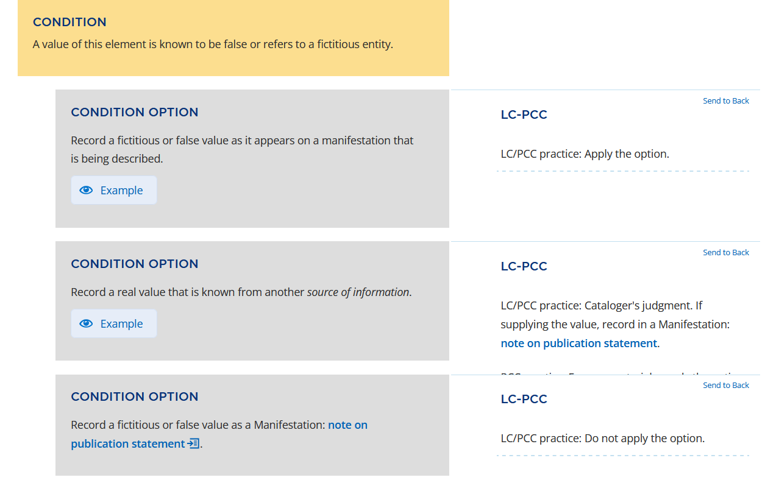
LC-PCC Policy Statements (LC-PCC PSs)
Identify the options in the RDA Toolkit that LC and PCC have decided to apply or not apply
Common LC-PCC PSs:
  Apply the option.
  Cataloger’s judgment.
  Do not apply the option.
LC-PCC PSs
Notes:
To help LC/PCC catalogers decide which options to apply, the Library of Congress and the Program for Cooperative Cataloging have created LC-PCC Policy Statements. The LC-PCC PSs provide information about the options in the RDA Toolkit that LC and PCC have decided to apply or not apply.
The three most common LC-PCC Policy Statements are: Apply the option, Cataloger’s judgment, and Do not apply the option.

Slide 13
LC-PCC Policy Statements (LC-PCC PSs)
Key Points
Indicate all LC/PCC Core elements
  Required for an effective description if applicable and readily ascertainable
Each option requires an LC-PCC PS
Brief without any examples or references to MARC 21 encodings
Include links to Metadata Guidance Documentation (MGDs)
Notes:
In addition, the LC-PCC Policy Statements indicate which elements are LC/PCC Core elements. For an effective description, all LC/PCC Core elements should be recorded if applicable and readily ascertainable.
With the change from instructions to options, LC/PCC decided that each option requires a policy statement so catalogers know if they should apply the option or not, or if they could exercise judgment to make the decision.
The new layout of the policy statements in the right column resulted in brief policy statements, without any examples or references to MARC 21 encodings. More extensive guidance and examples are included in the Metadata Guidance Documentation, which are linked from the LC-PCC Policy Statements.

Slide 14
Metadata Guidance Documentation (MGDs)
PDF documents available on the LC website
Provide longer or more specific guidance than is possible in the policy statements
Include examples encoded in MARC 21 and BIBFRAME
Must be used in conjunction with RDA Toolkit and LC-PCC PSs
Notes:
Metadata Guidance Documentation, or MGDs, are PDF documents available on the Library of Congress website. These documents provide longer or more specific guidance than is possible in the policy statements, including guidance for encoding values in MARC records and examples encoded in MARC and BIBFRAME.
The MGDs are not intended to be stand-alone documents. They must be used in conjunction with the official RDA Toolkit and the LC-PCC PSs.

Slide 15
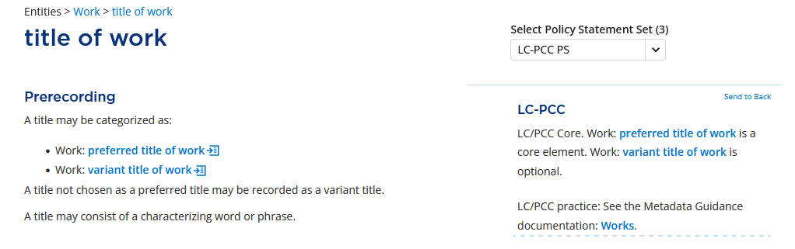
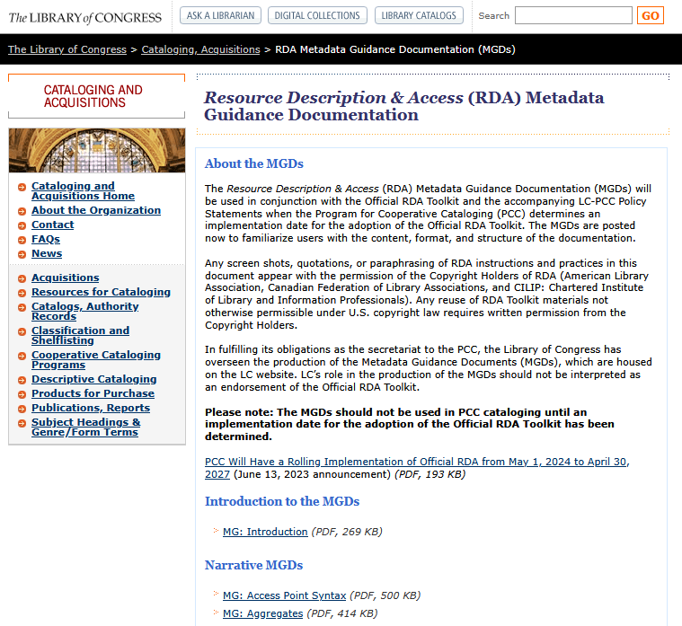
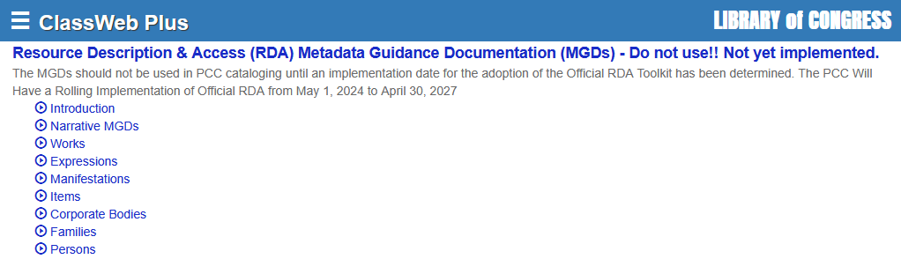
Accessing MGDs
1. Links from LC-PCC PSs
3. LC website at https://www.loc.gov/aba/rda/mgd/
2. ClassWeb Plus
Notes:
The most common way to access the MGDs is through direct links from the LC-PCC PSs in the official RDA Toolkit.
If your institution subscribes to ClassWeb Plus, the MGDs are included as part of the Cataloging Policy Documentation.
Alternatively, the MGDs can be accessed directly from the LC website at loc.gov/aba/rda/mgd.

Slide 16
What is IFLA/LRM? Training
2018-2020
Notes:
PCC’s training for official RDA began in 2018 when a task group was charged to develop training on the IFLA Library Reference Model (LRM).

Slide 17
What is IFLA/LRM? Training
Key Decisions
Focuses completely on the LRM model itself and only refers to other models and standards, such as FRBR & RDA, to offer broader context
An introduction to the basic concepts, not an in-depth class in applying the model
Provides sufficient understanding of the terminology and concepts to form a background for understanding cataloging standards, such as RDA, that are built on the model
Notes:
Because the 3R Project was still in progress and the new RDA text was not yet stable, the IFLA LRM training focuses completely on the LRM model itself and only refers to other models and standards, such as FRBR and RDA, to offer broader context.
This training is an introduction to the basic concepts, not an in-depth class in applying the model. It provides sufficient understanding of the terminology and concepts to form a background for understanding cataloging standards, such as RDA, that are built on the model.

Slide 18
What is IFLA/LRM? Training
Outline
What is LRM?
Terminology
Relationships
RES and WEMI
Agent
Place and Time Span
Nomen
Bibliographic Identities
Representative Expression Attribute
Introduction to Aggregates
Modelling Aggregates
Serials in LRM
https://www.loc.gov/catworkshop/RDA2020/index.html
Notes:
The IFLA LRM training consists of 12 modules on the following topics:
What is LRM?
Terminology
Relationships
The entities RES, Work, Expression, Manifestation, Item, Agent, Place, Time Span, and Nomen
Bibliographic identities
Representative expression attribute
Introduction and modeling of aggregates
Serials in LRM
PowerPoint slides of the training in English and a Spanish translation are available on the Catalogers Learning Workshop.

Slide 19
Phase 1:
PCC Introductory RDA Training
2020-2024
Notes:
In 2020, PCC began work on official RDA training.

Slide 20
SCT RDA Training Task Group: Monographs
Charge
Develop a training curriculum for PCC participants to catalog print and electronic book monographs using the official RDA Toolkit, LC-PCC Application Profile, LC-PCC Policy Statements, and LC-PCC Metadata Guidance Documents.
While the training may include concepts and examples applicable to a variety of formats, it is expected that other groups within PCC or specialized cataloging communities will develop more in-depth training for cataloging serials and other formats.
Notes:
The Standing Committee on Training (SCT) RDA Training Task Group: Monographs was charged with developing a training curriculum for PCC participants to catalog print and electronic books using the official RDA Toolkit, LC-PCC Application Profiles, LC-PCC Policy Statements, and Metadata Guidance Documentation.
While the training may include concepts and examples applicable to a variety of formats, it is expected that other groups within PCC or specialized cataloging communities will develop more in-depth training for cataloging serials and other formats.

Slide 21
SCT RDA Training Task Group: Monographs
Phases
Phase 1: PCC Introductory RDA Training
Phase 2: PCC RDA in Practice Training
Notes:
When the task group was charged in July 2020, the LC-PCC Policy Statements were still being added to the then beta RDA Toolkit and work on the Metadata Guidance Documentation had not started. As such, the training was planned to be released in two phases.
Phase 1 is introductory training, which was intended to focus on components that did not depend on the policy statements or metadata guidance documents; whereas Phase 2 would be the complete training for cataloging print and electronic books. While our timeline for releasing the training was continually been pushed back, we continued with this phased approached.

Slide 22
Phase 1: PCC Introductory RDA Training
Target Audience
PCC participants
  Primary: everyday cataloger
  Secondary: policy makers and specialist catalogers
Prerequisites:
  Basic level of cataloging training
Recommended training:
  SCT IFLA LRM (https://www.loc.gov/catworkshop/RDA2020/index.html)
Notes:
Early in the process, we discussed the target audience for our training. As a Program for Cooperative Cataloging training task group, our audience is PCC participants, with the primary audience being everyday catalogers and the secondary audience being policy makers and specialist catalogers. We also acknowledge that our training will be of interest to many catalogers who are not PCC participants.
To help ensure that our training is appropriate for all catalogers, we assumed a basic level of cataloging training. We wanted to make sure that everyone has the same background without assuming too much prior cataloging knowledge or experience. In this way, we hope that the training can be used by experienced catalogers moving from original RDA to official RDA, as well as catalogers who are new to the profession or PCC.
To better understand the conceptual model underlying RDA, the previously released IFLA LRM training is recommended but not required.

Slide 23
Phase 1: PCC Introductory RDA Training
Learning Outcomes
Identify key changes introduced during the 3R Project
Use and navigate the RDA Toolkit
Define key vocabulary terms
Understand new concepts
Notes:
In addition to defining our target audience, we also established several learning outcomes.
Since the Phase 1 training aims to help catalogers gain familiarity with the official RDA Toolkit and the new terms and concepts it introduces before getting into the practical cataloging details in Phase 2, we expect that at the end of the introductory training, catalogers will be able to identify key changes introduced during the 3R Project, use and navigate the official RDA Toolkit, define key vocabulary terms, and understand new concepts.

Slide 24
Phase 1: PCC Introductory RDA Training
Determining the Content (1)
Review of Existing Training & Presentations for Original RDA
Goals
  Identify possible strategies or best practices
  Identify things to avoid in our training
Outcomes
  Organize by RDA element not MARC field
  Focus on encoding agnostic
    Include MARC examples
  Train for today, but plan for the future
Notes:
One of our first tasks was to review existing training and presentations for both the original RDA Toolkit and what was still the beta version of the official RDA Toolkit.
In reviewing training for original RDA, we hoped to identify possible strategies or best practices that we might want to emulate or model in our training, as well as things we might want to avoid. Although not particularly relevant to the introductory training, we thought it was important to organize training based on RDA elements rather than MARC fields. As RDA is designed to be implemented in different scenarios, and PCC is slowly moving towards linked data and BIBFRAME, we thought it was important to focus first on how elements should be recorded according to RDA and then consider how they should be recorded in MARC. In this way, we feel that we can train for today, but plan for the future.

Slide 25
Phase 1: PCC Introductory RDA Training
Determining the Content (2)
Review of Existing Training & Presentations for Beta RDA
Goals
  Identify possible concepts
  Recommend existing training or presentations
Outcomes
  Decided to create cohesive training instead of a list of recommended training
  Identified concepts to include
  Identified possible training or presentations for reference
Notes:
When it came to reviewing existing training and presentations for the then beta RDA Toolkit, our initial goals were to identify possible concepts to include in our introductory training and to recommend existing training or presentations covering those concepts.
We reviewed presentations and workshops posted on the RSC and RDA Toolkit websites, as well as videos posted on the RDA Toolkit YouTube channel. For each item, we identified the concepts that were included, decided if we would recommend it or not, and rated it based on how closely it aligned to our introductory training outcomes. In the end, we decided not to create a list of recommended training or presentations. We felt it was more important to create a cohesive training that was logical and systematic in its approach rather than providing a collection of discrete, disjointed presentations. Fortunately, this review helped us to identify concepts for our introductory training, as well as possible presentations to which we could refer for additional information or ideas for how to present a concept.

Slide 26
Phase 1: PCC Introductory RDA Training
Determining the Content (3)
Review of RDA Guidance Chapters
Goals
  Identify possible concepts
Outcomes
  Not all content in the Guidance chapters is important to everyday catalogers
  Include Guidance chapter content in training if important for catalogers
Notes:
To build on the concepts we already identified by reviewing the existing training and presentations, we also reviewed the Guidance chapters in the new RDA Toolkit.
In reviewing the Guidance chapters, it became apparent that some parts are highly relevant to everyday catalogers while other parts are less important. For the parts that we felt were important, we wanted to make sure they were included in our training rather than just referring people to the Guidance chapter. By including this content in our training, we had the flexibility to change how it was presented by including more examples or additional context or explanation.

Slide 27
Phase 1: PCC Introductory RDA Training
Outline (1)
  Overview
Introduction to RDA
  Development and Basics of RDA
  Objectives and Principles Governing RDA
Using the RDA Toolkit
  Getting Started with RDA Toolkit
  Navigating RDA Toolkit
  Searching RDA Toolkit
  Personalizing RDA Toolkit
RDA Terminology and Concepts
  Recording Methods
  Data Provenance
  Coherent and Minimum Descriptions
  RDA Entities and Elements
  Timespan
  Nomens and Appellations
  Manifestation Statements
  Representative Expression
  Aggregates
  Diachronic Works
Notes:
After we identified possible concepts to include in our introductory training, we started drafting training slides and shortly afterwards developed a training outline.
The training outline organized the training topics into three main sections: Introduction to RDA, Using the RDA Toolkit, and RDA Terminology and Concepts. Since the Guidance chapters, except for Introduction to RDA, are in alphabetical order, we had to consider how we wanted to order the concepts and which ones could possibly be combined. While the specific content and order changed as we developed our training slides, the three main sections remained unchanged.
In the end, the full introductory training is comprised of 17 modules.

Slide 28
Phase 1: PCC Introductory RDA Training
Outline (2)
  Overview
Introduction to RDA
  Development and Basics of RDA
  Objectives and Principles Governing RDA
Using the RDA Toolkit
  Getting Started with RDA Toolkit
  Navigating RDA Toolkit
  Searching RDA Toolkit
  Personalizing RDA Toolkit
RDA Terminology and Concepts
  Recording Methods
  Data Provenance
  Coherent and Minimum Descriptions
  RDA Entities and Elements
  Timespan
  Nomens and Appellations
  Manifestation Statements
  Representative Expression
  Aggregates
  Diachronic Works
Notes:
Module 1 provides an overview of the Phase 1: PCC Introductory RDA Training.

Slide 29
Phase 1: PCC Introductory RDA Training
Outline (3)
  Overview
Introduction to RDA
  Development and Basics of RDA
  Objectives and Principles Governing RDA
Using the RDA Toolkit
  Getting Started with RDA Toolkit
  Navigating RDA Toolkit
  Searching RDA Toolkit
  Personalizing RDA Toolkit
RDA Terminology and Concepts
  Recording Methods
  Data Provenance
  Coherent and Minimum Descriptions
  RDA Entities and Elements
  Timespan
  Nomens and Appellations
  Manifestation Statements
  Representative Expression
  Aggregates
  Diachronic Works
Notes:
In the Introduction to RDA, module 2 covers the development and basics of RDA and introduces the IFLA Library Reference Model (LRM), while module 3 covers the Objectives and Principles Governing RDA and the user tasks find, identify, select, obtain, and explore.

Slide 30
Phase 1: PCC Introductory RDA Training
Outline (4)
  Overview
Introduction to RDA
  Development and Basics of RDA
  Objectives and Principles Governing RDA
Using the RDA Toolkit
  Getting Started with RDA Toolkit
  Navigating RDA Toolkit
  Searching RDA Toolkit
  Personalizing RDA Toolkit
RDA Terminology and Concepts
  Recording Methods
  Data Provenance
  Coherent and Minimum Descriptions
  RDA Entities and Elements
  Timespan
  Nomens and Appellations
  Manifestation Statements
  Representative Expression
  Aggregates
  Diachronic Works
Notes:
Modules 4 through 7 are focused on using the official RDA Toolkit, with separate modules for accessing and logging in, navigating, searching, and personalizing the RDA Toolkit. Each module is accompanied by a set of exercises to encourage purposeful exploration and practice in the RDA Toolkit.

Slide 31
Phase 1: PCC Introductory RDA Training
Outline (5)
  Overview
Introduction to RDA
  Development and Basics of RDA
  Objectives and Principles Governing RDA
Using the RDA Toolkit
  Getting Started with RDA Toolkit
  Navigating RDA Toolkit
  Searching RDA Toolkit
  Personalizing RDA Toolkit
RDA Terminology and Concepts
  Recording Methods
  Data Provenance
  Coherent and Minimum Descriptions
  RDA Entities and Elements
  Timespan
  Nomens and Appellations
  Manifestation Statements
  Representative Expression
  Aggregates
  Diachronic Works
Notes:
Modules 8 through 17 are devoted to RDA terminology and concepts, including recording methods, data provenance, coherent and minimum descriptions, RDA entities and elements, timespan, nomens and appellations, manifestation statements, representative expression elements, aggregates, and diachronic works.

Slide 32
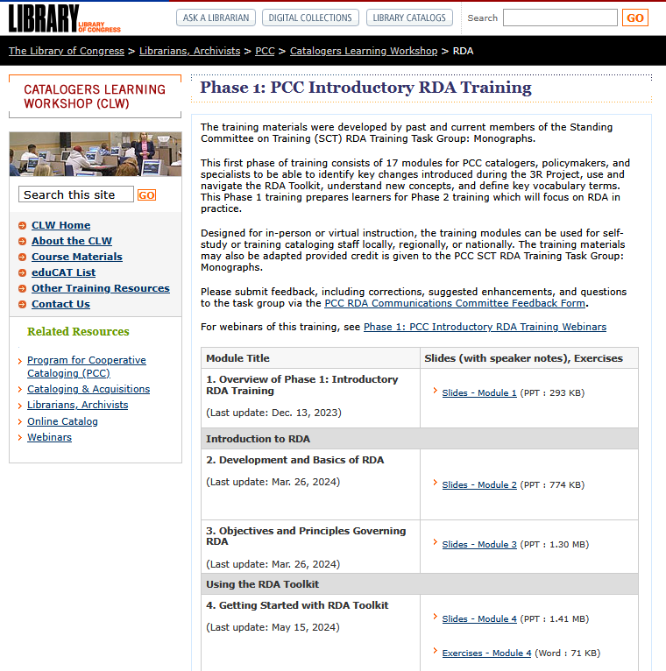
Phase 1: PCC Introductory RDA Training
Accessing the Training
Freely available on Catalogers Learning Workshop
https://www.loc.gov/catworkshop
/rda/index.html
Notes:
The introductory training is freely available on the Catalogers Learning Workshop and includes the complete slides with speaker notes in Microsoft PowerPoint and exercises and answers in Microsoft Word.

Slide 33
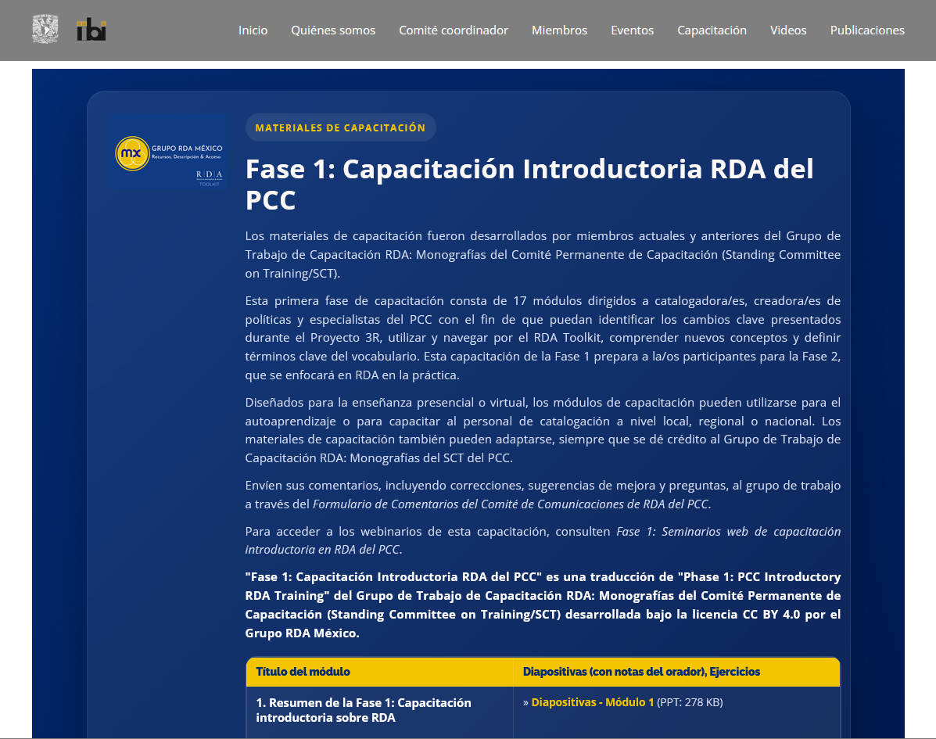
Phase 1: PCC Introductory RDA Training
Accessing the Spanish Translation
Freely available on RDA Mexico Group website
https://difusion.iibi.unam.mx/RDA-México/traduccion_es.html
Notes:
The Phase 1: PCC Introductory RDA Training has been translated into Spanish by the RDA Mexico Group and is freely available on their website.

Slide 34
Phase 1: PCC Introductory RDA Training
Webinars
  Introduction to RDA
  Using the RDA Toolkit, Part 1
  Using the RDA Toolkit, Part 2
  Recording Methods; Data Provenance
  Coherent and Minimum Descriptions; RDA Entities and Elements
  Timespan
  Nomens and Appellations
  Manifestation Statements
  Representative Expression
  Aggregates
  Diachronic Works
https://www.loc.gov/catworkshop/rda/PCC-Introductory-RDA-Training-Webinars/index.html
Notes:
After the release of the training materials, the training task group organized and presented the introductory training modules in a series of 11 webinars from March 13-May 22, 2024. The recordings for all webinars are freely available on the Phase 1: PCC Introductory RDA Training Webinars page.

Slide 35
Phase 1: PCC Introductory RDA Training
Using the Training
Self-study
Training cataloging staff locally (e.g., within your institution), regionally (e.g., within your consortia), or nationally
This training has been designed for virtual or in-person instruction
Training materials may be adapted to meet the needs of your staff or audience, but credit must be given to the PCC SCT RDA Training Task Group: Monographs
Notes:
The introductory training can be used for self-study or training cataloging staff locally, regionally, or nationally. This training has been designed for virtual or in-person instruction. If desired, the training materials can be adapted to meet the needs of the audience.

Slide 36
Phase 2:
PCC RDA in Practice Training
2024-present
Notes:
After the Phase 1 webinars, the SCT RDA Training Task Group: Monographs began working on Phase 2: PCC RDA in Practice Training.

Slide 37
Phase 2: PCC RDA in Practice Training
Charge & Deliverables
Charge
Develop training for PCC participants to catalog print and electronic books using the official RDA Toolkit, LC-PCC Application Profile, LC-PCC Policy Statements, and LC-PCC Metadata Guidance Documents
Deliverables
Report on the changes in PCC practice from original RDA to official RDA
Bridge training focused on changes in cataloging practice in official RDA
Full training for cataloging print and electronic books in official RDA
Notes:
The charge for phase 2 is to develop practical training that covers how to catalog print and electronic books using the official RDA Toolkit, LC-PCC Application Profiles, Policy Statements, and Metadata Guidance Documents.
There are three deliverables for the task group during phase 2: a report on changes in PCC practice from original RDA to official RDA, bridge training focused on changes in cataloging practice in official RDA, and full training for cataloging print and electronic books in official RDA. I will discuss each of these in more detail shortly.

Slide 38
Changes from Original RDA
Objective
  To systematically review official RDA elements, comparing how practices in official RDA are different from practices in original RDA
Elements
  A list of 163 elements to review was prepared based on:
    Draft PCC application profile for official RDA
    Element lists in the official RDA Toolkit
    Metadata Guidance Documentation (MGDs)
Assignments
  Task group members were divided into pairs and assigned a selection of elements to review with each element being reviewed by both people
Notes:
With those deliverables in mind, the training task group began a systematic review of official RDA elements to compare how practices in official RDA are different from practices in original RDA.
I prepared a list of 163 elements to review based on the draft PCC application profile for official RDA, element lists in the official RDA Toolkit, and Metadata Guidance Documentation.
To complete the review, task group members were divided into pairs and assigned a selection of elements to review. Each person reviewed their assigned elements separately, but the pairs ensured that each element was reviewed twice, and we were not making decisions based on only one person’s opinion.

Slide 39
Changes from Original RDA
Key Takeaways
Many practices remain unchanged
Most changes are minor (e.g., new recording method or option)
Significant changes in the cataloging process and how cataloging decisions are made
Documentation needs to be updated
Notes:
This review determined that many practices remain unchanged, which was expected. When a change in practice was noted, it was typically a minor change, such as a new recording method or option in addition to those we have been using in original RDA. While there is not likely to be many changes in the values that are recorded, there are significant changes in the cataloging process and how cataloging decisions are made. The review also identified several areas where the PCC documentation needed to be updated.
The task group compiled its findings into a report.

Slide 40
Changes from Original RDA for Monographs: Report
Purpose
To inform PCC and the larger cataloging community of changes from original RDA to official RDA for monographs and the impact of those changes on PCC practices
To serve as a reference for experienced RDA catalogers to look up common terms and elements from original RDA and find their corresponding term or element in official RDA
To illustrate how values of official RDA elements may be encoded in MARC 21 bibliographic records when there are possible changes from original RDA
Notes:
The Changes from Original RDA for Monographs: Report aims to inform PCC and the larger cataloging community of changes from original RDA to official RDA for monographs and the impact of those changes on PCC practices.
It also serves as a reference for experienced catalogers to look up common terms and elements from original RDA and find their corresponding term or element in official RDA if it has changed.
Lastly, the report includes examples to illustrate how values of official RDA elements may be encoded in MARC 21 bibliographic records when there are possible changes from original RDA.

Slide 41
Changes from Original RDA for Monographs: Report
Overview of Sections
Terminology Changes
RDA Entity Changes
RDA Element Changes
Changes in Practice
MARC Coding Changes
Notes:
The report is divided into five main sections:
Terminology Changes describes new terminology and changes in existing terminology.
RDA Entity Changes outlines the new RDA entities and changes to existing entities.
RDA Element Changes presents new RDA elements and changes to existing elements.
Changes in Practice highlights changes in cataloging practice for PCC. It includes some general changes in practice, element specific changes in practice, and changes to relationship labels.
MARC Coding Changes provides examples for encoding RDA data in MARC 21 bibliographic records where there is a change from original RDA, such as new RDA elements, a new MARC field or subfield, or a change in recording method.
It is a long, detailed report with a lot of tables, but we are hoping it will be useful and informative.

Slide 42
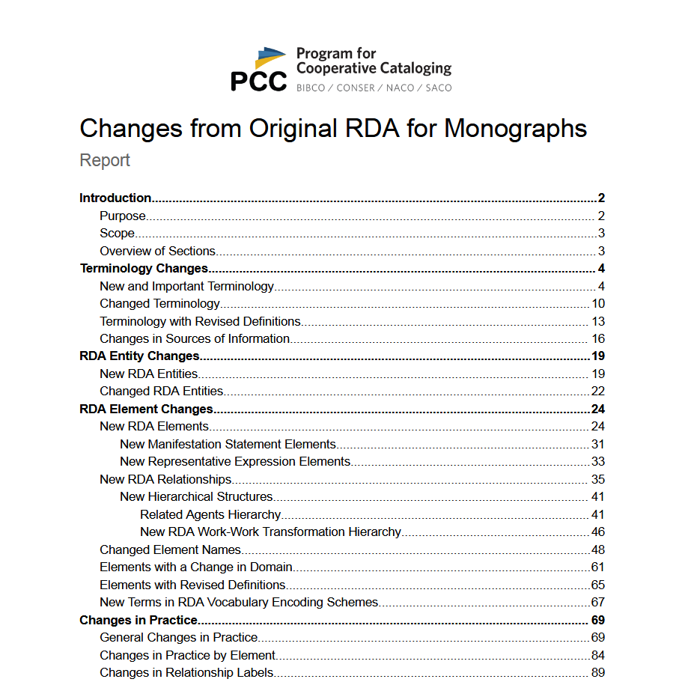
Changes from Original RDA for Monographs: Report
Accessing the Report
https://www.loc.gov/aba/pcc/sct/documents/Changes-from-Original-RDA-for-Monographs-Report.pdf
Notes:
A link to the Changes from Original RDA for Monographs: Report is available on the PCC home page or the direct link on this slide.

Slide 43
Cataloging Assignment
Objective
To help us identify training topics and how to present the training, catalog one print book or e-book using official RDA.
Notes:
Although the task group had been working on identifying changes in cataloging practice and drafting slides for bridge training, many task group members had not actually cataloged a resource using official RDA. The Cataloging Assignment had everyone choose a print or electronic book to catalog using official RDA.

Slide 44
Cataloging Assignment
Questions to Consider
What language or terminology did you encounter that should be explained in training?
What options or instructions did you encounter that should be explained in training?
Where did you encounter changes in PCC practice?
Where did you encounter difficulties or problems?
What questions did you have?
Where does the documentation need to be updated?
What was your process and how successful was it?
Notes:
While cataloging their book, task group members were asked to consider questions that would help us identify training topics and how to present the training. These questions included:
What language or terminology did you encounter that should be explained in training?
What options or instructions did you encounter that should be explained in training?
Where did you encounter changes in PCC practice?
Where did you encounter difficulties or problems?
What questions did you have?
Where does the documentation need to be updated?
What was your process and how successful was it?

Slide 45
Cataloging Assignment
Key Takeaways
Cataloging with official RDA can be challenging and frustrating
Training needs to include guidance for how to interpret some RDA instructions
Describing aggregates raised the most questions
There are numerous problems where the documentation needs to be updated
Notes:
While I am not going to go through each of the questions in detail, there are few key takeaways from the assignment. First, it is important to acknowledge that cataloging with official RDA can be challenging and frustrating. To help alleviate some of these challenges and frustrations, our training should include guidance for how to interpret some of the RDA instructions. In general, describing aggregates raised the most questions and will require special attention during training. The question that generated the most feedback was problems with documentation.

Slide 46
ALA RDA Preconference Workshop 2025
Learning Outcomes
Understand and apply official RDA instructions and PCC practices for describing print and electronic monographs in MARC 21 format
Understand and apply the BIBCO Standard Record (BSR) Official RDA Metadata Application Profile
Apply appropriate guidance in LC-PCC Policy Statements and RDA Metadata Guidance Documentation
Notes:
Building on the cataloging assignment, members of the SCT RDA Training Task Group: Monographs and the North American RDA Committee (NARDAC) presented a joint RDA workshop at the ALA Annual Conference in June 2025. The goal for the workshop was for participants to have a better understanding of how to apply RDA instructions and PCC documentation while cataloging an ebook.

Slide 47
ALA RDA Preconference Workshop 2025
Workshop Structure
Documentation used by PCC catalogers
Review of RDA concepts
Cataloging an ebook
  Describing the manifestation
  Describing the aggregating work & aggregating expression
  Describing an aggregated work & aggregated expression
  Recording data provenance
Workshop materials: https://bit.ly/RDA-ALA-25
Notes:
The workshop started by reviewing the documentation used by PCC catalogers, including the RDA Toolkit, LC-PCC Policy Statements, Metadata Guidance Documentation, and the draft metadata application profile for official RDA.
Then, we reviewed important RDA concepts, such as recording methods, vocabulary encoding schemes, string encoding schemes, and data provenance.
The remainder of the workshop was a detailed walkthrough of cataloging an ebook, going element by element through each of the RDA entities.

Slide 48
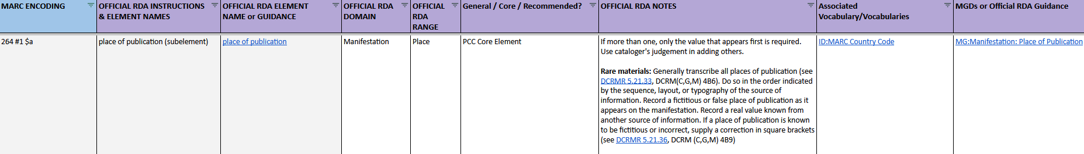
1. Consult Metadata Application Profile
Notes:
Throughout the workshop and later trainings, we consistently presented a standard process for cataloging using official RDA that started with consulting the appropriate metadata application profile to identify an applicable PCC Core or PCC Recommended element that we might want to record.

Slide 49
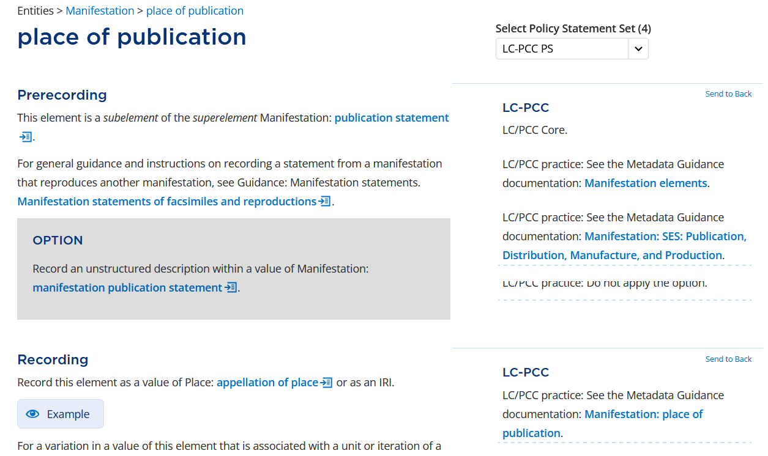
2. Review RDA instructions and LC-PCC PSs
Notes:
After identifying an element, we consulted the element in the RDA Toolkit and reviewed the relevant RDA instructions and LC-PCC Policy Statements.

Slide 50
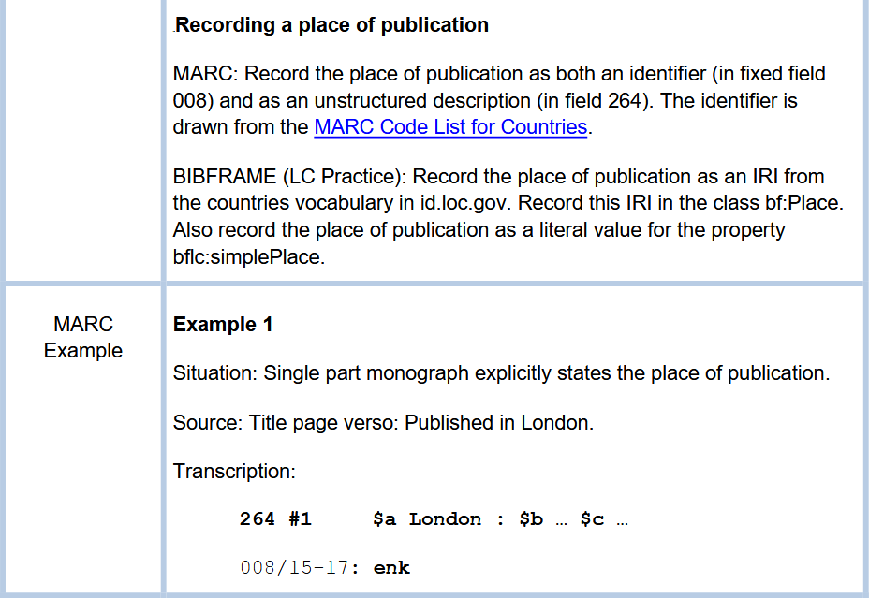
3. Review Metadata Guidance Documents
Notes:
Using the links in the policy statements, we reviewed the Metadata Guidance Documentation for additional guidance.

Slide 51
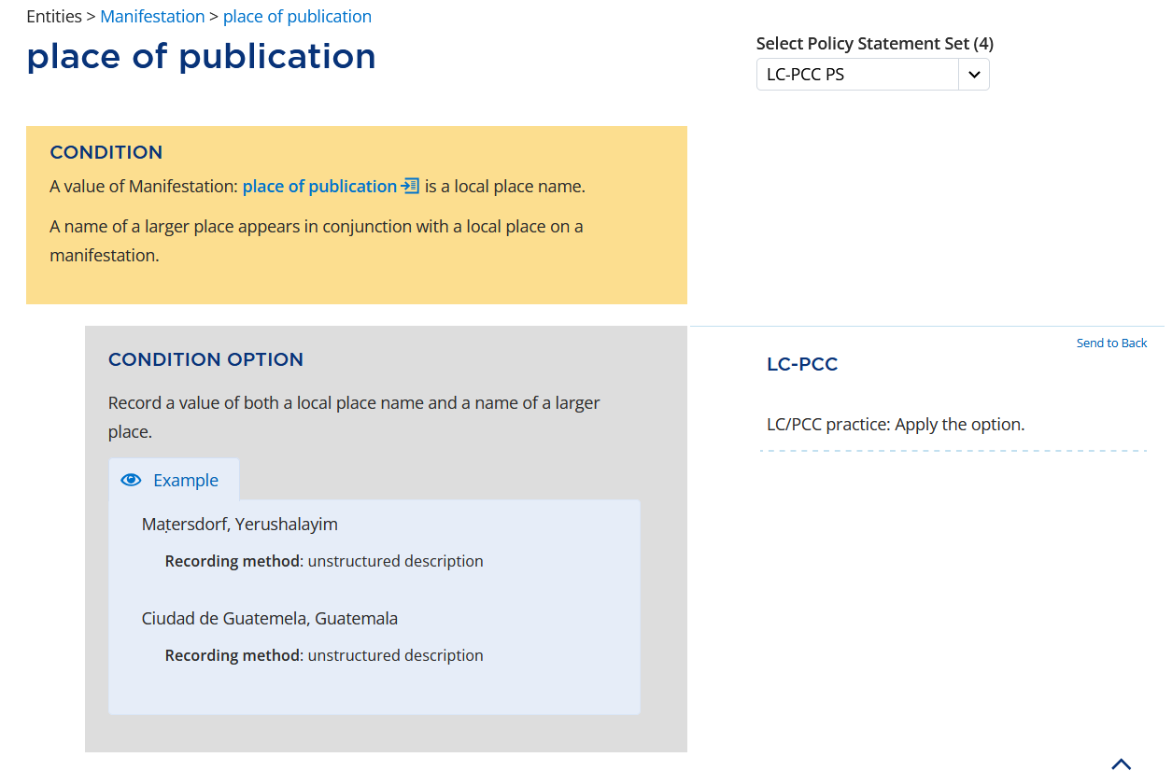
4. Determine the value to record
Notes:
After reviewing the relevant RDA instructions, policy statements, and MGDs, we determined the value to record.

Slide 52
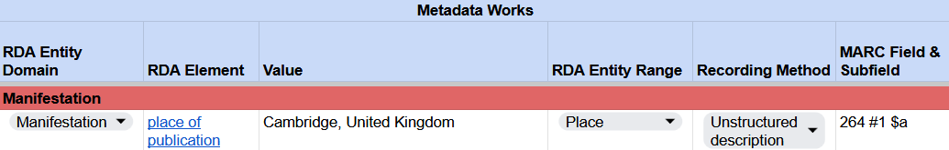
5. Record the value
RDA Record Template
MARC 21 Bibliographic Record
Notes:
That value was recorded in an RDA record template and in our MARC 21 bibliographic record.

Slide 53
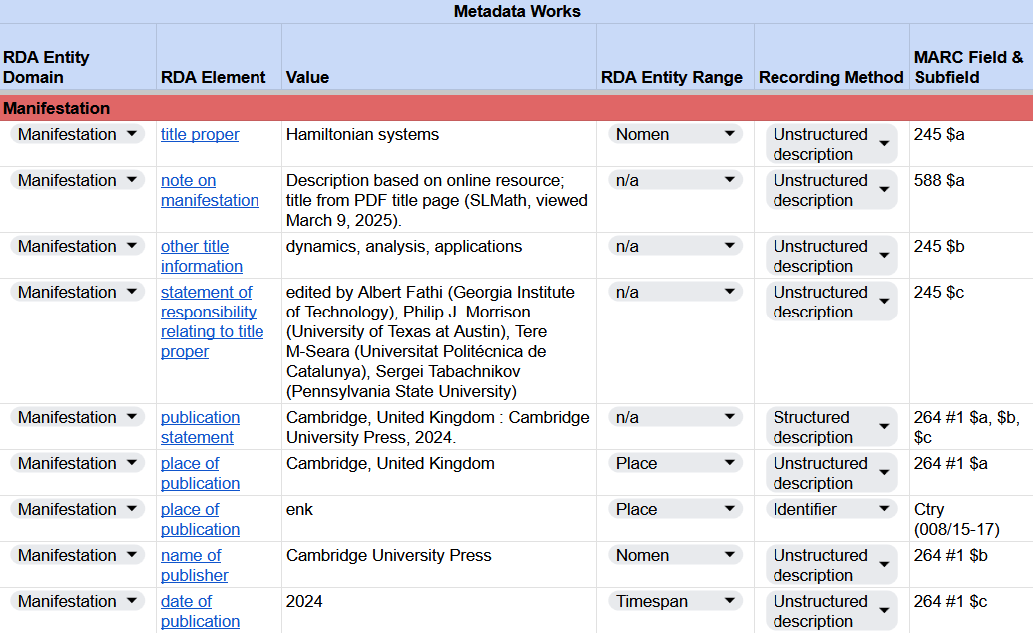
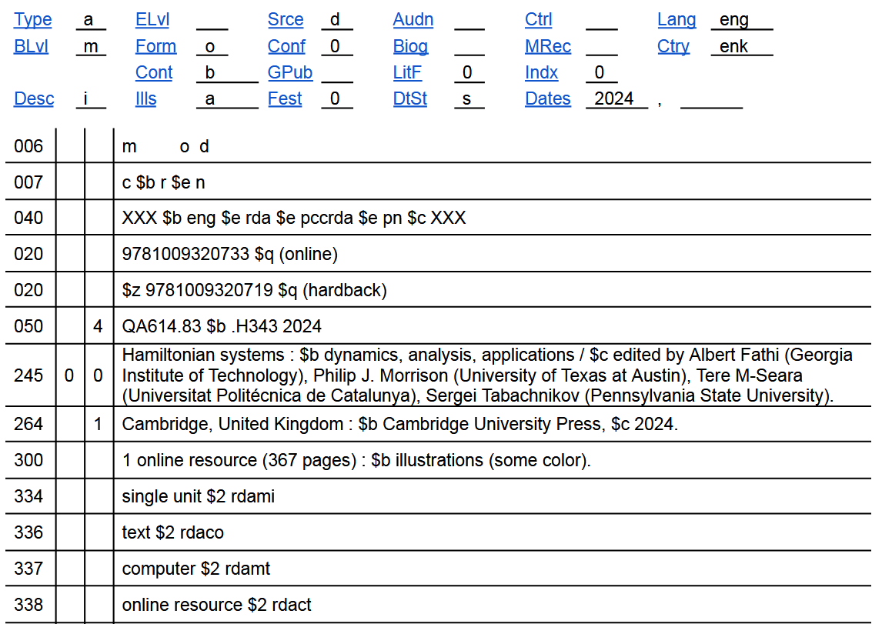
6. Repeat
RDA Record Template
MARC 21 Bibliographic Record
Notes:
We repeated this basic process for each element until we made it through the entire record. The RDA record template aimed to get participants thinking in terms of RDA and the values that needed to be recorded before considering how to record the values in MARC.

Slide 54
ALA RDA Preconference Workshop 2025
Key Takeaways
Everyone is still learning!
Continue to promote determining the value of the RDA element before deciding how to encode it in MARC
In the bridge training, consolidate content and avoid excessive repetition
Catalogers wanted more practice with exercises
Notes:
From the presenter perspective, this was an incredible learning experience; we learned so much about official RDA and gained greater insight into how to present the content during training.
We will continue to promote an RDA first approach in which we focus on determining the value of an RDA element before deciding how to encode it in MARC.
As we went through the workshop, there was a lot of repetition as some elements use the same set of instructions. When preparing the bridge training, we will consolidate this content and avoid excessive repetition.
Lastly, catalogers wanted more practice with exercises. While we had prepared exercises for the workshop, we didn’t have time to get to them. Even so, the time allocated for the exercises would have been insufficient for people to make much progress on cataloging the selected resources.

Slide 55
ALA RDA Preconference Workshop 2026
Learning Outcomes
Understand and apply official RDA instructions and PCC practices for describing monographs and other resources in MARC 21 bibliographic records
Understand and apply official RDA instructions and PCC practices for creating name authority records in MARC 21
Understand and apply the BIBCO Standard Record (BSR) Official RDA Metadata Application Profile
Apply appropriate guidance in LC-PCC Policy Statements and RDA Metadata Guidance Documentation
Notes:
To allow for more hands-on practice, the SCT RDA Training Task Groups and the North American RDA Committee (NARDAC) presented another preconference workshop at the ALA Annual Conference in June 2026. The learning outcomes for this workshop were expanded to include non-book resources and name authority records.

Slide 56
ALA RDA Preconference Workshop 2026
Workshop Structure
Recording unstructured descriptions
Recording structured descriptions
Recording identifiers; Recording data provenance
Exercises
    Books: Print books, ebook
    Music: Scores, audio recordings
    Video: Steaming video, DVD
    Authorities: Subfolders with each resource exercise
Workshop materials: https://bit.ly/RDA-ALA-26
Notes:
In the morning, the workshop featured presentations and demonstrations for recording unstructured descriptions, structured descriptions, identifiers, and data provenance. Each section started with a brief presentation that introduced the topic and was followed by demonstrations that walked through how to record values for selected RDA elements using the official RDA Toolkit and related PCC documentation.
In the afternoon, workshop participants worked independently or in small groups to catalog print and electronic books, music scores and audio recordings, a streaming video, and a DVD. Almost all exercises included one or more authority exercises. The exercises followed the same structure as the exercises from the 2025 workshop.

Slide 57
ALA RDA Preconference Workshop 2026
Key Takeaways
Some participants enjoyed the live demonstrations and wished we walked through cataloging the entire resource together
Some participants liked that most of the workshop was spent on individual or group exercises with experts available to answer questions
Navigating the official RDA Toolkit and terminology continued to be the biggest obstacles for catalogers
Lots of questions about how to describe aggregates
Notes:
Post-workshop survey responses indicated that some participants enjoyed the live demonstrations and wished we walked through cataloging the entire resource together, while other participants appreciated that most of the workshop was spent on individual or group exercises with experts available to answer questions.
Navigating the official RDA Toolkit and terminology continued to be the biggest obstacles for catalogers when using official RDA.
As presenters preparing the exercises, we still had a lot of questions about how to describe aggregates.

Slide 58
Phase 2: PCC RDA in Practice Training
Types of Training
Full training
  For less experienced catalogers new to RDA or PCC
  Also, for experienced catalogers who want a refresher or more in-depth training
Bridge training
  A subset of the full training focusing on elements where there is a difference in practice
  For experienced catalogers transitioning from original RDA to official RDA
Notes:
Getting back to the Phase 2: PCC RDA in Practice Training, the training task group is developing two sets of the training: full training and bridge training.
The full training is for less experienced catalogers who are new to RDA or PCC. It is also for more experienced catalogers who want a refresher and more in-depth training, particularly as they prepare to implement official RDA.
The bridge training is a subset of the full training. It is designed to help experienced catalogers transition from original RDA to official RDA by focusing on those elements where there is a difference in practice.

Slide 59
Phase 2: PCC RDA in Practice Training
Training Materials
Slides
  Freely available slides with speaker notes to support self-study or presenting to colleagues in your institution or beyond
Exercises
  To practice navigating the official RDA Toolkit and applying the instructions
Webinars
  Free webinars to present content from the slides and answer questions
  Will be recorded for later viewing
Notes:
For the bridge and full training, the training task group is preparing slides, exercises, and webinars.
The slides will be freely available on the Catalogers Learning Workshop and will include speaker notes to support self-study or presenting to colleagues.
The exercises will reinforce the content presented in the slides through practical application. For example, they will allow catalogers to practice navigating the official RDA Toolkit and applying the instructions.
The free webinars will present content from the slides and answer questions. The webinars will be recorded for later viewing.

Slide 60
Phase 2: PCC RDA in Practice Training
Learning Outcomes
Understand and apply official RDA instructions and PCC practices for describing print and electronic monographs in MARC 21 bibliographic records
Understand and apply the BIBCO Standard Record (BSR) Official RDA Metadata Application Profile
Apply appropriate guidance in LC-PCC Policy Statements and Metadata Guidance Documentation
Notes:
For both the bridge and full training, the learning outcomes are the same. Catalogers should be able to:
Understand and apply official RDA instructions and PCC practices for describing print and electronic monographs in MARC 21 bibliographic records
Understand and apply the BIBCO Standard Record (BSR) Official RDA Metadata Application Profile
Apply appropriate guidance in LC-PCC Policy Statements and Metadata Guidance Documentation

Slide 61
Phase 2: PCC RDA in Practice Training
Full Training Prerequisites
Essential
  Basic knowledge of cataloging and MARC 21
Optional
  Completed LRM training: What is IFLA/LRM?
  Completed Phase 1: PCC Introductory RDA Training
Notes:
When considering the full training for cataloging monographs, we are assuming a basic knowledge of cataloging and MARC 21.
To ensure the training is clear and accessible for the greatest number of catalogers, we are approaching the full training with the assumption that catalogers don’t know RDA. Consequently, the previously released LRM training and Phase 1: PCC Introductory RDA Training are considered optional. When appropriate, content from those trainings will be incorporated so the full training is a complete training curriculum.

Slide 62
Phase 2: PCC RDA in Practice Training
Full Training Outline (1)
Introduction to RDA
Using RDA Toolkit
PCC documentation
Recording basics
Describing manifestations
Describing works
Describing expressions
Describing aggregates
Special topics
Notes:
The biggest hurdle to implementing official RDA is becoming familiar with the new RDA Toolkit and how to apply the instructions in conjunction with the relevant PCC documentation. To help catalogers become familiar with the process of cataloging using official RDA, the first part of the full training is focused on fundamental skills.

Slide 63
Phase 2: PCC RDA in Practice Training
Full Training Outline (2)
Introduction to RDA
  What is RDA?
  Overview of RDA entities
Using RDA Toolkit
PCC documentation
Recording basics
Describing manifestations
Describing works
Describing expressions
Describing aggregates
Special topics
Notes:
The first section is a basic introduction to RDA.
Since the full training is for catalogers who are new to RDA, we should tell them what RDA is before we discuss how to catalog using RDA.
As the RDA Toolkit is structured around the RDA entities and their elements, it is important for catalogers to be familiar with the different RDA entities. Consequently, we present a brief overview of the RDA entities before we introduce the RDA Toolkit.
Following feedback from the Phase 1: PCC Introductory RDA Training, which expressed a desire for more practical training and less theory, we will not have a module on the IFLA Library Reference Model (LRM). If important, any relevant concepts from the LRM conceptual model will be discussed based on their usage in RDA.

Slide 64
Phase 2: PCC RDA in Practice Training
Full Training Outline (3)
Introduction to RDA
Using RDA Toolkit
  Getting started with RDA Toolkit
  Navigating RDA Toolkit
  Searching RDA Toolkit
  Personalizing RDA Toolkit
PCC documentation
Recording basics
Describing manifestations
Describing works
Describing expressions
Describing aggregates
Special topics
Notes:
The second section covers using the RDA Toolkit. It includes modules for getting started, navigating, searching, and personalizing the RDA Toolkit. They are slightly updated versions from the introductory training modules, but they also represent an essential component of the full training.

Slide 65
Phase 2: PCC RDA in Practice Training
Full Training Outline (4)
Introduction to RDA
Using RDA Toolkit
PCC documentation
  BIBCO Standard Record (BSR) Official RDA Metadata Application Profile
  LC-PCC Policy Statements
  (LC-PCC PSs)
  Metadata Guidance Documentation (MGDs)
  Using PCC documentation while cataloging
Recording basics
Describing manifestations
Describing works
Describing expressions
Describing aggregates
Special topics
Notes:
As RDA becomes a more international standard, documentation from cataloging communities, like the PCC, is important in defining the community’s policies and practices. Section 3 covers PCC documentation, including the BIBCO Standard Record (BSR) Official RDA Metadata Application Profile, LC-PCC Policy Statements, and Metadata Guidance Documentation.
Since all PCC documentation and training materials are to be used in conjunction with the official RDA Toolkit and are not intended to be separate, stand-alone documents, we conclude this section by discussing how to collectively use the RDA Toolkit and PCC documentation while cataloging.

Slide 66
Phase 2: PCC RDA in Practice Training
Full Training Outline (5)
Introduction to RDA
Using RDA Toolkit
PCC documentation
Recording basics
  Nomens and appellations
  Recording unstructured descriptions
  Recording structured descriptions
  Recording identifiers
  Recording IRIs
  Recording data provenance
  Recording relationships
Describing manifestations
Describing works
Describing expressions
Describing aggregates
Special topics
Notes:
Having discussed using the RDA Toolkit and PCC documentation, section 4 focuses on the basics for recording a value of an element based on the four recording methods: unstructured description, structured description, identifier, and IRI.
We also discuss recording data provenance, or metadata about metadata, as well as recording relationships, including the new PCC relationship labels.
This is our last fundamental section. Our hope is this provides a solid foundation for the rest of the training, which includes more detailed guidance and instruction that builds on these foundations.

Slide 67
Phase 2: PCC RDA in Practice Training
Full Training Outline (6)
Introduction to RDA
Using RDA Toolkit
PCC documentation
Recording basics
Describing manifestations
  title proper
  [other manifestation elements]
Describing works
  preferred title of work
  [other work elements]
Describing expressions
  content type
  [other expression elements]
Describing aggregates
Special topics
Notes:
In sections 5, 6, and 7, we will go element by element based on the RDA entities manifestation, work, and expression, respectively. For each element, we are planning to discuss the basics for recording a value for the element based on RDA and PCC policies, and then how to record the value in a MARC 21 bibliographic record.

Slide 68
Phase 2: PCC RDA in Practice Training
Full Training Outline (7)
Introduction to RDA
Using RDA Toolkit
PCC documentation
Recording basics
Describing manifestations
Describing works
Describing expressions
Describing aggregates
  Identifying aggregates
  Describing aggregates
Special topics
  Authorities
  Translations
  Amalgamations
  Working with copy
Notes:
The last sections are devoted to special topics.
The section on describing aggregates will include training for identifying and describing the different types of aggregates.
The other special topics might include working with authorities in the context of bibliographic records, cataloging translations and amalgamations, and finally training for working with copy and hybrid records.

Slide 69
Tentative Timeline for PCC Training
End of 2026: Release bridge and full training for monographs and name authority records
Early 2027: Provide bridge and full training webinars for monographs and name authority records
May 12, 2027: Original RDA Toolkit will no longer be available via the web, but PDF files will be available
TBD: Training for serials and integrating works
Notes:
Looking ahead, we are aiming to release the bridge and full training for monographs and name authorities by the end of 2026. After the release of the training materials, we will present the materials in a series of free webinars.
The bridge training will be presented first followed by the full training. This will allow catalogers who attend the bridge training but want more in-depth training to also attend the full training.
In addition, because the monographs training presents four sections of foundational training that is applicable for all official RDA training, the monographs training will be presented first, followed by the name authorities training.
We hope that all training for monographs and name authorities will be complete and PCC institutions able to implement official RDA several months before the original RDA Toolkit is removed from the web on May 12, 2027.
Note that PCC training for serials and integrating works is being planned, but work has not yet started.

Slide 70
Summary of PCC RDA Training (1)
What is IFLA/LRM? (English and Spanish translation)
https://www.loc.gov/catworkshop/RDA2020/index.html
Phase 1: PCC Introductory RDA Training
https://www.loc.gov/catworkshop/rda/index.html
Phase 1: PCC Introductory RDA Training (Spanish translation)
https://difusion.iibi.unam.mx/RDA-México/traduccion_es.html
Phase 1: PCC Introductory RDA Training Webinars
https://www.loc.gov/catworkshop/rda/PCC-Introductory-RDA-Training-Webinars/index.html
Notes:
As I conclude my presentation, here again are the links to the IFLA LRM training, the Phase 1: PCC Introductory RDA Training, and the Phase 1: PCC Introductory RDA Training Webinars.

Slide 71
Summary of PCC RDA Training (2)
Changes from Original RDA for Monographs: Report
https://www.loc.gov/aba/pcc/sct/documents/Changes-from-Original-RDA-for-Monographs-Report.pdf
ALA RDA Preconference Workshop 2025
https://bit.ly/RDA-ALA-25
ALA RDA Preconference Workshop 2026
https://bit.ly/RDA-ALA-26
Notes:
And here again are the links to the Changes from Original RDA for Monographs: Report, and the ALA RDA Preconference workshop materials from 2025 and 2026.

Slide 72
Questions
adam.baron@berkeley.edu
Notes:
If you have any questions, please feel free to contact me at adam.baron@berkeley.edu.

