Slide 1
Practical implementation of Official RDA at NLNZ
presentation to NARDAC Spring Forum April 2025
by Charlotte Christensen, MLIS
Senior Collection Description Specialist Te Puna Mātauranga o Aotearoa National Library of New Zealand
Notes:
Tēnā koutou kātoa, greetings to you all. My name is Charlotte Christensen and I'm pleased to be able to be here today to talk at this forum about our implementation of Official RDA at Te Puna Mātauranga o Aotearoa National Library of New Zealand. That's a bit of a mouthful, so I'm going to refer to my institution as NLNZ for the remainder of the presentation. This is also the abbreviation you will see on our policy statements and documentation.
But before we begin, as is customary here, I will say a very short whakatauki in Māori to focus us all on the sharing to come.

Slide 2
Ahakoa iti no te awhina
Mā te aroha
E whakanui
No reira e hoa mā
Kia ora rā
Although the help is small
Through love
It will become great
And so, friends,
May all be well with you
Notes:
Ahakoa iti no te awhina
mā te aroha, e whakanui.
No reira, e hoa mā
Kia ora rā

Slide 3
Background
May 2024: Implementing Official RDA at the National Library of New Zealand, by Anoushka McGuire (OCLC cataloguing community meeting, starts at approx. 4:40) <https://www.oclc.org/go/en/events/cataloging-community-meeting/may-2024.html>
November 2024: Implementing Official RDA : some notes from the experience at Te Puna Mātauranga o Aotearoa National Library of New Zealand, by Charlotte Christensen (RSC public meeting, starts at approx. 1 hr) <https://youtu.be/HMdMuhqRZeY?si=DrlYOYi0A4ixW-N9>
April 2025: RDA Toolkit, only the Toolkit and nothing but the Toolkit, by Ebe Kartus (RSC public meeting, video to be made available on RDA Toolkit YouTube channel)
Notes:
On the screen here are the previous three presentations relating to NLNZ's implementation of Official RDA, the most recent being last week's presentation at the public session of the RSC meeting. I mention them because together they build a fuller picture than I can give in any one presentation. I would recommend viewing these at some point if you have not already had the opportunity to do so.

Slide 4
Our key implementation notes
everything is in the Toolkit
focus on RDA first, encoding second
training for understanding - concepts and language
everyone at NLNZ contributes
transition takes time
iterative development
deliberate intentional decision-making
Notes:
For today I'll begin by briefly highlighting some of the points made in previous sessions because they are key to understanding our philosophy behind our implementation.
<click>Firstly, our approach is to have everything RDA-related accessible within the Toolkit itself.
<click>Secondly, our training heavily emphasised RDA, totally excluding any consideration of encoding until the very end because encoding methods can change but the data that is important to our descriptions should remain the same.
<click>In terms of training, it was entirely our intention to train for understanding. To ensure that every cataloguer wasn't just repeating past actions but was able to fully engage with the new standard and the underlying model of LRM, and so we dwelt on concepts and language to build that understanding.
<click>Which leads to the next thing, which is that at NLNZ, everyone contributes. While most of the policy and documentation writing is done by the senior staff, everyone down to the most junior of cataloguers is exposed to all the material and theory and can make informed suggestions for policy change or improvement.
<click>Our choice to give everyone that deep understanding did of course add to how long it took to get through our training, but it's important to recognise that whatever level you train at: transition will take time. Learning a new concept is one thing, applying it in a practical environment is another and may require refreshers and reminders and ongoing evaluation of which aspects might still be challenging.
<click>For us, we knew when we implemented that we did not have everything perfectly finished, but we had gone far enough that the people we were training could contribute to finding problems and helping to fix them. We didn't want to delay until it was perfect, and honestly we couldn't have because it was when the practical cataloguing started that we discovered gaps we hadn't realised existed. Allowing practitioners to contribute to discussions means a broader range of perspectives and a better result in our documentation.
<click>Finally, while it took a long time to get here, the end result is that our policies reflect intentional choices right down to the option by option level. We have analysed the implications of different choices and we have determined which ones best fit our needs, the community we serve, and the interoperability of our data with other systems. We have tested every past practice to see if it is still fit for purpose, abandoned some which don't fit our needs, and taken new approaches where they offer better future possibilities.

Slide 5
The training process (phases 1 & 2)
Phase 1: background and foundational concepts
Phase 2: deeper dive, preparation for practical cataloguing
Policy group: team leaders and senior collection description specialists who wrote policies and guidance documentation
Notes:
Looking closer at how we structured our training, it's important to remember that we didn't leap directly into the practical. It was absolutely critical to ensure we had a strong foundation of understanding so we could progress forward together.
Starting with phase one, we recognised that a major barrier in moving to Official RDA is that many cataloguers don't like the new language and structures. That's okay as a first reaction, it is different and challenging, but it's less of challenge than it first appears. Cataloguers trained under AACR2 had to learn language in order to understand those rules, this is the same thing, that new jargon becomes familiar and comfortable as you interact with it. The plain truth is that you cannot interact effectively with the instructions in the Toolkit if you don't understand what they say, so knuckling down and engaging with the new terminology from the start is important. To do that, you're going to need people who can encourage the cataloguers to make the effort. NLNZ's experience has been that everyone can engage with the Official RDA standard in much the same way as they have done with previous standards, it's about the foundations being solid, and so supporting people to engage through that learning phase is critical.
Phase two was about building on that understanding and making a deeper dive into concepts we were about to actively use. Phase one had been slow-paced and bite-sized, but phase two was deliberately intensive because we wanted concepts clear and fresh before cataloguers began directly engaging with the Toolkit so we did all of phase two across a single week and immediately prior to beginning the practical training phase.
To this point, only the policy group had been engaging directly with the Toolkit and the NLNZ documentation, but as we moved to the practical training component it became much more interactive.

Slide 6
Practical training
Initial training
Tutorials/demonstrations on Mondays
Practical activities for trainees
Small group discussion at the end of the week
Implementation
Peer-checking
Optional clinics
RDA checked before MARC conversion, then MARC check
Ongoing
Training discussion channel
Expansion to new material types
Notes:
During the first part of the initial training we worked with a pattern of having new information disseminated at the start of the week, practical activities for everyone to engage with whatever was taught, and then small group discussions to get feedback on how the week had gone. The Monday tutorials were lead by a rotation of the policy group members, and were always recorded so trainees could go back over anything that they missed. The change in presenters gave trainees a chance to hear messages in different ways, and took pressure off any one person being the lead for the training. This was a collaborative effort all the way through.
Similarly, the policy group were distributed across the small discussion groups. These sessions were both a chance to gauge how well concepts and activities had been understood, and also to capture any documentation problems that had been encountered. Sometimes the feedback resulted in a single concept being extended over a second week as we made changes and re-tested our approach.
When we got to implementation itself, we moved to a peer-checking model. Issues were still fed back to the policy group and we retained the small group concept but now as optional clinics where questions and issues could be discussed and worked out together. This was never a top-down experience, cataloguers were encouraged to think about the issues for themselves and to suggest resolutions to the problems they found. While the clinics were very well attended early on, the need for them diminished quickly. What was initially a vital tool simply became redundant as confidence and familiarity grew.
We are now is well beyond that implementation phase, but there is still activity ongoing and two aspects of that activity seem particularly worth mentioning.
The first is that all the way through our training journey we had a dedicated discussion channel where recordings, slides and notes can be put, and where questions can be asked and answered. We can look back over how our thinking has developed, and where practical use of our documentation led to policy change. This tool has been and continues to be really valuable.
The second is that we implemented initially for only a narrow range of material - static, text-based resources - but training has been ongoing for other types of material, building on what is now known and understood. There are subgroups who are repeating the earlier pattern of tutorials, activities and discussion groups for resources such as notated music, rare books and diachronic works. The same iterative development is also occurring for these areas, with documentation being improved through practical engagement, and so once each subgroup implements the training materials are then collated and made available, while new subgroups are formed. In this way, we will work through the remaining resources for which internal training has not yet been completed.

Slide 7
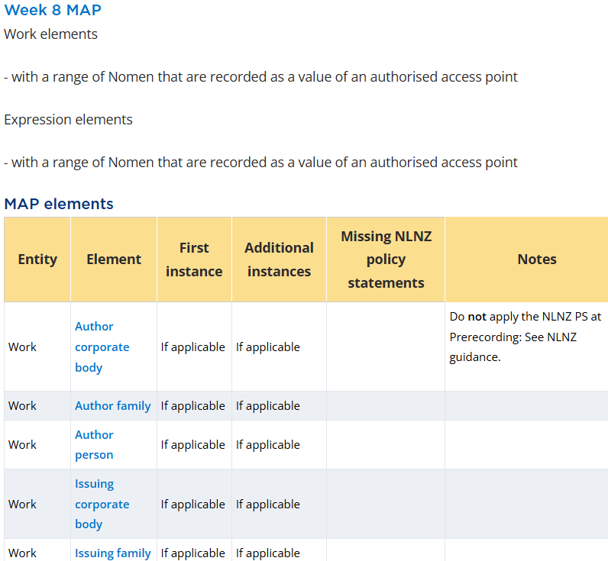
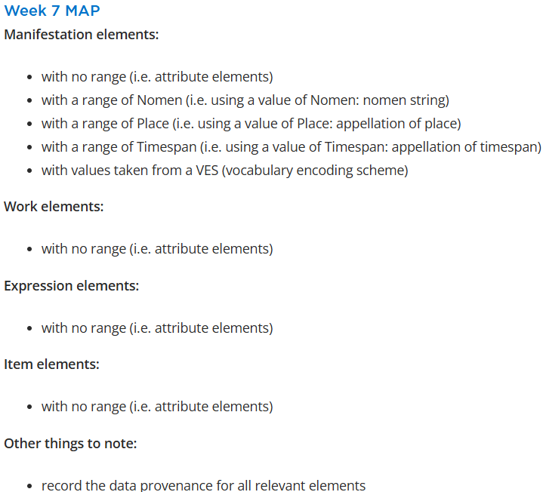
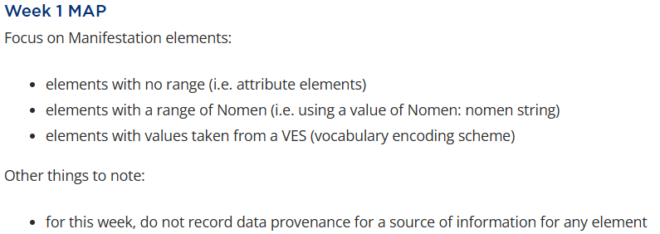
Training MAPs (metadata application profiles)
Notes:
When it came to actual cataloguing of resources, we make regular use of what we call MAPs, our metadata application profiles. These are subsets of the overall NLNZ application profile, focusing on the key elements important for particular types of metadata description sets.
Our training began with a focus on static text-based resources, but just to cover that slice of our daily work we have four separate MAPs: one for non-aggregates and three for different types of aggregate: augmentation, collection and parallel. This would have been too much to take in on day 1 of the practical training, so instead we started with training MAPs.
These training MAPs were heavily curated, listing only the elements covered by the training, and trainees were expected to only use the elements listed rather than exploring other elements at this stage.
For example, at week 1 we had a very limited range of Manifestation elements and no elements from any other entity, <click> but by week 7 we had almost completely covered Manifestation, as well as all attribute elements for Work, Expression and Item. <click>Then in weeks 8 to 11 we focused on access points, and so our MAPs stepped away from the elements we were already familiar with to focus on only those that helped us with that learning.

Slide 8
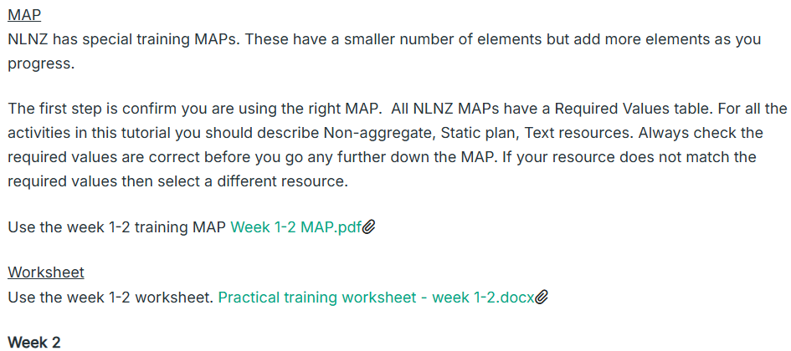
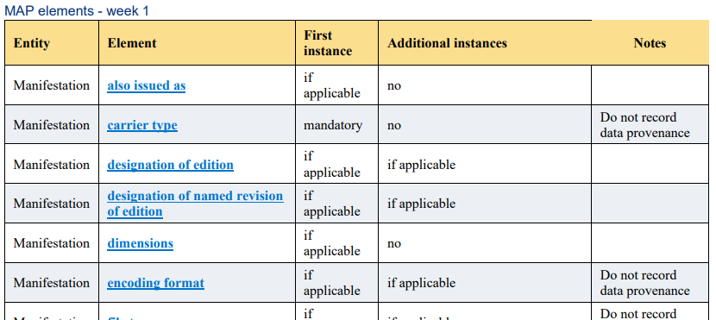
Notes:
While the live Toolkit versions of these training MAPs are not publicly accessible, there are PDF versions available through our Niche Academy tutorials. These are still hyperlinked so you're able to make use of them directly, but there is nothing to stop you developing your own MAPs if you want to cover more or less content than we did in a particular lesson. The key here is that this is simply a training tool so make use of it where it is useful, and adjust it where it isn't. We have certainly made adjustments as we went.
Remember that we didn't wait to have everything in place, every decision made, before we started training. We started with a core and built on as training progressed, and staying flexible has worked out well.

Slide 9
Pre-cataloguing decisions
Static or diachronic (and then what type of diachronic resource)?
Determine how many works are involved (i.e. aggregate?)
Use the NLNZ guidance: aggregate manifestations to determine which metadata application profile (MAP) to use
Consider existing descriptions and entity boundaries (i.e. is there an existing description?)
Notes:
Moving beyond training, though, let's look at the workflow of actually cataloguing an item.
When starting to catalogue there are a number of decisions that need to be made before I even start on recording my first value. I need to start by deciding whether my resource is static or diachronic, then determining how many works are involved in the resource I'm describing. Next, because this is about the NLNZ policies and guidance, I make use of the NLNZ aggregate guidance to convert that knowledge of how many works I have into which metadata application profile, or MAP, I need to use in my description.
Finally, I need to check whether there is an existing description available to me, and if so whether I can use it or whether I'm required to begin a new description.

Slide 10
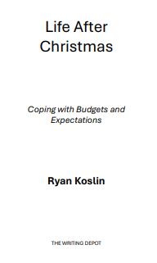
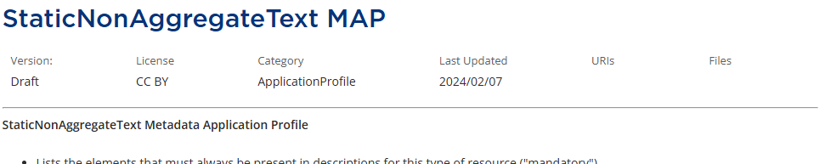
Image of cover
Title page
Imprint page (page 3)
Notes:
So here's a resource to use as an example. It's a static work, there's no indication of it being diachronic. It is text-based, there are no illustrations other than the cover image and there are no other works, so no introductions or other such textual content that would give me multiple works. <click>So following through the aggregates guidance I come to the conclusion I have a nonaggregate, and I will be using the static nonaggregate text MAP.
The next step is to work through the elements on that MAP and do my thinking about my RDA values.

Slide 11
Metadata works |  |  |  | Source of the metadata works
entity | element | value | recording method | data prov. entity | data prov. element | data prov. value
Manifestation | title proper | Life after Christmas | Unstructured description | n/a | n/a | n/a
Manifestation | other title information | coping with budget and expectations | Unstructured description | n/a | n/a | n/a
Manifestation | statement of responsibility relating to title proper | Ryan Koslin | Unstructured description | n/a | n/a | n/a
Work | extension plan | static plan | Structured description | Work | source consulted | rdaep
Work | content type | text | Structured description | Work | source consulted | rdaco
Manifestation | name of publisher | The Writing Depot | Unstructured Description | n/a | n/a | n/a
Manifestation | file type
Expression | language of expression
Notes:
In our training we used a simple worksheet to list our RDA values and keep our thinking separate from the encoding of those values. I've mostly completed my worksheet for this resource but I still have a few elements to complete, two of which we'll do together. In other words, we're going to do some actual cataloguing.
Now while I'm sure some of you are excited to hear me say that, keep in mind that we only have a limited amount of time so this is more about the flow of the work than a lesson. For a few people I will be going too slowly and they'll be wondering how I could possibly get through a cataloguing backlog if I'm spending this long on each element. For most, though, I will be going way too fast and skipping through things that you're unfamiliar with, and all I can do is apologise. The truth is that when you are learning to use the Toolkit you have to work much slower than I will today. And that when you're familiar with it, you simply won't spend this long on every element, only on the bits that are unique to the resource you're working on and which you're unfamiliar with. So I'm probably pleasing no-one, but I'm hoping you'll get something from this demonstration anyway.

Slide 12
Manifestation: file type
Notes:
The first element I will demonstrate is Manifestation: file type. The MAP tells me that this is an element I should consider for the description of my resource. I'm told that I should record it if it is applicable, and that it is possible to record more than one value.
Let's transfer to the live Toolkit and follow this through.
Going to the element I read the definition, and since I'm dealing with a digital file this sounds like it would be applicable.
Next I go to the prerecording section, which will tell me if there is anything that might change my mind about recording a value here. NLNZ does have a policy statement but it relates to integrating resources, so I don't need to worry about that for this resource. Next I move to the recording section and I'm told to use the structured description recording method so I can scroll straight down there now.
The first option here has a policy statement that tells me to apply it but to record only for the version held by NLNZ. Of the values in this vocabulary encoding scheme or VES the one that fits my resource is text file. So that will be my value. While I'm here, though, I note that this VES has a name: RDA File Type. That will be important soon.
The next option has a policy statement saying Do not apply, so I won't even read the option. The third one says apply, and specifically to apply a particular option at the linked section of the Data provenance page. The option tells me that I need to record a VES that is used as a source of information for a term, and then tells me that if I need general guidance I can follow a link to find out more about it. Well I did take a term from a VES, so because I apply this option I now have to say what that VES was, and I do that by applying the option that the link in the policy statement takes me to.
Once the page loads, the option I need is at the top of the screen. It simply says I apply it, so I read the condition option which says I need to record the source of information as a Work: source consulted of the metadata work.
Now to understand what this means, I need to remember that each value I record is part of a metadata statement, and a metadata statement is also a metadata work. So my statement is Manifestation has file type text file. When I read this option, I'm being told that I need to record a source for the value text file within that statement. Understanding that, I see that I'm told to record my source as a value of the element Work: source consulted. So off I go to that element.
At prerecording here I'm told that for situations where I want to refer to a source without using an appellation I need to use the element Work: note on metadata work. Now I need to remember that appellation means a name or label. So the question is: did my value text file come from a list with a name? Well yes it did, we took note of that, it was called the RDA File Type vocabulary encoding scheme. So we do have an appellation and that means we can use the element Work: source consulted.
Our recording method is not so straightforward, there are three different methods listed here at the Recording heading, but I'm also advised to go to the NLNZ guidance document. So off I go.
Here at the guidance I find the section to do with Recording, because that's where the policy statement came from, and I see that there are subsections for each recording method. I'm told to use unstructured description for title proper, statement of responsibility and variant title. But I'm looking for a relationship to file type, so I keep reading.
Structured description is only for authority work and I'm not doing that, so I move on to identifier, and here I find my element: Manifestation: file type. So this will be my recording method. At the bottom of the list I'm told to use identifiers from two different lists, and given the choice I choose to look at the Genre/Form Code and Term Source Codes list. Now that I'm here, I can search on the page for the name of my VES: RDA file type. And there it is, my value is rdaft.
So let's put all that into my worksheet.

Slide 13
Manifestation: file type
entity | element | value | recording method | data prov. entity | data prov. element | data prov. value
Manifestation | file type | text file | Structured description | Work | source consulted | rdaft
Notes:
So I have Manifestation: file type text file, structured description as my recording method, and for my source I have Work: source consulted rdaft.

Slide 14
Expression: language of expression
Notes:
Let's move on to a new element, Expression: language of expression.
The MAP tells me that this is a mandatory element for this kind of description, and that I can have more than one value if applicable. So let's go back to the Toolkit.
The definition looks good. At prerecording I've got information about aggregated expressions, but I already know my resource is a nonaggregate so I don't need to be concerned about that. There's some information in RDA at this section, the main point being that if there is a change in value it might indicate an entity boundary. This is relatively obvious in a practical sense: if I know Shakespeare originally wrote his plays in English and I'm working with a French expression then this will be a different expression than the English one. So that's fine too, I understand what it means and I don't need to think about it for my resource.
What about my recording method? Well, just like with source consulted, I have multiple possibilities and the instruction to see NLNZ guidance to find out what to do.
Here at guidance, under the heading Recording, I get a simple instruction: use identifier recording method. There is some additional information about when and how I can use an unstructured description but these situations don't apply to my resource, so I all I need is to use an identifier and I go back to the Toolkit.
I can now go straight down to the section Recording an identifier and at the first option the policy statement tells me I will apply this using the MARC code list for languages. The option says I will record an identifier or notation from an appropriate VES, my policy statement has told me the VES to use, so off I go to get that. And here I find the code for English is eng, so that is my value.
Returning to the Toolkit I continue down the page and I see that the next option is one I don't apply, and then I'm at the end of the section. I'm not recording an IRI, so I'm done.

Slide 15
Expression: language of expression
entity | element | value | recording method | data prov. entity | data prov. element | data prov. value
Expression | language of expression | eng | Identifier | n/a | n/a | n/a
Notes:
In this case, once I've entered my value and recording method, I'm done. Even though my value came from a VES, I wasn't instructed to record the source and so I didn't.

Slide 16
entity | element | value | recording method | data prov. entity | data prov. element | data prov. value
Manifestation | file type | text file | Structured description | Work | source consulted | rdaft
Expression | language of expression | eng | Identifier | n/a | n/a | n/a
Notes:
So my worksheet is complete, and here are the values that we just worked out together. But I'm not done yet. I still need to put my values into our encoding format, which for NLNZ is MARC 21.

Slide 17
Let's talk about MARC
Notes:
So let's talk about MARC for a bit.
NLNZ has used MARC 21 for decades, so it would be easy to believe we would not need to even teach our staff encoding, but that simply wasn't the reality.
RDA and MARC use different language and are not fully aligned. The MARC manual often does not reflect the element names from Official RDA, and even when it does it might define them slightly differently, so you need something to tell you where to put your RDA values in MARC.
But that isn't the only reason we kept them so separate, nor why we felt we had to spend a little time on MARC training in spite of working with staff who had had years of experience using MARC 21.

Slide 18
Implicit vs Explicit values
245 10 $a Life after Christmas
Manifestation has title proper Life after Christmas
Manifestation has work manifested Koslin, Ryan. Life after Christmas
240 10 $a Harry Potter and the philosopher's stone
245 10 $a Harry Potter and the sorcerer's stone
Manifestation has title proper Harry Potter and the sorcerer's stone
Manifestation has work manifested Rowling, J. K. Harry Potter and the philosopher's stone
Notes:
One of the big issues with MARC encoding when you're trying to deal with RDA values is that a lot of what we see in MARC is implicit rather than explicit.
If I give you the following MARC coding and value, what RDA value might this be?
<click>Well the obvious answer is that it is a value of title proper, and that would be correct. But that's not all it is.
<click>It could also be considered part of the value of the element authorized access point for work. In this situation there have been no previous publications of this resource, so we would not usually add a 240 field since it would contain exactly the same information as the 245 $a. But of course neither the 245 $a nor the 240 value would have given me the full value of authorized access point for work in this case anyway because you have to know to string together the value in the 100 field as well.
As cataloguers, we know this and can interpret it. But this kind of implicit value recording is difficult for a computer to make use of. The 245 $a is sometimes only a value of title proper and in this case also a value of authorized access point for work.
But it's not always part of a value of authorized access point for work. <click> Taking a different but very well known example, the value of title proper can differ from the title portion of the value of authorized access point for work, and we're very familiar with that happening in resources we describe.
All of this is just a single illustration of implicit values in MARC, and it has to be said that after you have put the effort into knowing exactly what your values are and why you want to include them, it can be a bit disheartening to have to lose that clarity when you type it into your library management software.
Which is why we spent some time looking at where we can use MARC to be explicit about our data. So far as possible we want to be able to identify our RDA values even while we continue to use MARC 21.

Slide 19
What we did
Made decisions about MARC after decisions about RDA
Looked at options for positioning of data within a MARC record
Maximised atomisation of data (so far as possible don't merge multiple values into a single field/subfield)
Use clear labelling to identify what a value is
https://natlib.govt.nz/librarians/cataloguing-standards-at-the-national-library/marc-record-changes-due-to-rda-implementation
Notes:
And here's what we did.
Firstly, we did not even do much thinking about MARC until after we had decided which RDA element values we wanted to include. Keeping these separate meant we did not get tangled in trying to figure out where to put things until after we knew we actually wanted to include them.
Once we knew what we wanted, we then looked at all the possibilities for where each value could be encoded. This usually started off with fields and subfields we were familiar with, but then included exploring newer available fields and determining which gave us the best result.
As we considered the options, we tried to prioritise solutions that gave us the most explicit and singular result. If the choice was between a field which would be used for many things, and a field which would be specific, we generally chose the latter. There were compromises at times, but we did our best to keep our data as clear as possible.
Which leads to the last step: wherever possible, and especially where a field can be used in multiple ways, we label the data. This is an ongoing expansion, sometimes including URIs but often simply an RDA element name in an appropriate labelling subfield is our current approach.
The language in these labels is not always particularly user-friendly, and we have configured our public displays to avoid them for the most part. In many cases our previous labels were not much better help to non-cataloguers, and by taking this approach we are future-proofing our new data as far as possible by being explicit about what the value represents.
If you're curious about what our choices have been, you can go to our website and see them listed. This page is adjusted every time we make a new choice about MARC data because as with everything we are refining our approach as implementation reveals new information.
But for now, let's go back to our resource and think about my workflow. I chose my MAP, I filled in my worksheet, now what do I do?

Slide 20
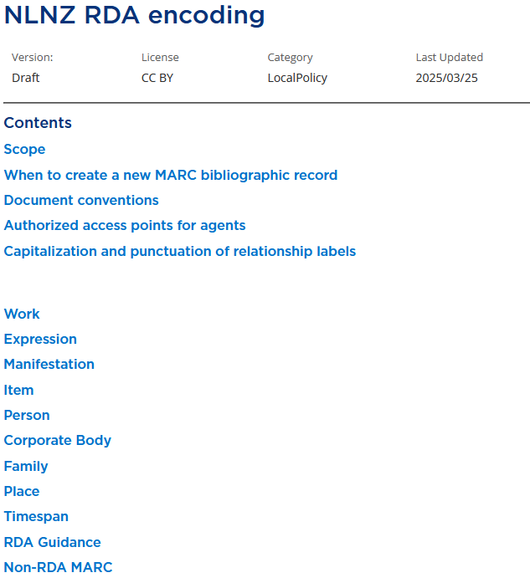
Notes:
Still within the RDA Toolkit we have a document specifically about how we encode our RDA values.
There are some introductory sections to cover general information, and at the bottom we have some further information about non-RDA MARC specific to our internal practices, but the majority of the document is organised by RDA element name.

Slide 21
NLNZ RDA encoding
Notes:
So looking at the section for Manifestation: file type, you can see that in a MARC bibliographic record I'm given instruction on how to handle a structured description value - specifically in the 347 subfield a. It also tells me to include a particular phrase in the subfield 3 and to place my data provenance value in a subfield 2, and to use separate 347 fields for each file type value.
Note that this doesn't repeat everything in the MARC manual, that is still there for me to consult when I need to, this simply provides the interface between RDA elements and MARC fields.

Slide 22
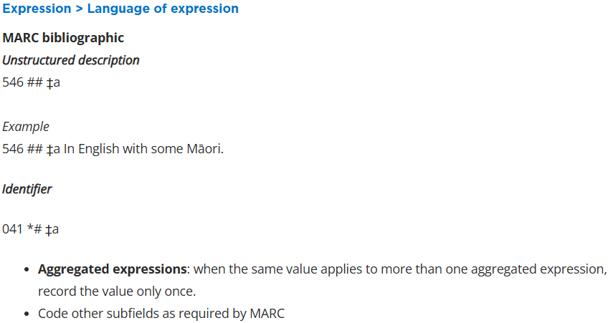
NLNZ RDA encoding
Notes:
Here at the section for language of expression we have the possibility of two recording methods: unstructured description and identifier.
For our description, we have an Identifier value of this element, so we're told to record it in an 041 field, specifically subfield a, and other specific advice is given, like don't repeat the same language value for each expression in an aggregate - saying once that there is English content is enough, we don't need to do it once for each short story in a collection, for example.
And so what I would do is work through my whole worksheet, check where in MARC I should be recording my values, and key them in, referring to the MARC manual as needed. But we don't need to take the time to do that here.
Let's wrap this up.

Slide 23
Takeaway messages
We've done this; you can do it too
Encourage and support
RDA first, encoding second
Look to the future
Notes:
So thinking again about implementation as a process, there are a few messages we'd like to reinforce.
Our first message to anyone watching is that we have done this and you can too. You don't have to start where we did, and go through the thousands of options line by line, there are now a range of policy statements in the Toolkit so you can test some out and see if any of them mostly fit your needs, and then adapt just the bits that don't. Building on the work of others is both sensible and efficient.
Encouragement and support are the most powerful tools to ensure the transition is effective. Staying with Original RDA isn't a valid option when that version of the standard is going to be removed, so finding a way forward is important, and Official RDA is a functional tool which can be used to continue practices cataloguers are familiar with. What has changed is the language and structure of the instructions.
As mentioned several times in this talk, when teaching Official RDA it's very important to keep very clear about what relates to RDA and what belongs to your encoding standard. Many more experienced cataloguers are accustomed to taking shortcuts and talking about where the values might be put, but this can quickly become confusing because there is not a one-to-one match between encoding fields and RDA elements. So when teaching RDA, always talk in terms of RDA. Once you have determined your values, then you can talk about the encoding, but avoid talking about encoding until you're ready to do that step. Remember RDA provides the values that are what you want to say about a resource, encoding is just how you put it into a computer, so the RDA side is the intellectual side of the task.
Finally, this is a great opportunity to question what it is you actually do need to say in your descriptions, to meet the needs of your user community. Sometimes this might mean adding extra information, but sometimes it means really scrutinising those things you have always done. Who is using that data you are entering, and in what way? Could information in a note be better used if it was provided in a different form, such as a search facet? There are implications to such choices, but NLNZ has found this to be a great opportunity to cease old practices that weren't really serving any purpose other than consistency for consistency's sake. We have also been looking to a future where we stop entering data into any kind of encoding system at all - our ideal would be a simple form where we fill in the element values and press a button to get an output in whichever encoding system we have selected. Conversion of old MARC data to a different encoding system is hard, but there are things we can do now while we're still using MARC that will make that future conversion easier, so we're prioritising those changes.

Slide 24
What next?
Finish developing material-specific policies, guidance & training
Begin supporting the NZ library community to transition to Official RDA
Contribute proposals via ORDAC (Oceania region RDA Committee) to resolve issues with RDA instructions and options discovered through practical interaction with the standard
Notes:
So finally, what next for NLNZ?
Well first we need to finish developing the documentation and training for our own staff, particularly in areas such as cartographic materials and audiovisual. These are in progress but not yet complete, as is the documentation and training for rare books, music, and diachronic works.
As we complete our own training phase for all materials we are also turning our attention to how we can support the New Zealand library community to transition as well. Our training materials are made public, but we may be able to provide advice as libraries prepare their own transition plans, relevant to their situation.
And thirdly, there are a number of matters that have come to our attention, both through the policy development phase and through daily cataloguing, that we feel need consideration by the RDA Steering Committee for change. As we focus less on developing documentation we will have more capacity to consider which issues need to prioritised and to working with ORDAC to get these considered. Often the issues may only be relevant to certain user communities, but RDA is an international standard, and providing new options for handling situations does not necessarily mean change for everyone, it simply provides a path for those who need it. We look forward to contributing to the continuing internationalisation of the standard in this way.

Slide 25
We can help: email nznb@dia.govt.nz
Niche Academy/training materials on RDA Toolkit learning resources
https://www.rdatoolkit.org/news/rda/learning-resources
Notes:
If, after hearing this talk, you feel like you want to know more about our experience, we're very happy to share - please do get in touch.
Your situation may not be identical to ours, but our training material is freely available through the RDA Toolkit website and can be used by individuals or teams.
Our training materials do assume use of our own supporting documentation, but could still be of value to trainers planning training using other policy statement and guidance document sets, so please do have a look and see what might be useful to you.

Slide 26
Questions?
nznb@dia.govt.nz
Pear285, CC BY-SA 4.0 <https://creativecommons.org/licenses/by-sa/4.0>, via Wikimedia Commons
Notes:
I'll just repeat that contact email here.
To help answer questions I'm joined here today by our three cataloguing team leaders, Anoushka McGuire, Teresa Preston and Ebe Kartus. Thank you for your time, now it would be wonderful to have a conversation about any aspect of what I've covered that you'd like to know more about.

