Slide 1
What to Know About the Countdown Clock
Renate Behrens
Chair, RDA Steering Committee
James Hennelly Director, ALA Digital Reference
May 2026

Slide 2

The Countdown Clock
The Countdown Clock started last week.
It will end at 12:01 am UTC -10 (Hawaii-Aleutian time zone) on May 11, 2027.
When the clock runs down to zero the Original Toolkit will be removed from the Web.
Click the icon next to the clock for more information.
Notes:
, t

Slide 3
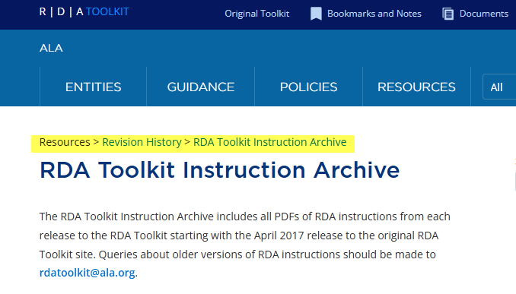
What happens to Original RDA?
The PDF versions of Original RDA will still be available in the Official Toolkit.
You will find all language versions of the Original PDFs at Resources > Revision History > Instruction Archive

Slide 4
What happens to Original RDA?
The webpages of Original RDA Toolkit will be moved to the ALA Institutional Repository, managed by the University of Illinois Urbana-Champaign.
The webpages will not necessarily appear in the Archive on May 12, 2027. There will likely be a delay.
Many of the details about the archiving of the Original RDA Toolkit are yet to be worked out. When details become known, they will be shared with the public.

Slide 5
What is included in the Archive?
All RDA chapters and appendices in all language versions
All policy statement sets
All globally shared workflow and map documents
Personalizations (e.g bookmarks, locally-shared or private workflow and map documents) will not be archived.

Slide 6
Can I save my personalizations?
Yes, you can download your local or private documents as PDFs, or…
You can change the sharing status of your documents to global.
No, your list of bookmarks will not make it to the archive. The best option is to take a screenshot of your bookmark list.

Slide 7
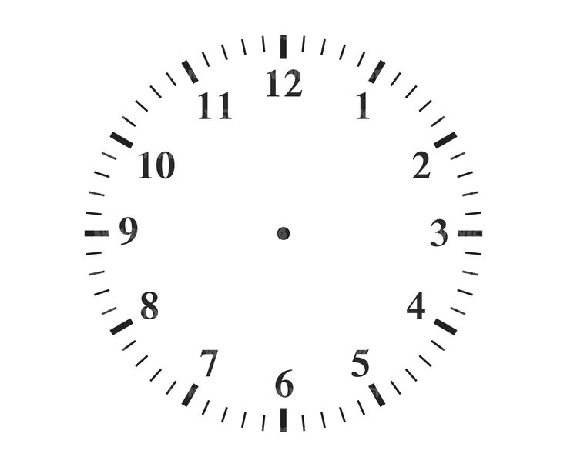
Don‘t panic!
What does this mean for me and my community?

Slide 8
Many Options, many Possibilities
Manuals
Artificial Intelligence?
Policy Statements
Solutions in motion
Application Profiles
Many more

Slide 9
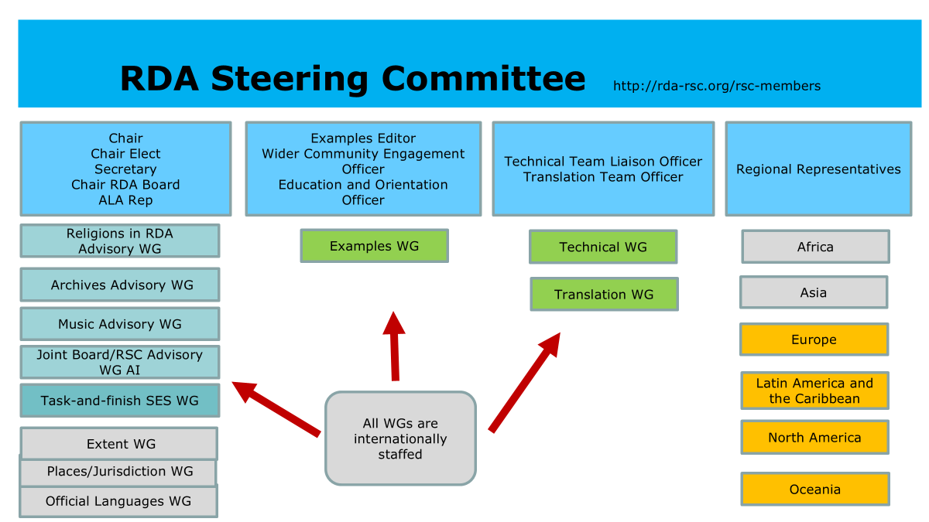
The whole RSC will support you.

Slide 10
Brilliant ideas
Excellent plans
Motivated colleagues
Not enough money
Too much concerns, prescriptions etc.
Not enough human resources
Local solution
| Renate Behrens | RDA goes international | RDA Board outreach | San Diego | 28 June 2024

Slide 11
Learn from others
A number of communities around the world have already developed implementations of Official RDA. Take a look at them – you might find a solution that works for your community too.
We have made these implementations available via the link below, and we would be delighted if you would share your own solutions, plans and projects with us.
Implementing Official RDA | ALA RDA Toolkit

Slide 12
Learning Resources
More webinars to come
RSC news and information
RSC presentations
RDA YouTube channel
Resources for educators
Community-based training materials
https://www.rdatoolkit.org/news/rda/learning-resources

Slide 13


Slide 14
Robert Maxwell RSC Chair Elect
The RSC will continue to support user communities in the future, not only during the Countdown Clock period but also beyond. Collaboration with user communities worldwide has always been important to us and will remain so in the future.

Slide 15
Thank you for your attention
Renate Behrens Chair RSC Steering Committee
rscchair@rdatoolkit.org James Hennelly Director ALA Digital Reference jhennelly@ala.org
Robert Maxwell Chair Elect RDA Steering Committee rmaxwell@rdatoolkit.org

