Slide 1


UNIMARC IN 2025-2026
Enriching the standard, improving the process
RDA in Europe Annual Meeting, May 29th 2026
Florence Tfibel (BnF, France), on behalf of the Permanent UNIMARC Committee (PUC, IFLA)

Slide 2
UNIMARC updates
Published updates to UNIMARC A and B in 2026

Slide 3
UNIMARC 2026 updates
17 proposals were discussed over 4 sessions (35th annual meeting in May-June 2025), of which 12 were accepted and published in version 1.2.0 edition of the Manual (January 2026).
Most notable evolution : creation of a new type of authority record in UNIMARC/A for the IFLA LRM entity Time-span (new code in the Record Label, specific access points (X70) and relevant attributes and relationships.
Other additions : a new relator code for Accessibility certifier (004), a new field in UNIMARC/B (471) to enable linking a described resource to the published research data on which it is based, and various improvements on the description of other IFLA LRM entities.
All this can be found in the IFLA repository : UNIMARC Bibliographic Format Manual 1.2.0 and UNIMARC Authorities Format Manual 1.2.0
Notes:
Currently : good coverage of LRM/RDA entities in UNIMARC ER

Slide 4
A roadmap for 2026-2028
Entity-based cataloguing, accessibility…

Slide 5
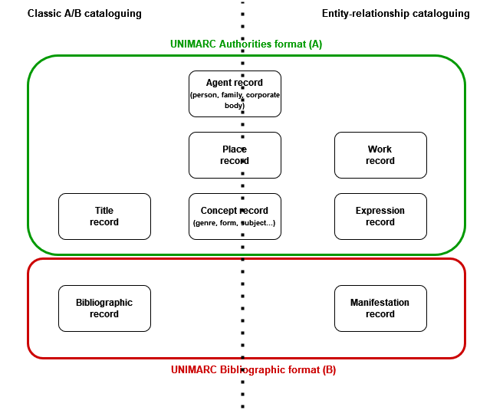
UNIMARC and the new standards
General principles so far :
Compatibility of IFLA standards
  Full LRM implementation
  RDA as an intermediary (but also ISBD-M)
One format, two cataloguing options
  Not a new, distinct format
  But also direct entity relationship management
Notes:
IFLA’s UNIMARC encoding and exchange format has undergone a major transformation with the adoption of a new entity-relationship (ER) conceptual model the IFLA Library Reference Model (IFLA LRM), which brings innovative cataloguing approaches for the digital environment. This shift from traditional metadata practices suggests promising benefits for both libraries and end-users. The key transformations and improvements to UNIMARC are:
Two cataloguing tracks: UNIMARC has evolved to provide two cataloguing options: 1) UNIMARC-ER (entity-relationship cataloguing) and 2) the “traditional” UNIMARC cataloguing. This flexibility allows agencies (institutions, networks etc.) to choose the most suitable track for their specific needs.
Entities and relationships: UNIMARC now accommodates almost all aspects of the IFLA LRM model, expanding UNIMARC’s scope, cataloguing choices and future potential.
UNIMARC-ER features: UNIMARC-ER supports a highly structured approach to library data. It enables enriched description and comprehensiveness. Entity records are created using the UNIMARC Authorities Format or the Bibliographic Format, depending on the entity type. The format retains familiar fields and elements from the “traditional” UNIMARC, supplemented by specific fields and scope of usage.

Slide 6
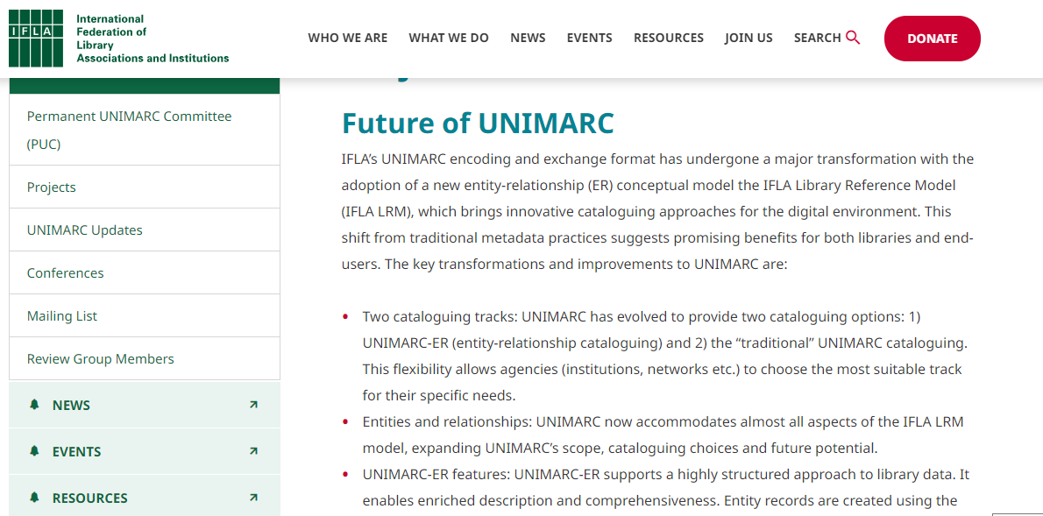
The Future of UNIMARC project
A project launched in 2023, which aims to facilitate exchanging, sharing and generating knowledge about the future of UNIMARC.
It focuses on exploring UNIMARC’s range of uses, increasing familiarity with its entity-relationship (ER) cataloguing track, and gathering information about the library community’s needs.
A webpage since early 2024
6th UNIMARC Users Meeting: Charting the Course: Future-Forward Cataloguing with UNIMARC, 12th November 2024 (Maribor, Slovenia/Online)
A worldwide survey (April-July 2024) : Landscape of Data Structure and Exchange Standards Survey
2025-2026 : Publication of a roadmap (strategy) on UNIMARC entity-based cataloguing with IFLA metadata content standards (PUC position paper)
Notes:
The survey took place from mid April to mid-July 2024, in order to better understand the needs and practices of users, and to shape the format’s next roadmap.
Questions focused on the use of content standards and formats in library systems, as well as on UNIMARC users’ needs and projects for the future, in general and more specifically concerning the new ER standards.

Slide 7
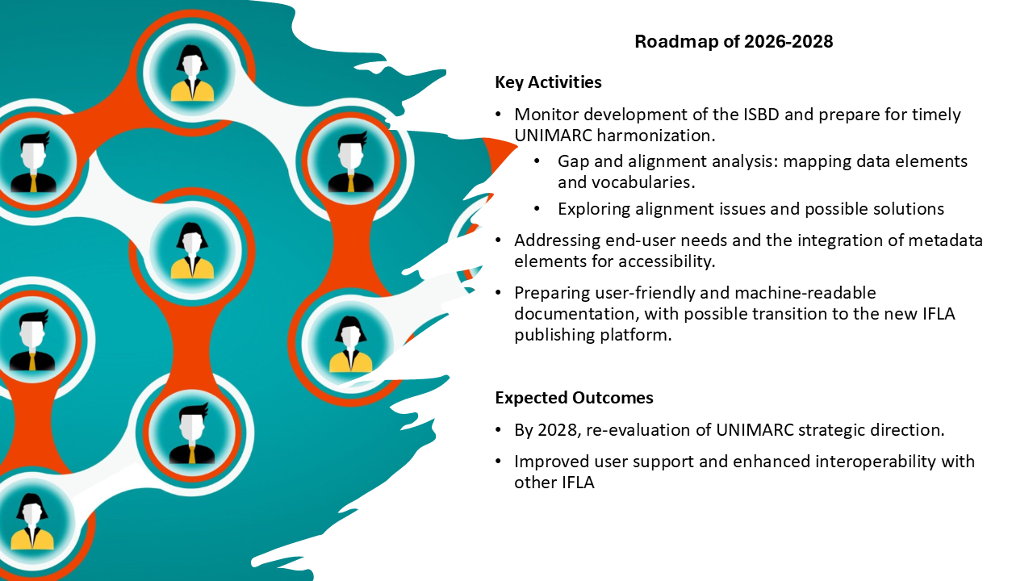

Slide 8
Active working groups and projects
UNIMARC – ISBDM Harmonisation
Accessibility Metadata
Proposal submission process
Publications
UNIMARC Development strategy
With IFLA ISBD Review Group ; comprehensive mapping, identifying limitations to compatibility
With the IFLA Accessibility Metadata Network ; in view of making a set of concerted improvements in UNIMARC
Creating a more ergonomic form, more interactions with users in preparing the proposals
Manuals, new tools (with IFLA METATEC), new outputs, workflow improvements
How to make UNIMARC into a standard that can function in an RDF environment
Notes:
Discussion about implementation needs, especially in view of the ISBD-UNIMARC harmonization group’s work on the mapping
UNIMARC is very open in terms of how to express LRM-based cataloguing codes : should we start collecting practical examples of implementation choices ?
The question how to make UNIMARC into a standard that can function in an RDF environment (and as such, can fully implement ISBD-M) is an important and strategic one. It must therefore be addressed in a timely manner, but also in a way that will allow all members of the PUC to contribute to the final decision on how to put it in practice. As it is a very technical question, the PUC members need more information to be able to make an informed decision.
We therefore intend to create of a specific working group within the PUC, which will :
Organize information sessions on relevant entrants to the discussion for PUC members (online, with the recordings made available to the people who couldn't attend). Such entrants could be a presentation of other encoding standards which are RDF compatible (BIBFRAME and Intermarc NG, others ?), as well as the issues encountered in the mappings with LRM/BIBFRAME compatible standards (ISBD M, RDA, RDA-FR).
Organize a 2 day meeting in Paris in the winter 2026 where the PUC will decide on a strategy regarding the development of UNIMARC (through a series of structured participative workshops)
In the meantime, we propose to make every effort to have as comprehensive and precise a mapping of ISBD M and RDA as possible, to provide a solid and circumstancial overview of the needs.

Slide 9
Thank you for your attention
florence.tfibel@bnf.fr
https://www.ifla.org/g/unimarc-rg/permanent-unimarc-committee-puc/

