Slide 1



Report from the
Europe Representative to the RSC
EURIG Annual Meeting, 2026
Ahava Cohen
ahava.cohen@nli.org.il Ahava.cohen@rdatoolkit.org

Slide 2
Meetings
Online joint RSC/RDA board meeting – April 2026
4 asynchronous meetings (November, July, January, April)
  All asynchronous meetings had public sessions
Upcoming public sessions:
  Tuesday 28 July at 18:00-20:00 UTC
  Tuesday 17 November at 19:00-21:00 UTC

Slide 3
RSC Membership
Filiberto Felipe Martinez Arellano was appointed to represent Latin America and the Caribbean through the Latin America and the Caribbean RDA Group (RDA ALyC) to June 2027
Trina Soderquist was appointed to represent North America through NARDAC to December 2027
Charlotte Christensen had to resign for personal reasons and was replaced by Jack Ennis Butler, representing Oceania through ORDAC to October 2027
Robert L. Maxwell was appointed Chair-Elect to December 2026.

Slide 4
Official RSC
Fast Tracks
Soft deprecated elements
Proposals
  Extent
Protocols
Working Groups

Slide 5
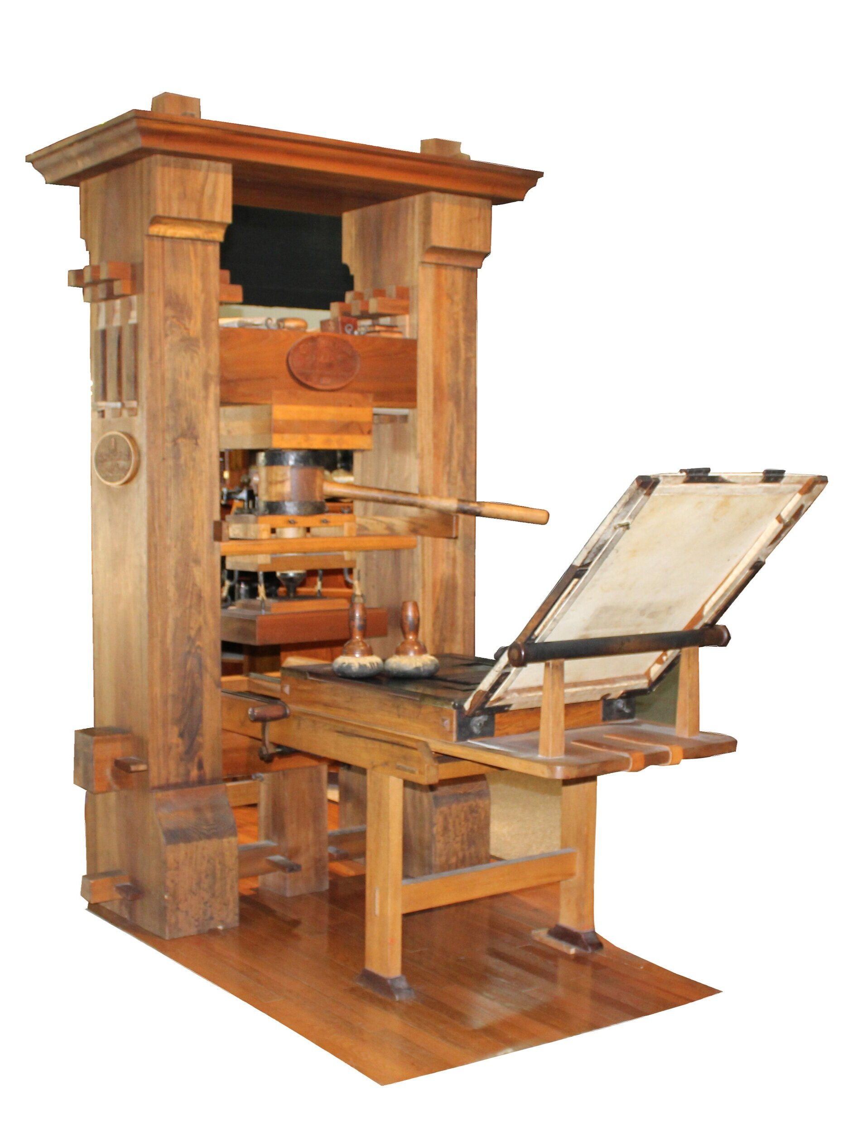
Fast Tracks
Definition of “alternate identity of person” vs. “alternate identity of person of”
Definition of “preceded by expression” and “succeeded by expression”
Addition of the term “keyboard reduction score” to the RDA Format of Notated Music VES
[Update terms] base authorized / variant access point / base of access point
base access point / base of access point
Notes:
Definition of “alternate identity of person” vs. “alternate identity of person of” definition of alternate identity of person of to match its inverse. This, along with a proposal by the Religions WG, brought up the problem that “real or official name” is used in the Toolkit, but has not been defined, wither in RDA or in earlier standards. A definition proposed by the Technical team Chair was found not to work for some non-Anglophone communities and so he and the chair of the Religions WG will work on a definition, alongside the European and Oceania reps.
correct the definitions of the elements preceded by expression and succeeded by expression to align with the definitions of preceded by work and succeeded by work.
Term was added to RDA and the new Music WG was asked to consider music VES in as timely a fashion as possible
All instances of base access point should become base of access point; all instances of base authorized access point should become base of authorized access point; and all instances of base variant access point should become base of variant access point to make it easier and more consistent to translate for languages with grammatical structures different than English
Seprated from above FT for procedural reasons and later approved

Slide 6
Soft deprecated elements
118 elements in RDA which are redundant with other elements or too granular in scope, including:
28 parallel elements
7 unstructured descriptions; could be handled by recording an unstructured description of the broader element
39 elements in which the broader element is a "note on" a WEMI entity
Notes:
Parallel elements are subject to heated debate; most implementations don’t use them, but those which do rely upon them.
Note on elements are likely to be kept because transferring these options to the broader element would be unwieldy

Slide 7
Soft deprecated element proposals
Soft-deprecated elements related to Manifestation: material
Soft-deprecated elements: “Details” elements
Upcoming in July:
Resource-to-resource digest, review, and critique elements
Soft-deprecated elements specific to content and carrier types
Future:
“Note on” elements
“Parallel” elements
Notes:
applied material, base material, emulsion on microfilm and microfiche, and mount were removed from the soft-deprecated list and returned to base RDA
39 “Details” elements were fully deprecated

Slide 8
Proposals – 2025
Proposal to revise Guidance: Aggregates and Guidance: Diachronic Works following from RSC/TechnicalWG/2024/2/rev/Decisions
Add to the end of Guidance: Diachronic works references to existing Guidance: Resource Description sections.
Inconsistency in the transcribed manifestation elements related to source of information
Scope Note for Corporate Body
Notes:
All proposals are available on the RSC website.
1.
Revise the section “Describing an aggregate” in the Aggregates Guidance to clarify the requirements in the context of a well-formed metadata description set.
Add to the end of Guidance: Diachronic works references to existing Guidance: Resource Description sections.
One recommendation withdrawn; the two sets of conditions and condition options under “Additional elements and designations” in variant access points for corporate body deleted
Set aside for procedural reasons – the TTLO and NARDAC were asked to work together on a new proposal
Brings up issues with IFLA-LRM, and so the Chair Elect was asked to liaise with the TTLO & Pat Riva

Slide 9
Proposals – 2026
RSC/TranslationsTLO/2026/1 – Proposal on adding new elements, applicable to rare and old materials, to the RDA Toolkit, the corresponding new definitions to the Glossary, and the corresponding new properties to RDA Registry
Notes:
1. compositor, facsimilist, printer X of plates, and rubricator added to Toolkit. Scribe, as well as other terms suggested in responses, need new proposals, which a group of RSC members are working on for the July meeting.

Slide 10
Extent proposals
Proposal for Manifestation: extent of manifestation and Manifestation: manifestation extent statement
Proposal for Manifestation: extent of unitary structure
Proposal for Manifestation: extent of unit and its subtype elements
Proposal for Manifestation: extent of aggregated content
Proposal for Manifestation: extent of embodied content and its subtype elements
Proposal for Manifestation: duration of embodied content
Proposal for container and storage subelements of Manifestation: extent of manifestation
Proposal for Manifestation: sequence of units of extent
Notes:
approval of the direction of travel, with the stipulation that the first action of the SES Working Group should be to draft ore detailed proposals showing how the direction of travel will be taken.

Slide 11
Protocols
Protocol between the RSC and
the ISSN International Centre

Slide 12
Working Groups
Standing Working Groups
Examples Working Group
Technical Working Group
Translations Working Group
Task and Finish Working Groups
String Encoding Scheme Working Group
Advisory Groups
Religions in RDA Working Group
Archives Working Group
Joint RDA Board and RSC Working Group on Artificial Intelligence
Music Working Group

Slide 13
Editorial Committee – 2026
Mélanie Roche - Bibliothèque nationale de France | June 2023 - June 2026
Maïté Roux – ABES | January 2023 – January 2026
Thurstan Young – British Library | June 2022 – June 2025
Anastasia Kerameos - CILIP | May 2025 – May 2028
Luna Sindin Cordery | Ex officio – EURIG Chair
Ahava Cohen | Ex officio – EdCo Chair
Hannes Lowagie | Ex officio – RDA Board IR
Szabolcs Dancs | Ex officio
EURIG Executive Secretary | Ex officio
Notes:
Thurstan is finishing his second consecutive term. According to the Cooperation Agreement, he must step down for at least one term.
At this point, former members are kept on our basecamp space. If it ever came down to a vote – they are not voting members. But their input, if they should offer it, is still welcome.

Slide 14
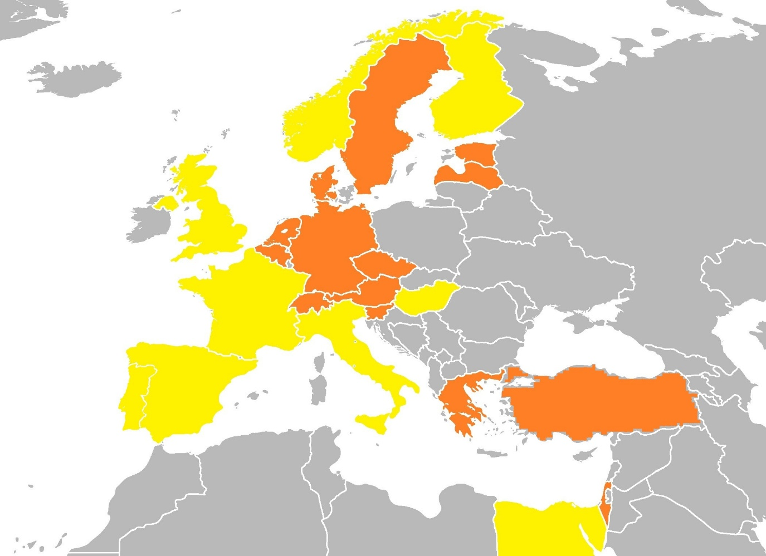


Full
Translations:
Partial translations:
Notes:
A full translation is being prepared in Catalan, Finish, French, Hungarian, Italian, Norwegian, Portuguese and Spanish. In some cases, such as French, Portuguese and Spanish, the translation procedures are coordinated by non-European countries. Partial translation work is also underway for Czech, Danish, Dutch, Estonian, German, Greek, Hebrew, Korean, Latvian, Slovenian, Swedish and Turkish.

Slide 15
Full translations | Partial translations
Arabic (in Registry) | Czech
Catalan (published) | Chinese (in Registry)
Finnish (published) | Danish (in Registry)
French (published) | Dutch (in Registry)
Hungarian (in Registry) | Estonian (in Registry)
Italian (in Registry) | German (in Registry)
Norwegian (published) | Greek (in Registry)
Portuguese | Hebrew
Spanish (published) | Korean
 | Latvian (in Registry)
 | Slovenian
 | Swedish (in Registry)
 | Turkish (in Registry)
 | Vietnamese (in Registry)
Notes:
Totally, from a world perspective, there are 9 full translation projects, and 14 partial translation ones.
This is a list of un-going and finished translations. Languages with other writing systems than Latin are highlighted in italic.
Five of the nine full translations have already been ready and published in Toolkit, and most of the partial translations are available in the Registry.

Slide 16
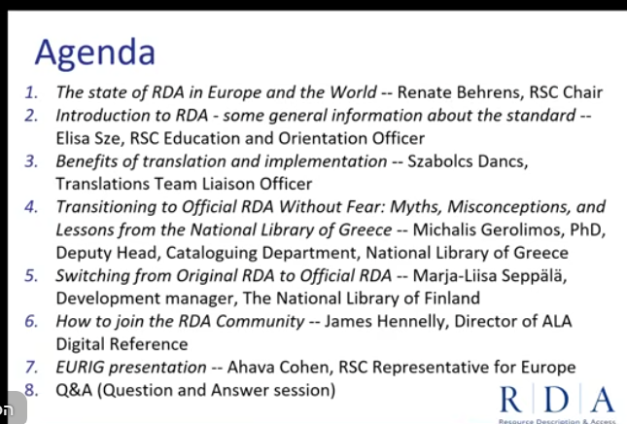
RDA in Europe (and the World) a webinar on RDA for beginners
Held online February 2, 2026
Available on YouTube -
  over 600 views

Slide 17


Questions? Comments?
Fast Track/Proposal ideas?

Slide 18
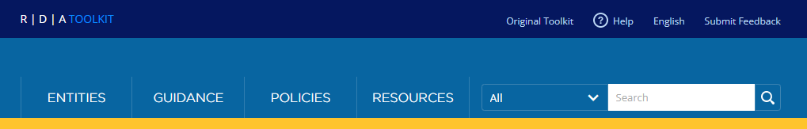
Ahava Cohen
National Library of Israel
Europe Representative to the RSC
ahava.cohen@nli.org.il Ahava.cohen@rdatoolkit.org
X: @AhavaCohen

