Slide 1
News from the RSC
Renate Behrens
Chair RDA Steering Committee
James Hennelly
Director, ALA Digital Reference
May 2026

Slide 2

The RSC is working really hard!
Walking around Brussels with Tintin

Slide 3
Key Tasks
Further development
Internationalization
Management
Broaden the scope

Slide 4
Further development (content)
Discussion and approval of several Discussion papers, Proposals or Fast Tracks
Proposals | ALA RDA Toolkit
Creation of examples
Translators WG
Policy Statements WG

Slide 5
Further development (technically)
3 Toolkit releases in 2025, February 2026
About 12 releases of the RDA Registry in 2025
Planned mapping RDA BIBFRAME
Several proposals concerning „Soft-deprecated elements“

Slide 6
Internationalization
Support of communities world-wide
Close contact with the Region Representatives
Translations
Webinars
Presentations Presentations | ALA RDA Toolkit

Slide 7
Management
4 Asynchronous meetings, with virtual parts and public sessions
Joint virtual meeting with the RDA Board
Recruit or re-appoint to several RSC positions
Management of the RSC Working Groups
Review of existing protocols and assigned liasisons

Slide 8
RDA Steering Committee http://rda-rsc.org/rsc-members
Chair
Renate Behrens (GER)
Chair elect
Robert Maxwell (US)
Secretary
Anne Welsh (GB)
Chair RDA Board
Christine Oliver (CAN)
ALA Representative
James Hennelly (US)
Examples Editor
Jessica Grzegorski (US)
Wider Community Engagement Officer
Getaneh Alemu (GB)
Education and Orientation Officer
Elisa Sze (CAN)
Technical Team Liaison Officer
Christopher Holden (US)
Translation Team Officer
Szabolcs Dancs (HUN)
Regional Representatives
Jack Ennis Butler (ORDAC/Australia)
Ahava Cohen
(EURIG/ Israel)
Trina Soderquist (NARDAC/US)
Felipe Martinez
(AlyC/Mexico)

Slide 9
RSC Working Groups https://www.rdatoolkit.org/rsc/workinggroups
Advisory Working Groups
Religions in RDA Working Group
2022-
Chair: David Roth (ISR)
Archives Working Group
2025-
Chair: Martin Lüpold (CH)
Joint RDA Board and RSC Working Group on Artificial Intelligence
2024-
Chair: Ahava Cohen (ISR)
Musik Working Group
2026-
Chair: Chelsea Hoover (US)
Standing Working Groups
Examples Working Group
Chair: Jessica Grzegorski (US)
Technical Working Group
Chair: Christopher Holden (US)
Translations Working Group
Chair: Szabolcs Dancs (HUN)
Task and finish Working Groups
SES Working Group
2026-2028
Chair: Thomas Brenndorfer (CAN)

Slide 10
Communication
Outreach Events
Website
Recordings
Publications
…
News | ALA RDA Toolkit

Slide 11
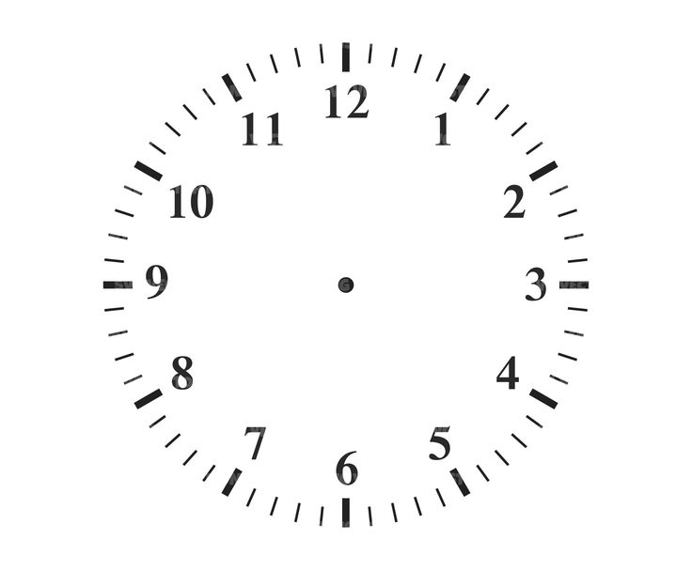
The Countdown Clock
The Countdown Clock started on May 11, 2026
It will end at 12:01 am UTC -10 (Hawaii-Aleutian time zone) on May 11, 2027.
When the clock runs down to zero the Original Toolkit will be removed from the Web.
Information icon next to the clock in the Original Toolkit
Notes:
, t

Slide 12
What happens to Original RDA?
The PDF versions of Original RDA will still be available in the Official Toolkit.
You will find all language versions of the Original PDFs at Resources > Revision History > Instruction Archive

Slide 13
What happens to Original RDA?
The webpages of Original RDA Toolkit will be moved to the ALA Institutional Repository, managed by the University of Illinois Urbana-Champaign.
The webpages will not necessarily appear in the Archive on May 12, 2027. There will likely be a delay.
Many of the details about the archiving of the Original RDA Toolkit are yet to be worked out. When details become known, they will be shared with the public.

Slide 14
What is included in the Archive?
All RDA chapters and appendices in all langauge versions
All policy statement sets
All globally shared workflow and map documents
Personalizations (e.g bookmarks, locally-shared or private workflow and map documents) will not be archived.

Slide 15
Can I save my personalizations?
Yes, you can download your local or private documents as PDFs, or…
You can change the sharing status of your documents to global.
No, your list of bookmarks will not make it to the archive. The best option is to take a screenshot of your bookmark list.

Slide 16


Slide 17
Thank you for your attention and grateful for your input!
Renate Behrens
Chair RSC Steering Committee
rscchair@rdatoolkit.org
James Hennelly
Director, ALA Digital Reference
jhennelly@ala.org

