Slide 1
Introduction to the RDA Board

Slide 2
Overview of today
RDA Governance and RDA Board
Structure of the RDA Board
Meetings and Communication
Background
2026 Membership of the RDA Board
2026 Activities

Slide 3
RDA Governance
Infrastructure supporting RDA and its development:
RDA Board
RDA Steering Committee (RSC)
ALA Digital Reference

Slide 4
Governance Model
The Governance Model document is on the RDA Toolkit website: https://www.rdatoolkit.org/rdaboard/rda-governance
From the introduction of the Governance Model document:
“The RDA Board is a decision-making body responsible for the strategic direction for the development of RDA. A key part of its mandate is ensuring good governance for all the committees engaged with the development of RDA.”

Slide 5
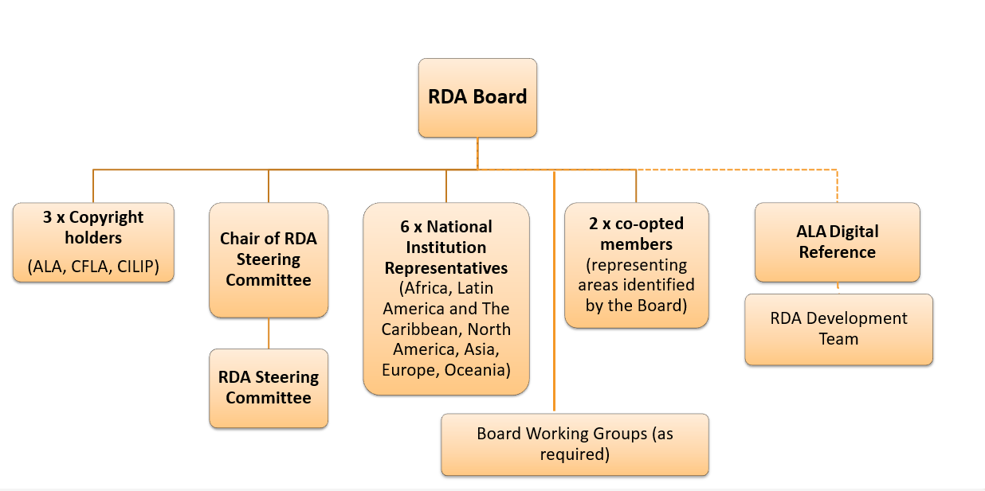
RDA board’s structure
Governance Model also determines the RDA Board’s structure

Slide 6
RDA Board members
  3 Copyright Holder representatives
  ALA Digital Reference representative (called ALA Publishing representative in the Agreement) ex officio
  6 National Institution representatives
  RSC Chair ex officio
  RDA Fund trustees ex officio (in practice, rarely attend Board meetings)
  (up to 2 co-opted members)

Slide 7
National Institution (NI) Representatives
one from each of the 6 regions
each representative serves one 4-year term
intention is to circulate among all eligible institutions in a region
criteria for selection: eligibility of the institution and qualifications of the individual
  institution: has implemented RDA or about to implement RDA within the calendar year
  individual is familiar with RDA
focus on “national institutions” because of their leadership role in their communities
recruited and approved by the Board

Slide 8
Role of NI Representatives
unique role of the NI reps is to bring forward regional intelligence and perspectives
  represent the region; indicate issues and concerns
  provide insight about the impact, challenges and opportunities
  help raise the profile of RDA in their region
NI representatives also share in the governance and strategy roles of the Board as a whole
  contribute to the development and delivery of the RDA Board strategic plan
  ensure that the overall governance of the standard continues to support internationalization

Slide 9
RDA Fund trustees
one trustee representing each Copyright Holder association
may be the same person as the Copyright Holder representative
with the ALA Digital Reference representative as chair, they manage the RDA Fund
RDA Fund may be spent on:
administrative support for RSC
development and research work
travel for in-person meetings
mitigate debt owed to ALA

Slide 10
Communication and meetings
the RDA Board has historically not had a highly visible role: behind the scenes and supporting the RSC
becomes visible when needed to lend weight to decisions such as the countdown clock and retirement of the original RDA Toolkit
meets four times a year
relies on Basecamp as the main means of communication among members
asynchronous meetings over a week with one video call within that week

Slide 11
Background
up to 2016 Committee of Principals and Joint Steering Committee
2016 Addendum to the 2011 Addendum to the 1989 Ango-American Cataloguing Rules Agreement
CFLA becomes a Co-Publisher and member of the RDA Board (replacing CLA)
2016-2017 Transitioning to the new governance model and new names
2018 RDA Board operating fully under the new model with 6 NI representatives

Slide 12
2026 membership of the RDA Board
Copyright Holder reps Colleen Barbus for ALA
Jenny Wright for CILIP
Chris Oliver for CFLA (chair, 2026-2027)
ALA Digital Reference James Hennelly
NI representatives Rania Osman for Africa (To serve 2022-2025+)
Hui Ling Ng for Asia (To serve 2026-2029)
Replaced Haliza Jailani, National Library Singapore
Hannes Lowagie for Europe (To serve 2025-2028)
Replaced Christian Aliverti, National Library of Switserland
Ángela Quiroz Ubierna for Latin America & the Caribbean (To serve 2023-2026)
Thi Bao Tran Phan for North America
Replaced Judith Cannan, LOC
Laura Jamieson for Oceania
Replaced Julia Hickie, National Library of Australia

Slide 13
2026 membership of the RDA Board (2)
RSC Chair Renate Behrens
To support smooth transitions between incoming and outgoing members, there are intentional overlaps in membership at certain points close to transitions.
Incoming RSC Chair Robert Maxwell

Slide 14
2026 activities
2025 09 (online)
2025 12 (online)
2026 02 (online)
2026 05 (online)
No ‘in person’ meeting this year
Agenda of the meetings (apart from the usual ‘updates’ (RSC, NI, and so on)

Slide 15
2025 09
Report from copyright holders
Financial situation copyright holders
Declining subscriptions, AI and copyright, fees of international transactions, …
Advisory Council – proposal discussed
RDA Certification

Slide 16
2025 12
2026-2028 Strategic Plan – voting
https://www.rdatoolkit.org/rdaboard/strategicplan – updated!
      1 Develop RDA as an international, flexible, and dynamic standard
      2 Continue to increase the internationalisation of RDA
      3 Ensure a Sustainable Business model
      4 Provide Relevant Governance
Joint RDA Board and RSC Working Group on AI
  + vote on the extension of the AI WG's term and ‘Should the Joint RSC/RDA Board Working Group on Artificial Intelligence transition from a task-and-finish working group to an advisory working group beginning in 2026?’

Slide 17
2026 02
Joint RSC/RDA Board Working Group on AI
  TOR approved by RSC
  Proceeding as an advisory working group (instead of "task and finish")
  Membership to be updated to include Angela and Hui Ling
Business Models
  Continue with slight shift in focus
    a) Shift to exploring pricing policies, "rational pricing".
    b) Recruit new members (Robert Maxwell, Laura Jamieson)

Slide 18
2026 02
Approval of NARDAC Terms of Reference
  Bermuda, Canada, Greenland, Saint Pierre and Miquelon, United States of America.
Legacy data
  RSC has been exploring how to deal with extent proposals, and determining what might move to legacy data. Discussion about copyright implications.
  CC Attribution
  Behind paywall
  Difference between Legacy data and community resources

Slide 19
2026 05
Countdown clock
  Information page
  Instruction archive → original RDA PDF in all languages
  Site will be archived at university of Illinois (pages/files, not as website) (waybackmachine-principle), but avoid that people keep using the archived site
    Also for historical reasons: what was RDA back in 2025

Slide 20
2026 05
Review wording of internationalisation principles
Governance model
Copyright
  With the creation of legacy space on Official RDA Toolkit, we will need a statement about permission to use the legacy material and under what conditions.
Strategic plan

