Slide 1
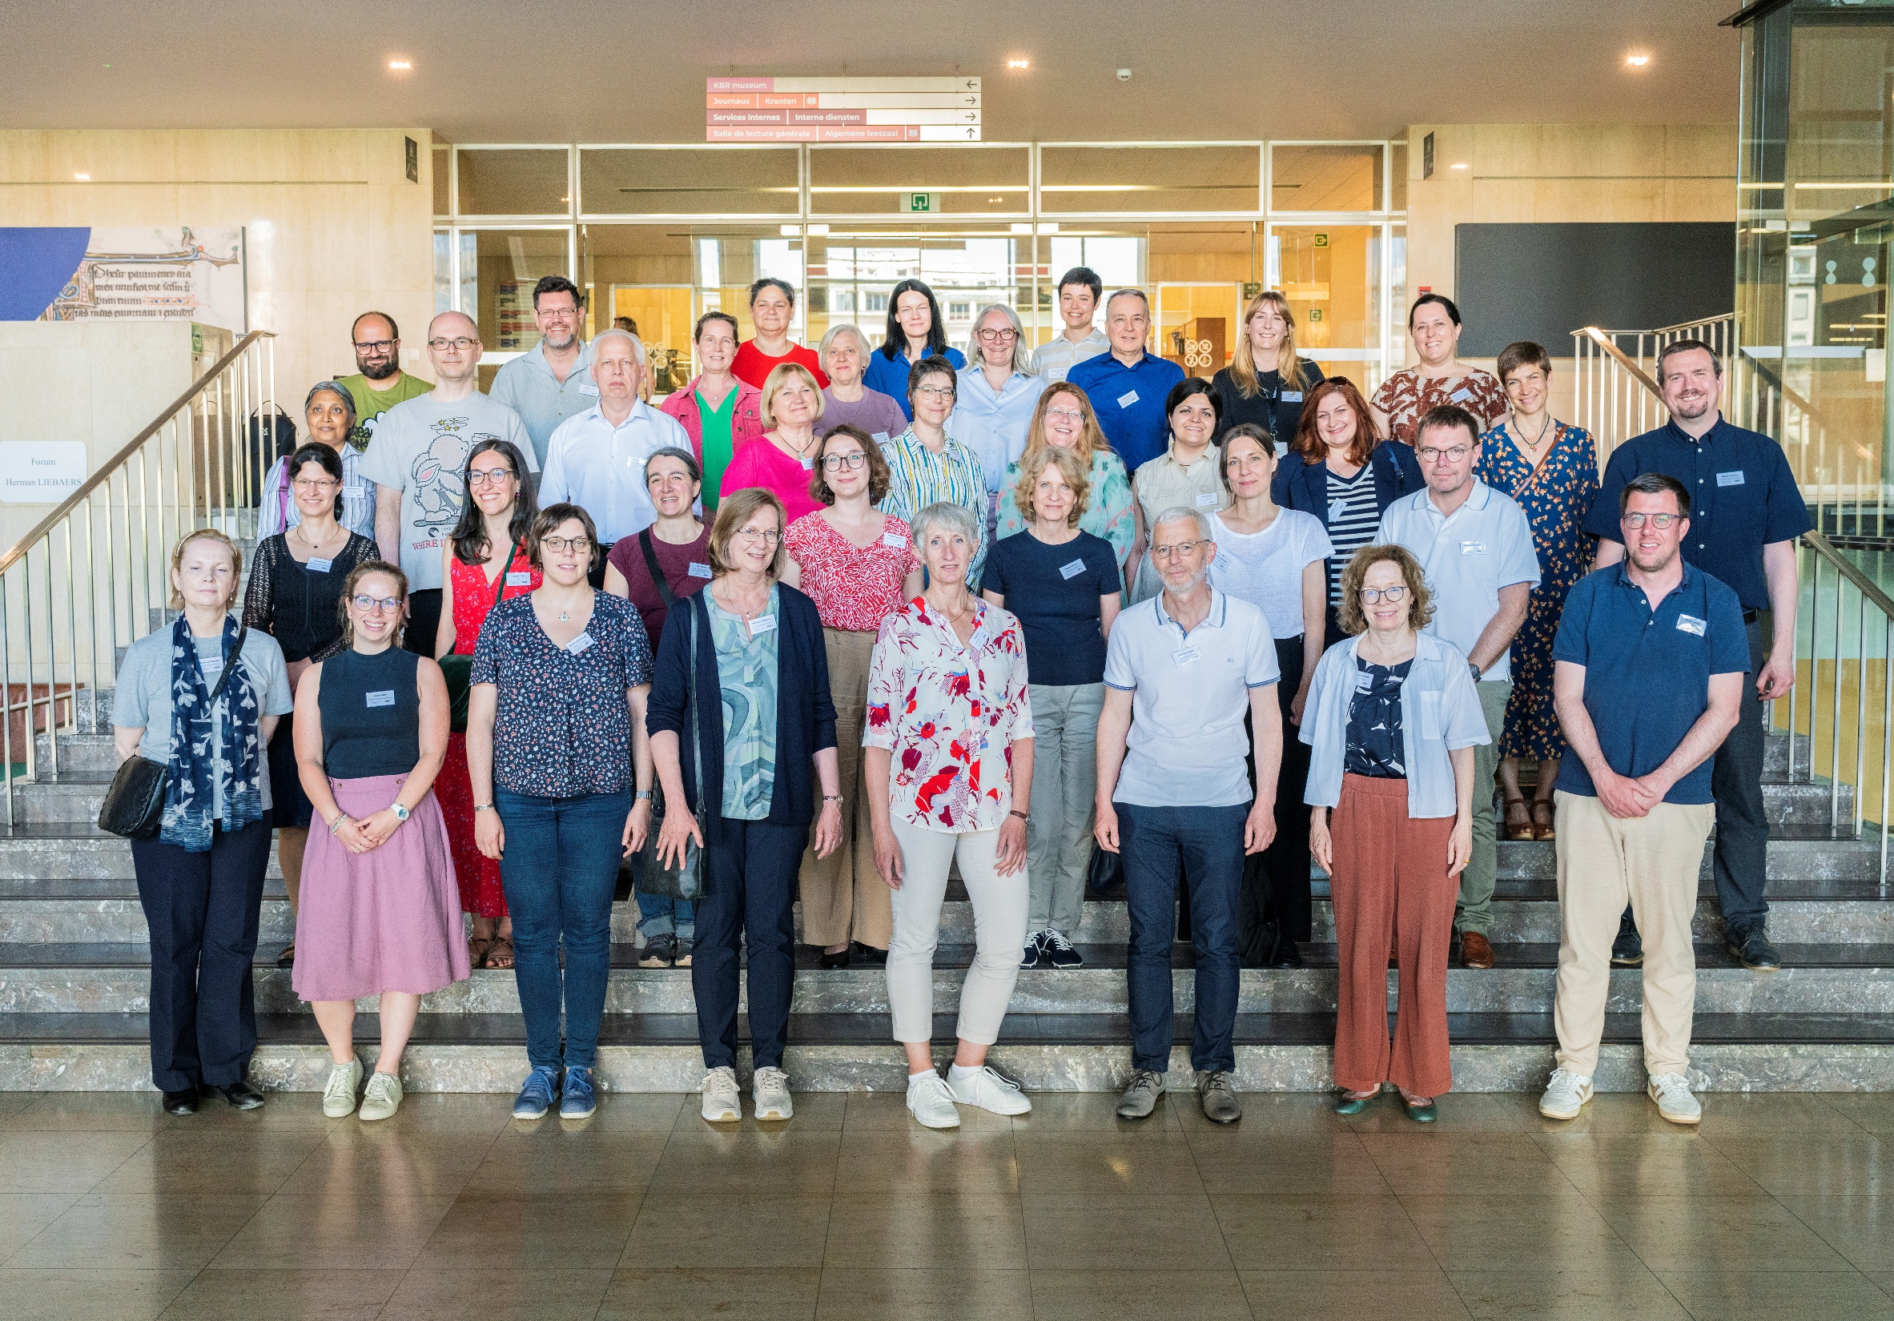

Slide 2
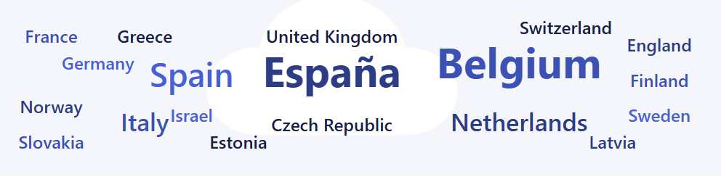
Survey on RDA implementation
Organised by EURIG
Januari – March 2026
45 responses

Slide 3
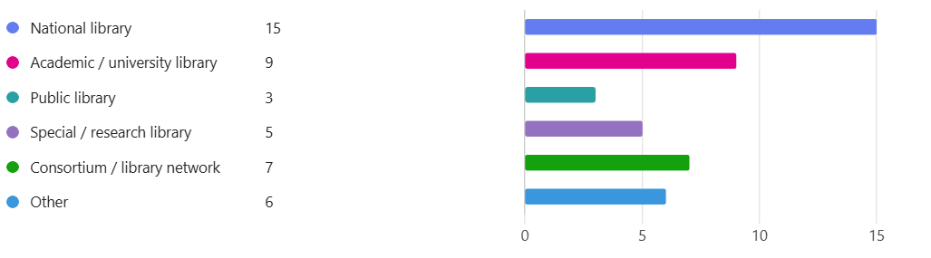
Type of institution

Slide 4
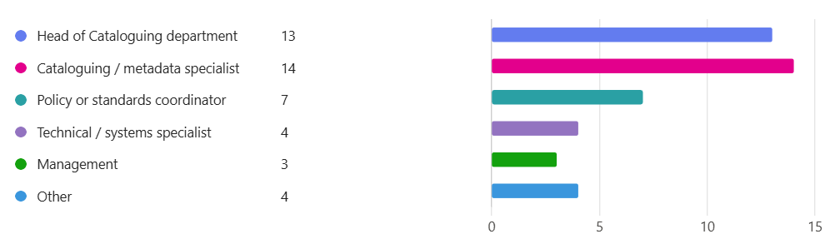
Role of respondent

Slide 5
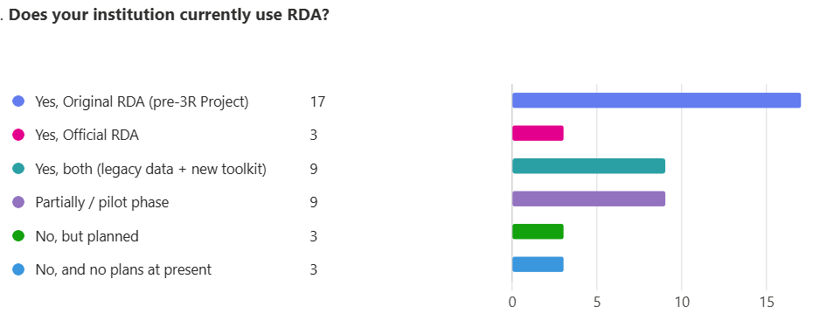

Slide 6
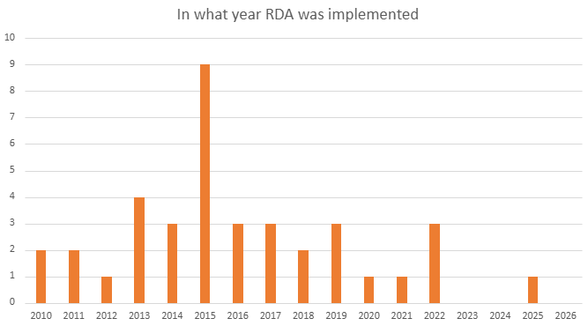
2010 : - Fundación Ignacio Larramendi - BNE 2010 according to the Biblioteca de Aragón, but the BNE itself stated 2019

Slide 7
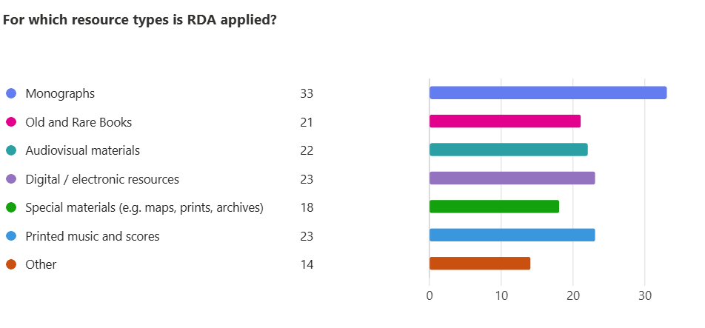

Slide 8
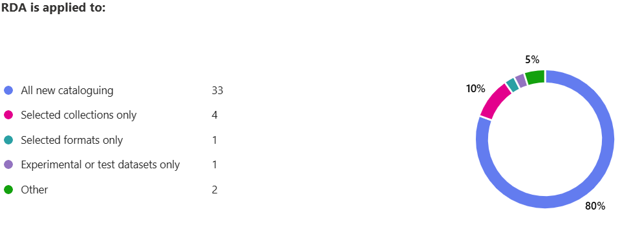
Other = authorities

Slide 9
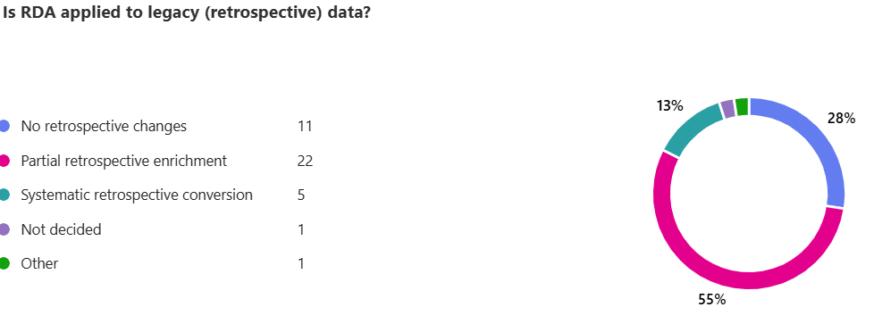

Slide 10
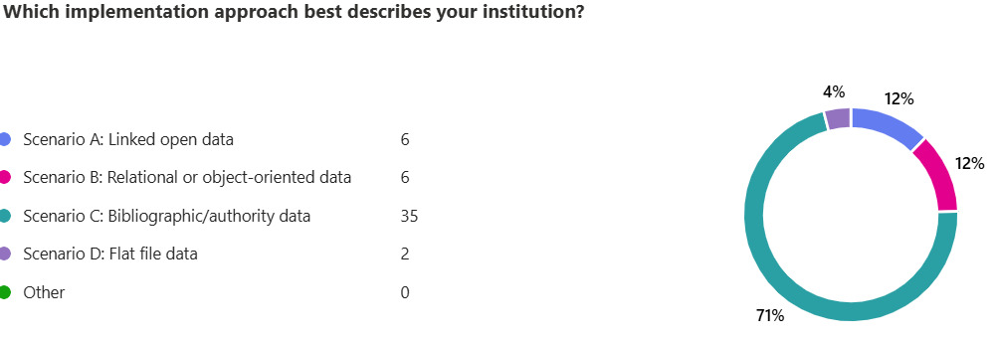

Slide 11
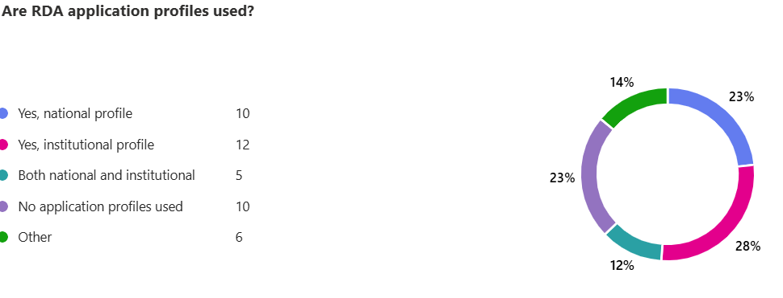
Other = RDA DACH

Slide 12
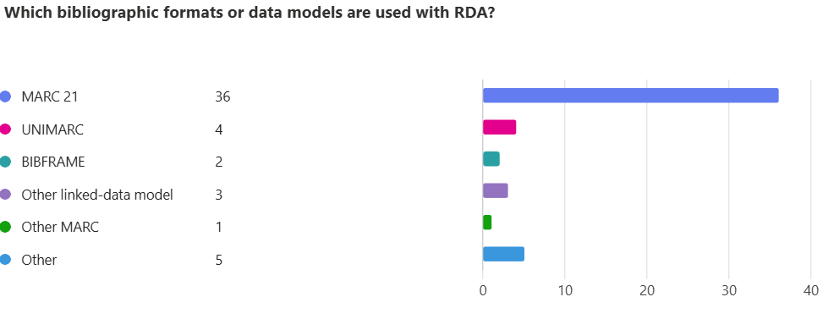
Other = PICA, other linked data or xml model

Slide 13
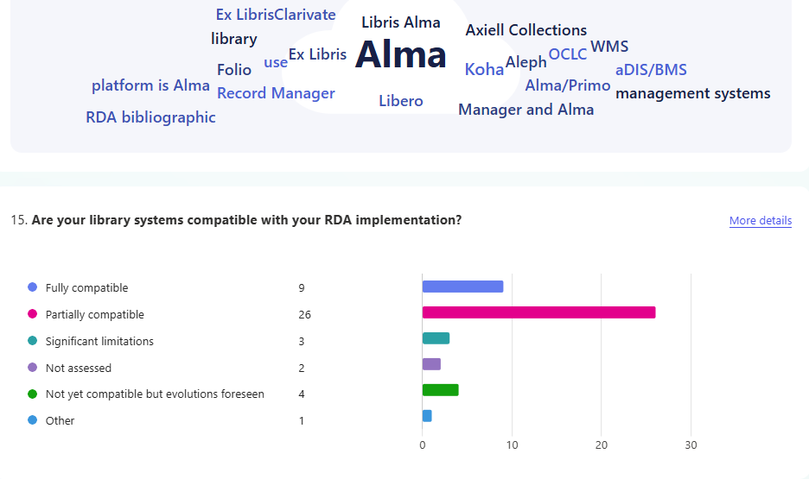

Slide 14
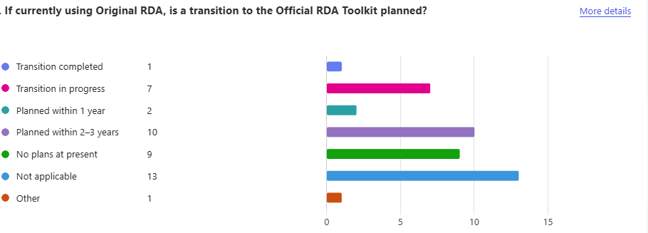

Slide 15
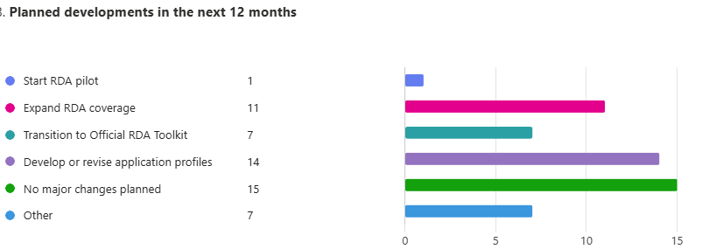
Gather all the necessary information to initiate the transition to RDA
Implementation of a WEMI structure in Axiell Collections
The Italian translation of RDA has been suspended in order to initiate a feasibility study on the possible future adoption of RDA within the Italian national library service
Setting up courses for the Official Toolkit; Following international developments.

Slide 16
Planned developments in the next 2–5 years
1. Transition to Official RDA and Linked Data/BIBFRAME environments
  A dominant theme is the move toward the Official RDA Toolkit alongside linked data infrastructures such as BIBFRAME. Many respondents describe transitions already underway or being planned:
    “Adoption of Official RDA and move to LD environment” (4)
    “Implementing the RDA based BIBFRAME version (BFFI) within a linked data system” (8)
    “Transition to Official RDA, implementing Linked Data” (24)
    “Investigating switch from MARC21 to BIBFRAME” (23)
    “Prepare for mental shift needed to work within both Official RDA and Bibframe” (14)

Slide 17
Planned developments in the next 2–5 years
2. Development and revision of application profiles, policies, and guidance
  Several responses emphasize the need for application profiles, coordinated policies, workflows, and cataloguing guidance to support implementation
    “working with application profiles” (6)
    “Develop or revise application profiles where necessary” (9)
    “RDA Application profiles and trainings” (11)
    “Development of training, policies, and guidelines to support coordinated implementation across the Catalan library network” (18)
    “Creation of fuller cataloguing guidelines and revised workflows” (27)

Slide 18
Planned developments in the next 2–5 years
3. Training, expansion of coverage, and gradual implementation strategies
  Respondents frequently mention expanding RDA coverage to additional materials/entities and supporting staff through training, often while acknowledging resource constraints or phased adoption:
    “Expand RDA coverage” (1)
    “Expand coverage to all materials, and description of agents” (16)
    “Expand RDA coverage to different resource types” (27)

Slide 19
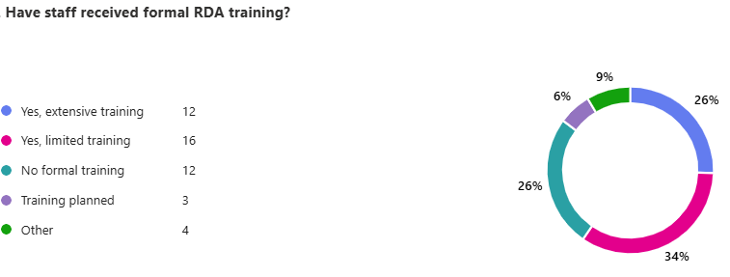

Slide 20
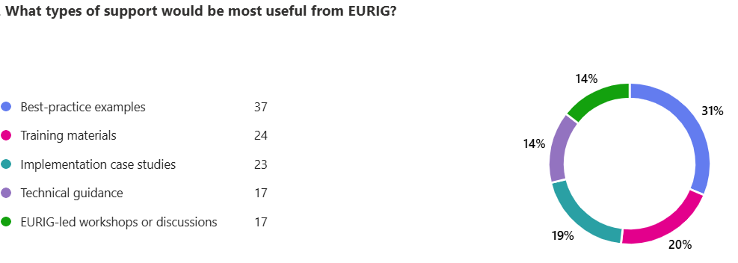

Slide 21
Survey in UK
https://journals.cilip.org.uk/catalogue-and-index/issue/view/56/7
  Article about Official RDA in UK (Thurstan Young)
  Article about the results of the survey

Slide 22
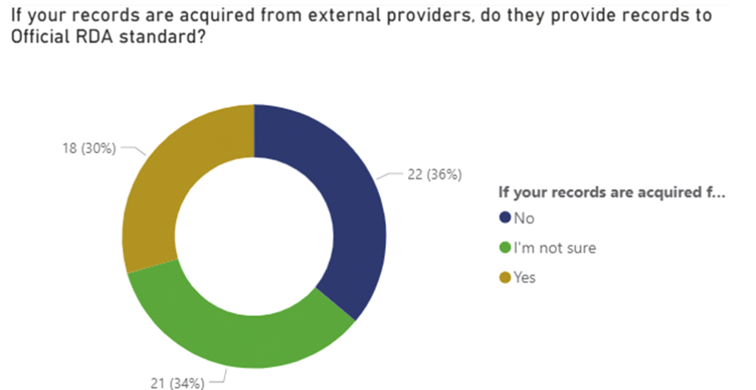
Survey in UK

Slide 23
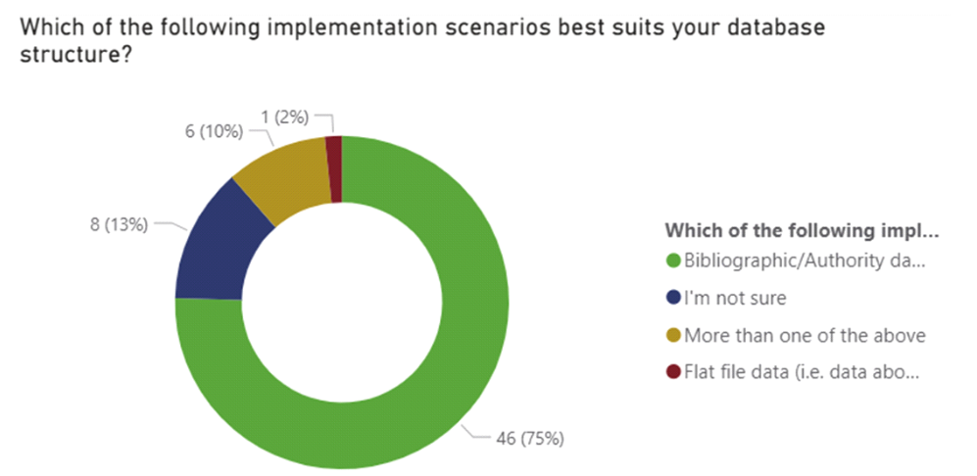
Survey in UK

Slide 24
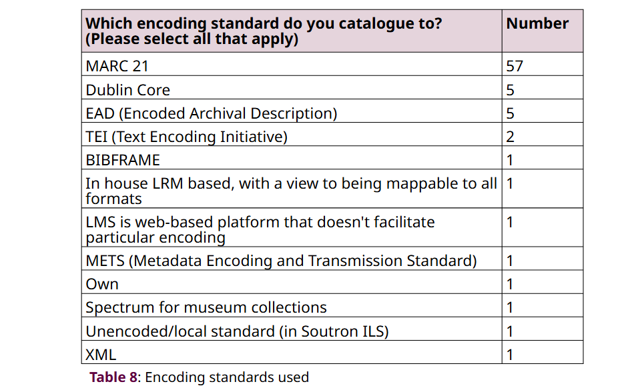

Slide 25
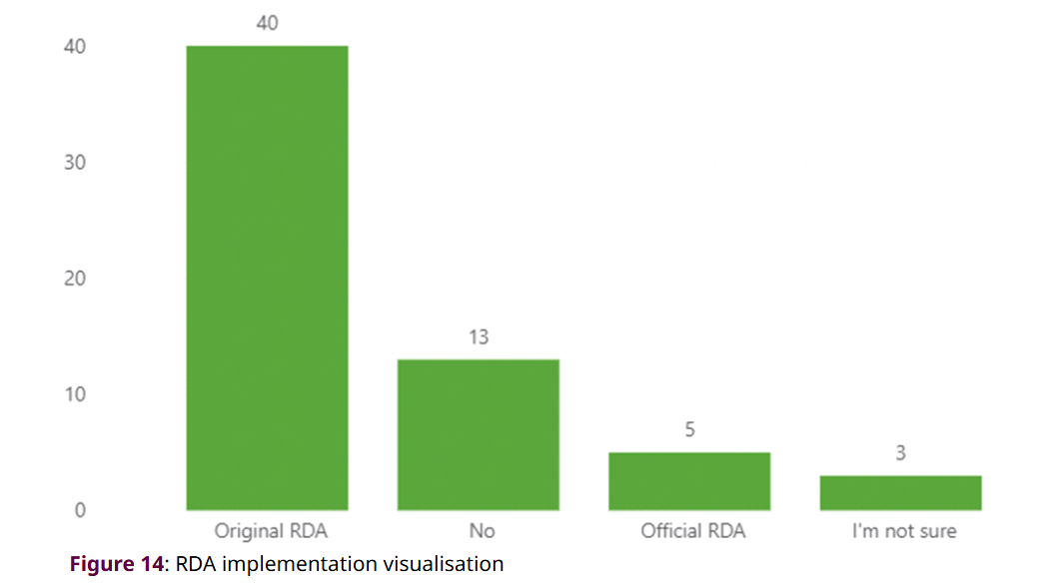
Survey in UK

Slide 26
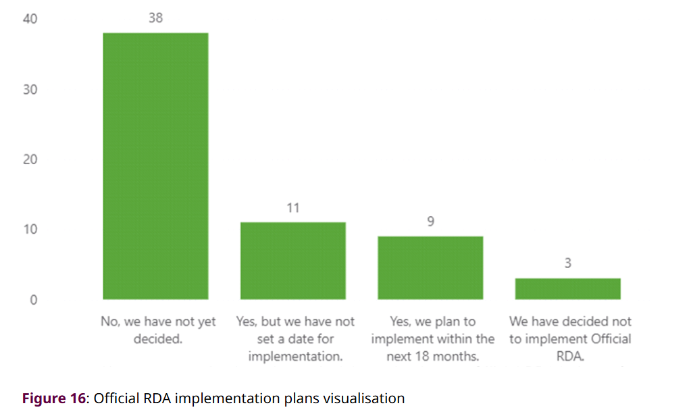
Survey in UK

Slide 27
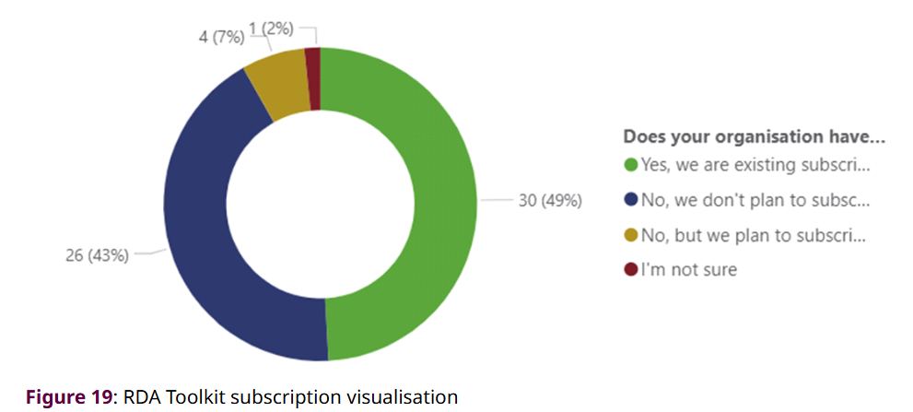
Survey in UK
Subscription to RDA Toolkit

Slide 28
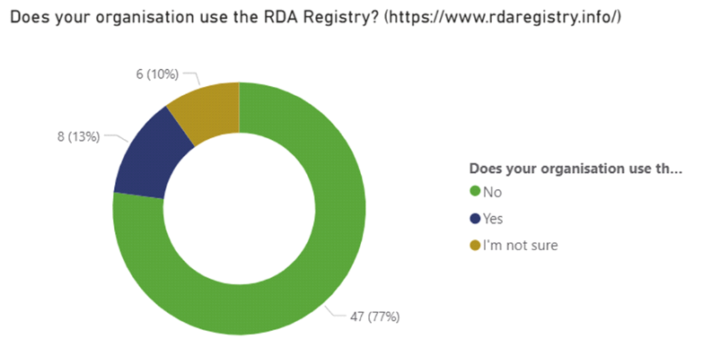
Survey in UK

Slide 29
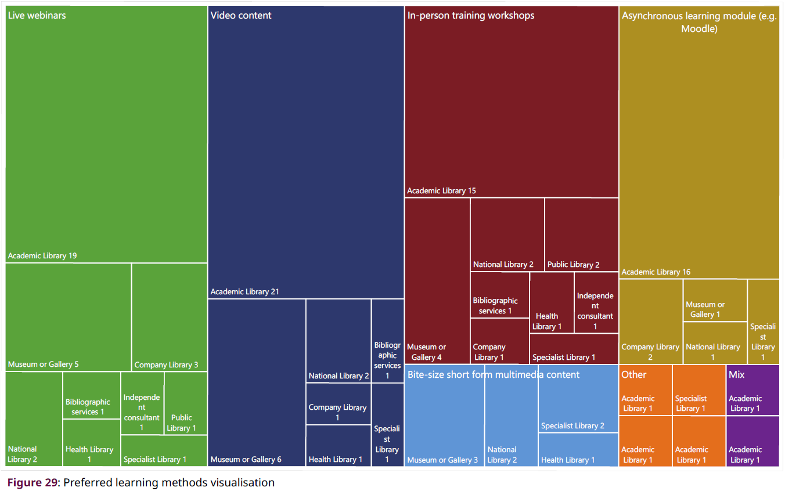
Survey in UK

Slide 30
UK and EURIG → Training needed
Provision in training
  On what level ? RSC – EURIG – national – institutional
  On each level needed, but how can one level help the other?

Slide 31
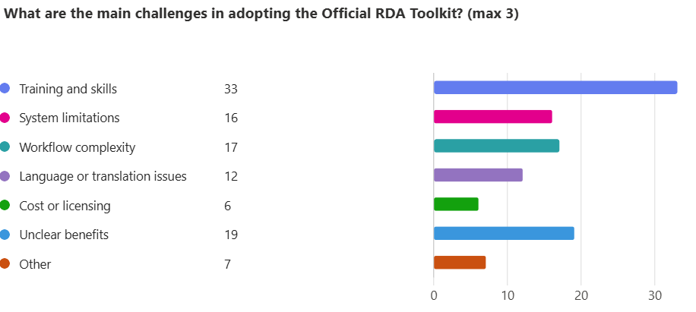

Slide 32
In your opinion, what is the biggest difficulty of
RDA implementation at your institution?
1. Training, Knowledge Gaps & Staff Understanding
2. System Limitations / MARC Compatibility
3. Complexity / Abstract Nature of RDA & Toolkit
  Library management systems are currently more of a hindrance than an asset to RDA implementation
4. Time, Staffing & Resource Constraints
  No interest from management
5. Legacy Data & Transition from Old Rules

Slide 33
What advice would you give to institutions planning
RDA implementation?
“Successful RDA implementation is less about learning a new standard and more about changing how an institution thinks about bibliographic data. The earlier that mindset shift happens, the less painful everything else becomes”
anonymous - Estonia

Slide 34
Proposal
General Survey
  High-level overview across all countries, but also ‘in depth’ per country
  Country-level filtering available
  Conducted every X years for trend tracking and benchmarking

