Slide 1

EURIG Chair report
Brussels, May 29th, 2026
Notes:
Good morning and welcome to the second day of our annual Meeting.

Slide 2

Members: new additions and changes
NEW:
  Yaroslav Mudryi National Library of Ukraine
  National Library of Serbia
  Tech’Advantage (France)
REPRESENTATIVE CHANGE:
  National and University Library of Slovenia
  National Library of the Czech Republic
Total: 56 members
Notes:
EURIG has 56 member institutions, with a good level of engagement. This is shown not only by the presence and contribution of all attending here, but also in the 3 new representatives we have since last year as member institutions.
Iryna Bankovska from the Yaroslav Mudryi National Library of Ukraine
Ana Stevanovic from the National Library of Serbia
Anne Dupiat from Tech’Advantage (France)
We have also experienced a couple of representative changes:
Irena Kavcic is the new rep for the National and University Library of Slovenia
Veronika Jarošová is the new rep for the National Library of the Czech Republic
Keep EURIG in mind when there are staff changes
So, Welcome all and in particular to the new faces ‘at the table’.

Slide 3
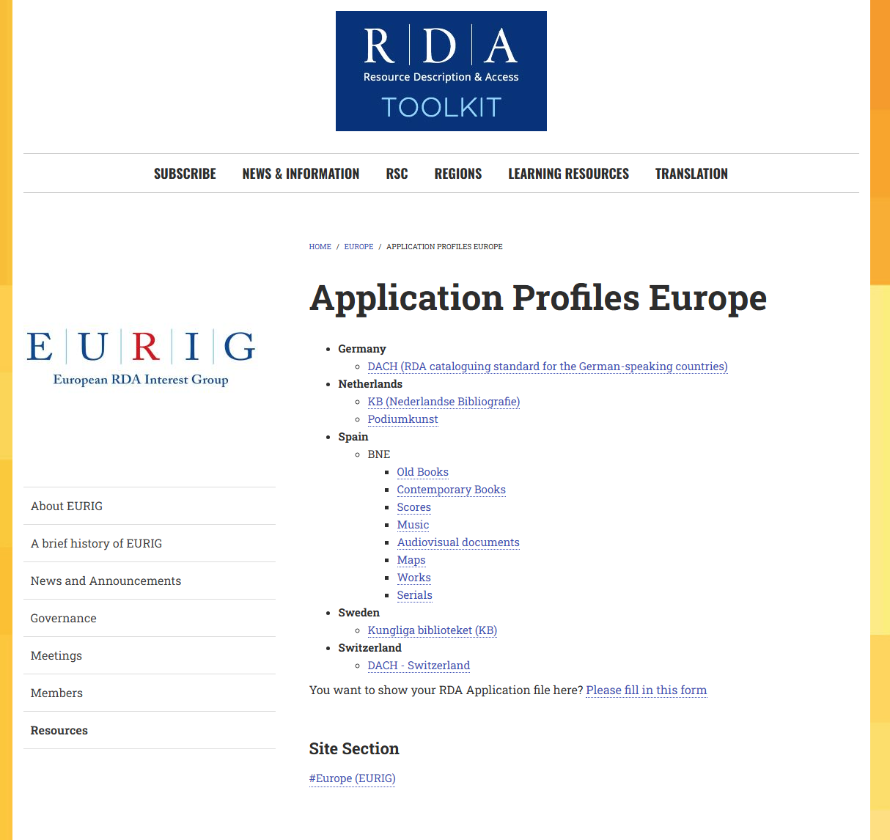
Executive Committee activities
New resources on our website: Application profiles
Preparing 2026 Annual meeting
Notes:
At last year’s Meeting we agreed on the plan of sharing EURIG members’ Application profiles on our website. The Executive has been able to do it thanks to Hannes, who has also been busy updating the News section when necessary.
We’ve also met monthly in order to organise this year’s Meeting.

Slide 4



EURIG: what’s next?
Vice-Chair and Secretary election
Transition to Official RDA in May 2027
2027 Annual meeting hosted by the National Library of Scotland
Notes:
So what’s in store next for EURIG?
By the end of the day we should have a new Vice-Chair and a new Secretary since Hannes and Emilie’s mandate comes to an end.
May 2027 is the date for the transition to Official RDA, the Executive is open to coordinate and support activities that our membres have suggested in the survey that Hannes carried out at the beginning of the year, and will be presenting in a few minutes.
I’m very glad to announce that thanks to Jenny Wright, our former Chair, the National Library of Scotland has offered to host us next year. So I look forward to seeing you in Edinburgh next year.

Slide 5
Thank you!
Luna Sindin
EURIG Chair
lsindin@bnc.cat
Notes:
I would like to finish my first report as Chair saying thank you very much to my colleagues on the Executive Committee, you’ve made my job very easy. I would also like to thank Hannes and Maud and their team for hosting us here at the Royal Library of Belgium.

