Slide 1
Official RDA Toolkit implementation: British Library Update
Thurstan Young
(Collection Metadata Standards Manager, British Library)
EURIG Meeting, May 28th 2026
Notes:
This presentation offers the latest update on the British Library’s implementation of Official RDA.

Slide 2
Overview
Context
Timeline
Policy Documentation
Training
Configuration and Mapping
Next Steps
Notes:
Here’s what it will be covering

Slide 3
Context
British Library planning for implementation was disrupted by Covid, cyber attack and other corporate priorities
Implementation designed to have low impact on cataloguers
Minimal change from current practice in the first instance:
MARC 21 Encoding Formats
ALMA Library Management System
Notes:
First, here are a few points about the context.

Slide 4

Countdown Clock for transition to new Toolkit
Countdown clock will start 11th May 2026
Original toolkit switched off 11th May 2027
  PDFs of Original RDA text to be retained in Official Toolkit instruction archive
11 May 2026: The Countdown Begins
Notes:
You may recall, that when the RDA Toolkit Restructure and Redesign (3R) project was announced, the RDA Board gave an undertaking to start a countdown clock a year before the Official Toolkit was withdrawn. The countdown clock is set to begin on May 11th this year and the Original Toolkit will therefore be removed on May 11th 2027.
Following its retirement, text from Original RDA is set to be available as pdf in the official Toolkit’s instructions archive.

Slide 5
Implementation Timeline (2025)
 | JAN | FEB | MAR | APR | MAY | JUN | JUL | AUG | SEP | OCT - DEC
International |  |  |  |  | EURIG
BL
UK
RDA Official Toolkit |  | Release |  |  |  | Release |  |  |  | Release
Hosting
Evaluation
Training/Docs Revision
Official RDA Roll Out: Phase One
ALMA Roll Out
Evaluator training
Evaluation review
Orientation sessions
Self paced learning
Notes:
Our implementation timeline for last year looked like this.
Rather than share another set of provisional dates with the wider community and risk these too being subject to unforeseen disruption and delay, we opted to keep communications internal for the duration and announce what progress had been made retrospectively.
In October 2024 the British Library took a decision to implement the ALMA Library Management System as a replacement to Aleph and this was scheduled to take place by the end of 2025. From that point on we knew that a roll out of Official RDA would have to be undertaken using a phased approach, allowing for the completion of the ALMA implementation before a resumption in the new year.

Slide 6
Policy Documentation
Audit of British Library policies and RDA policy documents ✓
Development of policy model for Official RDA Toolkit implementation ✓
Evaluation: different platforms to host local policy ✓
Decision: local policy hosted on MS Teams and Sharepoint ✓
Populating British Library policy statements in RDA Toolkit✓
Training Materials ✓
Developing local policy / maintaining British Library policy statements ✓ *
*Under ongoing development
Notes:
Beyond the broad picture of where things stand with our implementation of the new RDA Toolkit following phase one, this and the following slides offer a more detailed overview of our policy documentation and training to this point.
By October 2023, the British Library had already completed the first five activities listed here as a precursor to implementation.
Training materials for evaluators were also completed, but these could only be refined for our general roll out once the evaluation exercise was concluded at the beginning of last year.
To some extent our local policy documentation and policy statements in the Toolkit are still undergoing development. They will continue to evolve as we continue to receive feedback from staff, gain more familiarity with working in ALMA and as the RDA Toolkit itself continues to change.

Slide 7
RDA CATALOGUING GUIDANCE
Introduction, structure and use of documentation, generic guidance
Policy model
WRK
EXPR
PER
COLL
Pre-cataloguing, entity level guidance, links to special documents
ENTITIES
MAN
ITEM
FAM
CB
Application, interpretation & examples
Elements, MARC coding, recording method, description level
Application profile bibliographic record
Special Guidance Documents
Application profile authority record
Application, interpretation & examples
ELEMENTS
Notes:
This is an overview of how our documentation model was designed to look.

Slide 8
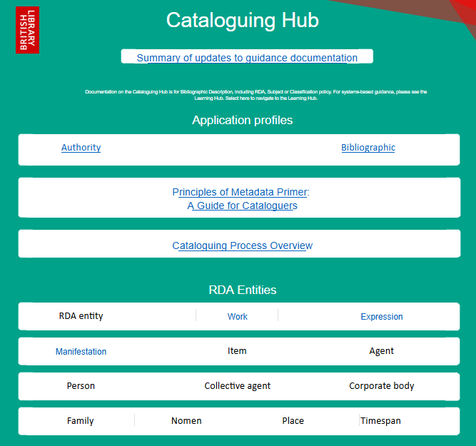
Cataloguing Hub (Landing Page)
Notes:
This model has been manifested as what we’ve called our Cataloguing Hub on Teams / Sharepoint. Here is a current view of the landing page. Based on testing and feedback we shifted the links to application profiles upwards and the general guidance downwards. A link to a summary of guidance updates was recently added to the top.

Slide 9
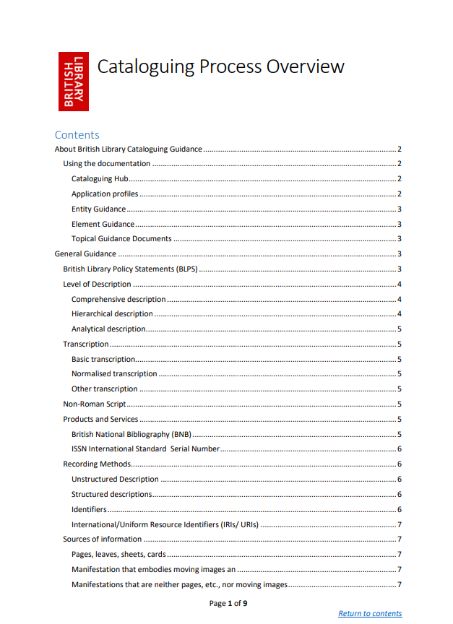
Principles of Cataloguing Hub
Application profiles act as indexes to supporting documentation
Supporting documents supplement the RDA Official Toolkit
Standard template
Consistency across workflows
Sufficiency of guidance
Worked examples (MARC 21)
Version control
Notes:
And here is a list of the principles which underpin the Catalogue Hub and which are covered in out Cataloguing Process Overview.

Slide 10
Application profiles (Why and What)
Why are they necessary?
What they are?
Navigational aid
Index to RDA and supporting documentation
Links to RDA instructions and element documents
Bibliographic Records
Authority Records
Based on ALMA templates and LDL Standard Record
RDA element MARC encoding
Recording methods
Vocabulary encoding schemes
Notes:
Looking specifically at application profiles, here is an explanation of why they are useful and what they consist of.

Slide 11
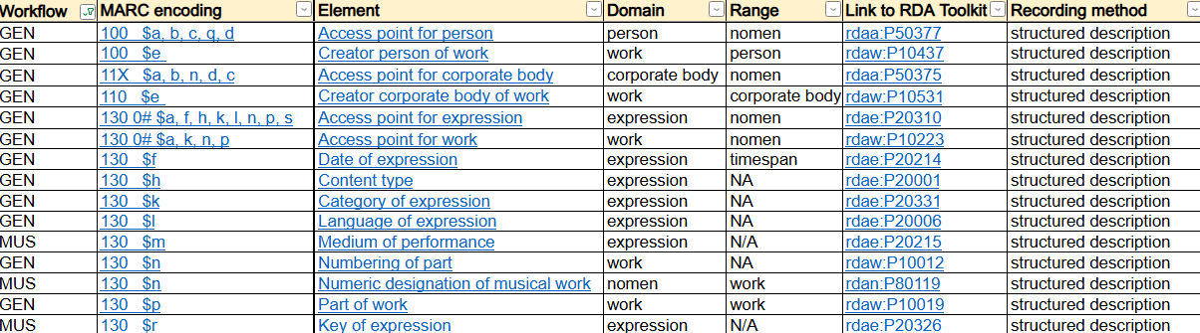
Application profile (bibliographic records)
Derived from ALMA input templates
Linked to MARC guidance
Linked to local guidance
Linked to RDA guidance
Filter by resourcetype
Notes:
And here is how the application profile for a bibliographic record looks in spreadsheet form.

Slide 12
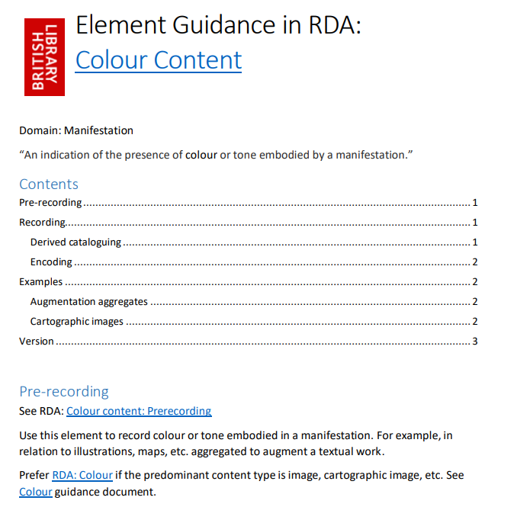
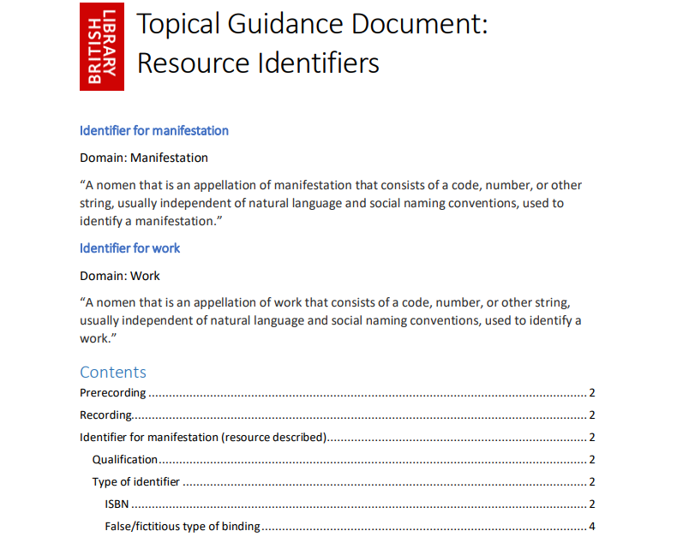
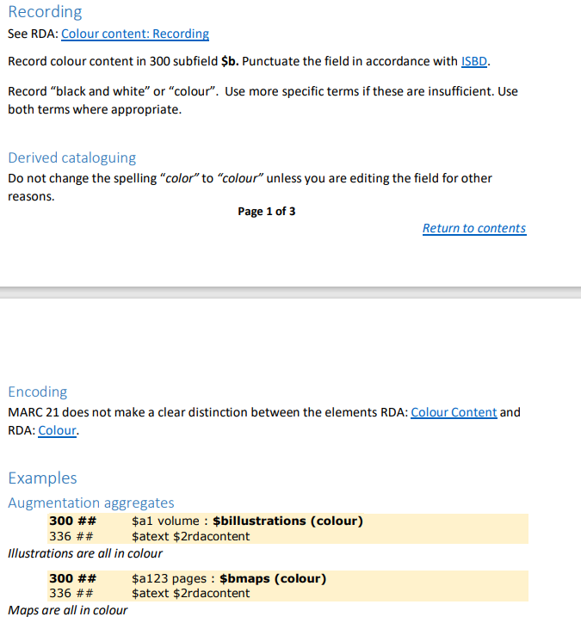
British Library RDA Element Guidance
Notes:
And this is an example of one of our element guidance documents. It covers the recording of colour content for all bibliographic workflows. Guidance documents follow a set structure and all follow the same order. Element guidance documents start with the RDA definition of the element. This is followed by contents table to aid navigation within the document. There is functionality to access the contents table from anywhere within a document. The pre-recording section covers issues to be considered in advance of cataloguing and includes links to other relevant documentation. The recording section provides general guidelines and then specific examples for different types of scenario. Within the recording section examples are presented with a manila background to stand out and they have explanatory labels attached.

Slide 13
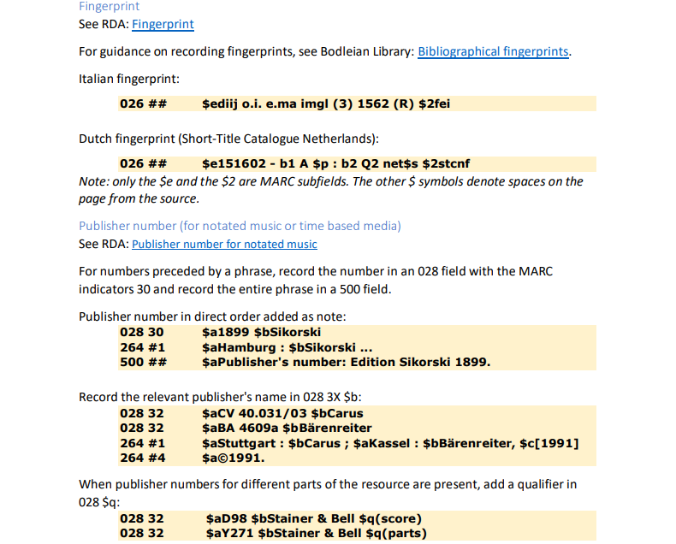
British Library RDA Special Guidance document
Notes:
And this is an example of one of our specialist guidance documents. It’s been used to bring guidance about different kinds of identifiers into one place, rather than having multiple documents which deal with separate types. Some of our specialist guidance covers whole workflows or sets of elements which are specific to a workflow such as integrating resources and authorized access points for music; others cover metadata which records a particular relationship between entities such as resources to agents, agents to agents and persons to nomens. Besides references to RDA and MARC 21, the guidance also references the ISBD standard and various communities of practise within cataloguing such as NACO for authority work, CONSER for serials and DCRMR for early print. The documents include guidance of specific relevance to BL staff and the material they process.

Slide 14
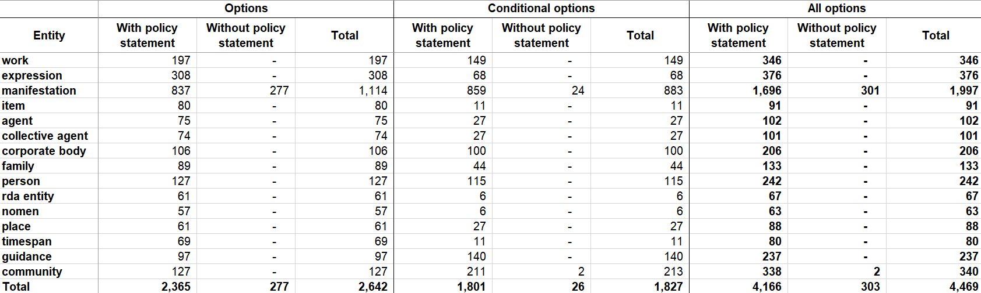
Policy statements coverage
Notes:
Now let’s move onto policy statements. There are about 200 policy statements in the Original RDA Toolkit. There are over 4000 options in the new Toolkit. We’ve provided policies for most of them to this point.
New policy statements continue to be required and existing policy statements may be revised as a consequence of changes to RDA or our application of it.

Slide 15
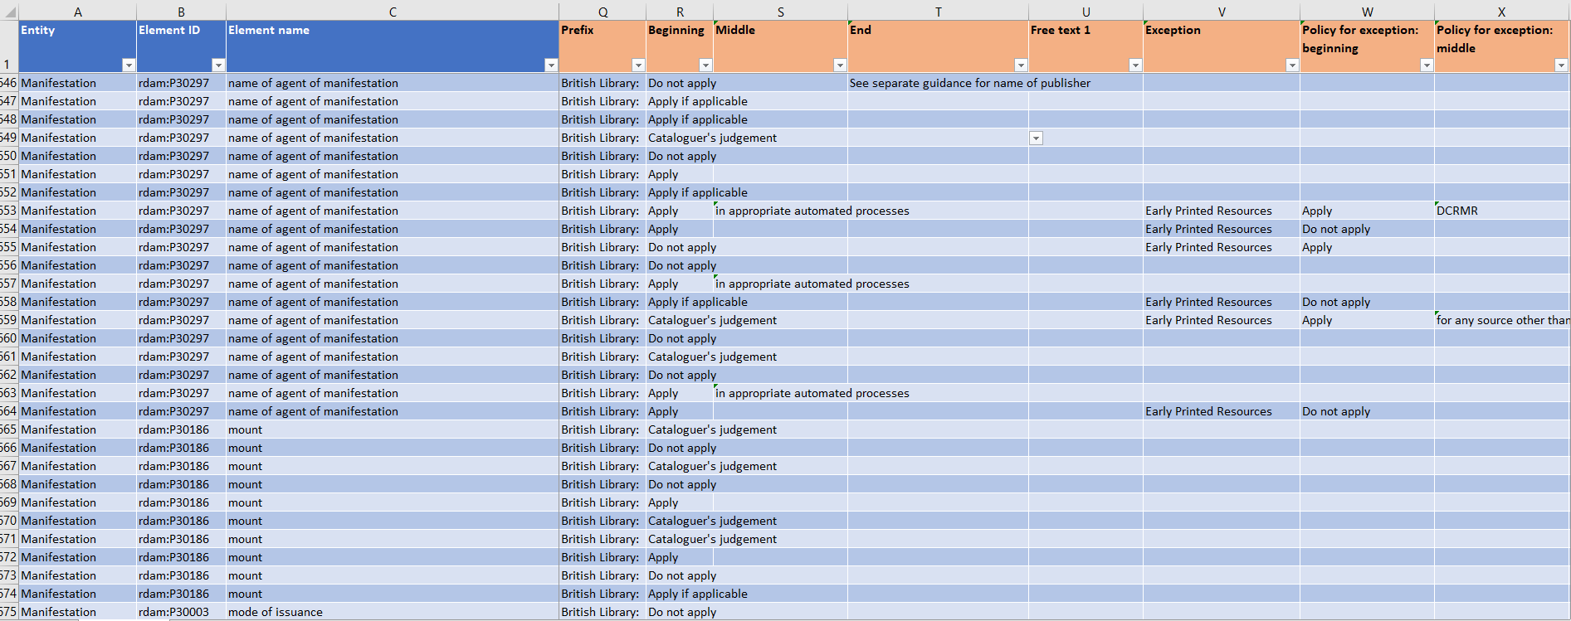
Policy statements management (batch load)
Notes:
Up to July 2023 we maintained a master spreadsheet behind the scenes to manage policy statements and enable the batch load of updates to the Alfresco Content Management System which populates the Toolkit. This process involved running an xquery and using an XSLT transform to generate policy statements at scale in the XML based DITA format. We designed this master spreadsheet so that it could accommodate alternative policies preferred by other Legal Deposit Libraries if necessary.

Slide 16
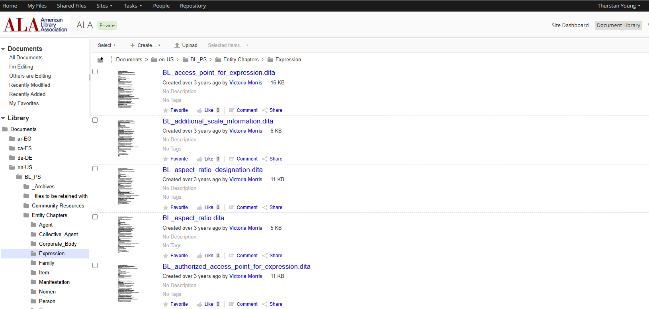
Policy statements management (Alfresco)
Notes:
By July 2023 we had carried out the vast majority of work we needed for an initial implementation of the new RDA Toolkit. Since then, additions, deletions and amendments to policy statements have taken place directly within the Alfresco Content Management System which sits behind the Toolkit and to which batch changes were previously uploaded.

Slide 17
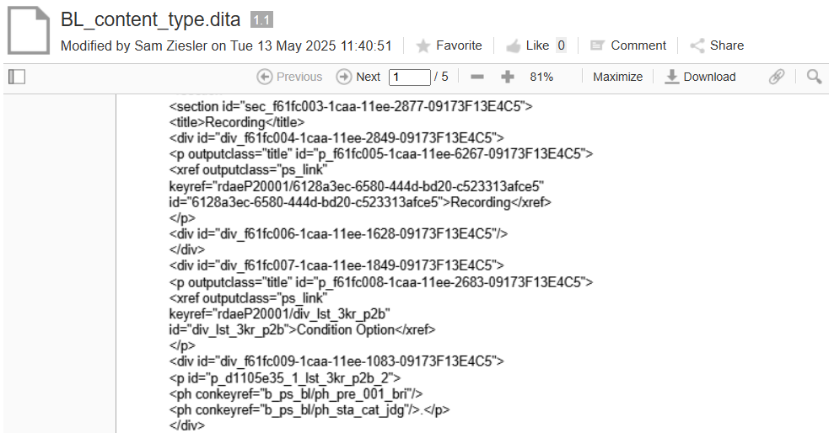
Policy statements back end
Notes:
Here is a view of what the raw XML for our policy statements looks like on the CMS. This can be edited in a more user-friendly way using the oXygen XML web author.

Slide 18


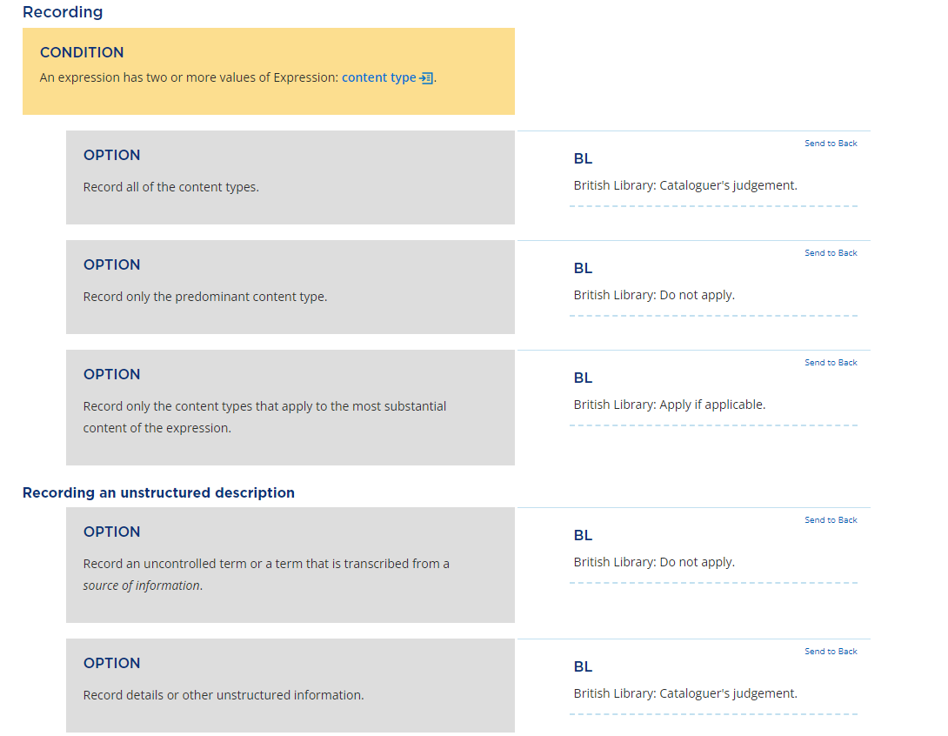
Policy statements display
Notes:
And here is a view of what the same policy statements look like in the Toolkit itself.
Policy statements appear in the right rail of the RDA Toolkit document window, in line with the appropriate heading, condition or option. Other policy statements are available from Library of Congress, National Library of New Zealand and Music Library Association amongst others.

Slide 19
Training (How and What)
How was it designed?
What did it cover?
Modular
Incremental
In person / Online
Interactive
Light touch
Measurable
LRM / RDA Models and terminology
Toolkit navigation
BL documentation
Cataloguing with 3R
Special topics including:
Aggregates, Diachronic works Provenance, Relationship elements, Community resources
Notes:
Turning to training, here is an explanation of how we went about it and what it covered.

Slide 20
Training (Who)
Who was involved (Trainers)?
Who was involved (Trainees)?
Collection Metadata Standards Manager
Cataloguing Policy Coordinator
Who was involved (Support)?
RDA 3R Implementation Group
Collections Acquisition and Description (CA&D) Training Team
Cataloguers
Cataloguing Managers
Technical support staff
Some curatorial staff
Notes:
Here are some details about who delivered, supported and received the training.

Slide 21
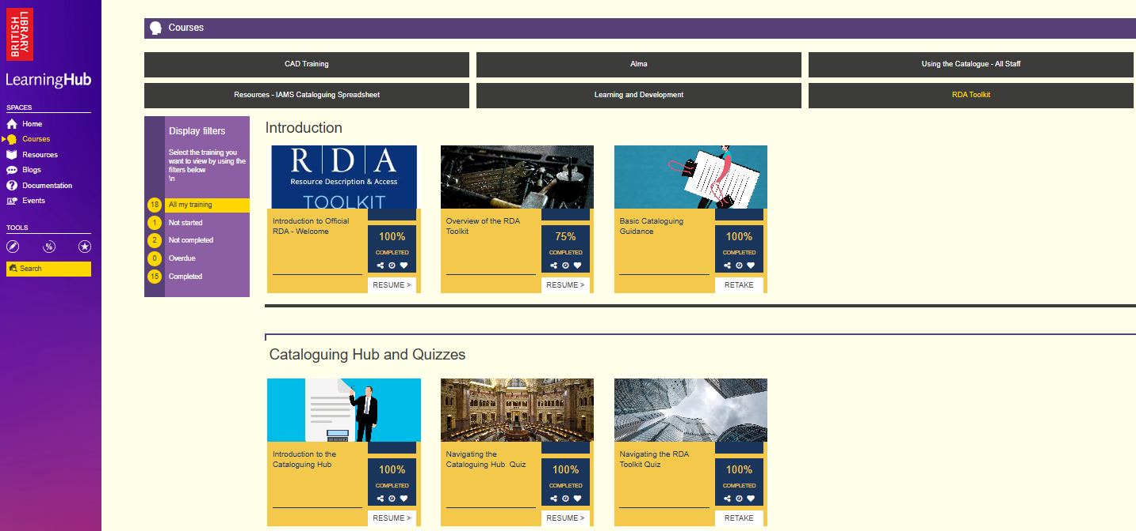
Learning Hub (RDA Course)
Notes:
In terms of the materials used to support our training, many of these were hosted on the BL’s local instance of Learning Hub from Learnify whilst others were based on Teams / Sharepoint. Here is the course page we’ve created for RDA on Learning Hub.

Slide 22
List of Training Materials Used
In house PowerPoint Presentations (Live / Recorded / AI generated)
RDA Toolkit YouTube Presentations
Quiz games (True / False / Multiple Choice Questions)
Learning Reports (Presentations viewed / Quiz games completed)
Spreadsheet cataloguing templates
Scanned resources to catalogue
Notes:
And here is a list of the materials we either created, reused or adapted in the process of delivering our training.
A key piece feedback that we received from evaluators at the beginning of last year was that more of the training should cater for a variety of learning styles and be more interactive in nature. At that point, the orientation process already involved live presentations with the opportunity to ask questions afterwards and offer feedback. Our spreadsheet-based templates and scanned resources to practice cataloguing on were also in place.
But we built on these foundations by creating additional slide based presentations with AI generated voice overs as an alternative to written notes. We also created quiz based activities which adapted those already used by NLNZ as part of its Official RDA implementation.

Slide 23
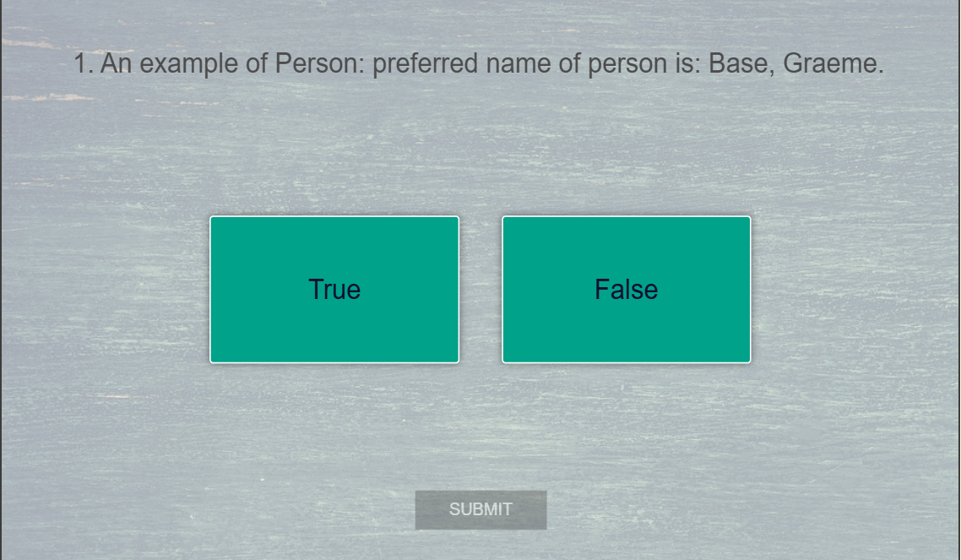
True / False Quiz Question
Notes:
This is an example of the quiz questions which we posed to cataloguing staff as part of their hands on training using Learning Hub.

Slide 24
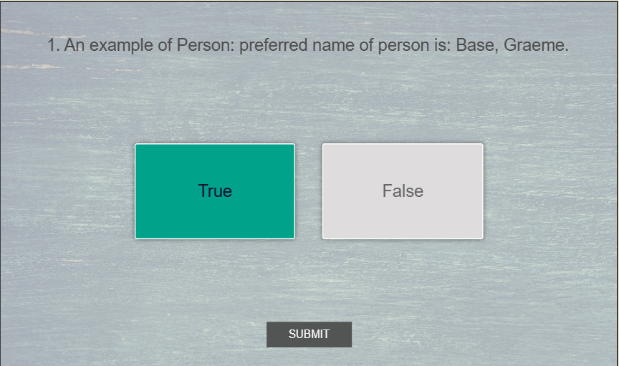
True / False Quiz Question
Notes:
Let’s pick false

Slide 25
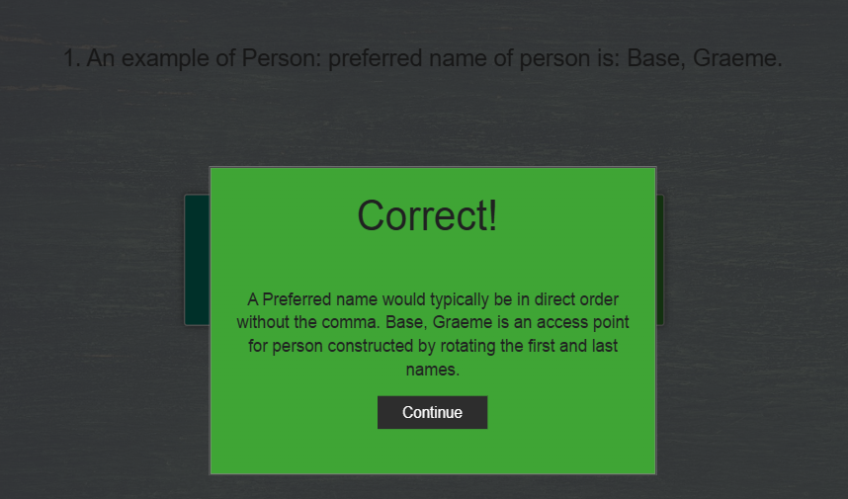
True / False Quiz Answer
Notes:
And this is the quiz answer..

Slide 26
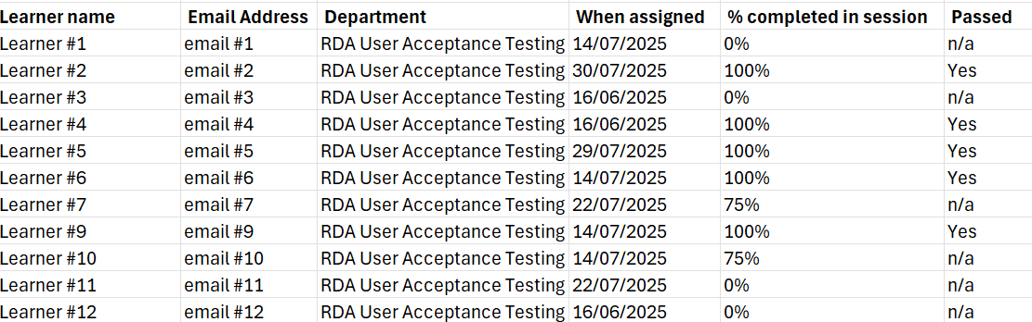
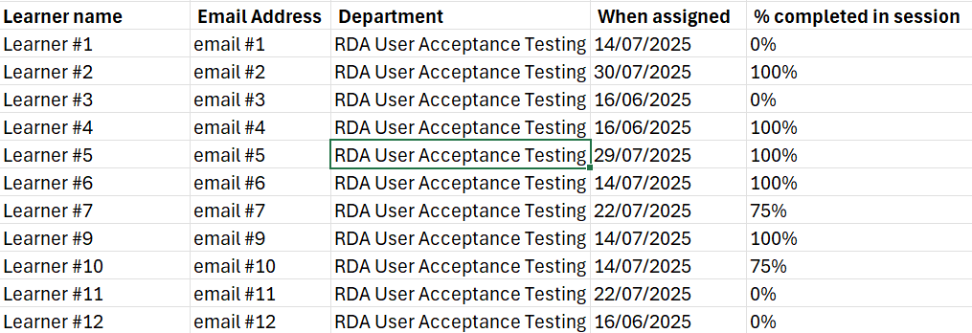
Sample Quiz Metrics
Notes:
And this is an example of the metrics we kept on staff successfully completing their activities within Learning Hub, before moving on to practice cataloguing using spreadsheets and scanned surrogates based on Teams/Sharepoint.

Slide 27
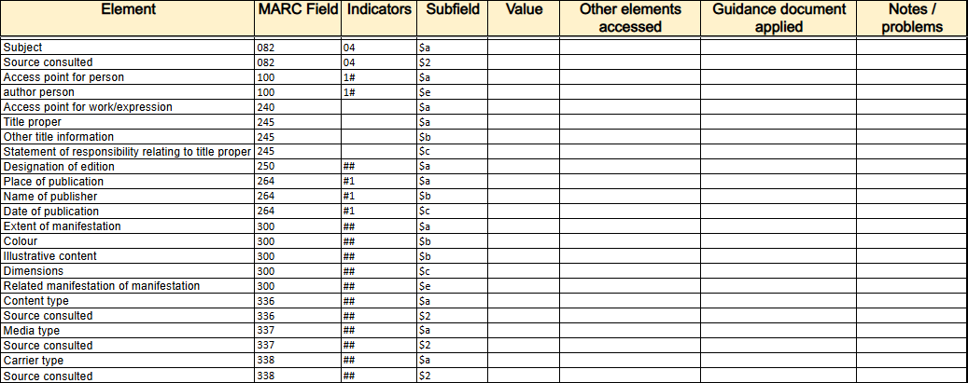
Cataloguing Template
Notes:
Meanwhile, this is an example of a cataloguing template we gave cataloguing staff as part of their training. Cataloguers were expected to create practise records for up to ten resources using the templates and scanned surrogates provided. They were asked to provide details of any RDA elements they needed to consult besides those which were recorded in the template itself. Also which guidance documents they consulted on the Cataloguing Hub. Finally, they were asked to make notes on problems they encountered as part of the process. Issues fed back by trainees to the trainers were recorded in an issues log which is still being worked through.

Slide 28
Access to British Library documentation
Now: work in progress and access is restricted to British Library staff.
Future: we hope to make it available externally for information or reuse / adaptation to local needs
Dependencies:
Permission from the RDA copyright holders (ALA/CILIP/CLA)
Secure delivery method: RDA Toolkit? PDF download? Other?
Notes:
Previous updates on the British Library’s implementation plans for RDA have included the aspiration to share documentation with the wider UK community as a means of facilitating the uptake for Official RDA. Here are some details on where things stand now as regards providing access.

Slide 29
MARC 21 Configuration and Mapping
MARC 21 changes
Indexes and displays
Validation
Cataloguing shortcuts
Cataloguing enhancements
RDA/MARC Mappings
Updating (British Library / Library and Archives Canada)
MARC/RDA Mappings
In development (MARC2RDA Project)
Notes:
Besides an update on documentation and training, here is one which covers system configuration and mapping changes in support of the new Toolkit.
Changes to our LMS configuration in preparation for Official RDA have mainly been a consequence of changes to MARC 21. Many changes to MARC 21 resulting from Official RDA took place between 2019 and 2022 during the period immediately following the new Toolkit’s publication and before the cyber attack. Changes made in Aleph could be transferred across to ALMA. However, more changes may be forthcoming as a result of RDA developments in future. Keeping ALMA and Primo configuration in synch with MARC changes arising from RDA will mean that any new elements can be indexed and displayed appropriately going forward.
The British Library is currently looking at options for quality assurance tools which supplement those checks which come as standard with ALMA. The QA tool MARC Report is still being kept up to date with MARC changes on a voluntary basis, since it ceased to be a commercial product in 2019. However, in referencing RDA, it continues to cite the Original and not the Official Toolkit.
Whereas we previously used MACRO Express in conjunction with Aleph in order to carry out routine cataloguing shortcuts, following go live with ALMA we are investigating what alternative tools are available within our new system for the purpose of achieving cataloguing efficiencies and enhancements. From an RDA perspective, one key area to consider is the means by which controlled vocabulary terms (for indexing and faceting) and their associated URIs (for linked data applications) might be recorded in future. It is noteworthy that, unlike its predecessor Aleph, ALMA is capable of exporting metadata in a variety of linked data flavours (i.e. Bibframe and RDA/RDF).
We continue to maintain RDA/MARC Mappings in the RDA Toolkit in collaboration with Library & Archives Canada. Reciprocal mappings, whilst a feature of Original RDA, are not part of the Official Toolkit. But in 2021 the University of Washington initiated a project to create such a mapping and, in recent years, the British Library has provided technical support for this.

Slide 30
Implementation Phase Two: Next steps
Already started:
Revising existing documentation based on phase one feedback
Drafting documentation not covered in phase one
Horizon scanning other implementations
Widening staff engagement with the RDA development process
Pending:
RDA implementation for British Library’s Sound Archive
Changes to cataloguing outputs designed to exploit RDA’s changing scope
Notes:
Here are a few pointers for what the British Library hopes to accomplish as part of its phase two for implementing Official RDA.

Slide 31
Other sources of information
RDA Toolkit YouTube channel
Learning Resources | RDA Toolkit
3R Project Frequently Asked Questions
Catalogue & Index December 2025, Issue 213
Notes:
And finally some links you may find useful.

Slide 32
Picture credits
Black Clock Free Stock Photo - Public Domain Pictures
CC0 Public Domain

