Slide 1
Translating the RDA DACH Documentation Platform:
Challenges of a Living Resource
EURIG, 26.05.2026

Slide 2
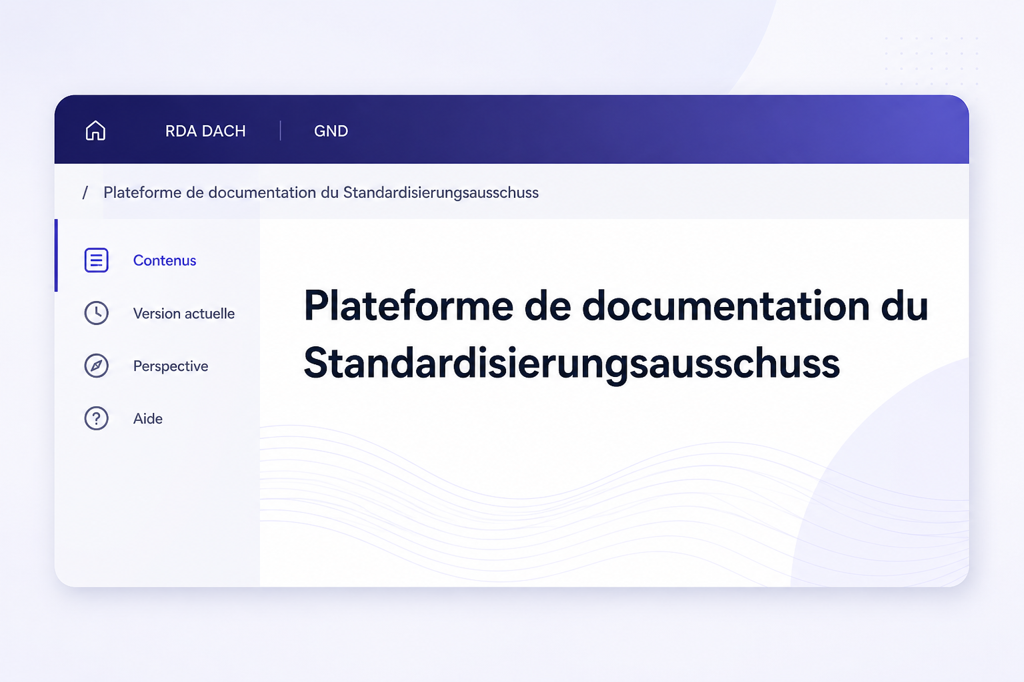
Agenda
  Swiss Library Service Platform (SLSP)
  Context
  Project Overview
  Challenges
  Achievements to Date
  Outlook
  Questions / Discussion

Slide 3
Swiss Library Service Platform (SLSP)

Slide 4

Swiss Library Service Platform (SLSP)
The Swiss Library Service Platform (SLSP) is a service provider for libraries and collaborates with them to run the national library platform swisscovery, which pools scientific information from currently 500 libraries in Switzerland – Libraries from all language regions of Switzerland.
Librarians from all language regions work with us.

Slide 5
Swiss Library Service Platform (SLSP)
Christiane Niklowitz: Team Leader, Metadata Services: Part of the newly established division “Service Technology Services”
Responsibilities:
Configurations / mass corrections
Data imports
Documentation / trainings
Implementation of RDA rules in the library system
GND / IdRef: Collaboration with GND and IdRef communities, updating, harmonizing and correcting authority data

Slide 6
SLSP
SLSP's approach:
SLSP follows the core principle of publishing all documents, pages, and information for employees and librarians of SLSP libraries in all national languages
SLSP RDA DACH platform translation project
Project period: 2023-2026

Slide 7
2. Context

Slide 8


Context
Context and key characteristics:
Platform RDA-DACH
Developed in the 3R* project by the Standardization Committee (STA)
First productive version went online on 1 August 2023
Central access point for standards and recommendations
Consolidates cataloging standards and application rules for German-speaking countries (GER/AUS/CH) and rules for maintenance of the GND
Contains element and resource descriptions
Toolkit is linked to the platform

Slide 9
Context
Context and key characteristics:
Platform RDA-DACH – compared to the RDA Toolkit
Improved navigation, as it is no longer necessary to switch from a main rule to an application / explanation rule, etc.
Vocabulary lists are no longer stored externally but integrated into the platform
The rules remain largely the same; many rules were adopted unchanged from the old toolkit
Improved wording for certain formulations that were unclear
Adaptation of certain rules that did not prove effective in practice
Notes:
Whether SLSP should offer thematic/special discovery views (beyond bibliographic views)
Trade-off: customer demand + paid work vs usability complexity + ongoing maintenance
Key risks/needs: low adoption (needs promotion/user research), stakeholder concerns, risk of becoming outdated; consider alternatives inside swisscovery (e.g., collections)

Slide 10
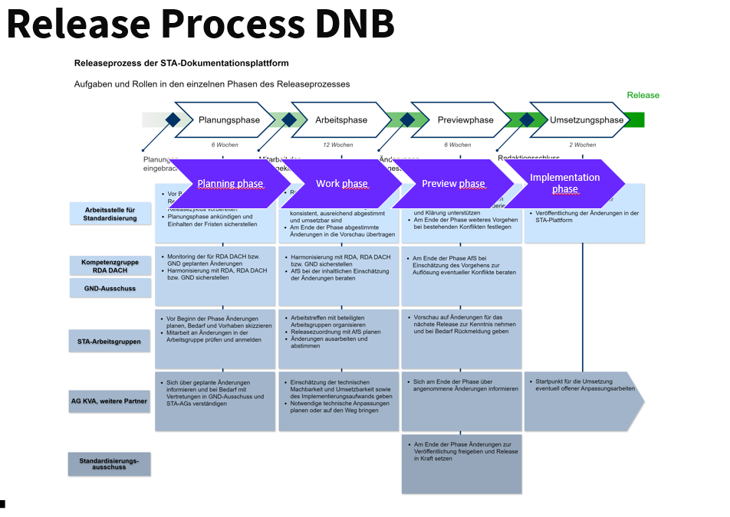
Context
Context and key characteristics:
Platform RDA-DACH
Releases: Twice a year
Notes:
Whether SLSP should offer thematic/special discovery views (beyond bibliographic views)
Trade-off: customer demand + paid work vs usability complexity + ongoing maintenance
Key risks/needs: low adoption (needs promotion/user research), stakeholder concerns, risk of becoming outdated; consider alternatives inside swisscovery (e.g., collections)

Slide 11
3. Project Overview

Slide 12
Project Overview
All SLSP librarians in Switzerland can use the RDA DACH platform
Close collaboration with the DNB to contribute to multilingual developments within the RDA DACH platform
Opportunities:
Notes:
Généré par Copilot
Les objectifs principaux sont clairement définis : permettre aux bibliothécaires de toute la Suisse d'utiliser la plateforme RDA DACH de manière fluide, et instaurer une collaboration étroite avec la DNB. Cette coopération vise à accélérer la traduction des futures modifications, assurant ainsi une mise à jour rapide et cohérente des contenus. Les icônes et la mise en page épurée renforcent la clarté de ces ambitions, soulignant l'importance de l'accessibilité et de la réactivité dans ce projet.
______

Slide 13
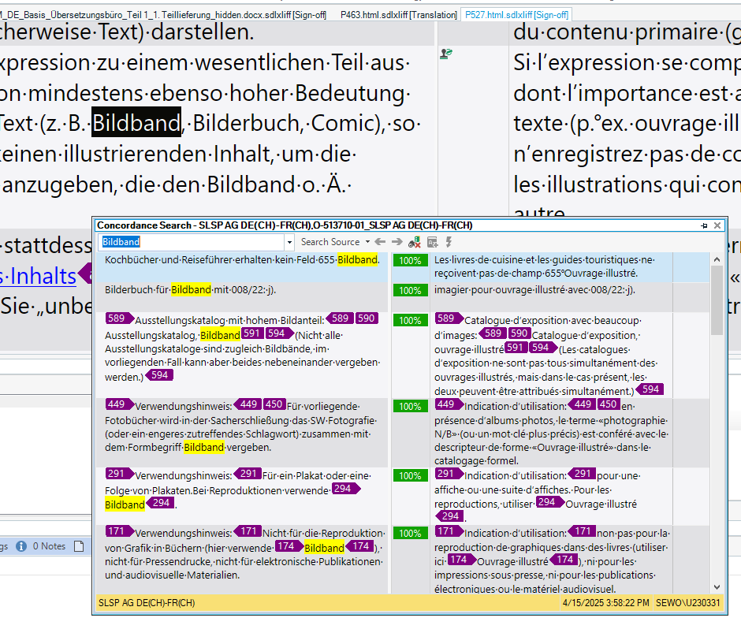
Project Overview
Objectives:
Translation of contents of the RDA-platform into French (2025: Approx. 305,000 words) - GND section only in German (librarians of French part of Switzerland use IdRef)
Creation of a terminology list with explanation (2026: Approx. 1000 termes)
Translation of releases content
Coordination of the transition to the use of the RDA DACH documentation platform for SLSP libraries
Training RDA DACH in French and in German for all SLSP librarians
Logiciel de traduction
Notes:
Whether SLSP should offer thematic/special discovery views (beyond bibliographic views)
Trade-off: customer demand + paid work vs usability complexity + ongoing maintenance
Key risks/needs: low adoption (needs promotion/user research), stakeholder concerns, risk of becoming outdated; consider alternatives inside swisscovery (e.g., collections)

Slide 14
Project Overview
Translation process:
DNB provided source files
SLSP translation office translates content - based on terminology lists, RDA Toolkit
Proofreading by a professional translator and SLSP librarian from French-speaking Switzerland
Creation of terminology lists and explanatory notes (Over 1,000 terms already listed by 1 May 2026)
Open issues discussed within the project team
Complex questions escalated to committees when necessary
DNB responsible for all technical aspects/STA Editor maintenance and implementation in the library system

Slide 15
Project Overview
current status
01.04.2026
Latest translations of the revised version
Techn. implementation (DNB)
Communication/Training
Proofreading
Launch of the French version
Realeses

Slide 16
Project Overview
Project Budget:
Project costs for SLSP: over CHF 150,000
Translations often require intellectual work, discussion, coordination with translation office and proofreader
Significant internal resources invested by the DNB

Slide 17
4. Challenges

Slide 18
Challenges
DNB: The DNB is responsible for all technical aspects of the platform, including implementation, the STA editor, etc.
Reliance on DNB regarding technical solutions for multilingual functionality
Dependence on DNB to find a technical solution for rapid corrections and adaptations of platform translations after the initial release
DNB showed very strong commitment in developing technical solutions: Close collaboration with Matthias Manecke (DNB, Arbeitsstelle für Standardisierung) throughout the project
Numerous meetings and close coordination throughout the project
Process lasting 3 years

Slide 19
Challenges
Numerous translation-related questions and terminology discussions
Translator question examples:
    Should these examples be translated (z. B. "Katharina II., Russland, Zarin, 1729-1796", "Aschmodai (Dämon)" usw.)?
    And should the official translation of the names be used in the examples (z. B. Nikolaus, von Kues, Kardinal, 1401-1464 > Nicolas, de Cues, Cardinal, 1401-1464)
Reference works, e. g. Biblisches Personenverzeichnis Deutschland → according to reference work France?
Gender-neutral spelling even if not consistently applied in the platform? → Many questions regarding gender-related terminology

Slide 20
Challenges
Numerous translation-related questions and terminology discussions
Notes proof-reader: Example with abbreviation “no” in lowercase, also seen “No” with a capital letter in the toolkit
Notes proof-reader: ‘je choisis d'utiliser la forme qui inclut les êtres non genrés (dieu·x·éesse) notamment car il y a des dieux androgynes comme Hermaphrodite’
The term creator (Erzeuger) and whether a gender-neutral variant existed in French as well?

Slide 21
Challenges
Numerous translation-related questions and terminology discussions
Questions regarding singular and plural forms:
  e. g. index vs. indices, Bildband vs. Bildbände, Festschrift is translated — in all sources — using a plural form: Mélanges (or Mélanges et hommages)
Question regarding authority: The reference source for checking identical corporate body names is only the Integrated Authority File (GND): in French: replace GND with IDRef?”
  Answer: no, no reference to IdRef, only GND

Slide 22
Challenges
Challenges from the Perspective of the Project Participants (Status as of 09/2024)
DNB: Scarcity of resources, finding a solution to establish the framework for multilingualism within the platform
Translation Office SLSP: Communication with external partners, many instances involved, time
Proof-reader: Correcting translation work that had partially been produced using Artificial Intelligence
r

Slide 23
5. Achievements to Date

Slide 24
Achievements to Date
Go live of French version
All files have been translated and uploaded to the editor
Go-live of the French version in early April 2026

Slide 25
Achievements to Date
Trainings / Communication
RDA Training – Work completed to date
Training materials prepared
DNB “Practical Updates” adapted, also translated in French SLSP training videos created
Q&A meetings conducted: 300 librarians, presentations in German, French, and Italian
SLSPhere page maintained (known issues, requests, updates, etc)
→ All SLSP libraries will work with RDA DACH

Slide 26
6. Outlook

Slide 27
Outlook
Releases
After the release, it depends on what needs to be adjusted.
If a term has been translated incorrectly, all pages containing that term are identified, and the correction is made directly in the STA editor.
The change is marked with a comment so that the DNB can transfer the updates to the live version.
However, if an entire paragraph is missing, a new HTML file is generated and translated again, as this is the easier approach.

Slide 28
Outlook
Open Issues
DNB:
  Preview mode for French version in development
  Search functionality ignoring accents and diacritics planned for a later phase
SLSP:
  Integration of SLSP contextual help (Feldhilfen) into the platform planned for the coming weeks
  Some files are currently undergoing final review
  SLSP: French-language examples currently under development
  Alignment of text content with the RDA DACH platform’s terminology lists in progress
o

Slide 29
Outlook
Possibly make a terminology list with reviewers’ comments publicly available
Expanded and structured discussions on the RDA DACH platform and its content with libraries from other French-speaking countries are also conceivable
Bibliosuisse is using the French version of the RDA DACH platform to develop an RDA course in French (planned for 2027)
DNB: Possible extension of the platform with an English version?

Slide 30
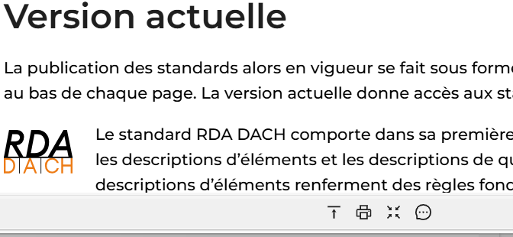
Outlook
Questions can also be asked via chat
For the French version of the platform, they are redirected to SLSP:

Slide 31
7. Questions / Discussion

Slide 32
Questions
What benefits do you see in the multilingual RDA DACH platform for your library or country?
Do you think aspects of this multilingual RDA DACH platform could also be useful for your library or your country?

Slide 33
Thank you for your attention!

