Slide 1
Entity-based cataloguing with LRM and RDA
Meeting the needs of the book industry and libraries combined
Fride Fosseng, product manager metadata
Maiken Songe Thorsen, product owner
EURIG annual meeting 28.05.2026

Slide 2
Bokbasen: The hub of Norwegian metadata
Established 2007
Owners
Employees
Norwegian publishing houses
Metadata
Tech
Administration / sales
Notes:
Bokbasen was established in 2007 and is owned by the largest Norwegian publishing houses, and we provide digital services for all publishers, physical and onlie retailers, distributors, libraries, streaming services, media etc.
Bokbasen has 19 employees:
Librarians working with metadata production and quality, developers and tech staff, people working with administration, sales, support etc.
We are a strategic partner for the National Library of Norway.
• Our core mission is: Ensuring high-quality metadata across the entire value chain

Slide 3
Central provider of digital and metadata services
Publishers
Retailers and streaming services
Libraries
Metadata well
Notes:
PUBLISHERS:
Metadata registration, administration, quality enhancement
Legal deposit of digital files
Distribution of e- and audio books
Reading app
RETAILERS AND STREAMING SERVICES
Online services for search and orders
Metadata for both physical and online retailers and streaming services
Reading app for advance copies
Management of available titles for streaming
LIBRARIES
Providing metadata for books published by the Norwegian publishers to the National library, the National bibliography and all Norwegian libraries.
The records include subjects from the Norwegian subject scheme NEO and Dewey
Legal deposit of digital files on behalf of Norwegian publishers

Slide 4
Metadata
Publisher
Bokbasen
Distributor
Quality
>200 metadata fields
Standards
Rules
Retrieval
Metadata well
Libraries
Bokbasen Search
Online / retailers
Publishers
Streaming services
Legal deposit files
Legal deposit
Metadata flow
Notes:
Bokbasen has extensive experience in producing metadata, and since we are directly integrated with publishers and distributors, metadata is available at an early stage.
Metadata is created by the publisher, the distributor and Bokbasen.
These metadata forms the basis for producing advance records for libraries and providing information about forthcoming titles for retailers, streaming services etc.
Some publishers are directly integrated with Bokbasen and use our online interfaces, some deliver metadata in the Onix format, and some deliver metadata via their distributor.
When Bokbasen receives this metadata, it is reviewed with a view to linking different editions to the correct work, names are retrieved from the Norwegian authority register for names, preliminary subject headings are set, etc.
As Maiken will show you later, we have worked extensively to add automated processes that will process the received metadata and link manifestations and works, authorities, etc.
Metadata does not go straight through from publishers but goes through bibliographic control at Bokbasen.
The systems are to help publishers be good – they should deliver relevant and correct metadata for various publications, so that metadata can be delivered correctly as early as possible.
To achieve this, we control both the amount of information based on the type of publication, and each field is checked both automatically and manually by our librarians when it comes to valid values, logical combinations of information, e.g. audio books should have a reader and playing time, not page numbers.
Regulations and standards are at the bottom as a basis for everything we do
The cataloguing process and Bokbasen's system are based on the LRM model. More on that in a moment.
The work information is delivered in a format developed together with the Biblioteksentralen.
Information about manifestation is provided in Onix format, with a pointer to the work record.
Metadata is checked twice, upon registration and upon publication, against printed material, digital or physical publication, both manually and mechanically.
Publishers send updates throughout the life cycle of the publication, but after Bokbasen has checked and finalized the information, updates will not be accepted, other than on price etc.
During cataloguing, all information is checked, it is linked to authority registers – such as noraf – where available, metadata is enriched by performing classification, and links between works, expressions and manifestations are added.

Slide 5
Entity-based cataloguing

Slide 6
Why entity-based cataloguing?
Moving from AACR2 to RDA principles
Replacing legacy systems
Goal: increase efficiency, and consistency
Built our own systems: Ebba and Meta
Notes:
Moving from AACR2 to RDA principles
Replacing legacy systems: No off-the-shelf solution met our needs
Goal: Increase efficiency, consistency, and prepare for Linked Data
Built our own system: Ebba (Cataloguing) and Meta (Publisher portal).
RDA to replace AACR2 in Norway
Old systems
Easy/easier transition from old entity-like system to new system
No system existed
Build own system
Hypothesis:
Efficiency
Consistency
Automation
Preparation for linked data
LRM / RDA or Bibframe
Transition from old to new system – how to reduce information loss
Agile methods – possible to change one’s mind
Example: started without the expression level, added at a later stage
Automation and machine learning
First to start with RDA in Norway and entity based

Slide 7
Implementing LRM and RDA
Focus on Work, Expression and Manifestation
Agile approach
Balancing the needs of commercial actors vs libraries
Preparing for transition to linked data
Notes:
Focus on Work, Expression, and Manifestation
Agile approach: Started without the Expression level, added it later to improve granularity
Balancing the needs of commercial actors (fast-paced) vs. libraries (detail-oriented).
Retailers, publishers, streaming services – commercial organizations are willing to change and make upgrades to accomodate new metadata descriptions etc.
As Bokbasen is the hub for metadata and digital services, our we are continuously in talks with the customers, to address their needs, to communicate changes in formats and standards and making sure that changes are possible to implement with as little impact as possible.
Libraries may traditionally need some more time to make room for changes in systems and interfaces.
We need to both follow the rules, as RDA, to accomodate the librarie’s needs and demands, and at the same time make sure that the metadata contains what retailers and publisher needs from a marketing perspective.
IN our online system for retailers, we display the title of the manifestation not the work.
More efficient for the retailer helping the customer in the store, to see the Norwegian title of Muakami’s Kafka on the beach not the Japanese prefereed title.
Our metdata contains many metadatafield not delivered to the libraries, f.i. availability status, marketing information, license constraints
Preparation for linked data

Slide 8
Standards
RDA Official
ONIX
NEO
Norwegian subjects
NORAF
WebDewey
Norwegian authority file
Norwegian WebDewey
Notes:
Etter avtale med NB, bruker vi RDA Official som regelverk i katalogisering.
ISBN
ISNI
Onix – som utvekslingsformat
Mer om konsekvenser av å levere i Onix til brønnen, ikke marc, sier litt mer om Onix om litt
Neo for emneord
Fjorårets lille revolusjon når det gjelder norske emneord, at vi nå har jobbet fram et felles norsk emnestystem, en felles tesaurus!
Thema – internasjonalt system for å angi sjanger og emnekategorier som vi har i tillegg til Neo
Noraf: alle bidragsytere identifiseres med ID-er fra norsk autoritetsregister
Deweynummer leveres fra Norsk WebDewey, og settes etter de til enhver tid gjeldende anbefalinger og retningslinjer fra NB, pluss selvsagt de reglene som ligger i Dewey-systemet selv.

Slide 9

Automation & cataloguing assistance: SmartCat
Using machine learning for manual and repetitive tasks.
Value-adding processes: Automated enrichment from ONIX and publisher data.
Goal: Catalogue more titles with higher quality in less time.

Slide 10
Automation and mapping
Automatically connecting a new manifestation to an existing work​.
Automatically verifying suggested series and agents​.
Mapping: Filling out what can be filled out based on the information we already got.
Notes:
Automatically connecting a new manifestation to an existing work
Automatically verifying suggested series and agents
Mapping: Filling out what can be filled out based on the information we already got.
Mapping from bookgroup to intellectual level, literary form, some Thema codes
e.g. If the bookgroup is 418 classical literature, the Thema code FBC for classical literature will be set. This mapping is an ongoing project.

Slide 11


Librarians being consistent
Notes:
Subtitle: For those who are, wonder if they are, or would like to become gay. Or for those who just wonder how this whole gay thing works.
The foreword says that if you’re embarrassed to be seen reading this book, you can simply remove the dust jacket.

Slide 12

Librarians being consistent

Slide 13
Thank you!
maiken@bokbasen.no
fride@bokbasen.no

Slide 14
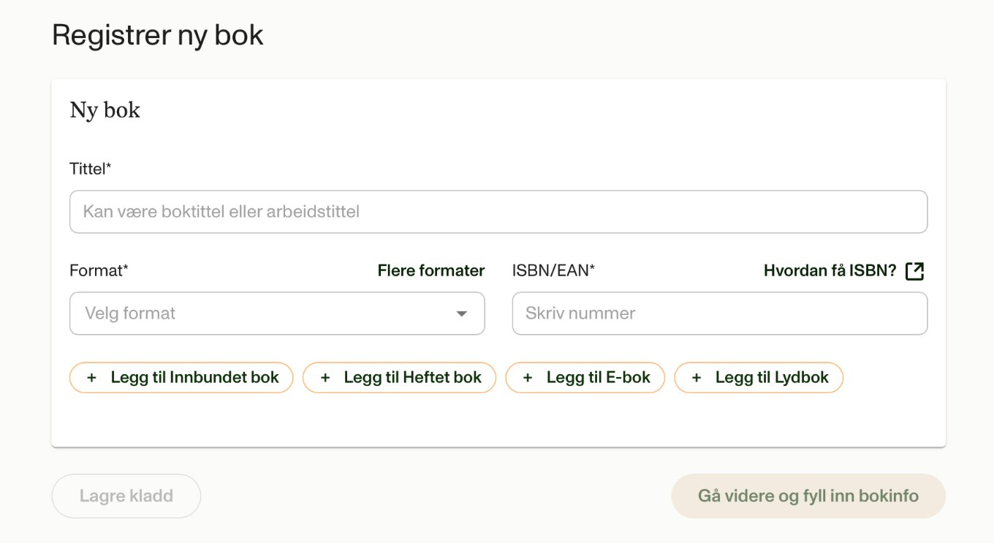
Meta

Slide 15
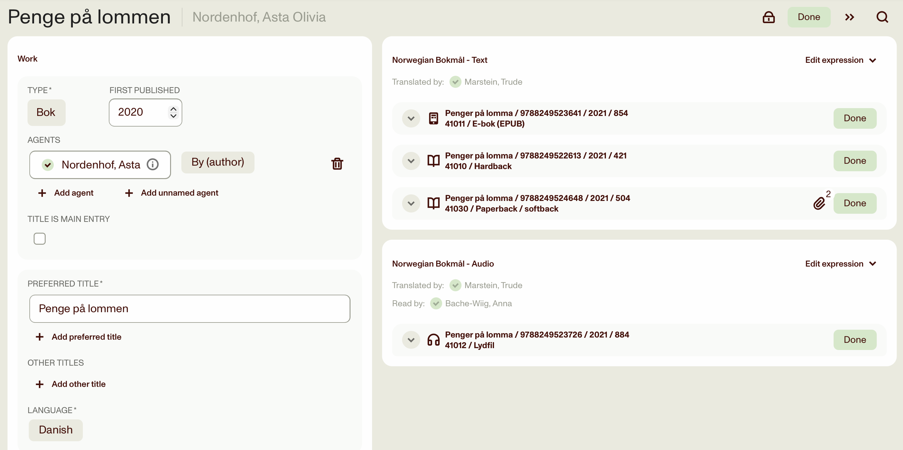
Ebba: Work, expression, manifestation

Slide 16
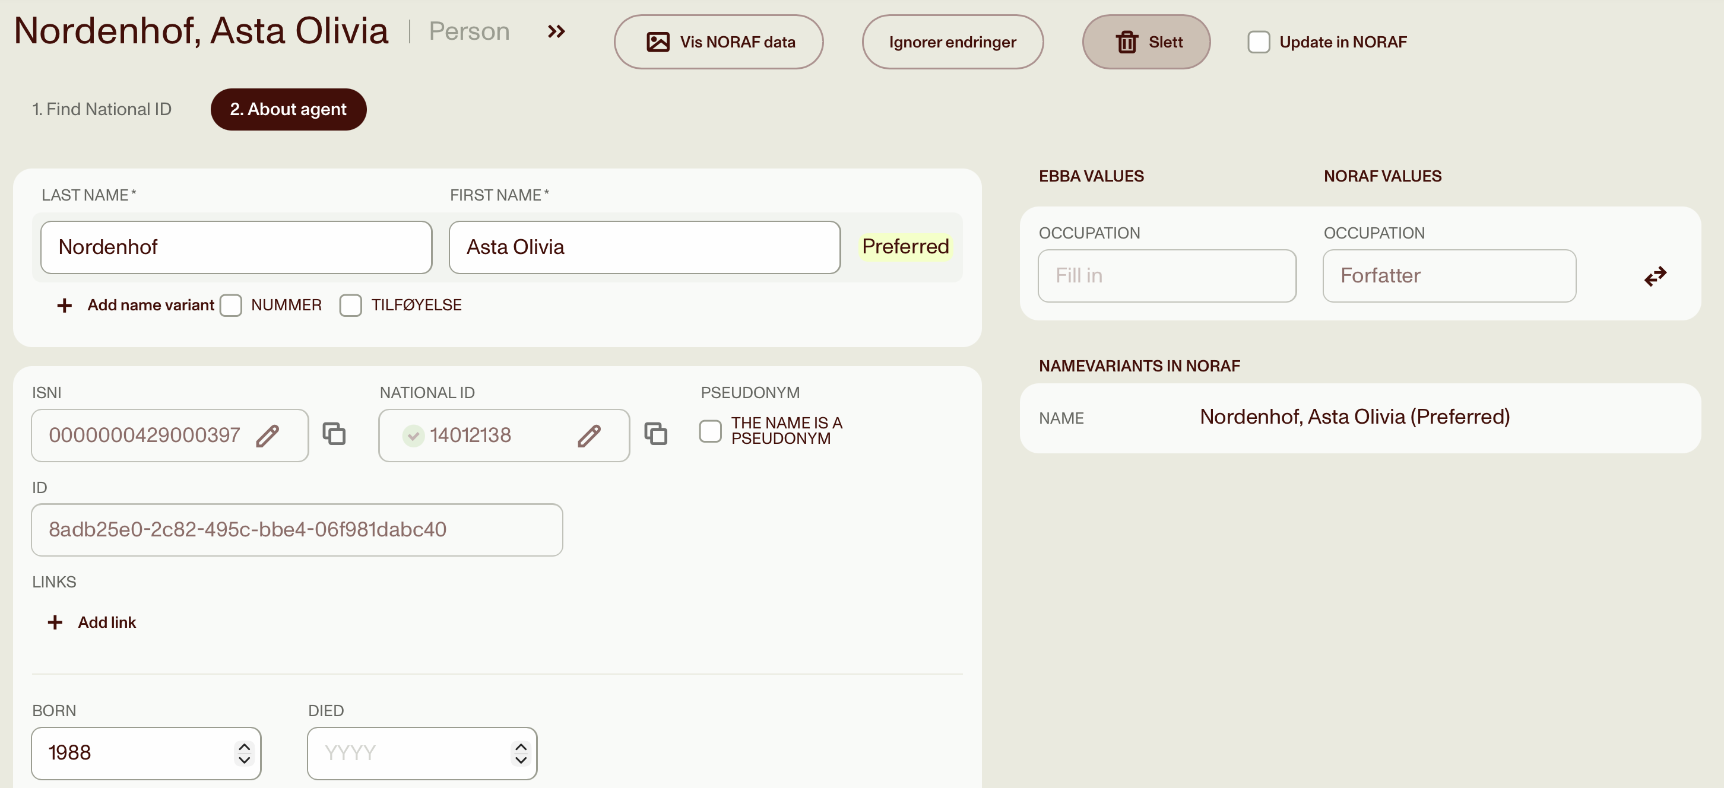
Ebba: Agent registry

Slide 17
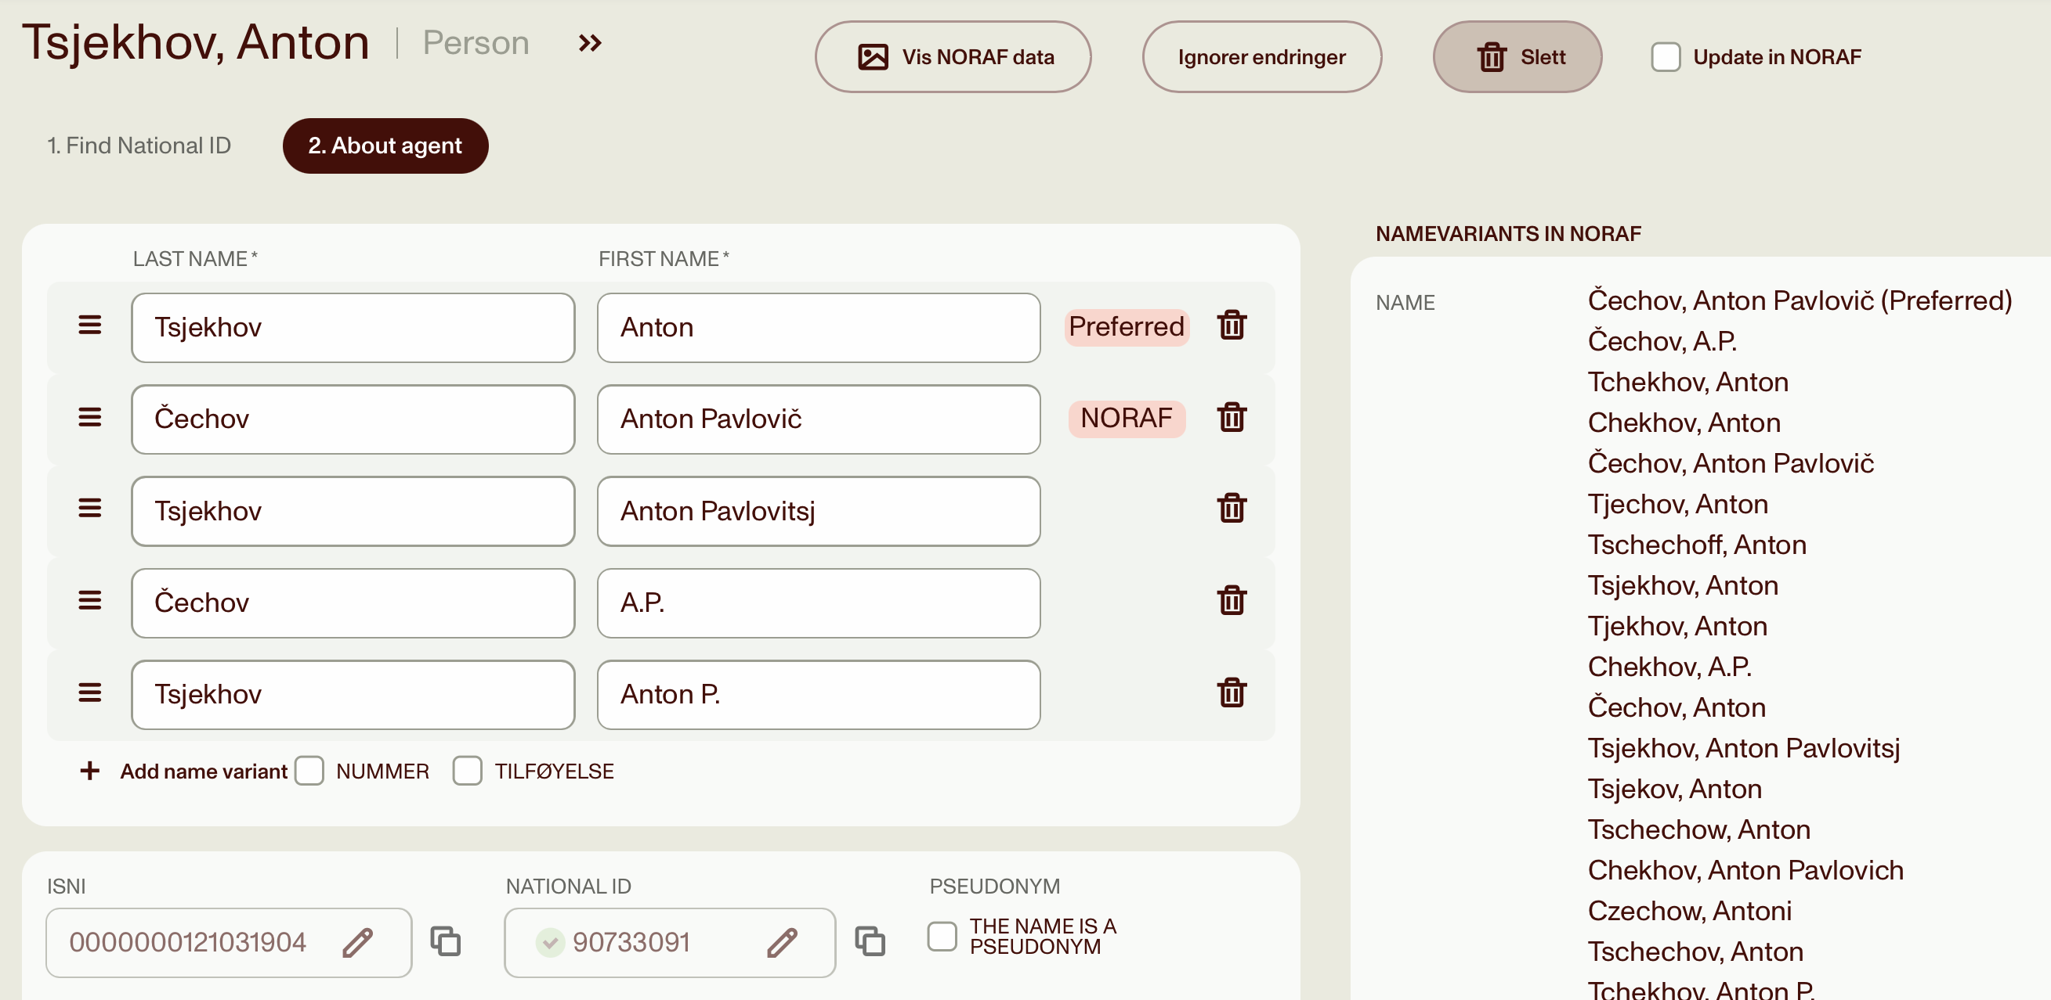
Preferred name of agent

Slide 18
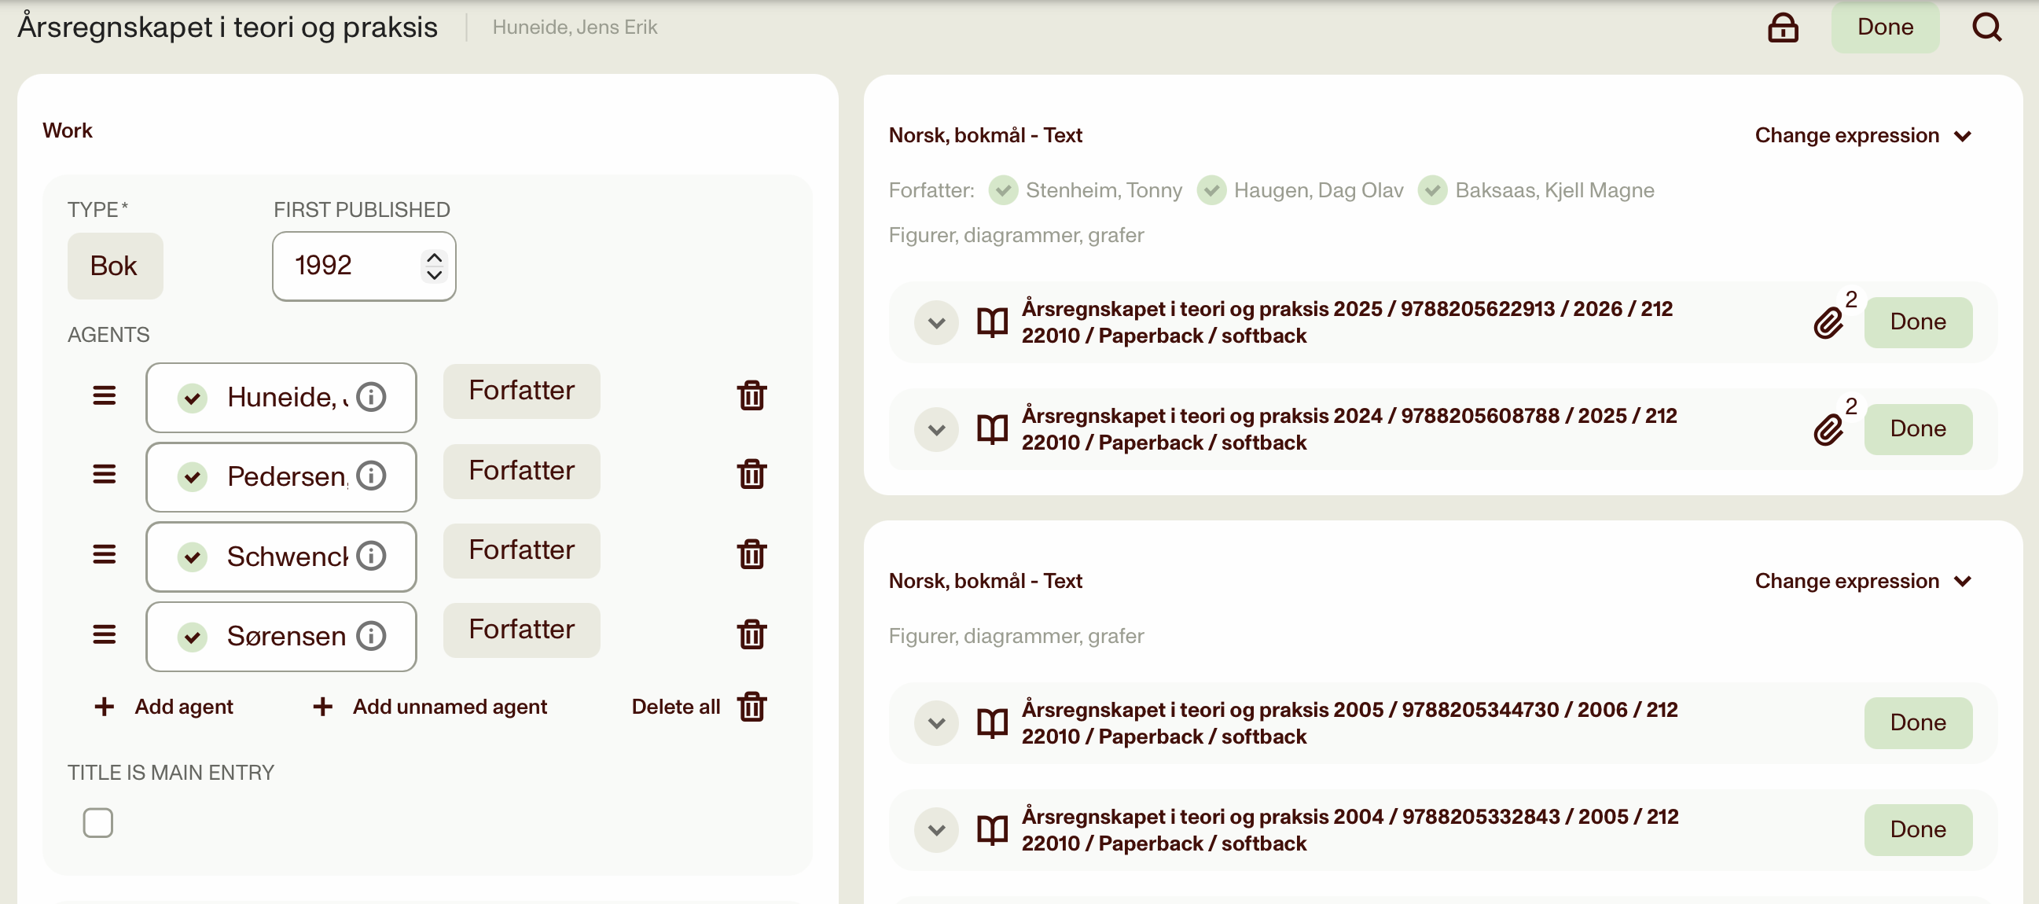
Work with different authors

Slide 19
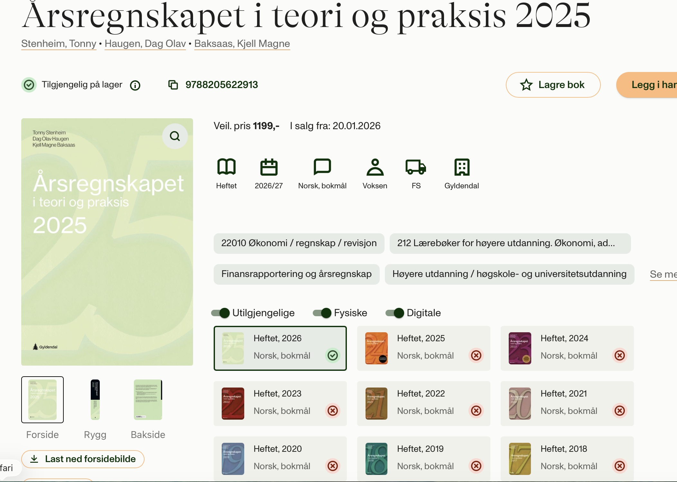
Work with different authors

Slide 20
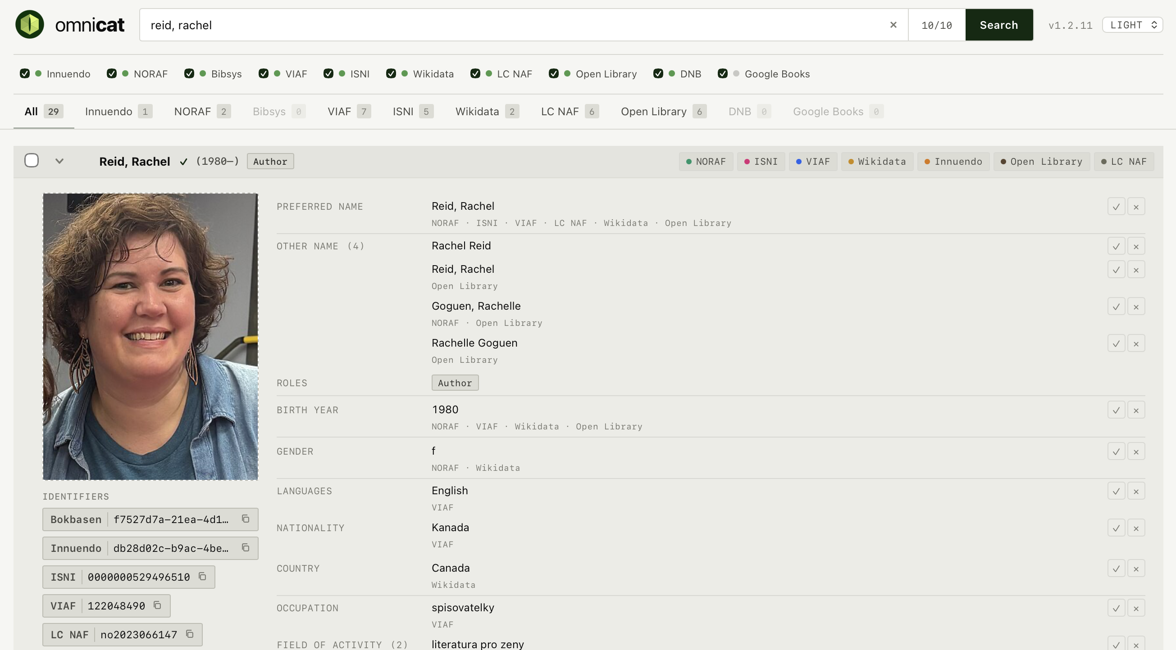
OmniCat

