Slide 1
Wrap-up

Slide 2
FAQs on Official RDA Implementation
https://bit.ly/PCC-RDA-FAQ
What are some notable changes from original RDA to official RDA?
What documentation and training will PCC provide?
What documentation and training are currently available from PCC?
What is PCC doing to prepare for official RDA implementation?
When should PCC institutions plan to implement the official RDA Toolkit?
Where should I send questions and feedback?
Notes:
As we wrap up today, I want to remind you of a few resources. The PCC RDA Implementation Task Group has an FAQ page to address questions catalogers may have about implementation. It includes links to PCC documentation and training, including the Phase 1: Introductory RDA Training and Webinars. If you want to know more about PCC’s RDA work, the FAQ includes a link to the PCC Official RDA Implementation Task list.

Slide 3
Tentative PCC Implementation Timeline
By end of 2026: Bridge and full training for monographs and name authorities is available
Early 2027: Webinars for bridge and full training for monographs and name authorities
Notes:
We are currently working on bridge and full training for monographs and name authorities, which we hope to have available by the end of the year. We will be organizing free webinars for the bridge and full training in early 2027.

Slide 4
When should PCC institutions plan to implement the official RDA Toolkit?
As PCC continues to prepare for official RDA implementation, dates will be announced when BIBCO, CONSER, and NACO records can be created using official RDA. These dates will vary for each program based on the availability of documentation and training. Furthermore, institutions will be given sufficient time to review the documentation and training before they implement official RDA.
Until instructed otherwise, PCC records should continue to be created using the original RDA Toolkit.
Notes:
PCC will announce dates when BIBCO, CONSER, and NACO records can be created using official RDA. These dates will vary for each program based on the availability of documentation and training, with the expectation that it will follow the completion of the bridge training webinars.
Until instructed otherwise, PCC records should continue to be created using the original RDA Toolkit.

Slide 5
Feedback
Provide feedback to PCC via PCC RDA Communications Committee Feedback Form: https://bit.ly/PCC-RDA-Feedback-Form
Notes:
The PCC RDA Communications Committee has a feedback form that you can use to submit questions and feedback on PCC’s implementation of official RDA. You can also submit revisions to LC-PCC Policy Statements, Metadata Guidance Documentation, BSR Official RDA Metadata Application Profile, and the introductory training. The link to the form is on the PCC website and on the slide here.

Slide 6
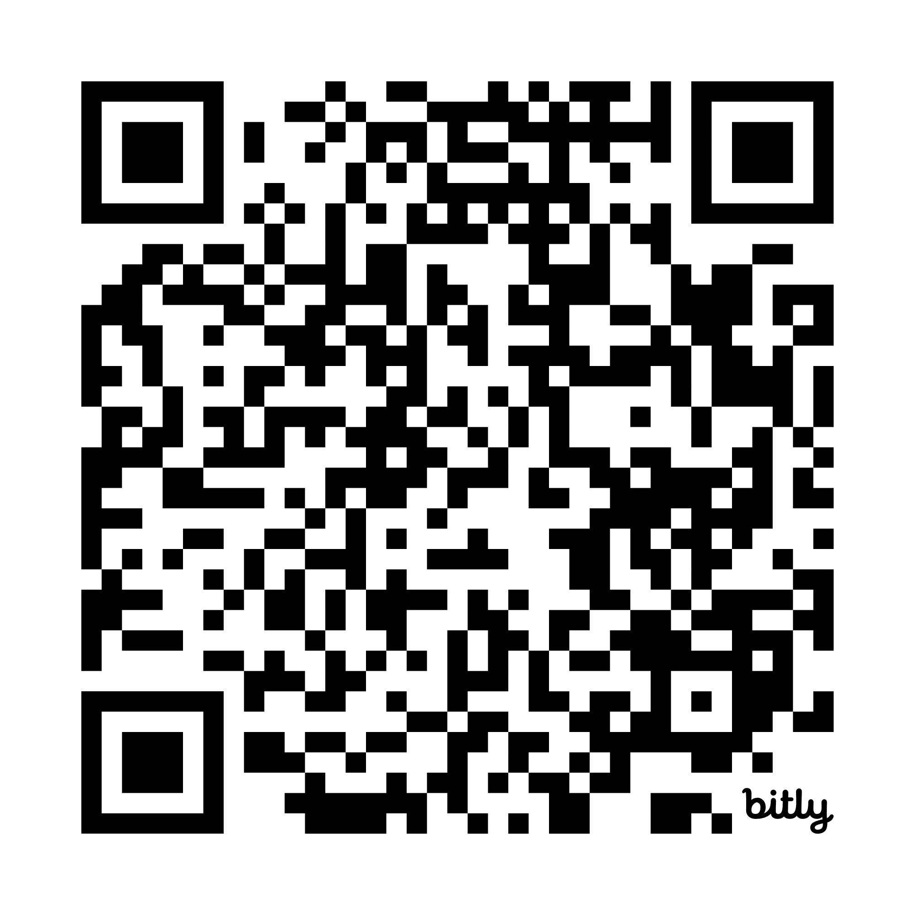
Workshop Survey
https://bit.ly/RDA-ALA-26-Feedback
Notes:
We welcome your feedback on today’s workshop. Your feedback will be used by the SCT RDA Training Task Groups for Monographs and Name Authorities as we continue to work on training for official RDA. Please provide your feedback by Friday, July 10.

Slide 7
Questions?

