Slide 1
Recording Data Provenance

Slide 2
RDA Copyright
©2010-2026 - American Library Association, Canadian Federation of Library Associations, and CILIP: Chartered Institute of Library and Information Professionals.
Screen images from the RDA Toolkit (www.rdatoolkit.org) used by permission of the Copyright Holders for RDA (American Library Association, Canadian Federation of Library Associations, and CILIP: Chartered Institute of Library and Information Professionals).

Slide 3
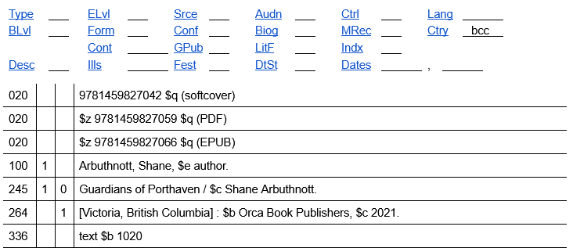
Metadata Statements
Metadata Statements
Notes:
When describing a resource or entity, we create metadata statements that assign a value to each RDA element we record. For example, Expression <has content type> text is a metadata statement. In fact, each value that we recorded in our RDA Record Template is a metadata statement.

Slide 4
Metadata Description Sets
Metadata Statements
Metadata Description Set
Notes:
One or more metadata statements forms a metadata description set. In MARC, the entire bibliographic or authority record is an example of a metadata description set.
If we wanted to provide information about the metadata we recorded, we would record data provenance.

Slide 5
Metadata Works = Works of Metadata
Metadata Works
Metadata Work
Notes:
The metadata that is described by data provenance is treated as a work, more specifically a metadata work. While we usually think of a work as the intellectual or artistic content of an information resource, a metadata work is some or all of the metadata that is used to describe the resource or entity. RDA defines metadata work as “a work that is a metadata statement or a metadata description set,” but you might find it easier to think of it as a work of metadata.

Slide 6
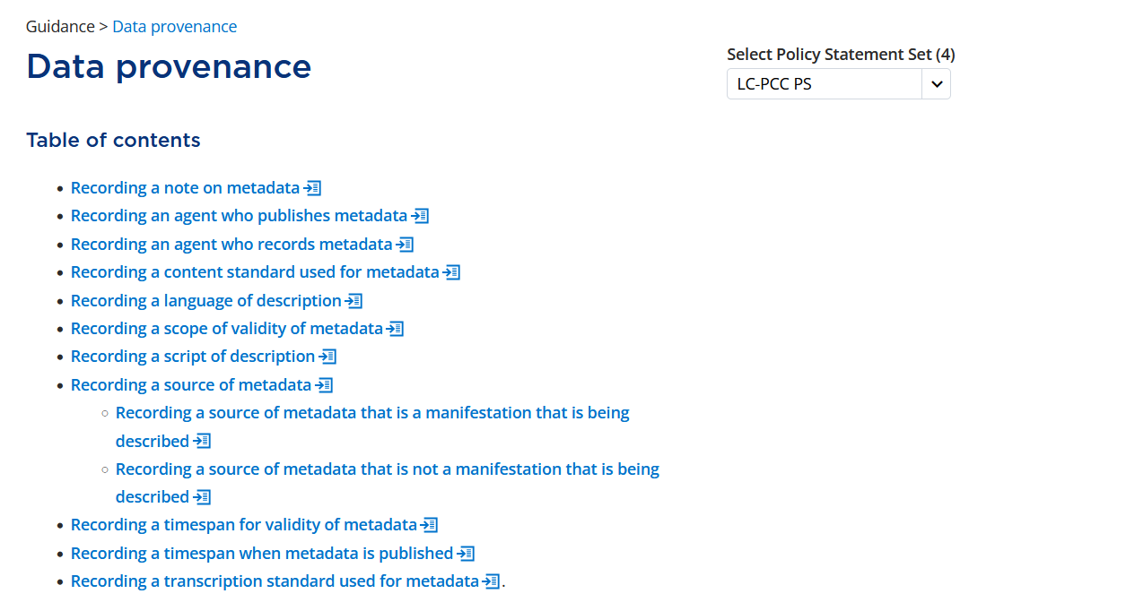
Notes:
To describe a metadata work, we can use any appropriate RDA element; however, the Data provenance guidance chapter provides common situations when we would want to record data provenance and an appropriate RDA element to use.

Slide 7
Field-Level Data Provenance
Purpose | RDA Element | MARC Field & Subfield | Guidance
Agent who records metadata | author corporate body | $5 | Record the institution to which the field applies
Scope of validity of metadata | scope of validity | $3 | Record the part of the described material to which the field applies
Source of metadata that is a manifestation being described | recording source or note on manifestation | 500 $a 588 $a etc. | Record the source from which the metadata was transcribed.
Source of metadata that is not a manifestation being described | source consulted | $2 | Record the source for terms or identifiers recorded from a VES
Timespan for validity of metadata | related timespan of work | Authority: 3XX $s, $t | Record the beginning or ending year
Notes:
To record data provenance for a metadata work that is a metadata statement, we record field-level provenance in MARC as follows:
In subfield $5, we can use the RDA element author corporate body to record the institution to which the field applies.
In subfield $3, we use the RDA element scope of validity to record the part of the described material to which the field applies.
In fields 500, 588, and others, we can use the RDA elements recording source or note on manifestation or a narrower element to record the source from which the metadata was transcribed.
In subfield $2, we use the RDA element source consulted to record the source for terms or identifiers recorded from a vocabulary encoding scheme.
In authority 3XX fields, we can record the RDA element related timespan of work in subfields $s or $t to indicate the beginning or ending year when the metadata is valid.

Slide 8
Record-Level Data Provenance
Purpose | RDA Element | MARC Field & Subfield | Guidance
Agent who publishes metadata | publisher corporate body | 040 $a, $d | Record the institution who added or replaced the record in the database
Agent who records metadata | author corporate body | 040 $a, $c, $d Srce (008/39) | Record the institution who created or edited the record in the database
Content standard used for metadata | related manifestation of work | 040 $e Desc (LDR/18) = a or i | See MG: Work: Related manifestation of work: Description convention source codes
Language of description | language of expression | 040 $b | Record the language of cataloging
Notes:
To record data provenance for a metadata work that is a metadata description set, we record record-level provenance in MARC as follows:
In field 040, subfields $a or $d, we record the RDA element publisher corporate body for the institution who added or replaced the record in the database.
In field 040, subfields $a, $c, or $d, we record the RDA element author corporate body for the institution who created or edited the record in the database.
Note that oftentimes a single value in MARC is used to indicate both the author and publisher of the metadata.
The element author corporate body is also used to record the Cataloging Source in fixed field 008, position 39.
In field 040, subfield $e, we record the RDA element related manifestation of work to indicate the content standard use for the metadata.
The element related manifestation of work is also used to record the Descriptive cataloging form in leader position 18 if coded “a” or “i”.
In field 040, subfield $b, we record the RDA element language of expression for the language of cataloging.
Note that many of the record-level data provenance values may be automatically supplied by your system.

Slide 9
Authority Record-Level Data Provenance
Purpose | RDA Element | MARC Field & Subfield | Guidance
Source of metadata that is not a manifestation being described | source consulted | 670 $a, $b | Follow the same practice from original RDA. See DCM Z1 for details.
Notes:
A special note about record-level data provenance in authority records:
Use the RDA element source consulted for your 670 field. Follow the same practice from original RDA as outlined in DCM Z1.
With this high-level summary in mind, let’s look at the specific RDA instructions that are used to record the field-level data provenance for source consulted and the record-level data provenance for the content standards used.

Slide 10
content type

Slide 11
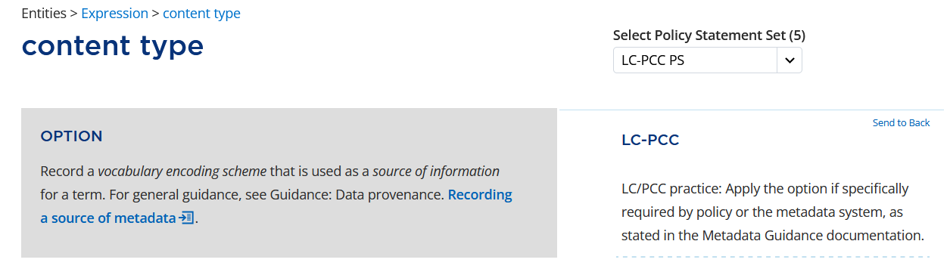
Notes:
In the RDA Toolkit, if we go back to the content type element page, we will see an option under Recording a structured description that says “Record a vocabulary encoding scheme that is used as a source of information for a term.” We will apply the option to indicate the source of the term “text” that we recorded earlier.
The option refers us to the Data provenance Guidance chapter, specifically the section Recording a source of metadata.

Slide 12
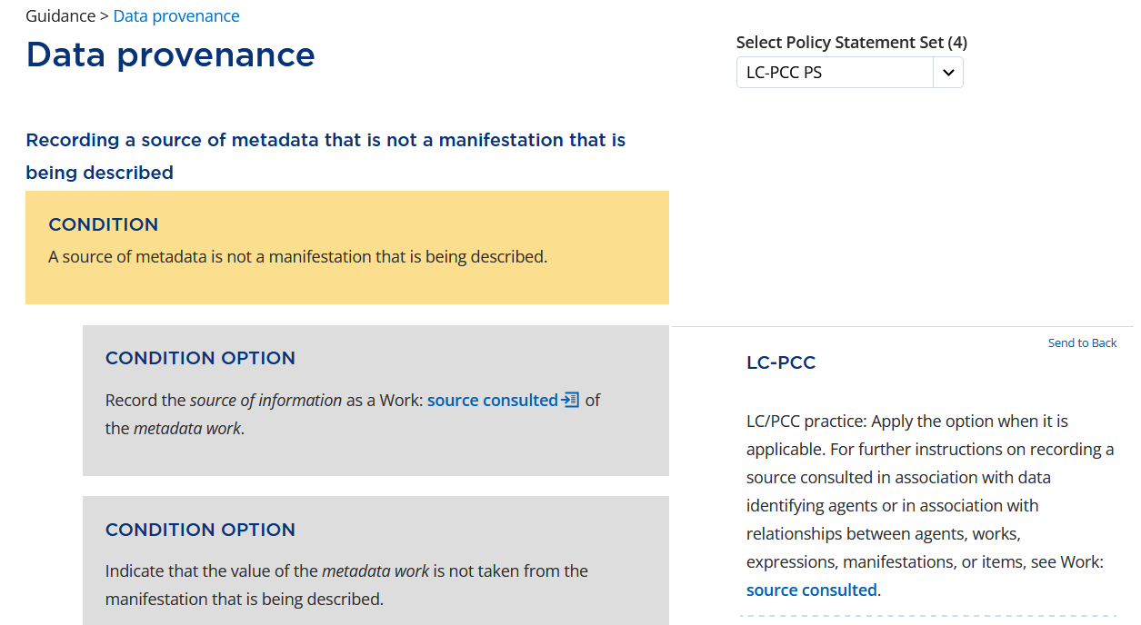
Notes:
On the Data provenance page, we will apply the option to use the element source consulted to record the source of the term since it came from outside the manifestation being described.

Slide 13
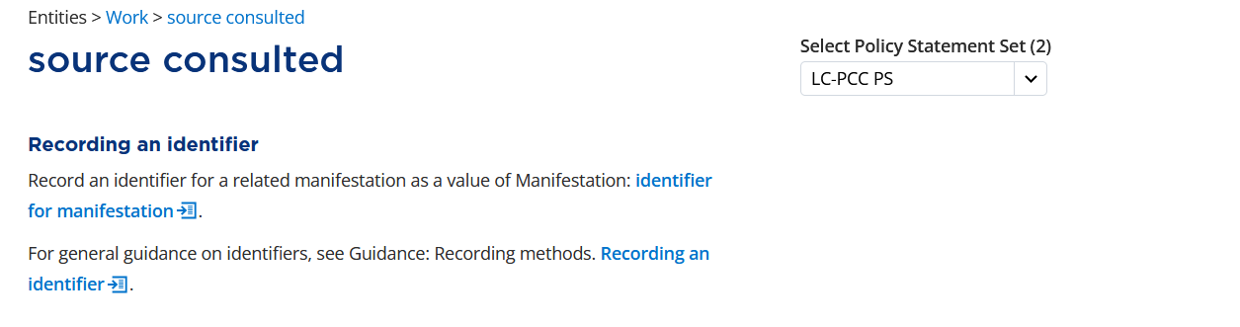
Notes:
Viewing the source consulted element page, we can see that RDA allows us to record the relationship using an identifier for the related manifestation. The related manifestation in this case is the RDA Content Type vocabulary encoding scheme. We want to record a code for the RDA Content Type VES.

Slide 14
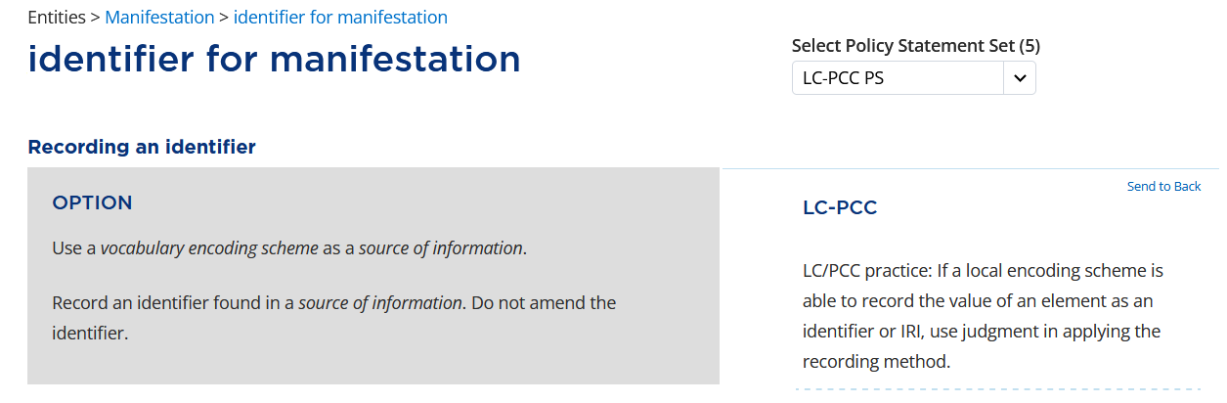
Notes:
Continuing to view the instructions in RDA, identifier for manifestation includes an option under Recording an identifier to “Use a vocabulary encoding scheme as a source of information.”

Slide 15
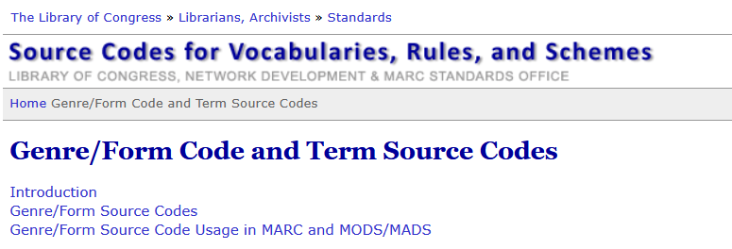

Notes:
Our source of information is the Genre/Form Code and Term Source Codes list. The code for the RDA Content Type VES is rdaco.
Note that if we applied the second option to record content type using a term from another appropriate vocabulary encoding scheme, we could have chosen to use the Term and code list for RDA content types and recorded the source of the term using the code rdacontent.

Slide 16
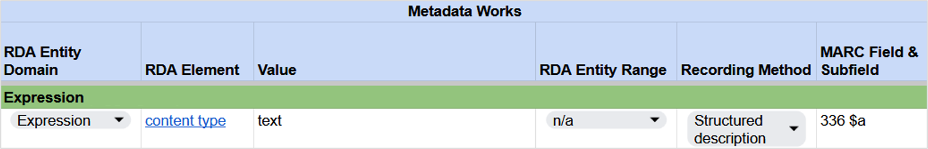
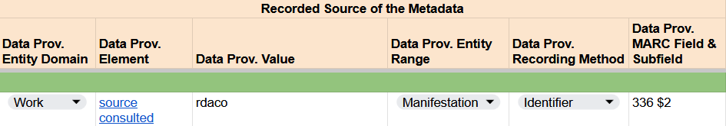
Recording content type
RDA Record Template
Notes:
In the RDA Record Template, the identifier “rdaco” is recorded as a data provenance value of source consulted for the term “text”.

Slide 17
related manifestation of work

Slide 18
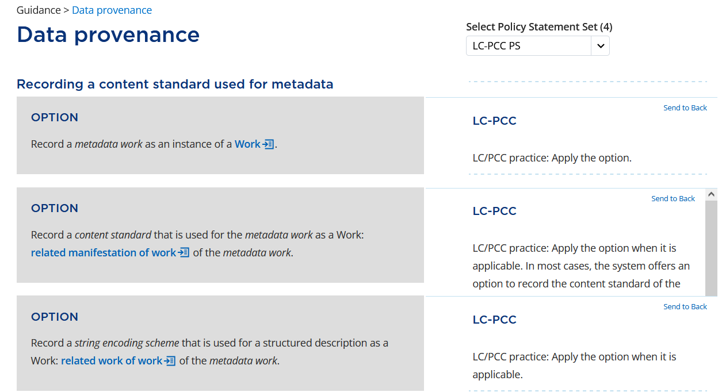
Notes:
Now, let’s go to the Data provenance guidance chapter and look at the instructions under Recording a content standard used for metadata.
As always, we will apply the option to “Record a metadata work as an instance of a Work.”
The second option says to “Record a content standard that is used for the metadata work as a Work: related manifestation of work of the metadata work.” The term “content standard” appears in italics, indicating it has a specific meaning in RDA, and it should be included in the RDA Glossary, so let’s look up what it means.

Slide 19
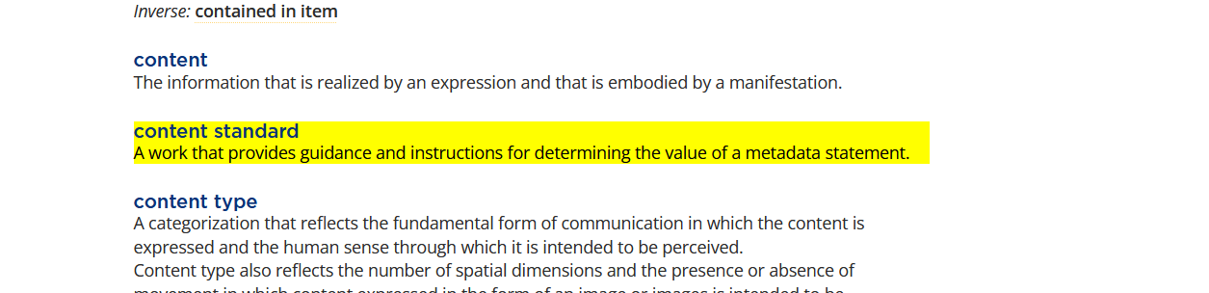
Content standards used while cataloging
RDA
PCC application profile (including BSR, LC-PCC PS, MGDs)
Notes:
Content standard is defined in the Glossary as “A work that provides guidance and instructions for determining the value of a metadata statement.” As we were determining values for all of the metadata statements, we applied guidance and instructions from RDA, the PCC application profile (including the BSR, LC-PCC Policy Statements, and Metadata Guidance Documentation).

Slide 20
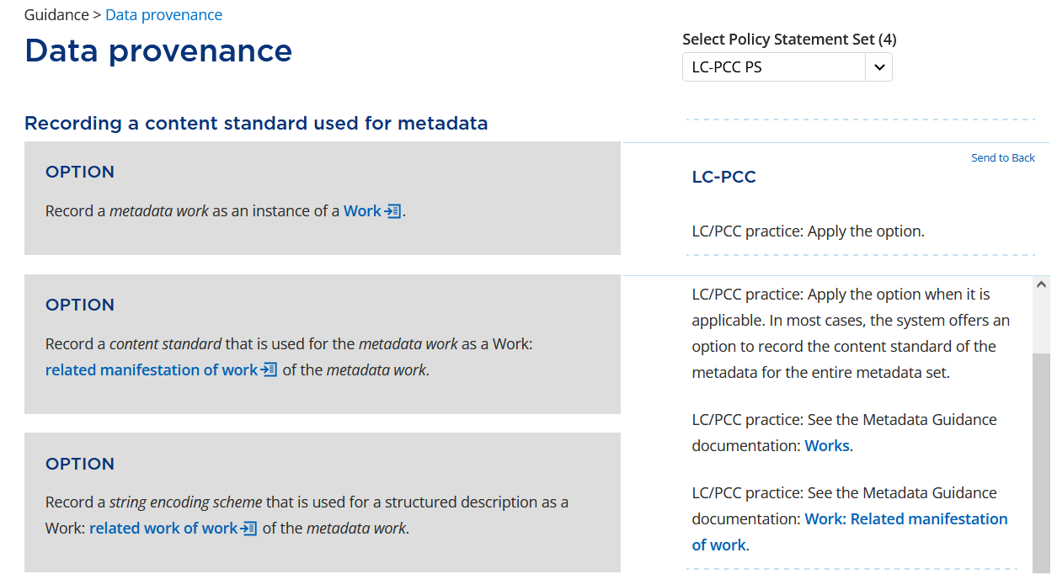
Notes:
Let’s go back to the option to “Record a content standard ….” This option tells us to use the element related manifestation of work to record the content standard, that is, the guidelines and instructions we used for the metadata. The LC-PCC PS says to apply the option and notes that the value may be supplied by the system. The LC-PCC PS also includes links to the Works narrative MGD and the related manifestation of work MGD. For now, let’s click on the link to open the related manifestation of work MGD, but we will review the rest of the RDA instructions before we look at it.

Slide 21
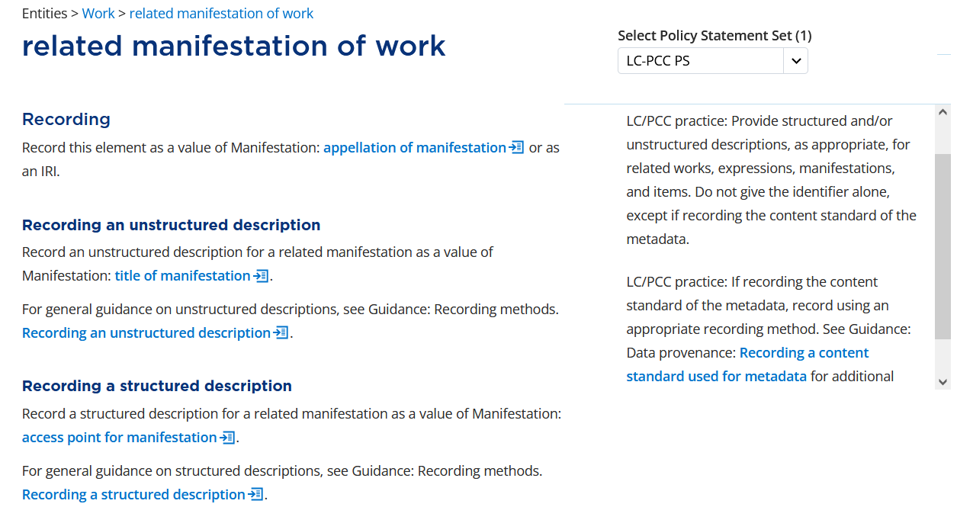
Notes:
If we look at the element related manifestation of work, the LC-PCC PS for Recording says to “Provide structured and/or unstructured descriptions, as appropriate, for related works, expressions, manifestations, and items. Do not give the identifier alone, except if recording the content standard of the metadata. … If recording the content standard of the metadata, record using an appropriate recording method.” We will record the content standard of the metadata using an identifier for manifestation.

Slide 22
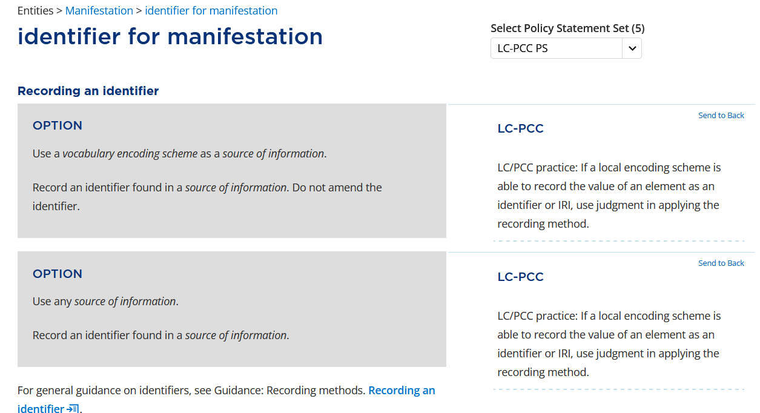
Notes:
There are numerous instructions for recording an identifier for manifestation, but the one that is applicable in our case is the first option under Recording an identifier, which says to “Use a vocabulary encoding scheme as a source of information.”

Slide 23
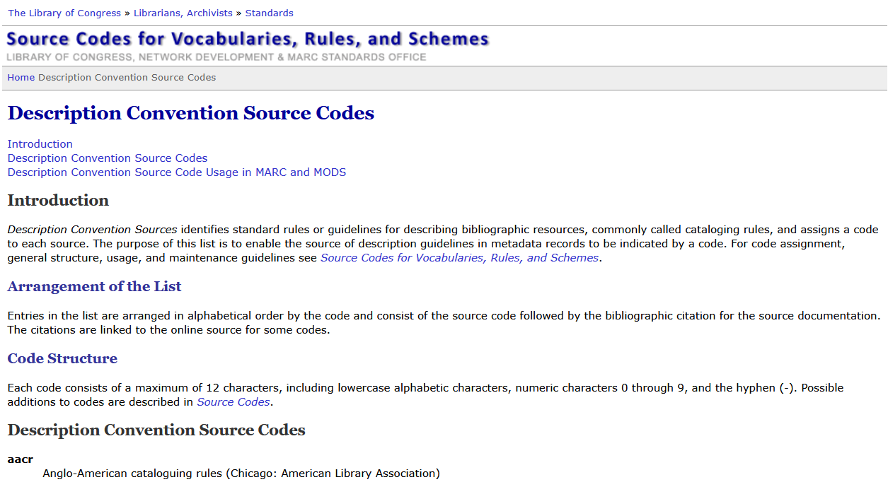
Notes:
We will record codes from the Description Convention Source Codes list (https://www.loc.gov/standards/sourcelist/descriptive-conventions.html).

Slide 24
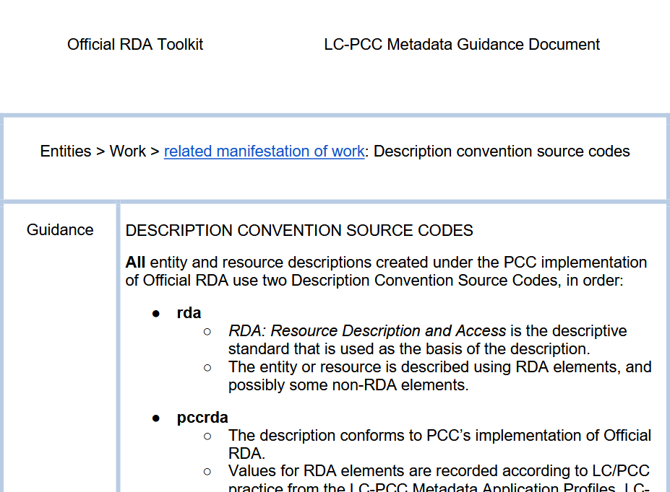
Notes:
With that background information, let’s look at the MGD for related manifestation of work, which is specifically for Description convention source codes.

Slide 25
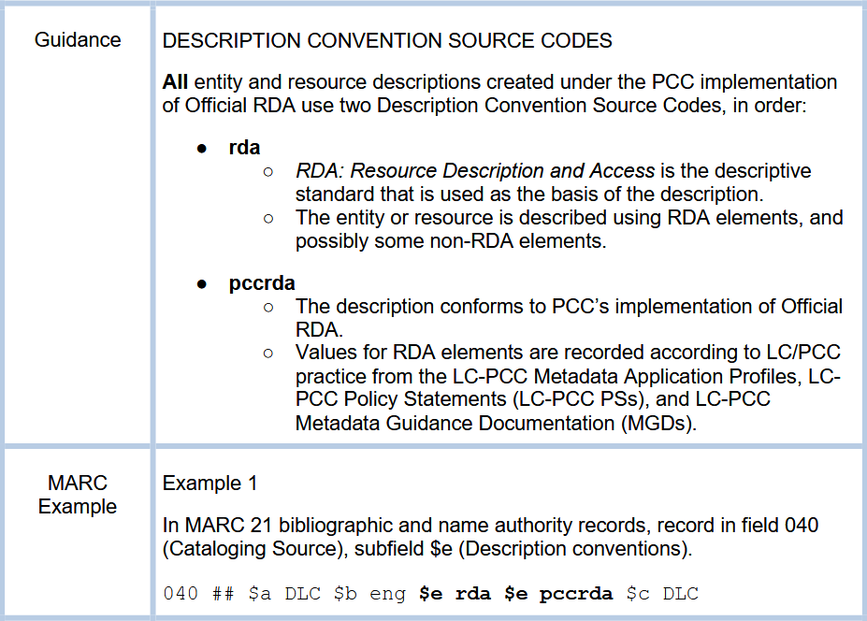
Notes:
First, all entity and resource descriptions created under the PCC implementation of official RDA use two Description Convention Source Codes, rda and pccrda, in that order. The code rda represents the RDA descriptive standard that is used as the basis of the description. The same code is used for both original RDA and official RDA. The code pccrda indicates that the description conforms to PCC’s implementation of official RDA and the values are recorded according to LC/PCC practice from the LC-PCC Metadata Application Profiles, LC-PCC Policy Statements, and LC-PCC Metadata Guidance Documentation. The code pccrda can be used to identify official RDA records, but only if they conform to LC/PCC practice. The codes are recorded in MARC field 040 subfield $e, which is repeated for each code.

Slide 26
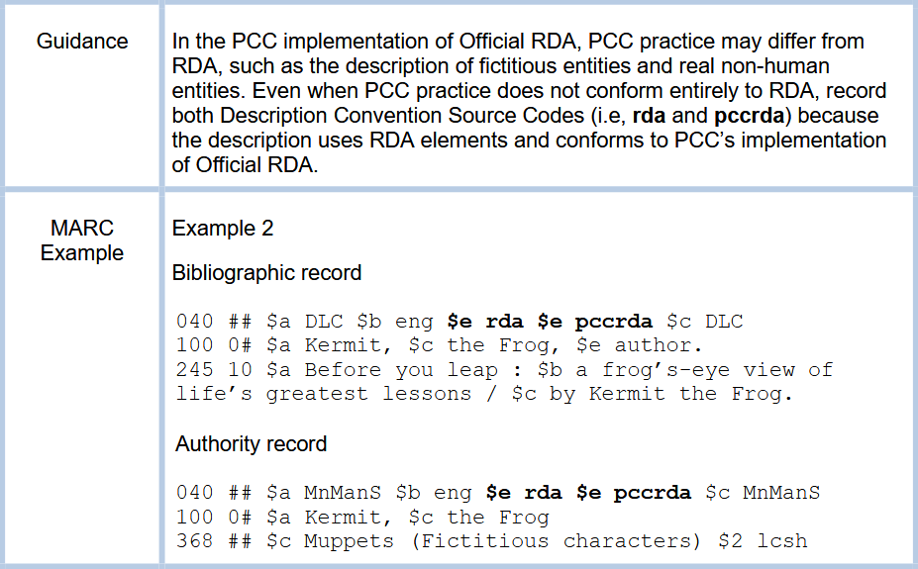
Notes:
In the PCC implementation of official RDA, PCC practice may differ from RDA, such as the description of fictitious entities and real non-human entities. Even when PCC practice does not conform entirely to RDA, record both Description Convention Source Codes (i.e., rda and pccrda) because the description uses RDA elements and conforms to PCC’s implementation of official RDA.

Slide 27
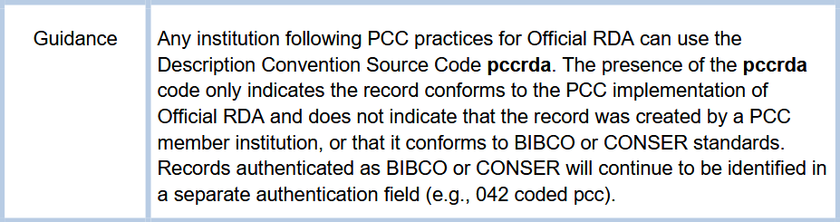
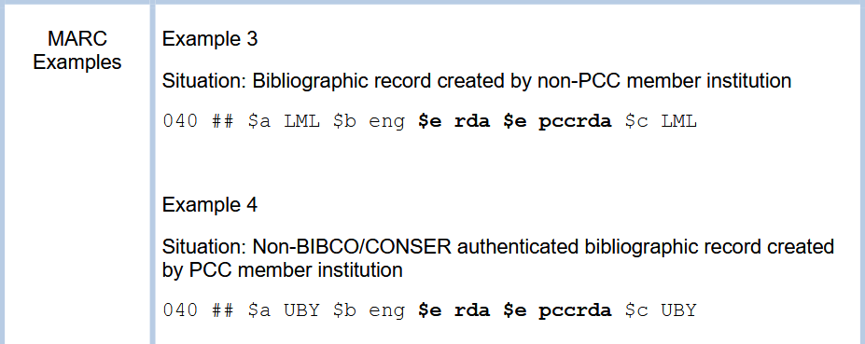
Notes:
Any institution following PCC practices for official RDA can use the Description Convention Source Code pccrda. The presence of the pccrda code only indicates the record conforms to the PCC implementation of official RDA and does not indicate that the record was created by a PCC member institution, or that it conforms to BIBCO or CONSER standards. Records authenticated as BIBCO or CONSER will continue to be identified in a separate authentication field (e.g., 042 coded pcc). In our example today, we are coding the record as following PCC practices but are not authenticating it as BIBCO.

Slide 28
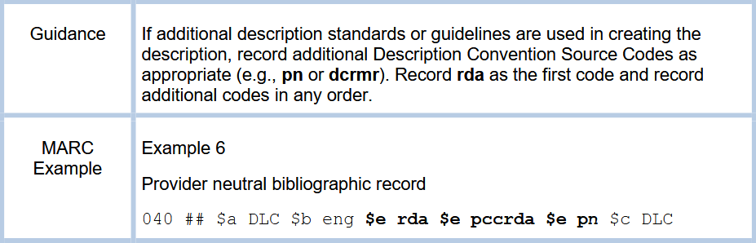
Notes:
If additional description standards or guidelines are used in creating the description, record additional Description Convention Source Codes as appropriate. Record rda as the first code and record additional codes in any order.

Slide 29
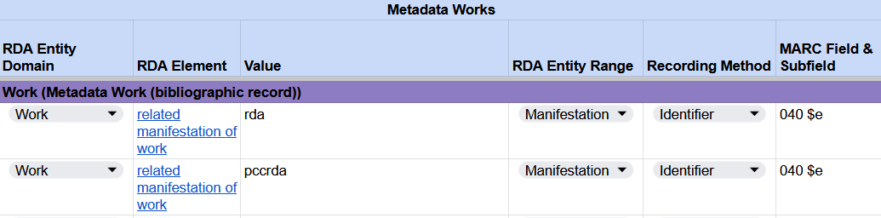
Recording a content standard used for metadata
RDA Record Template
Notes:
Because our description uses RDA elements and conforms to PCC’s implementation of official RDA, we will record the codes rda and pccrda.

