Slide 1
Recording Identifiers
Notes:
Good morning. I’m Trina Soderquist, and I’m a cataloging policy specialist in the Policy, Training, and Cooperative Programs division at the Library of Congress. Today I’m speaking in my capacity as a member of the North American RDA Committee and as a new member of the PCC SCT RDA Training Task Group on Monographs.

Slide 2
RDA Copyright
©2010-2026 - American Library Association, Canadian Federation of Library Associations, and CILIP: Chartered Institute of Library and Information Professionals.
Screen images from the RDA Toolkit (www.rdatoolkit.org) used by permission of the Copyright Holders for RDA (American Library Association, Canadian Federation of Library Associations, and CILIP: Chartered Institute of Library and Information Professionals).

Slide 3
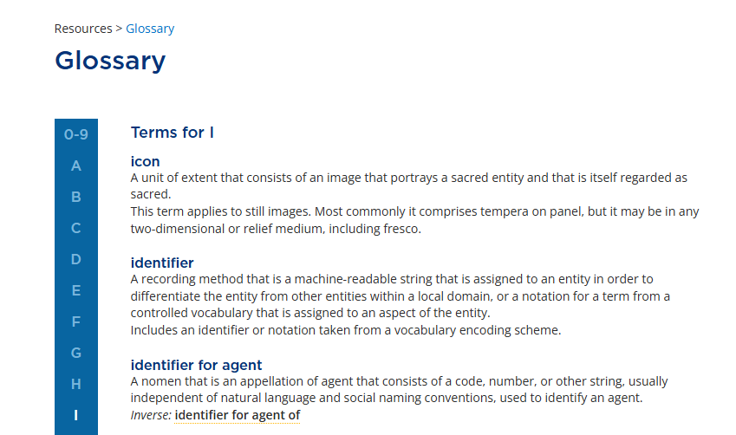
Notes:
The third recording method in the RDA Toolkit is using an identifier.
An identifier is a notation or string of characters assigned by an agent to refer to an entity or concept. Identifiers are unique within a local application.
Identifiers enable systems to recognize exactly what entity is being referenced, even if the labels change. They allow for targeted search and retrieval.

Slide 4
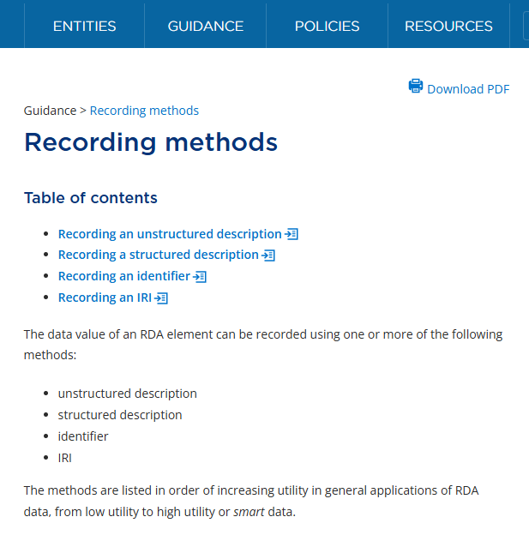
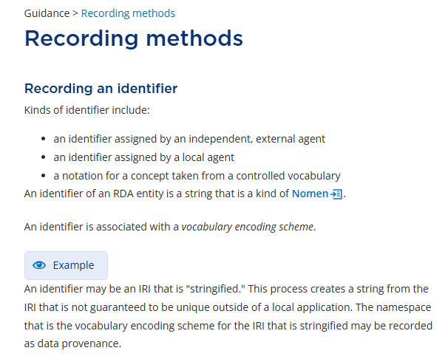
Notes:
In the Guidance section of the RDA Toolkit, select Recording methods, and then click on Recording an identifier to move directly to the instructions.

Slide 5
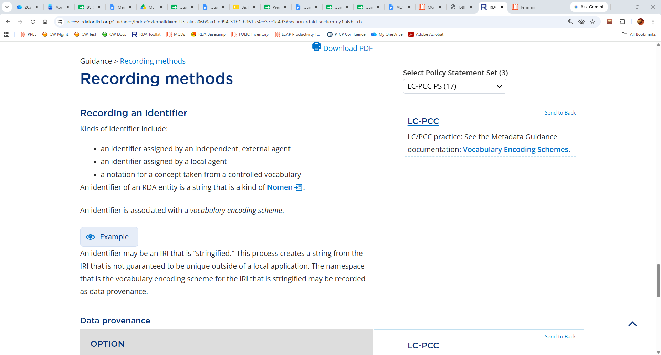
ISBN: 9781459827042
ISNI: 0000 0004 9809 186X
LCCN: no2017023508
LCCN: 2020951471
System control number
RDA Content Type VES: Notation 1020
Notes:
Identifiers may be assigned by independent, external agents, like the International ISBN Agency, the ISNI International Agency, or the Library of Congress. Identifiers may be assigned by local agents. For example, the system control numbers assigned by our library service providers are locally assigned. Finally, identifiers may be notations for concepts taken from a controlled vocabulary like the RDA Content Type vocabulary encoding scheme.

Slide 6
Notes:
In this section on recording identifiers, the LC-PCC policy statement directs us to the metadata guidance documentation on vocabulary encoding schemes.

Slide 7
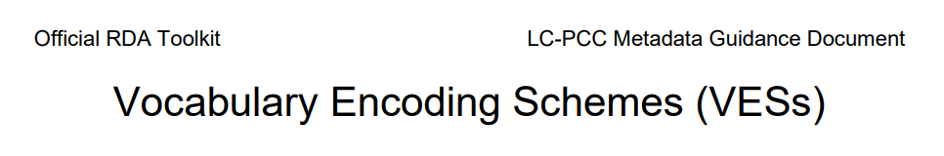
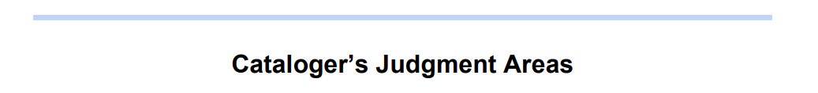
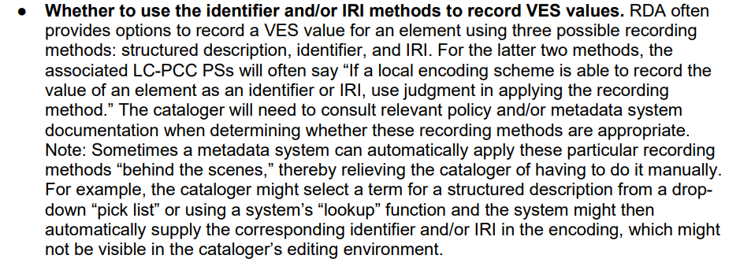
Notes:
A vocabulary encoding scheme value for an element can be recorded using a structured description, an identifier, and an IRI. Determining which method to use will depend on RDA instructions, LC-PCC documentation, local institutional policy, and cataloger judgement.

Slide 8
identifier for manifestation

Slide 9
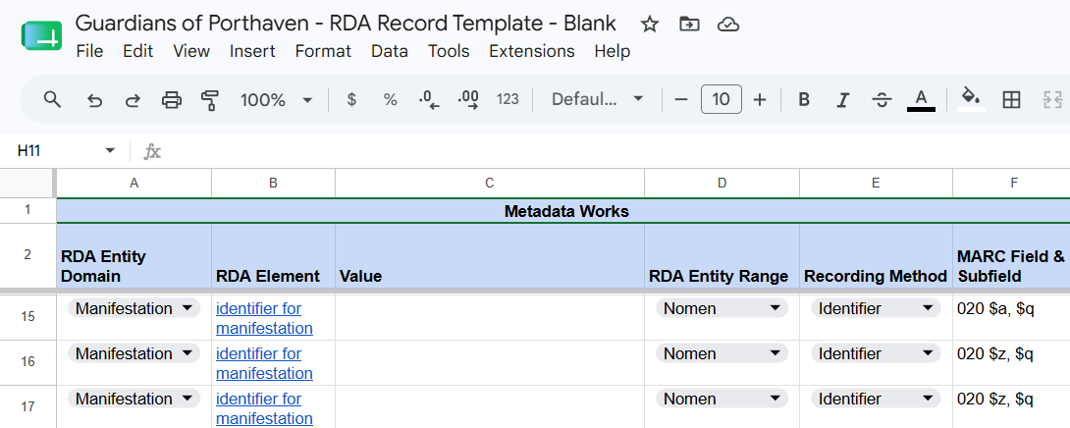
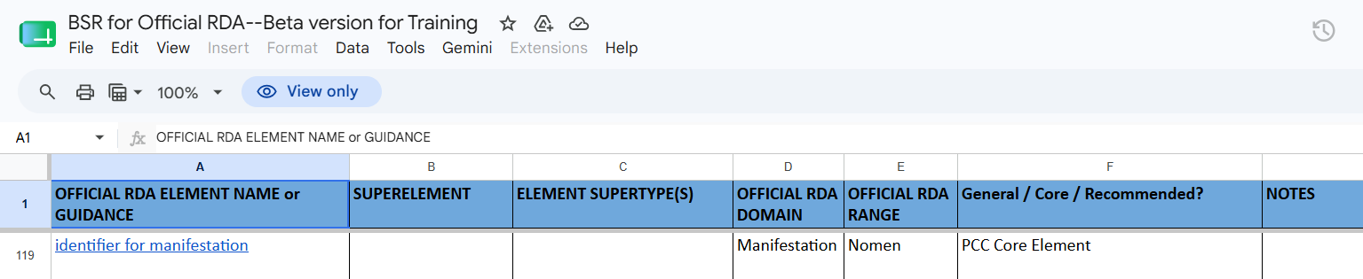
Notes:
Together we will record a value for the element identifier for manifestation. First look up the element in your record template and the Beta BSR.
As you can see from the record template, identifier for manifestation is recorded as an identifier, and it is recorded in MARC field 020. As you know, MARC field 020 is where we record the ISBN.
Next, looking at the Beta BSR, we discover that identifier for manifestation is a core element for PCC. If we continue scrolling to the right, we will find confirmation that this element is recorded in MARC field 020.

Slide 10
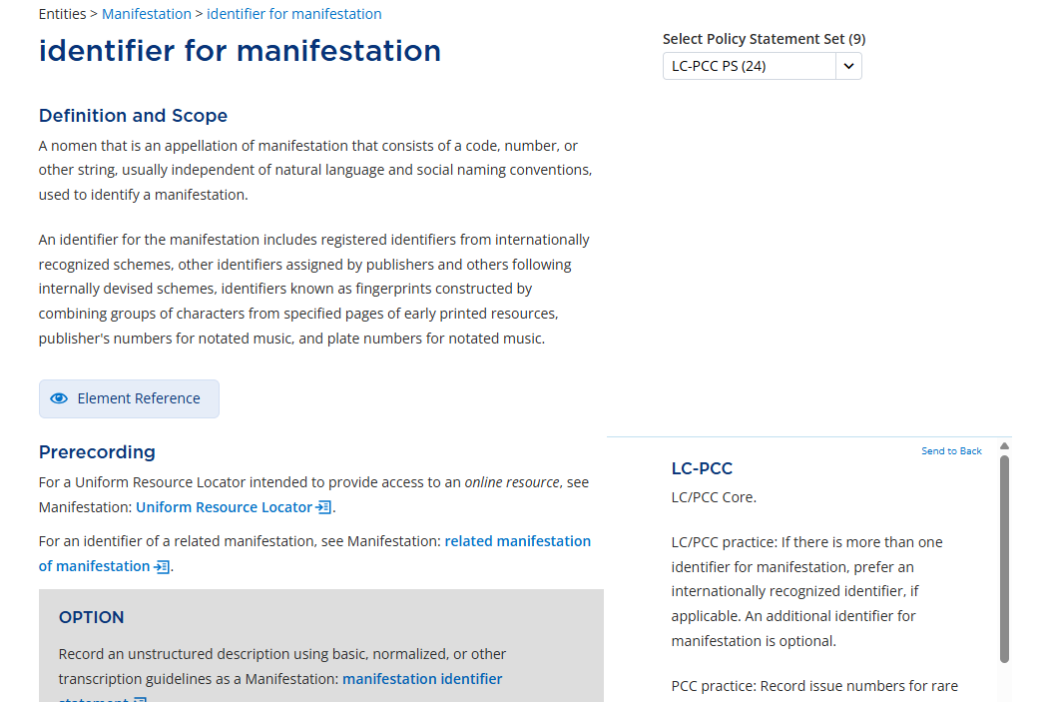
Notes:
Now let’s find the element in the Toolkit. According to the LC-PCC policy statements at the Prerecording section, the element is core for LC and the PCC, and it is optional to record additional identifiers for manifestation.

Slide 11
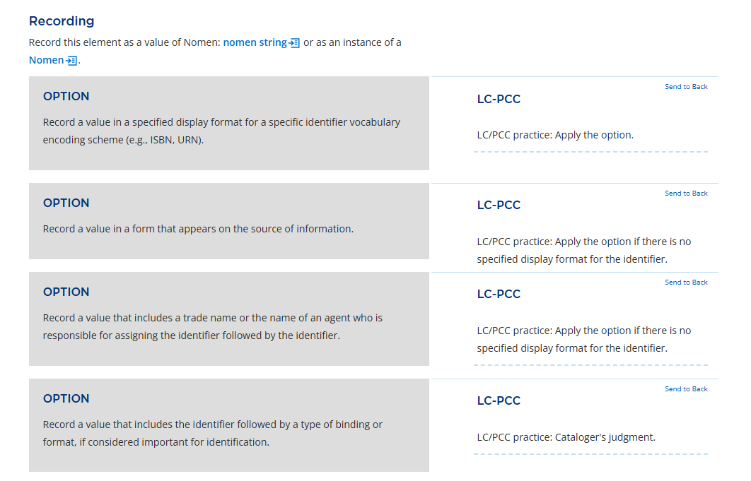
1
2
3
4
Notes:
Moving down the page to the Recording section, let’s see which ones apply for our resource.
The first option reads: Record a value in a specified display format for a specific identifier vocabulary encoding scheme (e.g., ISBN, URN). The accompanying policy statement indicates that we should apply this option.
For ISBNs, we will follow the MARC format, which specifies not to include embedded hyphens.
The second option instructs us to: Record a value in a form that appears on the source of information. But the policy statement says to apply the option if there is no specified display format for the identifier. Since we are following MARC guidance for our identifier for manifestation, we will not apply this option, nor the next.
The fourth option reads: Record a value that includes the identifier followed by a type of binding or format, if considered important for identification. Here the policy statement tells us that we can apply the option if we would like.
At this point we know that we’re recording a specific identifier for manifestation – an ISBN – in MARC field 020; that we can record more than one ISBN; and that we can qualify the ISBN by its type of binding.

Slide 12
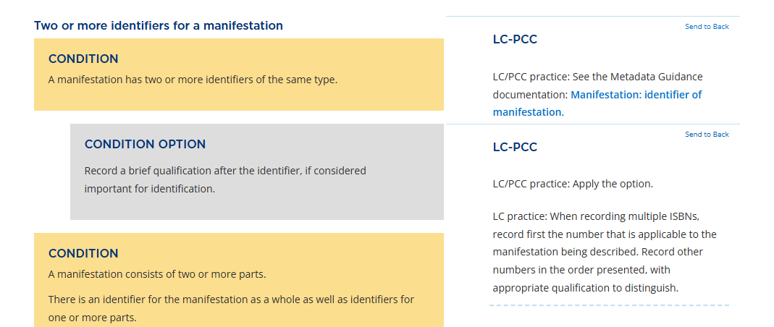
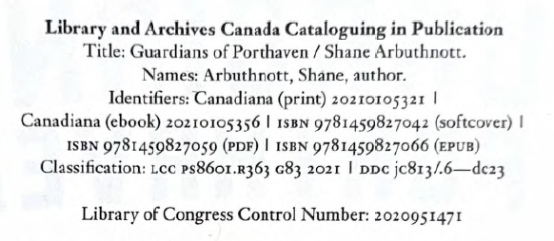
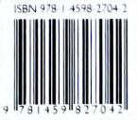
Notes:
Let’s scroll down the page to the section titled: Two or more identifiers for a manifestation.
The surrogates provided include multiple ISBNs. Our resource meets the first condition because it has two or more identifiers of the same type. Therefore, we should apply the condition option to record a brief qualification after the identifier if we consider it important for identification.
The accompanying policy statement instructs us to first record the ISBN that is applicable to the resource, followed by the other ISBNs in the order they are presented.

Slide 13
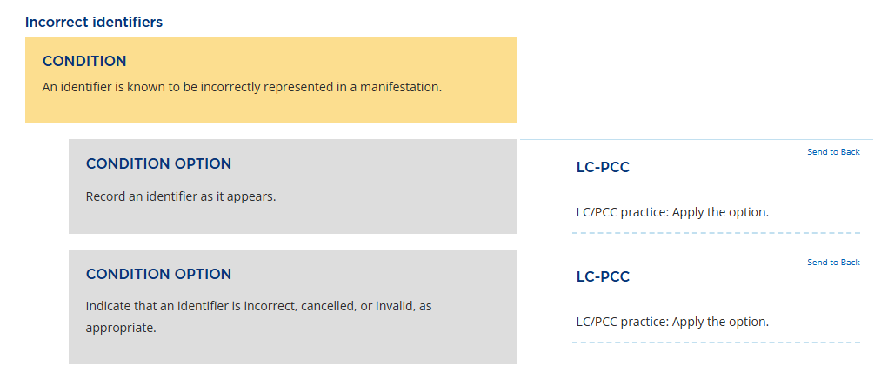
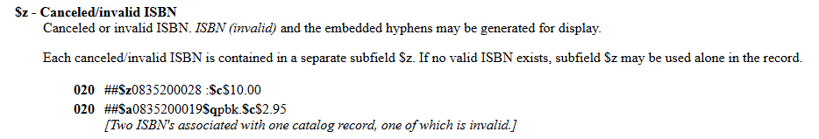
Notes:
Scrolling farther down the element page, we see a final condition that applies to our resource: An identifier is known to be incorrectly represented in a manifestation.
The resource in hand is a paperback book, but the cataloging-in-publication data on the title page verso includes ISBNs for two ebooks: the pdf and the epub versions. We can record these and indicate that the identifier is incorrect using MARC subfield $z.

Slide 14
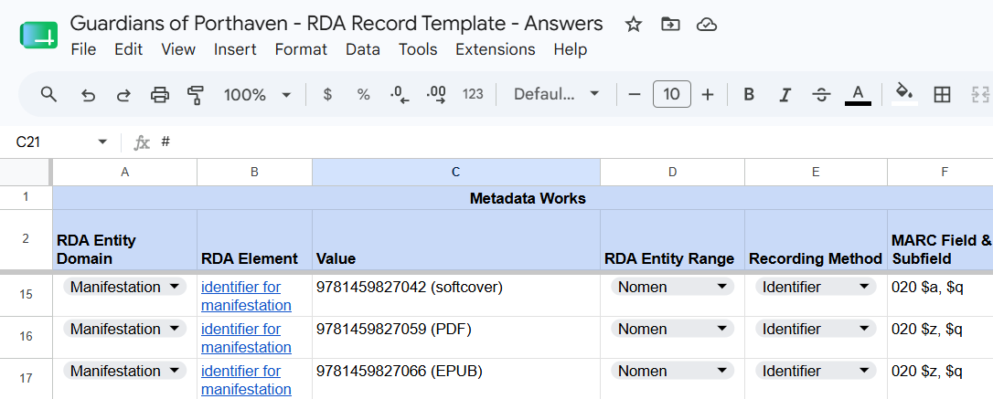
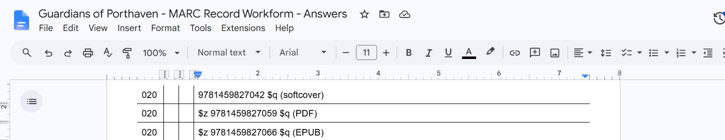
Notes:
Record all three ISBNs, including qualifiers in parentheses if you are following ISBD consolidated, in your RDA record template and MARC record workform.
9781459827042 (softcover)
9781459827059 (PDF)
9781459827066 (EPUB)

Slide 15
place of publication

Slide 16
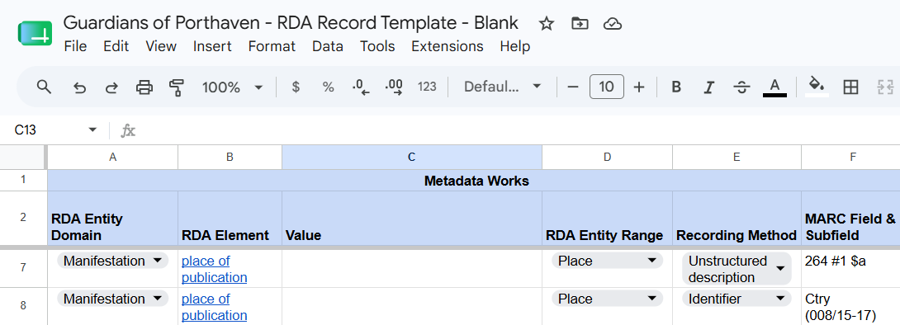
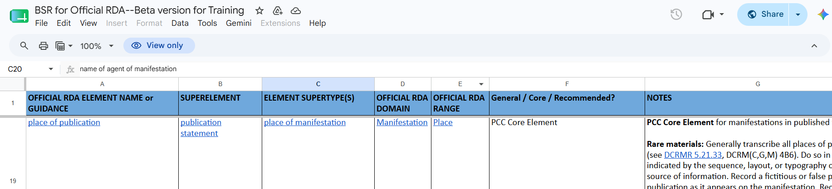
Notes:
Now let’s return to the element place of publication, which we’ve already recorded as an unstructured description in MARC field 264. Place of publication can also be recorded as an identifier in bytes 15-17 of MARC field 008. This information can be found both in your record template and in the Beta BSR.

Slide 17
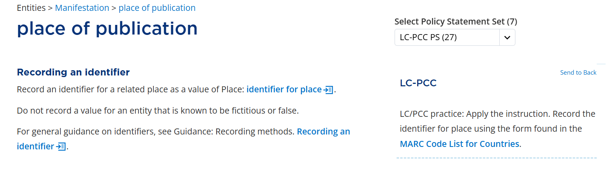
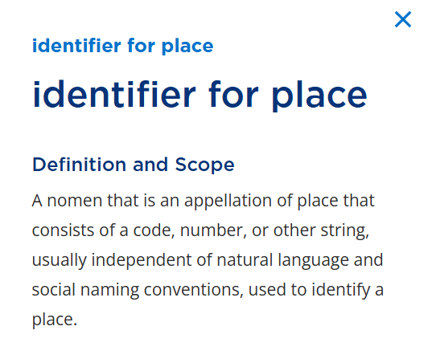
Notes:
Bob showed us how to look outside the source of information to determine that our resource’s place of publication is Victoria, British Columbia.
On the element page for place of publication, scroll down to the section on Recording an identifier. The instructions tell us to record an identifier for a related place as a value of Place: identifier for place. [Click] Click on the icon to show the definition of identifier for place. Identifier for place consists of a code, number or other string used to identify a place.

Slide 18

Notes:
Returning to the Toolkit instructions, the accompanying policy statement tells us to apply the option, using the MARC Code List for Countries. The code for British Columbia is bcc.

Slide 19
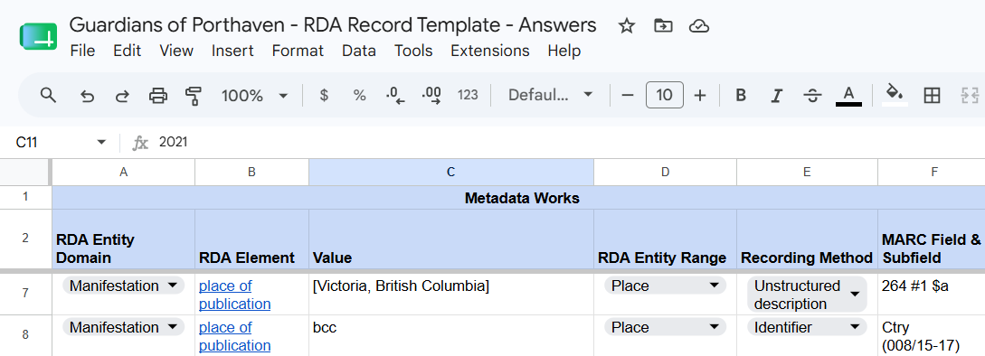
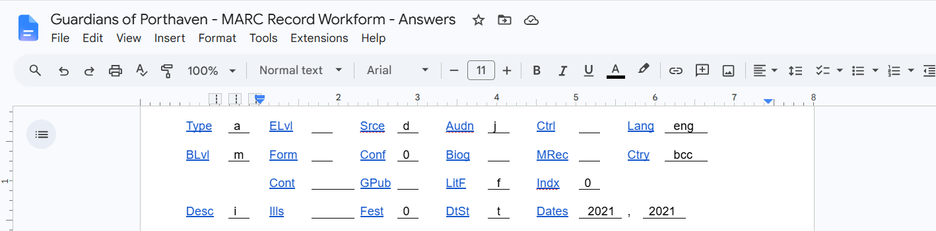
Notes:
Record the identifier for place of publication in your record template and in the MARC workform.

Slide 20
content type

Slide 21
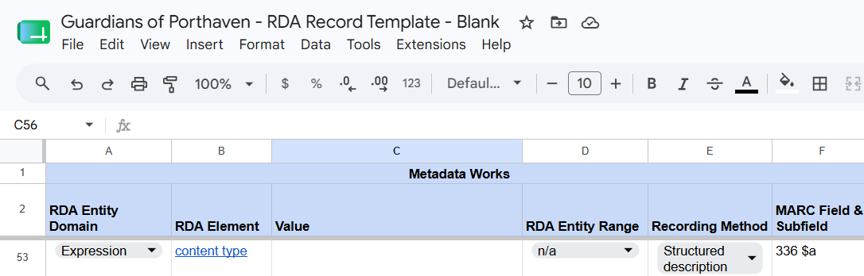
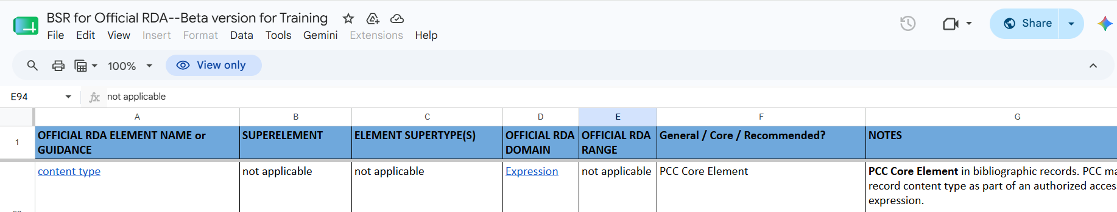
Notes:
The last identifier we will record together will be content type. Susie demonstrated how to record this core element content type as a structured description using a term from a vocabulary encoding scheme like the RDA Content Type VES or the MARC Term and Code List for RDA Content Types.
Recording the value in MARC field 336, subfield $a is sufficient for meeting PCC Core requirements. However, you can also, or you can alternatively, depending on how your library service provider is set up, record an identifier in MARC field 336, subfield $b.

Slide 22
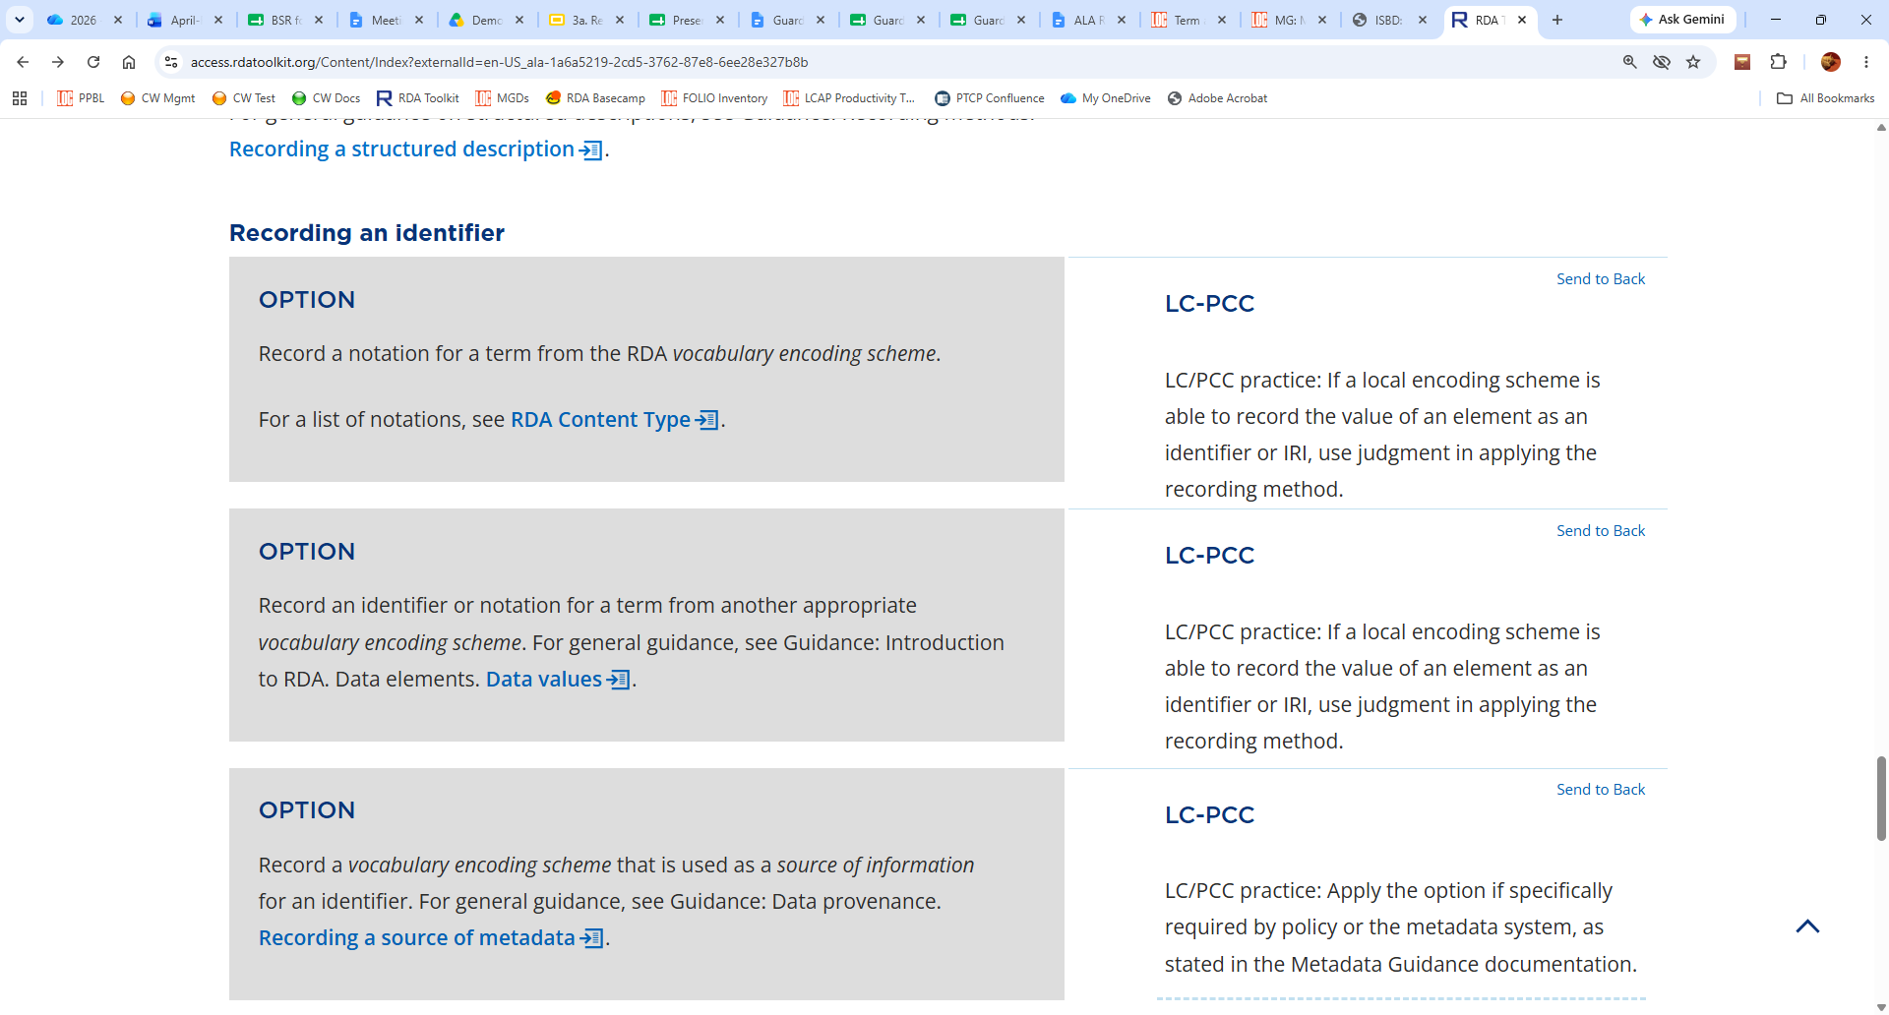
1
2
3
Notes:
On the element page for content type, there are three options under Recording an identifier.
The first option is to record a notation from the RDA Content Type VES. The second option is to record an identifier or notation from another appropriate vocabulary encoding scheme – for example, the MARC list.
The policy statements for both options indicate that if the encoding scheme – MARC, BIBFRAME, or something else – is enabled to record an identifier, you can use your judgment to decide whether to do so.
The third option specifies that we also record the name of the vocabulary encoding scheme that was used as the source of our identifier.

Slide 23
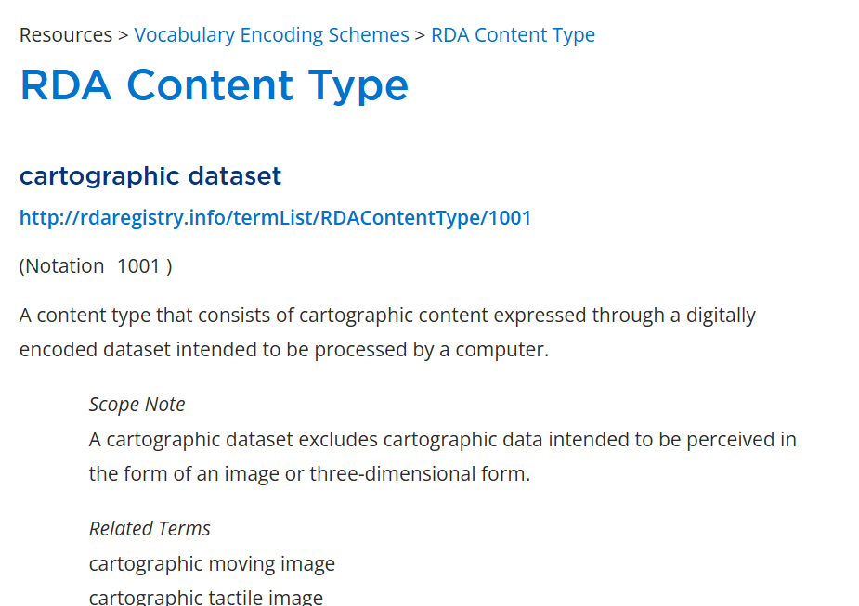
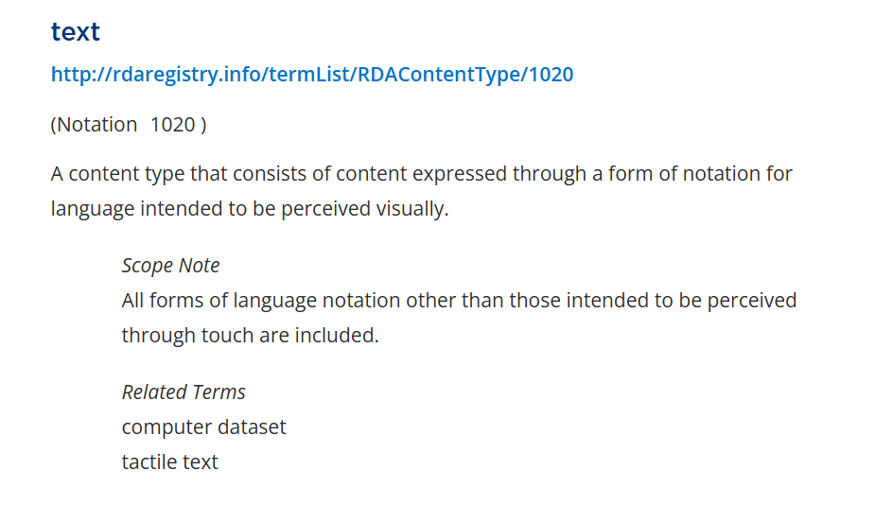
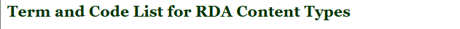
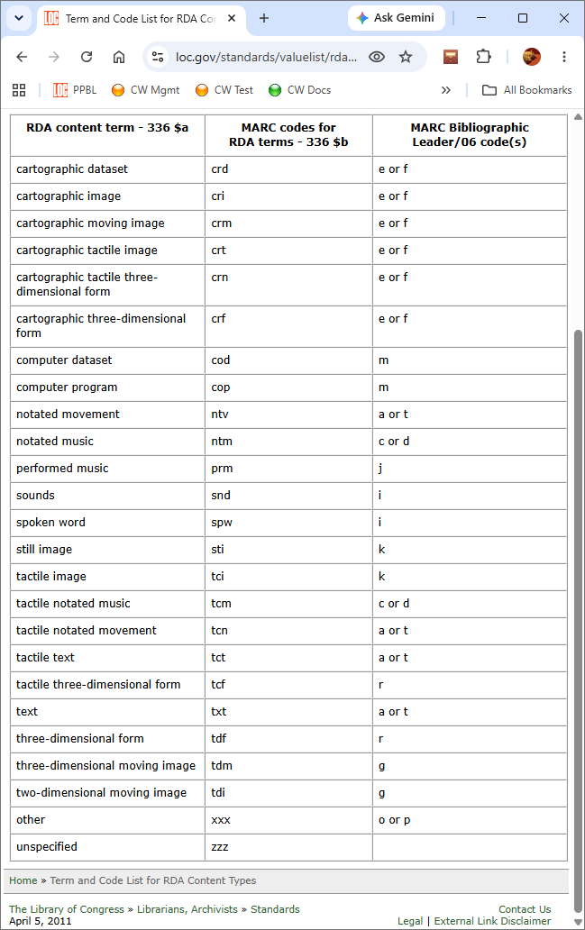
1
2
3
Notes:
Both vocabulary encoding schemes use the term “text,” which you recorded in MARC field 336, subfield $a, with Susie.
For the RDA Content Type VES, the identifier for “text” is 1020. For the MARC Term and Code List for RDA Content Types, the identifier for “text” is txt.

Slide 24
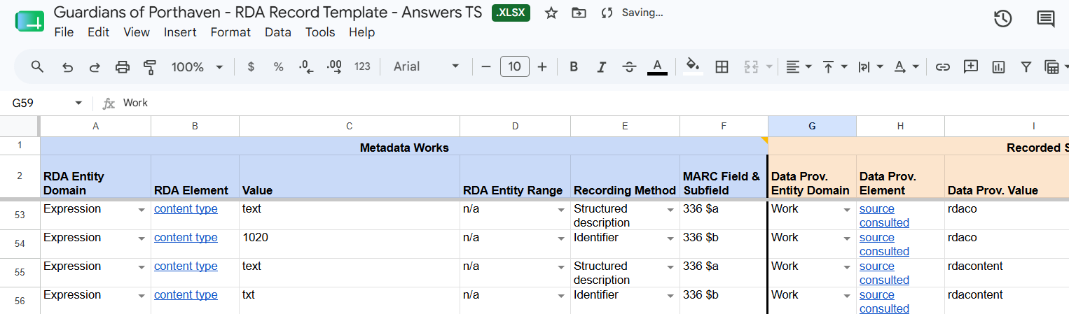
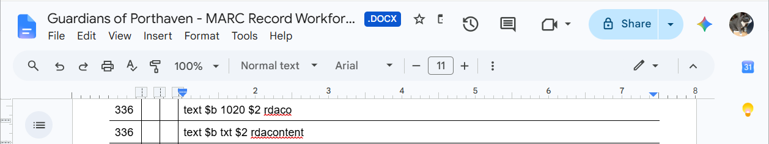
Notes:
Depending on which VES you used for the value in subfield $a, you can record a corresponding identifier in subfield $b.
I’ve recorded both sets of values in this record template and workform.

