Slide 1
Cataloging an eBook
Recording Data Provenance

Slide 2
RDA Copyright
©2010-2025 - American Library Association, Canadian Federation of Library Associations, and CILIP: Chartered Institute of Library and Information Professionals.
Screen images from the RDA Toolkit (www.rdatoolkit.org) used by permission of the Copyright Holders for RDA (American Library Association, Canadian Federation of Library Associations, and CILIP: Chartered Institute of Library and Information Professionals).

Slide 3
Minimum Description of Collection Aggregate
Aggregated Work
has authorized access point for work Arnaud, M.-C. (Marie-Claude). Denjoy subsystems and horseshoes
has expression of work Arnaud, M.-C. (Marie-Claude). Denjoy subsystems and horseshoes
Aggregating Work
has authorized access point for work Hamiltonian systems
has expression of work Hamiltonian systems
Aggregated Expression
has authorized access point for expression Arnaud, M.-C. (Marie-Claude). Denjoy subsystems and horseshoes
has work expressed Arnaud, M.-C. (Marie-Claude). Denjoy subsystems and horseshoes
has manifestation of expression Hamiltonian systems
Aggregating Expression
has authorized access point for expression Hamiltonian systems
has work expressed Hamiltonian systems
has manifestation of expression Hamiltonian systems
Manifestation
has title proper Hamiltonian systems
has expression manifested Hamiltonian systems
has expression manifested Arnaud, M.-C. (Marie-Claude). Denjoy subsystems and horseshoes
Notes:
At this point, we have described the manifestation, the aggregating expression and aggregating work, and an aggregated expression and aggregated work. To describe each entity, we created metadata statements that assigned a value to each RDA element we recorded. For example, Manifestation <has title proper> Hamiltonian systems is a metadata statement. One or more metadata statements forms a metadata description set. For example, all the metadata statements that we recorded to describe the manifestation is a metadata description set. In MARC, the entire bibliographic record is an example of a metadata description set.

Slide 4
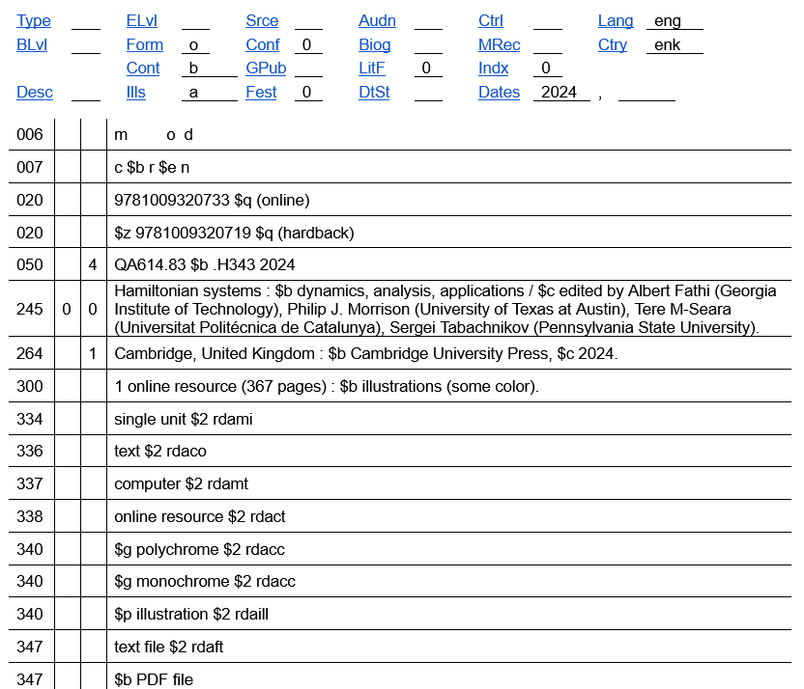
Who created the metadata?
Who published the metadata?
What content standard was used to create the metadata?
What is the language of the description?
Metadata description set
Notes:
Considering the entire metadata description set, that is, the MARC bibliographic record, we probably want to provide some information about the metadata we have recorded. For example:
Who created the metadata?
Who published the metadata?
What content standard was used to create the metadata?
What is the language of the description?
Information about the metadata that we recorded is known as data provenance. In other words, data provenance provides additional information about the metadata recorded.

Slide 5
Metadata Work
Aggregated Work
has authorized access point for work Arnaud, M.-C. (Marie-Claude). Denjoy subsystems and horseshoes
has expression of work Arnaud, M.-C. (Marie-Claude). Denjoy subsystems and horseshoes
Aggregating Work
has authorized access point for work Hamiltonian systems
has expression of work Hamiltonian systems
Aggregated Expression
has authorized access point for expression Arnaud, M.-C. (Marie-Claude). Denjoy subsystems and horseshoes
has work expressed Arnaud, M.-C. (Marie-Claude). Denjoy subsystems and horseshoes
has manifestation of expression Hamiltonian systems
Aggregating Expression
has authorized access point for expression Hamiltonian systems
has work expressed Hamiltonian systems
has manifestation of expression Hamiltonian systems
Manifestation
has title proper Hamiltonian systems
has expression manifested Hamiltonian systems
has expression manifested Arnaud, M.-C. (Marie-Claude). Denjoy subsystems and horseshoes
Notes:
The metadata that is described by data provenance is treated as a work, more specifically a metadata work. While we usually think of a work as the intellectual or artistic content of an information resource, a metadata work is some or all of the metadata that is used to describe the information resource. RDA defines metadata work as “a work that is a metadata statement or a metadata description set,” but you might find it easier to think of it as a work of metadata.

Slide 6
Who created the metadata?
Who published the metadata?
What content standard was used to create the metadata?
What is the language of the description?
Metadata Work
Notes:
As we saw earlier, data provenance can be recorded for a metadata statement, such as to record the vocabulary recording scheme from which a controlled term was taken. Now, we will record data provenance for a metadata description set, the MARC bibliographic record.

Slide 7
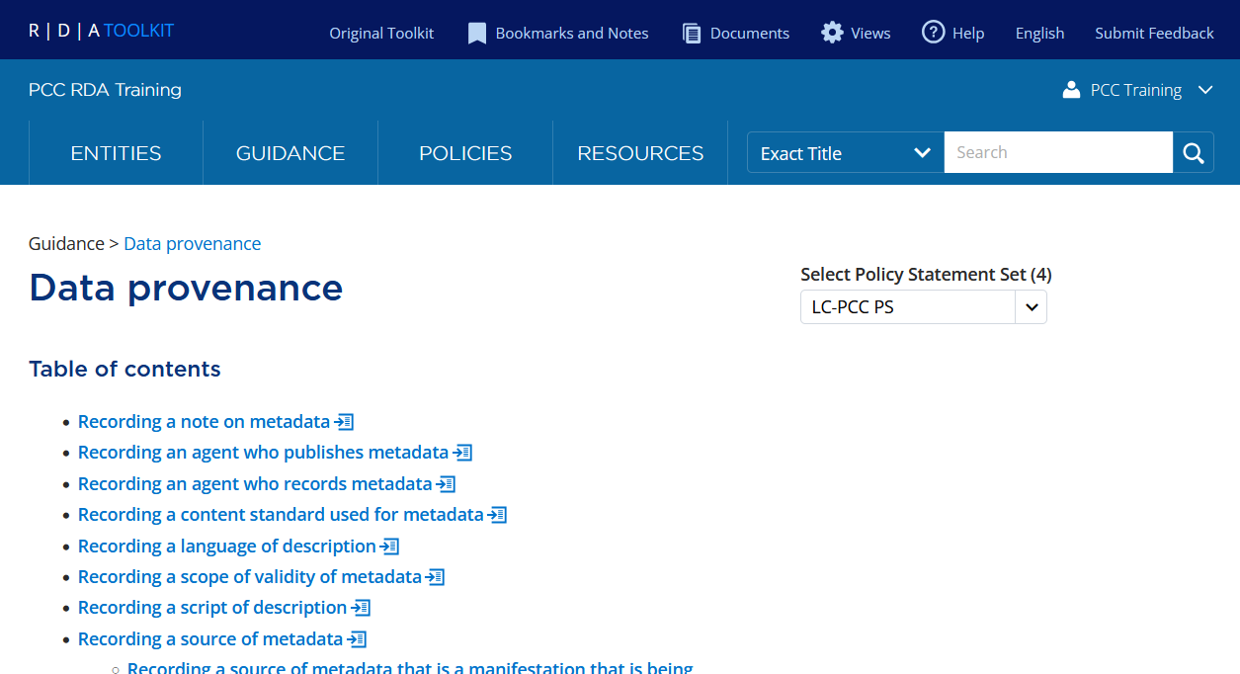
Notes:
To describe a metadata work, we can use any appropriate RDA element; however, the Data provenance guidance chapter provides all the information we need.

Slide 8
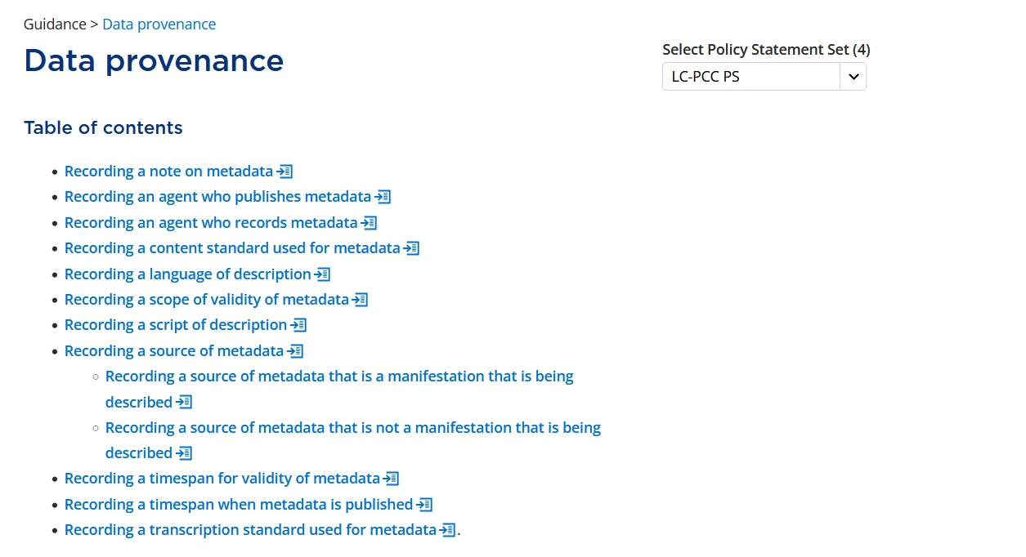
Notes:
The table of contents of the Data provenance guidance chapter provides numerous situations when we might want to record data provenance. To record data provenance for the metadata description set, we will be recording an agent who publishes and records metadata, the content standard used for metadata, and the language of description. Values for these elements are recorded in MARC field 040, so let’s discuss them in the order in which they are recorded, starting with an agent who records metadata.

Slide 9
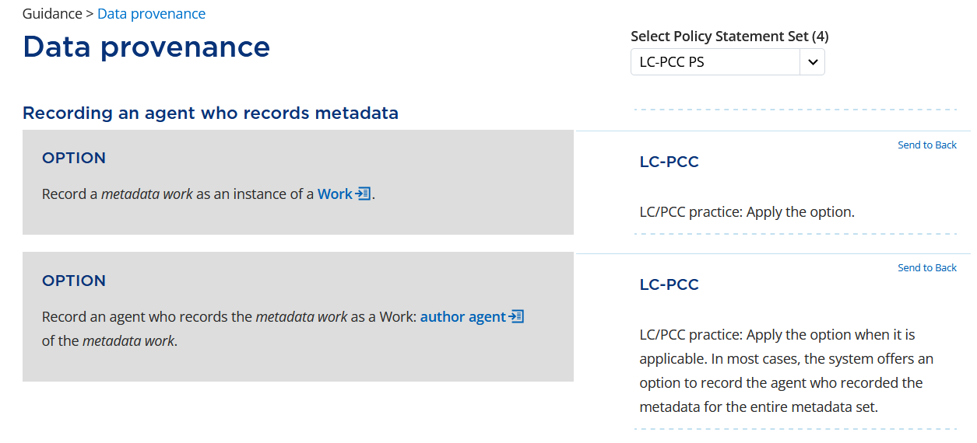
Notes:
Under Recording an agent who records metadata, the first option reads “Record a metadata work as an instance of a Work.” This means that we should treat the metadata description set as a Work when recording data provenance. This is a basic principle of data provenance, so of course the option is applied. In our RDA template, “Work” was recorded as the domain since we will be describing an instance of a Work entity.
The second option reads “Record an agent who records the metadata work as a Work: author agent of the metadata work.” This tells us to use the RDA element author agent to record the agent, that is, the person, family, or corporate body, who recorded the metadata. The option is applied when applicable and the value may be supplied by the system.

Slide 10
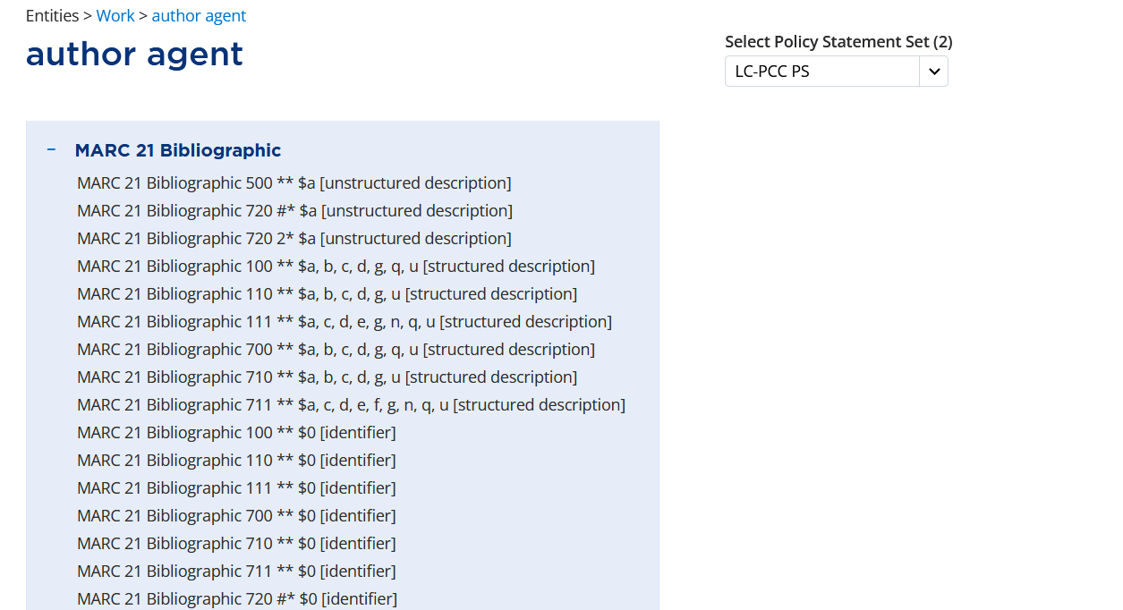
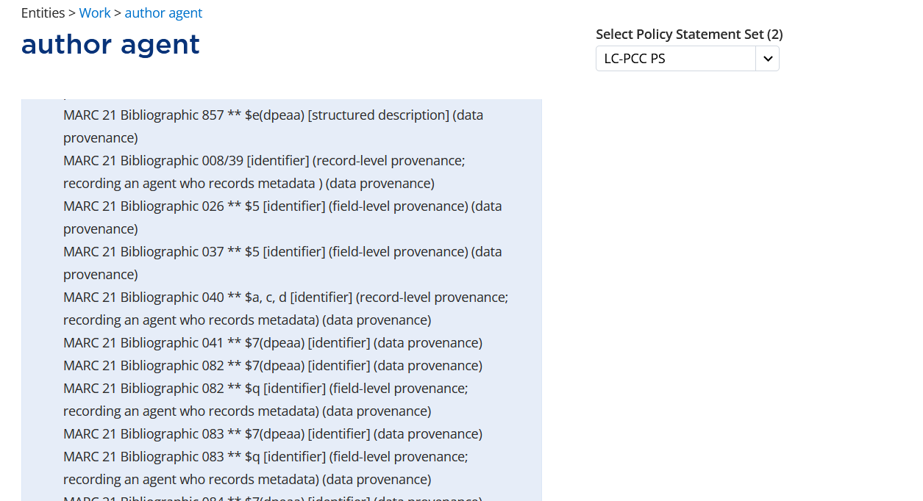
Notes:
When we look at the element author agent, we can expand the MARC 21 Bibliographic alignments by clicking on the plus sign. The alignments are arranged in MARC tag order based on the recording method; this is followed by the alignments for recording data provenance in MARC tag order based on recording method. If we scroll down, …
ADDITIONAL ALIGNMENTS AND RED BOX APPEAR ON CLICK
… we will eventually see that record-level data provenance for recording an agent who records metadata is recorded as an identifier in MARC bibliographic field 040, subfields $a, $c, and $d. Since this is a new record, we will only record subfields $a and $c.

Slide 11
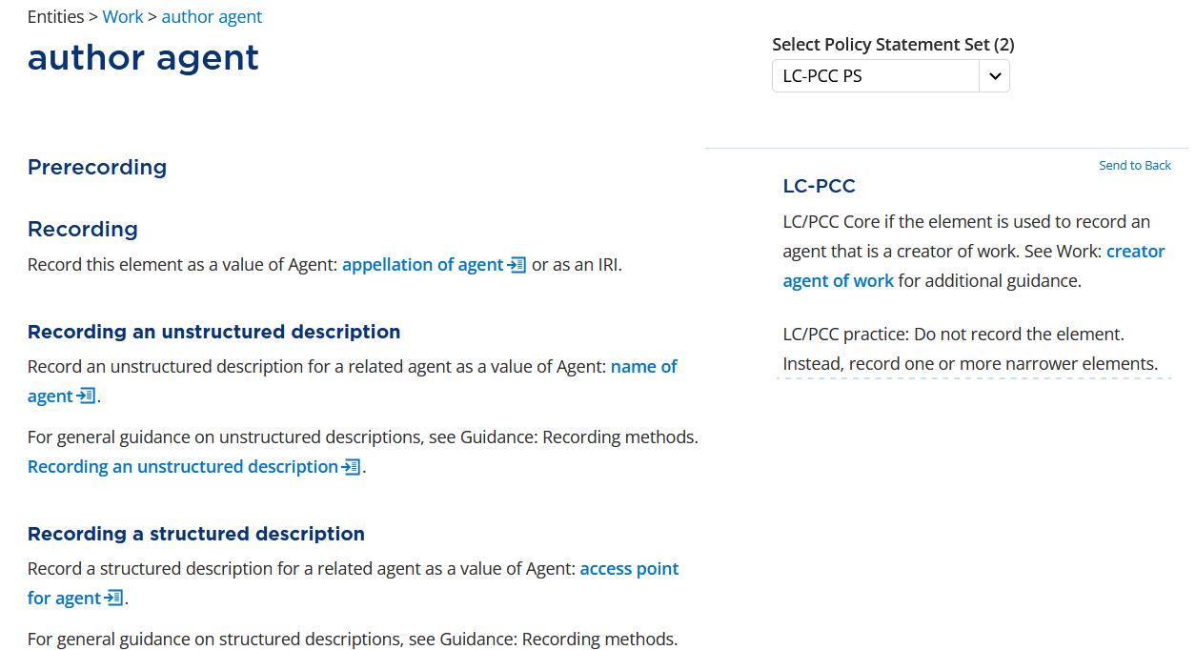
Notes:
Having confirmed the recording method (identifier) and MARC field and subfield (040 $a and $c), let’s focus on recording the value. If we scroll down to Prerecording, the LC-PCC PS tells us to not record the element author agent but to record a narrower element instead.

Slide 12
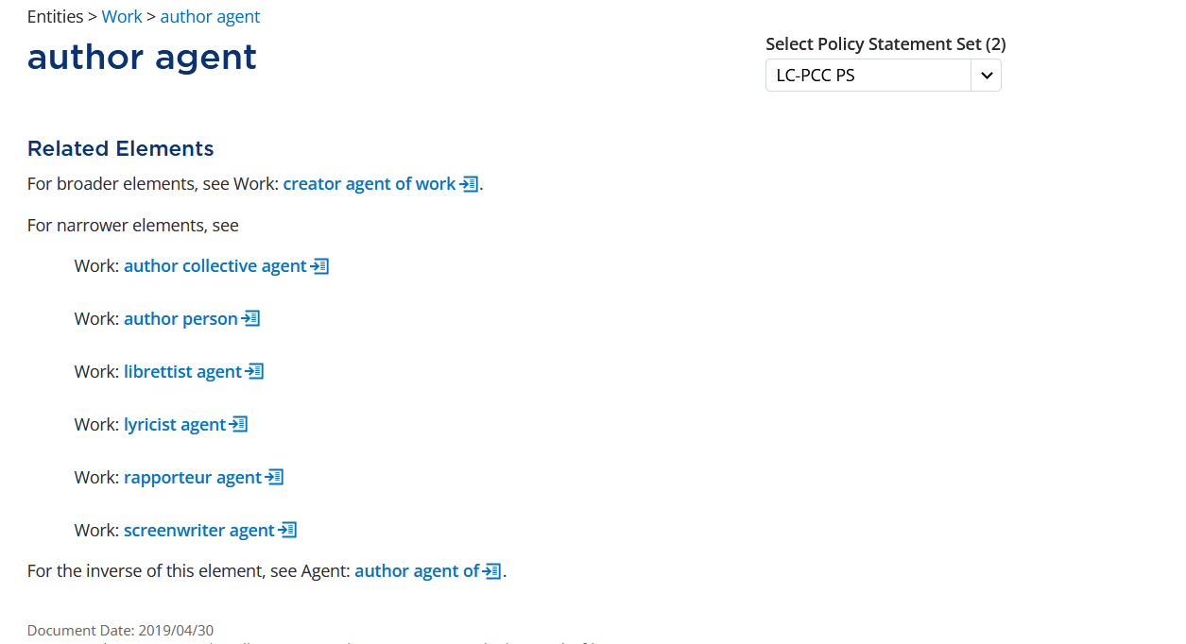
Notes:
Scrolling down to the Related Elements section, we see the narrower elements to consider, including author collective agent and author person. In MARC, the organization who recorded the metadata is recorded in the 040 field, so we will select author collective agent.

Slide 13
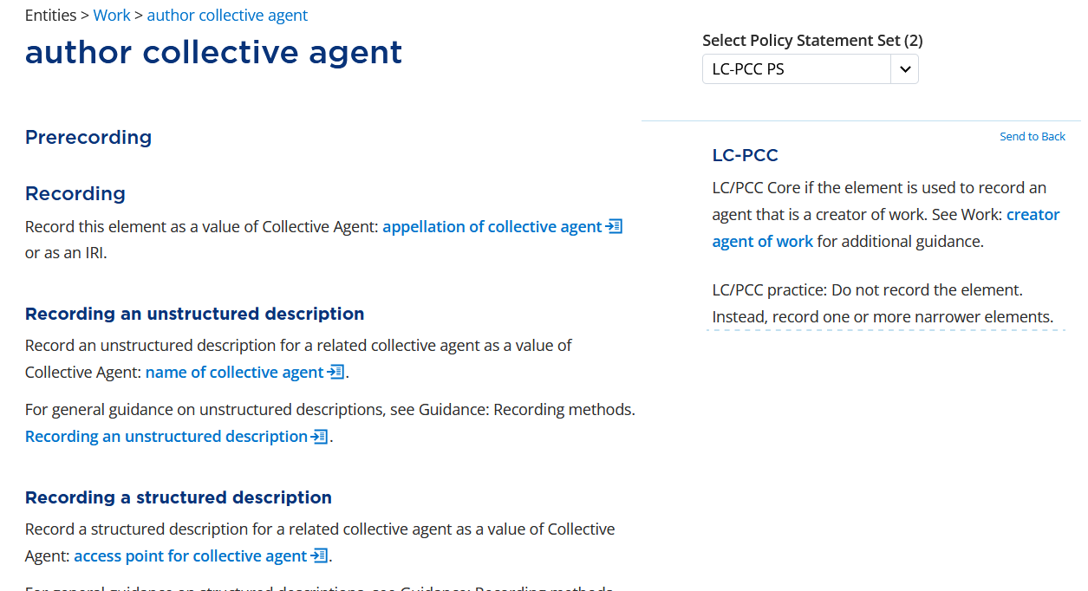
Notes:
If we scroll down to Prerecording, the LC-PCC PS tells us to not record the element author collective agent but to record a narrower element instead.

Slide 14
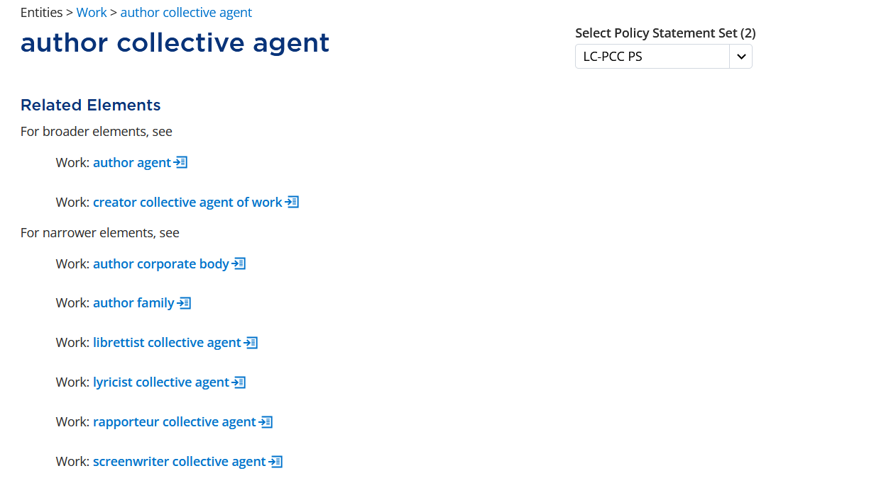
Notes:
Scrolling down to the Related Elements section, the narrower elements we will consider are author corporate body and author family. Since we will be recording the value for an organization, we will select author corporate body.

Slide 15
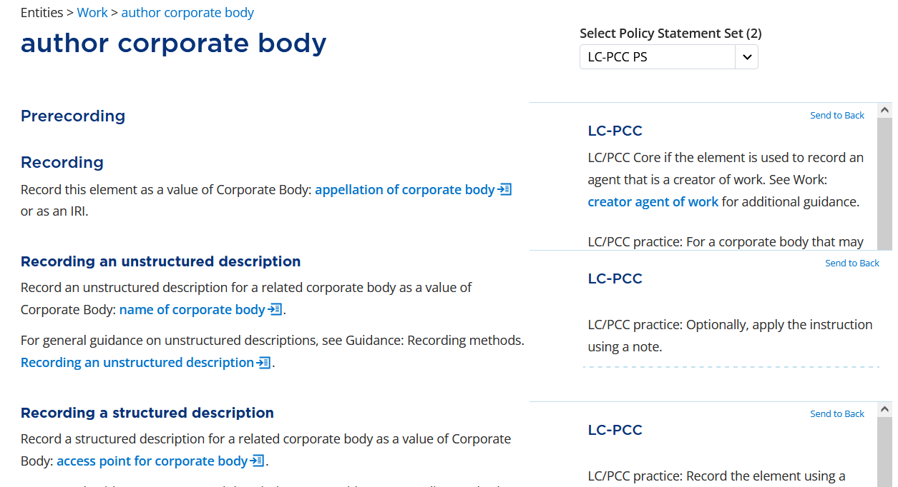
Notes:
The element page for author corporate body includes the basic instructions for recording a relationship element. Under Recording, the instruction tells us to “Record this element as a value of Corporate Body: appellation of corporate body or as an IRI.” An appellation of corporate body is either a name of corporate body, access point for corporate body, or identifier for corporate body depending on the recording method used. We have already determined that we want to record an identifier for corporate body.

Slide 16
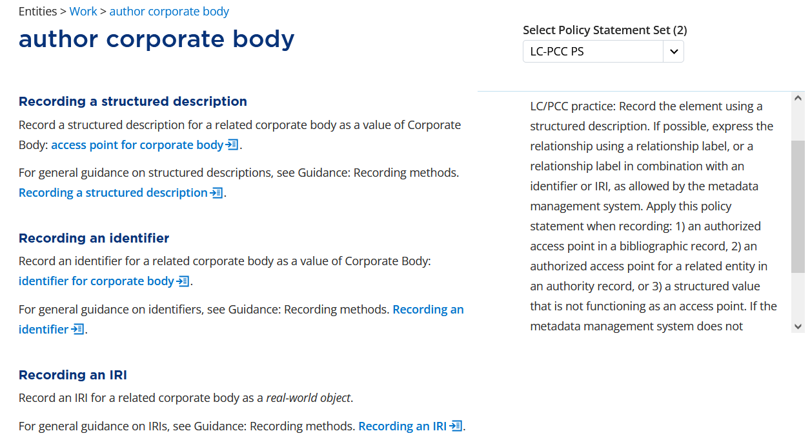
Notes:
If we review the LC-PCC PSs, there is a policy statement that says “LC/PCC practice: Record the element using a structured description. … Apply this policy statement when recording: 1) an authorized access point in a bibliographic record, 2) an authorized access point for a related entity in an authority record, or 3) a structured value that is not functioning as an access point.” This policy statement is not applied because we want to record an identifier not an authorized access point nor a structured value.

Slide 17
Notes:
To record a value for the element author corporate body as an identifier, we are instructed to “Record an identifier for a related corporate body as a value of Corporate Body: identifier for corporate body.”

Slide 18
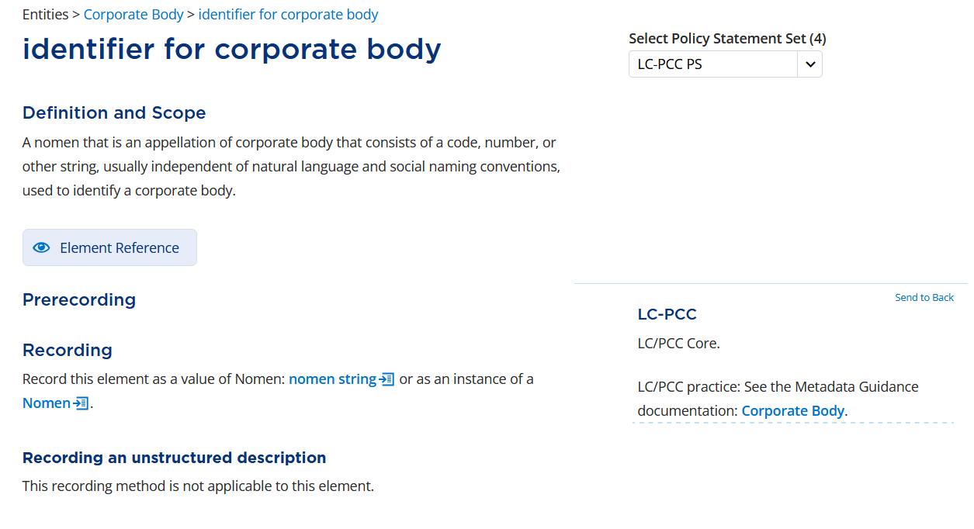
Notes:
The Definition and Scope of identifier for corporate body indicates that this is a code, number, or other string used to identify a corporate body. Since we are just looking for instructions on how to record an identifier for corporate body and not creating a description for a corporate body, we can ignore the LC/PCC Core requirement under Prerecording and just consider the instructions under Recording an identifier.

Slide 19
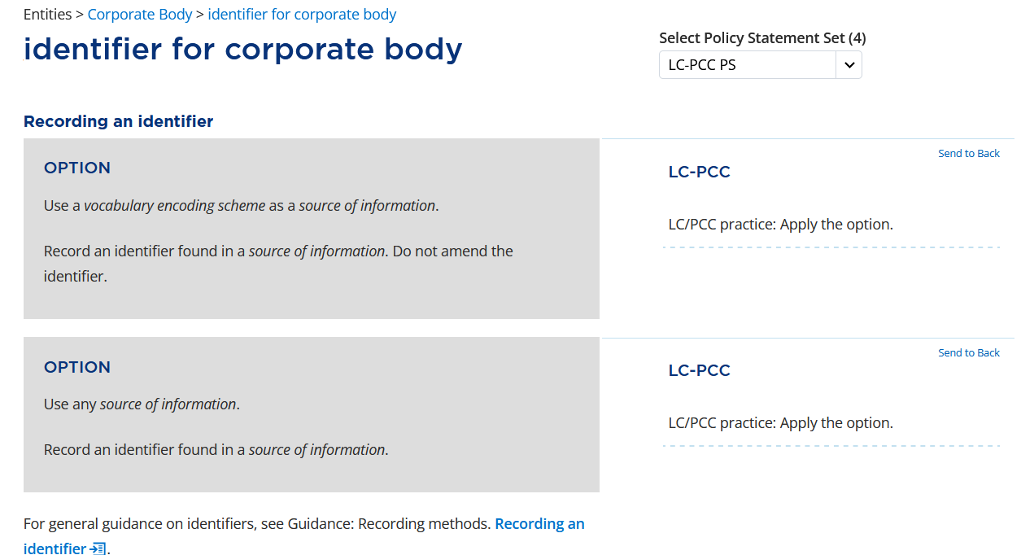
Notes:
There are two options under Recording an identifier. While the policy statement for both options is to “Apply the option”, we will only apply the first option to “Use a vocabulary encoding scheme as a source of information” because we will record an identifier using either the OCLC symbol or the MARC organization code of the cataloging institution. When recording the identifier, we record it as found in the source of information.

Slide 20
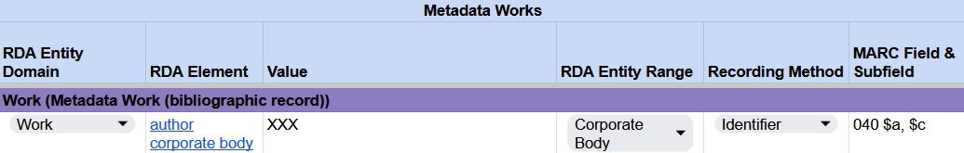
Recording an agent who records metadata
RDA Record Template
MARC 21 Bibliographic Record
Notes:
For the example, I will enter “XXX”, but you should enter your institution’s OCLC symbol or, if you are not an OCLC member institution, your MARC organization code. In MARC, this value will be recorded in field 040, subfields $a and $c. If editing an existing record, the value will be recorded in subfield $d.

Slide 21
Recording an agent who records metadata
The value may already be supplied by the system
  When creating a new record in OCLC Connexion, 040 subfields $a and $c already contain your institution’s OCLC symbol
  When replacing a WorldCat record, OCLC automatically adds your institution’s OCLC symbol in 040 subfield $d
If your institution records the name or initials of the cataloger who worked on the record, you may also have a value of Work: author person
There is no change to existing practice
Notes:
While we have reviewed all the instructions for recording a value for an agent who records metadata, that value may already be supplied by the system. For example, when creating a new record in OCLC Connexion, 040 subfields $a and $c already contain your institution’s OCLC symbol. When you replace a WorldCat record, OCLC automatically adds your institution’s OCLC symbol in 040 subfield $d.
Lastly, if your institution records the name or initials of the cataloger who worked on the record, you may also have a value of author person. This does not change any existing practices, it just provides a justification for recording that information in RDA.

Slide 22
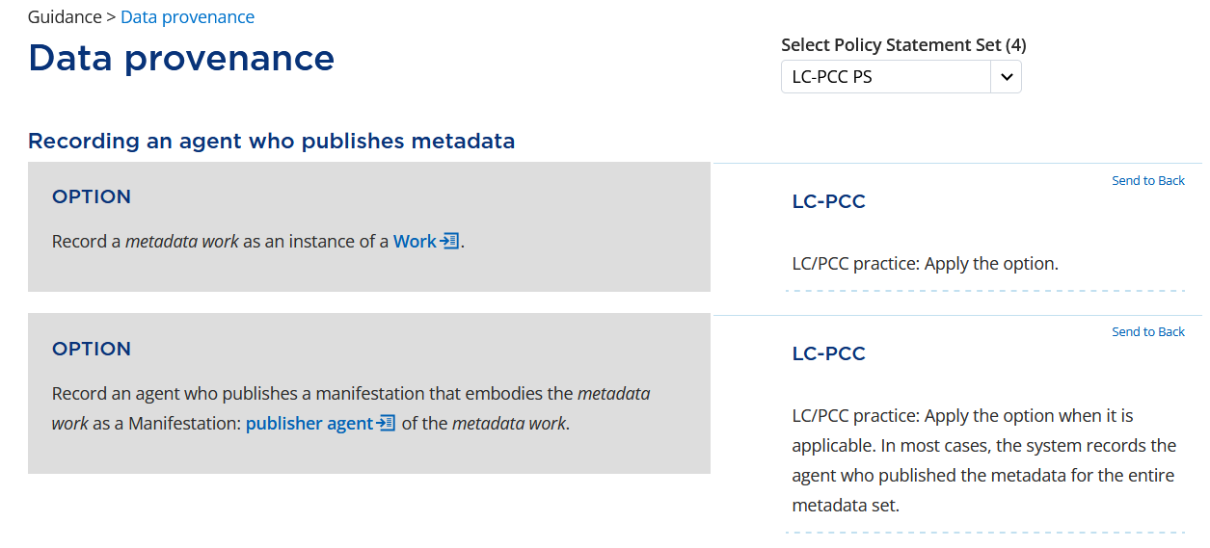
Notes:
Let’s go back to the Data provenance guidance chapter and look at the instructions under Recording an agent who publishes metadata.
Again, we will apply the option to “Record a metadata work as an instance of a Work.”
The second option is to “Record an agent who publishes a manifestation that embodies the metadata work as a Manifestation: publisher agent of the metadata work.” When a cataloger adds a record to WorldCat or replaces a WorldCat record, they are publishing a metadata work. We record the publisher of the metadata work using the Manifestation element publisher agent. When describing an entity, we typically only record elements with a domain that matches the entity being described; however, when describing a metadata work, we can use any appropriate RDA element and are not limited to just Work elements. According to the LC-PCC PS, this option is applied, but the value may be supplied by the system.

Slide 23
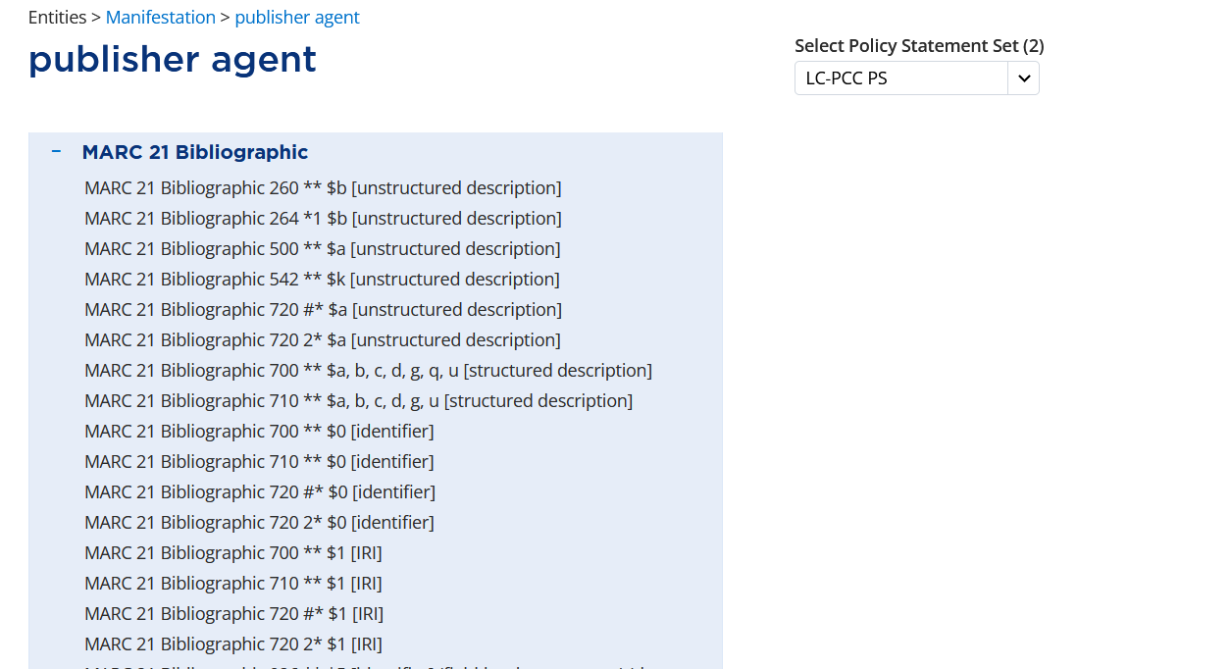
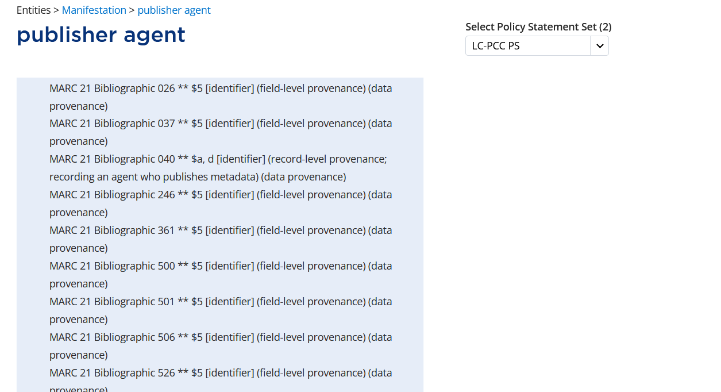
Notes:
On the publisher agent element page, we can expand the MARC 21 Bibliographic alignments to see the recording method and MARC fields to use.
ADDITIONAL ALIGNMENTS AND RED BOX APPEAR ON CLICK
To record record-level data provenance for an agent who publishes metadata, we record an identifier in MARC field 040, subfields $a or $d. This is the same field and subfields that are also used to record the agent who records the metadata. This is expected because the institution who creates or edits the record is also the one to publish the record.

Slide 24
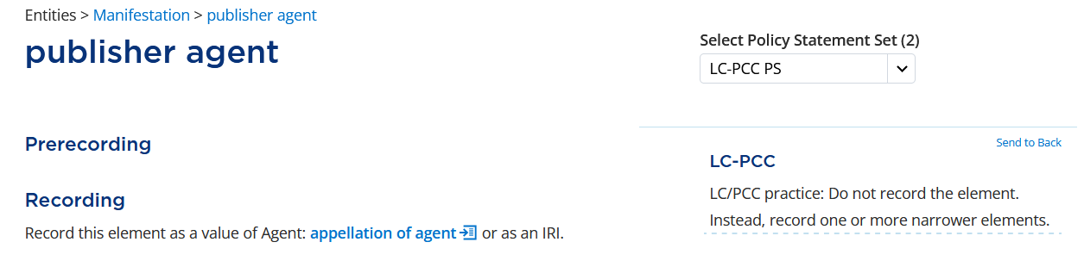
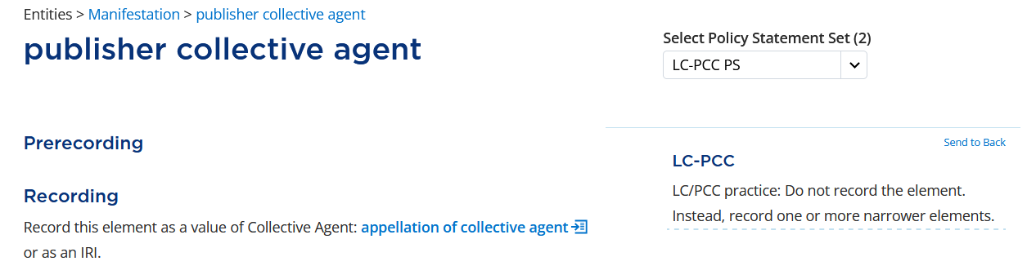
Notes:
While the element is different, the instructions for recording a publisher agent are exactly the same as recording an author agent. Instead of recording the broader elements publisher agent and publisher collective agent, …

Slide 25
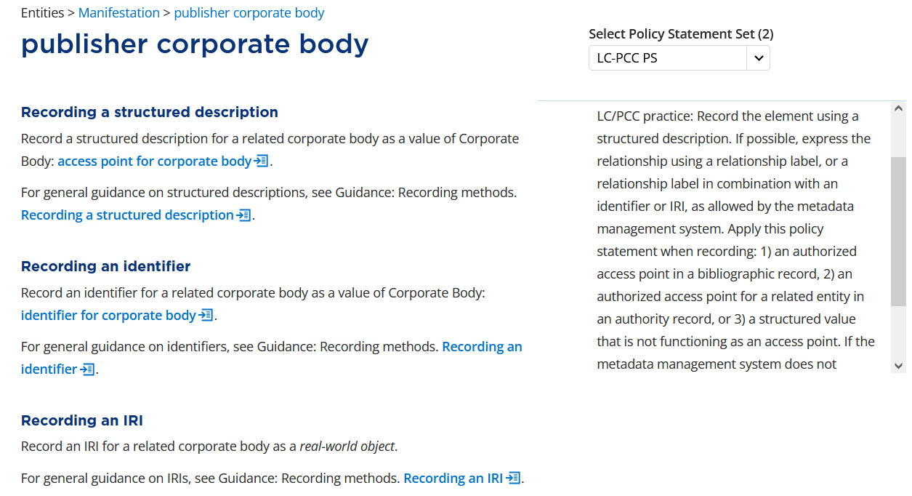
Notes:
… we record a value for publisher corporate body by recording an identifier for corporate body.

Slide 26
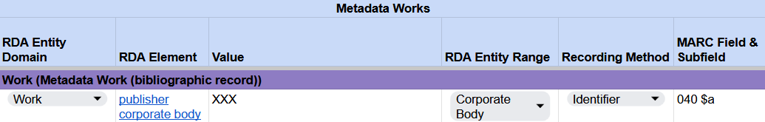
Recording an agent who publishes metadata
RDA Record Template
MARC 21 Bibliographic Record
Notes:
Again, the identifier will be either your institution’s OCLC symbol or MARC organization code. This value is already recorded in field 040 subfield $a in our MARC record and doesn’t need to be recorded separately since the value in MARC represents both the author and the publisher.

Slide 27
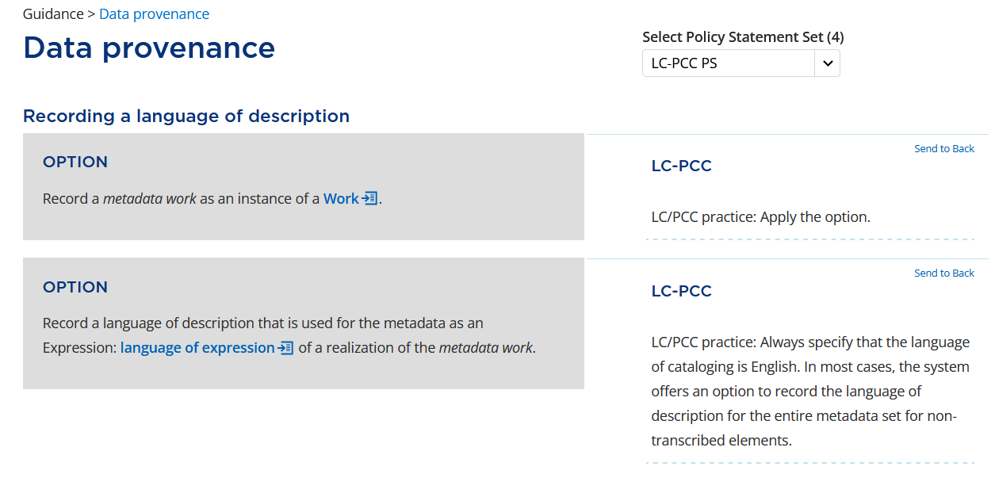
Notes:
Going back to the Data provenance guidance chapter, let’s now look at the instructions under Recording a language of description.
Again, we apply the option to “Record a metadata work as an instance of a Work.”
The second option says to “Record a language of description that is used for the metadata as an Expression: language of expression of a realization of the metadata work.” This means that we can use the element language of expression to record the language of cataloging. The LC-PCC PS says to “Always specify that the language of cataloging is English. In most cases, the system offers an option to record the language of description for the entire metadata set for non-transcribed elements.” Let’s look at the element language of expression to see how we need to record that the language of cataloging is English.

Slide 28
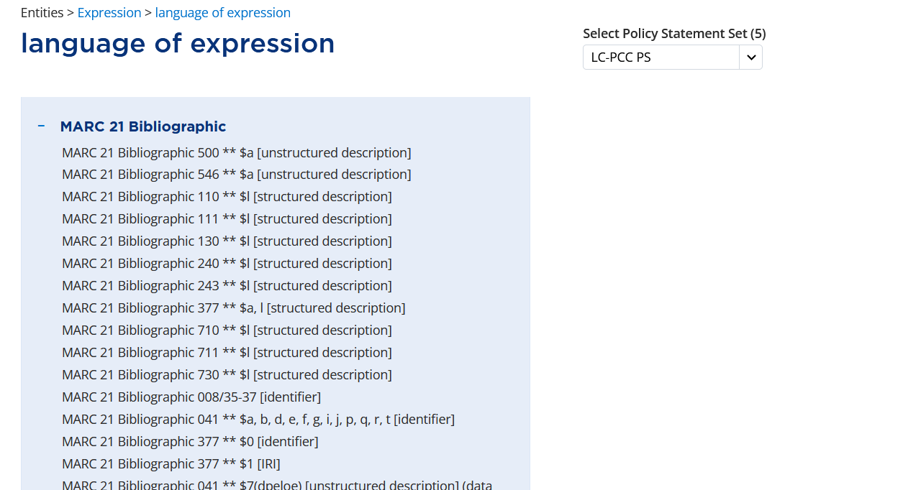
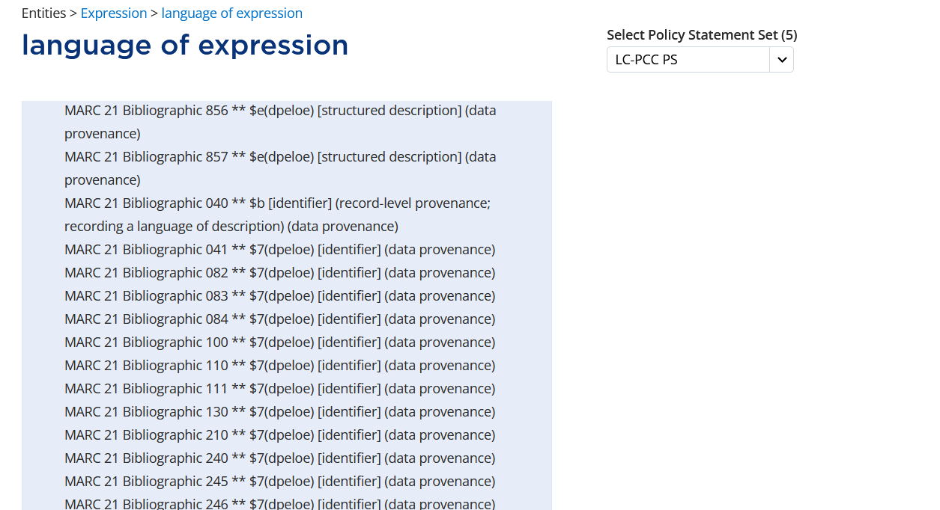
Notes:
On the language of expression element page, we can expand the MARC 21 Bibliographic alignments …
ADDITIONAL ALIGNMENTS AND RED BOX APPEAR ON CLICK
… to see that record-level data provenance for recording a language of description is recorded as an identifier in MARC field 040 subfield $b, just as we would expect.

Slide 29
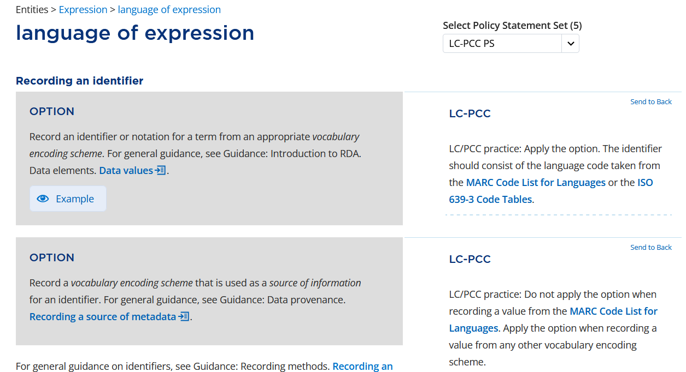
Notes:
Scrolling down to the section Recording an identifier, the first option is to “Record an identifier or notation for a term from an appropriate vocabulary encoding scheme.” The LC-PCC PS says to “Apply the option. The identifier should consist of the language code taken from the MARC Code List for Languages or the ISO 639-3 Code Tables.” We will record the language code from the MARC Code List for Languages.

Slide 30
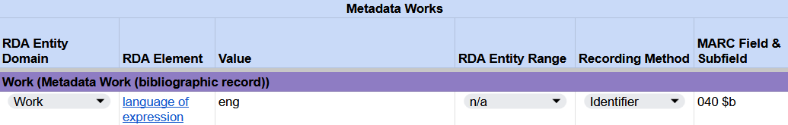
Recording a language of description
RDA Record Template
MARC 21 Bibliographic Record
Notes:
The MARC language code for English is eng, which is recorded in our RDA template and MARC field 040 subfield $b.

Slide 31
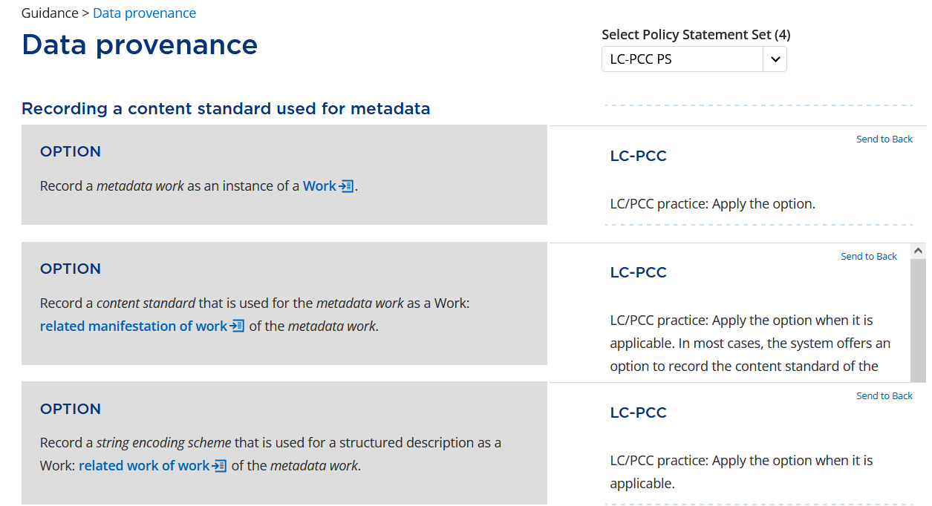
Notes:
Let’s go back for a final time to the Data provenance guidance chapter. This time, we will look at the instructions under Recording a content standard used for metadata.
As always, we will apply the option to “Record a metadata work as an instance of a Work.”
The second option says to “Record a content standard that is used for the metadata work as a Work: related manifestation of work of the metadata work.” The term “content standard” appears in italics, indicating it has a specific meaning in RDA, and it should be included in the RDA Glossary, so let’s look up what it means.

Slide 32
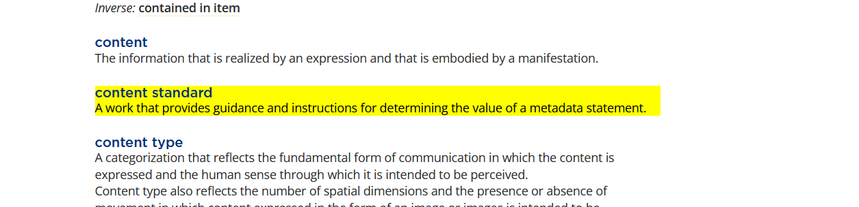
Content standards used while cataloging
RDA
PCC application profile (including BSR, LC-PCC PS, MGDs)
Provider-neutral guidelines
Notes:
Content standard is defined in the Glossary as “A work that provides guidance and instructions for determining the value of a metadata statement.” As we were determining values for all of the metadata statements, we applied guidance and instructions from RDA, the PCC application profile (including the draft BSR, LC-PCC Policy Statements, and Metadata Guidance Documentation), as well as the Provider-Neutral Guidelines.

Slide 33
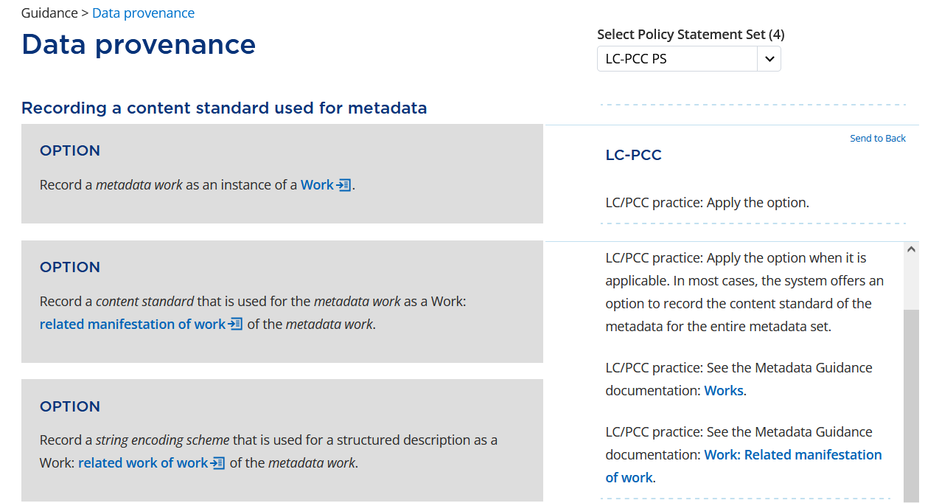
Notes:
Let’s go back to the option to “Record a content standard ….”This option tells us to use the element related manifestation of work to record the content standard, that is, the guidelines and instructions we used for the metadata. The LC-PCC PS says to apply the option and notes that the value may be supplied by the system. The LC-PCC PS also includes links to the Works narrative MGD and the related manifestation of work MGD. For now, let’s click on the link to open the related manifestation of work MGD, but we will review the rest of the RDA instructions before we look at it.

Slide 34
Notes:
The third option to “Record a string encoding scheme that is used for a structured description as a Work: related work of work of the metadata work.” is not applicable when considering the entire metadata description set and is, therefore, not applied.

Slide 35
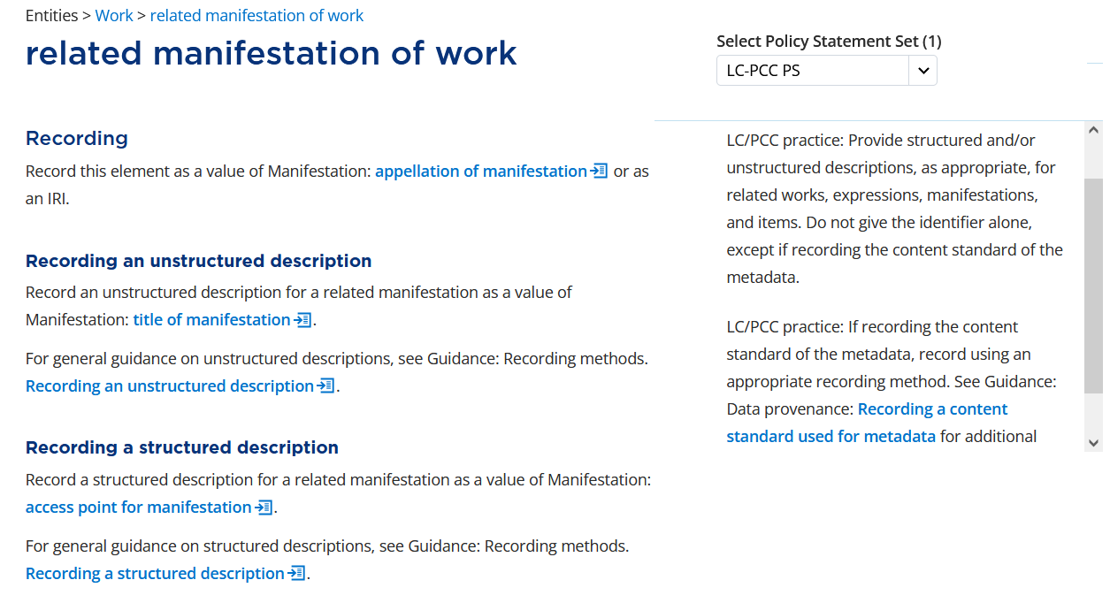
Notes:
If we look at the element related manifestation of work, the LC-PCC PS for Recording says to “Provide structured and/or unstructured descriptions, as appropriate, for related works, expressions, manifestations, and items. Do not give the identifier alone, except if recording the content standard of the metadata. … If recording the content standard of the metadata, record using an appropriate recording method.” We will record the content standard of the metadata using an identifier for manifestation.

Slide 36
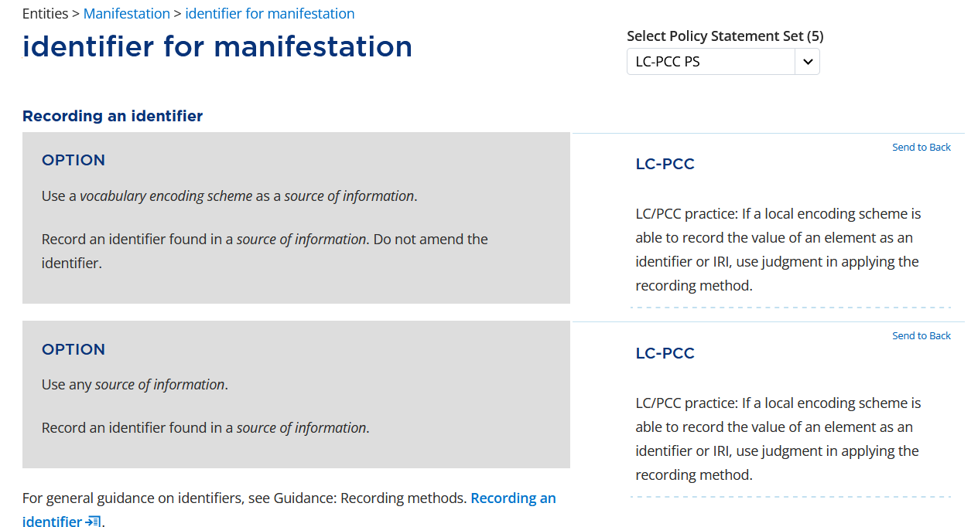
Notes:
There are numerous instructions for recording an identifier for manifestation, but the one that is applicable in our case is the first option under Recording an identifier, which says to “Use a vocabulary encoding scheme as a source of information.”

Slide 37
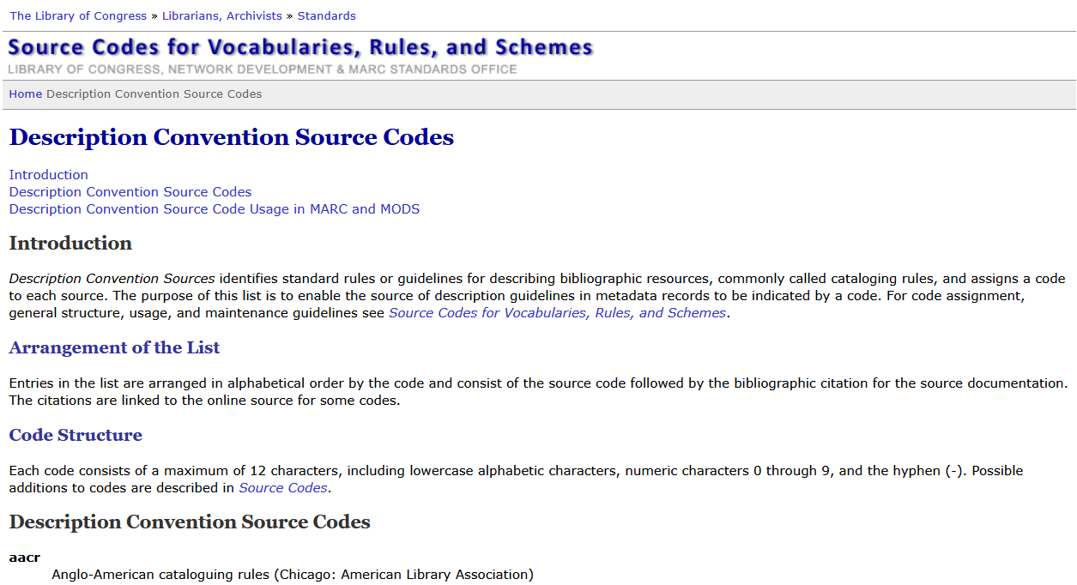
Notes:
We will record codes from the Description Convention Source Codes list (https://www.loc.gov/standards/sourcelist/descriptive-conventions.html).

Slide 38
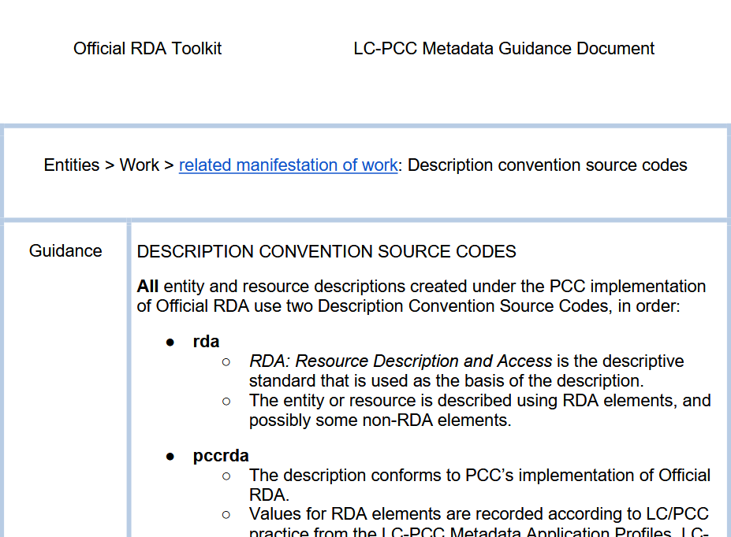
Notes:
With that background information, let’s look at the MGD for related manifestation of work, which is specifically for Description convention source codes.

Slide 39
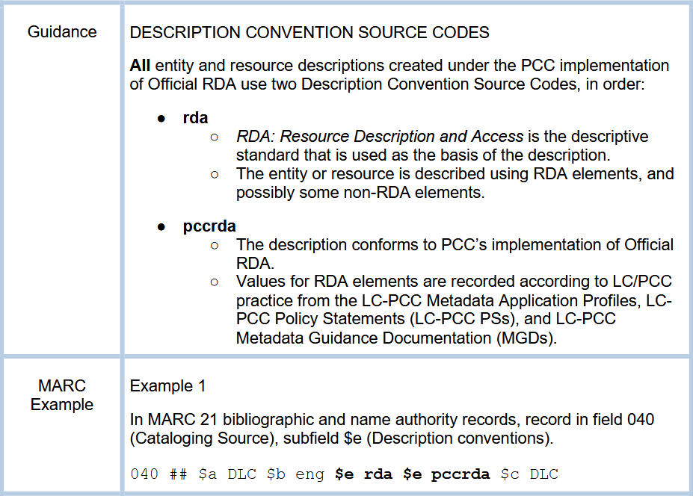
Notes:
First, all entity and resource descriptions created under the PCC implementation of official RDA use two Description Convention Source Codes, rda and pccrda, in that order. The code rda represents the RDA descriptive standard that is used as the basis of the description. The same code is used for both original RDA and official RDA. The code pccrda indicates that the description conforms to PCC’s implementation of official RDA and the values are recorded according to LC/PCC practice from the LC-PCC Metadata Application Profiles, LC-PCC Policy Statements, and LC-PCC Metadata Guidance Documentation. The code pccrda can be used to identify official RDA records, but only if they conform to LC/PCC practice. The codes are recorded in MARC field 040 subfield $e, which is repeated for each code.

Slide 40
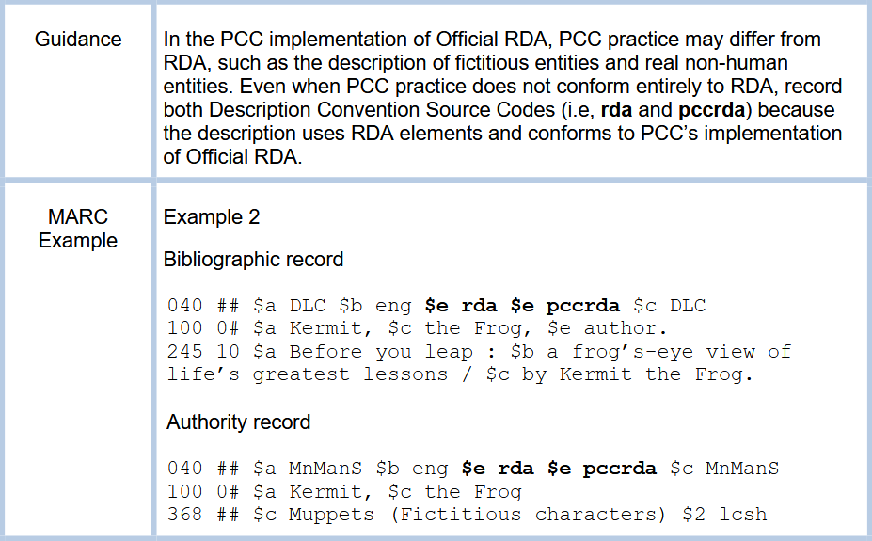
Notes:
In the PCC implementation of official RDA, PCC practice may differ from RDA, such as the description of fictitious entities and real non-human entities. Even when PCC practice does not conform entirely to RDA, record both Description Convention Source Codes (i.e., rda and pccrda) because the description uses RDA elements and conforms to PCC’s implementation of official RDA.

Slide 41
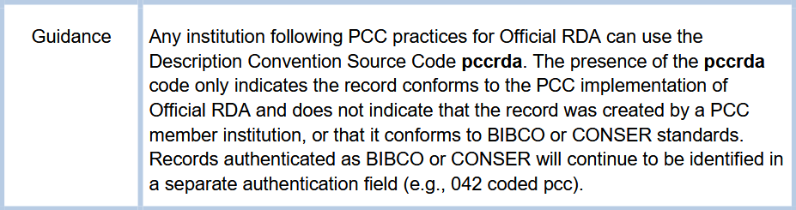
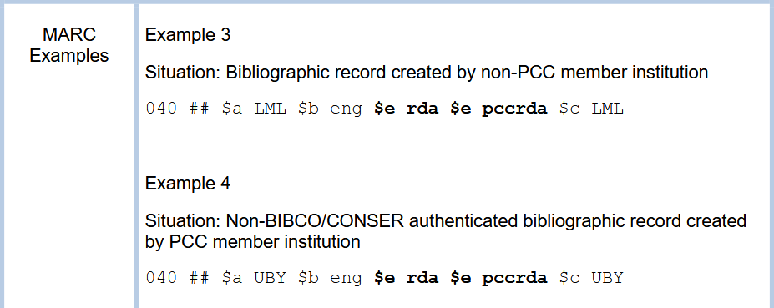
Notes:
Any institution following PCC practices for official RDA can use the Description Convention Source Code pccrda. The presence of the pccrda code only indicates the record conforms to the PCC implementation of official RDA and does not indicate that the record was created by a PCC member institution, or that it conforms to BIBCO or CONSER standards. Records authenticated as BIBCO or CONSER will continue to be identified in a separate authentication field (e.g., 042 coded pcc). In our example today, we are coding the record as following PCC practices but are not authenticating it as BIBCO.

Slide 42
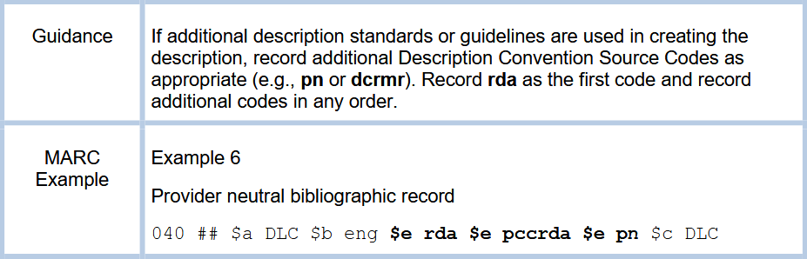
Notes:
If additional description standards or guidelines are used in creating the description, record additional Description Convention Source Codes as appropriate. Record rda as the first code and record additional codes in any order.

Slide 43
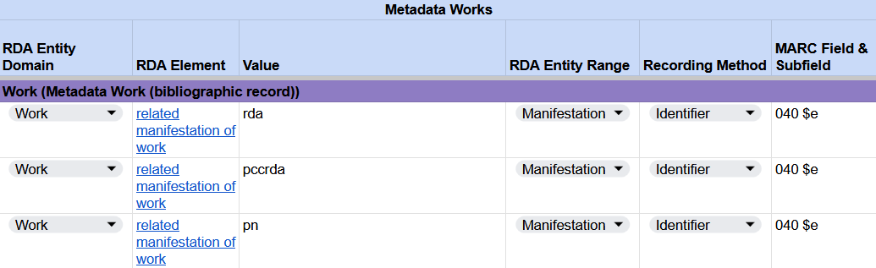
Recording a content standard used for metadata
RDA Record Template
MARC 21 Bibliographic Record
Notes:
Because our description uses RDA elements, conforms to PCC’s implementation of official RDA, and adheres to the Provider-Neutral Guidelines, we will record the codes rda, pccrda, and pn.
This concludes recording data provenance in MARC field 040. While the only difference in practice is the addition of subfield $e pccrda, the concept of recording data provenance is new in official RDA.

Slide 44
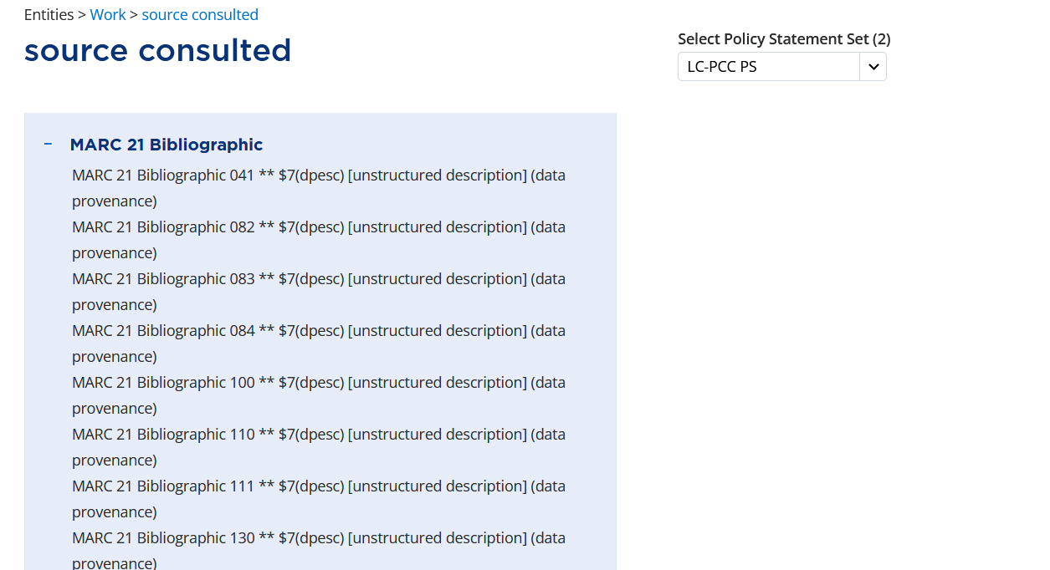
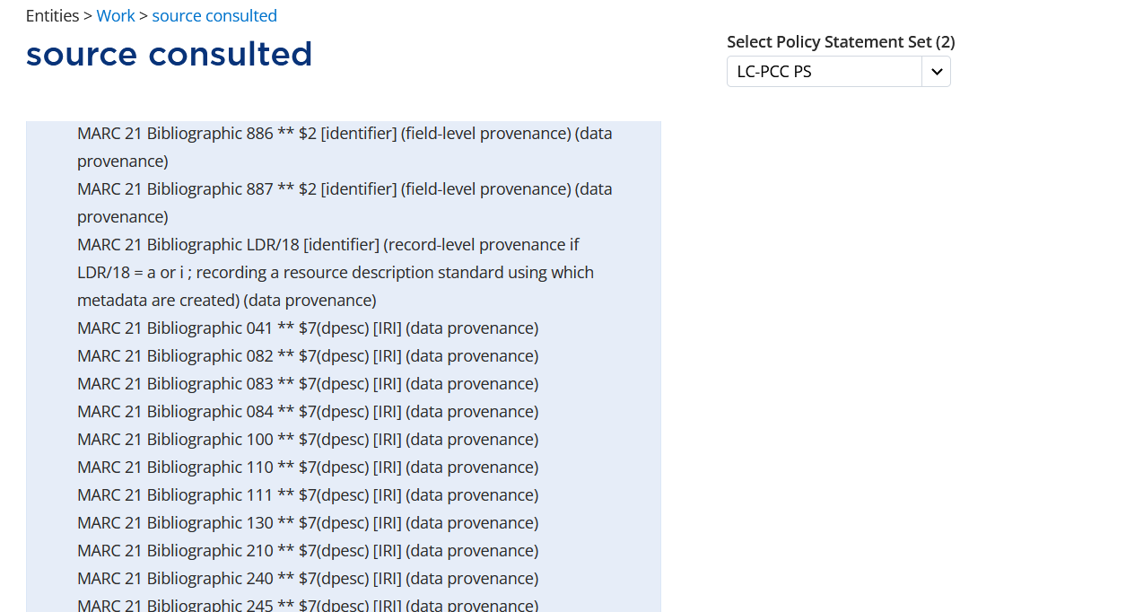
Notes:
Related to the content standard is recording MARC leader position 18, Descriptive cataloging form. This corresponds to the RDA element source consulted, which is a narrower element of related manifestation of work. The MARC 21 bibliographic alignment …
ADDITIONAL ALIGNMENTS AND RED BOX APPEAR ON CLICK
… indicates that leader position 18 is recorded as an identifier for record-level data provenance.

Slide 45
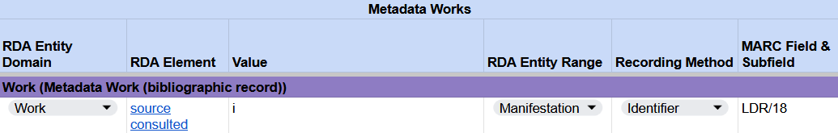

Recording a content standard used for metadata
RDA Record Template
MARC 21 Bibliographic Record
Notes:
We will code this as i - ISBD punctuation included.

Slide 46
Cataloging an eBook
Recording non-RDA &
MARC DATA

Slide 47
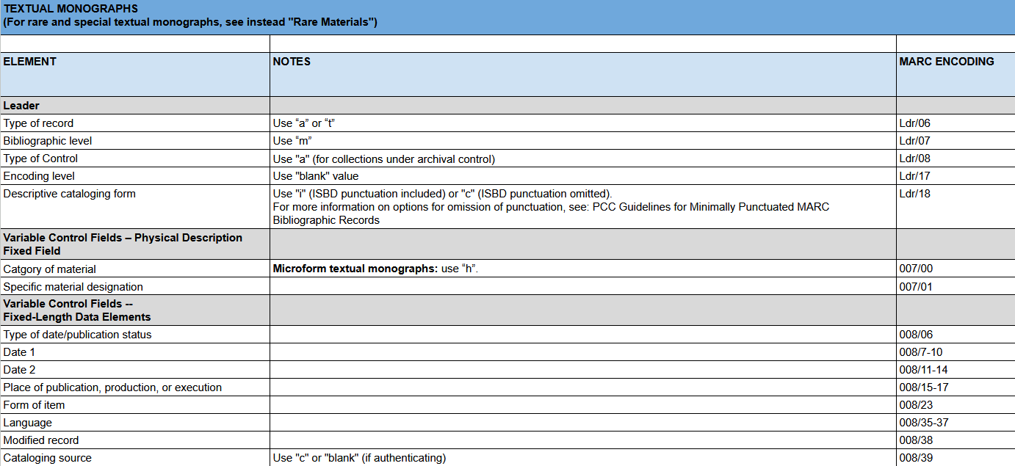
Notes:
To complete our MARC bibliographic record, there are some fields that are regularly recorded but for which there is not a corresponding RDA element. We can review these and other MARC fields in the Required Non-RDA & MARC Data tab of the draft BSR.
Type of record (LDR/06) is coded a - Language material
Bibliographic level (LDR/07) is coded m - Monograph/Item
Encoding level (LDR/17) is coded blank - Full level
Descriptive cataloging form (LDR/18) is already coded i - ISBD punctuation included
Type of date/Publication status (008/06) is coded s - Single known/probable date
Date, Place of publication, Form of item, and Language have corresponding RDA elements and have already been recorded
Cataloging source (008/39) is coded d - Other since we are not authenticating as BIBCO
Language of cataloging (040 $b) and Description conventions (040 $e) have already been recorded but there is guidance in the BSR

Slide 48
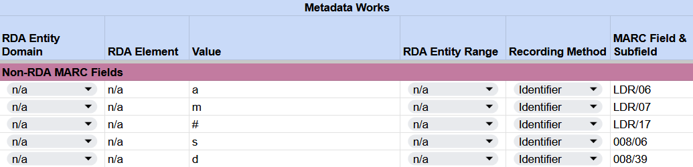
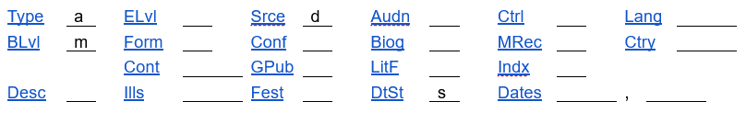
Recording non-RDA MARC Fields
RDA Record Template
MARC 21 Bibliographic Record

