Slide 1
Cataloging an eBook
Describing an Aggregated Work & Aggregated Expression

Slide 2
RDA Copyright
©2010-2025 - American Library Association, Canadian Federation of Library Associations, and CILIP: Chartered Institute of Library and Information Professionals.
Screen images from the RDA Toolkit (www.rdatoolkit.org) used by permission of the Copyright Holders for RDA (American Library Association, Canadian Federation of Library Associations, and CILIP: Chartered Institute of Library and Information Professionals).

Slide 3
Minimum Description of Collection Aggregate
Aggregated Work
Aggregating Work
has authorized access point for work Hamiltonian systems
has expression of work Hamiltonian systems
Aggregated Expression
Aggregating Expression
has authorized access point for expression Hamiltonian systems
has work expressed Hamiltonian systems
has manifestation of expression Hamiltonian systems
Manifestation
has title proper Hamiltonian systems
has expression manifested Hamiltonian systems
Notes:
As part of our description of our collection aggregate, we have described the manifestation, as well as the plan to select and arrange expressions in the aggregating expression and aggregating work. We are now going to describe an aggregated expression and aggregated work, which is one of the expressions and works embodied in the aggregate manifestation.

Slide 4
expression manifested

Slide 5
expression manifested (aggregated expression)
BSR: PCC Core element for Collection Aggregates
LC/PCC PS: LC/PCC Core for collection and parallel aggregates. … For a collection aggregate, record the first or predominant expression. Record other expressions according to judgment. It is not necessary to identify expressions in anthologies of poetry, hymnals, conference proceedings, journals, collections of interviews or letters, and similar resources.

Slide 6

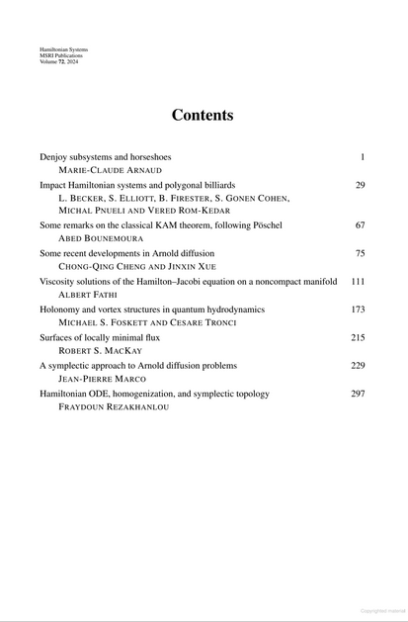
Hamiltonian systems is a collection aggregate
Notes:
Hamiltonian systems is a collection aggregate—it is a compilation of articles. So the BSR and PS apply: Expression manifested is a core element and we are at a minimum to record the first expression, here, the article by Marie-Claire Arnaud.

Slide 7
Expression manifested
Entities > Manifestation > expression manifested
Definition: An expression that is embodied by a manifestation.
  The article by Marie-Claire Arnaud is an example of an expression that is embodied by a manifestation.
Recording: Record this element as a value of Expression: appellation of expression or as an IRI.

Slide 8
Appellation of expression
Entities > Expression > appellation of expression
Definition: A nomen that is used within a given scheme or context to refer to an expression.
Recording: Record this element as a value of Nomen: nomen string or as an instance of a Nomen.
Recording a structured description: Record a structured description as a value of Expression: access point for expression

Slide 9
Access point for expression
Entities > Expression > access point for expression
Definition: A nomen that is an appellation of expression in natural language that is taken from a vocabulary encoding scheme or is constructed using a string encoding scheme.
Prerecording: An access point may be categorized as: Expression: authorized access point for expression …
  Because we are working in a bibliographic record, we will be recording an authorized access point for the expression, not a variant access point.
Notes:
Explain String encoding scheme if it hasn’t already been explained
Please go to Authorized access point for expression now.

Slide 10
Authorized access point for expression
Entities > Expression > authorized access point for expression
Definition: A nomen that is an access point of expression that is selected for preference in a specific vocabulary encoding scheme.
  Our specific vocabulary encoding scheme is the LC/NACO AF or LCSH
Recording a structured description.
  Option 1 tells us to use an authorized access point found in the LC/NACO AF
  Option 2 tells that if no AAP is found, to establish an AAP for the expression and then use it in the bibliographic record
  Option 3 tells us to follow PCC’s string encoding scheme while creating the AAP

Slide 11
Creating an authorized access point for expression
Entities > Expression > authorized access point for expression
Recording a structured description
  Base authorized access point for expression
    2 options. PS says not to apply the first (preferred title of expression), but to apply the second:
    Use a value of Work: authorized access point for work for the work that is realized by an expression to form a base access point.
    We are told to format the base following Expression: access point for expression. Format of base access points for expression.

Slide 12
Expression: access point for expression. Format of base access points for expression.
Entities > Expression > access point for expression
Format of base access points for expression.
  Record a title in direct order with no amendments.
  In other words, do not change the authorized access point for the work in any way.

Slide 13
Creating an authorized access point for expression
Entities > Expression > authorized access point for expression
Recording a structured description
  Additional elements and designations in authorized access points for expression
    Include values for other elements or designations in an access point if required:
    to distinguish the access point from a value of an access point for another entity
    to assist in the identification of the entity
    to conform to a string encoding scheme
    Apply the general instructions at Expression: access point for expression. Additional elements and designations in access points for expression

Slide 14
Access point for expression. Additional elements and designations in access points for expression
Entities > Expression > access point for expression
  The additional elements mentioned on the previous slide are:
    Content type
    Date of expression
    Designation of version
    Language of expression
    Any other designation that is a distinguishing characteristic of the expression that serves to differentiate the expression from another expression of the same work.

Slide 15
Building the access point for expression manifested
Based on Entities > Expression > authorized access point for expression (seen above), we first look in the NAF to see if an AAP has already been established. We know we’re looking for an AAP for a work, so it will begin with the AAP for the author, Marie-Claude Arnaud.

Slide 16
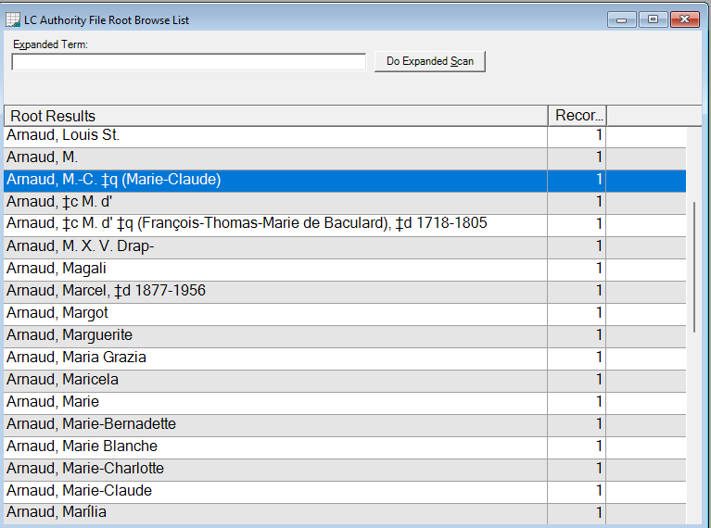
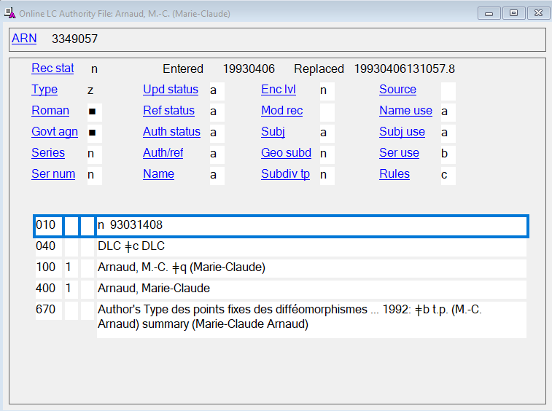
AAP for author
Notes:
This author does have an AAP, but we can see from the number of records (1) there are no work authority records related to her.

Slide 17
Building the access point for expression manifested
Based on Entities > Expression > authorized access point for expression (seen above), we first look in the NAF to see if an AAP has already been established. We know we’re looking for an AAP for a work, so it will begin with the AAP for the author, Marie-Claude Arnaud.
    Arnaud, M.-C. (Marie-Claude)
We found an AAP for the author, but no AAP for the work which will be the base for the AAP for the expression. So, we need to go with option 2, establish the AAP ourselves. We’ll start with the AAP for the work.

Slide 18
Authorized access point for work
Entities > Work > authorized access point for work
Definition: A nomen that is an access point of work that is selected for preference in a specific vocabulary encoding scheme (e.g., the NAF)
Recording a structured description
  Use a form already established (there isn’t one)
  Establish an AAP for the work and then use it in the bibliographic record (PS)

Slide 19
Authorized access point for work
Entities > Work > authorized access point for work
Base authorized access point for work
  Use a value of Work: preferred title of work to form a base access point.

Slide 20
Preferred title of work
Entities > Work > preferred title of work
Definition: A nomen that is a title of work that is selected for preference in a specific application or context.
Recording an unstructured description
  Option 1. Record a value of Work: title of work – yes, but which title?
  Option 2. Record a value that appears most frequently in sources of information.
In the case of our work the only form that appears is:
    Denjoy subsystems and horseshoes
So that is the preferred title

Slide 21
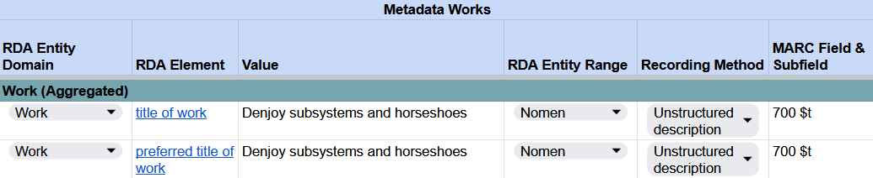
Recording title of work & preferred title of work
RDA Record Template
Notes:
For the aggregated work, record title of work and preferred title of work in the RDA Record Template.

Slide 22
Authorized access point for work
Entities > Work > authorized access point for work
Base authorized access point for work
  Use a value of Work: preferred title of work to form a base access point.
      Denjoy subsystems and horseshoes

Slide 23
Authorized access point for work
Entities > Work > authorized access point for work
Additional elements and designations in authorized access points for work
Additional elements for creator of work
  Use a value of Agent: authorized access point for agent as a qualifier for an access point.
Oh, really? How do we do this? As a parenthetical qualifier? No, see the PS:

Slide 24
PS for Entities > Work > authorized access point for work. Additional elements for creator of work
LC/PCC practice: Do not apply the option. Construct the authorized access point for work by combining Agent: authorized access point for agent, followed by a period, space, followed Work: preferred title of work.
We have enough information now to create the authorized access point for the work, following the PS instructions:
AAP for agent: Arnaud, M.-C. (Marie-Claude)
Preferred title of work: Denjoy subsystems and horseshoes
AAP for work: Arnaud, M.-C. (Marie-Claude). Denjoy subsystems and horseshoes

Slide 25
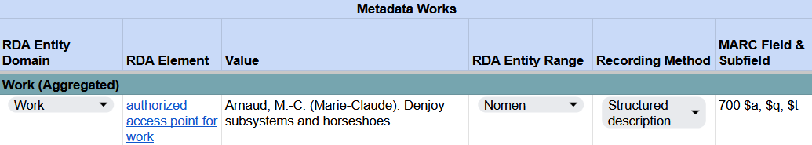
Recording authorized access point for work
RDA Record Template
Notes:
In our RDA Record Template, record authorized access point for work.

Slide 26
Authorized Access Point for Expression
Entities > Expression > authorized access point for expression
Base = Authorized access point for work
  Arnaud, M.-C. (Marie-Claude). Denjoy subsystems and horseshoes
Add to the base, as necessary:
    Content type
    Date of expression
    Designation of version
    Language of expression
    Any other designation that is a distinguishing characteristic of the expression that serves to differentiate the expression from another expression of the same work.

Slide 27
Authorized access point for expression
Possibilities:
  Arnaud, M.-C. (Marie-Claude). Denjoy subsystems and horseshoes. Text
  Arnaud, M.-C. (Marie-Claude). Denjoy subsystems and horseshoes. English
  Arnaud, M.-C. (Marie-Claude). Denjoy subsystems and horseshoes. 2024
  Etc.
  BUT …

Slide 28
PS and MGD for expression manifested
Guidance > Resource description > Describing a manifestation
  Describing a manifestation that embodies two or more expressions
    Relate the manifestation separately to one or more of the expressions that are aggregated using Manifestation: expression manifested
    LC/PCC practice for a collection aggregate: Identify the first or predominant expression. Record other expressions according to judgment.
    BUT SEE: MGD on Entities > Expression > authorized access point for expression > Additional elements and designations in authorized access points for expression
Notes:
https://www.loc.gov/aba/rda/mgd/expression/mg-e-authorizedAccessPointForExpression-01.pdf

Slide 29
MGD Entities > Expression > authorized access point for expression > Additional elements and designations in authorized access points for expression
PCC practice: PCC catalogers may record an authorized access point for work as an authorized access point for expression for any expression in the work's original language. However, they may distinguish between expressions in the original language if they judge it would be useful (e.g., in premodern literatures where there are often many different editions or versions in the original language).
In other words, authorized access point for work MAY stand for an authorized access point for an expression in the original language. However, PCC catalogers may instead record a real authorized access point for the expression, even for original language expressions.
Notes:
https://www.loc.gov/aba/rda/mgd/expression/mg-e-authorizedAccessPointForExpression-01.pdf

Slide 30
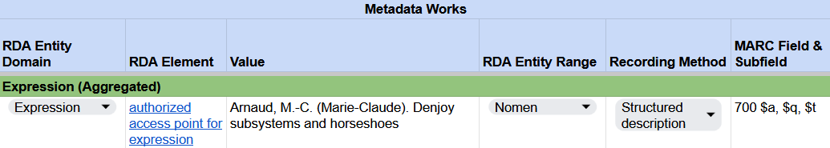
Recording authorized access point for expression
RDA Record Template
Or you may record an AAP for the expression with additional elements and designations, however you decide to establish it, e.g.,
Arnaud, M.-C. (Marie-Claude). Denjoy subsystems and horseshoes. English
Notes:
In our RDA Record Template, record the authorized access point for expression for the aggregated expression.

Slide 31
Value for expression manifested element
Record the AAP for the expression as the value for the expression manifested element
Arnaud, M.-C. (Marie-Claude). Denjoy subsystems and horseshoes
Or
Arnaud, M.-C. (Marie-Claude). Denjoy subsystems and horseshoes. English

Slide 32
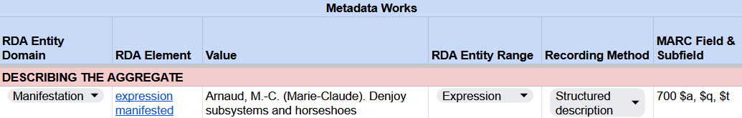
Recording expression manifested
RDA Record Template
MARC 21 Bibliographic Record
Notes:
The element expression manifested relates the manifestation to an expression, in this case an aggregated expression. In our RDA Record Template, under Describing the aggregate, record the expression manifested using the authorized access point for expression we just recorded.
In MARC, this is recorded as an analytical authorzied access point in field 700.

Slide 33
Relationship label
Refer to MGD on Relationship labels https://www.loc.gov/aba/rda/mgd/relationshipLabels/index.html
Use the relationship labels in the All Relationship labels spreadsheet at the top of the table
expression manifested
PCC Relationship Label: Element not currently used in PCC except for aggregates. For aggregates, use
contains

Slide 34
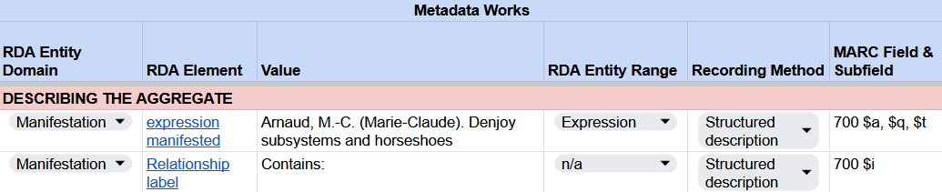
Recording expression manifested
RDA Record Template
MARC 21 Bibliographic Record
Notes:
In MARC, the relationship label is recorded in subfield $i. It begins with a capital letter and is followed by a colon. Ensure delimiter $a is added before the access point.

Slide 35
Minimum Description of Collection Aggregate
Aggregated Work
has authorized access point for work Arnaud, M.-C. (Marie-Claude). Denjoy subsystems and horseshoes
Aggregating Work
has authorized access point for work Hamiltonian systems
has expression of work Hamiltonian systems
Aggregated Expression
has authorized access point for expression Arnaud, M.-C. (Marie-Claude). Denjoy subsystems and horseshoes
Aggregating Expression
has authorized access point for expression Hamiltonian systems
has work expressed Hamiltonian systems
has manifestation of expression Hamiltonian systems
Manifestation
has title proper Hamiltonian systems
has expression manifested Hamiltonian systems
has expression manifested Arnaud, M.-C. (Marie-Claude). Denjoy subsystems and horseshoes
Notes:
At this point, we’ve related the expression to the aggregated expression; however, as part of a minimum description in RDA, we need to record relationships from the aggregated expression and aggregated work.

Slide 36
work expressed

Slide 37
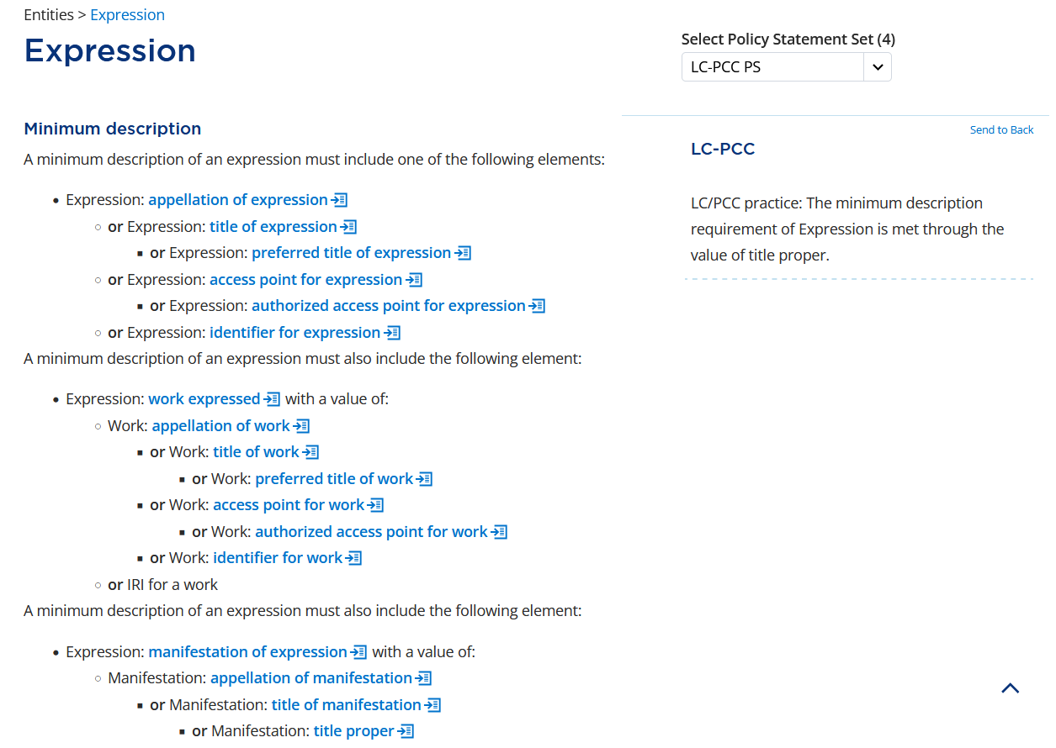
Notes:
In RDA, a minimum description of an expression must include an appellation of expression. We have already done that when we recorded the authorized access point for expression.
A minimum description of an expression must also relate the expression to the work using the element work expressed, which is recorded using an appellation of work. Since we already recorded an authorized access point for work, we just need to record that access point as our value for work expressed.

Slide 38
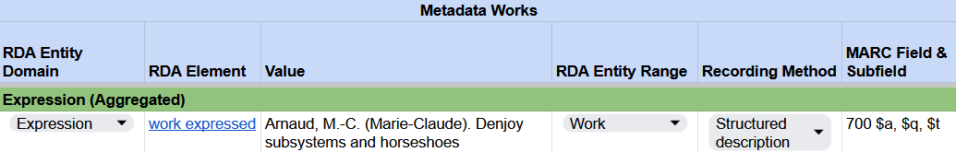
Recording work expressed
RDA Record Template
Notes:
In MARC, we do not explicity record this relationship, but the value will be included as part of the value of other elements. For example, the authorized access point for work will be included as part of the authorized access point for expression, which we already recorded in field 700.

Slide 39
Minimum Description of Collection Aggregate
Aggregated Work
has authorized access point for work Arnaud, M.-C. (Marie-Claude). Denjoy subsystems and horseshoes
Aggregating Work
has authorized access point for work Hamiltonian systems
has expression of work Hamiltonian systems
Aggregated Expression
has authorized access point for expression Arnaud, M.-C. (Marie-Claude). Denjoy subsystems and horseshoes
has work expressed Arnaud, M.-C. (Marie-Claude). Denjoy subsystems and horseshoes
Aggregating Expression
has authorized access point for expression Hamiltonian systems
has work expressed Hamiltonian systems
has manifestation of expression Hamiltonian systems
Manifestation
has title proper Hamiltonian systems
has expression manifested Hamiltonian systems
has expression manifested Arnaud, M.-C. (Marie-Claude). Denjoy subsystems and horseshoes
Notes:
We have now related the expression to the work using the element work expressed.

Slide 40
manifestation of expression

Slide 41
Notes:
Going back to the minimum description of an expression, RDA tells us that we must also include the element manifestation of expression, which relates the expression to the manifestation. We can do this using a value of title proper, which was the first element we recorded.

Slide 42
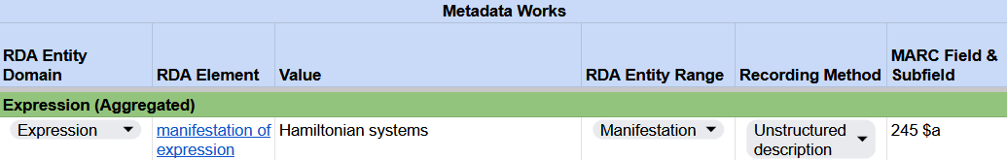
Recording manifestation of expression
RDA Record Template
Notes:
Again, in MARC, we do not explicity record this relationship, but we meet this minimum requirement when we record the title proper in field 245.

Slide 43
Minimum Description of Collection Aggregate
Aggregated Work
has authorized access point for work Arnaud, M.-C. (Marie-Claude). Denjoy subsystems and horseshoes
Aggregating Work
has authorized access point for work Hamiltonian systems
has expression of work Hamiltonian systems
Aggregated Expression
has authorized access point for expression Arnaud, M.-C. (Marie-Claude). Denjoy subsystems and horseshoes
has work expressed Arnaud, M.-C. (Marie-Claude). Denjoy subsystems and horseshoes
has manifestation of expression Hamiltonian systems
Aggregating Expression
has authorized access point for expression Hamiltonian systems
has work expressed Hamiltonian systems
has manifestation of expression Hamiltonian systems
Manifestation
has title proper Hamiltonian systems
has expression manifested Hamiltonian systems
has expression manifested Arnaud, M.-C. (Marie-Claude). Denjoy subsystems and horseshoes
Notes:
As you can see in our model, we’ve related the aggregated expression to the manifestation using the element manifestation of expression.

Slide 44
expression of work

Slide 45
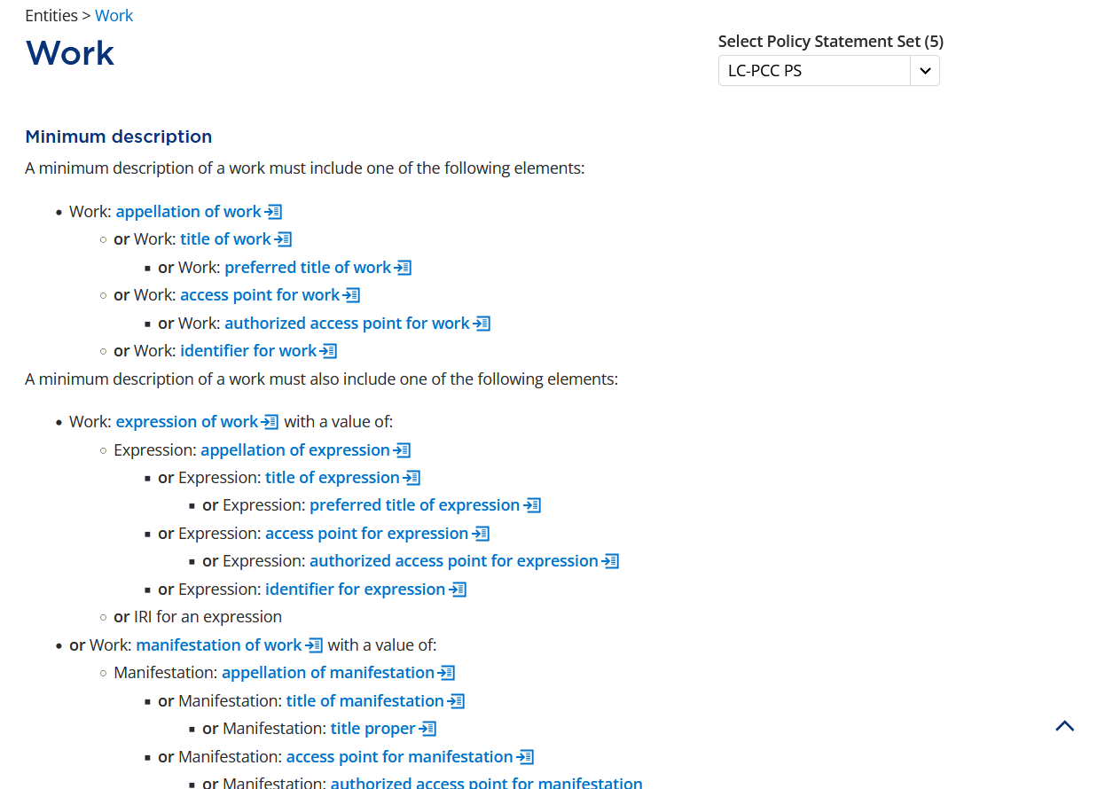
Notes:
For a minimum description of a work, the description must include an appellation of work, which we met when we recorded the authorized access point for work. It must also include the elements expression of work or manifestation of work. We want to relate the aggregated work to the aggregated expression, so we will record the expression of work using the authorized access point we recorded earlier.

Slide 46
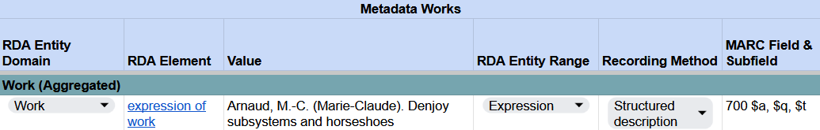
Recording expression of work
RDA Record Template
Notes:
This relationship is not explicity recorded in MARC, but its value will be included in the record as part of the value of another element.

Slide 47
Minimum Description of Collection Aggregate
Aggregated Work
has authorized access point for work Arnaud, M.-C. (Marie-Claude). Denjoy subsystems and horseshoes
has expression of work Arnaud, M.-C. (Marie-Claude). Denjoy subsystems and horseshoes
Aggregating Work
has authorized access point for work Hamiltonian systems
has expression of work Hamiltonian systems
Aggregated Expression
has authorized access point for expression Arnaud, M.-C. (Marie-Claude). Denjoy subsystems and horseshoes
has work expressed Arnaud, M.-C. (Marie-Claude). Denjoy subsystems and horseshoes
has manifestation of expression Hamiltonian systems
Aggregating Expression
has authorized access point for expression Hamiltonian systems
has work expressed Hamiltonian systems
has manifestation of expression Hamiltonian systems
Manifestation
has title proper Hamiltonian systems
has expression manifested Hamiltonian systems
has expression manifested Arnaud, M.-C. (Marie-Claude). Denjoy subsystems and horseshoes
Notes:
This now completes our minimum description of the collection aggregate. For each of the five entities, we have recorded an appellation element, which identifies the entity, and we have recorded the minimum relationships to relate the entities. In total, there are 13 required elements.

Slide 48
Minimum Description in MARC 21
245 00 $a Hamiltonian systems
700 12 $a Arnaud, M.-C. $q (Marie-Claude). $t Denjoy subsystems and horseshoes
Notes:
However, when we record that minimum description in MARC, we end up with two fields. The 245 field represents both the title proper and the access point for the aggregating work and aggregating expression, and the 700 field represents the access point for the aggregated work and aggregated expression.

Slide 49
content type
Notes:
Having covered the elements for a minimum description of the aggregated expression and aggregated work, let’s record additional elements for a more effective description. To start, let’s look at content type for the aggregated expression.

Slide 50
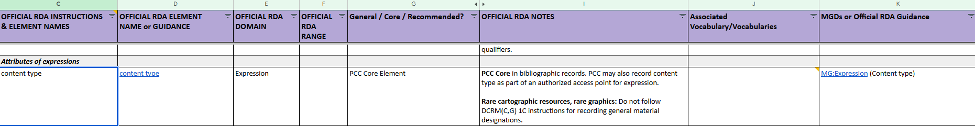
BSR: content type
Notes:
In the BSR, content type is listed as an attribute of expression, and a PCC Core element. This is an element we have been quite familiar with since the implementation of the original Toolkit. Let’s click on the link to go to content type in the Toolkit.

Slide 51
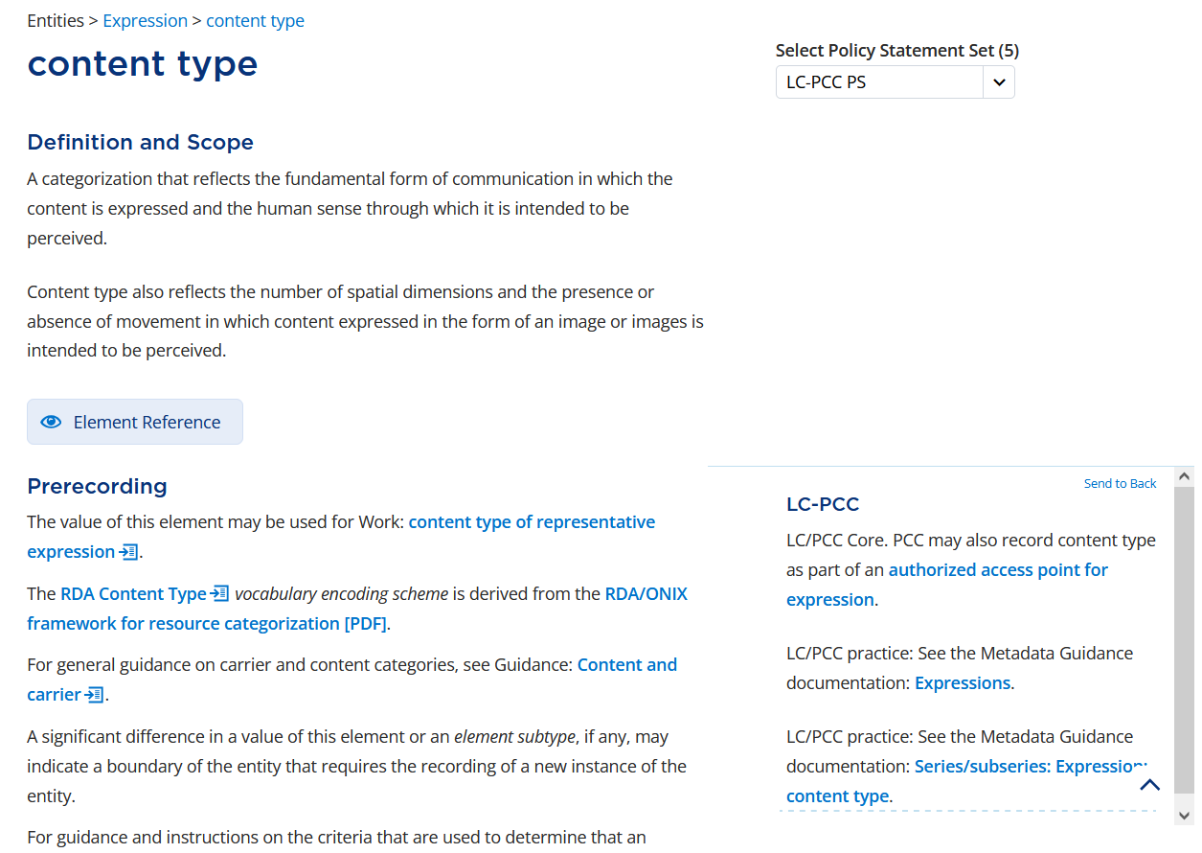
Notes:
Content type is defined as “A categorization that reflects the fundamental form of communication in which the content is expressed and the human sense through which it is intended to be perceived. Content type also reflects the number of spatial dimensions and the presence or absence of movement in which content expressed in the form of an image or images is intended to be perceived.”
In the Prerecording section, the LC-PCC PS tells us it is a Core element, and it can be recorded as an additional element of an authorized access point for expression. It also refers to related MGD documentation.

Slide 52
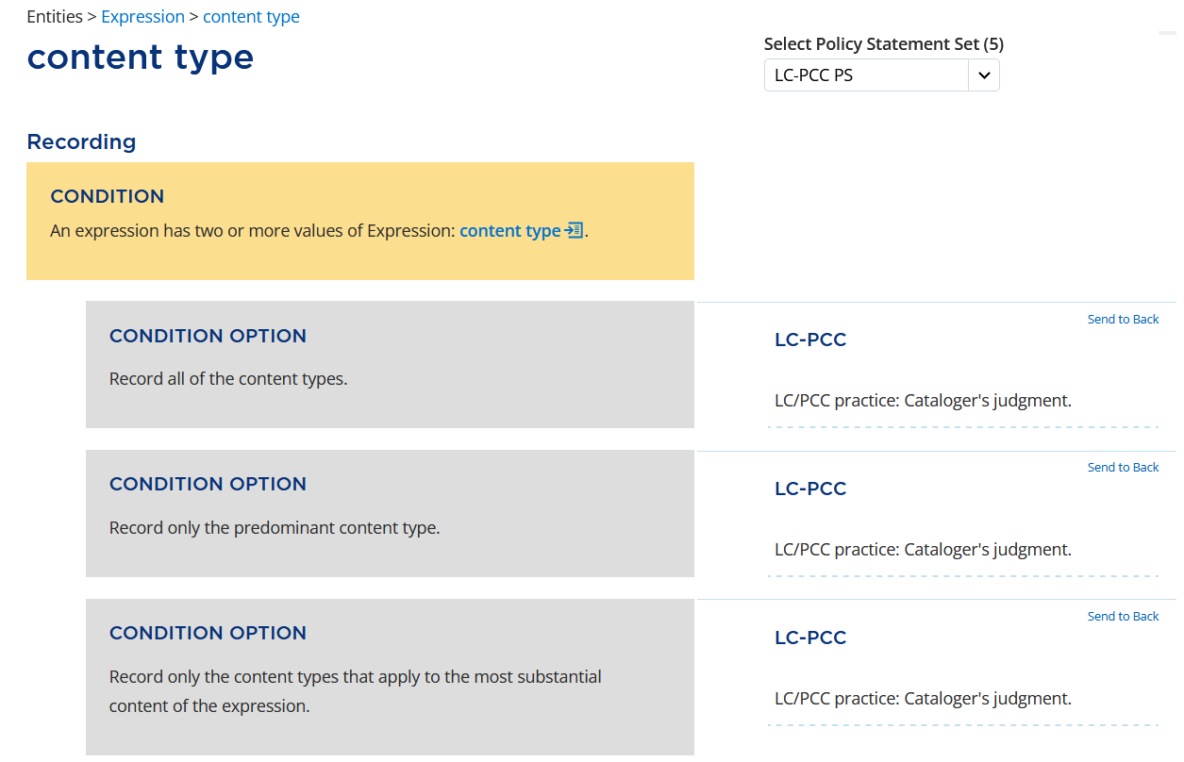
Notes:
Under Recording, the LC-PCC PSs tell us that it is our judgment to record all of the content types, or only the predominant content type. We will only record the predominant content type.

Slide 53
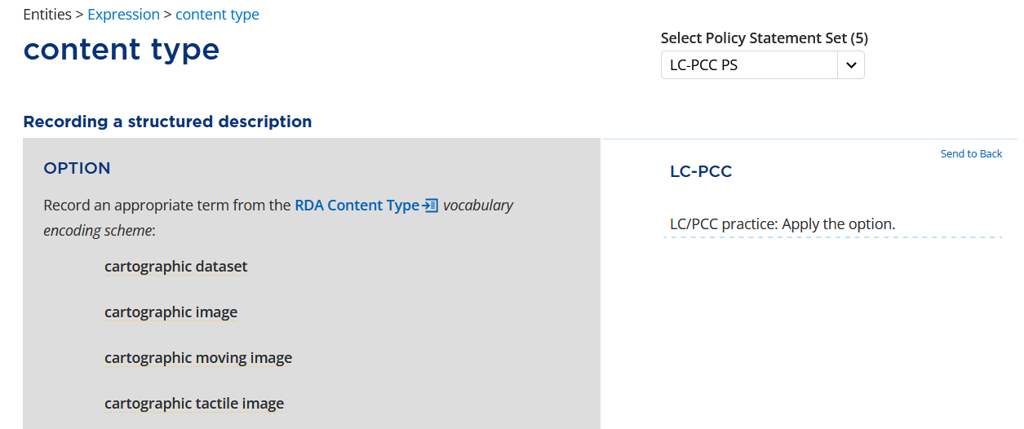
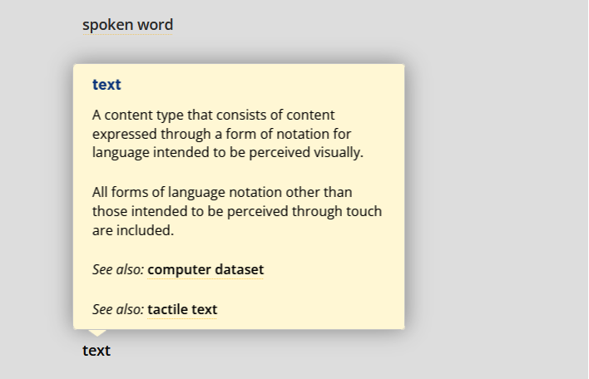
Notes:
As with media type and carrier type, we can choose to record a term from the RDA VES or another appropriate VES. We will apply the option to record a term from the RDA Content Type VES and record the term “text”.

Slide 54
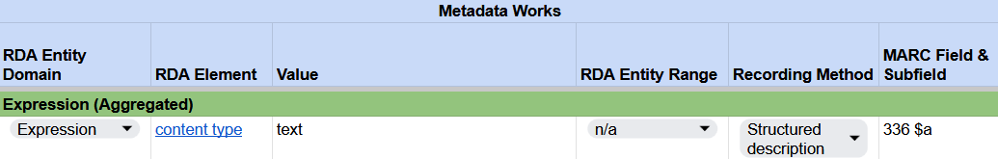
Recording content type
RDA Record Template
MARC 21 Bibliographic Record
Notes:
In our RDA Record Template, the term “text” is recorded as a structured description.
In MARC, this term is recorded in field 336, subfield $a.

Slide 55
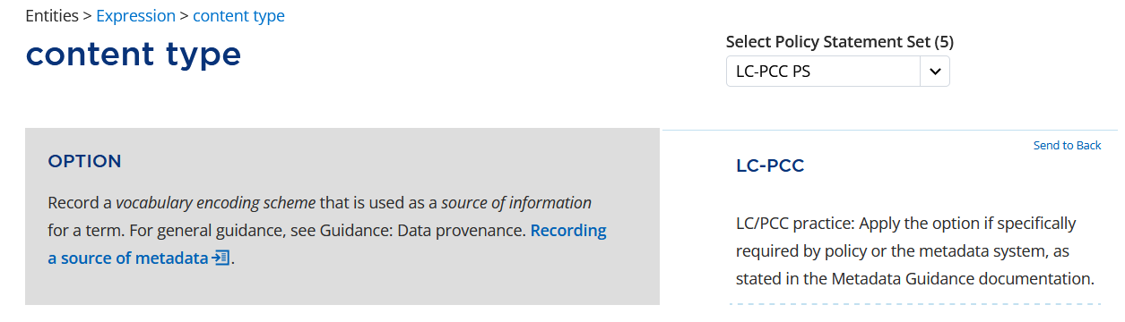
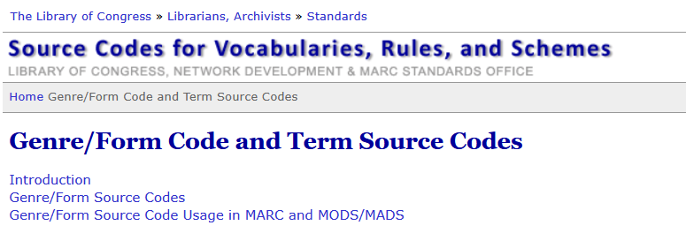

Notes:
As we have already seen, we will apply the option to “Record a vocabulary encoding scheme that is used as a source of information for a term.” The code that corresponds to the RDA Content Type VES is “rdaco”.

Slide 56
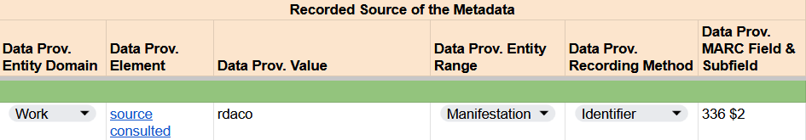
Recording content type
RDA Record Template
Notes:
In the RDA Record Template, the identifier “rdaco” is recorded as a data provenance value of source consulted for the term “text”.

Slide 57
Recording content type
RDA Record Template
MARC 21 Bibliographic Record
Notes:
In MARC, the code is recorded in subfield $2.

Slide 58
language of expression
Notes:
The last element we will record for the aggregated expression is language of expression.

Slide 59
BSR: language of expression
PCC Core element
MGD Expression: language of expression
Notes:
In the BSR, language of expression is an attribute of expression and a PCC Core element. Let’s click on the link to go to the Toolkit: language of expression.

Slide 60
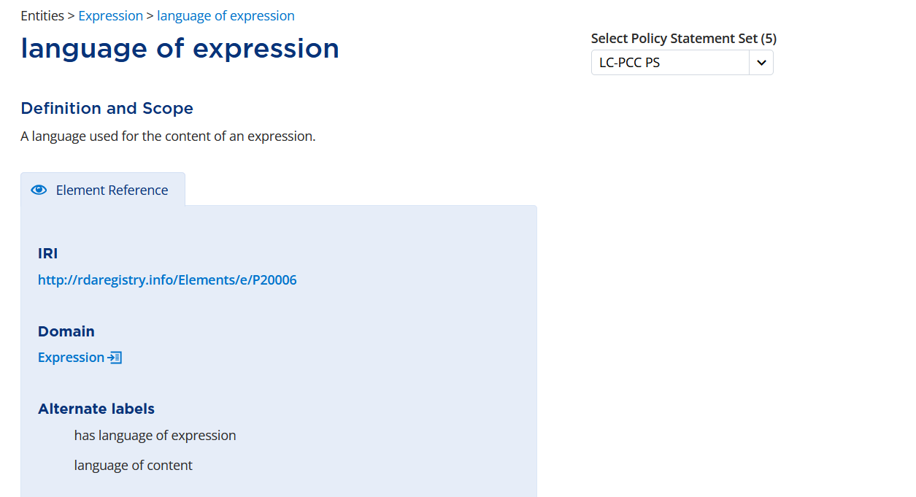
Notes:
Here is the definition: A language used for the content of an expression.
In the Element Reference box, we can see that this element has the alternate label “language of content” from the original RDA Toolkit.

Slide 61
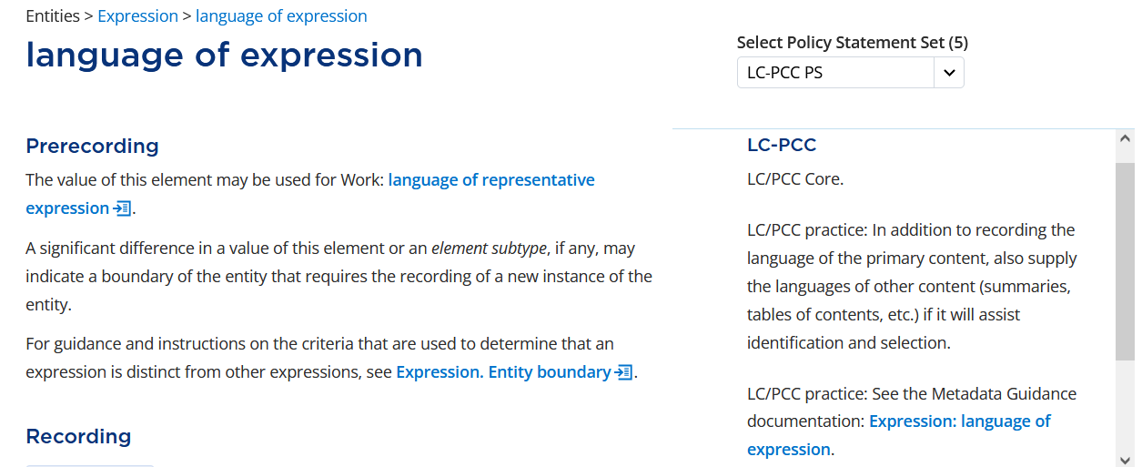
Notes:
In the Prerecording LC-PCC PS, it states language of expression is LC/PCC Core. LC/PCC practice: In addition to recording the language of the primary content, also supply the languages of other content (summaries, tables of contents, etc.) if it will assist identification and selection. It also refers to related Metadata Guidance Documentation.

Slide 62
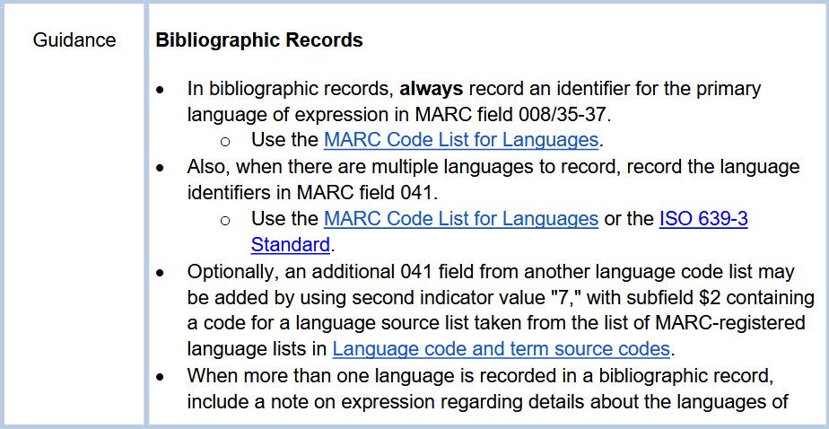
Notes:
In the MGD: Expression: language of expression, the instructions are split between authority and bibliographic records.
For bibliographic records, the guidance begins “always record an identifier for the primary language of expression in MARC field 008/35-37. Use the MARC Code List for Languages.”

Slide 63
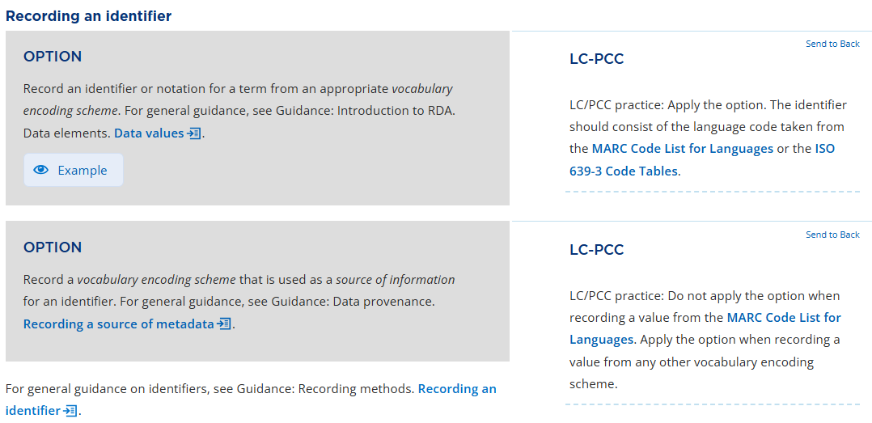
Recording: Identifier
Notes:
Since the MGD says to record an identifier, we can jump to that section in the RDA Toolkit. The LC-PCC PS also tells us to record a language code from the MARC Code List for Languages. It also tells us not to record the source if the language code is from the MARC Code List for Languages.

Slide 64
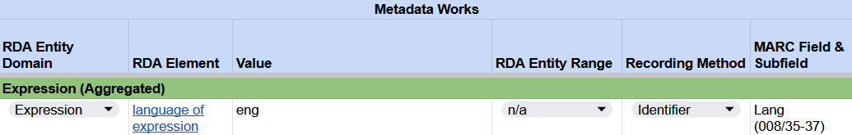

Recording language of expression
RDA Record Template
MARC 21 Bibliographic Record
Notes:
Our ebook is in English. In the Lang (008/35-37) fixed field, we will record the identifier value “eng” for English.

Slide 65
subject
Notes:
Moving on to elements to describe the aggregated work. The first of which is subject.

Slide 66
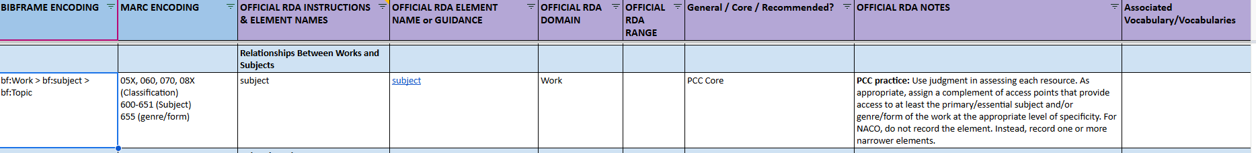
BSR: subject
PCC Core element
MARC encoding: classification, subject and genre form.
Notes:
Subject was covered in the original Toolkit in Section 7, Chapter 23: General Guidelines on Recording Relationships Between Works and Subjects.
In the BSR, subject is found under Relationships Between Works and Subjects. It is a PCC Core element. Let’s click on the link to go to the Toolkit.

Slide 67
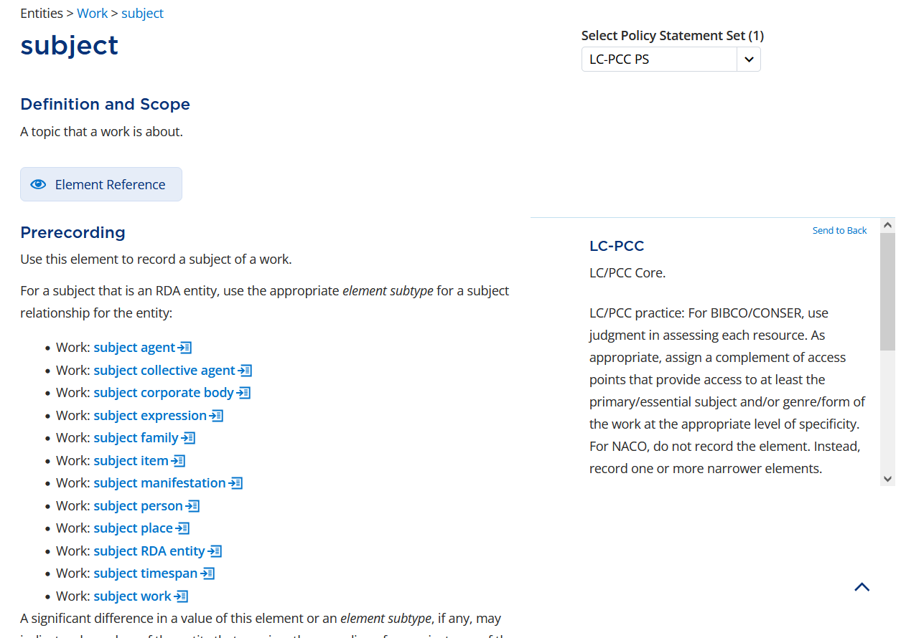
Notes:
As expected, subject is defined as “A topic that a work is about.” Under Prerecording, RDA tells us to use an appropriate element subtype if the subject is an RDA entity. For example, if the work is about a person, we should use the narrower element subject person.
The LC-PCC PS tells us subject is LC/PCC Core and provides guidance for BIBCO and CONSER records; however, let’s scroll down …

Slide 68
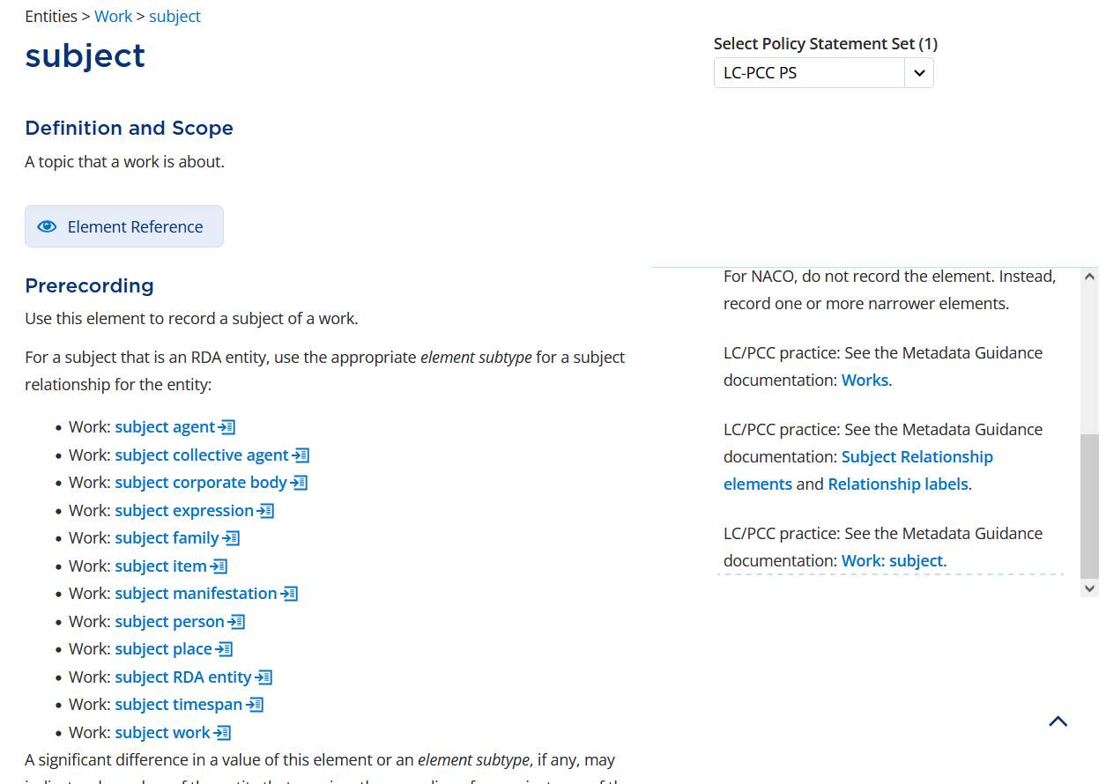
Notes:
… and review the MGD Work: subject.

Slide 69
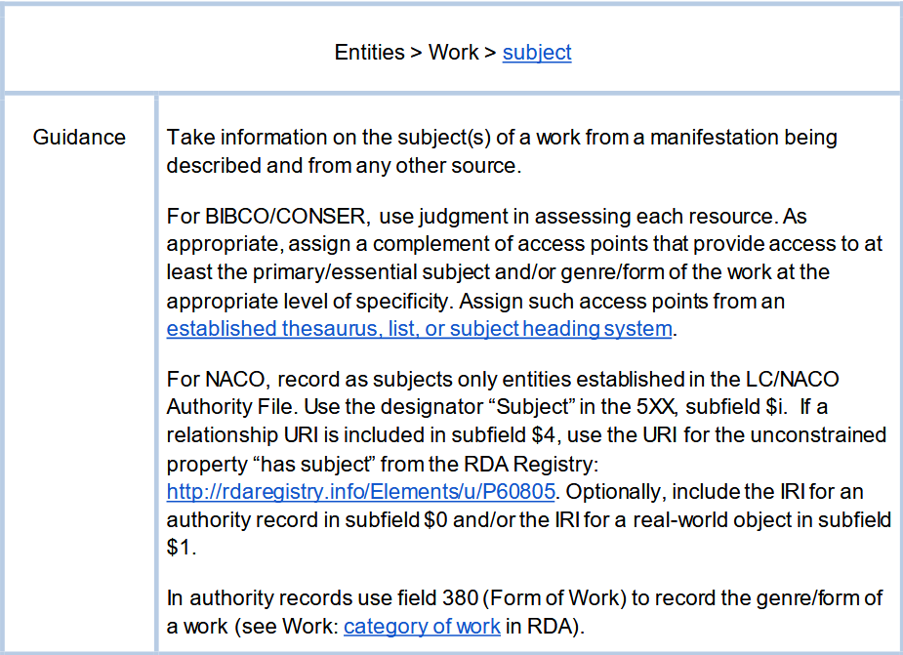
Notes:
The subject MGD tells us to “Take information on the subject(s) of a work from a manifestation being described and from any other source. For BIBCO/CONSER, use judgment in assessing each resource. As appropriate, assign a complement of access points that provide access to at least the primary/essential subject and/or genre/form of the work at the appropriate level of specificity. Assign such access points from an established thesaurus, list, or subject heading system.”

Slide 70
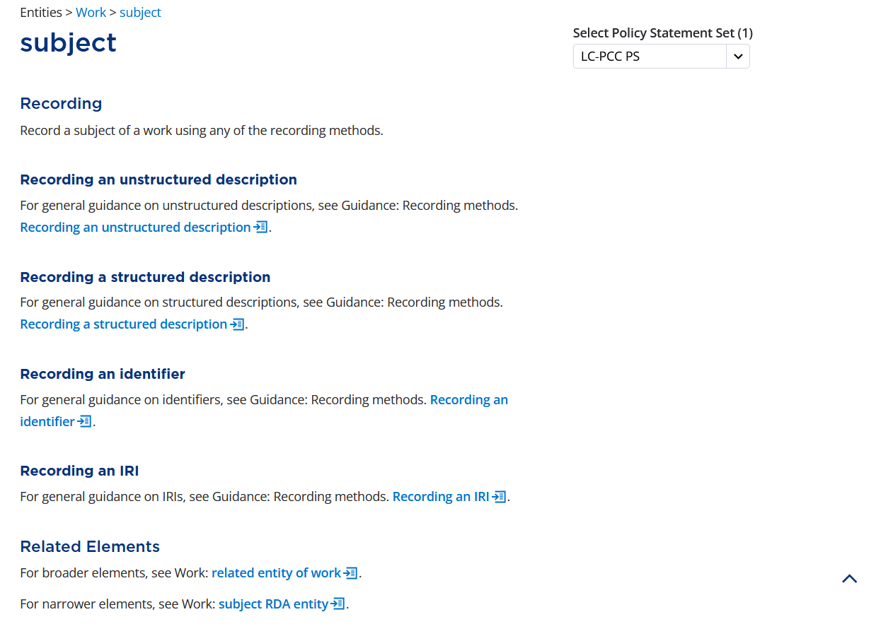
Notes:
In RDA, an access point is recorded as a structured description.

Slide 71
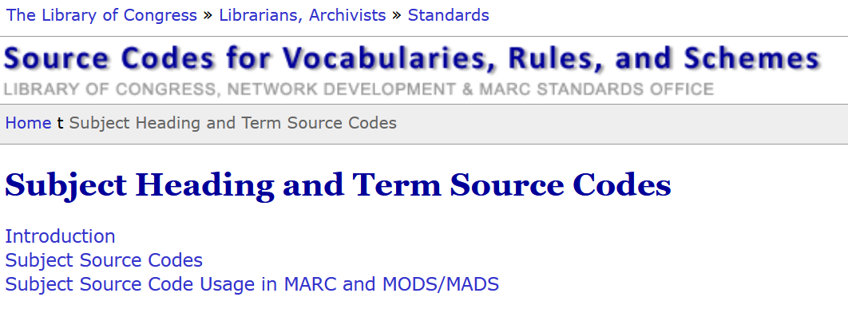

Notes:
There are many subject heading lists that could be used to record the subject of a work. The Subject Heading and Term Source Codes list (https://www.loc.gov/standards/sourcelist/subject.html) maintained by the Library of Congress provides identifiers for hundreds of subject vocabulary lists.

Slide 72
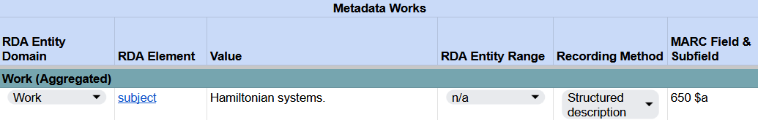
Recording subject
RDA Record Template
MARC 21 Bibliographic Record
Notes:
For this ebook, we chose to record the Library of Congress subject heading “Hamiltonian systems”.
As a topical subject heading, this is recorded in field 650 in MARC.

Slide 73
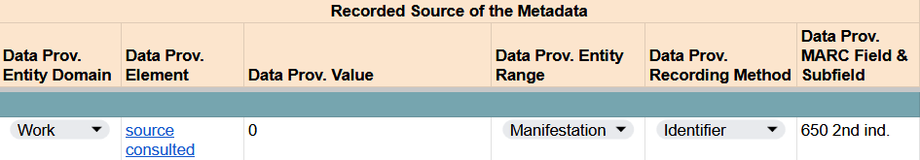
Recording subject
RDA Record Template
MARC 21 Bibliographic Record
Notes:
To indicate the source, we need to record data provenance information. The identifier 0 as the second indicator value indicates that the term is from LCSH.

Slide 74
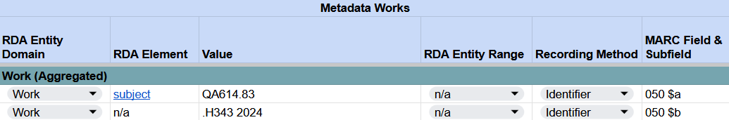
Recording subject
RDA Record Template
MARC 21 Bibliographic Record
Notes:
Classification can also be recorded as a subject in RDA using the identifier recording method. Note that only the classification part of the call number corresponds to the RDA element subject. For Library of Congress Classification, this corresponds to 050 subfield $a. The item number portion of the call number (i.e., 050 subfield $b) does not have a corresponding RDA element.
For our ebook, we have assigned the LC classification number QA614.83, which corresponds to Hamiltonian systems. We also assigned the item number .H343 2024.

Slide 75
category of work

Slide 76
BSR Metadata Application Profile
Notes:
The last element we will describe for the aggregated work is category of work. Again, starting with the BSR and then going into the RDA Toolkit.

Slide 77
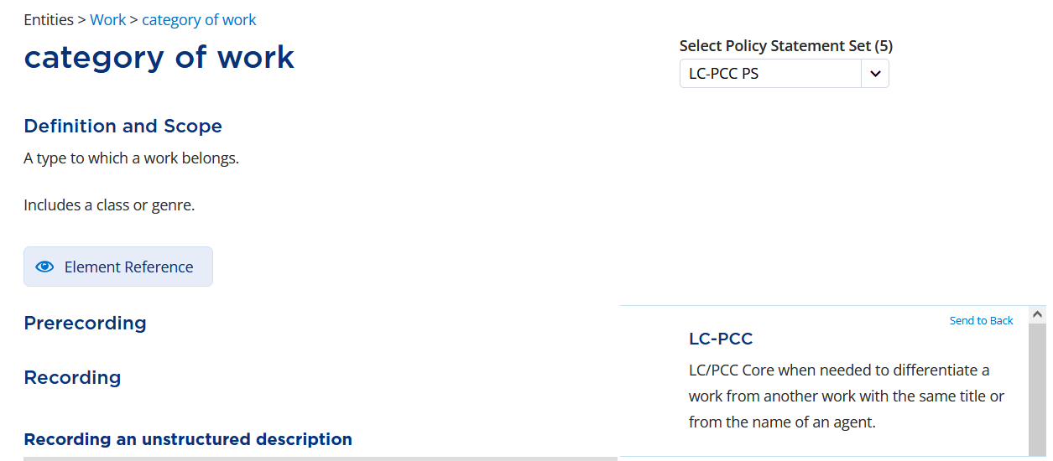
Notes:
Category of work is defined as “A type to which a work belong. Includes a class or genre.” While there is no meaningful genre to record, if we look at Element Reference, …

Slide 78
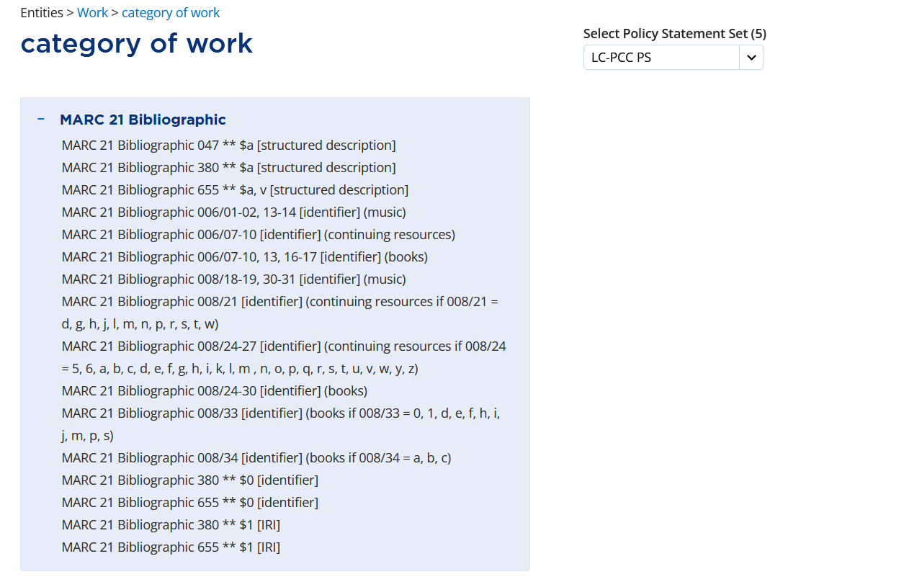
Notes:
… we can see that category of work is aligned with several MARC fixed fields, including 008 byte 33, Literary Form. The instructions for recording an identifier are the same as we’ve seen already, so we can jump straight into recording.

Slide 79
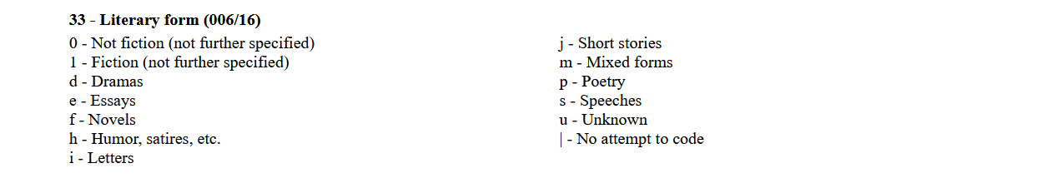
MARC 008
Notes:
For byte 33, the code 0 corresponds with Not fiction (not further specified), which is appropriate for our ebook.

Slide 80
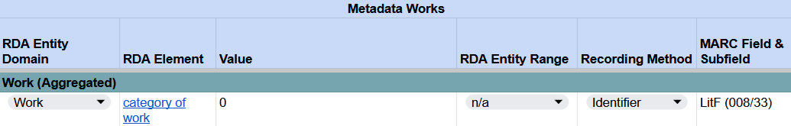

Recording category of work
RDA Record Template
MARC 21 Bibliographic Record
Notes:
Therefore, we will record 0 as an identier for category of work in our RDA Record Template and in the LitF (008/33) fixed field in MARC.

