Slide 1
Cataloging an eBook
Describing the Aggregating Work & Aggregating Expression

Slide 2
RDA Copyright
©2010-2025 - American Library Association, Canadian Federation of Library Associations, and CILIP: Chartered Institute of Library and Information Professionals.
Screen images from the RDA Toolkit (www.rdatoolkit.org) used by permission of the Copyright Holders for RDA (American Library Association, Canadian Federation of Library Associations, and CILIP: Chartered Institute of Library and Information Professionals).

Slide 3
Minimum Description of Collection Aggregate
Aggregated Work
Aggregating Work
Aggregated Expression
Aggregating Expression
Manifestation
has title proper Hamiltonian systems
Notes:
In this part, we will be looking at how we relate the description of our aggregate manifestation to the aggregating expression and the aggregating work, including how we construct their authorized access points. In the new aggregates model, an aggregating work is a plan to select and arrange multiple expressions, the content of an aggregate. An aggregating expression only realizes that plan. For practical purposes, its primary function is that it can function as a way to gather expressions that are aggregated. There is no content that may be recorded in an aggregating expression itself.

Slide 4
Minimum description
expression manifested, access point for expression, authorized access point for expression, work expressed, manifestation of expression, title of work, preferred title of work, authorized access point for work, expression of work
Notes:
In this section, we will focus on recording the elements for a minimum description of an aggregating expression and aggregating work. That may sound complicated, but we will see that we are not doing anything different or additional in practice to satisfy the minimum description requirements according to official RDA and PCC documentation.

Slide 5
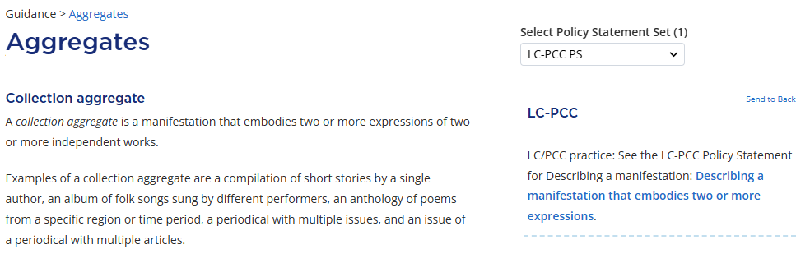
Notes:
The draft BSR does not fully address describing an aggregating expression and an aggregating work, so we will start with the RDA guidance page on aggregates. A key point for us to keep in mind is which type of aggregate we are working on, because the entities and elements that should be recorded explicitly are different depending on the kind of aggregate being cataloged. The narrative MGD on aggregates, which is linked on this guidance page, provides an overview of PCC practice in a more linear form, so it should also be consulted as needed.
Our ebook is for the most part a collection aggregate, a compilation of articles by multiple authors. So, we can start at the Collection aggregate section on the guidance page. Here, the policy statement directs us to Resource Description > Describing a manifestation page, the section for Describing a manifestation that embodies two or more expressions.

Slide 6
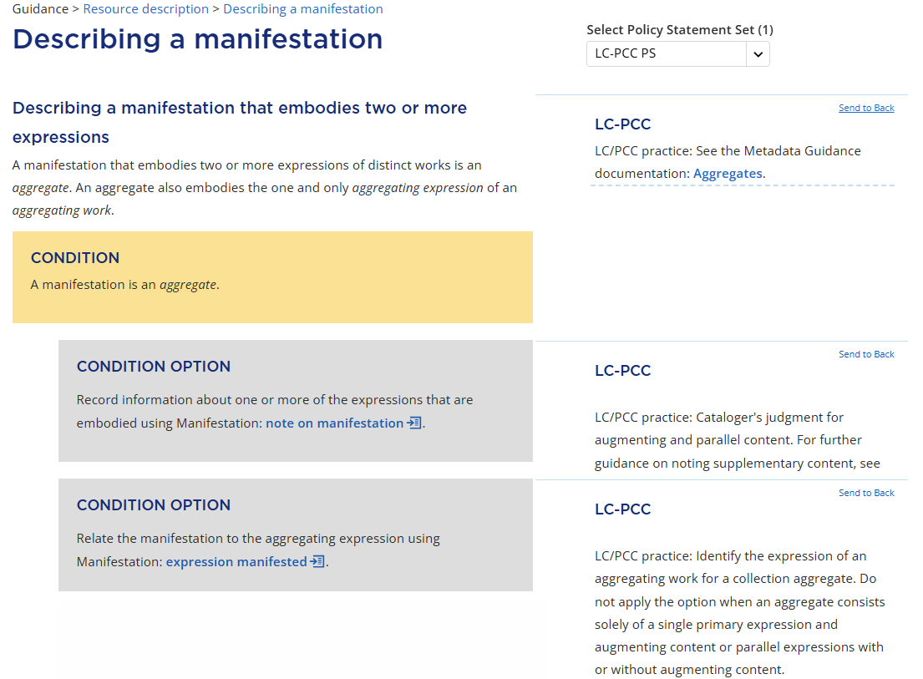
Notes:
When we go to the section, let’s just note in the interest of time that the second condition option is the only one that is relevant for our purposes. The option says “Relate the manifestation to the aggregating expression using Manifestation: expression manifested.” The policy statement says that identifying the aggregating expression is the PCC practice for a collection aggregate.

Slide 7
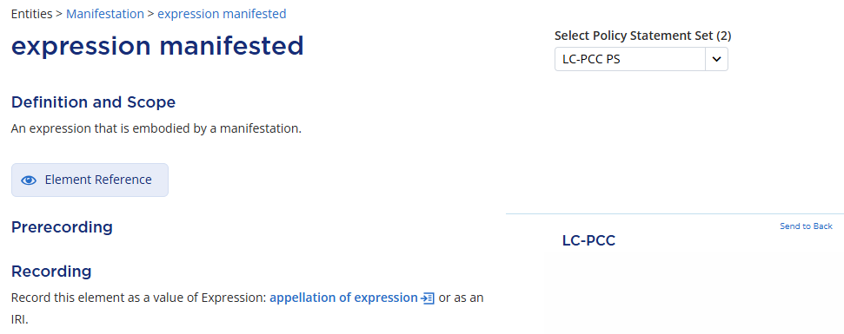
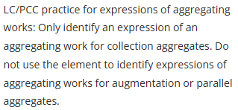
Notes:
Let’s go to the expression manifested element. The definition is “An expression that is embodied by a manifestation,” meaning that we use this element to record the relationship between our aggregate manifestation and the aggregating expression. The Prerecording section again has a policy statement stating that identifying an aggregating expression is the PCC practice for collection aggregates. The Recording section tells us to record this element as a value of appellation of expression or as an IRI.

Slide 8
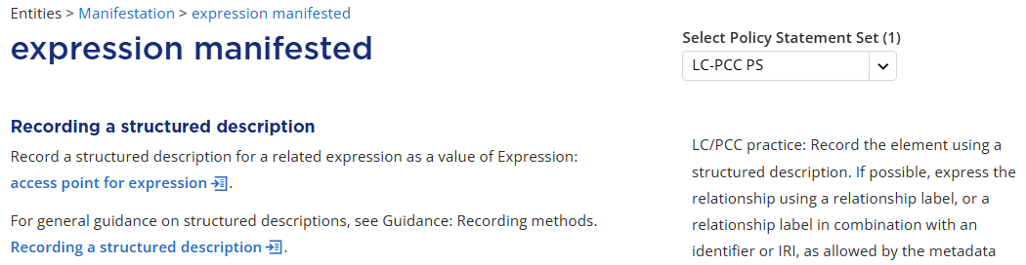
Notes:
Scrolling down to the Recording a structured description section, we are told to record a structured description for a related expression as a value of access point for expression, a subtype of appellation of expression. The policy statement says this is the PCC practice for the element, so we need to identify an access point for the aggregating expression to record a value for the expression manifested element.

Slide 9
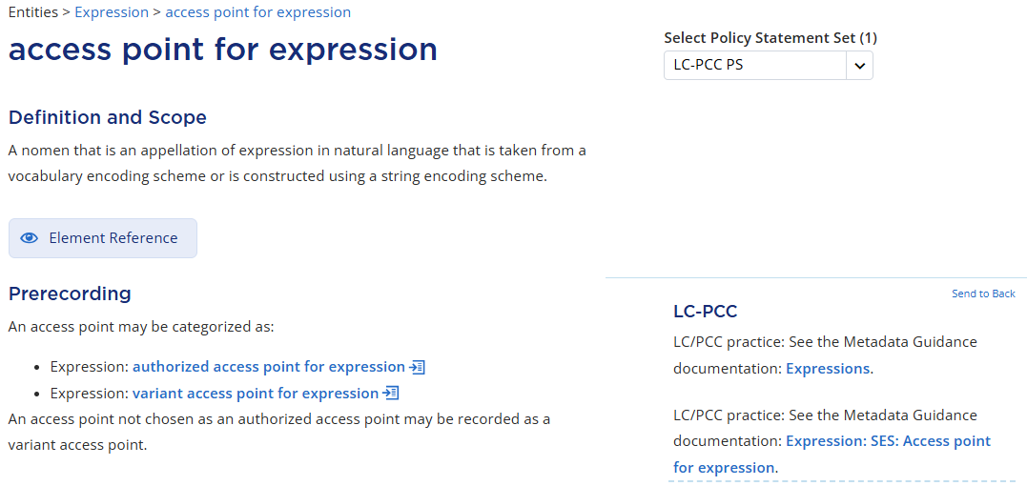
Notes:
We come to access point for expression. The Prerecording section says that an access point may be categorized as an authorized access point or a variant access point. Because we are working on a bibliographic record, we are recording an authorized access point for expression, rather than a variant access point, so we click on authorized access point.

Slide 10
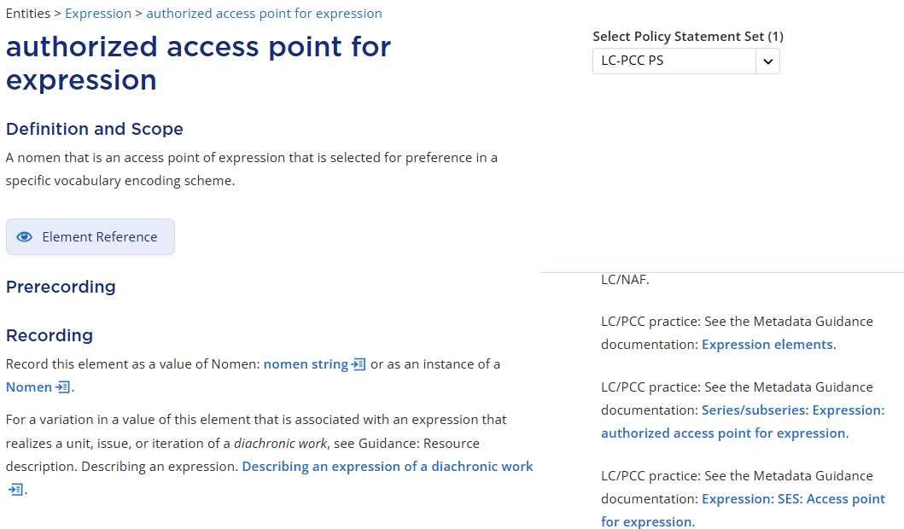
Notes:
On the authorized access point for expression page, the Prerecording section has a policy statement that points to relevant MGDs, including the string encoding scheme MGD for access point for expression.

Slide 11
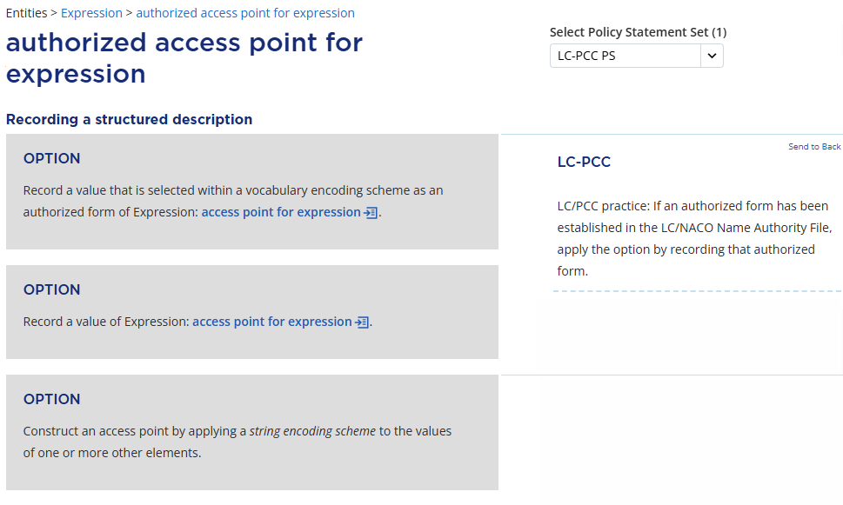
Notes:
Since an access point is a structured description, we scroll down to the Recording a structured description section, where we find general instructions. The first option is to record an authorized form in a vocabulary encoding scheme, so we first check the LC/NACO authority file to see if an authorized access point has already been established.

Slide 12
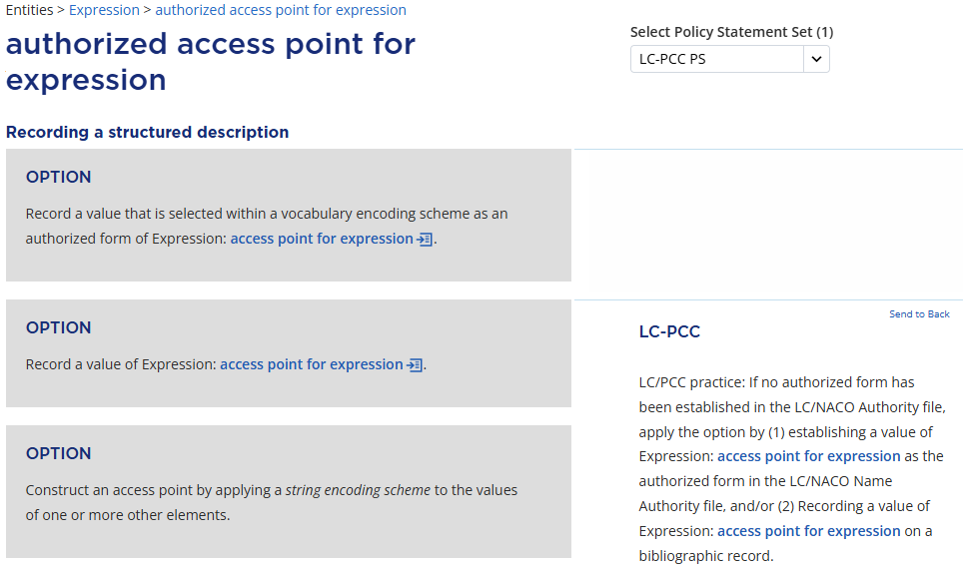
Notes:
Finding no existing authority record, we follow the policy statement to apply the second option, record a value of access point for expression, …

Slide 13
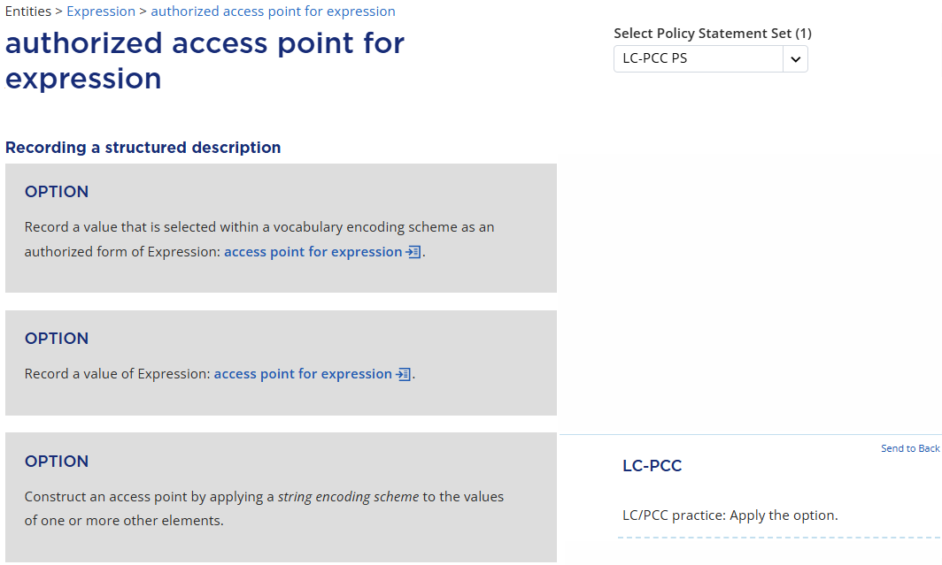
Notes:
… as well as the third option, “Construct an access point by applying a string encoding scheme…,” meaning that we will be constructing an authorized access point for expression using the PCC string encoding scheme.

Slide 14
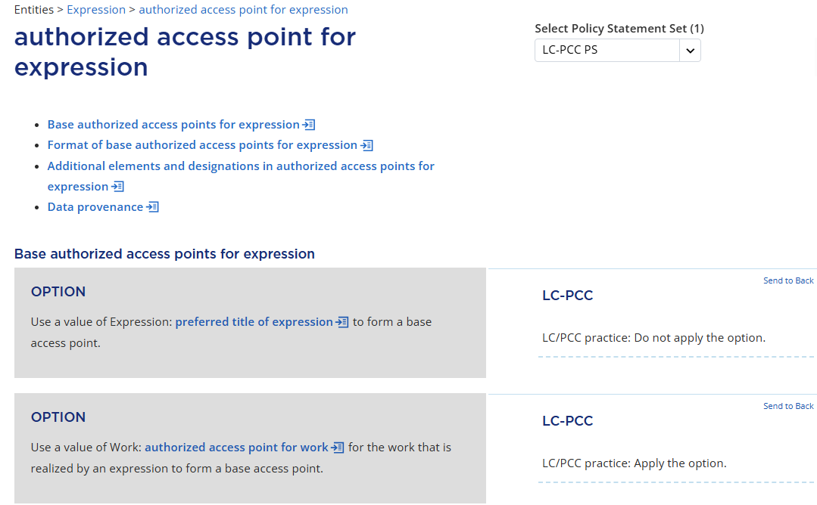
Notes:
We then come to the table of contents, which in effect outlines the workflow for constructing an authorized access point for expression.

Slide 15
Constructing an authorized access point for expression
1. Determine a value of the base authorized access point
2. Determine the format of the base authorized access point
3. Determine values of additional elements and designations
4. Apply the PCC SES to put values of all applicable elements together
Adapted from the National Library of New Zealand RDA practical training week 12 slides (2024)
Notes:
The workflow is common to constructing an authorized access point for any RDA entity, including expression and work as well as agent. First, we determine a value of the base authorized access point. Second, we determine the format of the base authorized access point. Third, we determine values of any additional elements or designation that may need to be included for differentiation, identification, or cataloging rules. Finally, we follow the general instruction to apply the PCC string encoding scheme and put values of all applicable elements together to construct the authorized access point.

Slide 16
Notes:
Let’s begin at the section for Base authorized access points for expression. PCC practice is to apply the second option and use an authorized access point for work to form a base authorized access point, meaning that we continue the practice of constructing an authorized access point for expression based on the authorized access point for work.

Slide 17
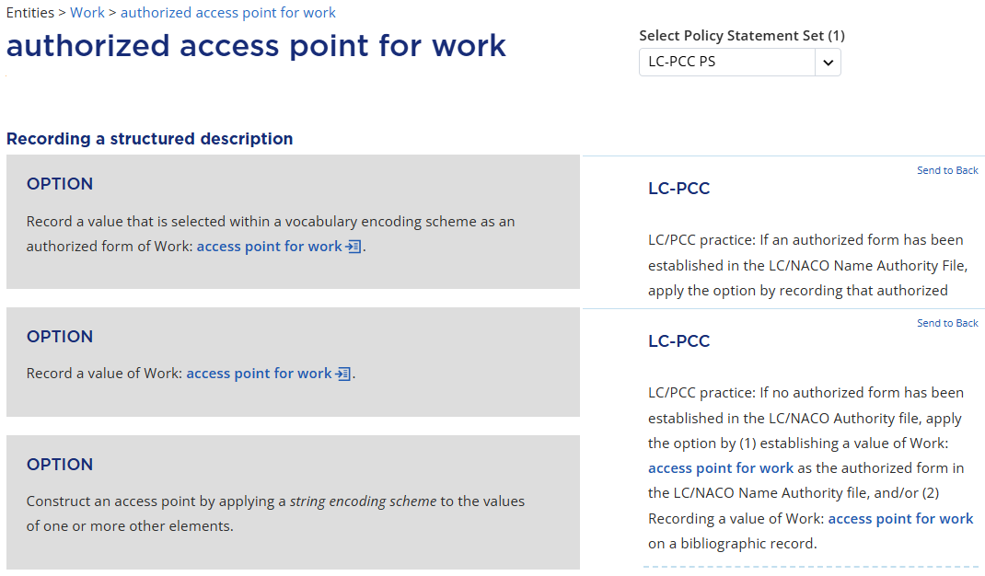
Notes:
We go to authorized access point for work to find a base value. The Prerecording section has a policy statement that points to relevant MGDs, including the string encoding scheme MGD for access point for work.
Scrolling down to the Recording a structured description section, we find general instructions including a similar set of three options. Since there is no existing authority record, PCC practice is to apply the second option, record a value of access point for work, …

Slide 18
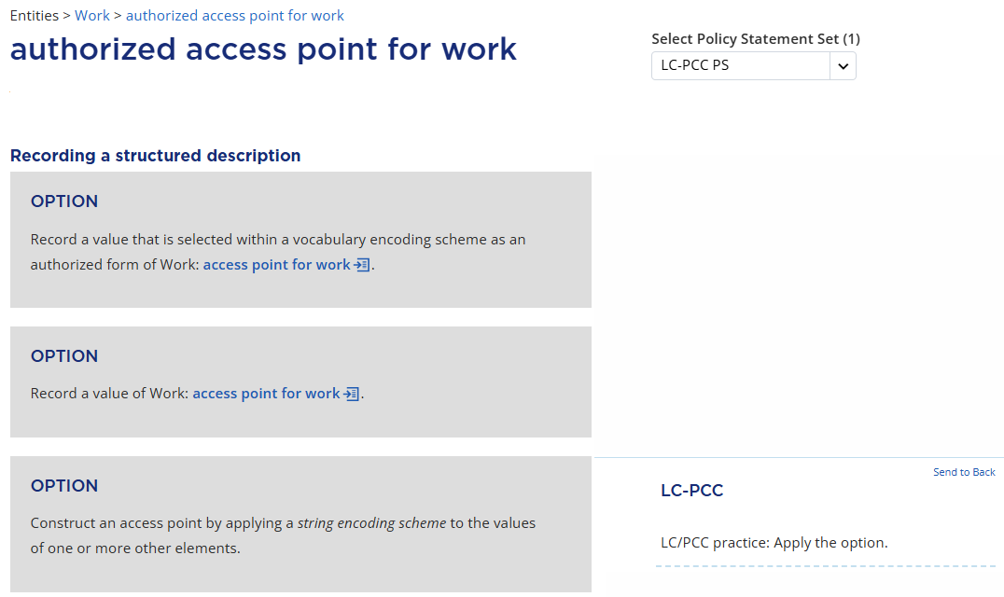
Notes:
… as well as the third option, “Construct an access point by applying a string encoding scheme,” meaning that we will be constructing an authorized access point for work using the PCC string encoding scheme.

Slide 19
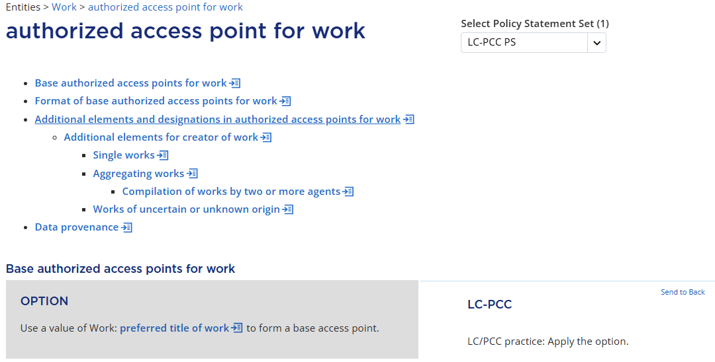
Notes:
The Recording a structured description section has some additional general instructions that are not relevant to our situation. Then we come to the table of contents outlining a similar workflow for constructing an authorized access point for work.
Let’s start with the section for Base authorized access points for work. The first option, which is applied in PCC practice, tells us to use a value of preferred title of work to form a base access point — again, the same familiar practice from original RDA.

Slide 20
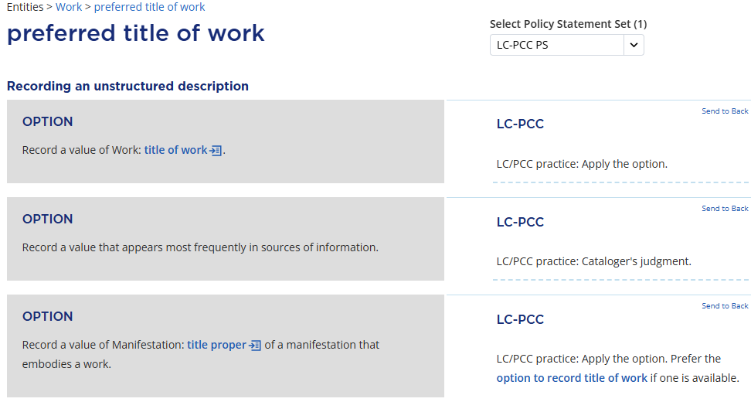
Notes:
We click on preferred title of work to find a base value. Scrolling down to the Recording an unstructured description section, the policy statement tells us to apply the first option to record a value of title of work, so we click the link to find a value.

Slide 21
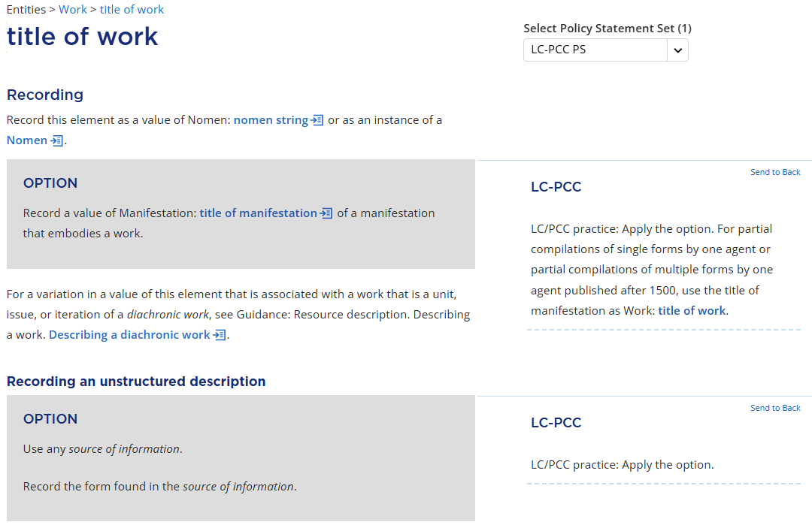
Notes:
On the title of work page, the Recording section tells us to record a value of title of manifestation of a manifestation that embodies a work. Then, moving to the Recording an unstructured description section, the only option to apply is to “Use any source of information. Record the form found in the source of information.” We will record the title proper that appears on the source as the title of manifestation that embodies the work, …

Slide 22
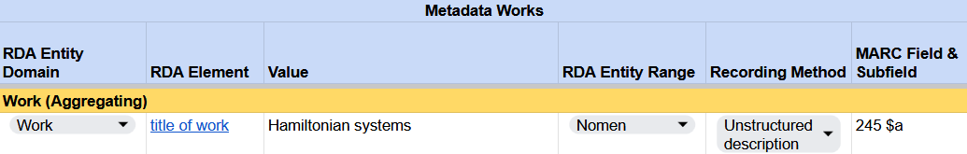
Recording title of work
RDA Record Template
Notes:
… so “Hamiltonian systems” is also the title of work for our ebook; the range is Nomen, recording method is unstructured description. Now we work back to the preferred title of work page because we came to this page to find a value of title of work.

Slide 23
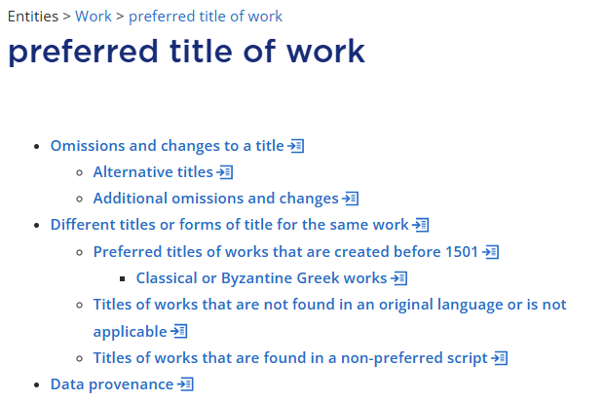
Notes:
Back on the preferred title of work page, we then find a table of contents and see what else might apply to our value. Let’s say that there are no omissions or changes that apply to the title. The section for Different titles or forms of title for the same work does not apply either because we have only one title of work, so we are done with this page.

Slide 24
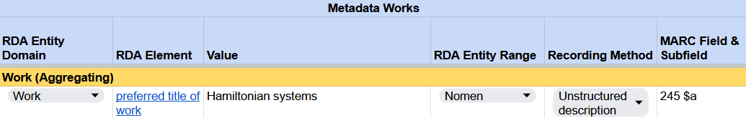
Recording preferred title of work
RDA Record Template
Notes:
The same “Hamiltonian systems” is the value of preferred title of work, with the same range Nomen and the recording method, unstructured description.

Slide 25
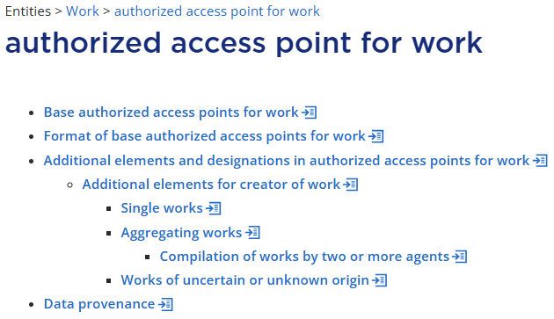

Notes:
Now we finally work back to authorized access point for work with the base authorized access point. Moving to the next section Format of base authorized access points for work, the instruction is to apply the general instructions at access point for work. Format of base access points for work.

Slide 26
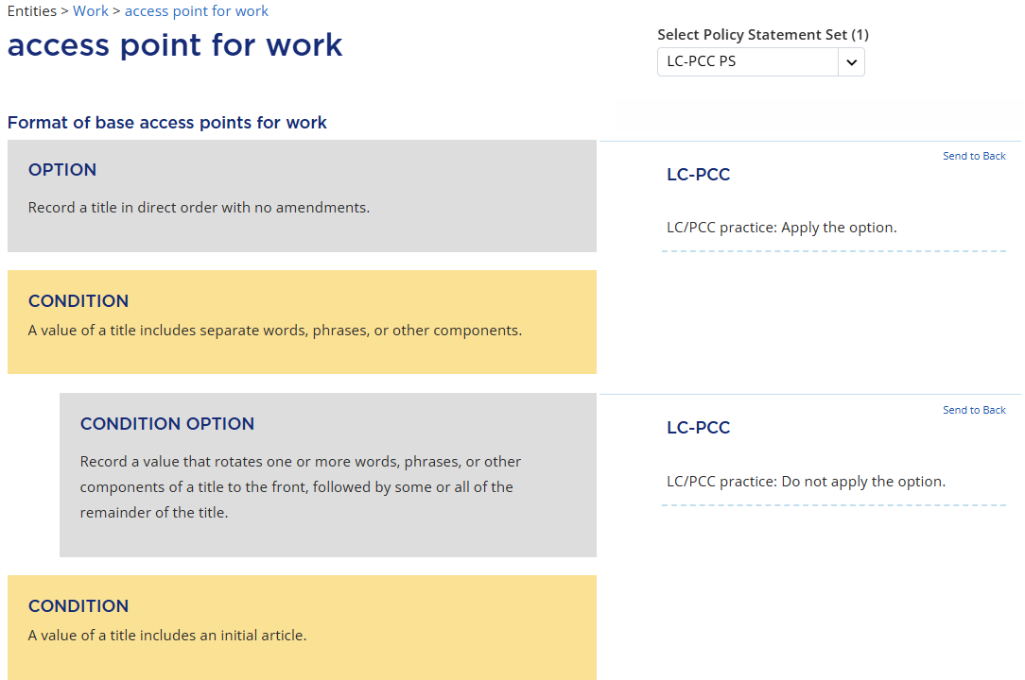
Notes:
Clicking on that link, we find that only the first option is applicable for our aggregating work, “Record a title in direct order with no amendments,” so “Hamiltonian systems” is the format of our base authorized access point for work.

Slide 27
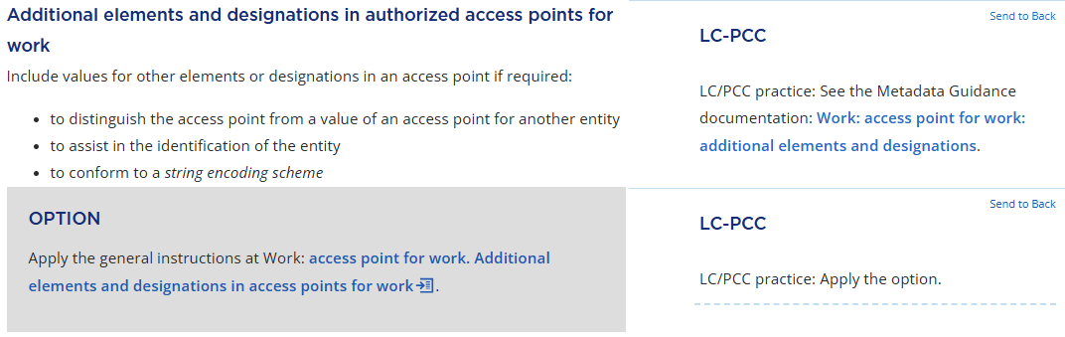
Notes:
The next section Additional elements and designations in authorized access points for work is about additions or qualifiers that may be included in an access point if required to break conflict, assist in identification, or conform to a string encoding scheme. We are likewise told to apply the general instructions at access point for work. The policy statement also links to the MGD which has additional guidance, such as testing for conflict or using a parenthetical qualifier to distinguish monographs.

Slide 28
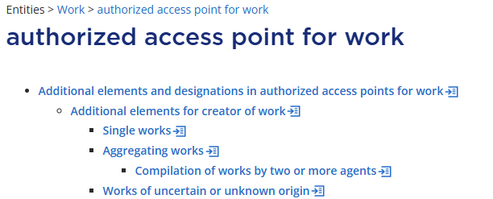

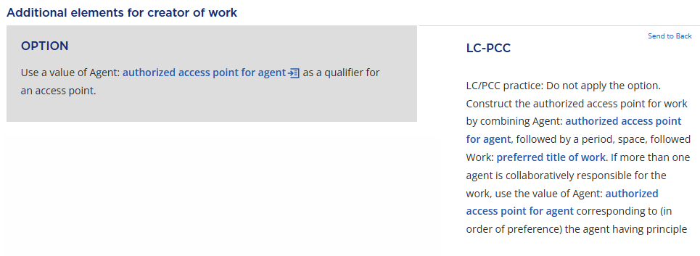
Notes:
Then, there is a subsection Additional elements for creator of work, which tells us to use authorized access point for agent as a qualifier for an access point. This instruction does sound like a major difference from original RDA.
But the policy statement says “Do not apply the option” and tells us instead that PCC practice remains the same and we continue to construct an authorized access point for work by first combining an authorized access point for agent followed by a preferred title of work.

Slide 29
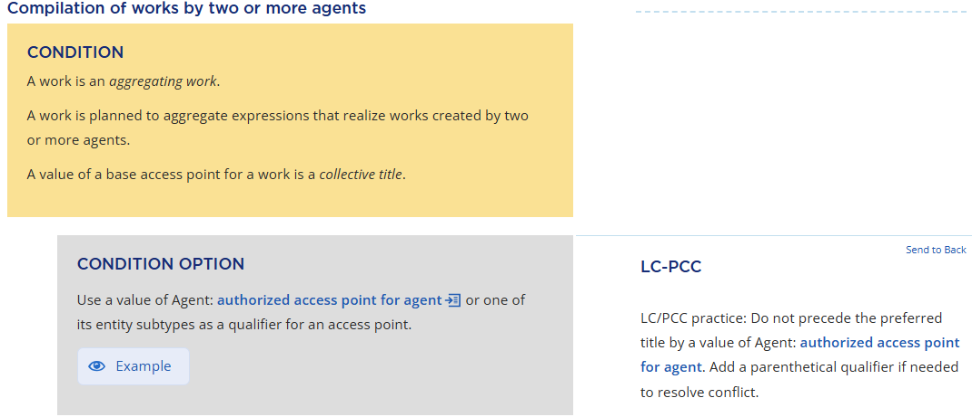
Notes:
However, there is a further subsection for Aggregating works, with a sub heading for Compilation of works by two or more agents This is exactly the type of aggregating work we have. When we are describing such a collection aggregate, the policy statement says that the preferred title is not preceded by an authorized access point for agent in an authorized access point for work. In other words, title main entry continues to be given in these cases, although an agent may be added as a qualifier if needed to resolve conflict. But we find no conflict in WorldCat records, so we have no additional elements or designations that need to be included in the authorized access point.

Slide 30
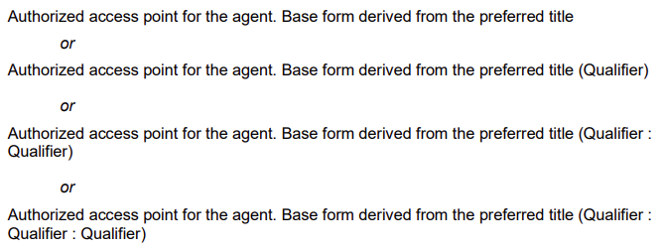
Notes:
Now we have values of all applicable elements, so one final thing to do is to follow the initial general instructions and apply the PCC string encoding scheme to put everything together and construct the authorized access point. Our ebook is the simplest case because the base authorized access point “Hamiltonian systems” does not have any additional elements like an authorized access point for agent or qualifier to be added and punctuated, so it is the value of the authorized access point for the aggregating work.

Slide 31
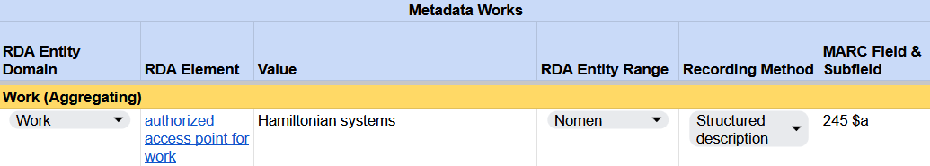
Recording authorized access point for work
RDA Record Template
Notes:
The range is Nomen, recording method is structured description using the string encoding scheme.

Slide 32
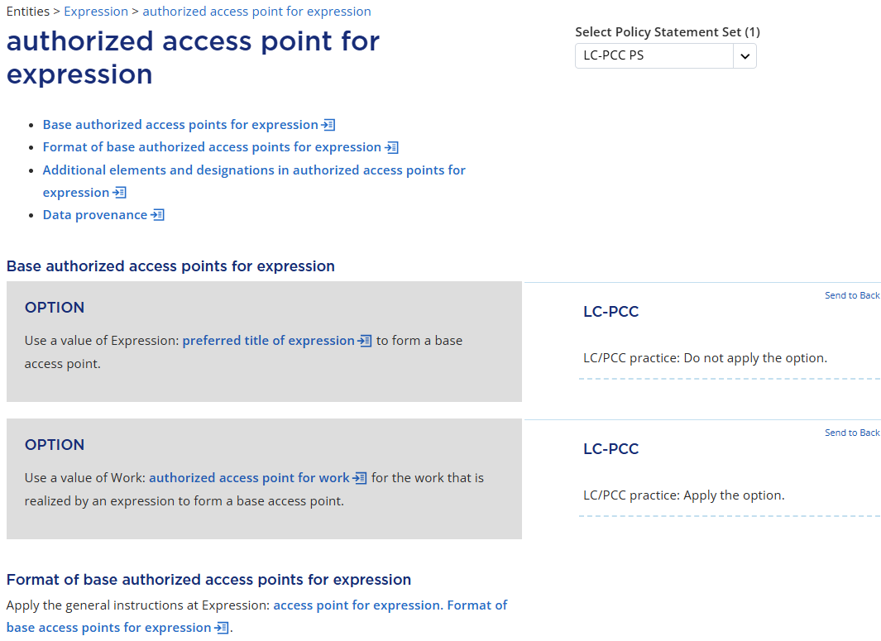
Notes:
At long last, we work back to the authorized access point for expression page with the value of the base authorized access point, which is the authorized access point for work. For the rest of the steps, we follow exactly the same pattern. We move to the next section Format of base authorized access points for expression, which tells us to apply the general instructions on the access point for expression page.

Slide 33
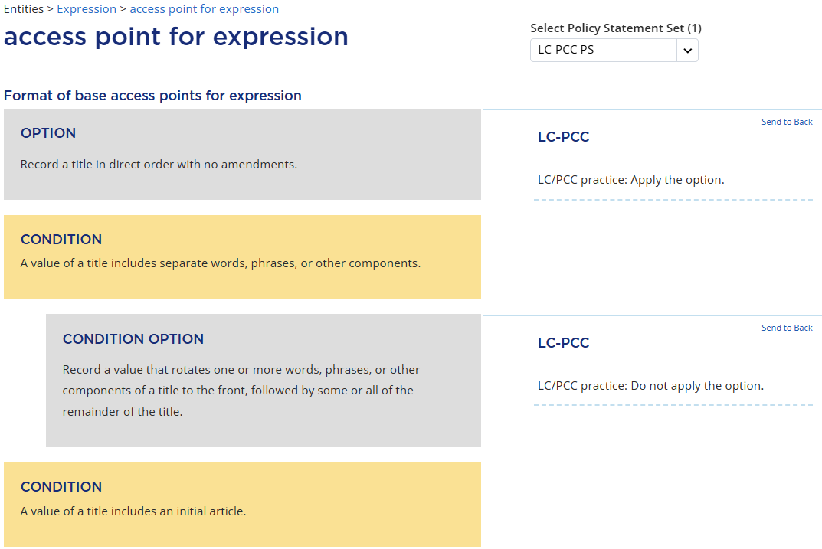
Notes:
Here we find that only the first option is applicable for our ebook, “Record a title in direct order with no amendments,” that is, in our context, do not change the authorized access point for work in any way. So, “Hamiltonian systems” is the format of our base authorized access point for expression.
In reality, this section can be skipped entirely in PCC practice because the base authorized access point for expression is the authorized access point for work, which is already formatted and then constructed by applying the PCC string encoding scheme.

Slide 34
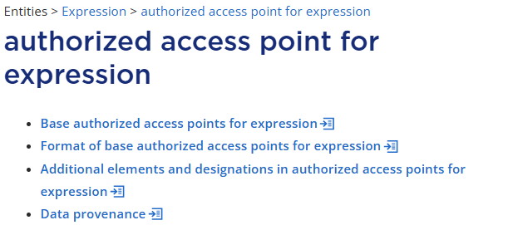
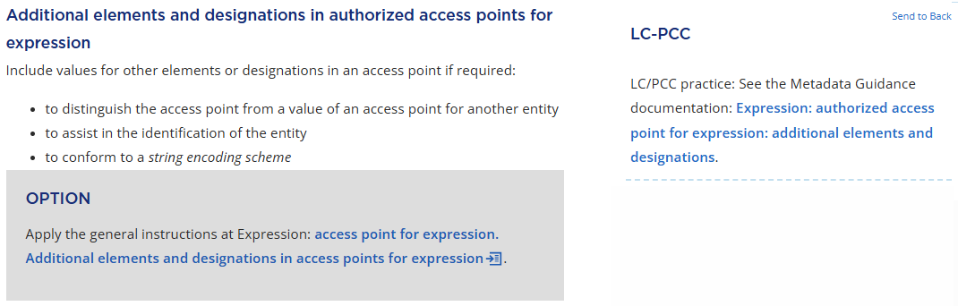
Notes:
In other words, once we have constructed the authorized access point for work, we may go straight to the next section Additional elements and designations in authorized access points for expression, which has instructions about recording additions and qualifiers if needed to break a conflict, etc. As was the case with authorized access point for work, the section tells us to apply the general instructions at the access point for expression page. This section also links to an MGD which has guidance on recording additional expression elements and designations, including how to identify translations and language editions. Also, similar guidance on recording additions is found as well in the string encoding scheme MGD on access point for expression.

Slide 35

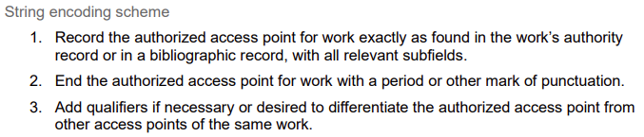
Notes:
These MGDs say that an authorized access point for expression is constructed by recording the authorized access point for work first and adding an expression element as a qualifier as needed to differentiate the expression from another expression, like language of expression and content type. So, the practice remains the same from original RDA. However, PCC practice allows catalogers to record an authorized access point for work as an authorized access point for expression for any expression in the work's original language. This means that we don’t need to differentiate the two access points.
Now we have values of all applicable elements, so one final step is to follow the initial general instructions and apply the PCC string encoding scheme to put everything together and construct the authorized access point. Because no qualifier or punctuation is added, the base authorized access point “Hamiltonian systems” is the value of the authorized access point for our aggregating expression.

Slide 36
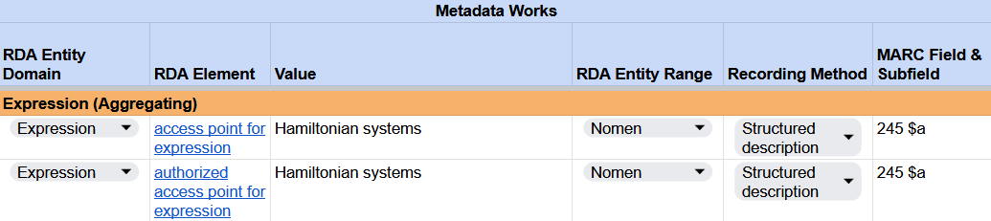
Recording access point for expression & authorized access point for expression
RDA Record Template
Notes:
Because an authorized access point for expression is a more specific type of access point for expression, we can record “Hamiltonian systems” as the value for both elements. Just like the authorized access point for work, the range is Nomen, recording method is structured description.

Slide 37
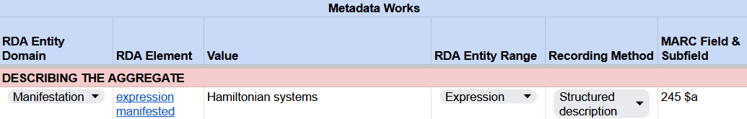
Recording expression manifested
RDA Record Template
MARC 21 Bibliographic Record
Notes:
Finally, we work our way back to the expression manifested element to identify our aggregating expression. The value and the recording method are the same as the authorized access point for expression. The range is Expression, as the element is relating the aggregate manifestation to the aggregating expression using the authorized access point.
Then, how is the element recorded in the MARC record?
Cataloging practice is not different in MARC for the aggregating expression of a collection aggregate. For our ebook, the expression manifested element is in effect recorded in 245 field $a because this is a title main entry and the authorized access point for the aggregating expression is the same value as the title proper. The element would be recorded in 130 field if we needed to qualify the authorized access point. Likewise, the element would be split between 1XX and 240 or 245 fields if a collection aggregate was a compilation of works by a single agent.

Slide 38
Minimum Description of Collection Aggregate
Aggregated Work
Aggregating Work
has appellation of work
has expression of work
Aggregated Expression
Aggregating Expression
has appellation of expression
has work expressed
has manifestation of expression
Manifestation
has title proper Hamiltonian systems
has expression manifested Hamiltonian systems
Notes:
Now we can be done here as we already have all we need for cataloging in MARC. However, for purposes of learning official RDA, let’s also look at what else is required for describing our aggregating expression and aggregating work in terms of creating their minimum metadata description.
RDA tells us that a minimum description of an expression requires an appellation of expression to refer to the entity itself, and it must also include work expressed and manifestation of expression to record the expression’s relationships with work and manifestation. A minimum description of a work requires an appellation of work to refer to the entity itself, and it must also include either expression of work or manifestation of work to record the work’s relationships with expression or manifestation.

Slide 39
Minimum Description of Collection Aggregate
Aggregated Work
Aggregating Work
has authorized access point for work Hamiltonian systems
has expression of work Hamiltonian systems
Aggregated Expression
Aggregating Expression
has authorized access point for expression Hamiltonian systems
has work expressed Hamiltonian systems
has manifestation of expression Hamiltonian systems
Manifestation
has title proper Hamiltonian systems
has expression manifested Hamiltonian systems
Notes:
Let’s see what values we have identified in our cataloging process.
The authorized access point for the aggregating expression is the value for appellation of expression and expression of work, as well as expression manifested. The authorized access point for the aggregating work is the value for appellation of work and work expressed. The title proper of our collection aggregate is the value for manifestation of expression and manifestation of work.

Slide 40
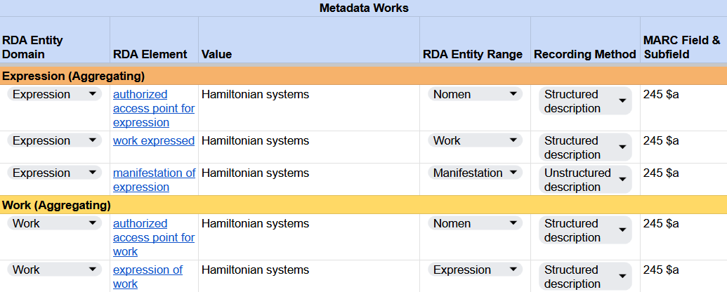
Recording work expressed, manifestation of expression, & expression of work
RDA Record Template
Notes:
Here we have the elements from the previous diagram that are required as part of the minimum description of a work and an expression in official RDA. We have already recorded the authorized access points, so just need to record work expressed, manifestation of expression, and expression of work.
We note that all the minimum description elements are already recorded in the MARC record as part of our normal cataloging practice. In the case of our ebook, 245 field $a is doing multiple duties representing all the elements we worked on. We are not doing anything different or additional in practice for cataloging in MARC at the moment.

Slide 41
aggregator person

Slide 42
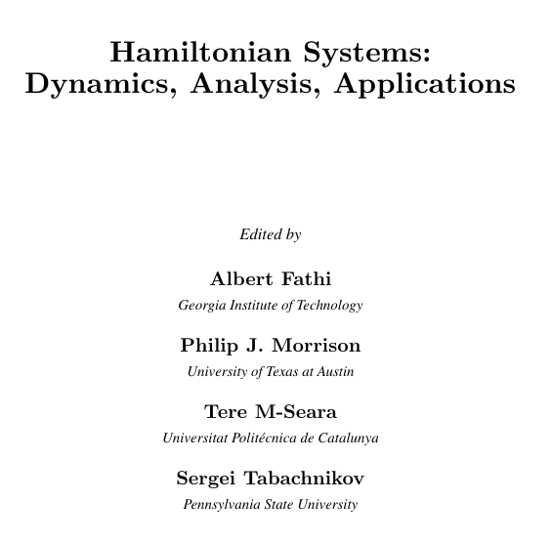
Are there any agents associated with the aggregating work that ought to be recorded? The title page of the resource names four “editors”:
Notes:
In this part, we will be looking at determining if there are any agents associated with the aggregating work that ought to be recorded.
The title page of the resource names four “editors”:
Edited by
Albert Fathi
Georgia Institute of Technology
Philip J. Morrison
University of Texas at Austin
Tere M-Seara
Universitat Politécnica de Catalunya
Sergei Tabachnikov
Pennsylvania State University
In case anyone notices: Note that the book has an incorrect spelling of the Catalan name of this university. The diacritic over the e should be grave, not acute: Universitat Politècnica de Catalunya

Slide 43
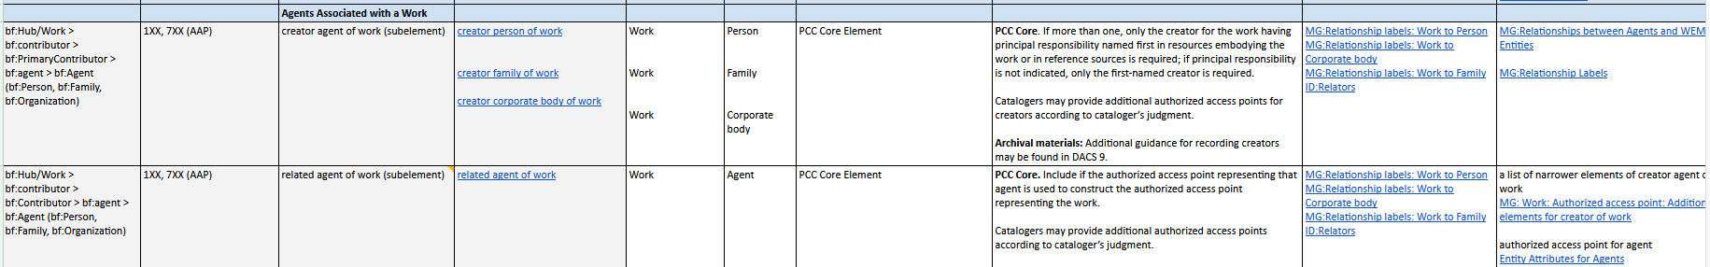
Consult the BSR for Official RDA
Under Agents Associated with a Work there are two sets of instructions to consider: creator agent of work and related agent of work. The work we are dealing with is an aggregating work, so the persons named are in some way responsible for the creation of the work.
Notes:
Consulting the BSR, we see that under Agents Associated with a Work there are two sets of instructions to consider: creator agent of work and related agent of work. The work we are dealing with is an aggregating work, so the persons named are in some way responsible for the creation of the work.

Slide 44
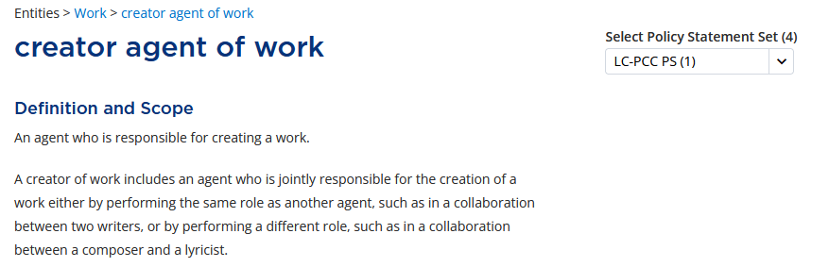
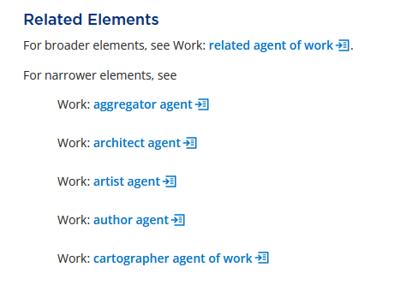
Consult Official RDA in the RDA Toolkit
Notes:
Looking in the RDA Toolkit, we find creator agent of work, “An agent who is responsible for creating a work.” Under that we find a narrower element, aggregator agent.

Slide 45
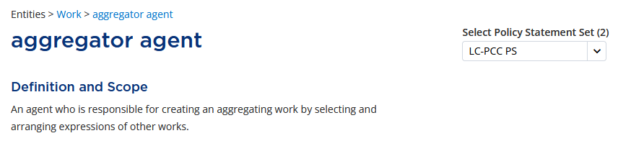
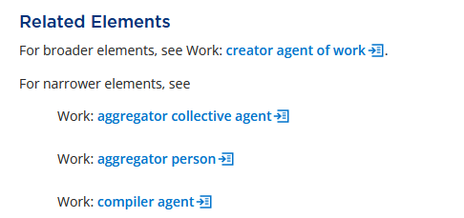
Consult Official RDA in the RDA Toolkit
Notes:
Narrower under aggregator agent we find the element aggregator person. We also find another narrower element, compiler agent.

Slide 46
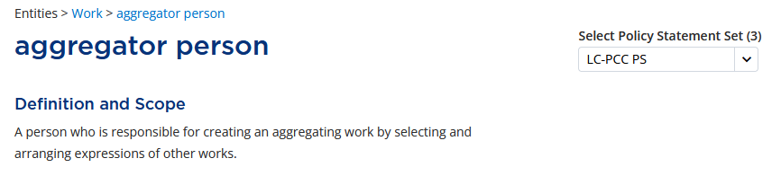
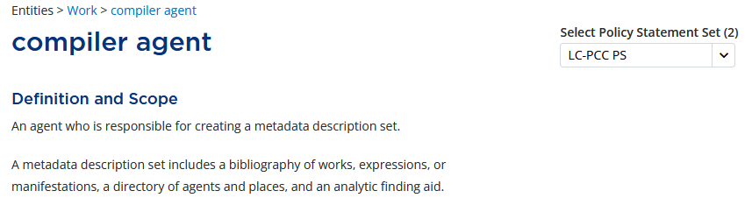
Consult Official RDA in the RDA Toolkit
Since our work is not a metadata description set, we should use aggregator person.
Notes:
Aggregator person is defined as “A person who is responsible for creating an aggregating work by selecting and arranging expressions of other works.” Compiler agent is defined as “An agent who is responsible for creating a metadata description set. A metadata description set includes a bibliography of works, expressions, or manifestations, a directory of agents and places, and an analytic finding aid.” Since our work is not a metadata description set, we should use aggregator person.

Slide 47
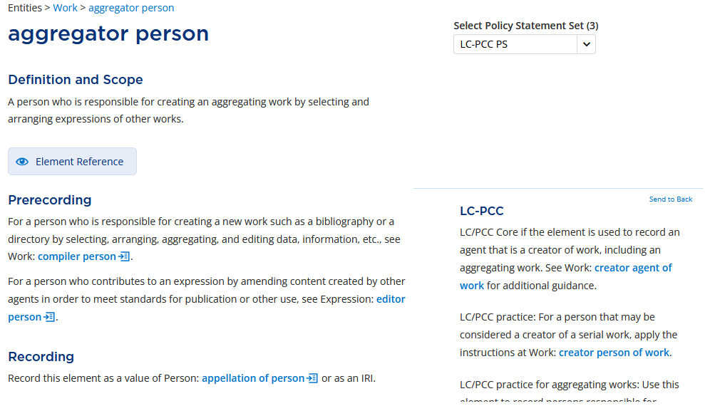
Consult Official RDA in the RDA Toolkit
Notes:
Looking at the Prerecording section of Aggregator person, we get further information:
For a person who is responsible for creating a new work such as a bibliography or a directory by selecting, arranging, aggregating, and editing data, information, etc., see Work: compiler person.
For a person who contributes to an expression by amending content created by other agents in order to meet standards for publication or other use, see Expression: editor person.
This confirms that Aggregator person is the correct element to use. In original RDA we would probably have used editor as the relationship, but that is now clearly a different kind of relationship in official RDA.
In the Prerecording section for Aggregator person, we see that there is an LC-PCC Policy Statement: LC/PCC Core if the element is used to record an agent that is a creator of work, including an aggregating work. See Work: creator agent of work for additional guidance.

Slide 48
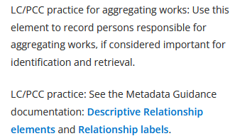
Consult Official RDA in the RDA Toolkit
Notes:
In addition, the policy statement provides an LC/PCC practice for aggregating works: Use this element to record persons responsible for aggregating works, if considered important for identification and retrieval.

Slide 49
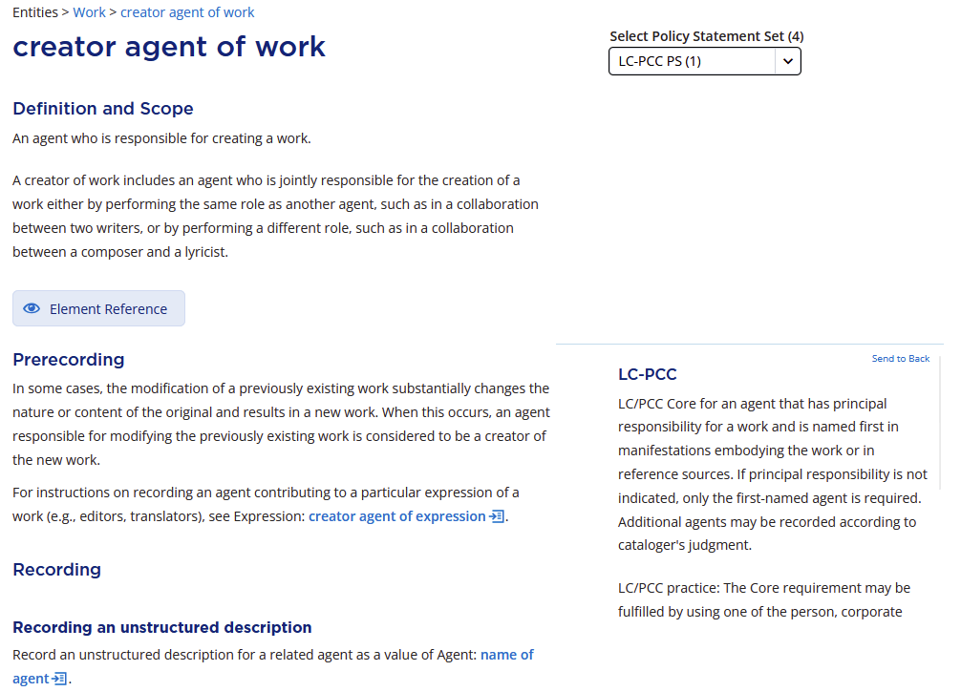
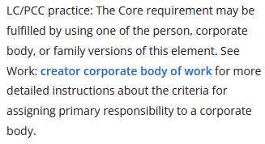
Consult Official RDA in the RDA Toolkit
Notes:
Consulting the additional guidance at creator agent of work we find this LC-PCC policy:
LC/PCC Core for an agent that has principal responsibility for a work and is named first in manifestations embodying the work or in reference sources. If principal responsibility is not indicated, only the first-named agent is required. Additional agents may be recorded according to cataloger's judgment.
LC/PCC practice: The Core requirement may be fulfilled by using one of the person, corporate body, or family versions of this element.

Slide 50
What have we learned so far?
Aggregator person is a core element.
Only the first-named agent is required in this case, since the statement of responsibility in our resource does not indicate anyone principally responsible.
Should we record any of the other three persons in addition to the first-named one?
In our judgment, all four persons are important for identification and retrieval, so we will record them all.
Notes:
So, we know now that Aggregator person is a core element. We also know that only the first-named agent is required in this case, since the statement of responsibility in our resource does not indicate anyone principally responsible.
Should we record any of the other three persons in addition to the first-named one?
In our judgment, all four persons are important for identification and retrieval, so we will record them all.

Slide 51
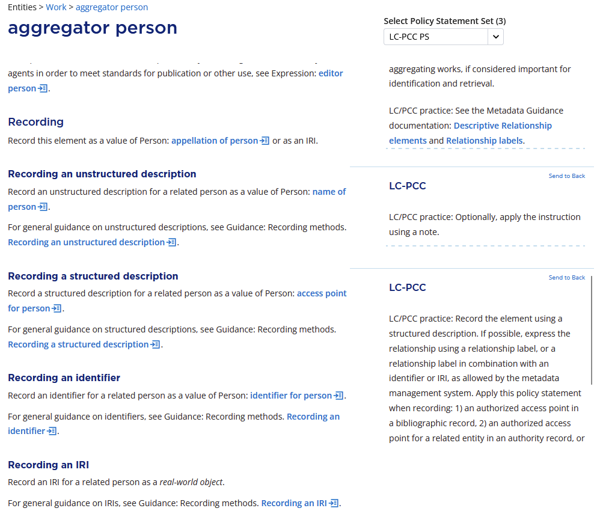
Recording the Aggregator Persons
Notes:
Going back to Aggregator person, under Recording, we are presented with four methods of recording: Unstructured description, Structured description, Identifier, and IRI. A policy statement tells us: Record the element using a structured description. If possible, express the relationship using a relationship label, or a relationship label in combination with an identifier or IRI, as allowed by the metadata management system. Apply this policy statement when recording: 1) an authorized access point in a bibliographic record. …

Slide 52
Recording the Aggregator Persons
In the bibliographic record, we will use an authorized access point for each of the four persons responsible for creating the aggregating work
Search the NAF to see if the persons have established authorized access points; upgrade or revise the NARs if necessary
If any do not have authority records, NACO participants would create them, following RDA and PCC guidelines and documentation
Non-NACO participants should still follow RDA and other policies they use to determine the preferred name and formulate the authorized access point for a person
Notes:
In our bibliographic record, then, we will use an authorized access point for each of the four persons responsible for creating the aggregating work. Search the NAF to see if the persons have established authorized access points; upgrade and revise the NARs if necessary. If any do not have authority records, NACO participants would create them, following RDA and PCC guidelines. Even if we weren't creating a name authority record, we should still follow RDA and any other policies we use to determine the preferred name and formulate the authorized access point for a person.

Slide 53
Recording the Aggregator Persons
Searching the authority file for the persons, we find that all four are already established:
100 1# $a Fathi, Albert
100 1# $a Morrison, Philip J.
100 1# $a Seara, Tere M., $d 1961-
100 1# $a Tabachnikov, Sergei, $d 1956-
Now that we have the authorized access points for the four creators of the aggregating work, we need to determine the appropriate relationship label to use with them.
Notes:
Searching the authority file for the persons, we find that all four are already established:
100 1# $a Fathi, Albert
100 1# $a Morrison, Philip J.
100 1# $a Seara, Tere M., $d 1961-
100 1# $a Tabachnikov, Sergei, $d 1956-
Now that we have the authorized access points for the four creators of the aggregating work, we need to determine the appropriate relationship label to include with them.

Slide 54
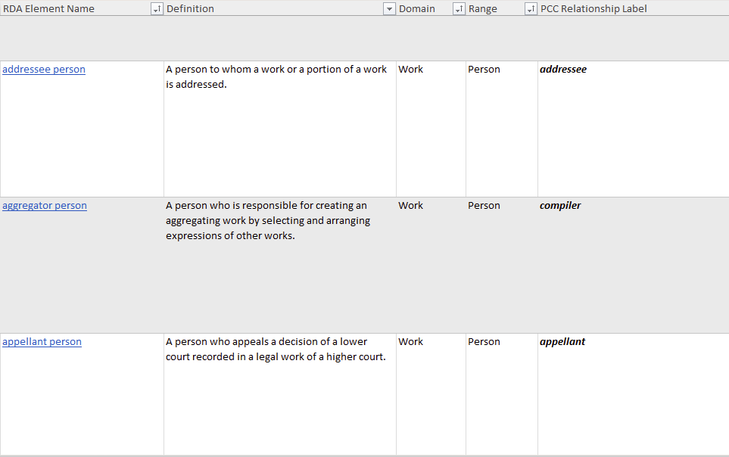
Relationship Labels
Consult the Metadata Guidance Documentation: Relationship Labels spreadsheet
Notes:
For relationship labels, consult the Metadata Guidance Documentation: Relationship Labels spreadsheet.
Looking for "aggregator person" we find the element in the spreadsheet, as shown on the slide. The PCC relationship label for this element is "compiler".

Slide 55
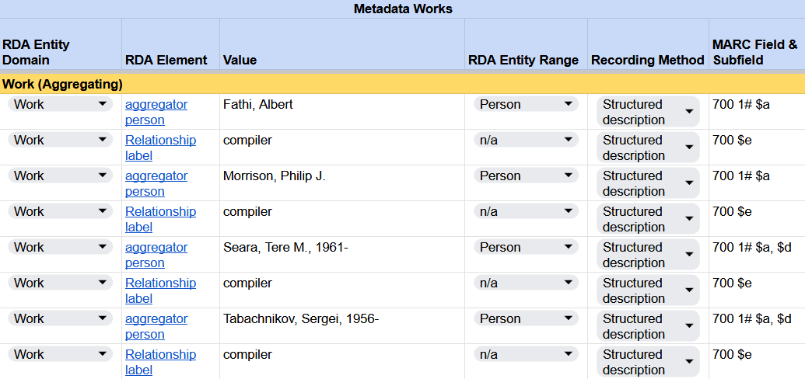
Recording aggregator person
RDA Record Template
Notes:
In our RDA Record Template, the access point from the authority file is recorded as a structured description without the MARC coding. The relationship label is recorded after each name.

Slide 56

Recording aggregator person
MARC 21 Bibliographic Record
Notes:
The MGD tells us the label to use is “compiler”. In our MARC record, we will therefore record:
700 1# $a Fathi, Albert, $e compiler.
700 1# $a Morrison, Philip J., $e compiler.
700 1# $a Seara, Tere M., $d 1961- $e compiler.
700 1# $a Tabachnikov, Sergei, $d 1956- $e compiler.

Slide 57
Recording the Aggregator Persons
Note that we could go further and record an IRI for a related person as a real-world object in subfield $1
700 1# $a Fathi, Albert, $e compiler. $1 https://id.oclc.org/worldcat/entity/E39PBJx8DjV8mBWyCTM4FxRdwC
700 1# $a Morrison, Philip J., $e compiler. $1 https://id.oclc.org/worldcat/entity/E39PBJtRQHDxvpbcjDjVvkcByd
700 1# $a Seara, Tere M., $d 1961- $e compiler. $1 https://id.oclc.org/worldcat/entity/E39PBJghvKRjdQPTP8fpgWQcyd
700 1# $a Tabachnikov, Sergei, $d 1956- $e compiler. $1 https://id.oclc.org/worldcat/entity/E39PBJrKYg6jgfpwYghrtymGHC
Notes:
Note that we could go further and record an IRI for a related person as a real-world object. The LC-PCC PS for recording the value for the element aggregator person tells us to use a structured description (i.e., an access point); however, there are no policy statements that prohibit also recording an identifier or IRI. That leaves it up to cataloger judgment. WorldCat Entity IRIs are shown in subfield $1 in the slide. If these four access points are controlled in OCLC, the WorldCat Entity IRI for each person will automatically be added by the software.

Slide 58

Recording the Aggregator Persons
We could also include a IRI from the RDA Registry for the relationship element, encoding it in subfield $4.
PCC policy is to use unconstrained property IRIs
Notes:
We could go even further and apply, according to the LC-PCC policy for recording the element Aggregator person, “a relationship label in combination with an identifier or IRI, as allowed by the metadata management system.” For that we could include an IRI from the RDA Registry for the relationship element, encoding it in subfield $4.
PCC policy is to use unconstrained property IRIs. Click on “Unconstrained properties” and search for “aggregator”.

Slide 59

Notes:
Within the unconstrained properties, we have searched for "aggregator." We want to obtain the unconstrained URI for “has aggregator”. To do this we right click on the CURIE rdau:P61091 and choose “copy link”.

Slide 60
Recording the Aggregator Persons
Right click on the CURIE for rdau:P61091 and choose “copy link”. The IRI copied is http://rdaregistry.info/Elements/u/P61091
You can also obtain the unconstrained IRI from the Relationship Labels spreadsheet
$4 follows $e and precedes $0 and $1
700 1# $a Fathi, Albert, $e compiler. $4 http://rdaregistry.info/Elements/u/P61091 $1 https://id.oclc.org/worldcat/entity/E39PBJx8DjV8mBWyCTM4FxRdwC
700 1# $a Morrison, Philip J., $e compiler. $4 http://rdaregistry.info/Elements/u/P61091 $1 https://id.oclc.org/worldcat/entity/E39PBJtRQHDxvpbcjDjVvkcByd
700 1# $a Seara, Tere M., $d 1961- $e compiler. $4 http://rdaregistry.info/Elements/u/P61091 $1 https://id.oclc.org/worldcat/entity/E39PBJghvKRjdQPTP8fpgWQcyd
700 1# $a Tabachnikov, Sergei, $d 1956- $e compiler. $4 http://rdaregistry.info/Elements/u/P61091 $1 https://id.oclc.org/worldcat/entity/E39PBJrKYg6jgfpwYghrtymGHC
Notes:
The IRI copied is http://rdaregistry.info/Elements/u/P61091 and this is what we will use in our MARC record should we decide to include it. You can also obtain the unconstrained IRI from the Relationship Labels spreadsheet that we looked at earlier.

Slide 61
For best practices on recording URIs in MARC records, see:
PCC Task Group on Linked Data Best Practices: Final Report
URIs FAQ
Formulating and Obtaining URIs: A Guide to Commonly Used Vocabularies and Reference Sources
All three of these documents are in the process of being updated by the PCC Task Group for URIs in MARC Implementation and Support. The latter document has an updated version on Wikidata at: https://www.wikidata.org/wiki/Wikidata:WikiProject_URIs_in_MARC

Slide 62
issue of
Notes:
In this part, we will be looking at work to work relationships and whether our aggregating work is related to any other works.

Slide 63


Notes:
Looking at our resource, we find a series title page that tells us that Hamiltonian Systems is issue 72 of something titled Mathematical Sciences Research Institute Publications. Mathematical Sciences Research Institute Publications is a monographic series and in describing the manifestation of Hamiltonian Systems we have already recorded the series statement that appears in the ebook in a 490 field in MARC. Series statement has the domain of manifestation. It is a transcribed element that we record using a structured description by applying a string encoding scheme to select, sequence, and punctuate values of one or more subelements (see first option under Recording a structured description, which the LC-PCC policy statement says to apply).

Slide 64

Recording Related Works
The BSR section for Related Works shows that “issue of” is likely the element we want to use for relationships to series. It includes a link to an MGD on Series/Subseries.
Notes:
To record the relationship of the aggregating work to a series work, we need to use a different RDA element. Looking at the BSR in the Related Works section, we find potential elements: related work of work, finding aid, and issue of. The first and third are work to work relationships, and in the Official RDA Notes column, we see that series is mentioned in the notes for issue of. We can click on the link to the RDA Toolkit for issue of.

Slide 65


Notes:
The definition in RDA of issue of is not the clearest: “A work that is a successive aggregating work that inspires the editorial policy, scope, and style of a static work.” Opening the Element Reference box, we see that the domain and range of this element are both work. And we see that an alternate label for this element is “in series.”
Voilà! That confirms for us that issue of is the element we need to relate our aggregating work to the series (aka “successive aggregating work that inspires the editorial policy, scope, and style of a static work”) that it is in.

Slide 66

Notes:
In the Recording section of the element, a policy statement tells us: “PCC practice for aggregated works: Do not record the element. Create instead an access point identifying the issue that includes the title of the successive aggregating work and the numeric and/or chronological designation of the issue.” It also refers us to the Metadata Guidance documentation: Series/subseries: Work: issue of. But let's look a bit further.

Slide 67


Notes:
Under Recording a structured description, a policy statement tells us “Record the element using a structured description. If possible, express the relationship using a relationship label, or a relationship label in combination with an identifier or IRI, as allowed by the metadata management system. Apply this policy statement when recording: 1) an authorized access point in a bibliographic record, 2) an authorized access point for a related entity in an authority record, or 3) a structured value that is not functioning as an access point. If the metadata management system does not permit recording a relationship label for the element, omit it.” So we have two conflicting policy statements, one that says to not record the element but to create an access point for the series and another that says to record the element using a structured description. This conflict will need to be resolved by the PCC. For now, we will follow the policy that says to record this element.

Slide 68

BSR
Notes:
If we go back to the BSR, we see that there is an Official RDA Note that says:
PCC Practice: Searching for series authority records, tracing the series (creating structured descriptions), and the creation and maintenance of series authority records are optional. If local institutional cataloging policy is to trace an expression of a series, use the authorized access point form of the expression of the series established in the LC/NACO Authority File. See MG: Series/Subseries for instructions.

Slide 69


MG: Series
Notes:
The MGD instructions for describing a series in a MARC bibliographic record also point us to the MGD Series/subseries: Work: issue of.

Slide 70


Slide 71
To Trace or not to Trace
Is your local institutional cataloging policy to trace series?
  No: Only a series statement will be recorded. The 490 field in a MARC record will have a first indicator value of 0 = Series not traced. You can stop there.
  Yes: Provide an authorized access point for the series in your bibliographic description. According to both the BSR and the MGD Work: issue of, use one of the MARC 80X-83X series added entry fields.

Slide 72
To Trace
Is there a series authority record for the series?
  Yes: Use the authorized access point already established. Upgrade to RDA and if necessary revise a non-RDA series authority if you are authorized to do NACO series work.
  No: If you are creating a BIBCO or CONSER record and tracing the series, you will need to create a series authority record for it. Catalogers trained for NACO series work can also create SARs even if they aren’t coding a bibliographic record as a PCC record. In all cases, the series added entry should conform to RDA and other policies followed by your institution for the formulation of successive aggregating work authorized access points.

Slide 73
To Trace
If your local policy is to trace series, you will find that there is already a series authority record for Mathematical Sciences Research Institute publications and it is coded as RDA, so you can use it in an RDA record

Slide 74

Notes:
If your local policy is to trace series, you will find that there is already a series authority record for Mathematical Sciences Research Institute publications and it is coded as RDA, so you can use it in an RDA record

Slide 75

Recording issue of
RDA Record Template
MARC 21 Bibliographic Record

Slide 76
To Trace
For a series established using title alone, MARC 830 is the appropriate field. So far, we would record:
830 #0 $a Mathematical Sciences Research Institute publications.
Where do we record the relationship label “issue of”?
  We don’t!
  PCC policy statement for recording this element tells us “Do not record the element. Create instead an access point identifying the issue that includes the title of the successive aggregating work and the numeric and/or chronological designation of the issue”
  There is no subfield in which to record a relationship label in the 800-830 fields. There’s also not a subfield $4 in which to record a relationship URI
  The MARC 800-830 fields by definition already convey the relationship “issue of” or “in series”

Slide 77

800-830 fields lack subfields $i and $4 for relationship labels and relationship URIs
Notes:
In the MARC 800-830 series added entry fields, there is no subfield defined to hold either a relationship label or a relationship URI. Note the absences of $i and $4 in the 830 field in the slide.
In case anyone asks: $e is defined in 800 and 810 and $j is defined in 811, but only for the name portion of an access point. PCC practice is not to record $e/$j after a name in a name-title access point.

Slide 78
To Trace
So far, we would record:
830 #0 $a Mathematical Sciences Research Institute publications.
We can also, if appropriate and considered important, include an identifier or IRI
  ISSN: subfield $x after the access point and series numbering. See MGD Series/subseries: Work: issue of and MGD Series: ISSN for more information
  Other identifiers, including authority record URIs: subfield $0
    Alphanumeric identifiers are preceded by a MARC code for the source in parentheses, e.g. $0 (DLC)n 84714376
    OCLC controlling software deletes $0s when access points are controlled
  Real world object IRIs: subfield $1
Notes:
Note: when an access point is controlled in OCLC, if there is an identifier or URI in $0 it will be removed. IRIs in $1 are retained, however.

Slide 79
To Trace
For our resource, we don’t have an ISSN for the series readily available, but there are both VIAF and Wikidata IRIs available that could be included
830 #0 $a Mathematical Sciences Research Institute publications. $1
http://viaf.org/viaf/175409275
or
830 #0 $a Mathematical Sciences Research Institute publications. $1
http://www.wikidata.org/entity/Q27940815
or
830 #0 $a Mathematical Sciences Research Institute publications. $1
http://viaf.org/viaf/175409275 $1 http://www.wikidata.org/entity/Q27940815
Notes:
Read the bullet in the slide.

Slide 80
To Trace
There is still one more thing to reckon with. Hamiltonian Systems is issue 72 of the Mathematical Sciences Research Institute publications. What does RDA tell us to do about that?
Notes:
There is still one more thing to reckon with, though. Hamiltonian Systems is issue 72 of the Mathematical Sciences Research Institute publications. What does RDA tell us to do about that? For that we turn to the next part of this training.

Slide 81
numbering of part

Slide 82
Numbering of Part
In the series statement in the 490 field, we combined the element title of series with the value Mathematical Sciences Research Institute publications with the element numbering within sequence with the value 72. Series statement is a manifestation level element
For the work to work relationship of the aggregating work to the series work of which it is part, we cannot use manifestation elements. We need to find a different element for the numbering of the series work than what we used in the manifestation description
Notes:
In the previous section, we recorded the element issue of. In our MARC record, we used field 830 to record the authorized access point for the series Mathematical Sciences Research Institute publications.

Slide 83


Series-Subseries MGD
Notes:
The Series-Subseries MGD has a section on Workflow for describing a series in a MARC bibliographic record. The bulk of this workflow deals with recording the series statement in field 490. The very end of it points us to a different MGD: “Index the series if your agency indexes series and the authority record for the series calls for it (see MG: Series: Issue of and, for information about tracing (indexing) practice as recorded in the authority record, MG: Series: Non-RDA elements).”

Slide 84

Series: Issue of MGD
Notes:
The Series: Issue of MGD tells us that:
The indexing form of the series is recorded in MARC bibliographic 8XX. It can potentially contain three elements:
the authorized access point for the series as found in the authority record for the series
numbering following the pattern found in the authority record for the series
ISSN

Slide 85

Series: Issue of MGD
Notes:
It goes on to specify the string encoding scheme for numbering:
Numbering is recorded in subfield $v. It is preceded by space – semicolon – space and followed by a full stop. In order for the string to index correctly, numbering must be recorded following the pattern that appears in the authority record for the series.

Slide 86
Notes:
So… back we go to look in the authority file to see if a numbering pattern has been recorded for this series.
The numbering pattern to follow in series added entries if given in MARC authority field 642. We can see from the value “1” in that field that only a number is recorded, without any preceding word or abbreviation such as “v.”, “no.”, “pt.”, etc.

Slide 87
Numbering of Part
Following the pattern in the series authority, we will record “72”
830 #0 $a Mathematical Sciences Research Institute publications ; $v 72.
In RDA, we know that the series authorized access point would be recorded in the element issue of. Where would the numbering go? There is no appropriate element for series numbering in the BSR, so we will go back to the RDA Toolkit to look for one
Notes:
Therefore, we will record “72” in our 830 field in $v, preceding it with space – semicolon – space and following it with a full stop (period):
830 #0 $a Mathematical Sciences Research Institute publications ; $v 72.
In RDA, we know that the series authorized access point would be recorded in the element issue of. Where would the numbering go? There is no appropriate element for series numbering in the BSR, so we will go back to the RDA Toolkit to look for one.

Slide 88


Notes:
If we look at the elements under the Work entity, we could scroll through all of them trying to find something appropriate.

Slide 89

Notes:
Eventually, we might find something that looks promising: numbering of part
Note that we could have also found this element by searching for the word "numbering" in the search box shown above or in the main search box in the upper right corner of any RDA Toolkit page.

Slide 90

Notes:
Let’s look at the numbering of part element in more detail.
This does appear to be what we are looking for.

Slide 91

Notes:
If we open the Element Reference, we see that this element can be recorded in 8XX fields, but the subfield shown is $n.
Hmmm, maybe this isn’t the right element after all. But let’s keep looking.

Slide 92

Notes:
Under Prerecording, there is a policy statement:
PCC practice: Use this element to record the authorized numbering format for Work: authorized access point for work for series and subseries.
Voilà! This indeed is the element we will use for numbering within the series work.
In addition, there is a policy statement that refers us to “See the Metadata Guidance documentation: Works.”

Slide 93

Works MGD
Notes:
The MGD Works includes a section on numbering of part that includes the following guidance:
Record numbering in authorized access points for series and subseries following the numbering pattern that has been established in the series authority record.
Use abbreviations listed under Abbreviations in access points for manifestation from Terms in specific languages.
For designations in English, do not capitalize words or abbreviations unless the word or abbreviation is capitalized in English.
See MG: Series-Subseries for additional guidance on recording numbering of part for series and subseries.

Slide 94

Recording numbering of part
RDA Record Template
MARC 21 Bibliographic Record

Slide 95
Numbering of Part
Note that if we decide to include any IRIs for the series work, they apply only to the work access point that is recorded in subfields $a, $n and/or $p, not the numbering in $v. Subfields $x, $0 and $1 are recorded at the end of the MARC 8XX, in that order.
830 #0 $a Mathematical Sciences Research Institute publications ; $v 72.
$1 http://viaf.org/viaf/175409275

