Slide 1
Cataloging an eBook
Describing the Manifestation

Slide 2
RDA Copyright
©2010-2025 - American Library Association, Canadian Federation of Library Associations, and CILIP: Chartered Institute of Library and Information Professionals.
Screen images from the RDA Toolkit (www.rdatoolkit.org) used by permission of the Copyright Holders for RDA (American Library Association, Canadian Federation of Library Associations, and CILIP: Chartered Institute of Library and Information Professionals).

Slide 3
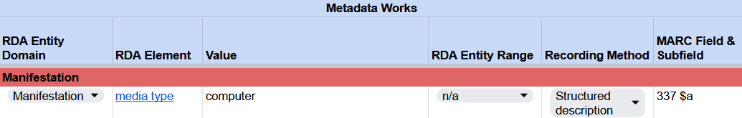
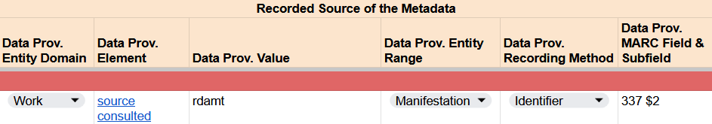
Recording media type
RDA Record Template
Notes:
Again, because we recorded a term from the RDA Media Type VES, we will record the identifier or code rdamt as the source consulted for the media type value “computer”.

Slide 4
Recording media type
RDA Record Template
MARC 21 Bibliographic Record
Notes:
In MARC, this code is recorded in 337 subfield $2.

Slide 5
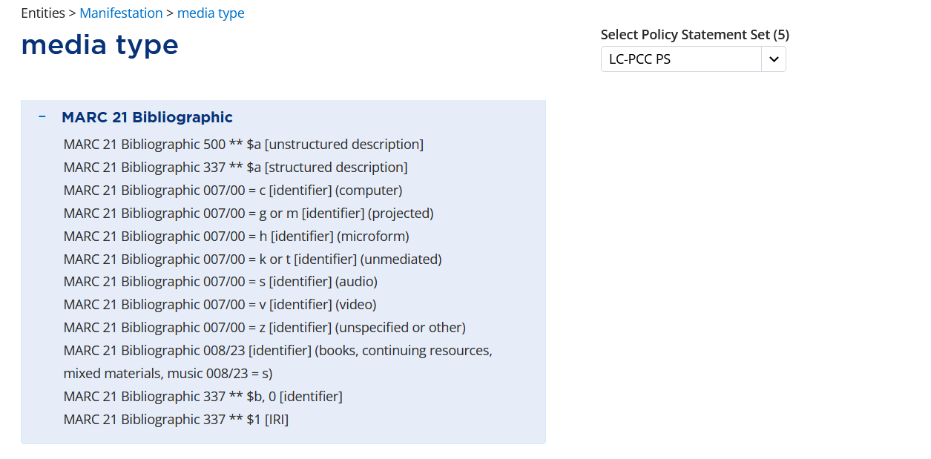
Notes:
In addition to recording media type in field 337, in the Element Reference box, the MARC 21 Bibliographic alignment indicates that media type can also be recorded in field 007, byte 00 as an identifier. The code “c” corresponds to the computer media type.

Slide 6
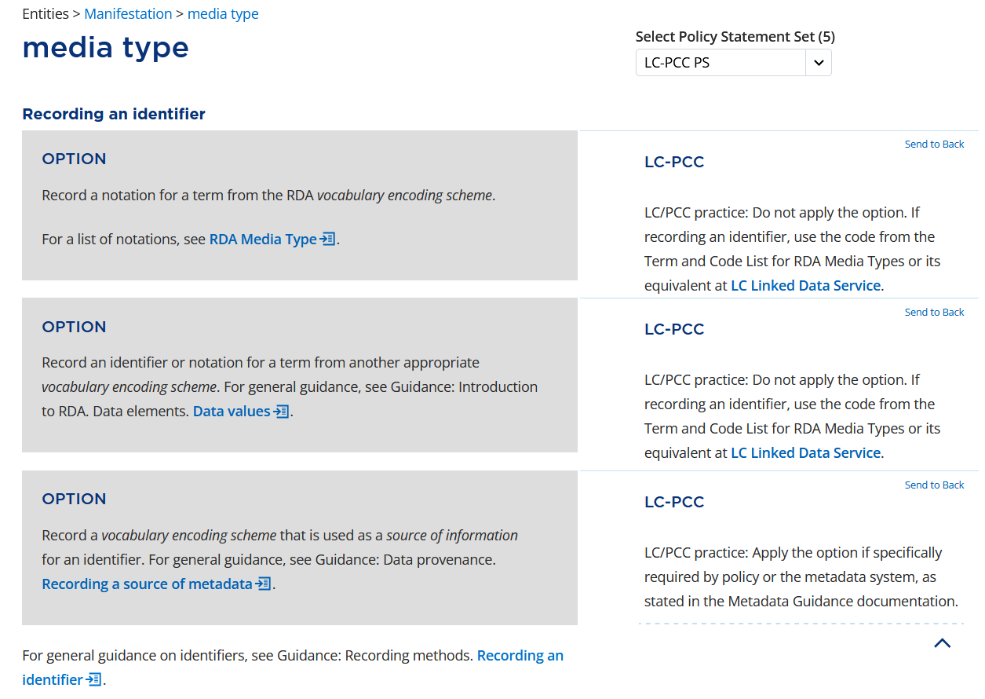
Notes:
In RDA, we are applying the option to “Record an identifier or notation for a term from another appropriate vocabulary encoding scheme.” In the case of the 007 field, the code comes from MARC.

Slide 7
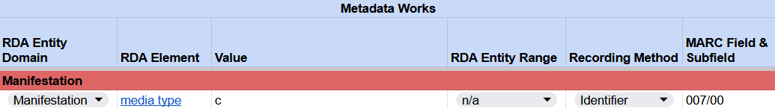
Recording media type
RDA Record Template
MARC 21 Bibliographic Record
Notes:
The code c is recorded as an identifier for media type and coded in 007 byte 00 (or subfield $a in OCLC).

Slide 8
carrier type

Slide 9
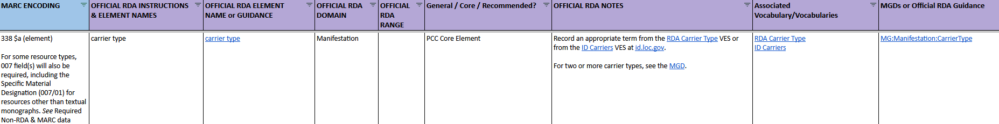
BSR Metadata Application Profile
Record an appropriate term from the RDA Carrier Type VES or from the ID Carriers VES at id.loc.gov.
Notes:
Following media type in the BSR is the element carrier type. Again, note the instruction to "Record an appropriate term from the RDA Carrier Type VES or from the ID Carriers VES at id.loc.gov."

Slide 10
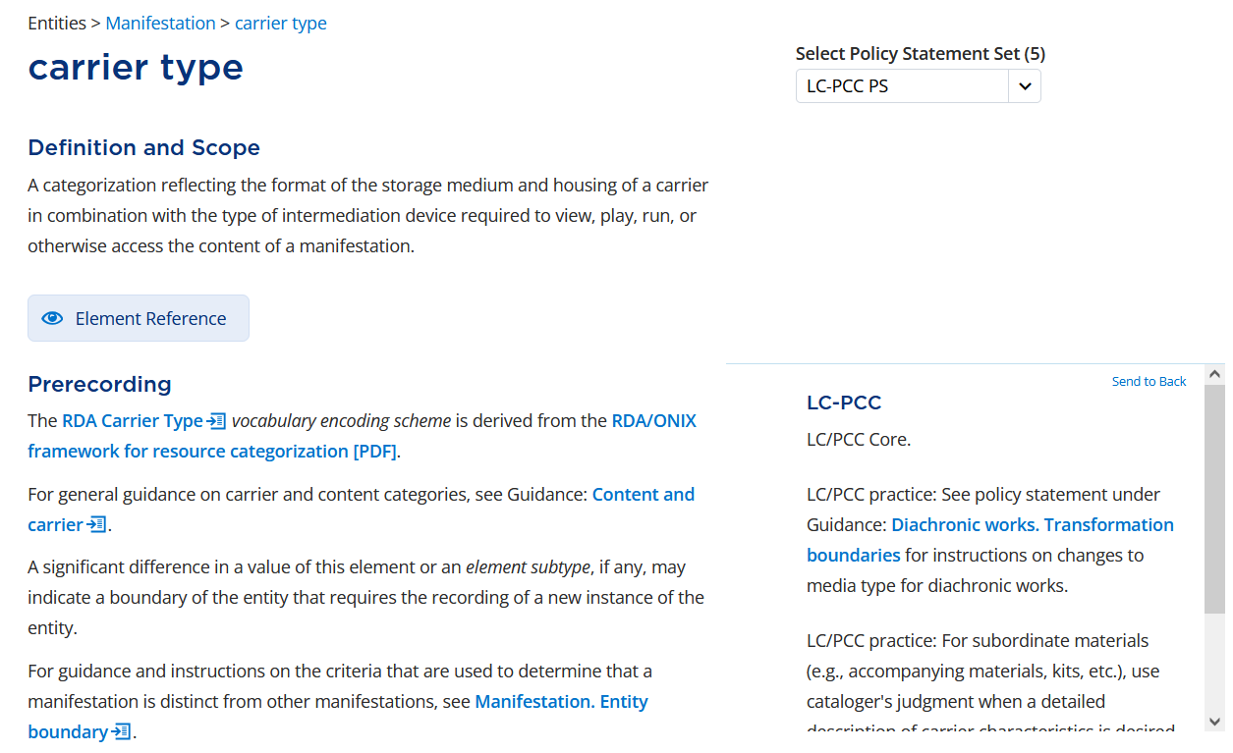
Notes:
Carrier type is defined in the toolkit as ‘A categorization reflecting the format of the storage medium and housing of a carrier in combination with the type of intermediation device required to view, play, run, or otherwise access the content of a manifestation.’ Put another way, what is the apparatus containing the content we are describing?
Under Prerecording, the policy statement reiterates that the element is LC/PCC Core.

Slide 11
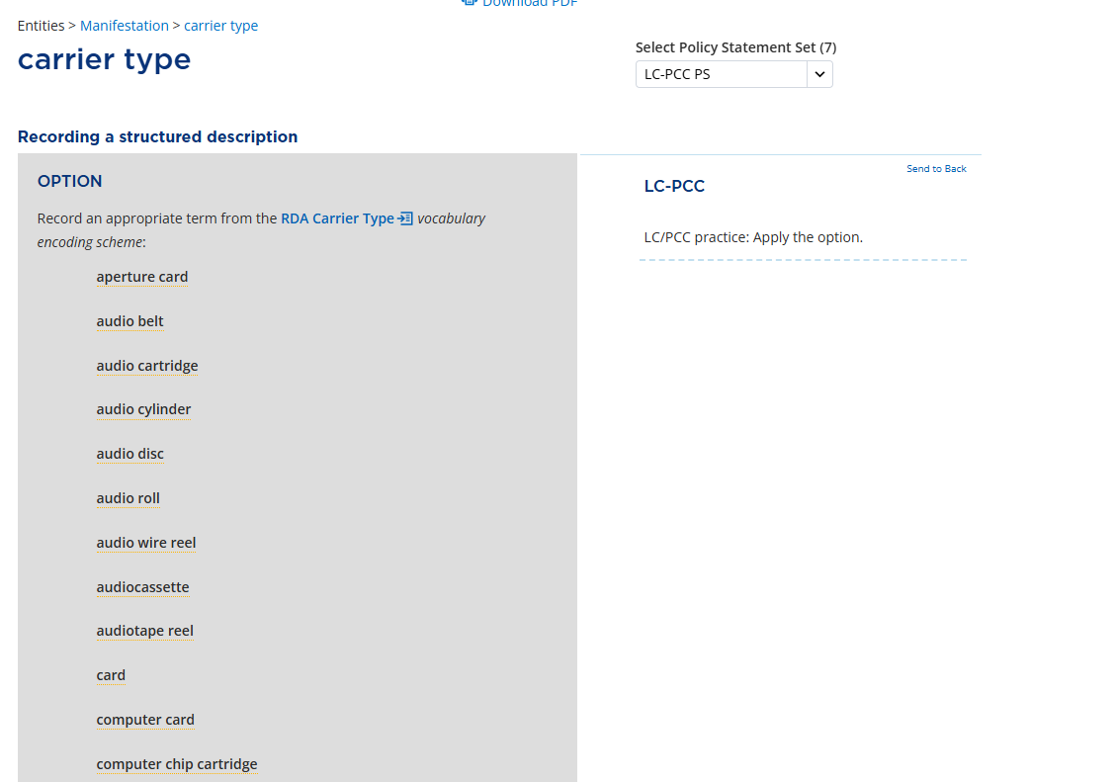
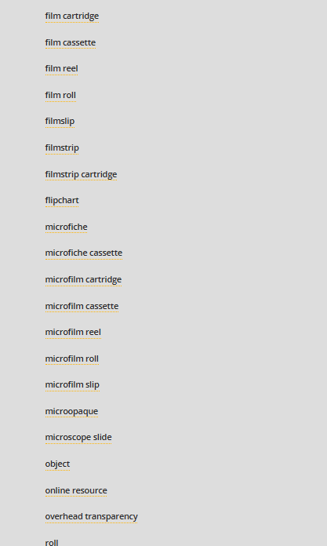
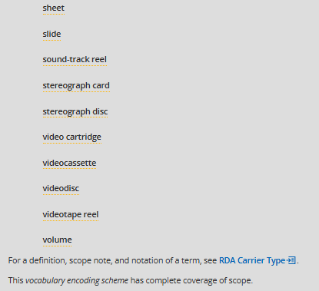
Notes:
Although carrier type can be recorded as an unstructured description, we will jump to Recording a structured description and apply the first option to record a term from the RDA Carrier Type VES; however, as with media type, you may apply the option to record a term from another appropriate VES instead.
In this case, we have an ebook so our carrier type is ‘online resource’.

Slide 12

Recording carrier type
RDA Record Template
MARC 21 Bibliographic Record
Notes:
The value “online resource” is recorded as a structured description for carrier type.
This information is encoded in the 338 field in MARC.

Slide 13
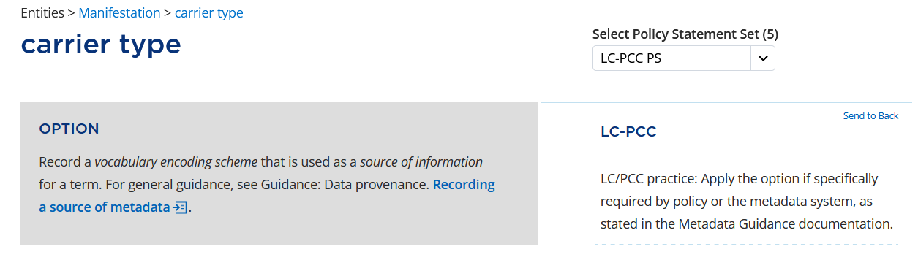
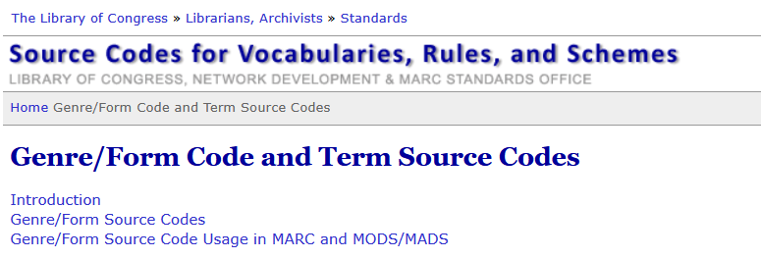

Notes:
We will apply the option to record the source of the term. As with media type, we will take the code from the Genre/Form Code and Term Source Codes list. The code for the RDA Carrier Type VES is rdact.

Slide 14
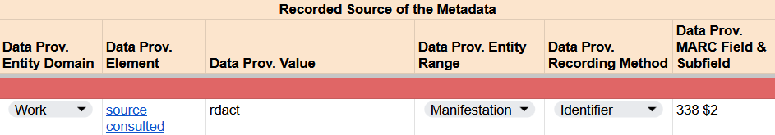
Recording carrier type
RDA Record Template
Notes:
In our RDA Template, the code rdact is recorded as the source consulted for the carrier type term “online resource”.

Slide 15
Recording carrier type
RDA Record Template
MARC 21 Bibliographic Record
Notes:
In MARC, the code is recorded in subfield $2.

Slide 16
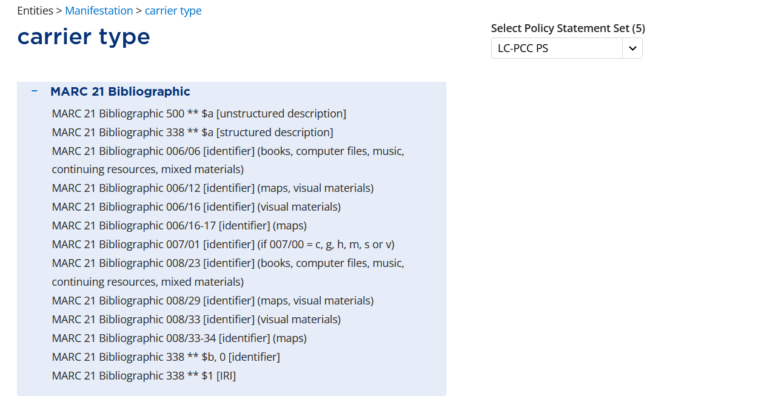
Notes:
The MARC 21 Bibliographic alignment indicates that carrier type can also be recorded as an identifier in field 006 byte 06, field 007 byte 01, and field 008 byte 23. The codes we record are found in the MARC standard.

Slide 17
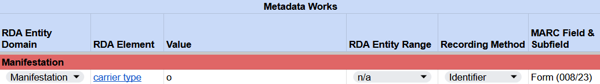

Recording carrier type
RDA Record Template
MARC 21 Bibliographic Record
Notes:
In the Form fixed field, or 008 byte 23, we record the code o, which corresponds “Online”.

Slide 18

Recording carrier type
RDA Record Template
MARC 21 Bibliographic Record
Notes:
In field 006, code byte 06 with the code o for online. If using guided entry in OCLC, you will first have to code byte 00 as m.

Slide 19

Recording carrier type
RDA Record Template
MARC 21 Bibliographic Record
Notes:
Lastly, we also record the identifier r in the 007 field, byte 01 (or subfield $b in OCLC).

Slide 20
category of manifestation

Slide 21
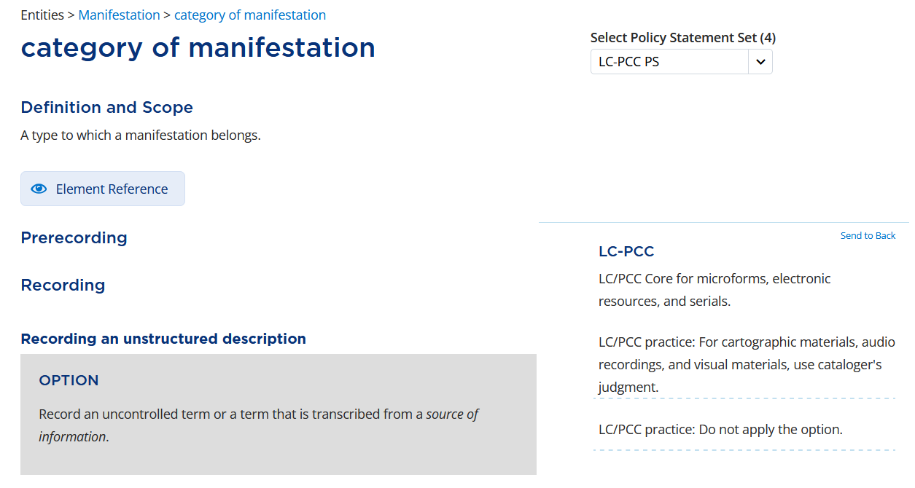
Notes:
Because of the different recording methods in official RDA, we can map data we have always recorded in MARC fields, such as 007 and 008, to official RDA elements. This data, recorded using an identifier, is no longer relegated to the realm of ‘non-RDA data’.
The category of manifestation is the type to which a manifestation belongs.
Per LC-PCC PS, this is Core for microforms, electronic resources, and serials.

Slide 22
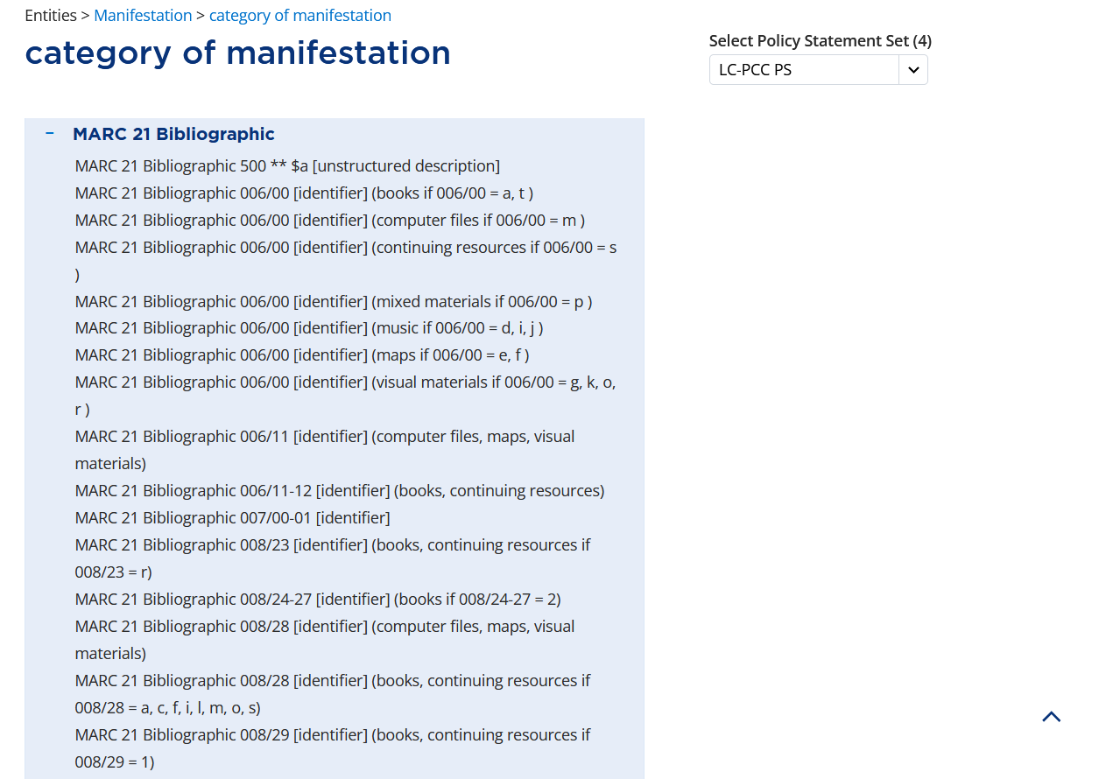
Notes:
The MARC 21 Bibliographic alignments list various fixed fields where category of manifestation is recorded as an identifier, including 006, 007, and 008.

Slide 23
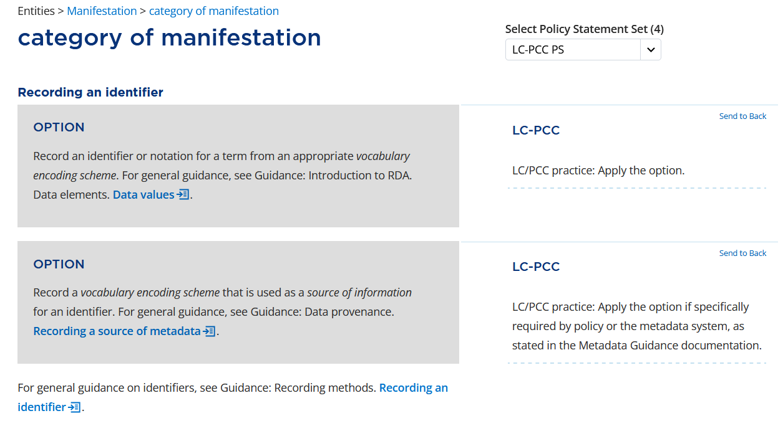
Notes:
As expected, PCC policy is to record this information using an identifier, which will be the MARC codes we have always used.

Slide 24
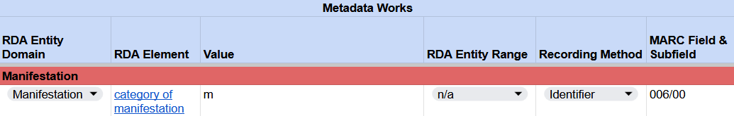
Recording category of manifestation
RDA Record Template
MARC 21 Bibliographic Record
Notes:
Beginning with field 006, we will code byte 00 (Form of material) with m (Computer file/Electronic resource).

Slide 25
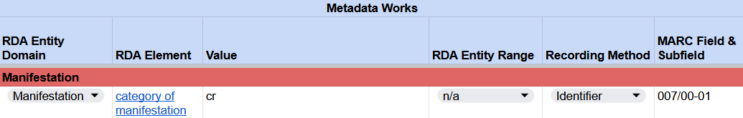
Recording category of manifestation
RDA Record Template
MARC 21 Bibliographic Record
Notes:
Category of manifestation also corresponds to the first two bytes of the 007 field, which we have already coded for media type and carrier type. We don’t have to do anything additional in our MARC record, but the identifier “cr” should be added in our RDA Record Template.

Slide 26
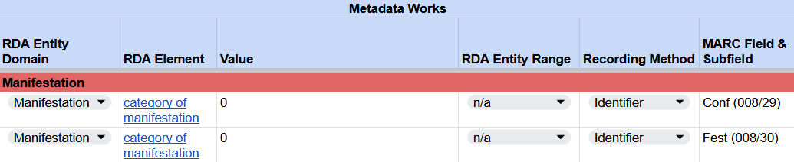

Recording category of manifestation
RDA Record Template
MARC 21 Bibliographic Record
Notes:
RDA considers conference publications to be a category of manifestation. Although RDA does not consider coding something as not a conference publication to be a category of manifestation, since we cannot leave the fixed field blank, we will treat the code 0 – Not a conference publication in field 008, byte 29 as a category of manifestation.
Similarly, we will treat coding 0 – Not a festschrift in 008/30 fixed field as a category of manifestation.

Slide 27
extent of manifestation

Slide 28
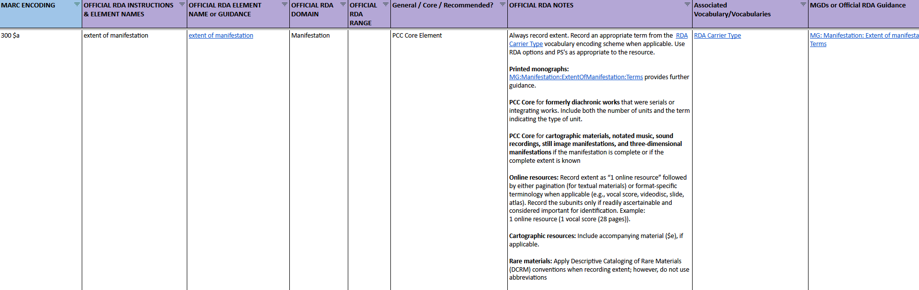
BSR Metadata Application Profile
Notes:
Following the order specified in BSR metadata application profile, the next element to record is the extent of manifestation. Click on the link to view the element in the RDA Toolkit.

Slide 29
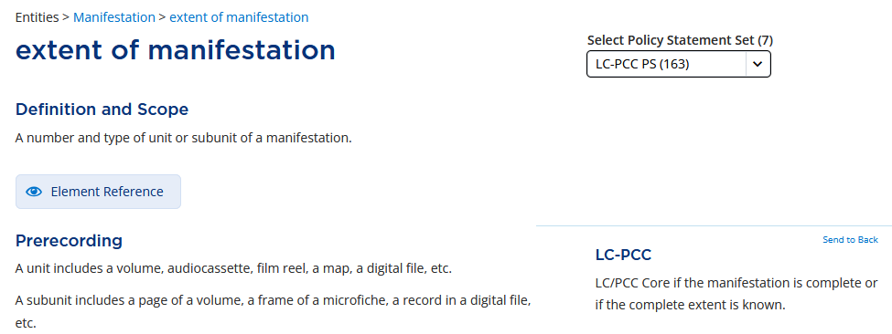
For the e-book: Hamiltonian systems
  We will need to record this element as the manifestation is complete, and the extent is known.
Notes:
In the RDA Toolkit, extent of manifestation is defined as “A number and type of unit or subunit of a manifestation.” In original RDA, this element is called “Extent”. Moving down to the Prerecording section, the LC‑PCC Policy Statement indicates this element is a Core element if the manifestation is complete or the complete extent is known. This applies to the ebook we are cataloging, so we will record it.

Slide 30
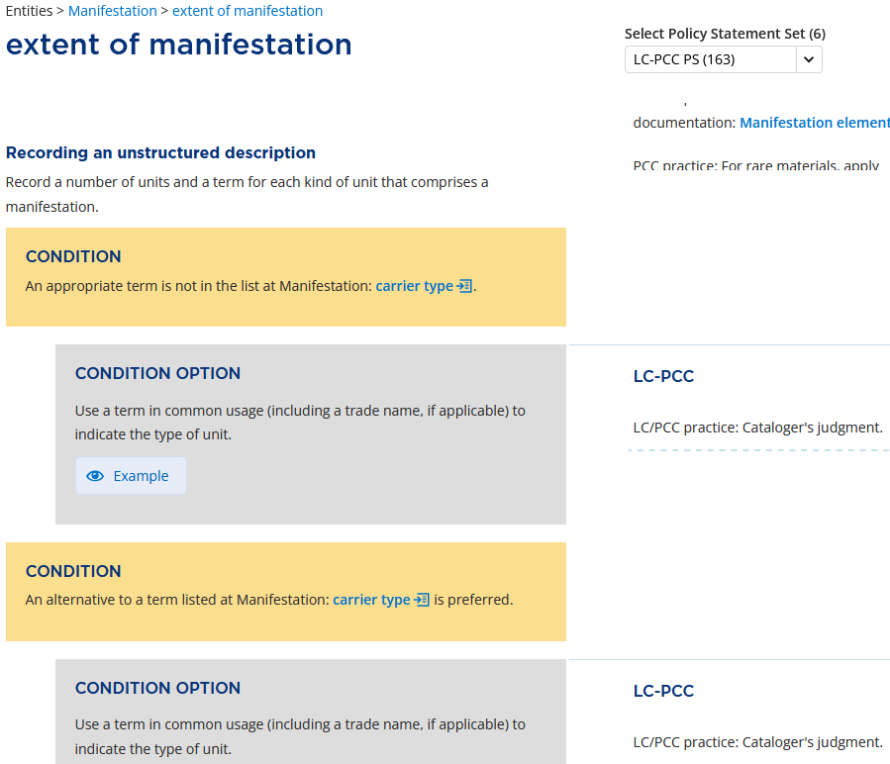
Notes:
The next question is “How do we record it?”
There are options under Recording an unstructured description to record a term in common usage or an appropriate uncontrolled term. We will not apply these options and will scroll down to see the instructions for recording a structured description.

Slide 31
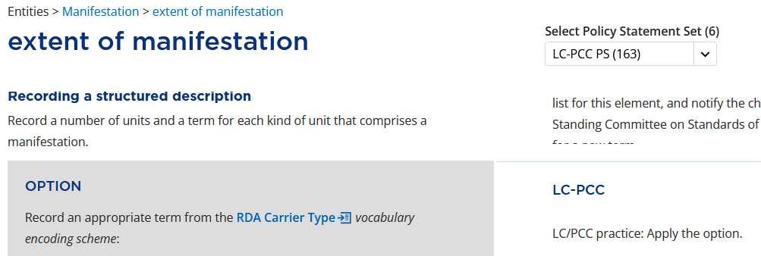
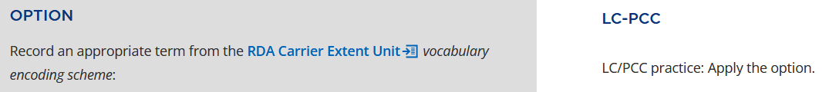
Notes:
Under Recording a structured description, it says “Record a number of units and a term for each kind of unit that comprises a manifestation.” For the term, the LC-PCC PSs instruct us to apply the options to use RDA vocabularies for “carrier type” and “carrier extent unit”.

Slide 32
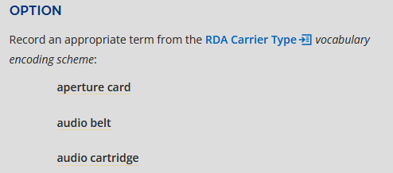
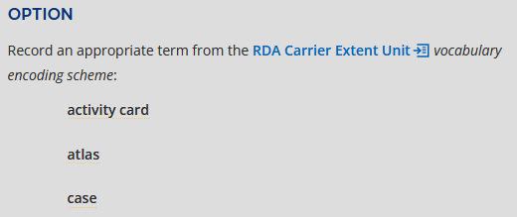


……
……
Notes:
Going through the RDA vocabularies for “carrier type” and “carrier extent unit”, we identified the terms “online resource” and “page” respectively, which are applicable to the item being cataloged and we will apply.

Slide 33
extent of manifestation
Carrier Type and Extent Unit
Recording a structured description
  Record a number of units and a term for each kind of unit that comprises a manifestation.
  Record an appropriate term from the RDA Carrier Types
    Record a number of units: 1
    RDA Carrier Type for the ebook being cataloged : online resource
  Record an appropriate term from the RDA Carrier Extent Unit
    RDA Carrier Extent Unit for the ebook: page
Notes:
Remember, the instruction under Recording a structured description says to “Record a number of units and a term for each kind of unit“. We will record the term “online resource” from the RDA Carrier Type VES as our term of unit. So far, for the ebook being cataloged, we know it is 1 online resource. We will review more detailed instructions for recording the carrier extent unit “page”.

Slide 34
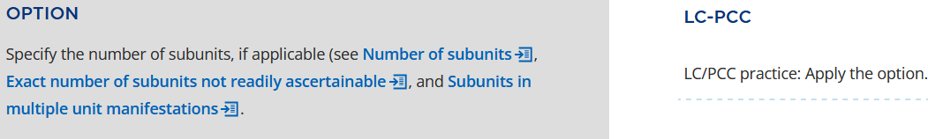
extent of manifestation
Number of subunits
Recording a structured description
  Specify the number of subunits, if applicable (see Number of subunits … )
    LC-PCC PS: Apply the option.
Notes:
We continue to examine and consider all relevant and applicable options and the LC-PCC Policy Statements for instructions. The next applicable option and LC-PCC PS says to apply is “Specify the number of subunits, if applicable (see Number of subunits, …).” This applies to the book we are cataloging because page is a subunit under the online resource. Let’s review the instructions under Number of subunits.

Slide 35
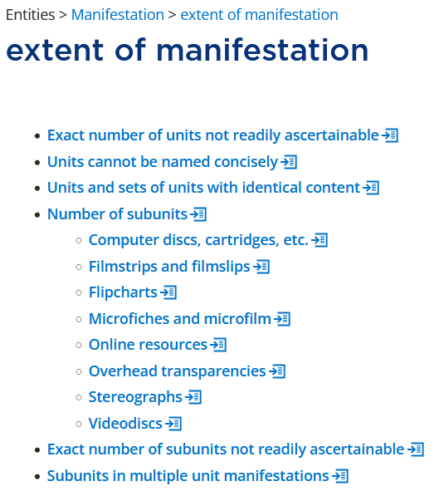
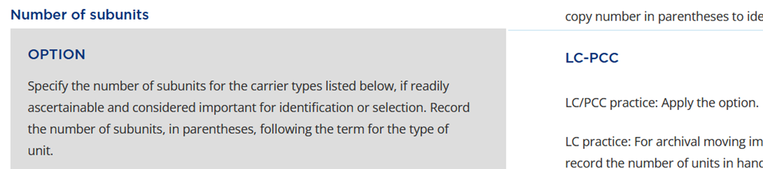
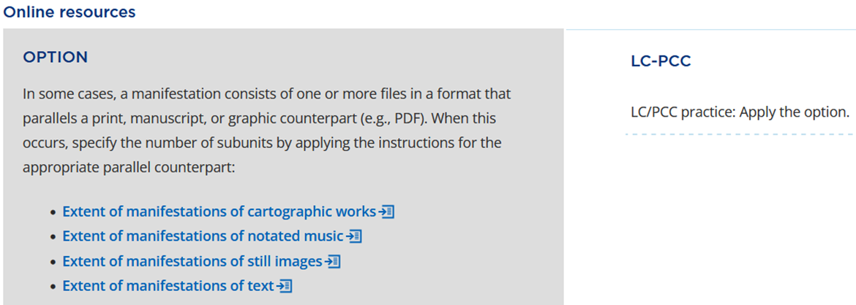
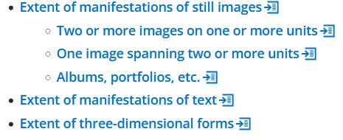
Reviewing other applicable conditions/options
Notes:
Under “Number of subunits” – RDA says to “Specify the number of subunits for the carrier types listed below, if readily ascertainable and considered important for identification or selection. Record the number of subunits, in parentheses, following the term for the type of unit.” LC-PCC PS says to “Apply the option.” These are helpful instructions which we will use later. Let’s first look at the list of carrier types.
Scrolling down the carrier types to “Online resources”, the option says “In some cases, a manifestation consists of one or more files in a format that parallels a print, manuscript, or graphic counterpart (e.g., PDF). When this occurs, specify the number of subunits by applying the instructions for the appropriate parallel counterpart …” This means, although we are cataloging an ebook, the way to record the extent of the subunit is the same as recording the extent of print text materials. We then click the link to navigate to the section “Extent of manifestations of text” for more detailed instructions.

Slide 36
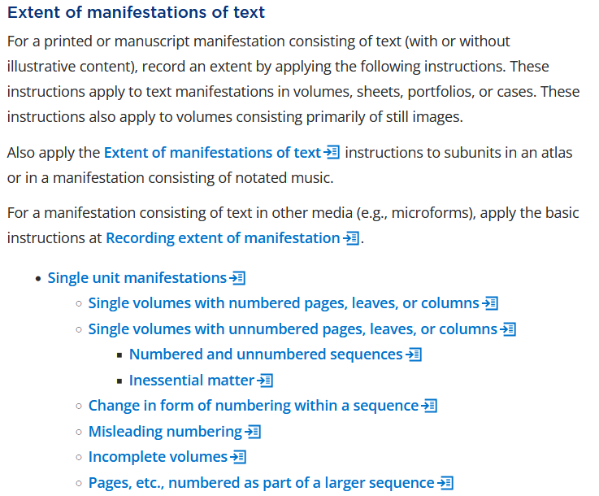
Relevant conditions
Notes:
From the section “Extent of manifestations of text”, we identified a couple of sections that are applicable to the ebook we are cataloging:
Single unit manifestations
Single volumes with numbered pages, leaves, or columns
Single volumes with unnumbered pages, leaves, or columns
Numbered and unnumbered sequences
We’ll click the links to locate the detailed instructions.

Slide 37
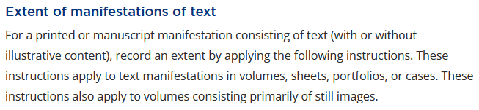
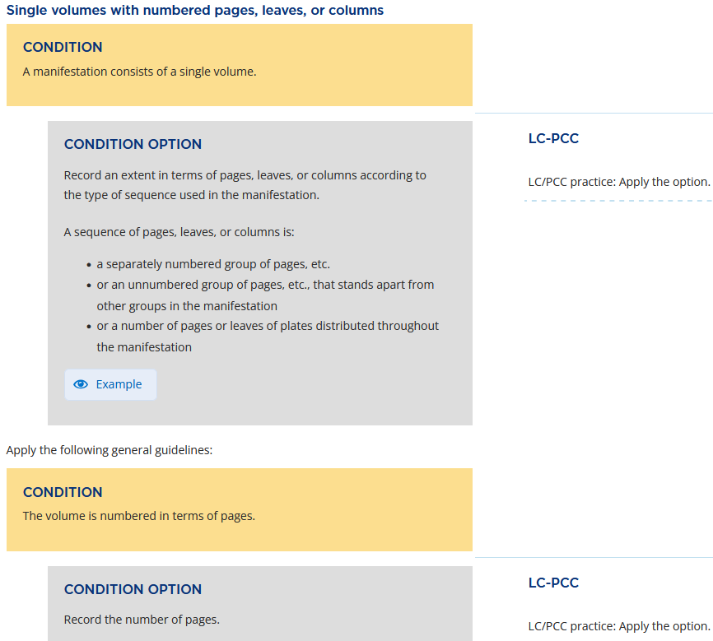
Notes:
Under the condition “A manifestation consists of a single volume”, the condition option has the instruction “Record an extent in terms of pages, leaves, or columns according to the type of sequence used in the manifestation.”
Under the condition “The volume is numbered in terms of pages”, the condition option instructs “Record the number of pages”.

Slide 38
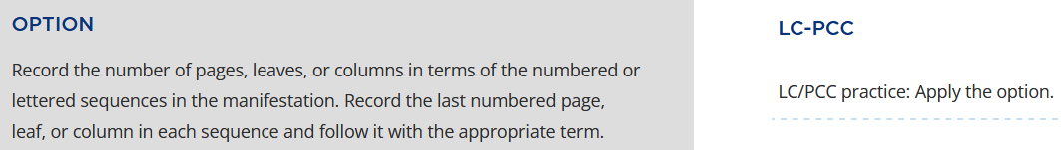
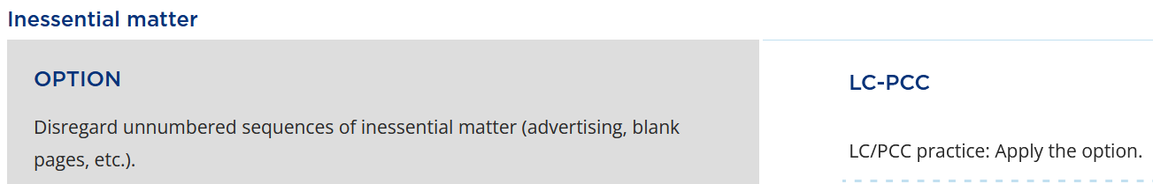
Single Unit Manifestation
Numbered and unnumbered sequences
Notes:
In the “Single unit manifestations” section, there is another important option which the LC-PCC PS says to apply. That is “Record the number of pages, leaves, or columns in terms of the numbered or lettered sequences in the manifestation. Record the last numbered page, leaf, or column in each sequence and follow it with the appropriate term.”
Since there is only one numbered sequence, we record the number of the last page, 367, followed by the term “pages”.
The ebook also includes a sequence of unnumbered pages. We will apply the option to “Disregard unnumbered sequences of inessential matter.”

Slide 39
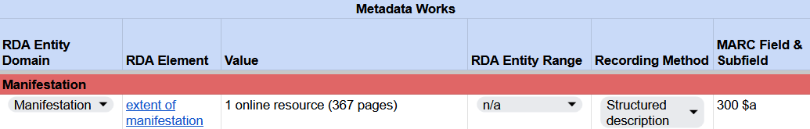
Recording extent of manifestation
RDA Record Template
MARC 21 Bibliographic Record
Notes:
To summarize the options we have applied, we will record a number of units and a Carrier Type term, followed by a number of subunits and a Carrier Extent Unit term in parentheses.
The value of the element “extent of manifestation” is: 1 online resource (367 pages)
In MARC, this value is recorded in field 300, subfield $a.
300 $a 1 online resource (367 pages)

Slide 40
dimensions

Slide 41
BSR Metadata Application Profile
Notes:
The next element in the BSR is dimensions. Again, click on the link to view the element in the RDA Toolkit.

Slide 42
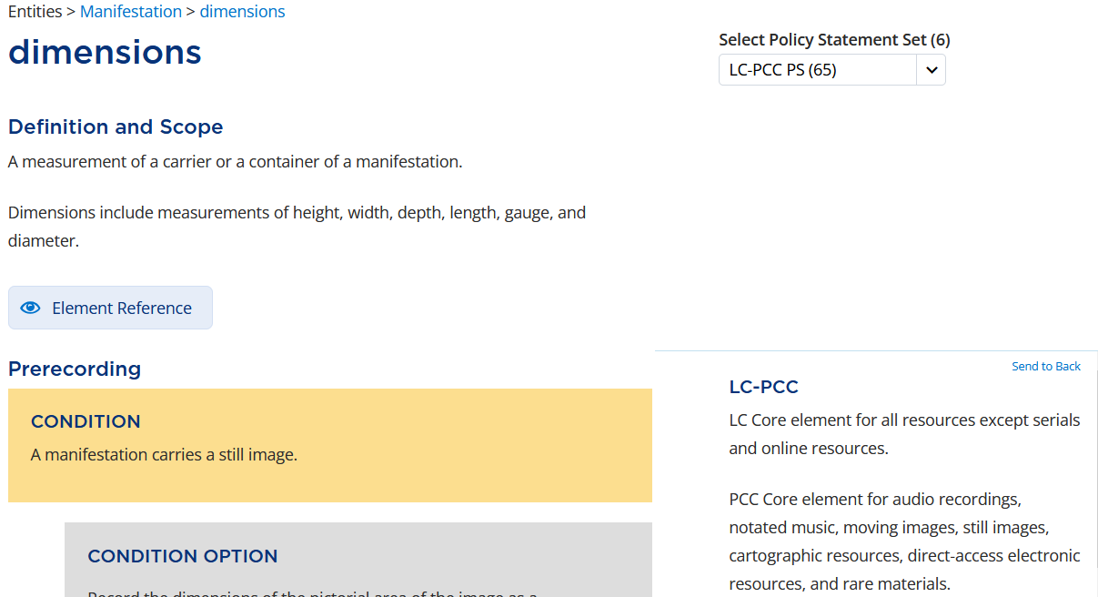
No data entry is needed for the ebook being cataloged
Can enter MARC 007
007/04 n
Notes:
The RDA definition of the element is “A measurement of a carrier or a container of a manifestation.” It includes “measurements of height, width, depth, length, gauge, and diameter.”
Since ebooks do not have a carrier or a container, the measurements of a carrier do not apply.

Slide 43
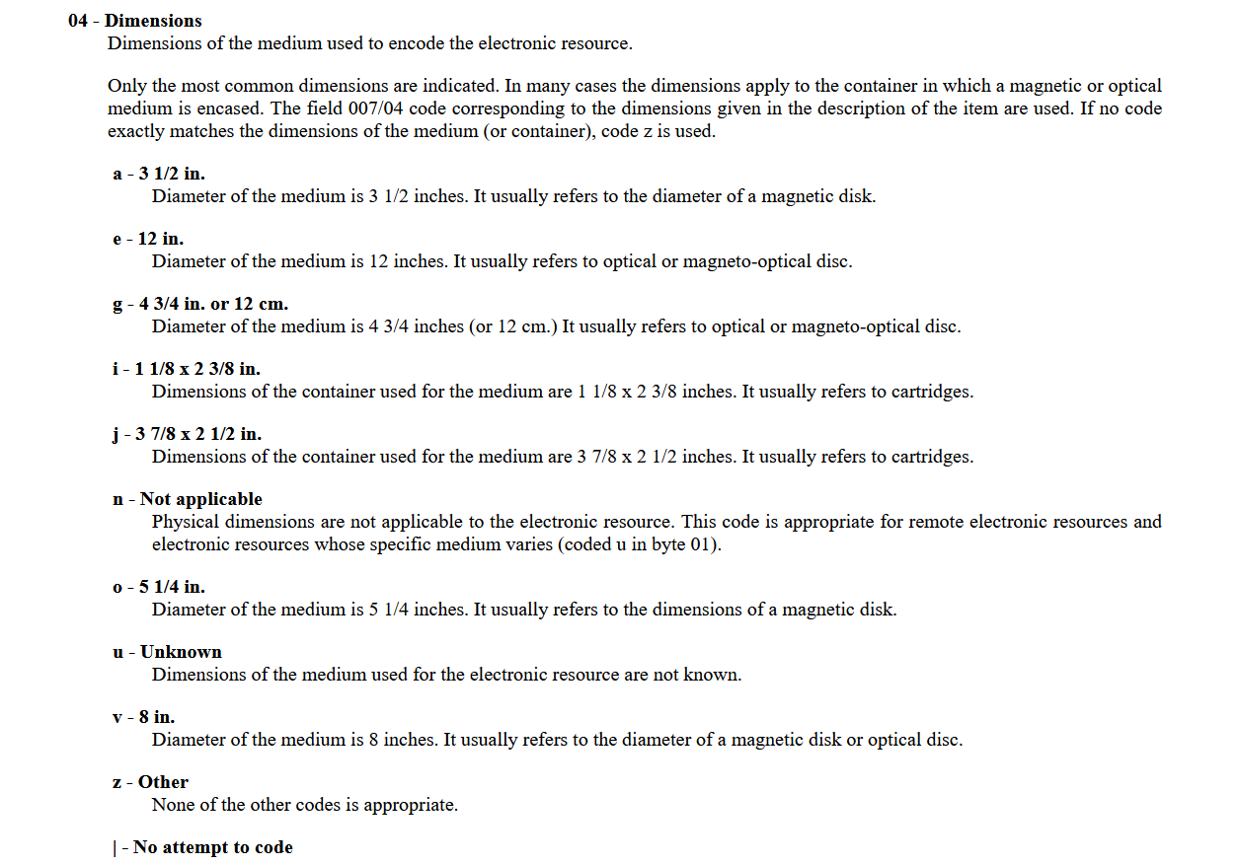
Notes:
In terms of the MARC bibliographic description, we do not include field 300, subfield $c, but we do enter the 007 fixed field to describe the physical characteristics for electronic resources. Since the code “Dimensions” in the 007 electronic resource does not apply to remote access e-resources, 007, byte 4 will be coded “n” as “not applicable”.

Slide 44
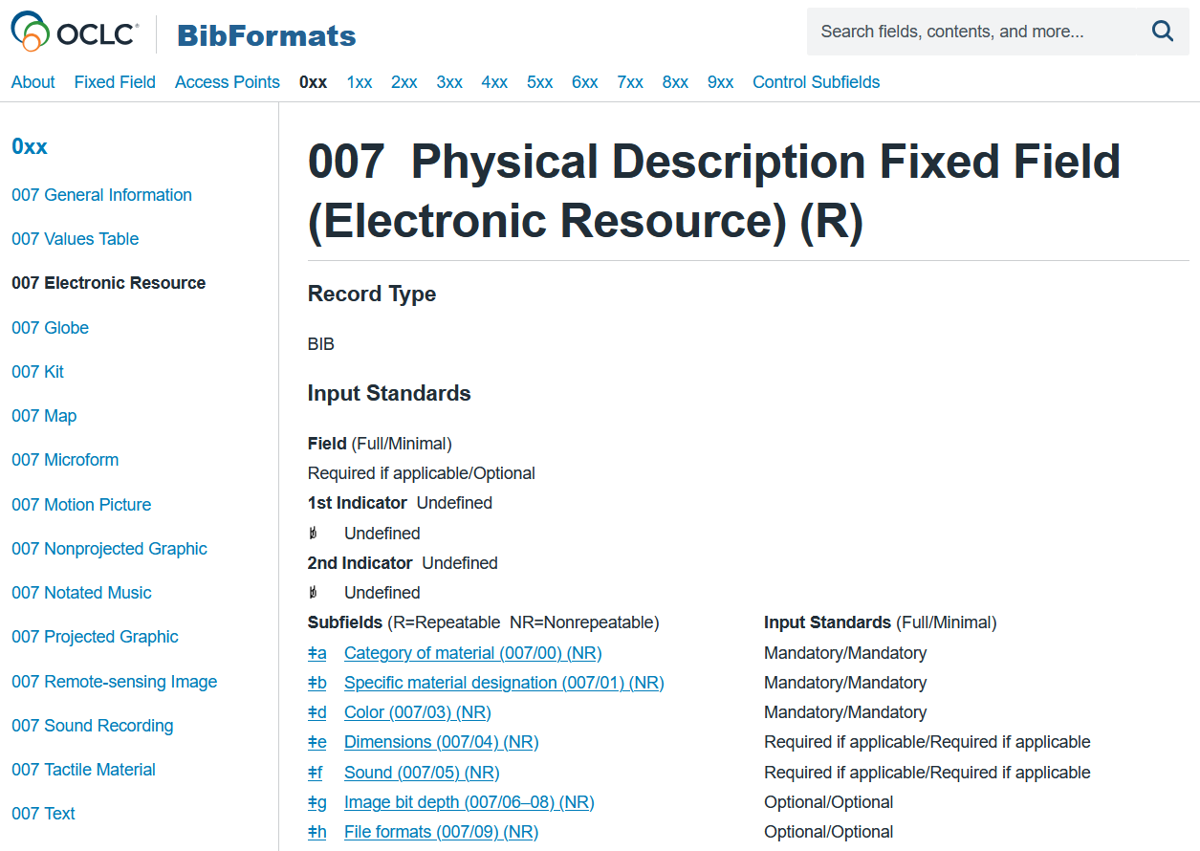
Notes:
In OCLC Connexion, this is recorded in field 007, subfield $e.

Slide 45

Recording dimensions
RDA Record Template
MARC 21 Bibliographic Record
Notes:
Please note that coding MARC 007/04 is essentially using the identifier recording method; however, official RDA indicates that the identifier recording method is not applicable for this element.

Slide 46
file type

Slide 47
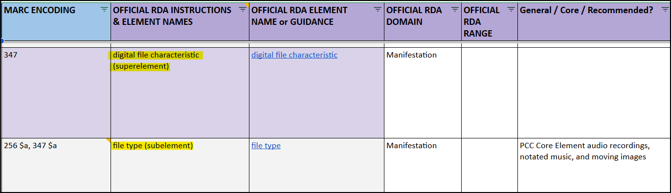
file type
The BSR shows that “file type” is a subelement of the superelement “digital file characteristic”
Notes:
Now let’s look at recording the element “file type”. From the BSR, we learn that “file type” is a subelement of the superelement “digital file characteristic”. First, let’s have a look at the superelement “digital file characteristic”. We can quickly navigate to this element in the Toolkit by clicking on the element name.

Slide 48
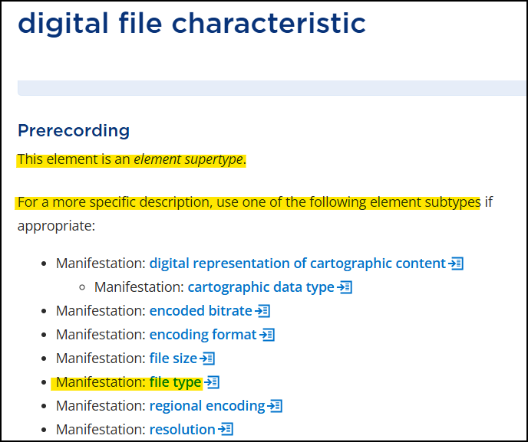
Notes:
By reviewing the Prerecording section, we find that “digital file characteristic” is an element supertype. The LC-PCC PS tells us to “Record specific digital file characteristics using the narrower elements”, which are also listed in this section.
Click on Manifestation: file type.

Slide 49
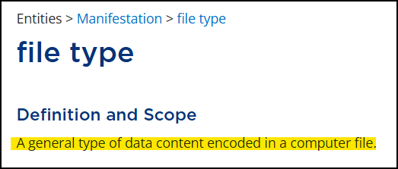

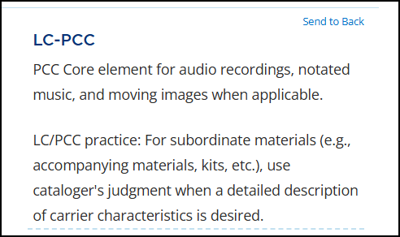
Notes:
The definition for “file type” is: A general type of data content encoded in a computer file.
Scroll down to the Prerecording section. Here we find the LC-PCC Policy Statement: PCC Core element for audio recordings, notated music, and moving images when applicable.
Ebooks are not in this list, so we can conclude that this element is optional for our type of resource and apply cataloger’s judgment to record “file type”.

Slide 50
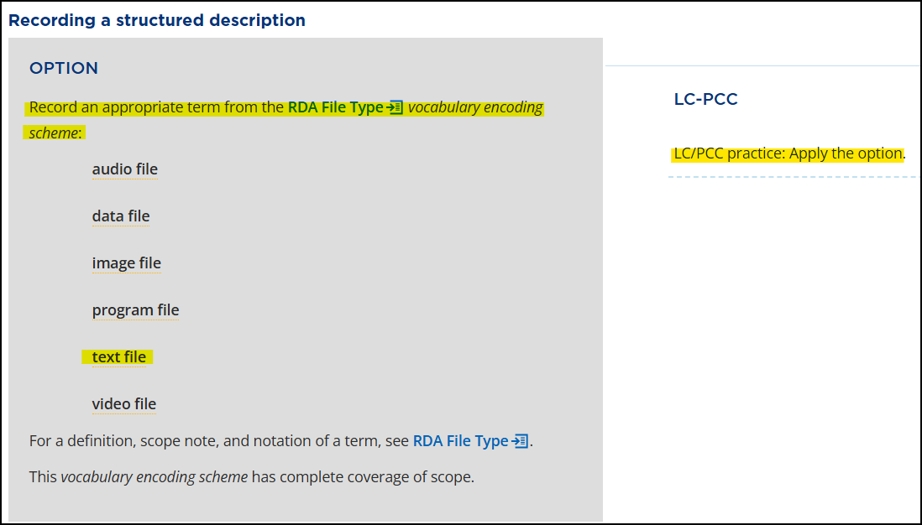
Notes:
Scroll down to Recording a structured description and review Option 1: Record an appropriate term from the RDA File Type vocabulary encoding scheme: …
The accompanying LC-PCC policy statement states: LC/PCC practice: Apply the option.
From the RDA File Type list found in the option, choose “text file” as the appropriate term.

Slide 51
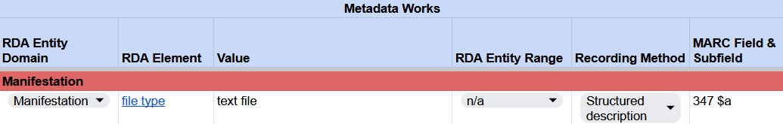
Recording file type
RDA Record Template
Notes:
We can record “text file” in our RDA template as the value for the element file type, but we’ll hold off on recording it in MARC for now.

Slide 52
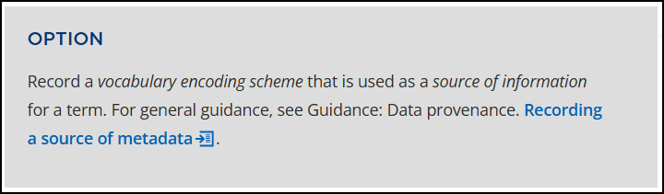
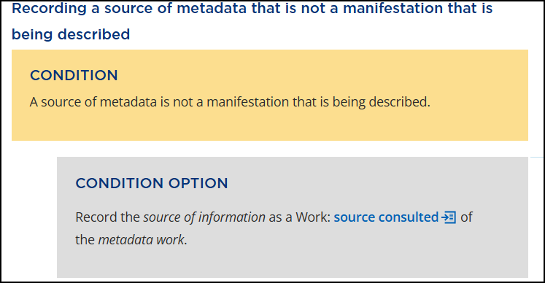

Notes:
We also need to record the source by applying the option to “Record a vocabulary encoding scheme that is used as a source of information for a term.” When recording a source of metadata, we will consult the Data provenance Guidance chapter and, under the section Recording a source of metadata that is not a manifestation that is being described, apply the option to record a source consulted. Despite the policy statements, we will record the source consulted using an identifier by recording the code “rdaft”, which corresponds to the RDA File Type VES as listed in the Genre/Form Code and Term Source Codes.

Slide 53

Recording file type
RDA Record Template
Notes:
In our RDA Template, the code “rdaft” is recorded as the data provenance value for the value “text file”.

Slide 54


Notes:
Let’s now look at how to encode the element “file type” in MARC 21. By referring to the BSR, we find that the appropriate MARC field is 347 $a. This is confirmed by returning to the Toolkit and looking under MARC 21 Bibliographic in the Element Reference box. Here we find: MARC 21 Bibliographic 347 ** $a [structured description]

Slide 55
Recording file type
RDA Record Template
MARC 21 Bibliographic Record
Notes:
Let’s put this all together in MARC:
347 ## $a text file $2 rdaft

Slide 56

Fixed Field: 006/09 (type of computer file) = d (document)
Notes:
In addition to recording file type as a structured description, this element can also be recorded as an identifier. The Element Reference box indicates that file type can be encoded in the fixed field: MARC 21 Bibliographic 006/09 [identifier] (computer files). For this ebook, the appropriate value to use is “d” (document).
Fixed Field: 006/09 (type of computer file) = d (document)

Slide 57

Recording file type
RDA Record Template
MARC 21 Bibliographic Record

Slide 58
encoding format

Slide 59


Notes:
Our ebook is available in PDF format. Let’s determine how to record this format in our record.
Starting with the BSR, let’s review the PCC Core Elements sheet to determine if the ebook format should be recorded. Scrolling down, we find the “encoding format (subelement). As we discovered with the previous element “file type”, “encoding format” is another subelement of the superelement “digital file characteristic”. Click on “encoding format” in the BSR to move directly to this element in the Toolkit.

Slide 60



Notes:
First, let’s review the definition of the element: A schema or standard that is used to encode the digital content of a manifestation.
Scroll down to the Prerecording section and review the LC-PCC policy statement that states: PCC Core element for audio recordings and moving images when applicable.
Ebooks are not mentioned in the policy statement, so we can conclude that this element is optional for our resource and apply cataloger’s judgment to record “encoding format”.

Slide 61

Notes:
Should this be recorded as an unstructured or structured description? The first option under Recording an unstructured description states: Record an uncontrolled term or a term that is transcribed from a source of information. The policy statement states: LC/PCC practice: Cataloger's judgment. If recording encoding format, use a term from the LC Linked Data Service: Encoding Format Vocabulary.

Slide 62


Notes:
Using a term from a vocabulary encoding scheme makes this a structured description, so let’s move down the element page to Recording a structured description.
Option 1 states: Record a term from an appropriate vocabulary encoding scheme. The policy statement points us to a vocabulary: LC/PCC practice: Cataloger's judgment. If recording encoding format, use a term from the LC Linked Data Service: Encoding Format Vocabulary.
Open the LC Linked Data Service page and search for the Encoding Format Vocabulary. We find it under Cataloging > Encoding Format. As the ebook is a PDF, the appropriate vocabulary term to record is “PDF file”.

Slide 63

Recording encoding format
RDA Record Template
Notes:
Let’s record “PDF file” in our RDA Template as a structured value for the element “encoding format”.
And then look at how to record this in MARC.

Slide 64

Notes:
Let’s return to the toolkit and use the arrow to move to the top of the element page to review the MARC 21 Bibliographic fields located in the Element Reference box. Here we find 347 ** $b [structured description].
Let’s also double check the BSR for the appropriate MARC field to use. The BSR confirms that “347 $b” is the appropriate field and subfield. Also, note that the Encoding Format vocabulary is linked in the “Associated Vocabulary” column of the BSR. This provides a quick way to access the vocabulary encoding scheme.

Slide 65
Recording encoding format
RDA Record Template
MARC 21 Bibliographic Record
Notes:
Now to record this in MARC 21:
347 ## $b PDF file
Note that there is no subfield $2 because no code has been assigned for the Encoding Format Vocabulary.

Slide 66
restriction on access to manifestation

Slide 67


Notes:
Next, let’s determine how to record the access restrictions for our ebook. By narrowing our search to “Exact Title” and entering “restriction on access” into the RDA search box, we find the element “restriction on access to manifestation”. This element is defined as: a limitation placed on access to a manifestation. However, our version of the ebook is available Open Access and there are no restrictions on access.

Slide 68

Notes:
If we scroll down to Recording an unstructured description, there is a condition that states: Information affirming the absence of restrictions is considered important for access. We will apply the Condition Option and record that there are no restrictions on access.

Slide 69

Recording restriction on access to manifestation
RDA Record Template
Notes:
We will record the value “Open access versions available from some providers.” based on the example in the provider-neutral guidelines.

Slide 70

Notes:
Reviewing the MARC 21 Bibliographic alignments in the Element Reference box, we note that the 506 $a is the MARC 21 field to use when recording an unstructured description.

Slide 71
Recording restriction on access to manifestation
RDA Record Template
MARC 21 Bibliographic Record
Notes:
Therefore, this element can be recorded as:
506 0# $a Open access version available from some providers.

Slide 72
Notes:
The Element Reference box also indicates the element restriction on access to manifestation can be recorded as a structured description in MARC field 506, subfield $f. Let’s look at how to also include a controlled vocabulary term for this element.

Slide 73


Notes:
Scroll down to Recording a structured description. Option 1 states: Record a term from an appropriate vocabulary encoding scheme. Note that the LC-PCC practice is: Cataloger’s judgement.
The vocabulary we are going to use is the “access rights” vocabulary from COAR (Confederation of Open Access Repositories) Controlled Vocabularies for Repositories. This vocabulary indicates that “open access” is the appropriate term to use.

Slide 74

Recording restriction on access to manifestation
RDA Record Template
MARC 21 Bibliographic Record
Notes:
The term “open access” is recorded as a structured description in our RDA Template.
In MARC, this is recorded in our existing 506 field in subfield $f.

Slide 75

Notes:
When using a vocabulary encoding scheme, it is also important to record the source. Option 2 states: Record a vocabulary encoding scheme that is used as a source of information for a term. For general guidance, see Guidance: Data provenance. Recording a source of metadata. The LC-PCC practice is: Apply the option. As we are already familiar with how to record a source of information, we know that the source code is to be recorded as an identifier.

Slide 76

Recording restriction on access to manifestation
RDA Record Template
Notes:
The source code for the COAR access rights vocabulary is “coarar”. This is recorded as the data provenance for the value “open access”.

Slide 77
Recording restriction on access to manifestation
RDA Record Template
MARC 21 Bibliographic Record
Notes:
In MARC, this is recorded in the 506 subfield $2.

Slide 78



Notes:
Because not all versions of the ebook are available as Open Access, we probably want to record a scope of validity. Scope of validity is a data provenance element that allows us to indicate when the recorded metadata is applicable. The definition for this element is: An unstructured or structured description of a set of entities for which the value of a metadata work is valid. Scroll down to Recording an unstructured description and review Option1: Record details or other unstructured information. The LC-PCC practice is: Cataloger’s judgement.
To indicate that only certain versions are available through open access, we will use the phrase “some versions”, as indicated in the provider-neutral guidelines. This is recorded in the MARC field 506 $3, as indicated in the Element Reference box.

Slide 79

Recording restriction on access to manifestation
RDA Record Template
Notes:
In the RDA Template, the scope of validity “Some versions” is recorded as a second data provenance value for the value “open access”.

Slide 80
Recording restriction on access to manifestation
RDA Record Template
MARC 21 Bibliographic Record
Notes:
In our MARC record, “Some versions” is recorded to the beginning of our 506 field in subfield $3 and is followed by a colon. Remember to add the subfield $a delimiter if missing.

Slide 81

Notes:
The element restriction on access to manifestation can also be recorded as an identifier by applying the option to “Record an identifier or notation for a term from an appropriate vocabulary encoding scheme.”

Slide 82

Notes:
In MARC 21, field 856, subfield $7 is used to record the Access status and the code “0” represents Open access.

Slide 83

Recording restriction on access to manifestation
RDA Record Template
MARC 21 Bibliographic Record
Notes:
In our RDA Template, the value “0” is recorded as an identifier for restriction on access to manifestation.
In MARC, this is recorded in 856 subfield $7.
Of course, we now need to record the URL that is Open Access.

Slide 84
Uniform Resource Locator

Slide 85

BSR Metadata Application Profile
Notes:
Let’s now look at how to record the URL (or Uniform Resource Locator) for the ebook. Starting with the BSR, the Uniform Resource Locator is found on the PCC Core Elements sheet. This element is a PCC Core Element.
Clicking the “Uniform Resource Locator” RDA element name in the BSR, takes you directly to this element in the RDA toolkit.

Slide 86

Notes:
First, let’s review the definition of the Uniform Resource Locator element: An address of an online resource. A Uniform Resource Locator includes all manifestation identifiers intended to provide online access to a manifestation using a standard Internet browser.

Slide 87


Notes:
The LC-PCC Policy Statement located by the Prerecording section, indicates that this element is: LC/PCC Core. LC/PCC practice: Do not record a URL that is restricted for use at a specific institution (e.g., proxy URL) in a shared bibliographic utility record unless it is the only URL available. LC/PCC practice: See the Metadata Guidance documentation: Manifestation elements.
Reviewing the MGD for Uniform Resource Locator, we find it repeats the instruction to not record a URL that is restricted for use at a specific institution …

Slide 88


This option and these 2 conditions do not apply to our ebook
Notes:
Return to the toolkit and scroll down to the Recording section. The option and conditions listed here do not apply to our ebook:
Option1: there is not a related manifestation
Condition 1: there are not two or more URLs
Condition 2: the URL is still valid
As URLs are structured data, this element will be recorded as structured description.

Slide 89


Notes:
Lastly, let’s use the arrow to move up to the top of the element page and review the “MARC 21 Bibliographic” alignments listed in the Element Reference box. Here it indicates: MARC 21 Bibliographic 856 *0 $g, h, u [structured description]. We should also double check the MARC field in the BSR. Here it notes that “856 $u” is the appropriate field to use.

Slide 90

Recording Uniform Resource Locator
RDA Record Template
MARC 21 Bibliographic Record
Notes:
We have now confirmed that the URL for this ebook should be entered in the Manifestation > Uniform Resource Locator element, corresponding to MARC 21 field: 856 40 $u.
Additionally, when reviewing the “restriction on access to manifestation” element, we determined that the access status could also be recorded in MARC 21 field 856, subfield $7. The code “0” represents Open access.
Let’s put this all together:
856 40 $u https://library.slmath.org/books/Book72/index.html $7 0

Slide 91
also issued as

Slide 92


Title page verso
Notes:
The title page verso for this ebook indicates that there is a physical version available. According to the PCC Core Elements sheet in the BSR, the appropriate RDA guidance for related manifestations can be found under “related manifestation of RDA entity”. The BSR also indicates that this is a PCC Core Element for reproductions. Since the BSR does not provide a direct link to this element, the quickest way to locate this element is to enter “related manifestation of RDA entity” into the RDA Toolkit search box and filter by “Exact Title”.

Slide 93


Notes:
Let’s start by reviewing the definition: A manifestation that is associated with an RDA entity. This is a very broad element that is used to relate a manifestation to a work, expression, manifestation, item, agent, or any other RDA element.

Slide 94


Notes:
Because it is a very broad element, if you scroll down the page to the Recording section, the policy statement states: LC/PCC practice: Do not record the element. Instead, record one or more narrower elements.
So now we know that we need to use a narrower element. Scroll down to the Related Elements section, where you will find narrower options to consider. Let’s start with “Manifestation: related manifestation of manifestation”.

Slide 95


Notes:
The definition for this element is: A manifestation that is associated with a manifestation. This is still very broad so let’s scroll down and review the narrower elements.
Since the ebook version is a different format of the physical book, let’s have a look at the element “Manifestation: equivalent manifestation”.

Slide 96



Notes:
Once again, let’s start by reviewing the definition: A manifestation that embodies the same expression of a work.
Next, review the Related Elements section and look at the narrower element “Manifestation: also issued as”. The definition is: A manifestation that embodies the same expression of a work in a different format. This seems like the element we want to use.

Slide 97

Notes:
Scroll down to the Prerecording section. Review the LC/PCC practice: See the Metadata Guidance documentation: Descriptive Relationship elements and Relationship labels.

Slide 98




Notes:
There are three MGDs covering descriptive relationships: Agent-Agent, Agent-WEMI, and WEMI-WEMI. Since our element is “also issued as”, let’s look at the MGD titled “Relationships: WEMI-WEMI”. Click on “related manifestations” in the table of contents to jump to page 52. Here we find some common manifestation relationships, including reproductions and different formats of the same expression. The second entry applies to our ebook as we have different formats of the same expression, that is, a book versus a PDF of the book. If there was any doubt, this confirms that we want to record a relationship to a related manifestation.
This section also notes that related manifestations are an LC-PCC Core element for reproductions, where the word “reproduction” includes all resources formerly identified as reproductions, republications, reprints, reissues, facsimiles, etc., that still represent equivalent content between an original resource and a reproduction of that original. In our case, we will consider the ebook and print book to be simultaneously published and will not treat it as a reproduction; however, we will still record the relationship to the related manifestation. The MGD provides an example of a structured description in MARC field 776 for the same expression in a different format.

Slide 99

Notes:
Having confirmed that we want to record a relationship to a related manifestation, let’s return to the RDA Toolkit to determine how to record the value. Scroll down to Recording a structured description and review the LC-PCC policy statement: … LC/PCC practice: Record the element using a structured description. If possible, express the relationship using a relationship label, or a relationship label in combination with an identifier or IRI, as allowed by the metadata management system. Apply this policy statement when recording: 1) an authorized access point in a bibliographic record, 2) an authorized access point for a related entity in an authority record, or 3) a structured value that is not functioning as an access point. If the metadata management system does not permit recording a relationship label for the element, omit it.
We will choose to record a structured value that is not functioning as an access point.

Slide 100


Notes:
Field 776, Additional Physical Form Entry, is the appropriate MARC field to use for this linking entry. This is confirmed in the Element Reference box for “also issued as” in the toolkit. Under MARC 21 Bibliographic, we find several options including 776 [structured description]. The structure for recording is determined by following the instructions found on the MARC 21 76X-787 page. We will record the relationship by recording the title, publication statement, and identifiers for manifestation for the print book (i.e., ISBN, LCCN, and OCLC control number).

Slide 101


OCLC Tip:
If working in OCLC Connexion or Record Manager, use the “Insert from Cited Record” function to easily generate the 776 field.
Notes:
Note: If working in OCLC Connexion or Record Manager, you can use the “Insert from Cited Record” function to easily generate the 776 field if there is a WorldCat record for the related manifestation.

Slide 102

Recording also issued as
RDA Record Template
MARC 21 Bibliographic Record
Notes:
Our value for the element “also issued as” is: Hamiltonian systems. Cambridge, United Kingdom ; New York, NY : Cambridge University Press, 2024 9781009320719 (DLC) 2024008669 (OCoLC)1423498572

Slide 103

Notes:
For the relationship label, let’s have a look at the new relationship labels spreadsheet. For the element “also issued as”, the PCC Relationship Label column notes that the PCC also uses other labels, such as Online version. This implies that we can use the relationship label: Print version.

Slide 104

Recording also issued as
RDA Record Template
MARC 21 Bibliographic Record
Notes:
Now, let’s record the relationship label “Print version” with our value for the element also issued as.
In MARC 21 encoding, the value is: 776 08 $i Print version: $a Hamiltonian systems. $d Cambridge, United Kingdom ; New York, NY : Cambridge University Press, 2024 $z 9781009320719 $w (DLC) 2024008669 $w (OCoLC)1423498572

Slide 105
Cataloging an eBook
Describing the Aggregate
Notes:
In this next section, we are still describing the manifestation, but we will focus on elements that describe the aggregate.

Slide 106
note on manifestation

Slide 107


Hamiltonian systems is an aggregate
Notes:
Hamiltonian systems is a compilation of articles, or, in other words, it is an aggregate that embodies multiple expressions.

Slide 108

BSR: expression manifested
Notes:
The draft BSR for official RDA tells us that the element expression manifested is PCC Core for collection aggregates and instructs us to “Give a contents note …”.

Slide 109

Notes:
The element expression manifested has some important information for us. First, the LC-PCC PS under Prerecording directs us to “See the Metadata Guidance documentation: Aggregates.” For recording an unstructured description, the policy statement says “PCC practice: For a collection aggregate, provide a complete contents note unless the contents are indicated in another part of the description. … Use Manifestation: note on manifestation to record a contents note.”

Slide 110

Notes:
The element note on manifestation is used to record unstructured information about any attribute or aspect of a manifestation. As we saw previously, PCC practice for aggregates is to provide a contents note.

Slide 111

Notes:
The RDA options for recording an unstructured description are very basic and just tell as to “Record details or other unstructured information.” So let’s look at the Aggregates MGD for additional information.

Slide 112

MGD: Aggregates
Notes:
An aggregate is a manifestation that embodies multiple expressions. Information about aggregates appears throughout RDA, but the best source to introduce the concept is the MGD: Aggregates.
Most resources we deal with are aggregates in some way. The MGD gives some examples, among them: Monographs with multiple independent essays by different agents, which is what we have in our ebook.

Slide 113

MGD: Aggregates
Notes:
To make sense of the rules around aggregates, you need to know the two kinds of expressions they contain and the three types of aggregates themselves.
First, the types of expressions in an aggregate:
The aggregated expression(s)--there can be more than one–which embodies the content
The aggregating expression, which is the plan, i.e. what content was selected and how it’s ordered. Not the content itself.
Second, the types of aggregates:
Augmentation aggregate, with supplementary content supporting a main work
Collection aggregate, with expressions of two or more independent works, and finally
Parallel aggregate, with multiple expressions of a single work
The type that applies to this part of our description set is collection aggregate. Other types apply to other parts of the description; we’ll get to those later.

Slide 114

MGD: Aggregates
Notes:
The section on collection aggregates states the need for a formal contents note, and the Access to content section tells you when and when not to make the note:

Slide 115
MGD: Aggregates
Not required if contents are indicated in another part of the description
Collection aggregate takes priority over other types
No limit unless burdensome
Do not apply to:
  anthologies of poetry, hymnals, conference proceedings, journals, collections of interviews or letters, chapters of multivolume monographs cataloged as monographic sets, and similar resources
Collection aggregate:
Formal contents note
Notes:
Not required if the contents are indicated in another part of the description (e.g., the value of Manifestation: title proper is not a collective title).
If the resource has characteristics of multiple types of aggregates—collection, augmenting, or parallel—collection takes precedence and only one contents note may be used to describe those characteristics.
No limit on the number of aggregated expressions in the note unless burdensome.
Do not apply to several types of resources: anthologies of poetry, hymnals, conference proceedings, journals, collections of interviews or letters, chapters of multivolume monographs cataloged as monographic sets, and similar resources.

Slide 116

MGD: Aggregates
Formal contents note
Notes:
And it points to detailed guidance on formatting the note.

Slide 117

Recording note on manifestation
RDA Record Template
Notes:
From this you have all the information you need to make the contents note, or in RDA terms, to find the value of the element note on manifestation for this collection aggregate.

Slide 118

Recording note on manifestation
MARC 21 Bibliographic Record
Notes:
The contents note is recorded in MARC field 505.

Slide 119
illustrative content
Notes:
Now we’ll consider how to describe the fact that Hamiltonian systems has illustrations.

Slide 120


Illustrative content
Notes:
The BSR doesn’t mention illustrations specifically--they are not PCC core--so we’ll turn to the Toolkit itself to start.
In the RDA instructions on Describing a manifestation that embodies two or more expressions, the final condition option says to “Relate the manifestation to aspects of the content of one or more of the expressions that are aggregated using any of the following elements,” among which is Manifestation: illustrative content. Another way to put this is that we’ll relate the aggregate manifestation to some aspect of the content of an aggregated expression.
Note that illustrative content was an expression element in original RDA but has changed to a manifestation element in official RDA.
LC-PCC practice is to apply it to augmenting expressions, which is also to say augmentation aggregates.

Slide 121

Notes:
If we look at its element description, illustrative content is to be used for content that meets three criteria:
an image that
supplements main expressions
in an augmentation aggregate
and it lists what does and does not qualify as image content.

Slide 122

Notes:
The Prerecording section has a PS noting that this element is LC core for children’s materials, and it points to the MGD for aggregates.

Slide 123


MGD: Aggregates
Notes:
That MGD explains why we are dealing with an aggregate in the context of illustrations. Recall that an aggregate is a manifestation that embodies multiple expressions, and illustrations that support the main content of an expression are considered to be expressions in their own right. In the case of illustrations, it’s an augmentation aggregate.

Slide 124

Notes:
Back in RDA, there are many options under the general Recording heading. For our purposes, we’ll only apply those where the PS says to “Apply the option”:
Record the general term illustration.
Record a term in the singular or plural, as applicable.

Slide 125

Notes:
We’ll record this information as a structured description using a term from the RDA Illustrative Content vocabulary encoding scheme as listed in the option,
in this case the general term “illustration,” and making it plural by applying the fourth option above.

Slide 126

Recording illustrative content
RDA Record Template
Notes:
So, we arrive at the value “illustrations”.

Slide 127

Notes:
In the Element Reference box in RDA, we can see that illustrative content is recorded as a structured description in MARC field 300 subfield $b and MARC field 340 subfield $p.

Slide 128
Recording illustrative content
RDA Record Template
MARC 21 Bibliographic Record
Notes:
In the 300 field, we will record the value in the plural in subfield $b, preceded by a space-colon-space.

Slide 129

Recording illustrative content
RDA Record Template
MARC 21 Bibliographic Record
Notes:
While not required, we will also record illustrative content in MARC field 340 by recording the value exactly as it appears in the RDA vocabulary encoding scheme, illustration.

Slide 130


Notes:
To indicate the source of the term, we will apply the option to record data provenance information. The code for the RDA Illustrative Content VES is rdaill.

Slide 131

Recording illustrative content
RDA Record Template
Notes:
In our RDA Record Template, the identifier “rdaill” is recorded as the source consulted for the value “illustration”.

Slide 132
Recording illustrative content
RDA Record Template
MARC 21 Bibliographic Record
Notes:
In MARC, it is recorded in subfield $2 following the term.

Slide 133
Notes:
Going back to the Element Reference box in RDA, illustrative content can also be recorded as an identifier in the 008 fixed field.

Slide 134


Notes:
We will apply the option to record an identifier from another appropriate vocabulary encoding scheme and use the code “a” from MARC 21.

Slide 135

Recording illustrative content
RDA Record Template
MARC 21 Bibliographic Record
Notes:
The value “a” is recorded in our RDA Record Template as an identifier and in the fixed field Ills (008/18) in our MARC record.

Slide 136
colour content
Notes:
Now let’s look at how we record the colour content of those illustrations.

Slide 137

Manifestation: colour content
Notes:
Back in Describing a manifestation, Manifestation: colour content is another of the elements we can use to describe the content of aggregated expressions.

Slide 138

Notes:
The Prerecording section of the colour content element description has a few PSs, but I want to draw your attention to the LC practice to substitute the American spelling of color or use a phrase like “some color” or “chiefly color” in most cases.

Slide 139

Notes:
When we get to recording, PCC practice for the first option is to record an uncontrolled term, such as “color”, as an unstructured description.

Slide 140

Notes:
The option to record details or other unstructured information like “some color” is left to cataloger’s judgment.

Slide 141


Illustrations in color and b&w
Notes:
Hamiltonian systems has illustrations in both colour and black and white

Slide 142

Recording colour content
RDA Record Template
MARC 21 Bibliographic Record
Notes:
Applying the guidelines for unstructured description in the PS, the value of this element is “some color”.
In MARC, this is added as a parenthetical addition to 300 $b:
300 … $b illustrations (some color)
Because our MARC record has a 490 field, we will add a terminal period.

Slide 143

Notes:
It’s a matter of judgment whether to also record a structured description using a term from the RDA Colour Content VES, which has just two values: monochrome and polychrome, or to use another VES.

Slide 144

Recording colour content
RDA Record Template
MARC 21 Bibliographic Record
Notes:
We’ll apply the option to include terms from the RDA Colour Content vocabulary. In a case like this where there are illustrations in both black and white and color, it’s appropriate to record both values: polychrome and monochrome.
In MARC, colour content is recorded in 340 $g.

Slide 145


Notes:
Again, we will apply the option to record data provenance information to indicate the source of the term. The code for the RDA Colour Content VES is rdacc.

Slide 146

Recording colour content
RDA Record Template
Notes:
In our RDA Record Template, the identifier “rdacc” is recorded as a data provenance value for the element source consulted.

Slide 147
Recording colour content
RDA Record Template
MARC 21 Bibliographic Record
Notes:
In MARC, it is added in subfield $2.

Slide 148
supplementary content
Notes:
In this section, we’ll provide information about some supplementary features of the aggregated expressions within Hamiltonian systems. Specifically, we want to make a note about the presence of bibliographical references in those individual contributions.

Slide 149

Supplementary content
Notes:
Back in the RDA instructions on Describing a manifestation that embodies two or more expressions, the final condition option has the instruction to “Relate the manifestation to aspects of the content of one or more of the expressions that are aggregated using any of the following elements,” among which is Manifestation: supplementary content. The LC-PCC practice is to apply it to augmenting expressions.
What makes it an augmenting expression? The bibliographical references are supplementary to the work that is the individual chapter.

Slide 150

Notes:
The element page for supplementary content indicates that it applies to a Manifestation that is an aggregate. LC-PCC PS for Prerecording notes that it is LC core for indexes and bibliographies in monographs and points to two relevant MGDs. The LC-PCC PS for Recording an unstructured description includes a link to the MGD for Supplementary content.

Slide 151

MGD: Manifestation: Supplementary content
Notes:
From MGD: Manifestation: Supplementary content, we learn that for PCC, whether to record that element as an unstructured description is a matter of cataloger judgment, and when we do record it as a note, we should also record it as an identifier in the fixed field.

Slide 152

MGD: Manifestation: Supplementary content
Notes:
The MARC examples that follow show how that works in the usual arrangement of 500 and 504 notes and the identifier values in the 008 bytes 24-27 for bibliographies and 008/31 for indexes.

Slide 153

MGD: Manifestation: Supplementary content
Notes:
There’s a link in that MGD (and back in the PS) to MG: Aggregates, which has the instructions for those notes beginning on page 8 under “Notes describing augmenting content.”

Slide 154

MGD: Aggregates
Notes:
Here is where you find the instructions to make a note for bibliographical references using Manifestation: supplementary content and to add pagination if considered important unless the references are scattered.

Slide 155

MGD: Aggregates
Notes:
Further down, we find the instructions to use the specific phrasing “Includes bibliographical references.”

Slide 156


Notes:
Note that the instructions in RDA for recording an unstructured description and an identifier are the exact same instructions we’ve already seen.

Slide 157

Recording supplementary content
RDA Record Template
MARC 21 Bibliographic Record
Notes:
The aggregated expressions in Hamiltonian systems have scattered bibliographical references and no index, so this gets us to the value of Manifestation: supplementary content: Includes bibliographical references.
This is recorded in MARC field 504.

Slide 158

Recording supplementary content
RDA Record Template
MARC 21 Bibliographic Record
Notes:
And, per the MGD for supplementary content, record the value as an identifier in 008/24: b

Slide 159


Recording supplementary content
RDA Record Template
MARC 21 Bibliographic Record
Notes:
Lastly, we will code that there is no index using the value 0 in 008/31.

Slide 160
Minimum Description of Collection Aggregate
Aggregated Work
Aggregating Work
Aggregated Expression
Aggregating Expression
Manifestation
has title proper Hamiltonian systems
Notes:
We are almost done describing the manifestation. To complete our description, we need to related our manifestation to its aggregating expression and an aggregated expression, which we will cover the next sections.

