Slide 1
Cataloging an eBook
Describing the Manifestation

Slide 2
RDA Copyright
©2010-2025 - American Library Association, Canadian Federation of Library Associations, and CILIP: Chartered Institute of Library and Information Professionals.
Screen images from the RDA Toolkit (www.rdatoolkit.org) used by permission of the Copyright Holders for RDA (American Library Association, Canadian Federation of Library Associations, and CILIP: Chartered Institute of Library and Information Professionals).

Slide 3
Minimum Description of Collection Aggregate
Aggregated Work
Aggregating Work
Aggregated Expression
Aggregating Expression
Manifestation

Slide 4
title proper

Slide 5
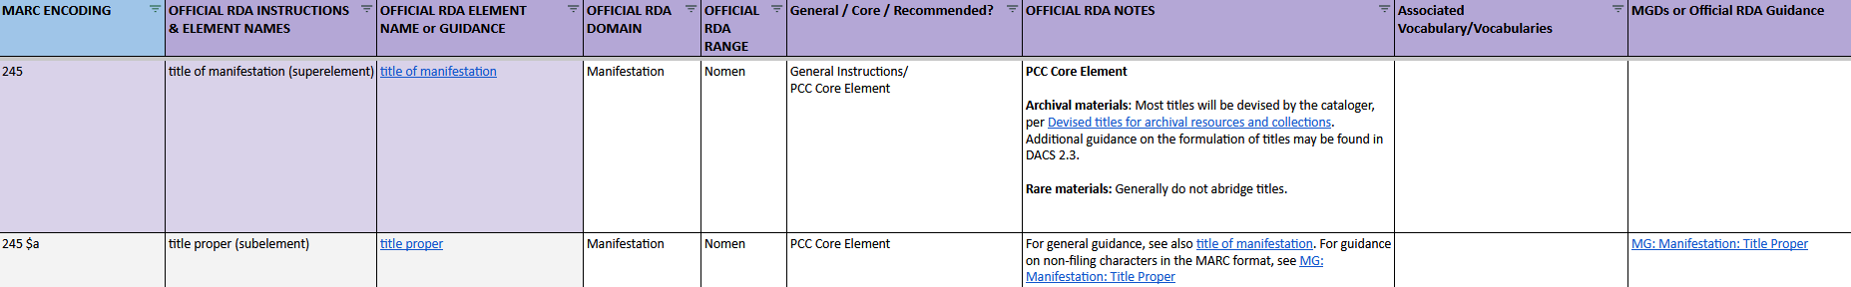
BSR Metadata Application Profile
Notes:
The draft BSR for official RDA starts with general instructions, such as the Introduction to RDA, Guidelines on normalized transcription, Numbers expressed as numerals or words, etc. The first two elements we come across are title of manifestation and title proper. Since we are already familiar with title proper, let’s click the link to start there in the RDA Toolkit.

Slide 6
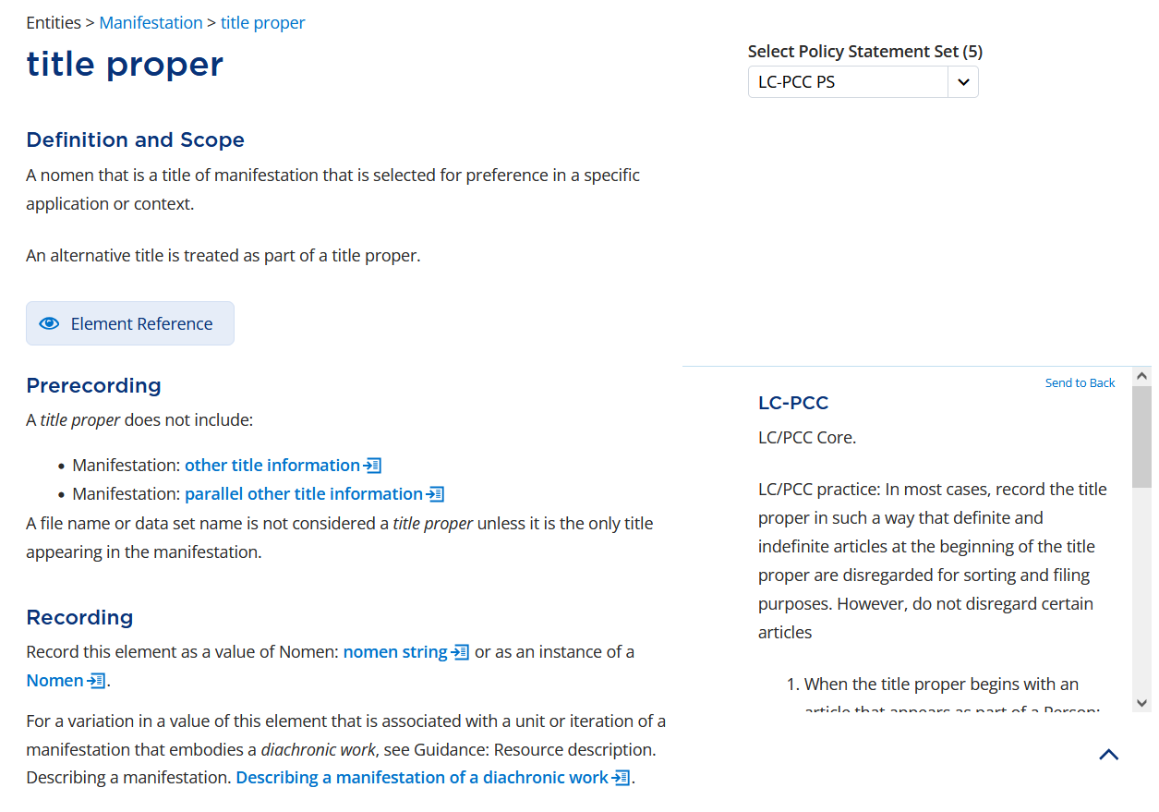
Notes:
In RDA, title proper is defined as “A nomen that is a title of manifestation that is selected for preference in a specific application or context.” The LC-PCC PS for Prerecording tells us the element is LC/PCC Core. It also tells us to record the title proper so initial articles are disregarded for soring and filing; we will do that using the second indicator in MARC.

Slide 7
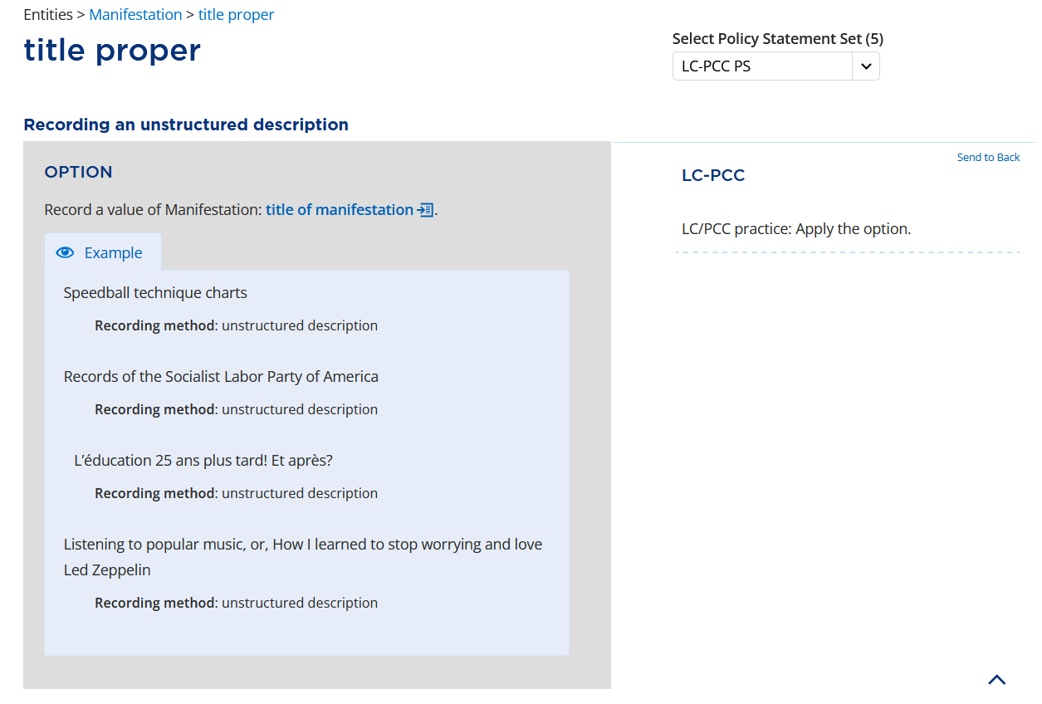
Notes:
Scrolling down to Recording an unstructured description, we come across a rather confusing option that we are told to apply. The option reads “Record a value of Manifestation: title of manifestation.” This means that if we have a value for title of manifestation, we can record that same value as our title proper. Let’s look at the instructions for title of manifestation.

Slide 8
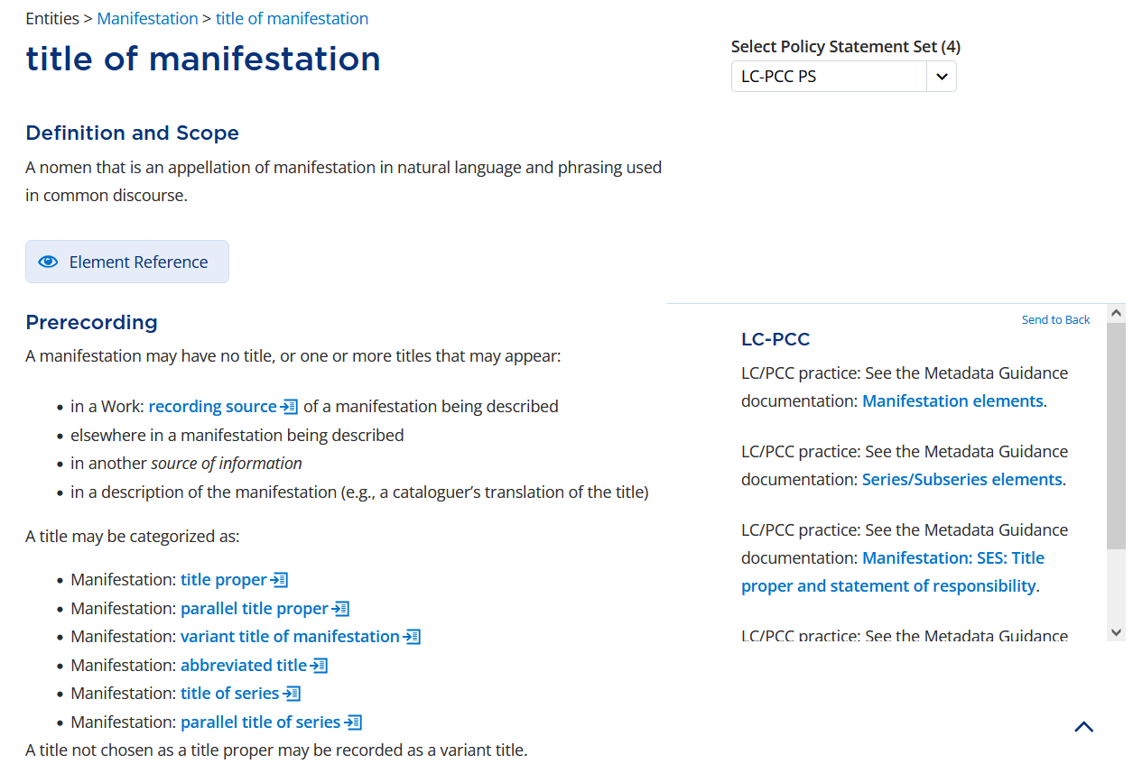
Notes:
A title of manifestation is “A nomen that is an appellation of manifestation in natural language and phrasing used in common discourse.” The instructions under Prerecording tell us that a title may come from a source within the manifestation being described, among other sources. They also tell us that a title may be categorized as a title proper, which is the element we are trying to record.
Note that the instructions for title of manifestation replace the Basic Instructions on Recording Titles in the original RDA Toolkit.
Also note that the SES MGD for Title proper and statement of responsibility appears in the LC-PCC PS. We will consult that MGD shortly.

Slide 9
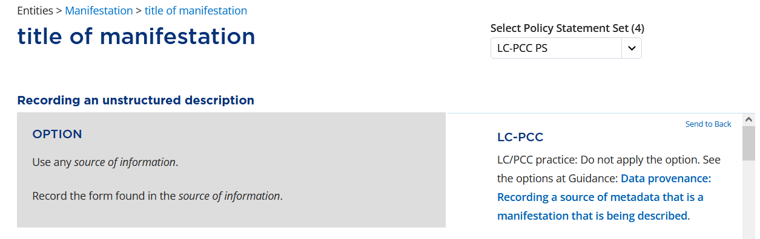
Notes:
Under Recording an unstructured description, there is an option to “Use any source of information”; however, the LC-PCC Policy Statement says to not apply the option. Instead, we are directed to the Data provenance Guidance chapter.

Slide 10
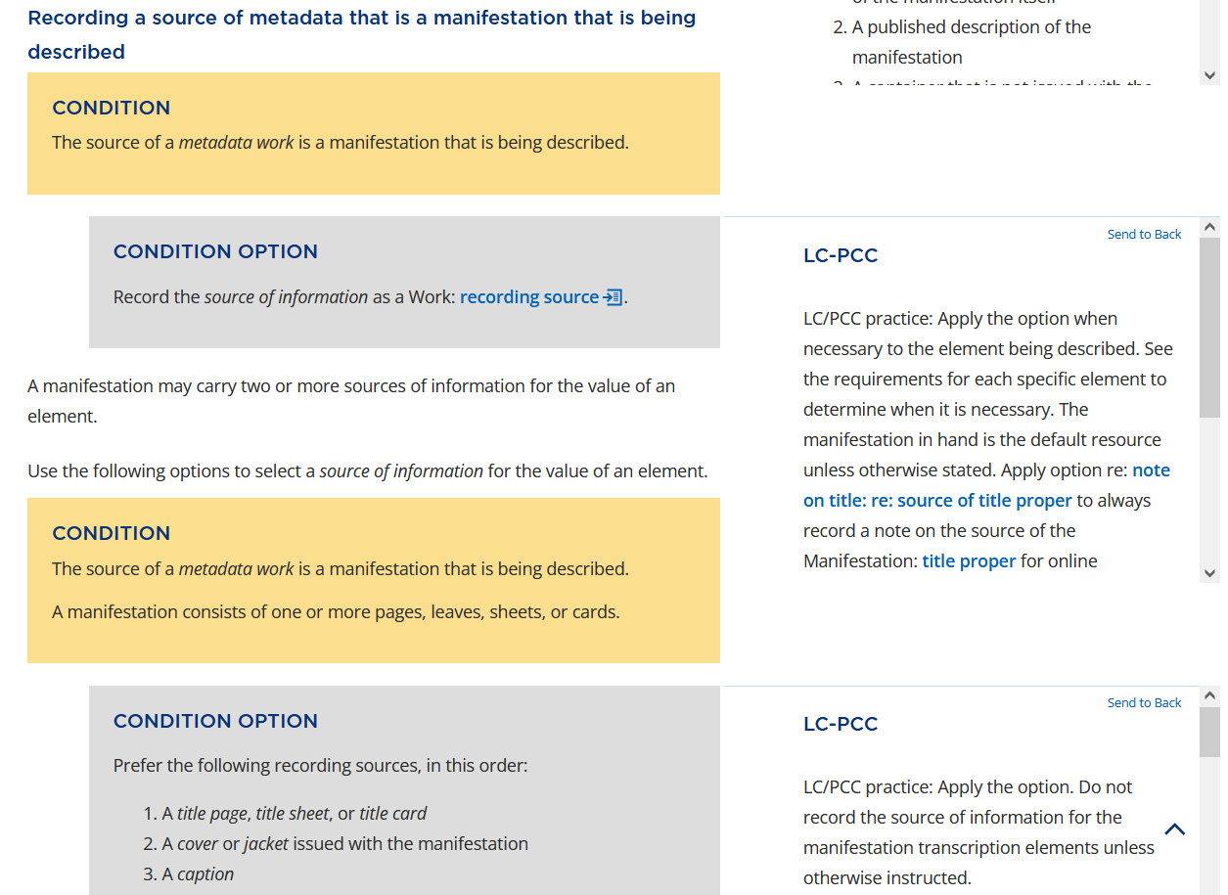
Notes:
The link in the PS takes us to the section for Recording a source of metadata that is a manifestation that is being described. We will apply the option under the second condition, which is to prefer the title page as our recording source.

Slide 11
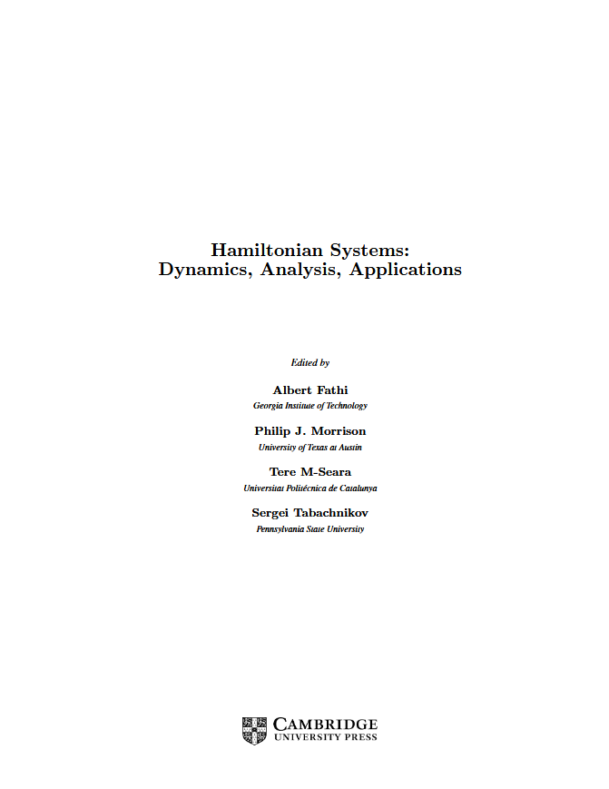
Notes:
Here is the title page of the resource we are cataloging. Given this, what is the title proper for this book? “Hamiltonian systems”.

Slide 12
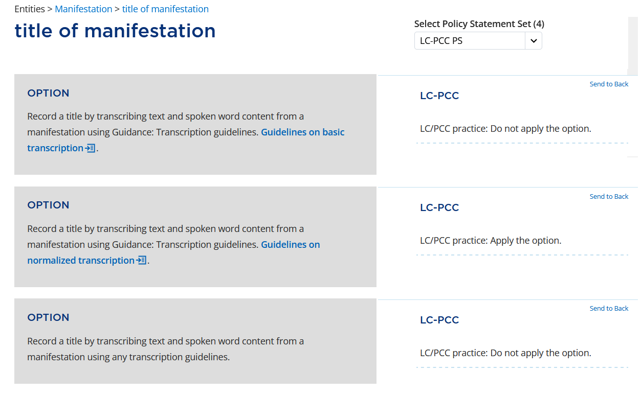
Notes:
Going back to title of manifestation, the next set of options tells us to record a title by transcribing text from a manifestation. There are different options based on the transcription standard we should want to use. The LC-PCC PSs tell us to apply the option to use the Guidelines on normalized transcription.

Slide 13
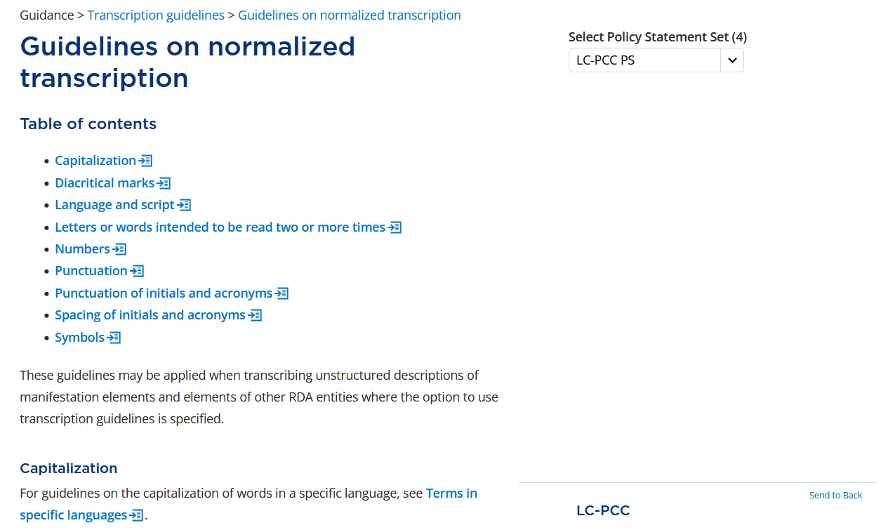
Notes:
In the Guidelines on normalized transcription, there are a couple sections that are most relevant for our resource: capitalization and punctuation.

Slide 14
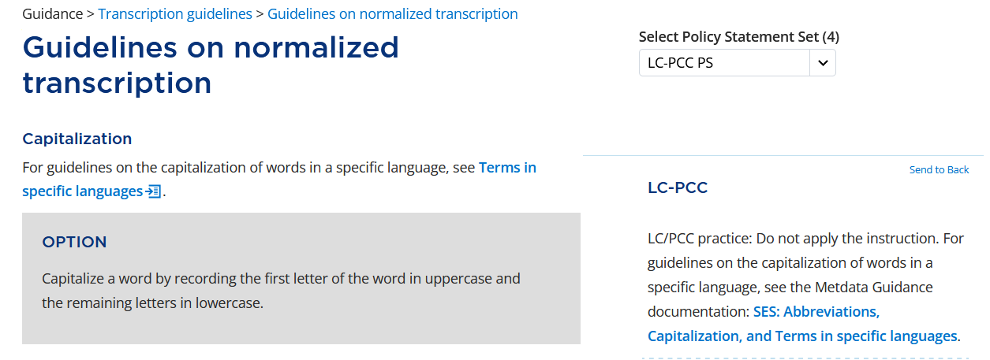
Notes:
Under Capitalization, the LC-PCC PS tells us to not apply the instruction and refers us to the MGD for abbreviations, capitalization, and terms in specific languages.

Slide 15
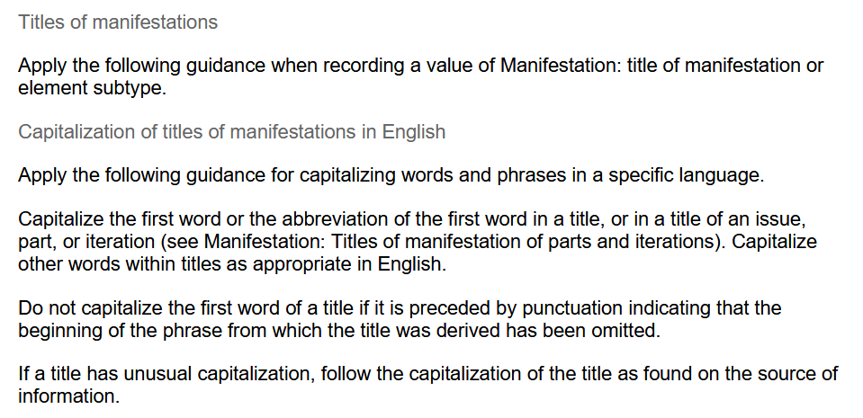
Notes:
Under Terms in English > Titles of manifestations, we see the guidance “Capitalize the first word … in a title … Capitalize other words within titles as appropriate for English. There are other options we apply related to capitalization, but they all get us to the same result.

Slide 16
Notes:
The last question, is what do we do with the colon that separates the title proper from other title information?

Slide 17
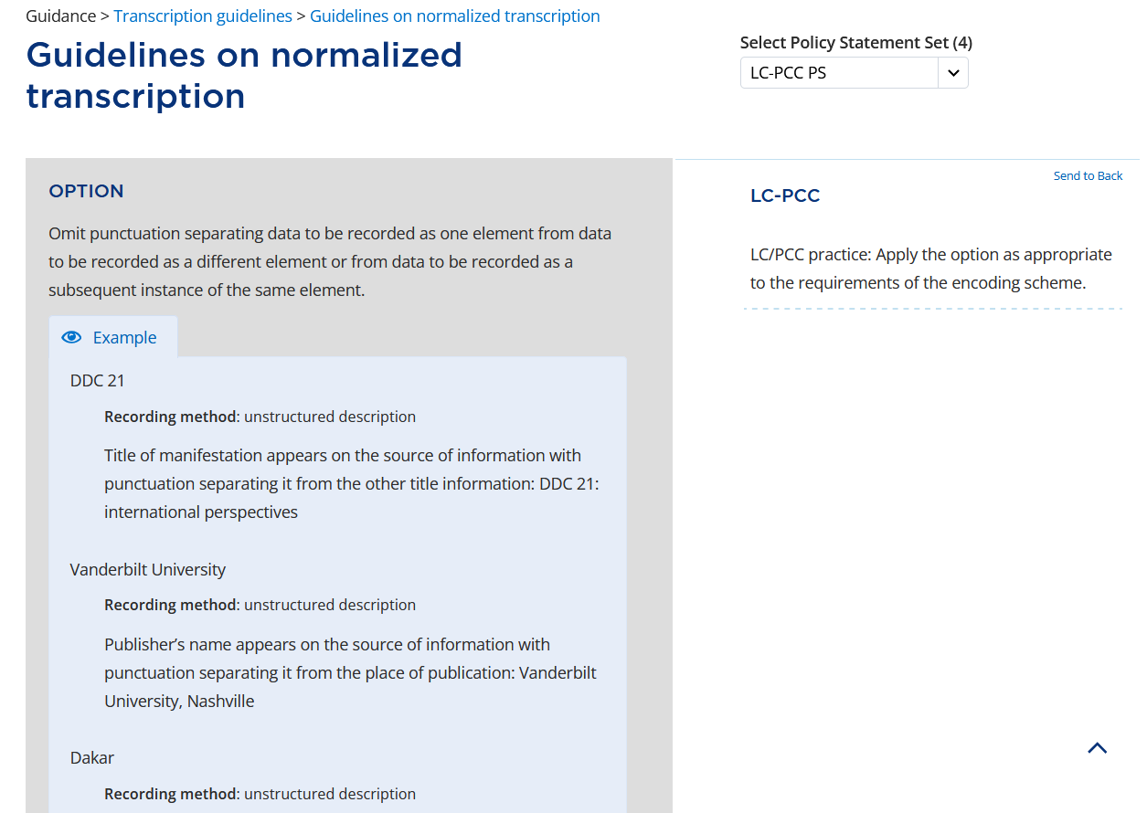
Notes:
We will apply the option to “Omit punctuation separating data to be recorded as one element from data to be recorded as a different element…”
There are additional instructions for recording a title of manifestation and a title proper; however, none of them apply to our situation.

Slide 18
Manifestation: SES: Title proper and statement of responsibility
Title proper
Element order
Record the title proper as the first element in the string, preceding any elements of other title information, statements of responsibility relating to title proper, and associated parallel elements.
Capitalization
In most cases, capitalize the first letter of the first word of the title proper.
Notes:
Now we will consult the MGD SES: Title proper and statement of responsibility mentioned earlier. The MGD tells us to “Record the title proper as the first element in the string.”

Slide 19
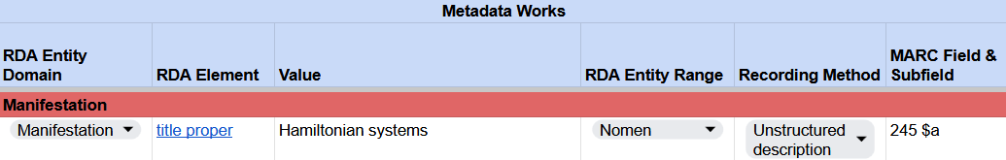
Recording title proper
RDA Record Template
MARC 21 Bibliographic Record
Notes:
In our RDA Record Template, record the title proper “Hamiltonian systems”.
In MARC, this is recorded in field 245 subfield $a. And if you remember early, we will code the second indicator to account for 0 filing characters. We will wait to code the first indicator.

Slide 20
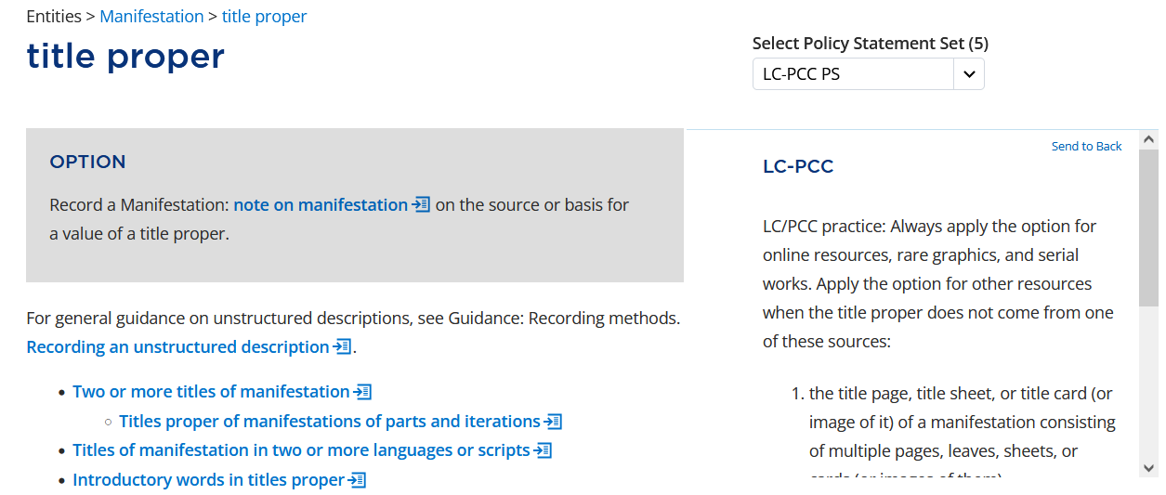
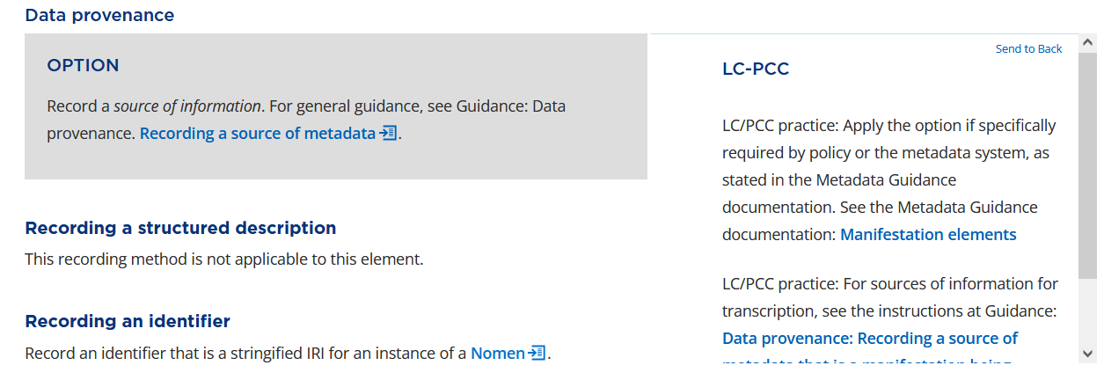
Notes:
Before we leave title proper, there are two options we need to consider. The first is to “Record a Manifestation: note on manifestation on the source or basis for a value of a title proper.” The LC-PCC PS tells us to always apply the option for online resources.
The second option is to record a source of information. We will record this information using the element note on manifestation.

Slide 21
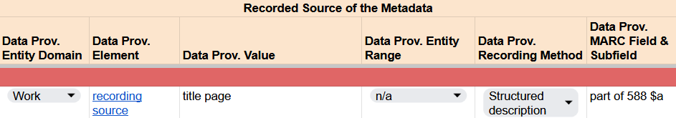
Recording title proper
RDA Record Template
Notes:
In our RDA Record Template, we could record data provenance for the title proper.

Slide 22
note on manifestation

Slide 23
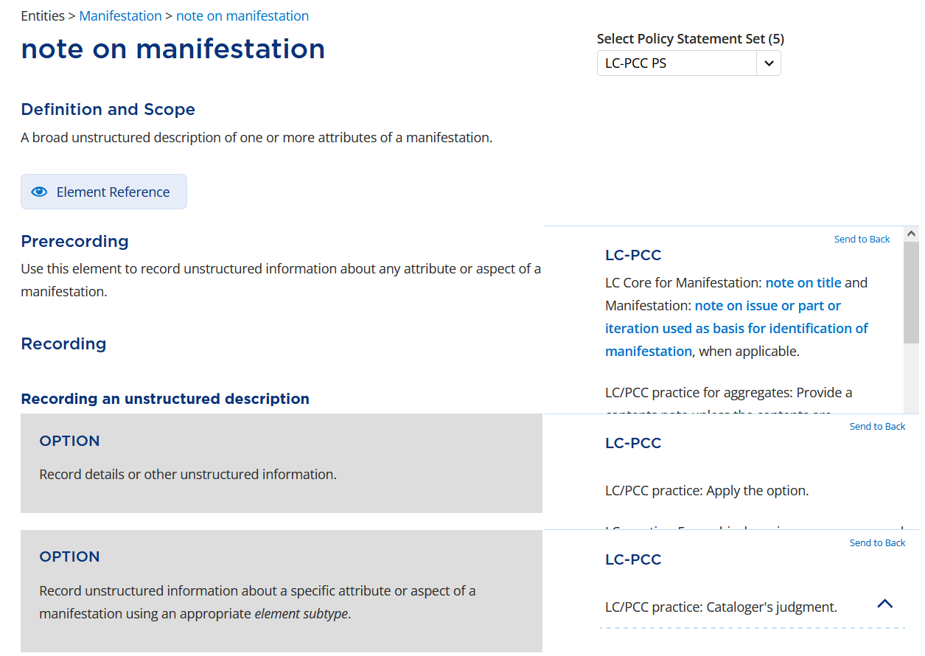
Notes:
From the title proper, we were directed to record a note on manifestation, which is “A broad unstructured description of one or more attributes of a manifestation.” We will use this element to record a note on title and a note on issue or part or iteration used as basis for identification of manifestation.
For recording the information, RDA only tells us to record unstructured information, so let’s take a look at note on title.

Slide 24
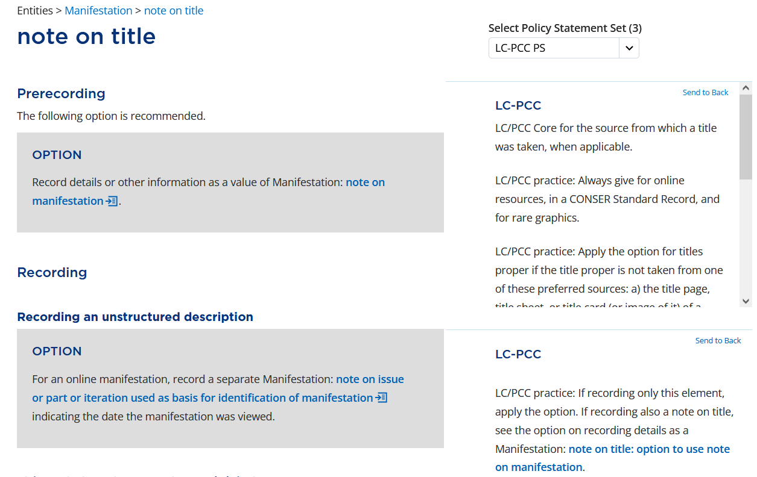
Notes:
Note on title is LC/PCC Core for the source from which a title was taken, when applicable, and we are told to always give for online resources.
There is also an option for online manifestations to “Record a separate Manifestation: note on issue or part or iteration used as basis for identification of manifestation indicating the date the manifestation was viewed.”; however, the LC-PCC PS says to use the broader element note on manifestation if also recording a note on title.

Slide 25
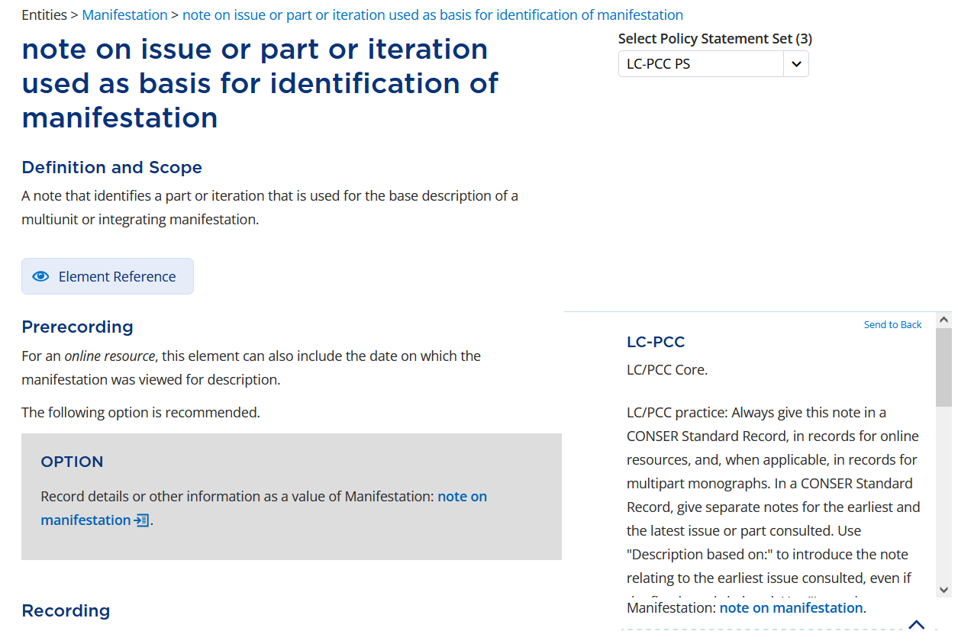
Notes:
Again, note on issue or part or iteration used as basis for identification of manifestation is LC/PCC Core and should always be recorded for online resources.

Slide 26
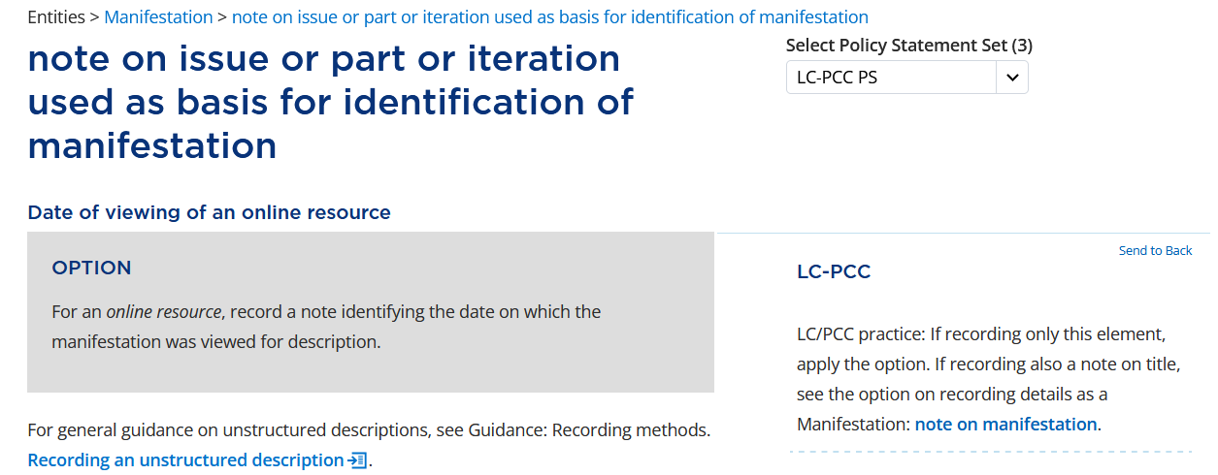
Notes:
The only other information in RDA is to record the date on which the manifestation was viewed for description.

Slide 27
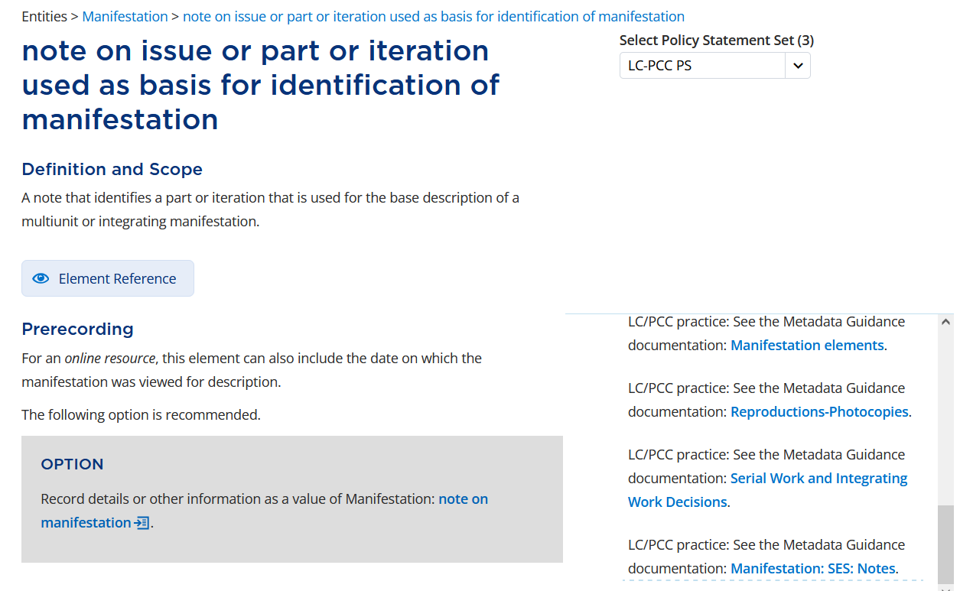
Notes:
Let’s scroll up and look at the MGD SES: Notes.

Slide 28
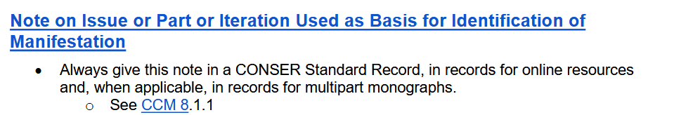
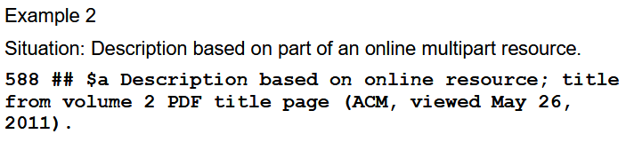
Notes:
In the SES: Notes MGD, we are told “If the description is based on a single monographic online resource, combine in one note the source of description, source of title, the provider, and the date viewed. If considered useful, add the file format of the resource viewed.” There is also a helpful example.

Slide 29
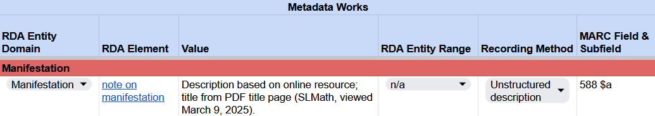
Recording note on manifestation
RDA Record Template
MARC 21 Bibliographic Record
Notes:
Based on the example, we can record “Description based on online resource; title from PDF title page (SLMath, viewed March 9, 2025).”
This is recorded in field 588 subfield $a in MARC.
Note that the date was based on when the task group first started working on this resource, but you can enter today’s date, June 27, 2025.

Slide 30
other title information

Slide 31
BSR Metadata Application Profile
Notes:
Going back to the BSR, the next element applicable to our manifestation is other title information.

Slide 32
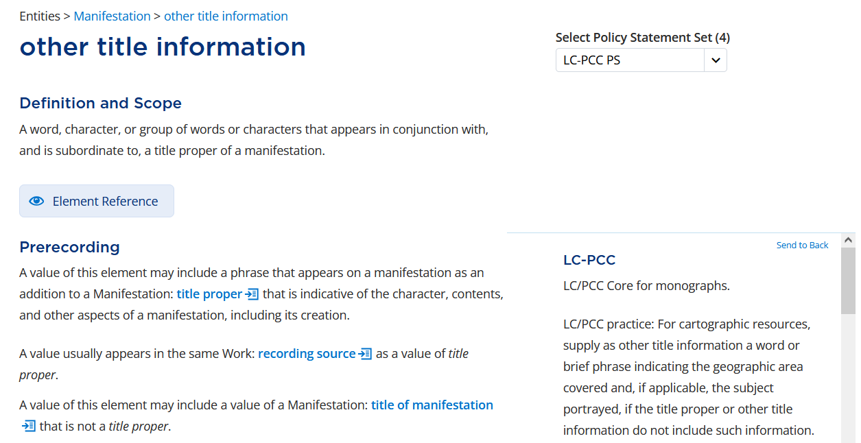
Notes:
Other title information is: A word, character, or group of words or characters that appears in conjunction with, and is subordinate to, a title proper of a manifestation. This element is LC/PCC Core for monographs.
Under Prerecording, we are also told that “A value usually appears in the same Work: recording source as a value of title proper.”

Slide 33
Notes:
Therefore, we will record the other title information from the title page from which we took the title proper.

Slide 34
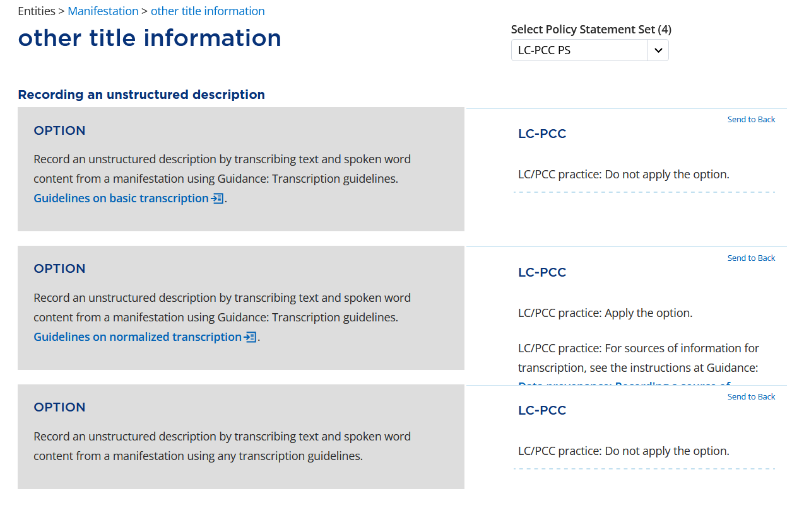
Notes:
As with the title proper, we will apply the option to transcribe other title information using the Guidelines on normalized transcription.

Slide 35
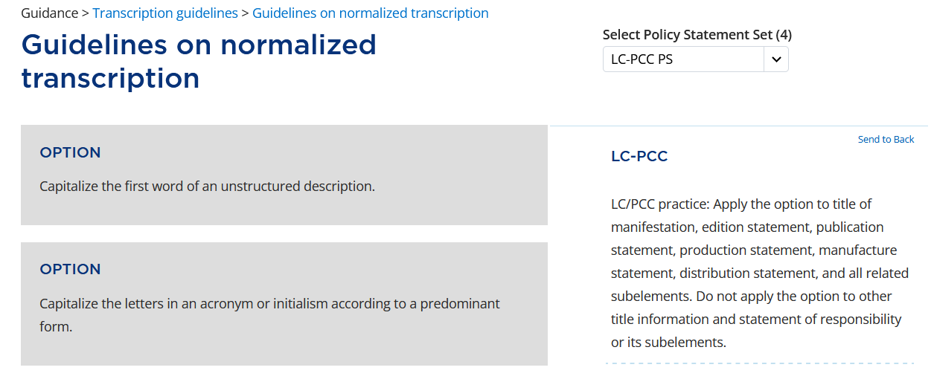
Notes:
Of particular note is the option to “Capitalize the first word of an unstructured description.”; however, the LC-PCC PS says, “Do not apply the option to other title information and statement of responsibility or its subelements.”

Slide 36
Manifestation: SES: Title proper and statement of responsibility
Other title information
Element order
Record other title information following the title proper.
Capitalization
Do not capitalize the first letter of the first word of the element, unless it would otherwise be capitalized according to the conventions of the language.
Punctuation
Precede each instance of other title information with a space-colon-space.
Notes:
Returning to the SES: Title proper and statement of responsibility MGD, we are told to “Record other title information following the title proper” and to “Precede each instance of other title information with a space-colon-space.”

Slide 37
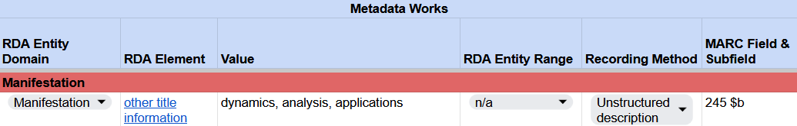
Recording other title information
RDA Record Template
MARC 21 Bibliographic Record
Notes:
In our RDA Record Template, we transcribe the other title information in all lowercase.
In our MARC record, we record other title information in 245 subfield $b following the title proper and preceding it with a colon.

Slide 38
statement of responsibility relating to title proper

Slide 39
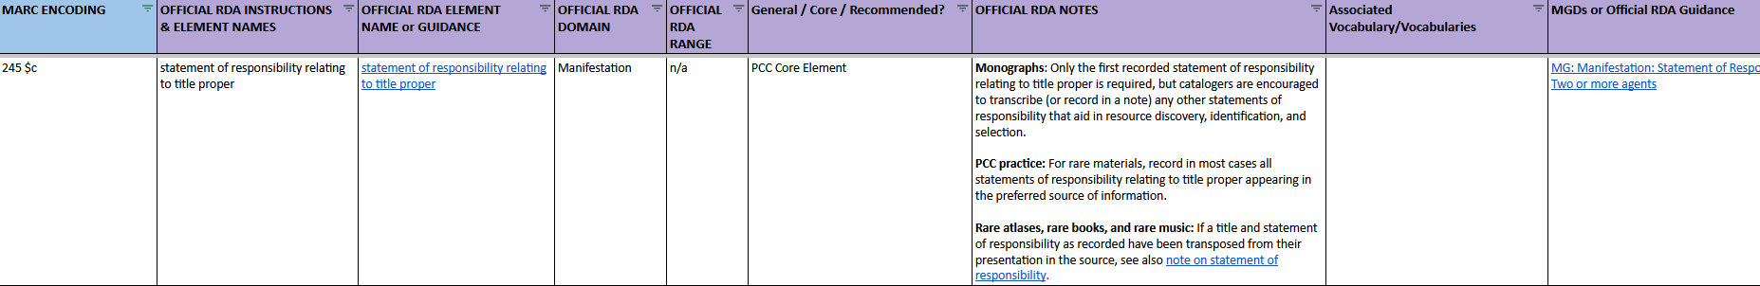
BSR Metadata Application Profile
Notes:
Continuing with the BSR, the next applicable PCC Core element is statement of responsibility relating to title proper.

Slide 40
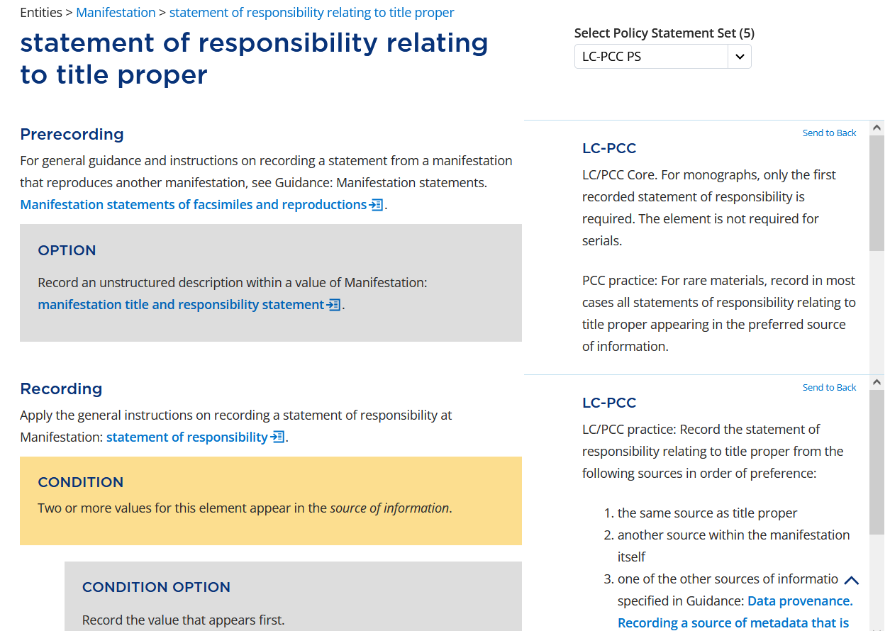
Notes:
Statement of responsibility relating to title proper is LC/PCC Core. For monographs, only the first recorded statement of responsibility is required.
Under Recording, the LC-PCC PS tells us to record the value from the same source as the title proper. The RDA instruction says to “Apply the general instructions on recording a statement of responsibility at Manifestation: statement of responsibility.” So let’s go there.

Slide 41
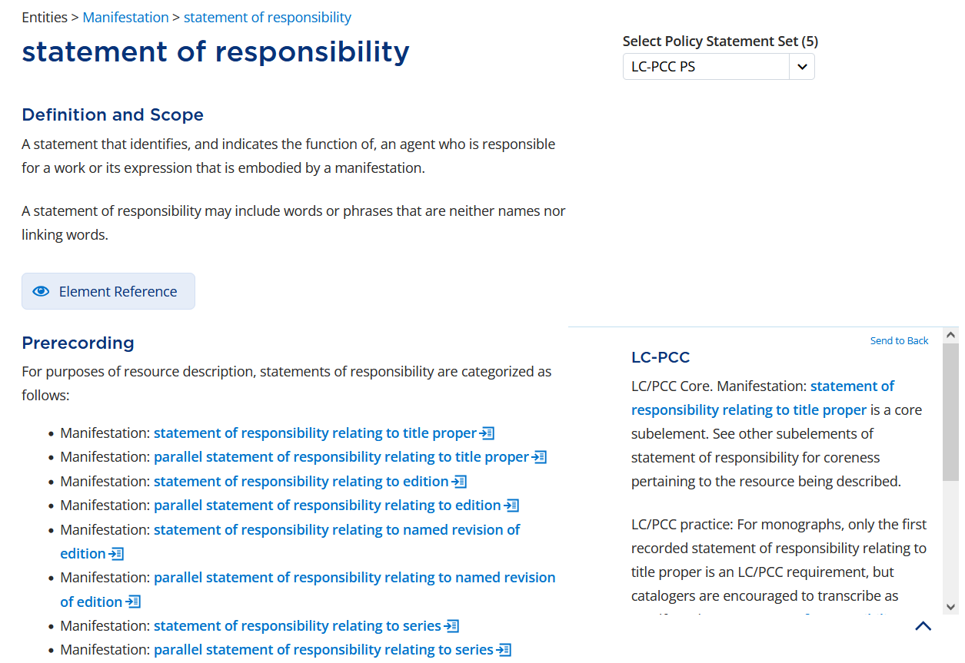
Notes:
A statement of responsibility is “A statement that identifies, and indicates the function of, an agent who is responsible for a work or its expression that is embodied by a manifestation.”

Slide 42
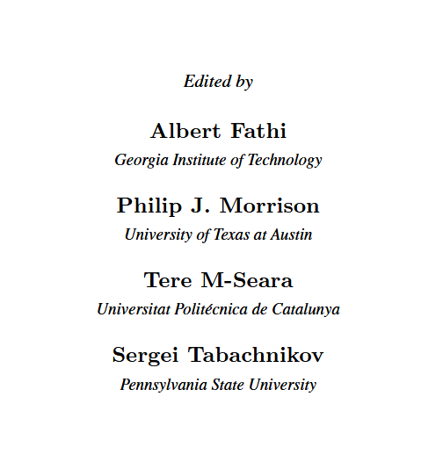
Notes:
On our title page, do we have a statement that identifies agents responsible for the works or expressions? Yes.

Slide 43
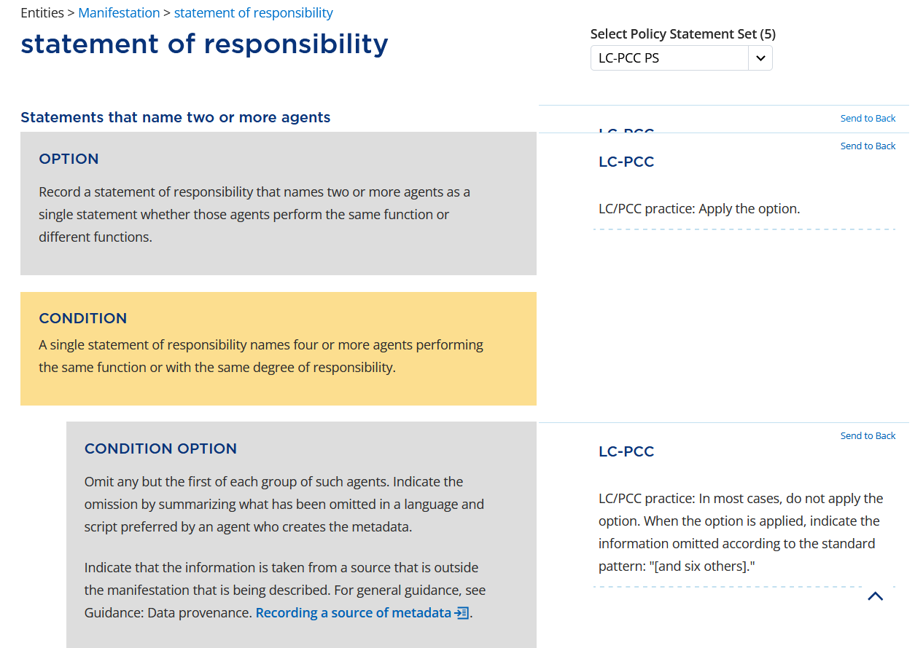
Notes:
Before we consider how to record the statement of responsibility, there are a couple options under Statements that name two or more agents that we need to consider. First, we will apply the option to “Record a statement of responsibility that names two or more agents as a single statement…”
The second is a condition: Do we have a single statement of responsibility that names four or more agents performing the same function or with the same degree of responsibility? Yes, so let’s consider the condition option to omit any but the first of each group. The LC-PCC PS says, “In most cases, do not apply the option.” Therefore, we will record all for agents.

Slide 44
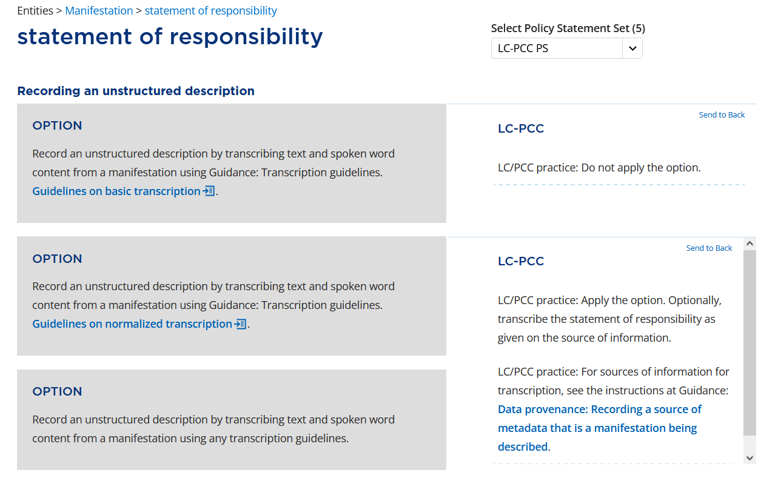
Notes:
Now that we know what to record, let’s look at how to record it. As you might have guessed, we will again apply the option to transcribe an unstructured description using the Guidelines on normalized transcription.

Slide 45
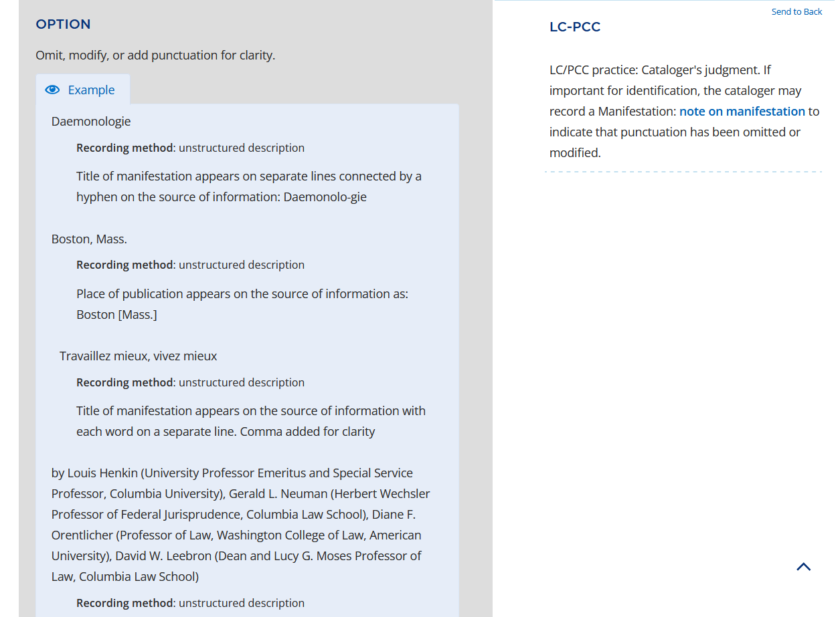
Notes:
We have already seen the instruction to not capitalize the first word of the statement of responsibility, so we are not going to look further at the capitalization instructions, but we will look at what do with the affiliations following each name.
In the section on Punctuation, there is the option to add punctuation for clarity. The last example show on the slide is a statement of responsibility that appears on the source of information with each name, academic title, and affiliation on a separate line. Commas and parentheses added for clarity. We will apply this option and also add commas and parentheses.

Slide 46
Manifestation: SES: Title proper and statement of responsibility
Statement of responsibility relating to title proper
Element order
Record the element following the title proper (if no other title information is present) or following the other title information (if it is present).
Capitalization
Do not capitalize the first letter of the first word of the element, unless it would otherwise be capitalized according to the conventions of the language.
Punctuation
Precede the element with a space-slash-space. Precede any subsequent instances of the element with a space-semicolon-space.
If the statement of responsibility is the last element in the string, end it with a period.
Notes:
And going back to the SES: Title proper and statement of responsibility MGD one last time, there is guidance to record the statement of responsibility relating to title proper following the other title information and to precede it with a space-slash-space. If the statement of responsibility is the last element, end it with a period.

Slide 47
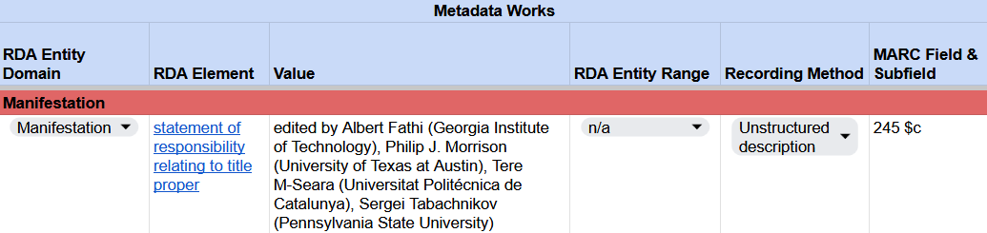
Recording statement of responsibility relating to title proper
RDA Record Template
MARC 21 Bibliographic Record
Notes:
In our RDA Record Template, we transcribe the value by not capitalizing the first word but adding parentheses and commas for clarity.
In MARC, this value is recorded after the statement of responsibility in subfield $c, preceded by space-slash-space, and followed with a period.
Note: There is is an option to abridge a statement of responsibility and not record the affiliations.

Slide 48
publication statement
place of publication, name of publisher, date of publication

Slide 49
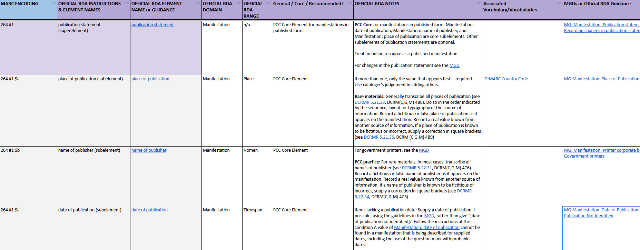
BSR Metadata Application Profile
Notes:
Let's start with the BSR and scroll down to the element publication statement. We can see that it is a superelement shaded in purple and the subelements appear below in grey. Let’s click on the link to view the element in the RDA Toolkit.

Slide 50
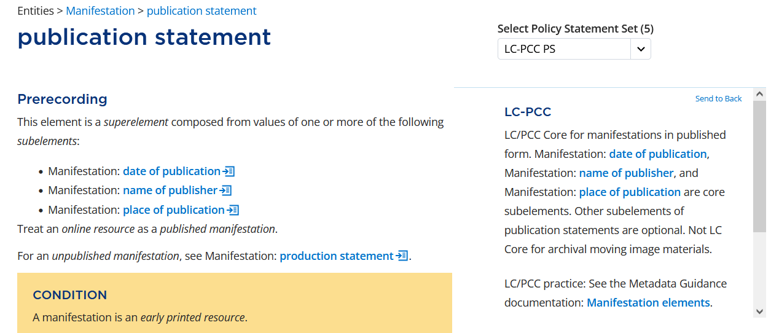
Notes:
In the RDA Toolkit, under Prerecording, we can see that Publication statement is a superelement that is composed of date of publication, name of publisher, and place of publication. It also tells us to “Treat an online resource as a published manifestation.” The LC-PCC PS confirms that the element is LC/PCC Core for manifestations in published form and that the subelements are also core.
So, we have to record a publication statement. Let’s start by looking at place of publication.

Slide 51
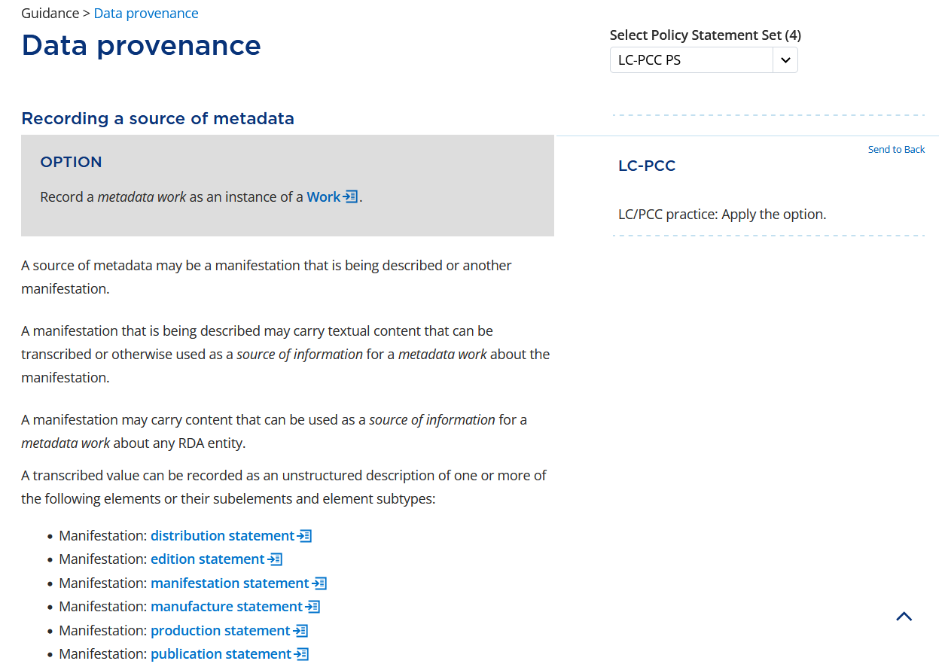
Notes:
Before we record any values, let’s first consider the sources of information. In the RDA Toolkit, the Data provenance Guidance chapter includes a section for Recording a source of metadata. That section includes the instruction that “A transcribed value can be recorded as an unstructured description of one or more of the following elements or their subelements …” The list includes publication statement.

Slide 52
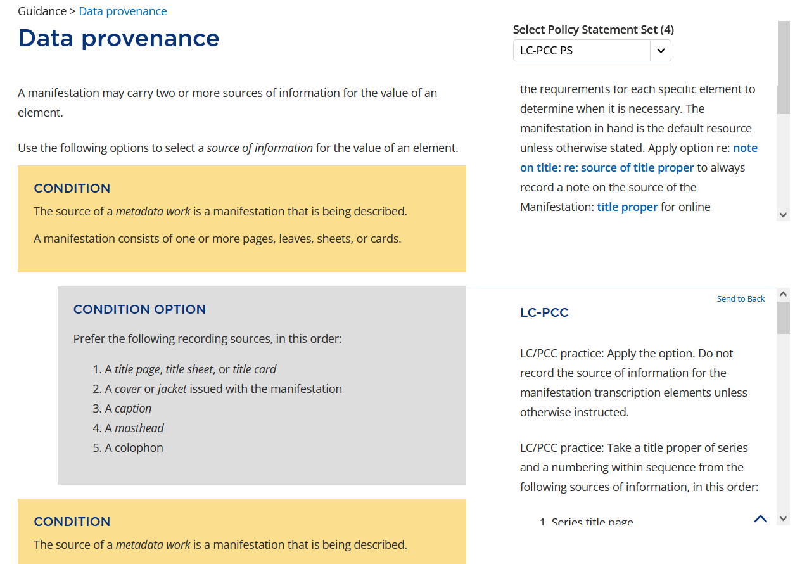
Notes:
Scrolling further down, we see the instruction to “Use the following options to select a source of information for the value of an element.” The first condition applies to our resource because our source is the manifestation we are describing, and the manifestation consists of pages. Therefore, we apply the condition option to use the title page as the preferred source of information.

Slide 53

Notes:
For our resource, we'll find all our information on both sides of the title page.
Since the superelement publication statement is composed from values of the subelements, we’ll record values for the subelements first.

Slide 54
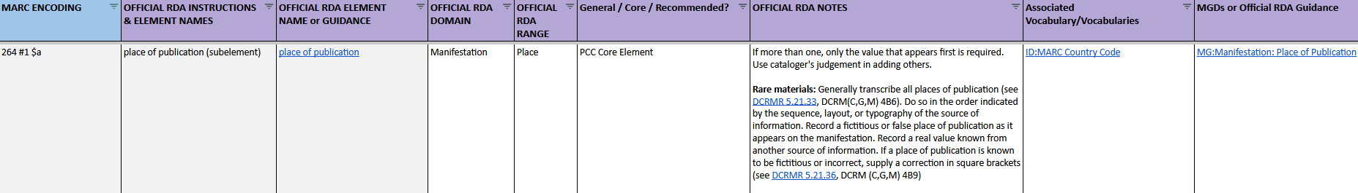
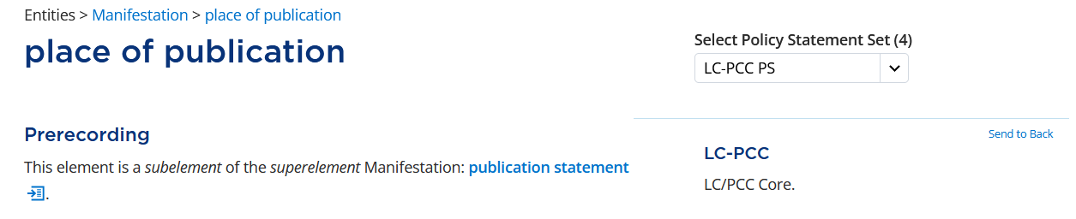
Notes:
The first subelement we will look at is place of publication. Beginning with the BSR, we can see it is PCC Core element. If we click the link to view the element in the RDA Toolkit, we see this same information under Prerecording.

Slide 55
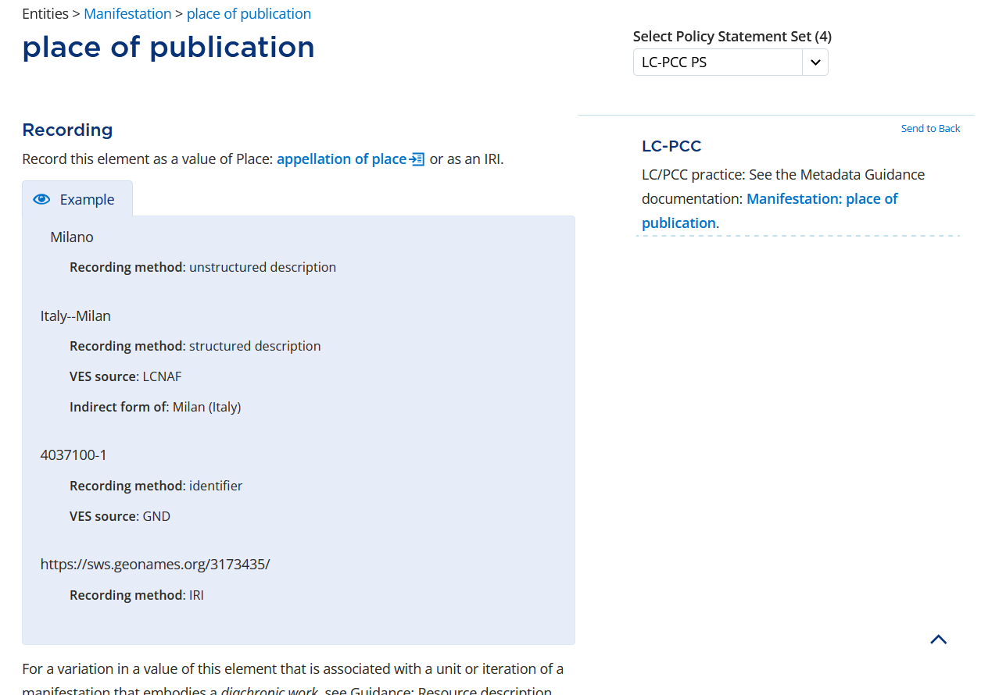
Notes:
Scrolling down to Recording, we see there is a link to the MGD place of publication. Let’s open it to see if any of the guidance pertains to our situation.

Slide 56
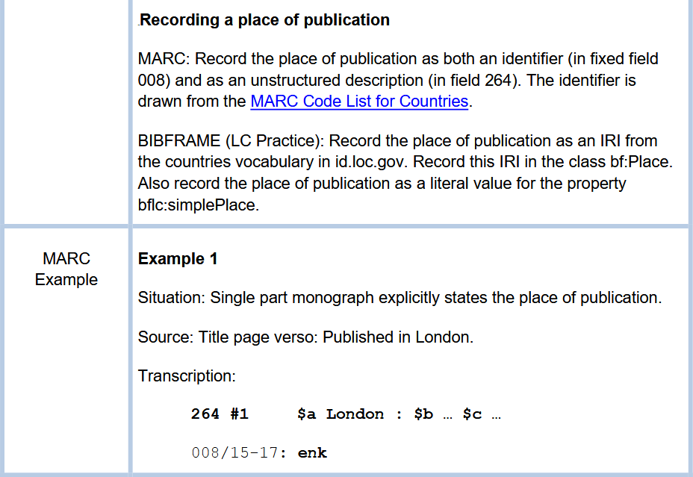
Notes:
The MGD says to “Record the place of publication as both an identifier (in fixed field 008) and as an unstructured description (in field 264).” This great to know, but we can’t do anything with it yet.

Slide 57
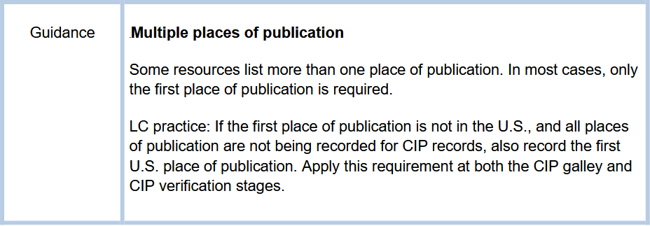
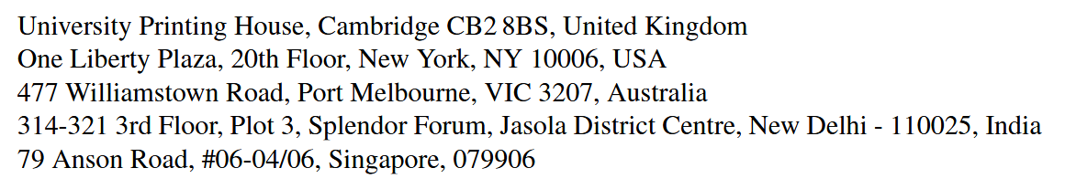
Notes:
Scrolling further down in the MGD, we see that some resources list more than one place of publication. On the title page verso, we see several places listed. The MGD says that “In most cases, only the first place of publication is required.” There is an LC practice to “also record the first U.S. place of publication”; however, we will not be following that practice.

Slide 58
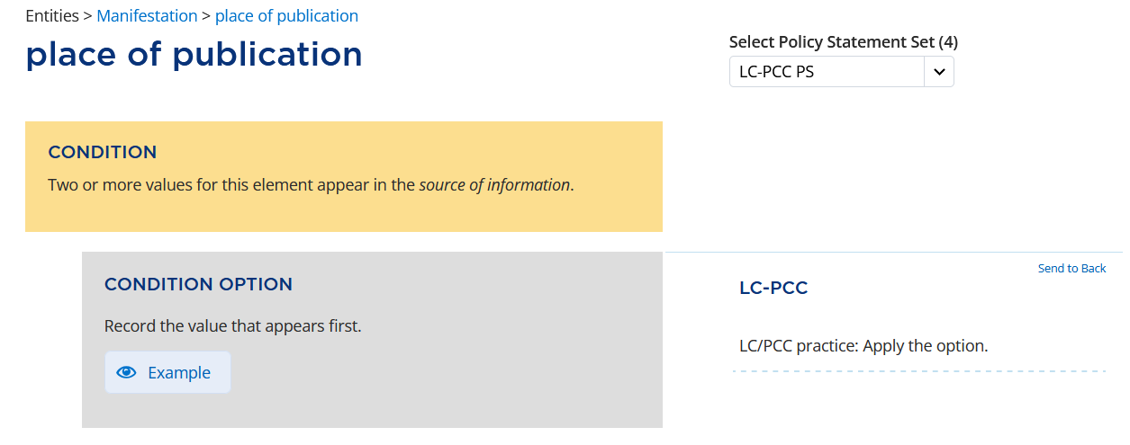
Notes:
Going back to the RDA Toolkit, there is a condition that if “Two or more values for this element appear in the source of information”, like in our case, LC/PCC applies the option to “Record the value that appears first.”

Slide 59
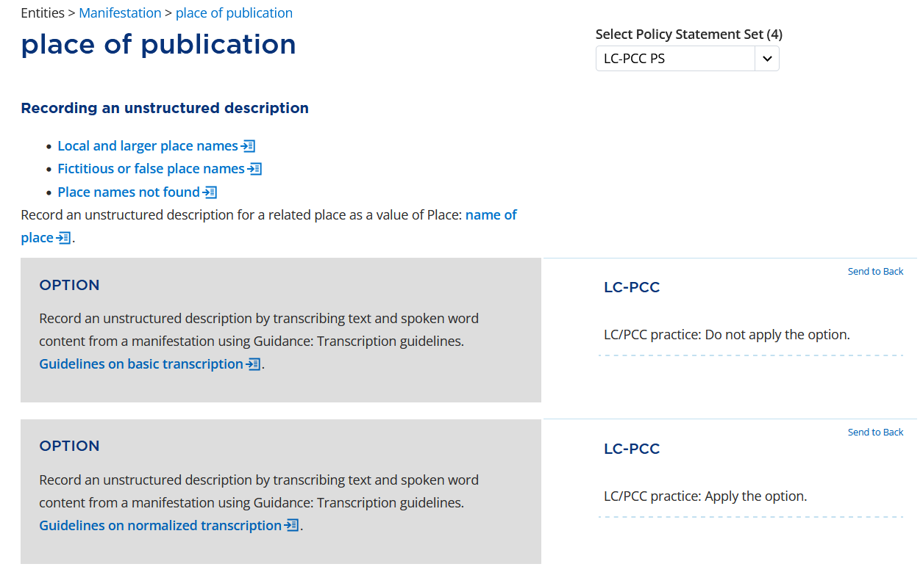
Notes:
Time to record! What are our instructions?
Under Recording an unstructured description, PCC applies the option to “Record an unstructured description by transcribing text … using the … Guidelines on normalized transcription.”
In the interest of time, we will not review the Guidelines on normalized transcription right now.

Slide 60
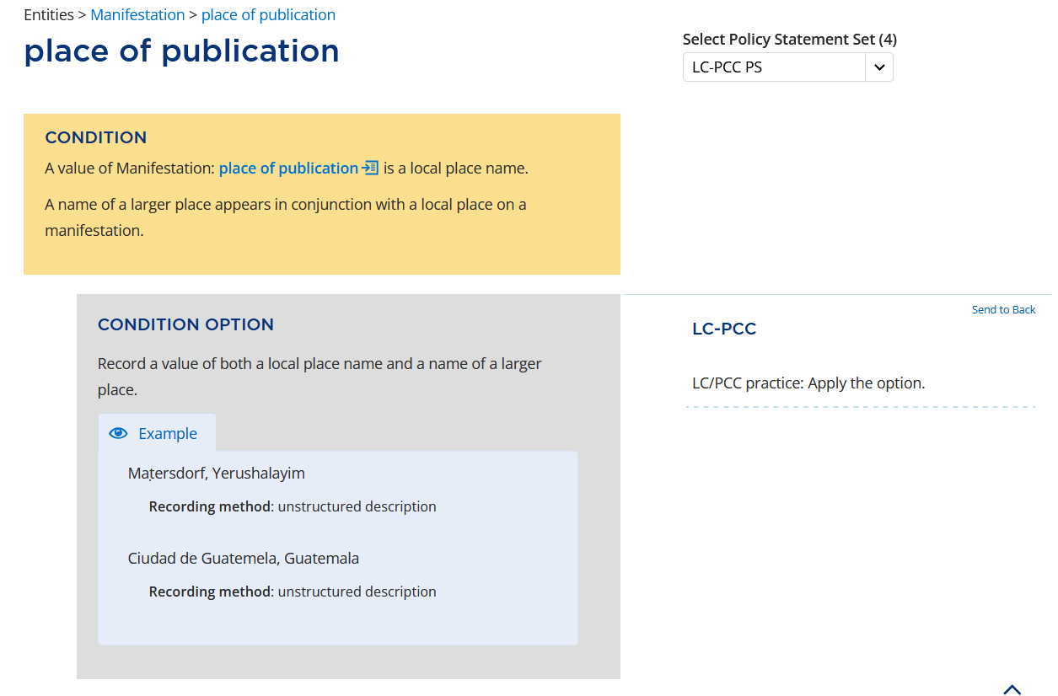
Notes:
Scrolling down further, we come across the condition for a place of publication that includes a local place name and a name of a larger place. We will apply the option to record both the local place name and the name of the larger place.

Slide 61
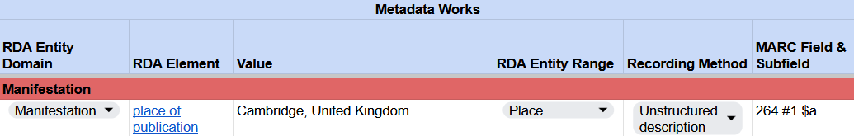
Recording place of publication
RDA Record Template
MARC 21 Bibliographic Record
Notes:
“Cambridge, United Kingdom” is record as an unstructured description of a place of publication in our RDA Template. In our MARC bibliographic record, this is recorded in 264 #1, subfield $a.

Slide 62

Notes:
If you remember, we were told earlier to also record place of publication as an identifier. In the RDA Toolkit, scroll down to the Recording an identifier section. We will apply the basic instruction to record an identifier for place. Note that while the policy statement says to record a name of place, we actually want to record the code from the MARC Code List for Countries.

Slide 63

Recording place of publication
RDA Record Template
MARC 21 Bibliographic Record
Notes:
In our RDA Template, record the country code “enk” as an identifier for place of publication.
In our MARC record, in the Ctry (008/15-17) fixed field, also record “enk”.

Slide 64


Notes:
The next subelement we will look at is name of publisher, which is a PCC Core element as identified in the BSR and LC-PCC PS. In the RDA Toolkit, the Prerecording section explains that this is a shortcut element, but we don't need to study this now. Scrolling down, the next option that applies to our resources is …

Slide 65


Notes:
Under Recording an unstructured description. Again, we will apply the option to record a name by transcribing text from the manifestation using the Guidelines on normalized transcription.

Slide 66


Notes:
In the Guidelines on normalized transcription, we will apply the options to “Capitalize a word by recording the first letter of the word in uppercase and the remaining letters in lowercase.” and to “Capitalize proper names.” among others.

Slide 67

Recording name of publisher
RDA Record Template
MARC 21 Bibliographic Record
Notes:
In our RDA Template, record the name of publisher “Cambridge University Press”.
In our MARC record, name of publisher is recorded in 264 #1, subfield $b.

Slide 68


Notes:
As reflected in the BSR and the LC/PCC PS, date of publication is a core element.

Slide 69


Notes:
Scrolling down the element page for date of publication, the next applicable option is to record an unstructured description by transcribing text from a manifestation using the Guidelines on normalized transcription.

Slide 70

Notes:
In the Guidelines on normalized transcription, the Number section includes a policy statement that says, “For number, the options below apply to the elements …”.

Slide 71

Notes:
Date of publication is part of the list; therefore, …

Slide 72

Notes:
We can apply the option to “Transcribe the number as it appears.”

Slide 73

Recording date of publication
RDA Record Template
MARC 21 Bibliographic Record
Notes:
Since the title page verso says, “First published 2024”, we can record “2024” in our RDA Template as an unstructured description of date of publication.
In our MARC record, date of publication is recorded in 264 #1, subfield $c.

Slide 74


Notes:
In reviewing the MARC 21 Bibliographic alignments in the Element Reference box, we can see that date of publication is also recorded as a structured description in the 008 fixed field. The instructions for Recording a structured description are to record an access point for timespan.

Slide 75

Notes:
On the element page for access point for timespan, we will apply the third option under Recording a structured description to “Construct an access point by applying a string encoding scheme to the values of one or more other elements.” Since we are recording the date in a date-specific field, we will record the value using the conventions of the field.

Slide 76

Notes:
This means using the standard specified in MARC 21.

Slide 77


Recording date of publication
RDA Record Template
MARC 21 Bibliographic Record
Notes:
In our RDA Template, record “2024” as a structured description of date of publication.
In our MARC record, record “2024” in the first Dates field.

Slide 78

Notes:
Now that we have values for all the subelements, let’s return to the superelement and put everything together to get our publication statement. Under Recording a structured description, apply the option to "Record a structured description by applying a string encoding scheme to select, sequence, and punctuate values of one or more subelements.“ There is a policy statement that links to the string encoding scheme MGD for Publication, Distribution, Manufacture, and Production.

Slide 79



Notes:
The MGD specifies to precede each name recorded in subfield $b with a space-colon-space, to precede the date in subfield $c with a comma-space, and to add a terminal period at the end of field 264.

Slide 80

Recording publication statement
RDA Record Template
MARC 21 Bibliographic Record
Notes:
In our RDA Template, the publication statement is the entire 264 field.
In our MARC record, because we already entered the values in subfields $a, $b, and $c, we just need to add the missing punctuation to complete the publication statement.

Slide 81
series statement
title of series, numbering within sequence

Slide 82

BSR
Notes:
Let’s start with the BSR. The next superelement that the BSR defines as a PCC Core Element is the series statement.

Slide 83

Series Title Page
Notes:
Looking at the series title page of our e-resource, we can see “Mathematical Sciences Research Institute Publications, 72” – indicating that Hamiltonian Systems is Volume 72 of this series.

Slide 84
BSR
Notes:
This means that the next step in our cataloging process is to record the series statement superelement, which includes all relevant series statement subelements that PCC designates as core for the resource.
First let’s take a look at the series statement superelement. Clicking on the hyperlinked series statement in the Official RDA Element Name or Guidance column of the BSR takes us to the Official RDA Toolkit.

Slide 85

RDA Toolkit
Notes:
This is where we first find the definition and scope of the series statement superelement.

Slide 86


RDA Toolkit
Notes:
Let’s look at the Prerecording. Here, the series statement subelements are listed. (You can find these subelements listed in the BSR as well.)
The Prerecording section is where we also find our first LC-PCC Policy Statements. The policy statements tell us that this is a core element (as the BSR did), that title of series and numbering within sequence are core subelements, and that we must refer to the other subelements to determine whether they are core for the resource we are currently describing.
Although the policy statements also instruct us to record ISSN as part of the series statement, we will not record an ISSN since it does not appear on the resource. We’ll also disregard the policy statement having to do with tracing the series, as we will discuss tracing the series later in the workshop.
Finally, the policy statement refers us to the series statement and series statement string encoding scheme MGDs for additional information. In these MGDs, we can find general information about the superelement and its subelements, sources of information, string encoding schemes, and transcription. We’ll keep these in mind as we move through the options in the toolkit and reference them accordingly.

Slide 87


RDA Toolkit
Notes:
Now let’s take a quick look at the Recording a structured description section. Here we see two options; the policy statements instruct us to apply only the first option: “Record a structured description by applying a string encoding scheme to select, sequence, and punctuate values of one or more subelements.”
The policy statement also refers us to the MGD for the series statement string encoding scheme, the same MGD referenced in the Prerecording section. Again, we’ll keep this MGD in mind to reference later.

Slide 88
RDA Toolkit
Notes:
That’s all the information we need to know now for the series statement superelement. As we learned from the Prerecording section, the relevant subelements that we will need to record for our resource are title of series and numbering within sequence. We’ll refer to the documentation for those elements individually to determine how to record their values.
Once we’ve determined the values for those subelements, we will return to this superelement page and the referenced MGDs to determine how to encode the entire series statement in MARC.

Slide 89
title of series
Subelement of series statement
Notes:
Now let’s take a look at the first subelement of the series statement: title of series.

Slide 90
BSR
Notes:
We’ll begin again with the BSR, where we can see that title of series is a PCC Core element. Clicking on the hyperlinked title of series takes us back to the Official RDA Toolkit, …

Slide 91

RDA Toolkit
Notes:
… where we first find the definition and scope of the title of series subelement.

Slide 92

RDA Toolkit
Notes:
Let’s look at the Prerecording. The prerecording and first policy statement give us some information that we’ve already seen in the BSR: that the title of series is a subelement of the series statement superelement, and that title of series is LC/PCC Core.
The policy statements also direct us to three related MGDs that we can reference if necessary. For now, we can take note of the first MGD – Series: Title of series – which provides the instructions for transcription and MARC coding that we will reference later.

Slide 93


RDA Toolkit
Notes:
The Recording an unstructured description section provides us with some options and conditions. The first is an option without a condition: “Apply the basic instructions on recording titles at Manifestation: title of manifestation.” The policy statement tells us to apply this option and also refers us to the documentation Data provenance: Recording a source of metadata that is a manifestation being described within the Toolkit, which we’ll come back to later.
Since none of the remaining options apply, we can just focus on the first option and apply the basic instructions on recording titles at Manifestation: title of manifestation.

Slide 94

RDA Toolkit
Notes:
Clicking on the hyperlinked title of manifestation takes us to that element’s page. We will use these instructions to record the title of series value.
Let’s look first at the Prerecording section. One thing to note here is that prerecording tells us how a title may be categorized, and that one of the categorizations is title of series – so we know we are in the right place!
The policy statements in the Prerecording section refer us to a number of MGDs (some of which we have seen previously) that we can reference if necessary.

Slide 95

RDA Toolkit
Notes:
Let’s move on to the Recording section and Recording an unstructured description. Instead of applying the first option to use any source of information, the policy statement directs us to Data provenance: Recording a source of metadata that is a manifestation that is being described. Clicking this link will take us to the appropriate section of the Data provenance page.

Slide 96



RDA Toolkit
Notes:
After looking through the various conditions and condition options, we see that the appropriate one for this element is the second condition (“A manifestation consists of one or more pages, leaves, sheets, or cards”) and its policy statement (“Take a title proper of series and a numbering within sequence from the following sources of information, in this order: 1) series title page, 2) another source within the manifestation itself, or 3) one of the external sources of information in the referenced documentation”).
We can find the title of the series for Hamiltonian Systems on the series title page, so this will be our recording source.

Slide 97

RDA Toolkit
Notes:
Let’s go back to title of manifestation now. The final three options under Recording an unstructured description provide instructions for transcription, and the policy statements tell us to apply only the second option: “Record a title by transcribing text and spoken word content from a manifestation using Guidance: Transcription guidelines. Guidelines on normalized transcription.”
Let’s click on the link to take a closer look at the Guidelines on normalized transcription.

Slide 98

RDA Toolkit
Notes:
We’ll start with Capitalization. The policy statements tell us not to apply the first instruction for capitalization and refers us instead to the MGD: SES: Abbreviations, Capitalization, and Terms in specific languages.

Slide 99



MG: SES: Abbreviations, Capitalization, and Terms in specific languages
Notes:
Since the title on the series title page is in English, we’ll go to the Terms in English section and move down to find the section Titles of manifestations.
The relevant instruction here is to “capitalize the first word or the abbreviation of the first word in a title” and to “capitalize other words within titles as appropriate in English.”
Since the series title contains a name, let’s also take a look at the Names of corporate bodies section. Here we’re instructed to capitalize the names of institutions, associations, companies, and other bodies.

Slide 100


RDA Toolkit
Notes:
Now that we know the guidance for capitalizing terms in English specifically, let’s return to the Capitalization section of the Guidelines on normalized transcription in the Toolkit.
Here there are three options that the policy statements instruct us to apply. The first is: “Capitalize a word by recording the first letter of the word in uppercase and the remaining letters in lowercase.” Nothing surprising there.
The second option we’ll apply is: “Capitalize the first word of an unstructured description.” We know to apply this because the policy statement says to apply the option specifically for title of manifestation.
The last relevant option for us here is: “Capitalize proper names” (as this is appropriate for English).

Slide 101

RDA Toolkit
Notes:
There are no diacritical marks in our series name, so we’ll skip the next section and move on to Language and script.
Here, we find the final relevant transcription option: “Record a value in the language and script in which it appears on a manifestation.” The policy statements instruct us to apply this option, so we will record the series title in English and Latin script, as is found on our series title page.

Slide 102


RDA Toolkit
Notes:
Now we’re ready to move back to Title of manifestation to see if there are any other instructions we need to apply when recording.
Looking at our series title page, we can see that the series title does not contain errors, is not long enough to need to be abridged, and has no introductory words, so we will move past those sections. But we will stop and take a look at Titles of manifestations that include names of agents, as our series title includes the name of an agent, the Mathematical Sciences Research Institute.
There are three conditions with corresponding options listed here – the condition relevant to our case is that “a value of Manifestation: manifestation title and responsibility statement includes a name of an agent that is an integral part of the title.” This is true, and the policy statement tells us that if true, we should “record a value that includes a name.”

Slide 103
Series Title Page
title of series value:
Mathematical Sciences Research Institute publications
Notes:
Going back to our series title page and taking all of this guidance into account, we now know to record the value of our series title as “Mathematical Sciences Research Institute publications,” including the name of the institute and capitalizing all words of it, while writing “publications” in lowercase.

Slide 104

Recording title of series
RDA Record Template
Notes:
Record this value in your RDA Record Template as an unstructured description of title of series.

Slide 105
RDA Toolkit
Notes:
The last step is to encode it in MARC. Let’s head back to the Toolkit and the Title of series element.
Remember that the Prerecording section referred us to the MGD: Series: Title of series, and that this MGD contains instructions for MARC coding. Let’s take a look at those now.

Slide 106

MG: Series: Title of series
title of series MARC coding:
490 _# $a Mathematical Sciences Research Institute publications
Notes:
In the MARC coding section, we are told that “the title of series element is recorded in MARC bibliographic 490, subfield $a. It is the first element of the series statement. It may stand alone, or other elements may follow.”
So, we will take the value that we devised and encode it in the MARC 490 subfield $a.
But, as the MGD notes, while this is the first subelement of the series statement, other elements may follow. We can see on our series title page that there is one other subelement that we must record, so let’s move on to Numbering within sequence.

Slide 107
Recording title of series
RDA Record Template
MARC 21 Bibliographic Record
Notes:
It should look like this in your MARC Record Workform.

Slide 108
numbering within sequence
Subelement of series statement

Slide 109
BSR
Notes:
Let’s return to the BSR. The next series statement subelement that is part of the Manifestation, and that we know we must record because it appears on Hamiltonian Systems’ series title page, is numbering within sequence.
We also know we must record it because the BSR informs us that it is a PCC Core Element.
So let’s click on the hyperlinked numbering within sequence and head back to the Official RDA Toolkit.

Slide 110

RDA Toolkit
Notes:
Here again, we'll first find the definition and scope of the numbering within sequence subelement.

Slide 111

RDA Toolkit
Notes:
Let’s move to the Prerecording. The policy statements here tell us that this subelement is Core (which we knew from the BSR), and directs us to the MGD: SES: Series statement, which has previously been referenced and which we already know we will return to at the end of this module.

Slide 112

RDA Toolkit
Notes:
Under Recording an unstructured description, the only relevant option that the policy statements instruct us to apply is to “Record an unstructured description by transcribing text and spoken word content from a manifestation using Guidance: Transcription guidelines. Guidelines on normalized transcription.”
The Guidelines on normalized transcription should sound familiar, as we just referenced these when recording the title of series.
Before we head back there, let’s take a look at the other guidance in the policy statement, which directs us to the MGD for numbering within sequence.

Slide 113

MG: Series: Numbering within sequence
Notes:
This has a number of helpful sections. We’ll return to the Introduction, which provides guidance on MARC coding, once we have generated our numbering within sequence element value and are ready to record it.
For now, we’ll focus on the Transcription section, which instructs us to record this subelement “exactly as found on the manifestation being described” and to “follow the Guidelines on normalized transcription, but do not otherwise manipulate the data.”
Since the toolkit instructions also referred us to the Guidelines on normalized transcription, let’s go there now (either by clicking the link here or where we found it previously in the Toolkit).

Slide 114


RDA Toolkit
Notes:
The most useful section of the Guidelines on normalized transcription for transcribing numbering within sequence is the Numbers section.
The first policy statement here advises us that the options in this section apply to several elements, of which numbering within sequence is one, so we know that we are in the right place.

Slide 115

RDA Toolkit
Notes:
The next policy statement tells us to apply the first option -- “Transcribe a number as it appears” -- except when recording numerals found in certain non-Latin scripts. Since we are working with a Latin script, we will go ahead and transcribe the number as we see it on the series title page.
As none of the rest of the options here apply to the number we’re recording, and a quick scan of the numbering within sequence page of the Toolkit shows that none of the remaining options there apply, we can move on with determining our value.

Slide 116
Series Title Page
numbering within sequence value:
72
Notes:
Going back to our series title page and taking all of the guidance into account, we now know to transcribe the value for the numbering within sequence element as it appears on the series title page – “72.”

Slide 117

Recording numbering within sequence
RDA Record Template
Notes:
Record this value in your RDA Record Template.

Slide 118
RDA Toolkit
Notes:
The last step is to encode it in MARC. Recall that the Recording an unstructured description section of the numbering within sequence page of the Toolkit refers us to the MGD: Series: Numbering within sequence. In addition to containing guidance for transcription, which we referenced earlier, this MGD also contains instructions for MARC coding. Let’s take a look at those now.

Slide 119

MG: Series: Numbering within sequence
numbering within sequence coding:
490 _# $v 72
Notes:
In the Introduction, we are told that “the numbering within sequence element is recorded in MARC bibliographic 490, subfield $v.

Slide 120
Recording numbering within sequence
RDA Record Template
MARC 21 Bibliographic Record
Notes:
Record “$v 72” in your MARC record.

Slide 121
series statement
Bringing Everything Together

Slide 122
RDA Toolkit
Notes:
Now that we’ve determined the values for the subelements, we can return to the series statement page in the Toolkit, and the Recording a structured description section.
Recall that the policy statements instruct us to apply only the first option here: “Record a structured description by applying a string encoding scheme to select, sequence, and punctuate values of one or more subelements.”
Now let’s take a look at the referenced MGD for the series statement string encoding scheme to determine how to encode the series statement.

Slide 123

MG: SES: Series statement and subelements
series statement coding:
490 1# $a Mathematical Sciences Research Institute publications ; $v 72
Notes:
The MGD provides examples of what the series statement should look like in MARC. The title of series is the first element followed by numbering within sequence. In the series statement, the numbering is preceded by a space-semicolon-space.
We also find information about the MARC indicators in this section, which tell us that if we want to trace this series, we should include a first indicator “1.” We will discuss how to trace the series in a later section of our presentation, but for now, let’s assume that we will trace the series.

Slide 124

Recording series statement
RDA Record Template
MARC 21 Bibliographic Record
Notes:
Our final value for the series statement superelement is: Mathematical Sciences Research Institute publications ; 72
Encoded in MARC, this is:
490 1# $a Mathematical Sciences Research Institute publications ; $v 72

Slide 125
mode of issuance

Slide 126
BSR Metadata Application Profile
Notes:
First let’s return to the BSR. The mode of issuance is an element of Manifestation. Click the link in the Official RDA Element Name or Guidance column to go directly to the element’s page in the Toolkit.

Slide 127

Notes:
The Definition and Scope tell us that this is “A categorization that reflects whether a manifestation is issued in one or more units.”
There are no instructions at Prerecording but there is an LC-PCC Policy Statement that says this is a Core element and instructs us to “See the Metadata Guidance documentation: Basic Cataloging Decisions”.

Slide 128


Changes in Mode of Issuance from Original RDA to Official RDA
From Basic Cataloging Decisions
Notes:
In original RDA, mode of issuance was defined as “A categorization reflecting whether a resource is issued in one or more parts, the way it is updated, and whether its termination is predetermined or not.” In official RDA, mode of issuance only provides information on the number of units, specifically if there is one unit or more than one unit. A new element, extension plan, has been created to “…describe whether or not a resource intends to continue or not, the method by which is intends to do so, and the planned termination point”. Because this is a monograph, the extension plan is “static”.
Taken together the two elements, mode of issuance and extension plan, help the “…cataloger to decide the type of work(s) in hand and the consequent number of records that are necessary”. More information is included in the Basic Cataloging Decisions MGD.
The main thing to note right now is that the scope of mode of issuance has changed. Let’s go back to the Toolkit and go over the instructions for recording a structured description.

Slide 129

Notes:
In the toolkit, LC/PCC applies the option to record an appropriate term from the RDA Mode of Issuance VES. We will record “single unit”.

Slide 130

Recording mode of issuance
RDA Record Template
MARC 21 Bibliographic Record
Notes:
The term “single unit” is recorded in the RDA Record Template and in field 344 subfield $a in MARC.

Slide 131



Notes:
Next, we need to record the source of the VES. This is done by applying the option to “Record a vocabulary encoding scheme that is used as a source of information for a term.” We will take the code from the Genre/Form Code and Term Source Codes list. The code for the RDA Mode of Issuance VES is rdami.

Slide 132

Recording mode of issuance
RDA Record Template
Notes:
“rdami” is recorded as data provenance information for the value “single unit”.

Slide 133
Recording mode of issuance
RDA Record Template
MARC 21 Bibliographic Record
Notes:
The code is recorded in MARC subfield $2.

Slide 134
identifier for manifestation
Notes:
The next element to discuss will be Manifestation: identifier for manifestation.

Slide 135

Notes:
This element is used for any code, number, or other string, independent of natural language, that identifies a manifestation. It can be one of many types:
Registered identifiers such as ISBN, ISSN, or DOI
Identifiers assigned by publishers
Fingerprints derived from early printed resources
Publisher or plate numbers for music, etc.

Slide 136

MARC fields
Notes:
The extensive list of MARC fields where this element can be recorded gives a sense of the variety of things that count as an identifier.

Slide 137

identifier for manifestation: Prerecording
Notes:
From the Prerecording section we learn a couple things relevant to our ebook:
There is a separate element to use for URLs.
This is a core element. LC and PCC practice is to prefer an internationally recognized identifier if there is more than one, but it’s optional to record more than one.
There is an MGD for this element, which we’ll get to shortly.

Slide 138
identifier for manifestation: Recording
Does the VES specify a display format?
  Yes: Record identifier in that format
  No: Record identifier as it appears
  No, AND there is a trade or agency name:
  Record as it appears and add the name
Notes:
There are several options with LC/PCC policy statements in the Recording section. To summarize those:
If the identifier VES such as ISBN has a specified display format, record it in that format.
If the identifier VES does not have a specified format, record it as it appears, and follow it with the name of the agency assigning it if there is one.

Slide 139
Identifier for manifestation: Recording
Cataloger judgment
Follow the identifier with type of binding or format
Record details about the identifier in Manifestation: note on manifestation
Notes:
Two options are left to cataloger judgement if you consider them important:
Whether to follow the identifier with the type of binding or format
Whether to record details about the identifier as Manifestation: note on manifestation

Slide 140


Two or more identifiers
Notes:
Later under Recording, there are instructions for how to handle a manifestation with two or more identifiers of the same type. LC/PCC practice is to apply the option to record a qualifier. Also note the LC practice to make the first identifier you record the one for the manifestation being described followed by others in order.
The MGD linked here has more detail.

Slide 141


MGD: Identifier for manifestation: Two or more identifiers
Notes:
Sometimes you find identifiers for each of different versions of the same resource. How you record those depends on whether they’re considered different manifestations that would require a separate record. For example, an electronic and a print version of the same thing are distinct manifestations. The ISBN for the manifestation you’re describing goes in 020 $a, while the ISBN for the other goes in 020 $z. If you wouldn’t normally make a separate record, as when both hardcover and paperback ISBNs are available, both can go in $a. When you have them, qualifiers go in $q.

Slide 142

Incorrect identifiers
Notes:
If an identifier is incorrect, record it as it appears and indicate why: it’s incorrect, cancelled, or invalid.

Slide 143


Identifiers found
Notes:
There are a few identifiers associated with Hamiltonian systems. The publisher’s website has the ISBN for the ebook and a DOI. The web page for the book itself and its PDFs include an ISBN for the hardcover manifestation.
With two types of identifier, remember that one is core and more are optional to record. We’ll record the ISBNs and opt to skip the DOI.

Slide 144
Identifier for manifestation: Recording
MARC: Omit hyphens from 020
Notes:
The ISBN for the hardcover appears with hyphens, but the MARC format says to record it without them.

Slide 145

Recording identifier for manifestation
RDA Record Template
MARC 21 Bibliographic Record
Notes:
So finally, we have two identifiers in 020 fields: the one for the ebook in $a with the qualifier (online) in $q …

Slide 146

Recording identifier for manifestation
RDA Record Template
MARC 21 Bibliographic Record
Notes:
… and one for the hardback manifestation in a separate 020 in $z with the qualifier (hardback) in $q.
[If anyone asks: if recorded, the DOI would go in 024 #7 10.1017/9781009320733 $2 doi]

