Slide 1
Cataloging an eBook
Getting Started
Notes:
In this section, we are going to walkthrough cataloging an ebook using official RDA and related PCC documentation.

Slide 2
Documents needed
Documentation
RDA Toolkit
BIBCO Standard Record (BSR) Metadata Application Profile
Resource to catalog – Hamiltonian systems
Access https://library.slmath.org/books/Book72/
Alternatively: View 1. Hamiltonian systems - Complete Ebook.pdf
Blank record template and workform
Copy of: 2. Hamiltonian systems - RDA Record Template - Blank
Copy of: 3. Hamiltonian systems - MARC Record Workform - Blank
Notes:
To get started, you want to have access to the following documents:
RDA Toolkit
The draft BSR for official RDA
A copy of the ebook Hamiltonian systems
A copy of the Hamiltonian systems - RDA Record Template - Blank
A copy of the Hamiltonian systems - MARC Record Workform - Blank

Slide 3
Accessing the materials
Access the workshop materials at: https://bit.ly/RDA-ALA-25
Open Exercises > 1. Hamiltonian systems - Ebook.

Slide 4
Creating copies of blank templates
If you have a Google account:
Sign into your Google account.
Open 2. Hamiltonian systems - RDA Record Template - Blank.
Select File > Make a copy.
In the Copy document window, change the Folder where the copy will be created.
Repeat with 3. Hamiltonian systems - MARC Record Workform - Blank.
If you do not have a Google account:
Open 2. Hamiltonian systems - RDA Record Template - Blank.
Select File > Download > Microsoft Excel (.xlsx).
Repeat with 3. Hamiltonian systems - MARC Record Workform - Blank.
Notes:
Before proceeding, you should have copies of the blank RDA Record Template and MARC Record Workform for Hamiltonian systems.

Slide 5
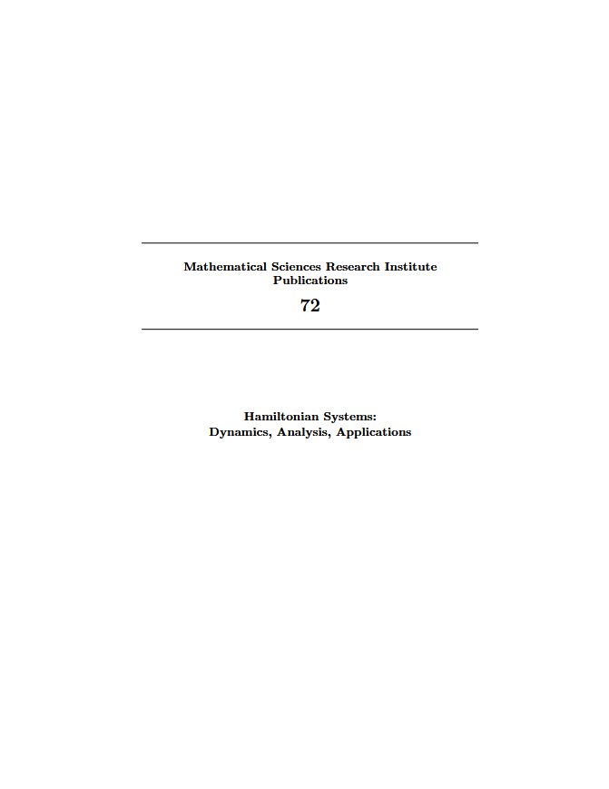
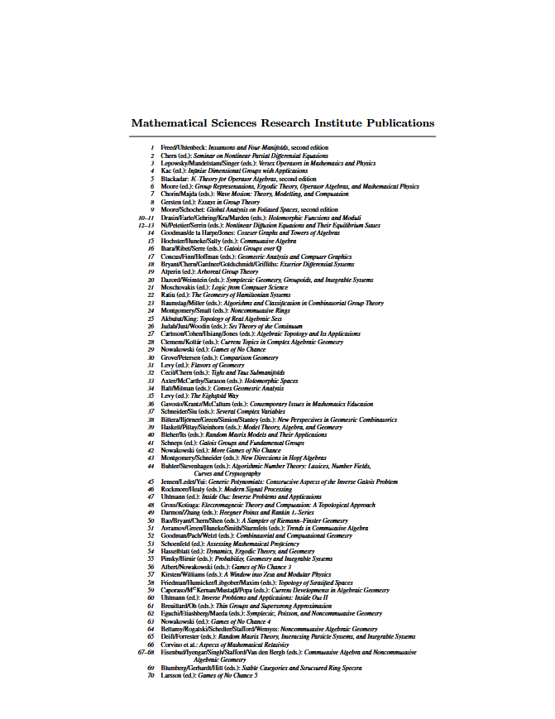
Notes:
You should now be ready to catalog the ebook Hamiltonian systems. Let’s familiarize ourselves with the ebook and some of the information we may be recording.
What information on these two pages can you identify?
A. Title of series, numbering within sequence

Slide 6
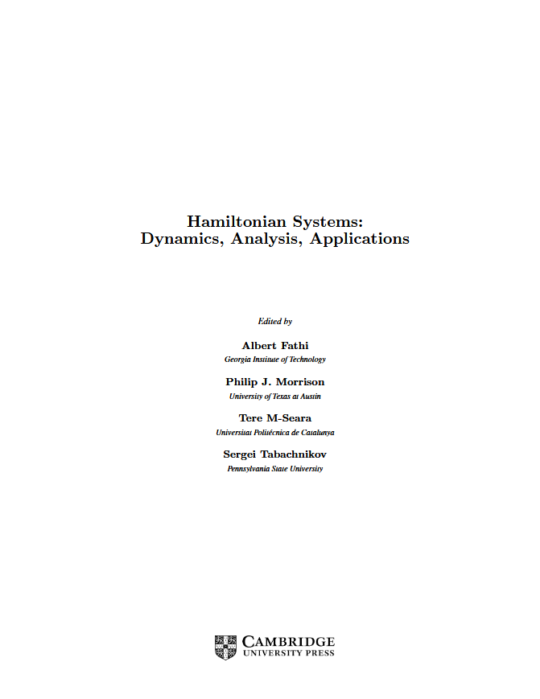
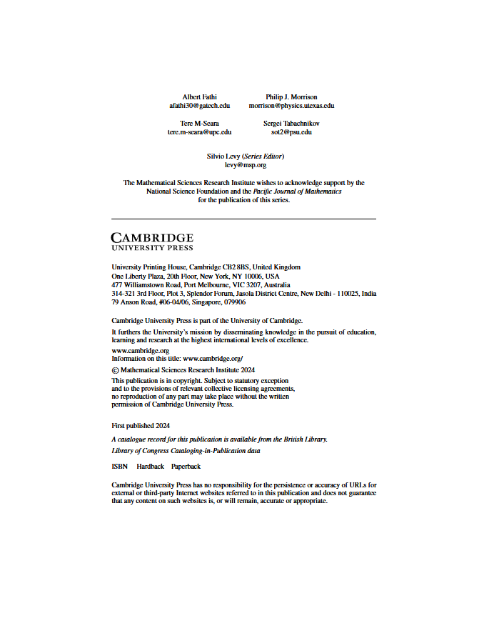
Notes:
What information can you identify from the title page and title page verso?
A: title proper, other title information, statement of responsibility relating to title proper, name of publisher, place of publication, date of publication

Slide 7
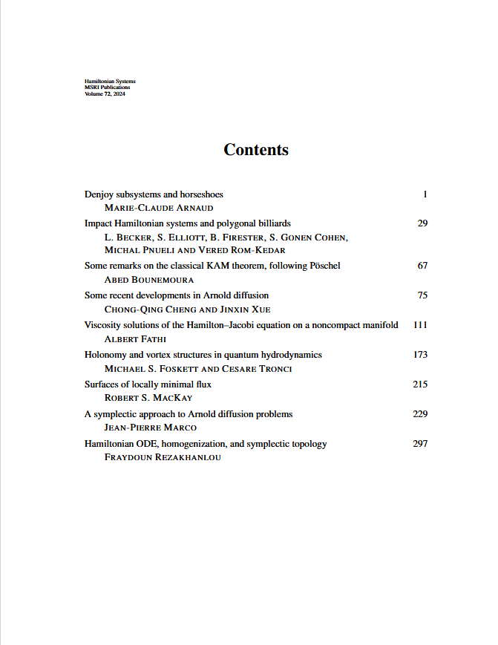
Notes:
What information on this page?
A: note on manifestation (contents note)

Slide 8
What are we cataloging?
A collection aggregate
Notes:
A collection aggregate is a manifestation that embodies two or more expressions of two or more independent works.

Slide 9
Minimum Description of Collection Aggregate
Aggregated Work
Aggregating Work
Aggregated Expression
Aggregating Expression
Manifestation
Notes:
Earlier, we discussed how RDA is structured around the description of RDA entities and elements. For our collection aggregate, we will start by describing the manifestation. Then, we will describe the aggregating expression and aggregating work, which is the plan to select and arrange expressions and embody them in an aggregate. From there, we will describe an aggregated expression and aggregated work, or one of the expressions and works that are contained in the manifestation.

Slide 10
Overview of the Process
Identify elements to record.
Review relevant RDA instructions and PCC documentation.
Determine the value to record.
Record the value in RDA Record Template.
Record the value in MARC Record Template.
Notes:
As we go through the process, we will do the following for each element:
Identify elements to record.
Review relevant RDA instructions and PCC documentation.
Determine the value to record.
Record the value in the RDA Record Template. The RDA Record Template aims to get you thinking in terms of RDA entities and elements.
Record the value in the MARC Record Template.
In this process, we focus on using RDA and the PCC documentation to determine the value to record and then we encode that value in MARC.

Slide 11
Continue to:
Describing the Manifestation

