Slide 1
Recording Structured Descriptions

Slide 2
RDA Copyright
©2010-2026 - American Library Association, Canadian Federation of Library Associations, and CILIP: Chartered Institute of Library and Information Professionals.
Screen images from the RDA Toolkit (www.rdatoolkit.org) used by permission of the Copyright Holders for RDA (American Library Association, Canadian Federation of Library Associations, and CILIP: Chartered Institute of Library and Information Professionals).

Slide 3
Learning Outcomes
At the end of this module, you will be able to:
Define a structured description
Record a value using a Vocabulary Encoding Scheme (VES)
Record a value using a String Encoding Scheme (SES)
Construct an access point
Notes:
Now that we’ve covered unstructured descriptions, we’ll move on to structured descriptions.
We’ll go over what a structured description is, how to record values using different types of structured descriptions, and the basics of constructing access points.

Slide 4
What is a structured description?
RDA defines a structured description as:
A recording method that is a human-readable string that is a full or partial description of an entity that is based on a string encoding scheme, or is a controlled term that describes an aspect of an entity.
Includes an access point or a controlled term taken from a vocabulary encoding scheme.
Notes:
So, what is a structured description? The full RDA definition is shown here, with the main parts of the definition highlighted.
Essentially, a structured description is either a controlled term taken from a vocabulary encoding scheme, or a text string that is constructed following the rules of a string encoding scheme.
If the terms vocabulary encoding scheme and string encoding scheme are unfamiliar, don’t worry. While the specific terms may be unfamiliar, as we define them in the coming slides, you’ll come to recognize these as familiar concepts.

Slide 5
Types of Structured Descriptions
Type | Example
Name or title taken from authority control system | Butler, Octavia E. (name taken from LCNAF) Bible. New Testament (title taken from LCNAF)
Term taken from a non- RDA controlled vocabulary | Time travel (term taken from LCSH)
Term taken from an RDA controlled vocabulary | still image (term taken from RDA Content Type VES)
Structured note | Prologue -- The river -- The fire -- The fall -- The fight -- The storm -- The rope -- Epilogue (formal contents note)
Value associated with a structured data type, including numbers, dates, and times | 1979-06-16 (date structured using EDTF)
Notes:
Here are some examples of the different types of structured descriptions that we already use while cataloging, and that we will continue to use in Official RDA.
Types of structured descriptions include:
(1) names taken from an authority control system, like the Library of Congress Name Authority File
(2) terms taken from a controlled vocabulary, like the Library of Congress Subject Headings
(3) structured notes, like formal contents notes
(4) values associated with structured data types, like dates structured using EDTF
(5) terms taken from an RDA controlled vocabulary

Slide 6
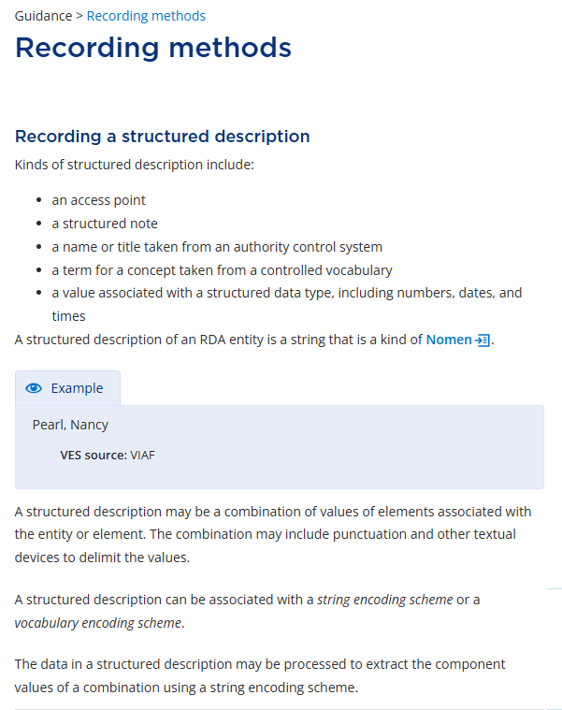
Structured Descriptions: Documentation
Information about structured descriptions can be found in the Guidance section of the Toolkit, under Recording methods
RDA 32.80.30.93
Notes:
General information about structured descriptions can be found in the Guidance section of the RDA Toolkit, on the Recording methods page. The section for Recording a structured description is directly beneath the one for Recording an unstructured description.
Information in this section includes a list of different kinds of structured descriptions, a definition of a structured description, and relevant RDA options and LC/PCC Policy statements. Let’s go through those options and policy statements now…

Slide 7
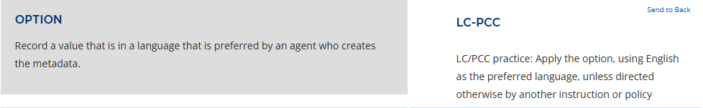
Structured Descriptions: LC/PCC Policy Statement #1
Apply the option to “record a value that is in a language that is preferred by an agent who creates the metadata”
Use English as the preferred language, unless directed otherwise
RDA 16.50.63.08
Notes:
The LC/PCC policy statements instruct us to apply the first RDA option for recording structured descriptions: “Record a value that is in a language that is preferred by an agent who creates the metadata.”
For PCC catalogers, that means using English as the preferred language, unless directed otherwise.

Slide 8
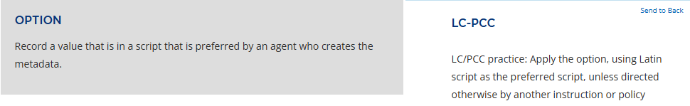
Structured Descriptions: LC/PCC Policy Statement #2
Apply the option to “record a value that is in a script that is preferred by an agent who creates the metadata”
Use Latin script as the preferred script, unless directed otherwise
RDA 91.25.60.04
Notes:
The LC/PCC policy statements also instruct us to apply the second option for recording structured descriptions: “Record a value that is in a script that is preferred by an agent who creates the metadata.”
For PCC catalogers, that means using Latin script as the preferred script, unless directed otherwise.

Slide 9
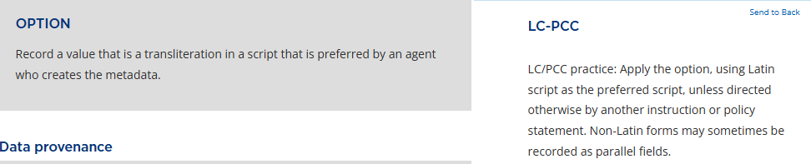
Structured Descriptions: LC/PCC Policy Statement #3
Apply the option to “record a value that is a transliteration in a script that is preferred by an agent who creates the metadata”
Record non-Latin data in a transliterated form, using Latin script as the preferred script, unless directed otherwise.
Non-Latin forms may sometimes be recorded as parallel fields
RDA 77.51.44.80
Notes:
Finally, the LC/PCC policy statements instruct us to apply the third option for recording structured descriptions: “Record a value that is a transliteration in a script that is preferred by an agent who creates the metadata.”
For PCC catalogers, that means recording non-Latin data in a transliterated form, unless directed otherwise. Additionally, we may use parallel fields to record non-Latin forms.

Slide 10
Structured Descriptions, Encoding Schemes
A structured description can be associated with a vocabulary encoding scheme or a string encoding scheme (Guidance > Recording methods)
VES or SES | Example of VES or SES | Category of Encoding Scheme
Vocabulary Encoding Scheme | LC/NAF RDA Content Type VES | Controlled vocabulary for selecting a term from an updating authority file Controlled vocabulary for selecting a term from a closed list
String Encoding Scheme | MG: SES: Person: access point for person | PCC guidance for constructing access points, which may be established in a VES
 | MG: SES: Publication statement MG: SES: Notes | PCC guidance for constructing superelements, not established in a VES PCC guidance for constructing certain types of notes, not established in a VES
Notes:
Here are some examples of different types of VES and SES. Most of time, a VES or SES falls into one of the following categories:
A VES can be an authority control system that is meant to be updated for name and title nomens
A VES can be a closed list
An SES can apply to a string composed of a name qualified with various elements - this is an access point and meant to be added to a VES.
An SES can apply to a string that combines related elements into a superelement - this is a superelement (attribute) not meant for a VES.
An SES can apply to a string that is a structured note - neither an access point nor a superelement, and not meant for a VES.
Now that we’ve gone over what a structured description is, where to find information in the RDA Toolkit, and the various options and policy statements applied to structured descriptions, let’s discuss some specific types of structured descriptions in more detail.

Slide 11
What is a vocabulary encoding scheme (VES)?
RDA defines a vocabulary encoding scheme, or VES, as:
A named structured list of representations of controlled values for elements.
A vocabulary encoding scheme includes an RDA list of terms or their corresponding value vocabularies in the RDA Registry, an ISO code list, a standard terminology, an authority control system, etc. Simple keyword indexes are excluded.
A vocabulary encoding scheme is a controlled vocabulary.
Notes:
First, vocabulary encoding schemes, or VESs. The full RDA definition is shown here, with the main parts of the definition highlighted.
Essentially, a vocabulary encoding scheme is a list of controlled values, or a controlled vocabulary.

Slide 12
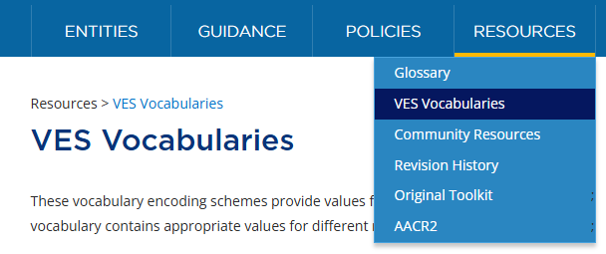
Vocabulary Encoding Schemes: Documentation
A list of RDA VESs can be found in the Resources section of the Toolkit.
Information about using terms from RDA and other VESs can be found in the metadata guidance documentation, MG: Vocabulary Encoding Schemes
Notes:
A complete list of the RDA vocabulary encoding schemes can be found in the Resources section of the RDA Toolkit, on the VES Vocabularies page.
General information about using vocabulary encoding schemes can be found in the metadata guidance documentation: Vocabulary Encoding Schemes.

Slide 13
Types of Vocabulary Encoding Schemes (VESs)
RDA VES Examples
RDA Carrier Type
RDA Colour Content
RDA Content Type
RDA Illustrative Content
RDA Media Type
Other VES Examples
LCSH
LCNAF
LCGFT
FAST
VIAF
AAT
ULAN
RBMSCV
MeSH
PCC MG: Relationship labels
Notes:
There are two types of vocabulary encoding schemes: RDA VESs and non-RDA VESs. Both categories include vocabularies you may already be familiar with.
Some examples of RDA VESs include the RDA Content, Media, and Carrier Type vocabularies. Familiar examples of non-RDA VESs include LCSH, LCNAF, and FAST.

Slide 14
How to choose a VES
MG: Vocabulary Encoding Schemes provides the following guidance on when to use a VES:
The decision of whether or not to use a VES to record the value of an element (and, if so, which VES to use) will…
…sometimes be determined by RDA instructions,
…sometimes by LC/PCC documentation (e.g., policy statement, application profile, or metadata guidance document),
…sometimes by local institutional policy,
…and sometimes by cataloger judgment.
Notes:
So, how do we decide whether or not to use a vocabulary encoding scheme in the first place? And with so many different VESs, both RDA and non-RDA, how do we choose which one to use for a given element?
We can determine whether or not to use a VES, and, if necessary, which VES to use, a variety of ways:
(1) RDA instructions may tell us to use a VES for a structured description
(2) LC/PCC documentation may also instruct us on when to use a VES and which one to use
(3) Local practice at your institution may dictate which VES to use for a given element
(4) Which VES to use may be up to cataloger judgement
Let’s look further at how we might make some of these decisions…

Slide 15
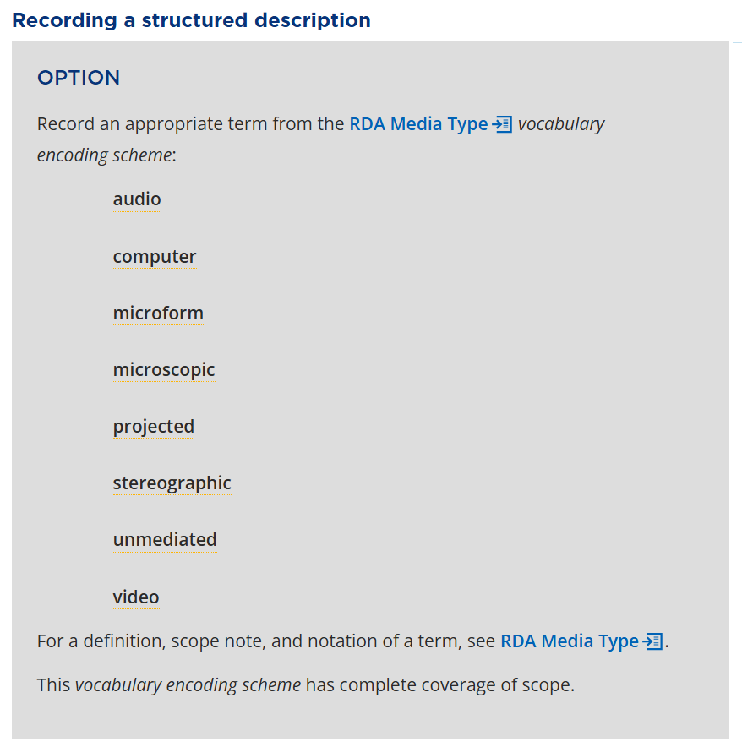
Using an RDA VES
When using a VES for an element (apart from an an access point element) RDA generally provides two options.
The first option (if a relevant RDA VES exists) uses the following language:
“Record an appropriate term from the RDA XXX vocabulary encoding scheme”
RDA 95.67.31.13
Notes:
When recording a structured description in which use of a vocabulary encoding scheme is necessary, RDA generally provides two options. **Note that neither of these two options apply to access points, which are subject to different conditions and options**
The first of the two options, if a relevant RDA VES exists, is to use an RDA VES. This option will always use the following (or similar) language: “Record an appropriate term from the RDA XXX vocabulary encoding scheme.”
The screen shot on this slide is taken from the media type element page. The option here uses the same general instruction, specifying the relevant RDA VES. If you take a look at other elements with options to record a term from an RDA VES (such as carrier or content type), you will notice this same language.

Slide 16
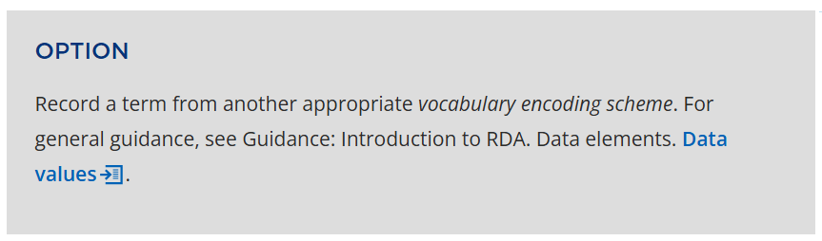
Using a non-RDA VES
The second option gives you the choice to use a non-RDA VES, and generally uses the following language:
“Record a term from another appropriate vocabulary encoding scheme”
RDA 63.91.97.12
Notes:
The second of the two options when instructed to use a vocabulary encoding scheme is to use a non-RDA VES. As a reminder, an example of a non-RDA VES is LCGFT. The LC/NAF is also a non-RDA VES, but different options and language apply - this will be discussed in the Access points section of the presentation.
The screen shot on this slide is also taken from the media type element page. But again, if you take a look at other elements with options to record a term from a VES (such as carrier or content type), you see this same instruction.

Slide 17
What is a string encoding scheme (SES)?
RDA defines a string encoding scheme, or SES, as:
A set of string values and an associated set of rules that describe a mapping between that set of strings and a value of an element.
In other words, a string encoding scheme specifies the rules for selecting values, and assembling, ordering, and punctuating them.
A string encoding scheme can be thought of as a syntax
Notes:
Now let’s move on to string encoding schemes, or SESs. The full RDA definition is shown here, with the main parts of the definition highlighted.

Slide 18
String Encoding Schemes: Documentation
Information for SESs is documented in several MGDs:
MG: SES: Abbreviations, Capitalization, and Terms in specific languages
MG: SES: Access Point for Work
MG: SES: Access Point for Musical Work
MG: SES: Access Point for Expression
MG: Expression: SES: Scale
MG: SES: Title Proper and Statement of Responsibility
MG: SES: Edition Statement
MG: SES: Publication, Distribution, Manufacture, and Production
MG: SES: Series Statement
MG: SES: Notes
MG: SES: Access Point for Person
MG: SES: Access Point for Corporate body
MG: SES: Variant Access Point for Corporate body
MG: SES: Access Point for Family
MG: SES: Access Point for Place
Notes:
String encoding schemes can be used to construct a variety of elements, like superelements (the “statement” SES’s), access points and notes..
On this slide, we’ve listed the MGDs that provide documentation on using SESs both generally and for specific elements. We won’t go through all of them now, but this list can give you a sense of which elements you may use SESs to record.
Note that string encoding schemes are created by individual communities. RDA will instruct you to apply a string encoding scheme, but will not tell you what it should look like.

Slide 19
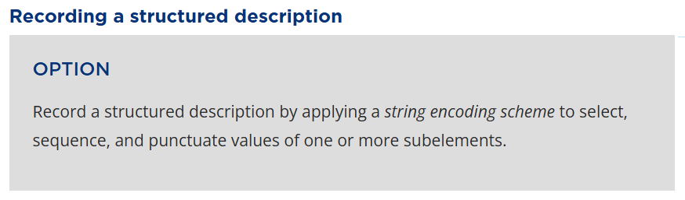
Using an SES
RDA provides this option to use with a superelement. It consists of at least one subelement, and is constructed with one of the string encoding scheme that end in “statement” e.g. MG: SES: Edition statement:
“Record a structured description by applying a string encoding scheme to select, sequence, and punctuate values of one or more subelements”
RDA 36.86.01.46
Notes:
Like the RDA instructions for recording a structured description using VESs, you’ll find that the general option RDA provides for using SESs often uses the same language, no matter the element.
The general instruction for using SESs is to “record a structured description by applying a string encoding scheme to select, sequence, and punctuate values of one or more subelements.” This screenshot is taken from the publication statement element page, but you’ll find the same option using the same language on several other element pages as well.
As this screenshot is taken from the publication statement element page, let’s think of publication statement as an example. The publication statement is an element that is made up of one or more subelements: place of publication, name of publisher, and date of publication. In order to record the entire publication statement, we must apply a string encoding scheme to determine how to order the individual subelements, and what punctuation should separate them. This can be applied more generally to all such elements made up of subelements for which SESs are used. Access points are included in this category.

Slide 20
SES for superelements and structured notes
A superelement is a text string that consists of at least one subelement. A superelement is constructed with one of the Manifestation string encoding schemes such as MG: SES: Publication, Distribution, Manufacture and Production Statement.
A structured note is also a text string. A structured note is constructed with the MG: SES: Notes.
Catalogers use a PCC string encoding scheme to construct a superelement or structured note on a bibliographic record. This type of structured description is not intended for use in a VES.

Slide 21
What is an access point?
RDA defines an access point as:
An appellation of an entity in natural language that is selected from a vocabulary encoding scheme or constructed using a string encoding scheme by an agent who creates metadata.
Both SES and VES options apply to access points - this makes them unique among the structured description types.
Catalogers use a PCC SES to construct an access point and record it on a bibliographic record. NACO catalogers may establish it for use as an authorized form for use in a VES (in the LC/NAF).
Notes:
The final type of structured description we’ll discuss is an access point. The full RDA definition is shown here, with the main parts of the definition highlighted.
An access point can either be selected from a vocabulary encoding scheme (such as a name chosen from the Library of Congress Name Authority File) or constructed using a string encoding scheme.

Slide 22
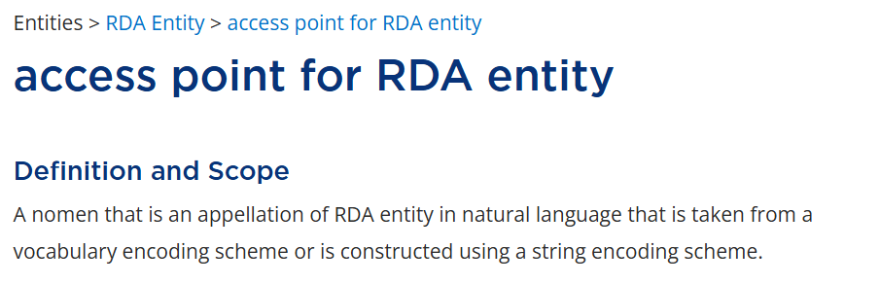
Access points: Documentation (1/2)
Information about access points can be found in the access point for RDA entity section of the Toolkit:
All RDA entities are modeled as subtypes of the superclass RDA Entity. Instructions found here are therefore applicable to any more granular entity.
Notes:
Very general information about access points for any RDA entity can be found in the RDA Entity section of the RDA Toolkit, on the access point for RDA entity page.
RDA is structured around the enhanced entity-relationship modeling in the LRM (Library Reference Model). All RDA entities are modeled as subtypes of the superclass RDA Entity, and instructions and guidance for recording RDA Entity are therefore applicable to recording any more granular element, such as Work: access point for work. Supplementary instructions are given as needed to describe each narrower element
This page includes the definition of access point for RDA entity, as well as instructions for recording the access point as a structured description.

Slide 23
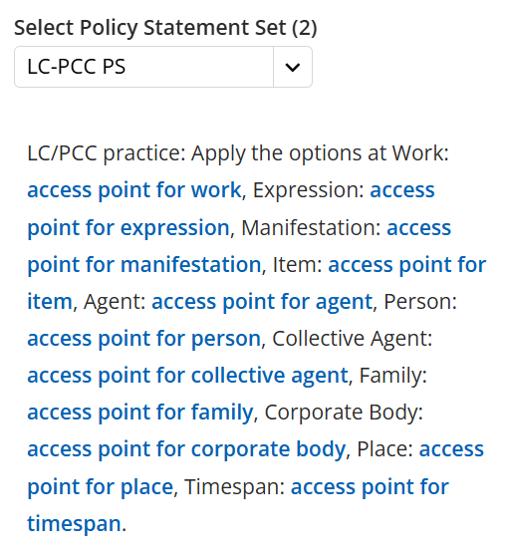
Access points: Documentation (2/2)
Information for constructing access points is also documented in several SES MGDs:
MG: SES: Access Point for Work
MG: SES: Access Point for Musical Work
MG: SES: Access Point for Expression
MG: SES: Access Point for Person
MG: SES: Access Point for Corporate Body
MG: SES: Variant Access Point for Corporate Body
MG: SES: Access Point for Family
MG: SES: Access Point for Place
Notes:
Information about access points for specific entities – such as work, person, or corporate body – can be found in the respective string encoding scheme MGDs and on specific element pages in the RDA Toolkit.

Slide 24
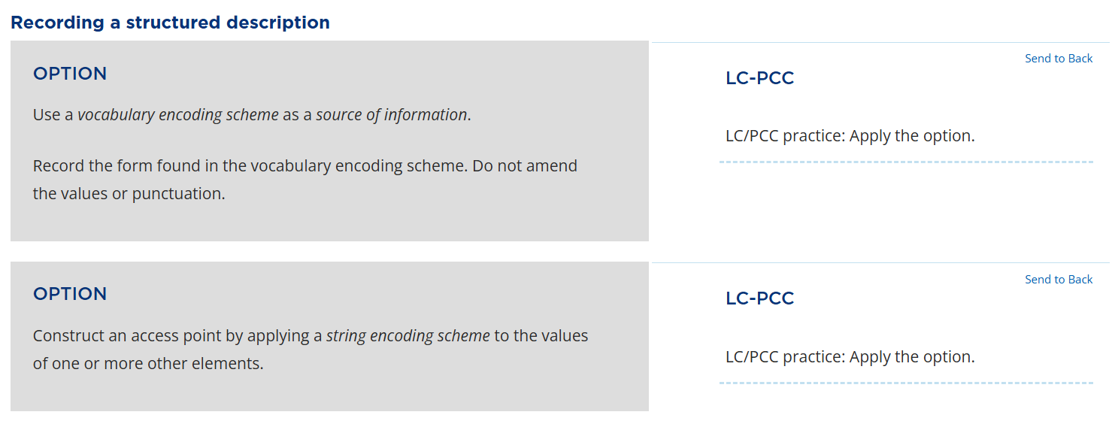
Constructing an access point (1/3)
When not using an access point from a VES, RDA always instructs:
“Construct an access point by applying a string encoding scheme to the values of one or more other elements”
RDA 34.82.98.75
Notes:
This screenshot depicts the two most common options for recording an access point of any kind as a structured description. You’ll find these options, using the same or similar language, on the element pages for multiple access points.
The first option is to use a VES to record an access point (such as taking a name from the Library of Congress Name Authority File).
The second option, often applied when there is no appropriate term in a relevant VES, is to construct an access point by applying an SES. **Note that the phrase is “one or more other elements” in contrast to a superelement, which consists of “one or more subelements.”
Let’s talk a bit more about how to construct an access point…

Slide 25
Constructing an access point (2/3)
Step 1. Use a value of a selected appellation element to form a base
of access point (e.g. preferred name of person, preferred title of work).
– Person: William Shakespeare
– Work: The bluest eye
Step 2. Format the base by applying applicable options to omit,
reorder, or add elements in the base value.
– Person: Shakespeare, William
– Work: Bluest eye
Notes:
We’ll get into a more detailed demonstration about constructing access points later. For now, let’s go over the standard basic steps.
First, the base of an access point – any access point – is an appellation, that is, a label in text for an RDA entity such as a name and title. We start by using a value of a selected appellation element to form a base of access point. This is another way of saying, for example, that an authorized access point is based on a preferred name of person or title of work.
Next, we format the base by applying applicable options, by omitting, reordering, or adding elements in the base value. (May note that a SES is already applied here, as the inverted form of name is punctuated.)

Slide 26
Constructing an access point (3/3)
Step 3. Include additional elements and designations if required:
– Person: Shakespeare, William, 1564-1616
– Work: Morrison, Toni, 1931-2019. Bluest eye
Step 4. Apply a string encoding scheme to record the access point
string in MARC.
– Person: Shakespeare, William, $d 1564-1616
– Work: Morrison, Toni, $d 1931-2019. $t Bluest eye
Notes:
Then, other elements and designations may be added to the formatted base if needed to distinguish the access point from another, assist in the entity’s identification, or to conform to an SES. Examples include:
(1) adding the person’s birth and/or death dates to the inverted base form
(2) adding the authorized access point for creator of work to the preferred title of work in the base form
Finally, we follow the PCC string encoding scheme to apply the rules for assembling, ordering, and punctuating all applicable elements to record an entire access point string in MARC.

Slide 27
Summary
A structured description is a recording method that is based on a String Encoding Scheme (SES) or taken from a Vocabulary Encoding Scheme (VES).
A Vocabulary Encoding Scheme (VES) is a list of controlled terms.
An String Encoding Scheme (SES) is a set of rules defining how to select, order and punctuate multiple values or subelements.
An access point can taken from a VES or constructed using an SES.
Notes:
Let’s review:
We started by defining a structured description and going over the different types of structured descriptions.
We then discussed vocabulary encoding schemes (or VESs), which are lists of controlled terms, or controlled vocabularies, like the RDA media type vocabulary or the Library of Congress Name Authority File.
Next, we discussed string encoding schemes (or SESs), which are a set of rules, or syntax, used to define how to order and punctuate multiple values or subelements.
Finally, we discussed access points, which can either be taken from a VES or constructed using an SES.
Are there any questions before we move on to the next recording method?

Slide 28
Demonstration
Notes:
Now it’s time to demonstrate how to record some elements as structured descriptions using the official RDA toolkit.

Slide 29
Structured description: SES and VES
Part 1: Manifestation: publication statement
Value is constructed with a string encoding scheme
Part 2: Expression: content type
Value is chosen from a vocabulary encoding scheme
Notes:
RDA defines structured description as: a recording method that is a human-readable string that is a full or partial description of an entity that is based on a string encoding scheme, or is a controlled term that describes an aspect of an entity.
A structured description could be an access point, a controlled term taken from a vocabulary encoding scheme, or any other element constructed using a string encoding scheme, like a superelement or a structured note.

Slide 30
publication statement

Slide 31
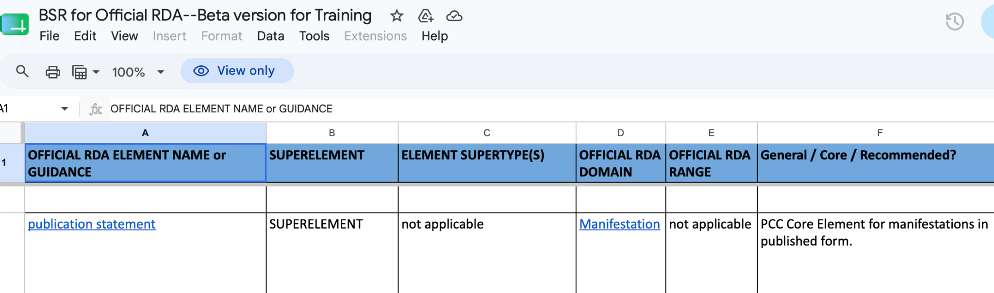
1.1 Manifestation: publication statement, on the BSR:
A superelement - superelements are structured descriptions. LC/PCC core.
Notes:
A superelement is a structured description constructed with a string encoding scheme that consists of at least one subelement Other examples: Edition statement, Series statement, etc.

Slide 32
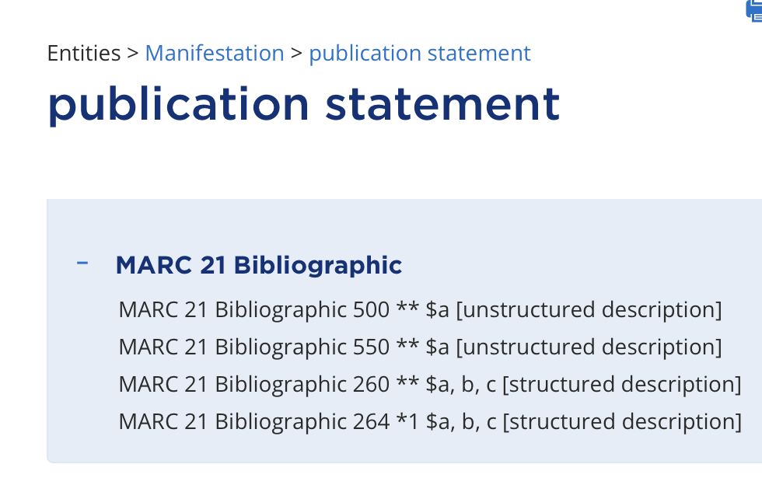
1.2 Manifestation: publication statement, Recording method
Element Reference Card: MARC 21 Bibliographic shows two recording methods are associated with this element.
BSR: in column L, see that publication statement maps to MARC 264.
The element reference card shows that field 264 is associated with structured description.
Notes:
We talked about unstructured descriptions earlier - now it’s time to explain the various types of structured descriptions.
Element reference card: gives information about the element - domain entity, range if a relationship element, and corresponding MARC tags.
MARC 21 Bibliographic: this element can be recorded as either structured description in 264 or as an unstructured note.
The BSR maps the publication statement element to MARC 264, corresponding to structured description.
We’ll record this element as a structured description.
Create the structured description by applying a string encoding scheme to a set of elements.

Slide 33
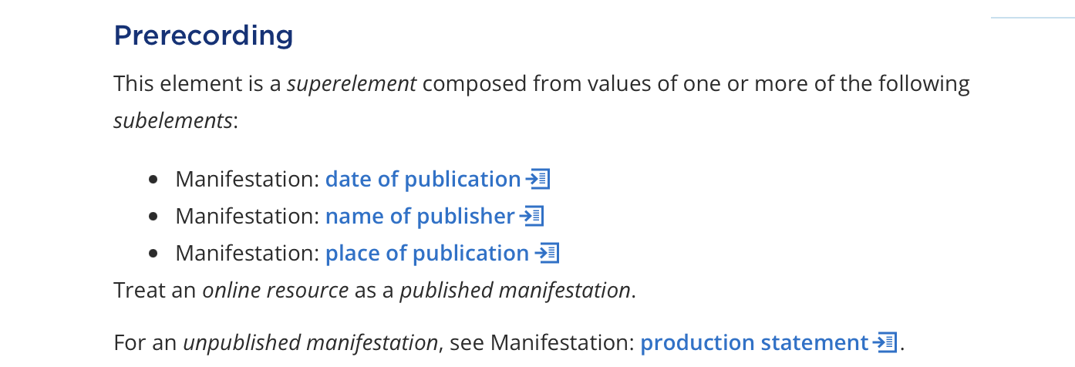
1.3 Manifestation: publication statement, Prerecording
A superelement is a string consisting of at least one subelement.
The string is ordered and punctuated with the appropriate string encoding scheme.
Notes:
A superelement is constructed using a string encoding scheme.
Note: the elements in the string are only ever called subelements in the context of talking about the superelement - in any other context they are just elements.

Slide 34
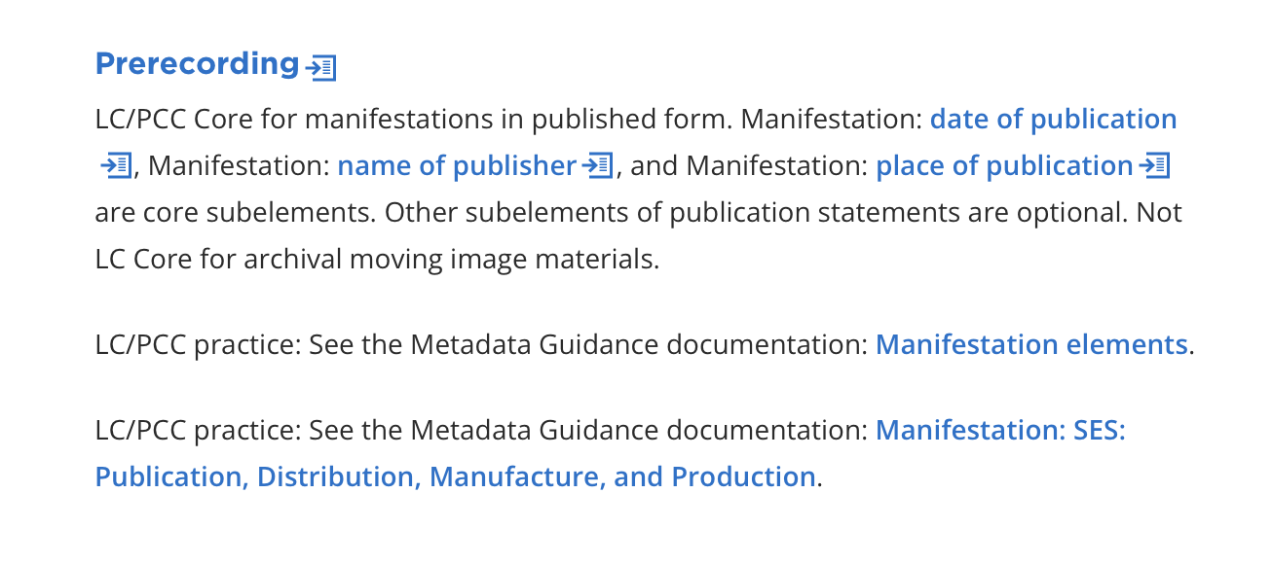
1.4 Manifestation: publication statement, LC-PCC policy statement
The string encoding scheme is linked to the Prerecording LC/PCC policy statement.
MG: Manifestation: SES: Publication, Distribution, Production, Manufacture and Production.
Notes:
The LC/PCC policy statement indicates that the superelement is LC/PCC core, and so are the individual subelements.
The LC/PCC policy statement also links to Metadata Guidance documentation: Manifestation: SES: Publication, Distribution, Manufacture, and Production, which we will need next.

Slide 35
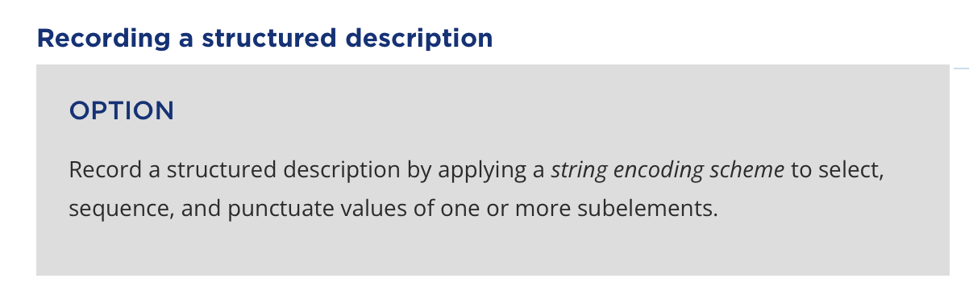
1.5 Manifestation: publication statement, Recording a structured description
Apply the SES to the individual subelement values:
Date of publication =
2021
Name of publisher =
Orca Books Publishers
Place of publication =
Victoria, British Columbia
Notes:
Apply Option: “Record a structured description by applying a string encoding scheme to select, sequence, and punctuate values of one or more subelements.”
We recorded these in the template earlier as unstructured descriptions. Now we stitch them together using structured description to make a publication statement
Look at the MGD - Manifestation: SES: Publication, Distribution, Manufacture, and Production

Slide 36
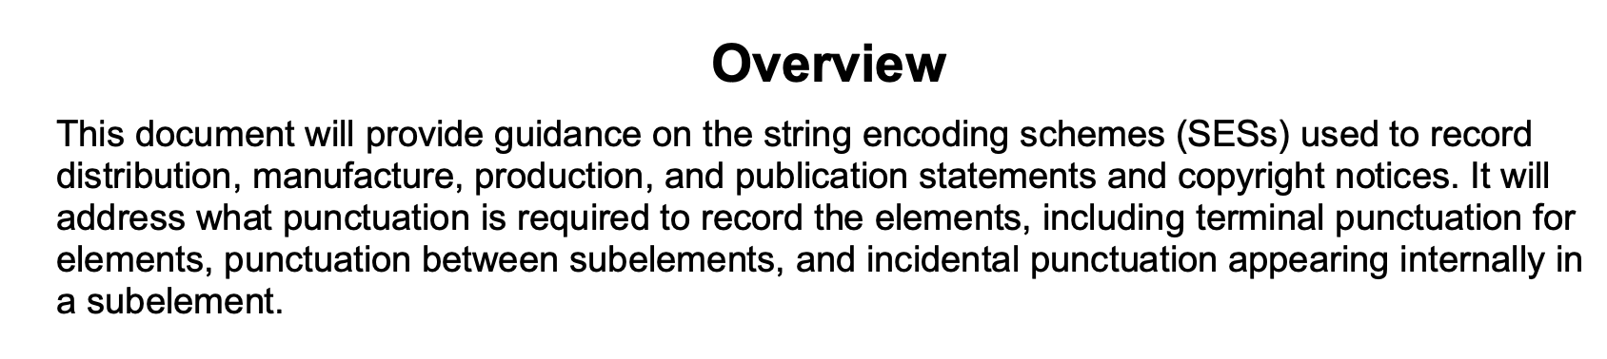
1.6 MG: Manifestation: SES: Publication, Distribution, Production, Manufacture and Production
Use the publication statement string encoding scheme to sequence and punctuate subelement values. Record in the RDA template.
Map the value for the MARC field and subfields on the MARC workform.
Notes:
Pages 2-3 provide instructions for sequencing the subelements and applying punctuation.
On page 10 there are MARC examples illustrating the publication statement string encoding scheme in various scenarios with MARC coding and ISBD punctuation.
This MGD is specifically about the structure and coding of the subfields. Any instruction about the content of each subfield is found in the toolkit with the individual subelement.

Slide 37
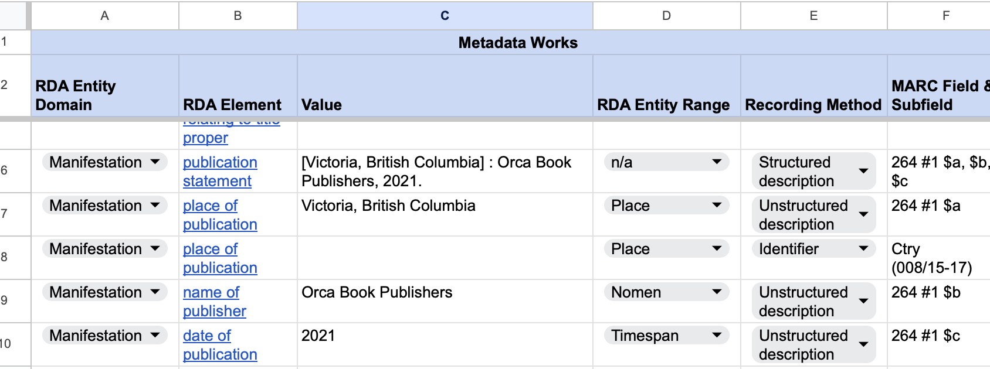
1.7 Record the superelement value on the RDA template:
Use column F to map the superelement value on the MARC workform.
Notes:
We already have values recorded in the template for the LC/PCC core subelements:
Place of publication = Victoria, British Columbia
Name of publisher = Orca Book Publishers
Date of publication = 2021.
To get the value for Manifestation: publication statement, apply the string encoding scheme to the set of subelements. On the RDA template, record the subelements in the prescribed order with the correct punctuation as the value for the superelement.
Use the MARC mapping from the BSR to transform the values into MARC:

Slide 38
content type

Slide 39
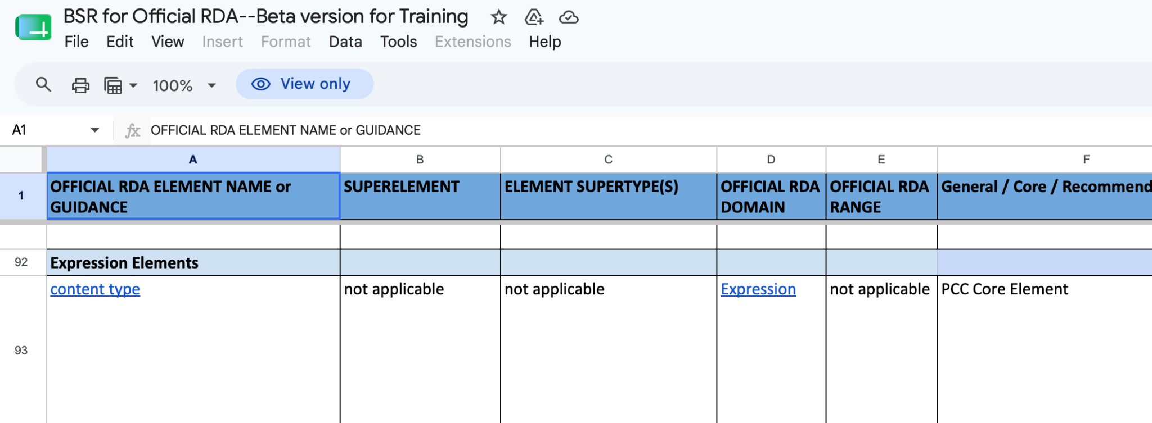
2.1. Expression: content type, on the BSR:
LC/PCC Core element.

Slide 40
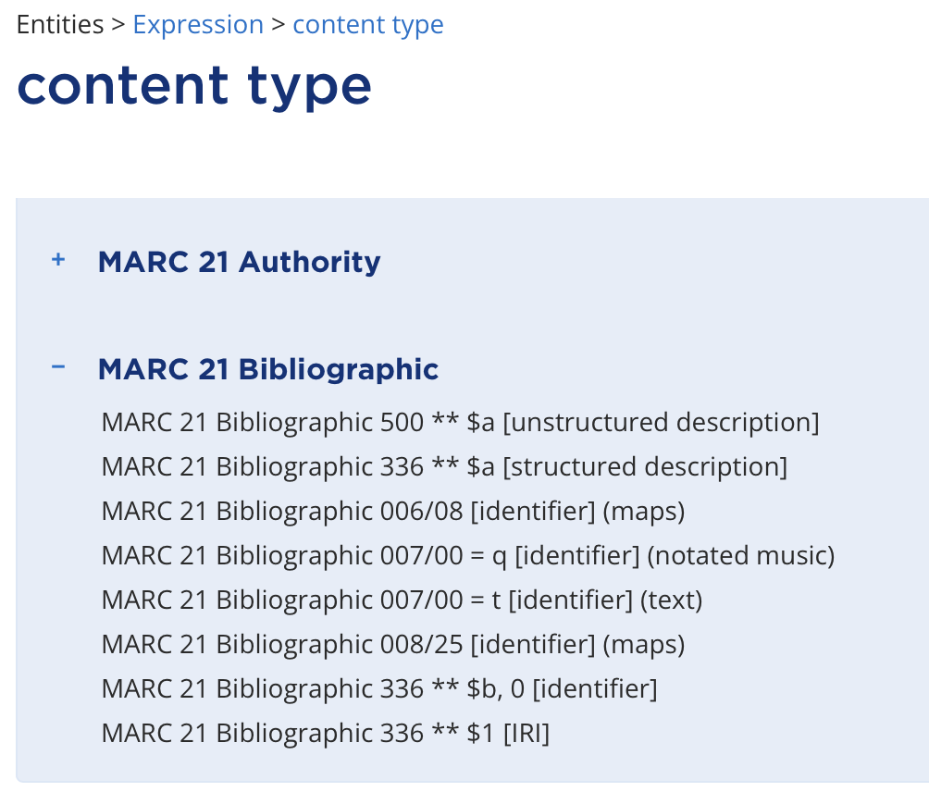
2.2 Expression: content type, Recording method
Element Reference Card: MARC 21 Bibliographic shows all four recording methods are associated with this element. BSR: column L shows various fields and subfield correspond to content type.
We can’t determine the recording method from here. We can go to the LC/PCC policy statement and check MG: Expressions, which says record content type in MARC 336 $a - structured description (page 10).
Notes:
The BSR maps Expression: content type to various MARC fields.
On the element reference card, the element can be recorded in any one of the four recording methods, although some can be ruled out as they are for specific formats.
To figure out what recording method we want, as a last resort we can go to the MGD link to in the Prerecording policy statement. The MGD says to use MARC field 336 $a, which corresponds to structured description (page 10).
Record the structured description by choosing a term from either the RDA or the MARC vocabulary encoding scheme.

Slide 41
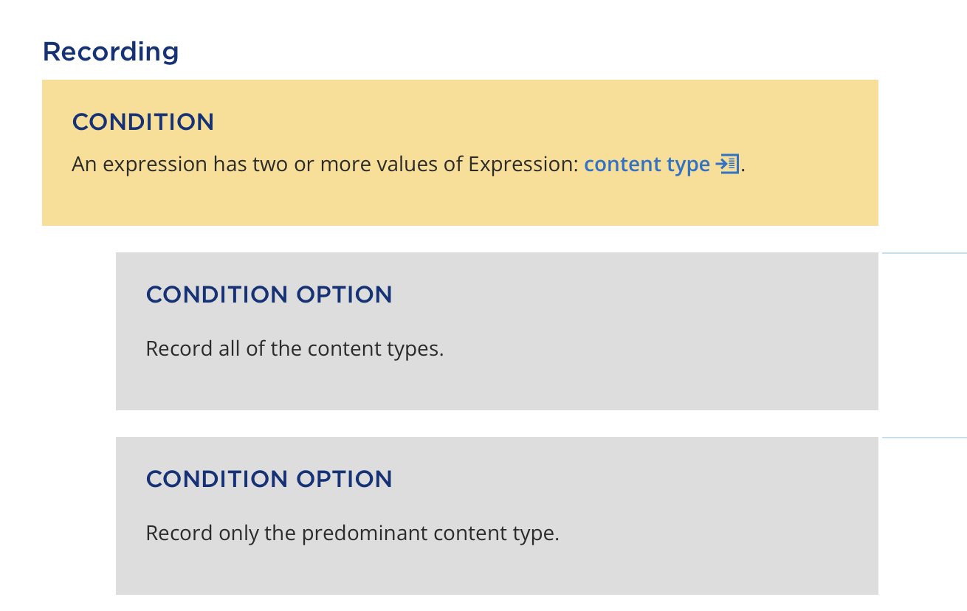
2.3 Expression: content type, Recording
The LC/PCC policy statement here tells us it is cataloger’s judgement whether to record all content types, just some types, or only the predominant type.
We only have one type of content, so this condition does not apply.
Notes:
It is cataloger’s judgement whether to record all content types, just the predominant type, or only the content types that apply to the most substantial content of the expression. See the policy statement at Recording, and also MG: Expressions for guidance.
This condition doesn’t apply to our example - there’s only one type of content.

Slide 42
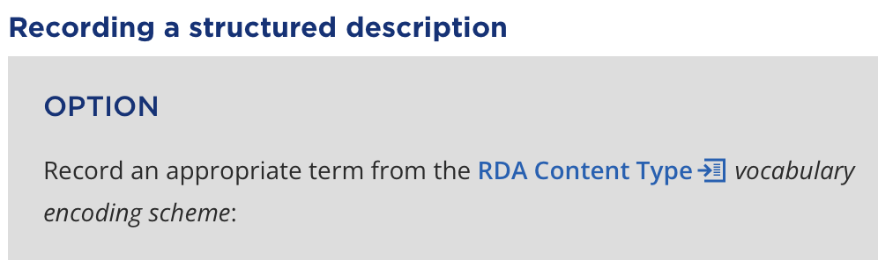
2.4 Expression: content type, Recording an RDA content type term
Common terms are: text, spoken word, and still image.
For our example, we want text.
Notes:
Common terms are text, spoken word, and still image.
For our example, we want text.

Slide 43
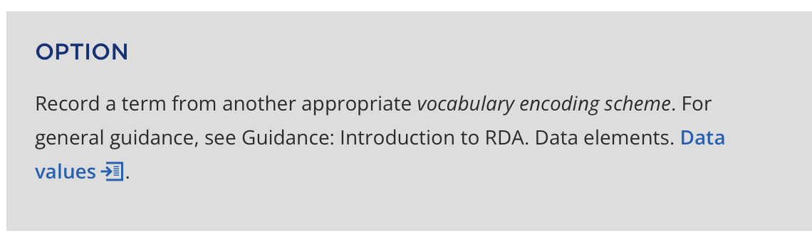
2.5 Expression: content type, Recording a MARC content type term
Cataloger’s judgement: use either the RDA term or the MARC vocabulary term.
In the MARC vocabulary the terms are the same as in the RDA vocabulary..
Notes:
Cataloger’s judgement: use either the RDA Content Type VES, or the Term and Code List for RDA Content Types (original RDA/MARC)
The terms are the same. If the cataloger opts to record a term from the Term and Code List for RDA Content Types, then also optionally record an identifier. Identifiers are discussed later on in the workshop.
PCC catalogers must record data provenance for this element. Data provenance is discussed later on in the workshop.

Slide 44
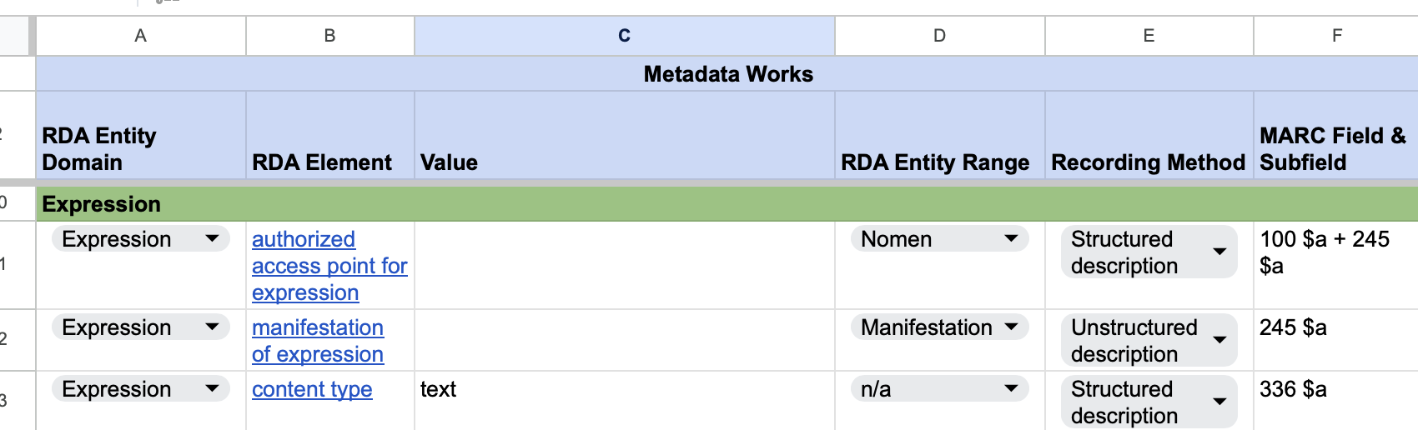
2.6 Record the Expression: content type value on the RDA template:
Use column F to map the term on the MARC workform.
Notes:
On the template, record the structured description for Expression: content type, text.

Slide 45
Structured Description
Person elements

Slide 46
author person

Slide 47
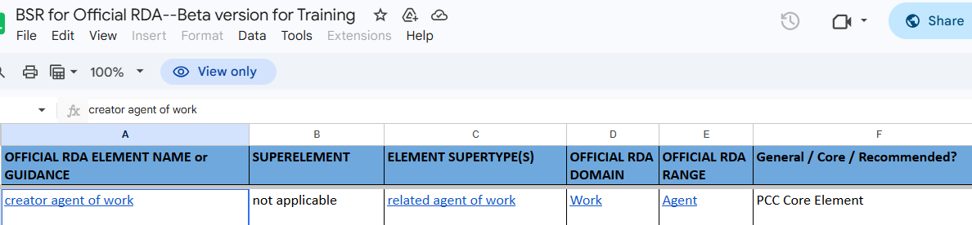
Notes:
The Draft BSR says creator agent of work is a PCC Core element, so we’re going to figure out the value for it.

Slide 48
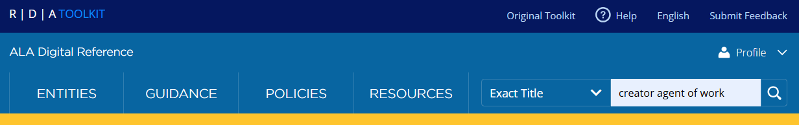
Notes:
First, we need to read the element definition so we understand what it is. Search the toolkit for Exact Title creator agent of work.
It takes us straight to the creator agent of work element page…

Slide 49
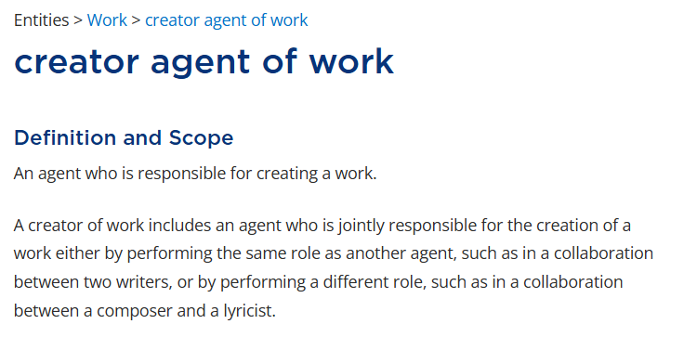
Notes:
This element is defined as an agent who is responsible for creating a work.
Let’s view our work cat again to confirm it has a creator agent…

Slide 50
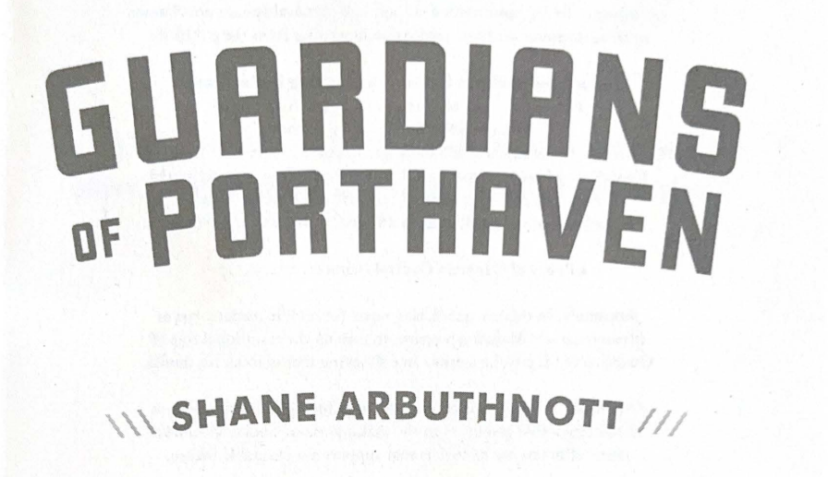
Notes:
It does: Shane Arbuthnott is the creator of our work cat.
The next step in the Toolkit is to scroll down to Prerecording for the element and read the policy statement there.

Slide 51
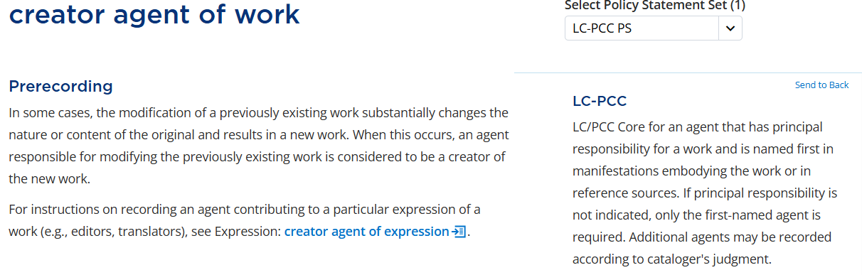
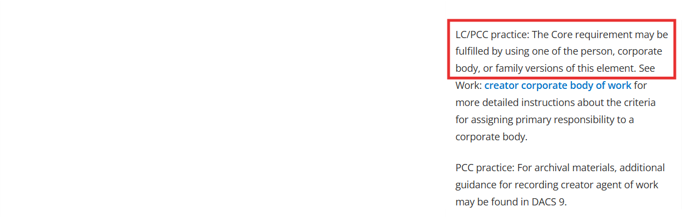
Notes:
The first paragraph says the element is PCC Core for an agent that has principal responsibility for a work. That fits our situation. The second paragraph says the Core requirement may be fulfilled by using one of the person, corporate body, or family versions of this element.
As Bob already showed earlier, Shane Arbuthnott is a person.
On the creator agent of work page, we will scroll down to the narrower elements (and Ctrl-F) so we can find one for person…

Slide 52
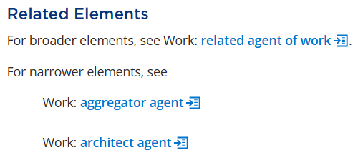

…
Notes:
There’s an element for creator person of work, so let’s go check it out…

Slide 53
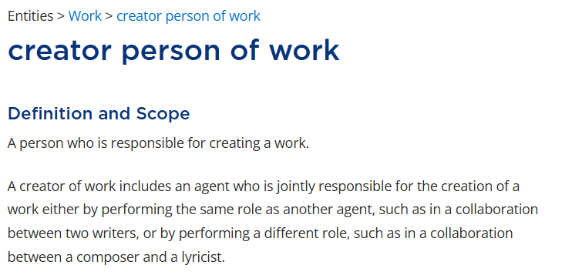
Notes:
The definition says that this element is a person who is responsible for creating a work.
Of course in cataloging we like to be as precise as possible, so let’s scroll down and see if there’s an even narrower element that fits our situation.

Slide 54
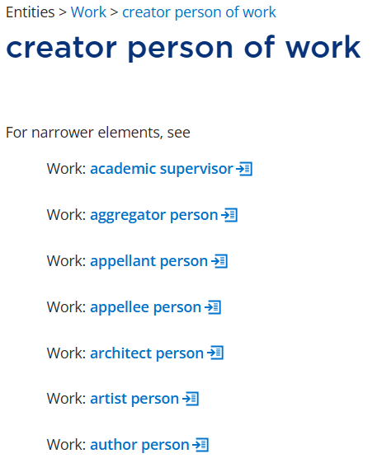
Notes:
“Author” is a word we tend to use when describing books, so let’s look at author person.

Slide 55
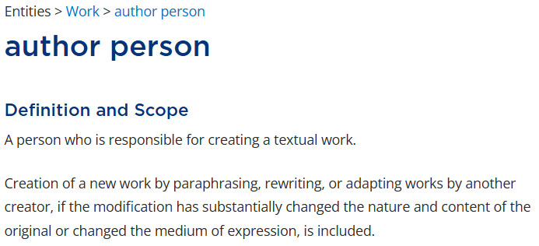
Notes:
Here’s the definition.
I’d like to point out here that this element is specifically for a person who has created a textual work, which is what we are cataloging. So this element precisely describes Shane Arbuthnott.

Slide 56
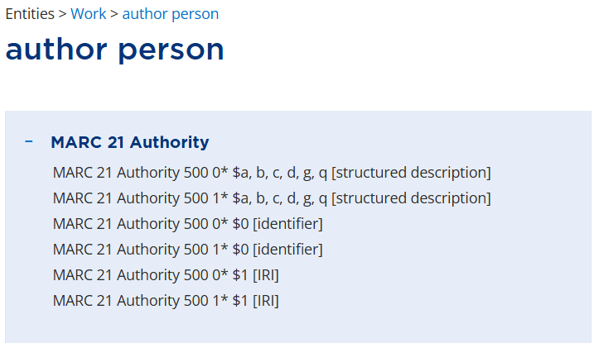
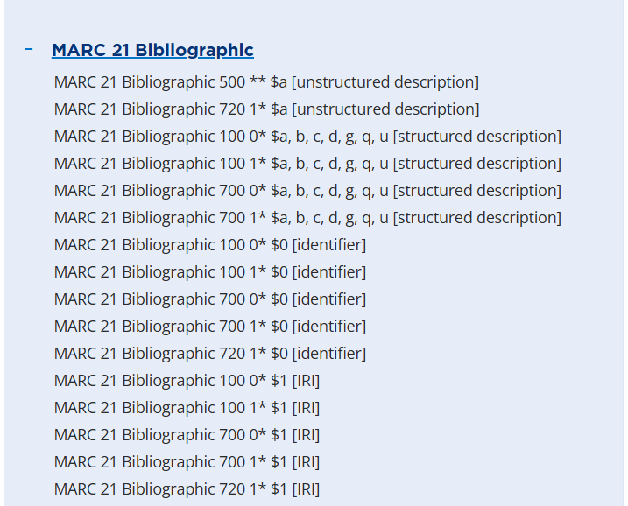
Notes:
For those of us who are used to MARC, we can also look at the Element Reference box for reassurance. There are sections for both Authority and Bibliographic fields here.
It can be helpful to see that the fields here represent either notes or access points. And it confirms that this element is used in MARC 100 in a bibliographic record. It’s also worth noting that the Authority list contains only MARC 500 fields – that is, fields where an author relationship can be recorded.
Now we have to read the Prerecording section and policy statements for this element…

Slide 57
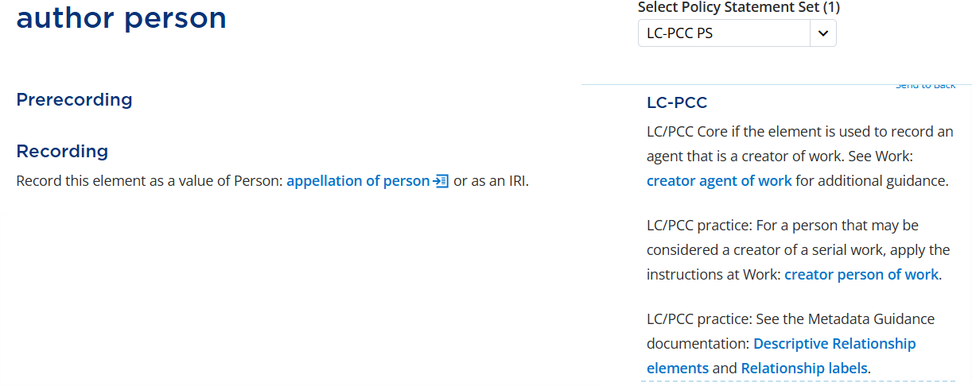
Notes:
The first two paragraphs point to elements we already looked at, and we don’t need to go back to those.
The third paragraph has links to two MGDs.
First, we’ll click on Descriptive Relationship elements.

Slide 58
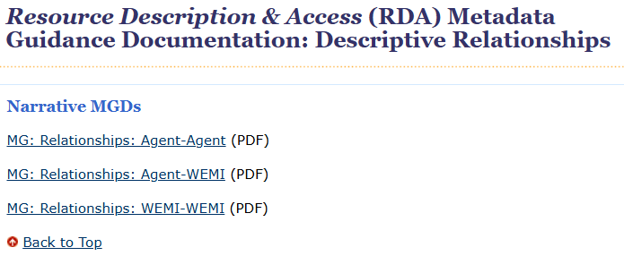
Notes:
This page gives us some options.
We’re trying to describe the relationship between a person (an Agent) and a work (a WEMI entity). So we’ll open the Agent-WEMI MGD.

Slide 59
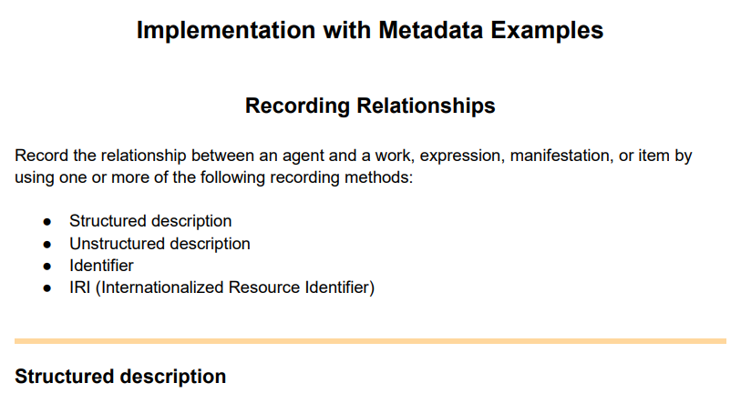
Notes:
To save time, we’re going to skip down to “Implementation with Metadata Examples.” It says to record the relationship between an agent and a WEMI entity by using one of the recording methods listed.
The first method listed is “Structured description.” Setting aside the fact that we’re currently in the “structured description” demo for the workshop, how would we know which recording method to apply when recording author person for our bib record? Let’s go back to the Toolkit.

Slide 60
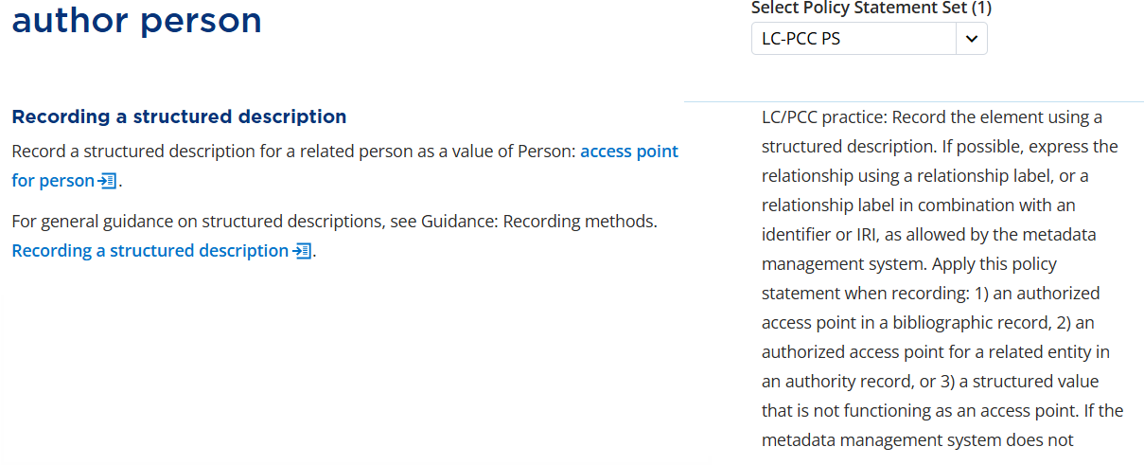
Notes:
Remember to always check the full page in the Toolkit. Even if you’ve already gotten some useful information up top, there’s often additional info further down. We’re going to “send to back” the Prerecording PS, then skip past the unstructured description because we’re not trying to record a note.
For Recording a structured description, we have this PS.
It says: “Record the element using a structured description. If possible, express the relationship using a relationship label... Apply this policy statement when recording: 1) an authorized access point in a bibliographic record…” and we can stop there, because that is what we’re doing.
For the sake of this exercise we are pretending our author doesn’t have an authority record. So, we will need to construct an access point, which we’ll get to in a few minutes.

Slide 61
Notes:
Remember how the Prerecording section for author person referred to two MGDs?
And we’ve only viewed the first one. So let’s go look at the other, Relationship labels.

Slide 62
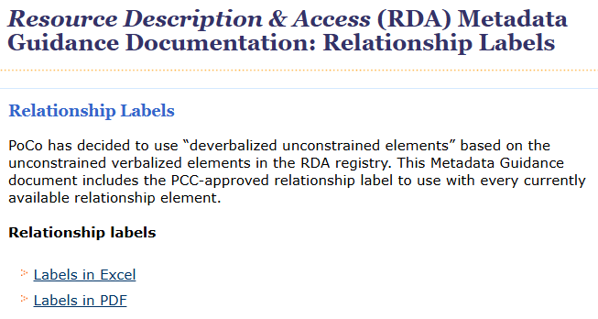
Notes:
Basically this blurb says that PCC has human-friendly terms for us to use instead of the official RDA jargon. So let’s open the PDF. The RDA term is the hyperlink in the first column, and the PCC term is bolded & italicized in the fourth column. And now search for ‘author person.’

Slide 63
Notes:
Here it is. It says that instead of ‘author person’ we should use “author” for our relationship label. So we will put “author” in the Relationship label field in our bibliographic exercise template.

Slide 64
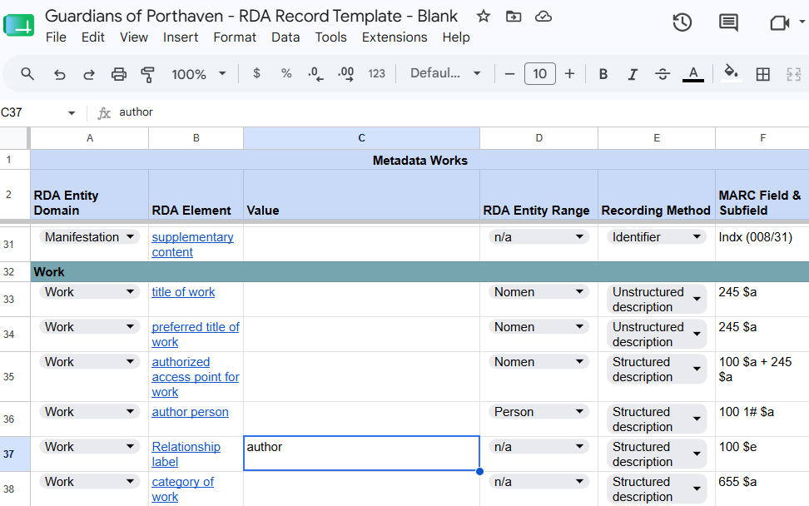
Notes:
And again, since this is a work relationship, we will scroll down to the Work section.
But we still need to record an “author person” value in this template. Let’s go back to the structured description guidance for author person…

Slide 65
Notes:
On the left, RDA says to record ‘author person’ using a value of ‘access point for person.’ The PS says it applies when recording an authorized access point in a bib record, so now we’re going to walk through how to record an authorized access point for person. We’ll just click that link right there to access point for person…

Slide 66
authorized access point for person

Slide 67
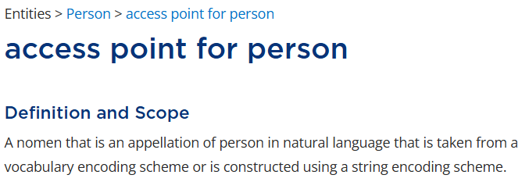
Notes:
Here we are at the top of the access point for person page.
Remember from Susie’s presentation that the LC Name Authority File is a vocabulary encoding scheme, and an access point can be added to the authority file if it is constructed according to NACO’s string encoding scheme. So even though this definition here contains a lot of words, it’s really the same practice that we’re used to.
Let’s open the MARC section in the Element Reference box…

Slide 68
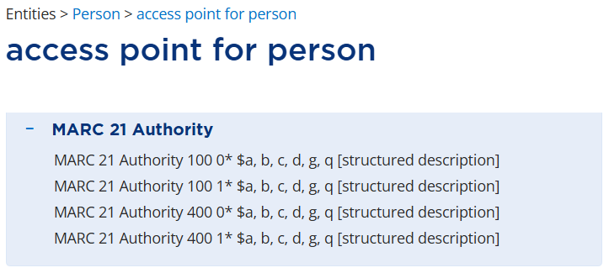
Notes:
Notice how, unlike for author person, there are only authority MARC fields here. This confused me at first, because in original RDA, we can record an access point for a person in a bib record. But then I thought about how ‘author person’ is recorded in the bib 100 or 700 as a relationship element in Official RDA, relating the author to their work. In Official RDA, an ‘access point for person’ is used in recording a value for ‘author person’ but the two elements are not equivalent, because they convey different relationships. ‘author person’ relates a work to an author, and ‘access point for person’ relates an author to a nomen.
With that in mind, let’s continue on the path to determine our access point for person value so that it can be used to record the ‘author person’ value in our bib template.
We go down to Prerecording…

Slide 69
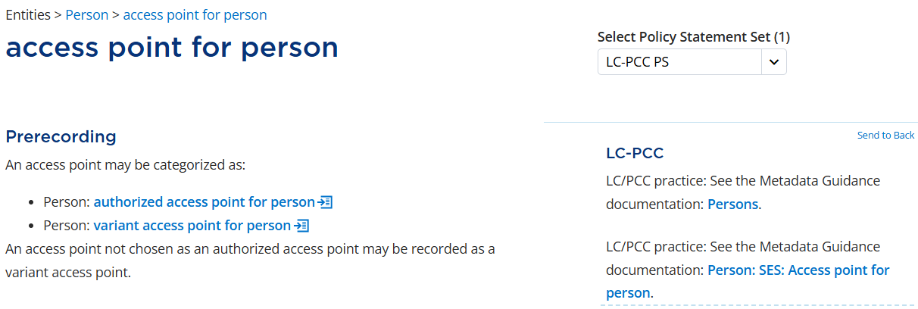
Notes:
The RDA text on the left breaks access points down into two categories: authorized and variant. It’s not completely clear from the language, but this is an either/or situation. In practice, this means we only work through the broader ‘access point’ element to get general instructions that apply to both of the narrower elements. We don’t ever record a simple “access point for person.” And an access point in a bib record is considered authorized even if there’s no authority record to support it.
Let’s remember there are some MGDs here to check out later, and click the RDA link to authorized access point for person now.

Slide 70
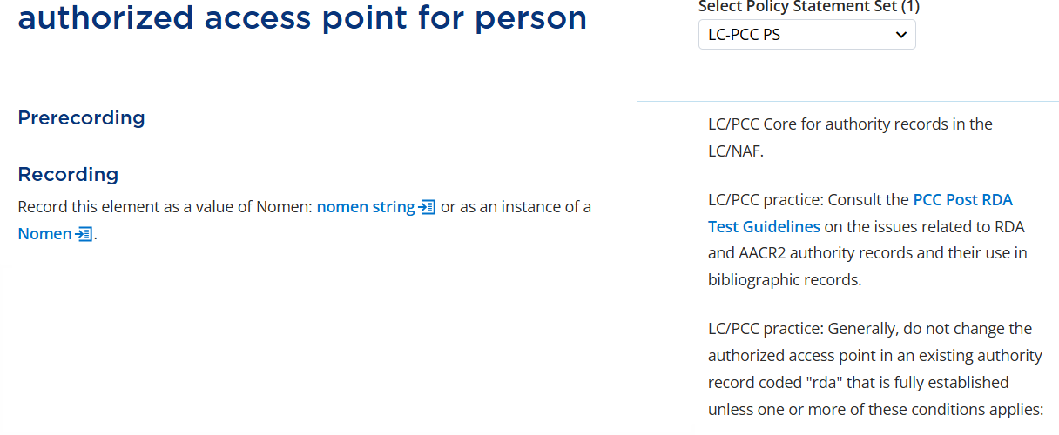
Notes:
To save time, we’ll skip down to Prerecording.
This PS indicates that an authorized access point must be included when adding an authority record to the LC/NAF. For our workshop exercise, that means we’ll need to record the authorized access point in our authority template.
There’s some other stuff in the PS that doesn’t really apply to us, so let’s scroll down the page.

Slide 71
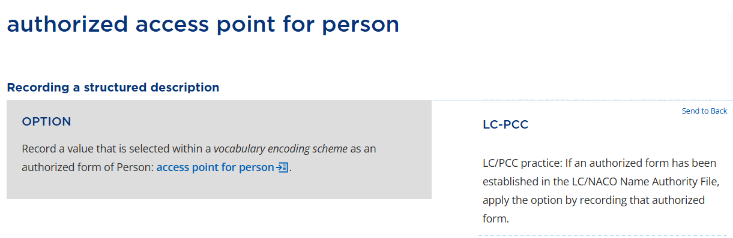
Notes:
Let’s look at the first option for recording a structured description. The PS says, “If an authorized form has been established in the LC/NACO Name Authority File, apply the option by recording that authorized form.”
Well, we’re pretending that Shane Arbuthnott isn’t in the authority file. So we move on to the next option.

Slide 72
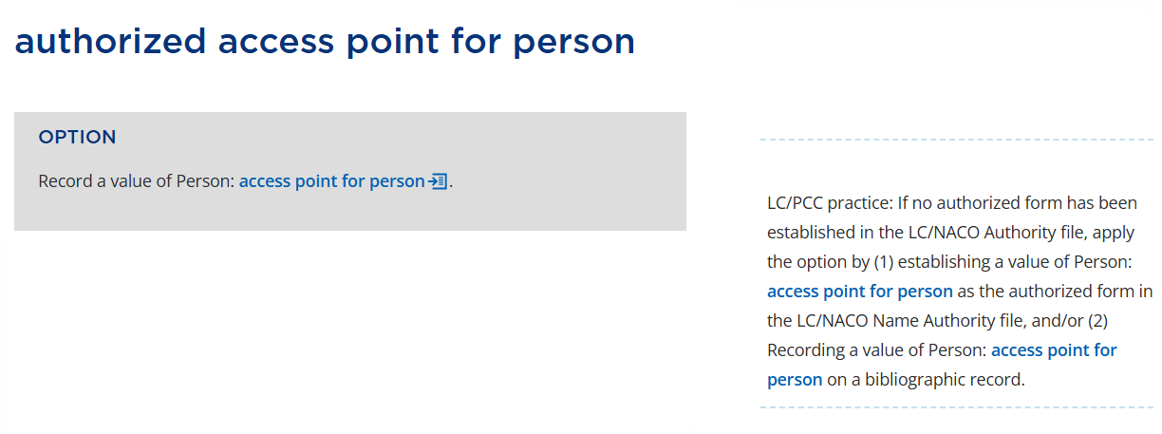
Notes:
The PS tells us we can either make an authority record for this person or simply record an access point for them in the bib record. We want to make an authority record. There’s a link to ‘access point for person’ but clicking on it at this point will make things more confusing, so for now we’re going to continue on this page.

Slide 73
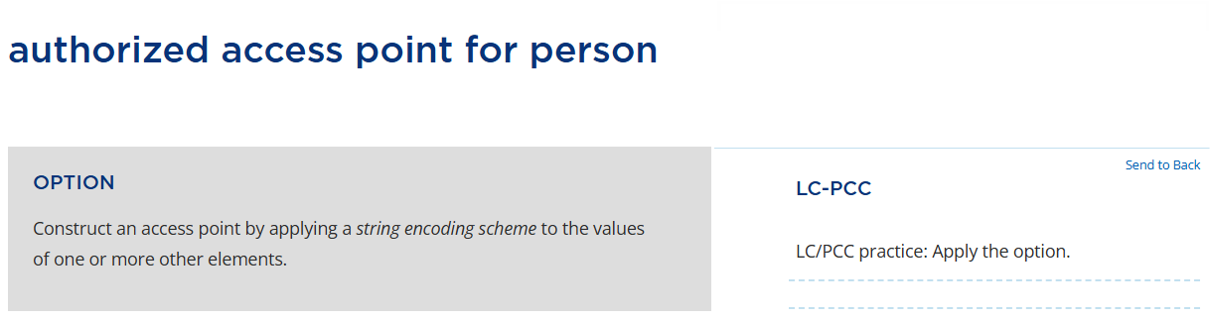
Notes:
The last option, which PCC tells us to apply, is to construct an access point by applying a string encoding scheme to the values of one or more other elements.
Susie explained earlier that an SES is essentially a syntax. Before we can apply PCC’s SES, we need to figure out the values that will be part of our element. The rest of this toolkit page will help us do that.

Slide 74
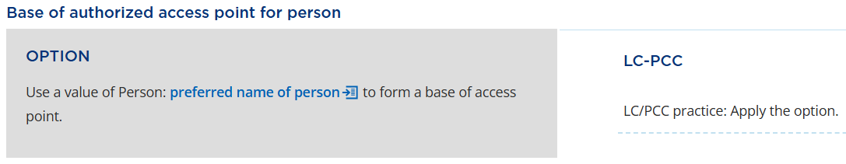
Notes:
Scrolling down, we reach “base of authorized access point for person” which says to use a value of ‘preferred name of person’ to form a base of access point.

Slide 75

Notes:
Bob already showed us how to determine the ‘preferred name of person’ and we have it recorded in our authority template: Shane Arbuthnott.

Slide 76
Notes:
But what is a “base of access point?” This is actually something that I think is pretty intuitive about official RDA – the “base of access point” is just the basic draft access point we start with, before we add dates or other distinguishing components to build a final access point.

Slide 77

Notes:
If we keep scrolling down, there’s this RDA instruction which is easy to miss because it has no policy statement.
It says to apply the general instructions at Person: access point for person. Format of base of access point for person. Again, even though we aren’t actually recording the ‘access point for person’ element, we still need to view the instructions for it, because they impact what we record for our narrower element. So let’s click that link.

Slide 78

Notes:
Now we’ve got some RDA jargon. The condition in yellow is what applies to our situation, because our person’s name contains two separate words: Shane and Arbuthnott. RDA says we will format our base access point by recording a value that rotates part of the name to the front, followed by the remainder of the name. That sounds like what we’re used to doing: last name comma first name.
The attached PS says to apply the option in certain cases and directs us to MGDs but doesn’t provide links. When you see a PS like this, it’s implied that the MGDs are the ones linked in the Prerecording PS. So we’ll go back up to Prerecording.

Slide 79
Notes:
Here are those two MGDs we passed earlier. We will skip clicking the first link because it doesn’t really provide any extra info for our particular situation. We will click the second link, to MG: Person: SES: Access point for person.

Slide 80

Notes:
We’re going to click on the Basic String Encoding Scheme Instructions.

Slide 81

Notes:
First we have some MARC info, which you can come back to when you fill out your MARC workform.

Slide 82

Notes:
The next section is also MARC related, and I think the header needs to be adjusted, but it confirms our interpretation of the RDA jargon: When a personal name contains a surname element, we create the base of our access point by recording the surname, followed by a comma and a space, and then the forename.
Our Shane Arbuthnott example is a common Western-style “First Name Last Name” situation, without any initials or additional components, so we don’t need to consult the rest of the Surname instructions in the MGD. The MGD also contains instructions for MARC subfields beyond $a, so keep that in mind when you work on the exercises this afternoon.
We now have our base of access point for person – which is also the base of authorized access point for person: Arbuthnott, Shane
We’re going to go back to where we left off in the Toolkit, access point for person. Format of base of access points for person.

Slide 83
Notes:
None of the other conditions in this section apply to our person, so we’ll keep scrolling.

Slide 84

Notes:
Now we come to Additional elements and designations in access points for person.
It lists some situations in which we’d need to include additional components in our access point. These guidelines are on this element page because they apply to both authorized and variant access points.
Here are the policy statements that say we should always include birth and death dates, if known, when making new access points. We don’t know Arbuthnott’s birth date, so we can’t add it.

Slide 85

Notes:
If we were to scroll down, we’d see the guidance on breaking conflicts by including fuller form of name, period of activity, etc.
But we don’t have any of this info for our author, and he has no conflict in the authority file anyway.
(Side note: If we were to return to the authorized access point for person page and view the Additional elements and designations in authorized access points for person section, it would send us right back here.)
We have finished our authorized access point, so let’s go add it to our authority template AND the ‘author person’ field in the bib template.

Slide 86

Authority template
Notes:
Enter the authorized access point: Arbuthnott, Shane
Then copy it (just as you would with the 1XX from a NAR)…

Slide 87

Bibliographic template
Notes:
… and paste it into the bib template, in the ‘author person’ field.
And that’s it!

