Slide 1
Report on BIBFRAME Workshop in Europe 2024
Held September 17th and 18th in 2023 in Helsinki
Matias Frosterus
EURIG 2025

Slide 2
What is the BFWE?
Series of annual workshops coordinated by the Organizer Group
A forum for sharing knowledge about the practice of, production with, and planning of BIBFRAME implementation
First one in Frankfurt in 2017
A mailing list with now more than 500 participants https://lists.dnb.de/mailman/listinfo/eurbibframe
Repository of presentation from past editions at www.bfwe.eu
Slack Channel https://bfwe.slack.com
Active during the workshop

Slide 3
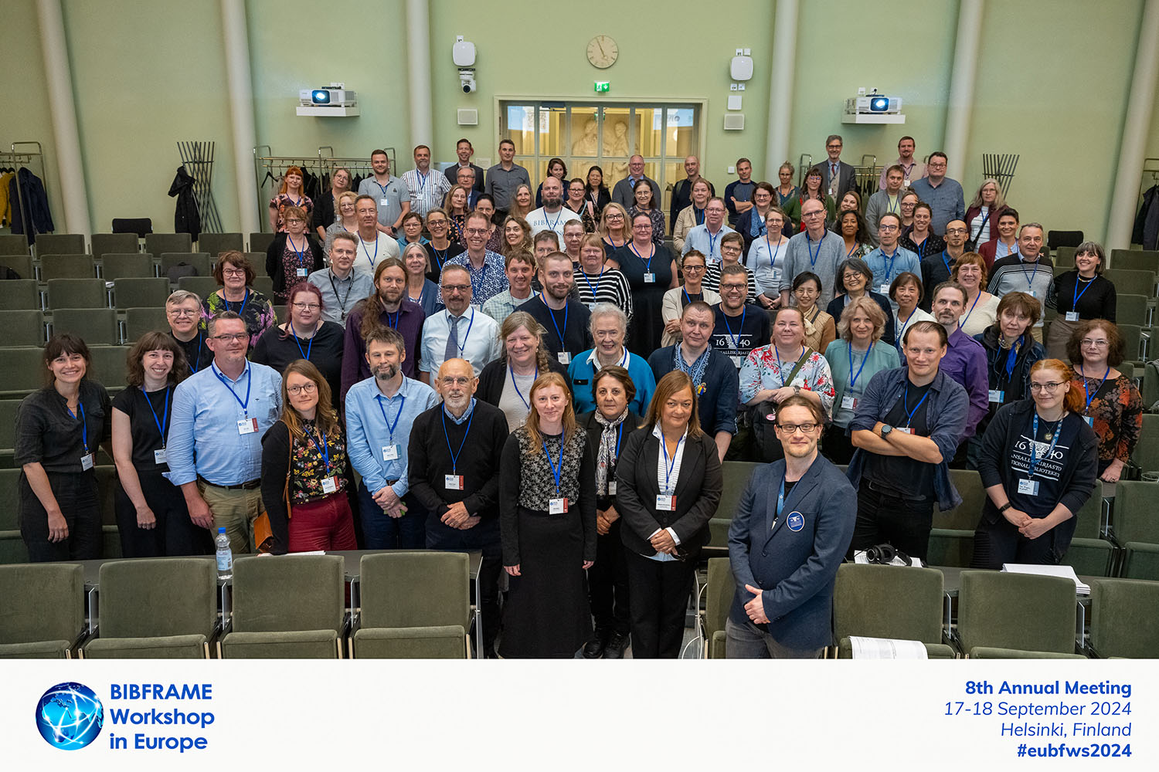
BFWE 2024
Held in Helsinki, September 17th-18th
~100 in-person participants
Almost 400 online participants
All of the slides and recordings are online
https://www.bfwe.eu/helsinki_2024
Photo: Marko Oja, National Library of Finland

Slide 4
Modern MARC
Library of Congress’ set of guidelines for producing MARC records that are easier for BIBFRAME
Aims to better comply with RDA
https://www.loc.gov/marc/ModernMARC-index.html
Less coded data in fixed fields
Favors strings and identifiers
More identifiers
Minimal ISBD punctuation

Slide 5
BIBFRAME 2.4
Relations between entities from direct to indirect
This removes “hardcoding” from these relations and allows easier interoperability with, e.g., RDA relations
bfWork1
bf:hasSeries
bfWork2
bfWork1
bf:relation
bfRelation1
bf:relationship
bf:hasSeries
bf:associatedResource
bfWork2

Slide 6
BFWE 2024: Community Updates
Library of Congress update
Sally McCallum, Library of Congress (LoC), Chief of Network Development and Standards Office
BIBFRAME Shapes: Validating our Approach
Nancy Lorimer, Stanford University, Associate Director for Metadata Services
Planning and Designing: An Update from Blue Core
Kalli Mathios, Stanford University, Linked Data Community Outreach Librarian

Slide 7
BFWE 2024: Community Updates
Share Family: advancements in linked data collaboration
Tiziana Possemato, @Cult, Founding partner & Director
Serena Cericola, Casalini Libri, R&D assistant
Normalising and coordinating types in bibliographic data
Andreas Andersson, National Library of Sweden, Metadata Specialist

Slide 8
BFWE 2024: From theory to practice
Report from RDA Steering Committee
Renate Behrens, RSC, Chair
Expressions and Aggregates in BIBFRAME
Matias Frosterus, National Library of Finland, Information Systems Manager
Building a Semantic Knowledge Graph at National Library Board Singapore
Richard Wallis, Data Liberate, Founder

Slide 9
BFWE 2024: From theory to practice
Adventures in BIBFRAME: Cataloguing Rare Books Using Sinopia at the University of Leeds
Trevor Hough, University of Leeds, Metadata & Discovery Coordinator
Kim Taylor, University of Leeds, Metadata & Discovery Manager
Toward a new way of cataloging: investigating the feasibility of implementing an entity-relationship model in Flemish central cataloging
Gwenny Vlaemynck, Cultuurconnect, Innovation Manager
Hannelore Baudewyn, Cultuurconnect, Product Owner Open Vlacc
Lynn Van Kerckhove, Cultuurconnect, Domain expert IT
Guy Cools, Cultuurconnect, Metadata specialist

Slide 10
BFWE 2024: BIBFRAME Environments
Working with linked data at scale in library workflows
Jeff Mixter, OCLC, Senior Product Manager Metadata and Digital Services
Unlocking BIBFRAME: Practical Insights for Alma and Primo
Adina Marciano, Ex Libris, Product Manager
Margarita Perez Martinez, University of Miami, Cataloging & Metadata Librarian and Law School Institutional Repository Manager
Practical use cases for shared bibliographic infrastructure
Sebastian Hammer, Index Data, President
Tiziana Possemato, @Cult, Founding partner & Director

Slide 11
BFWE 2024: BIBFRAME Environments
Linked Data LMS: Experiences from Production
Magdalena Olofsson, Axiell, Product Manager
Emma Tennevall, Metadata Specialist
The UNIMARC-BIBFRAME mapping in SHARE Catalogue: an evolving path
Claudio Forziati, University of Naples Federico II, Librarian
KORMARC data mapping for BIBFRAME transforming
Mihwa Lee, Kongju National University

Slide 12
BFWE 2024: Roundtables
BIBFRAME editors in the future
The Era of Dual Format Environments: BIBFRAME and MARC
Insights into the practicalities of working with BIBFRAME

Slide 13
BFWE 2025
16th and 17th of September 2025
Hosted by the University of Naples Federico II, Italy
Note that September is prime tourist season for Naples so make your reservations well in advance
Online participation also possible
Attendance to the conference is free
Registration: https://www.bfwe.eu/naples_2025
Presentation proposals still open
Deadline May 27th

Slide 14
Some other news of interest
BIBFRAME advisory committee under consideration
Share-VDE liaison to RSC
Aimed to ensure consistent data interoperability among BIBFRAME and RDA
Share Family, composed of a community of BIBFRAME users, has MARC and UNIMARC users
BIBFRAME Interoperability Group BIG
Building machine-readable application profiles for minimum BIBFRAME shapes for interoperable exchange of BIBFRAME

Slide 15
Conclusions
BIBFRAME is here
Many implementations are old enough that challenges and solutions are more mature
The tools are more and more concerned with user experience and smooth processes
The whole metadata ecosystem is considered
Library system vendors adding BIBFRAME support
Another major theme was one of co-operation.
Multiple collaborative initiatives had presentations
strong progress being made on true sharing of data.
RDA also present as an important consideration in practical BIBFRAME implementations

Slide 16
Thank you and welcome!

