Slide 1
RDA / UNIMARC harmonization: update #5
Structuring principles, current situation and upcoming work
RDA in Europe Annual Meeting, May 23rd 2025
Florence Tfibel (BnF, France), on behalf of the Permanent UNIMARC Committee (PUC, IFLA)

Slide 2
Presentation plan
PUC activities in 2024-2025
Updates to the format and its documentation
Working groups and projects
Focus : the « Future of UNIMARC » project
Survey results
Roadmap for the future

Slide 3
UNIMARC in 2024-2025
An overview of the Permanent Unimarc Committee’s activities

Slide 4
UNIMARC 2024 updates
27 proposals were to be discussed (34th annual meeting in June, additional meeting in July and corresponding meeting in September)
Mostly for structuring and extending UNIMARC/A to accommodate attributes and relationships elements aligned with IFLA LRM
Cluster ISSN (within UNIMARC/B field 011)
Electronic Archive Location and Access (new UNIMARC/B field 857)
URI ($3 – Authority Record Identifier or Standard Number (extended), $R – Real World Object (URI) (new))
20 were accepted and published in the 2024 edition of the Manual

Slide 5
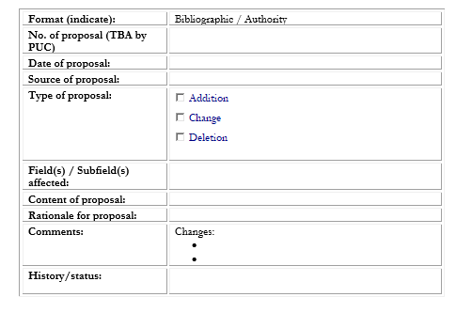
Proposals and discussion papers
https://www.ifla.org/g/unimarc-rg/permanent-unimarc-committee-puc/
Notes:
This year, we have also published a proposal form on the PUC webpage, along with instructions on how to submit it.
Please note that proposals should be sent to the national UNIMARC committee or to a library institution working with the PUC.
For UNIMARC users from countries without professional institutions affiliated with the PUC, you can submit your proposal directly, but please contact the PUC first for consultation.

Slide 6
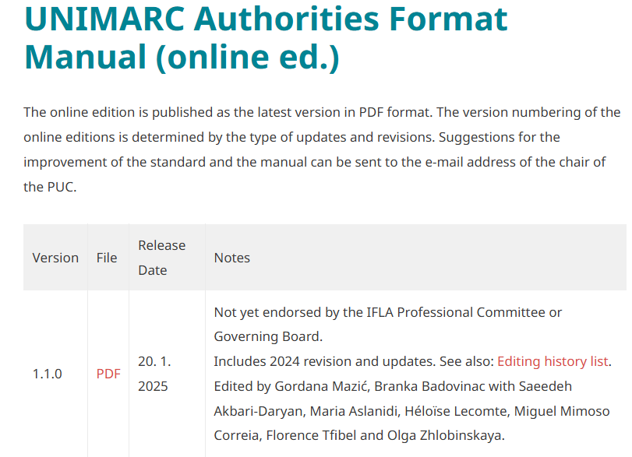
UNIMARC Manuals
Full online publications since 2023
Updates in 2024 with supporting documentation & workflow :
IFLA repository versions
web page
history list
2024: Endorsement
process (in progress)

Slide 7
Working groups and projects
Mappings and harmonization
LRM, RDA, UNIMARC Authorities, BIBFRAME Mapping for Musical Works (in progress)
UNIMARC – ISBDM Harmonisation : with ISBD Review Group Task Force on ISBD for Manifestation (in progress)
Tools and documentation
“Future of UNIMARC”
UNIMARC – IFLA LRM Mapping (closed)
IFLA Namespaces : with Metatec (in progress)
Manuals and documentation (ongoing)
Roadmap (in progress)
Worldwide survey (closed)
6th UNIMARC Users’ Meeting (closed)
Webpage (ongoing)

Slide 8
Future of UNIMARC

Slide 9
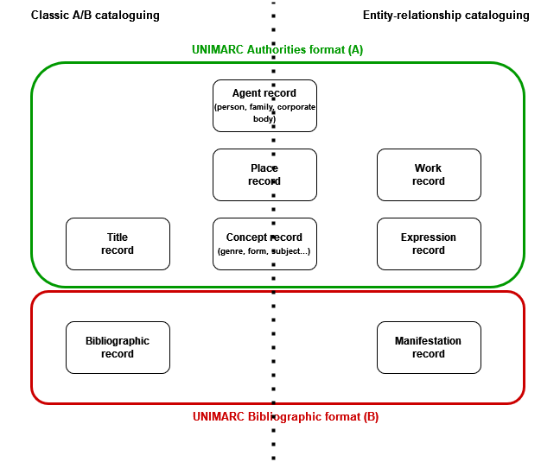
UNIMARC and the new ER based standards
General principles so far :
Compatibility of IFLA standards
Full LRM implementation
RDA as an intermediary (but also ISBD-M)
One format, two cataloguing options
Not a new, distinct format
But also direct entity relationship management
Pending questions :
Implementation strategies
ISBD consequences ?

Slide 10
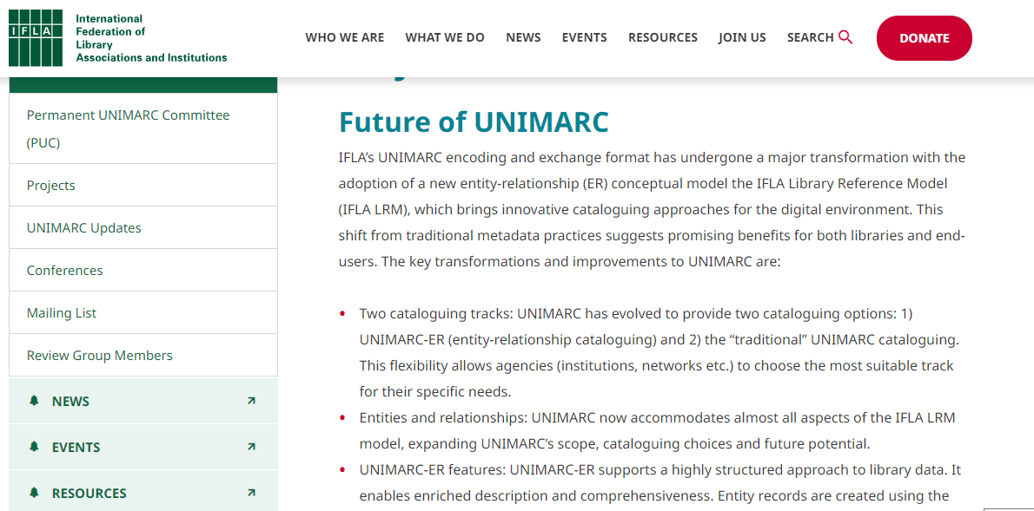
Future of UNIMARC
A project launched in 2023, which aims to facilitate exchanging, sharing and generating knowledge about the future of UNIMARC.
It focuses on exploring UNIMARC’s range of uses, increasing familiarity with its entity-relationship (ER) cataloguing track, and gathering information about the library community’s needs.
A webpage since early 2024
6th UNIMARC Users Meeting: Charting the Course: Future-Forward Cataloguing with UNIMARC, 12th November 2024 (Maribor, Slovenia/Online)
A worldwide survey (April-July 2024) : Landscape of Data Structure and Exchange Standards Survey
Goal for 2025-2026 : Publication of a roadmap (strategy) on UNIMARC entity-based cataloguing with IFLA metadata content standards (PUC position paper)
Notes:
The survey took place from mid April to mid-July 2024, in order to better understand the needs and practices of users, and to shape the format’s next roadmap.
Questions focused on the use of content standards and formats in library systems, as well as on UNIMARC users’ needs and projects for the future, in general and more specifically concerning the new ER standards.

Slide 11
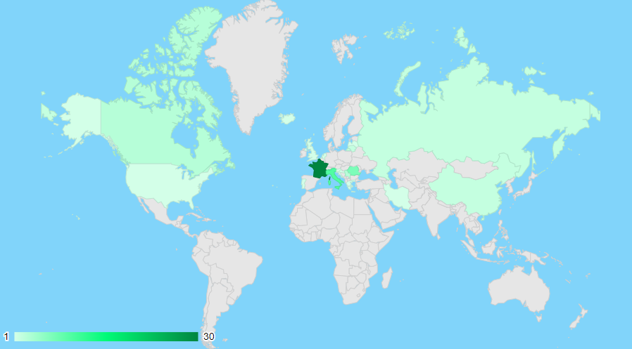
Landscape of Data Structure and Exchange Standards Survey Results UNIMARC in the world
Number of survey responses by country
69 full answers, from 18 countries
Almost always from a national library/bibliographic agency
From different types of users : direct users (for cataloguing or exchange), users of UNIMARC-based formats, or of other formats keeping updated.
Notes:
Survey responses offer a good indication of which countries use UNIMARC consistently : they follow its evolutions.
Centers on Europe, with users in the Asia and North America.
Most responding countries have done so through their national library or bibliographic agency. ILS/services providers also have an interest in keeping informed directly.
Among other institutions, academic libraries are the ones most likely to stay informed and involved directly.
This does not mean that public libraries do no use UNIMARC, but rather than in countries where the national library or bibliographic agency is involved, they may not feel the need to stay updated directly on the PUC’s activities.
In some cases, this is reinforced by the use of a national UNIMARC based format maintained by the national library/bibliographic agency.
Users of UNIMARC itself, for cataloguing or exchanging data, are located overwhelmingly in Europe. Users from Asia (as well as some in Europe) use standards derived directly from UNIMARC, whereas respondents from North America (and some in Europe) follow its developments while using other formats, mostly MARC21.

Slide 12
Landscape of Data Structure and Exchange Standards Survey Results UNIMARC and the new standards
CONTENT STANDARDS USED BY UNIMARC OR UNIMARC-BASED USERS FOR PRODUCTION

Slide 13
Landscape of Data Structure and Exchange Standards Survey Results Plans for the future
To change or not to change,
and why ?
User expressed needs
Better and more user-friendly documentation online (manuals, information about UNIMARC ER)
Tutorials, especially on how to migrate from classic UNIMARC to UNIMARC ER
Compliance with RDA, with frequent updates
Need to replace their ILS (technically obsolete, financial reasons, integration into a network) (7)
Wish to adopt a new ER content standard or format (5)
Notes:
4 respondents said they already use the UNIMARC-ER data element structure (Martynas Mažvydas National Library of Lithuania, Biblioteca Centrala Universitara "Lucian Blaga" Cluj-Napoca (Romania), SCD Université Claude Bernard Lyon 1 (France), Avignon Université (France))
1 is planning to in the near future (National Library of Russia)
4 eventually (National Library and Archives of Iran, Université de Toulon (France), Casalini Libri, and a public library in Italy)
1 is considering implementing ER cataloguing in another format, depending on the LIS providers’ offers (ABES (France))
3 respondents use MARC21 as a cataloguing format that supports ER cataloguing : McGill University (Canada), an institution in the United States, and OCLC

Slide 14
A Strategy (“roadmap”) for entity-based cataloguing with UNIMARC
(Re)evaluate long-term strategy for UNIMARC within IFLA metadata standards
Review of survey and 6th UNIMARC Users Meeting
Review of ISBD-UNIMARC Harmonization Group Report to the PUC
SWOT analysis of UNIMARC development
Strengths, Weaknesses (internal factors)
Opportunities, Threats (external factors)
PUC position paper?
Notes:
Two cataloguing tracks flexibility:

Slide 15
Thank you for your attention
florence.tfibel@bnf.fr
https://www.ifla.org/g/unimarc-rg/permanent-unimarc-committee-puc/

