Slide 1
RDA – a standard on the way to more partnership
Renate Behrens
Chair RDA Steering Committee
James Hennelly Director, ALA Digital Reference
May 2025

Slide 2
RDA as a Cataloguing standard
RDA was always intended as a cataloguing standard. It comes from the Anglo-American tradition and the Original Toolkit has largely continued this tradition.
But cataloguing was already in a phase of upheaval at this time.
This process has been intensified in the following years and all standards, not just RDA, must face up to the new challenges.

Slide 3
RDA since 2015
The committees responsible for RDA took up this challenge back in 2015, and the 3R project marked the start of a paradigm shift for cataloguing with RDA, some of which is still ongoing.
This has changed a lot for the user communities, which does not always seem easy at first, but offers new opportunities for many.
The circle of user communities has thus been significantly expanded and numerous applications in the field of cultural institutions have been created since then.

Slide 4
What has changed?
Internationalisation
Options
Community Resources
Web-based Toolkit
Linked-data Applications
…

Slide 5
What must change?
RDA has a firm and proven committee structure.
This helps to manage the standard, make it reliably available and carry out the ongoing customisation processes.
But tried and tested procedures also need to be reviewed and adapted.

Slide 6
This process was initiated by the RDA committees and initial results are available. James Hennelly will now report on this.

Slide 7
What We Are Working on
Community Resources
Companion Subscription
Representation
Training

Slide 8
Community Resources
Partner
Work in the Toolkit CMS
Fee involved
Contributing
Work in the HTML editor
No fee

Slide 9
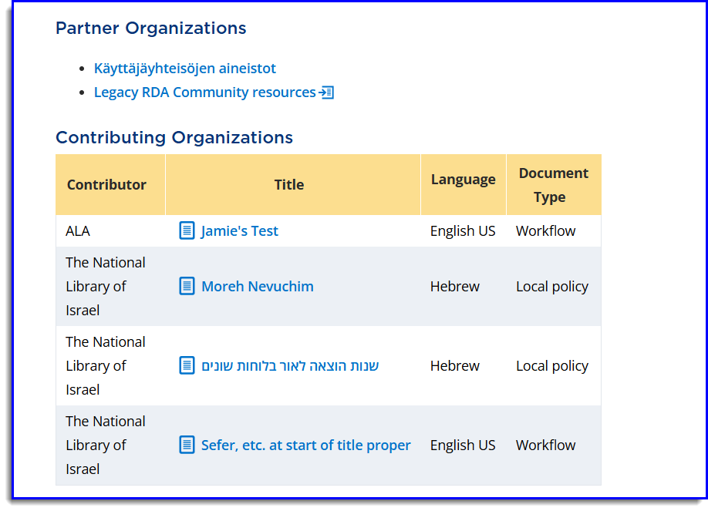

Slide 10
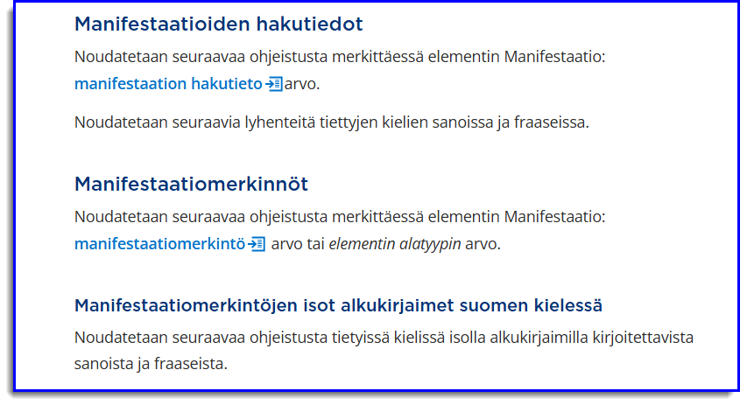

Slide 11
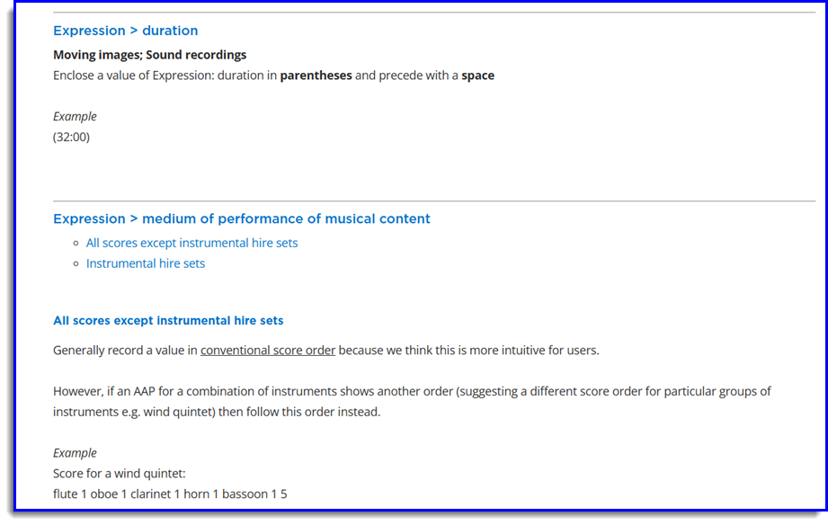

Slide 12
Companion Subscription
New subscription level for groups or institutions that want to permission to create an online cataloguing manual
Intended for those sharing an online manual for a large community of libraries

Slide 13
Companion Subscription
Benefits include
Permission to publish an online cataloguing manual based on RDA
Access to RDA content management system for translation, PS, and CR
Toolkit Access that aligns with the needs of the community served
Membership in proposed group*

Slide 14
Companion Subscription
Pricing
Flexible pricing
Based on community population
Renewal required to maintain permission

Slide 15
Representation
Looking for new ways to better engage with RDA Toolkit stakeholders.
Proposal for an Advisory Council that would meet with RDA Board twice a year.
Propsed council would align with the broader strategic and business issues that is teh Board‘s role and expand participation in the Board.

Slide 16
Training
There remains great demand for training.
Training needed for the practices that are specific to a region.
RDA Board is exploring how we can develop trainers for all parts of the world.

Slide 17
Conclusion
With these changes, the RDA committees want to take a forward-looking approach and shape the future of cataloguing with RDA together with the user communities.

Slide 18
Thank you for your attention and grateful for your input!
Renate Behrens Chair RSC Steering Committee
rscchair@rdatoolkit.org James Hennelly Director, ALA Digital Reference jhennelly@ala.org

