Slide 1
Report from the Europe Representative to the RSC EURIG Annual Meeting, 2025
Ahava Cohen
ahava.cohen@nli.org.il Ahava.cohen@rdatoolkit.org

Slide 2
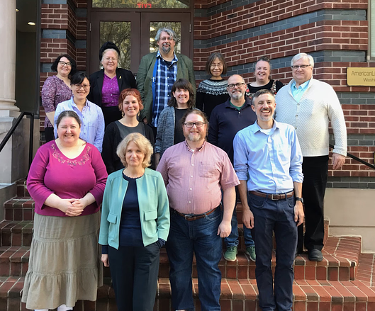
Meetings
RSC meeting in person meeting, Washington DC (USA) November 2024
Online joint RSC/RDA board meeting – April 2025
3 asynchronous meetings (July, January, April)
All asynchronous meetings had public sessions
No in-person meeting 2025

Slide 3
RSC Membership
Damian Iseminger completed his term as Technical Team Liaison Officer. Christopher Holden succeeded to December 2026.
ORDAC and EURIG representatives appointed for second terms.
First terms ending December 2025:
Translations Team Liaison Officer Szabolcs Dancs (December 2025).
RDA Examples Editor Jessica Grzegorski
Education and Orientation Officer Elisa Sze
RSC Secretary Anne Welsh (December 2025).
NARDAC representative Robert Maxwell (December 2025).
Second term ending December 2025:
Wider Community Engagement Officer Charlene Chou

Slide 4
Official RSC
Fast Tracks
Proposals
Community Resources
Protocols
Working Groups
Education

Slide 5
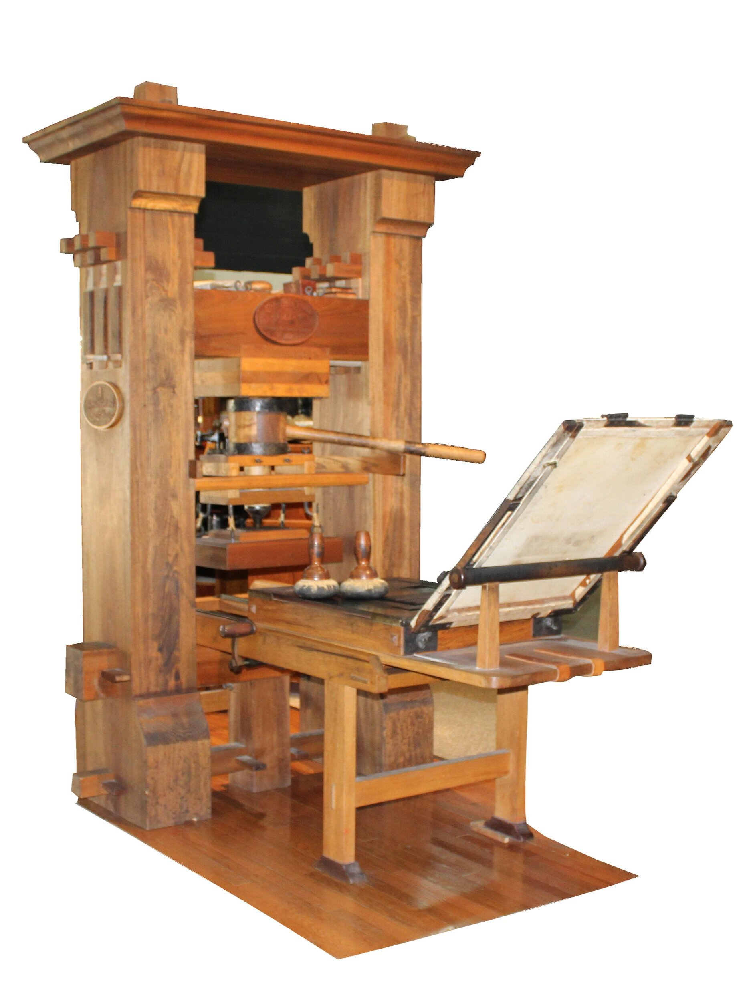
Fast Tracks
Source:
Translation WG: 2
RSC Secretary: 1

Slide 6
Proposals – 2024/2025
Proposal to Revise Name of Corporate Body
Prepared by the Religious WG. Discussedand approved at the November 2024 meeting. Allows recording official name of corporate body even when publications use a different name
Religions WG was given specific permission to go beyond the limits of their mandate and identify broader areas in the Toolkit where their proposal would apply.
Proposal to add glossary definitions for fictitious entity and non-human entity
Prepared by Technical Team Liaison Officer and Examples Editor. Discussed at the November 2024 meeting and approved with changes to wording. Request to include “exhibiting human characteristics” to definition of non-human entity not approved.
Notes:
All proposals are available on the RSC website.

Slide 7
Proposals – 2024/2025
Proposal to revise the definitions of aggregate, aggregating work and aggregates guidance
Prepared by Technical Team Liaison Officer and Education and Orientation Officer. Discussed at the November 2024 meeting and approved with changes to wording.
[Proposal on] Dual-language naming of Corporate Body and Place
Prepared by ORDAC. Approved at November 2024 meeting after work by a Rapid Action Group. Final wording of text was left to the admin team. Issues of scripts remain untreated.
Proposal on numerals associated with given names
Prepared by NARDAC. Approved with amendments in the April 2025 Public Session of the RSC Meeting. A draft of RSC/NARDAC/2025/1/Decisions is with the North America representative and the Technical Team Liaison Officer.
Notes:
All proposals are available on the RSC website.

Slide 8
Community Resources
Technology ready to accept communities;
application available online
Protocols
Protocol between the RSC and the BIBFRAME community represented by the Share Family / Share-VDE Advisory Council
Approved at April 2025 meeting; final draft sent to BIBFRAME community for approval.

Slide 9
Slides for educators
Template RDA Teaching Slides
RDA Teaching & Training Tips

Slide 10
Working Groups
Extent Working Group
Joint RDA Board and RSC Working Group on Artificial Intelligence
Religions in RDA Working Group
Archives Working Group
Music Working Group: draft for July 2025 meeting

Slide 11
Working Groups
Standing Working Groups
Examples Working Group
Technical Working Group
Translations Working Group
Task and Finish Working Groups
Extent Working Group
Joint RDA Board and RSC Working Group on Artificial Intelligence
Advisory Groups
Religions in RDA Working Group
Archives Working Group
New Terms of Reference approved at April 2025 meeting
2 members from Switzerland, 2 from Israel, two from USA
Started survey of RDA in archives

Slide 12
Editorial Committee – 2025
Mélanie Roche - Bibliothèque nationale de France | June 2023 - June 2026
Maïté Roux – ABES (replaces Héloïse Lecomte) | January 2023 – January 2026
Thurstan Young – British Library | June 2022 – June 2025
Anastasia Kerameos - CILIP | May 2025 – May 2028
Christian Aliverti | Ex officio – RDA Board IR
Jenny Wright | Ex officio – EURIG Chair
Ahava Cohen | Ex officio – EdCo Chair
Hannes Lowagie | Ex officio
Szabolcs Dancs | Ex officio
Emilie Sørine Ullerup | Ex officio
Notes:
At this point, former members are kept on our basecamp space. If it ever came down to a vote – they are not voting members. But their input, if they should offer it, is still welcome.

Slide 13
Translations
Partial translations:
Czech
Danish
Dutch
Estonian
German
Greek
Hebrew
Korean
Latvian
Slovenian
Swedish
Turkish
Chinese
Vietnamese
Full translations:
Arabic
Catalan
Finnish
French
Hungarian
Italian
Norwegian
Portuguese
Spanish

Slide 14
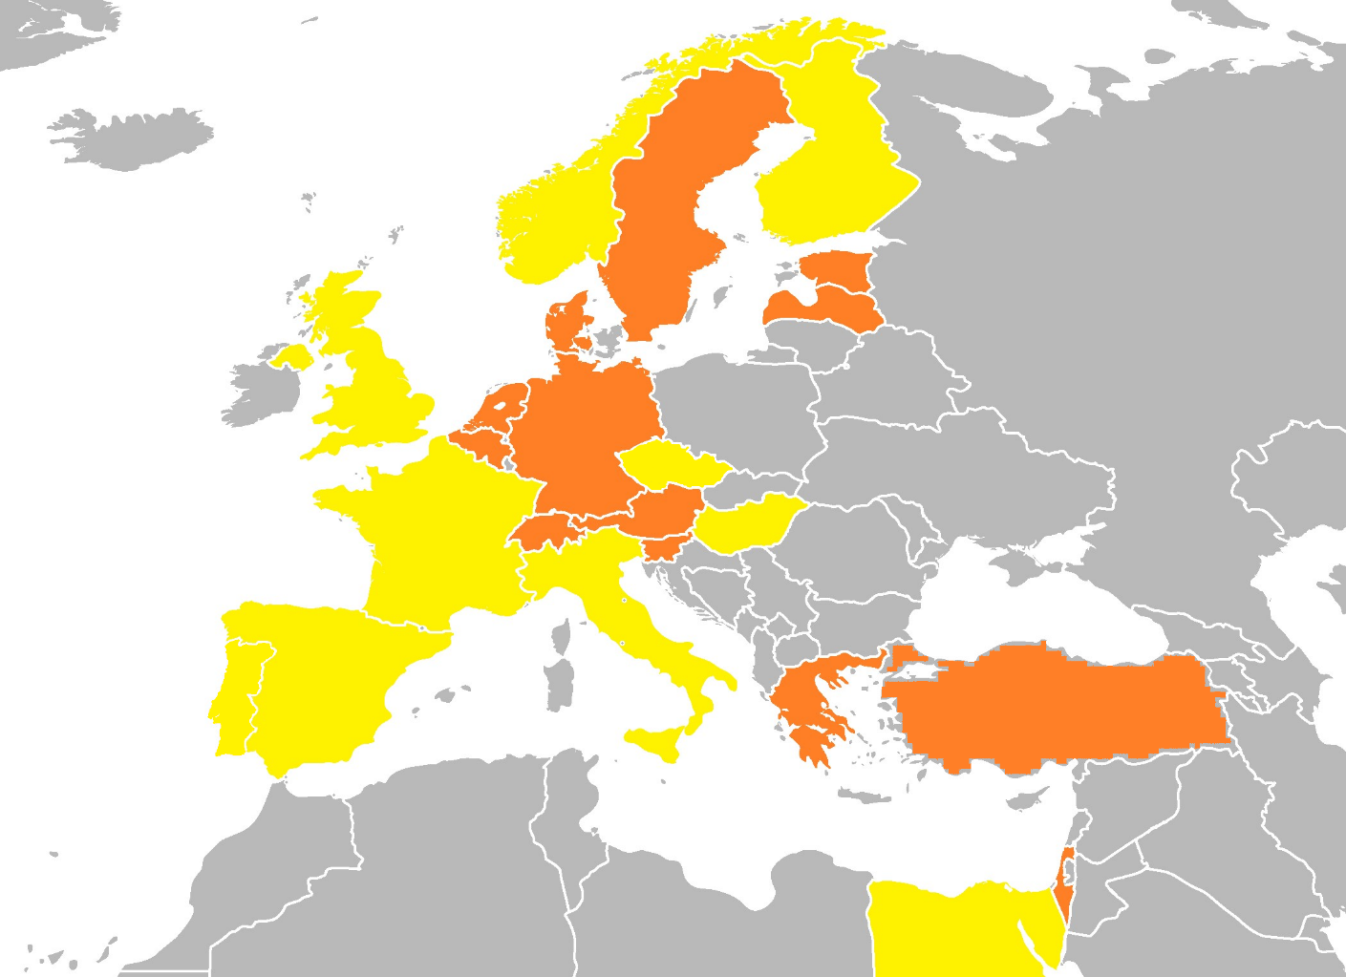
In Europe
RDA Translation Statuses (last updated: May 2025) can be found on Googe Drive
Full
Translations:
(9)
Partial translations:
(14)

Slide 15
Questions? Comments? Fast Track/Proposal ideas?

Slide 16
Ahava Cohen
National Library of Israel
Europe Representative to the RSC
ahava.cohen@nli.org.il Ahava.cohen@rdatoolkit.org
X: @AhavaCohen

