Slide 1
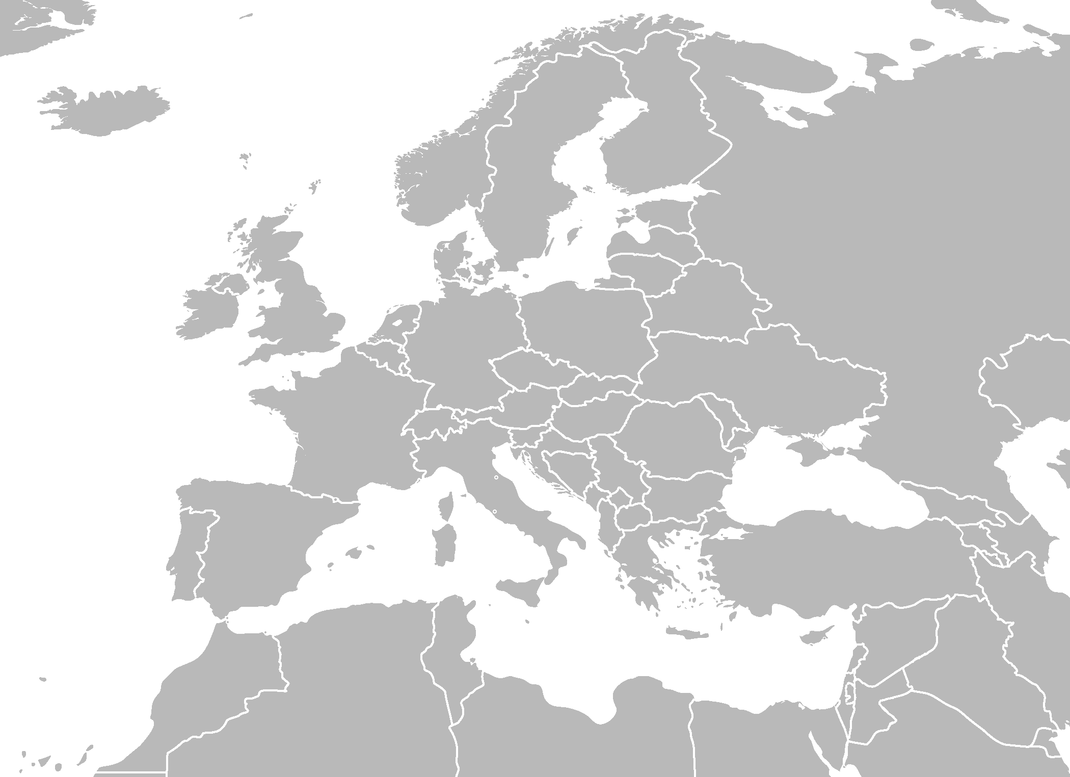
•
•
•
•
•
•
•
•
•
•
•
•
•
•
•
•
•
•
•
•
•
•
•
•
•
•
•
•
•
•
•
•
•
•
•
•
•
•
•
•
•
•
•
•
•
•
•
•
•
•
•
•
•
https://upload.wikimedia.org/wikipedia/commons/5/5a/BlankMap-Europe-v4.png
Notes:
EURIG has 53 member institutions, with a good level of engagement. This is shown not only by the presence and contribution of all attending here, but also in the 8 new representatives we have since last year as member institutions
Keep EURIG in mind when there are staff changes
CILIP new rep, Anastasia Kerameos
ISSN new rep, Juan Ignacio Módenes
ABES new rep, Maïté Roux
Bavarian State Library new rep, Sylvia Daniel ; thanks to Michael Beer for all his years of contributions
National Library of Scotland new rep., Carol Campbell
ICCU new rep., Giuliano Genetasio
National and University Library in Zagreb new rep., Lana Krišto Lončarić
The Consortium of Library Networks, Julia Neuman (replacing Rita Albrecht, had Verena as interim last year)
So, Welcome all and in particular to the new faces ‘at the table’.

Slide 2
Notes:
EURIG exists to promote the interests of current and potential users of RDA in Europe, and to provide a forum for discussion and co-operation, where we can communicate and benefit from each others’ experiences. We are also charged with the dissemination of information from the RSC, and to contribute to the development of RDA by working with the RSC.
As well as putting together the content for our annual meeting, and keeping the membership list up to date, the EURIG Executive committee have improved the website, thanks in large part to Hannes. Since our last meeting we have also followed up on the vote that took place and got our new logo in place.
On the meetings page you will find links to past presentations, and in due course the presentations from this meeting too. It is a useful source of inspiration and information which I recommend to you

Slide 3
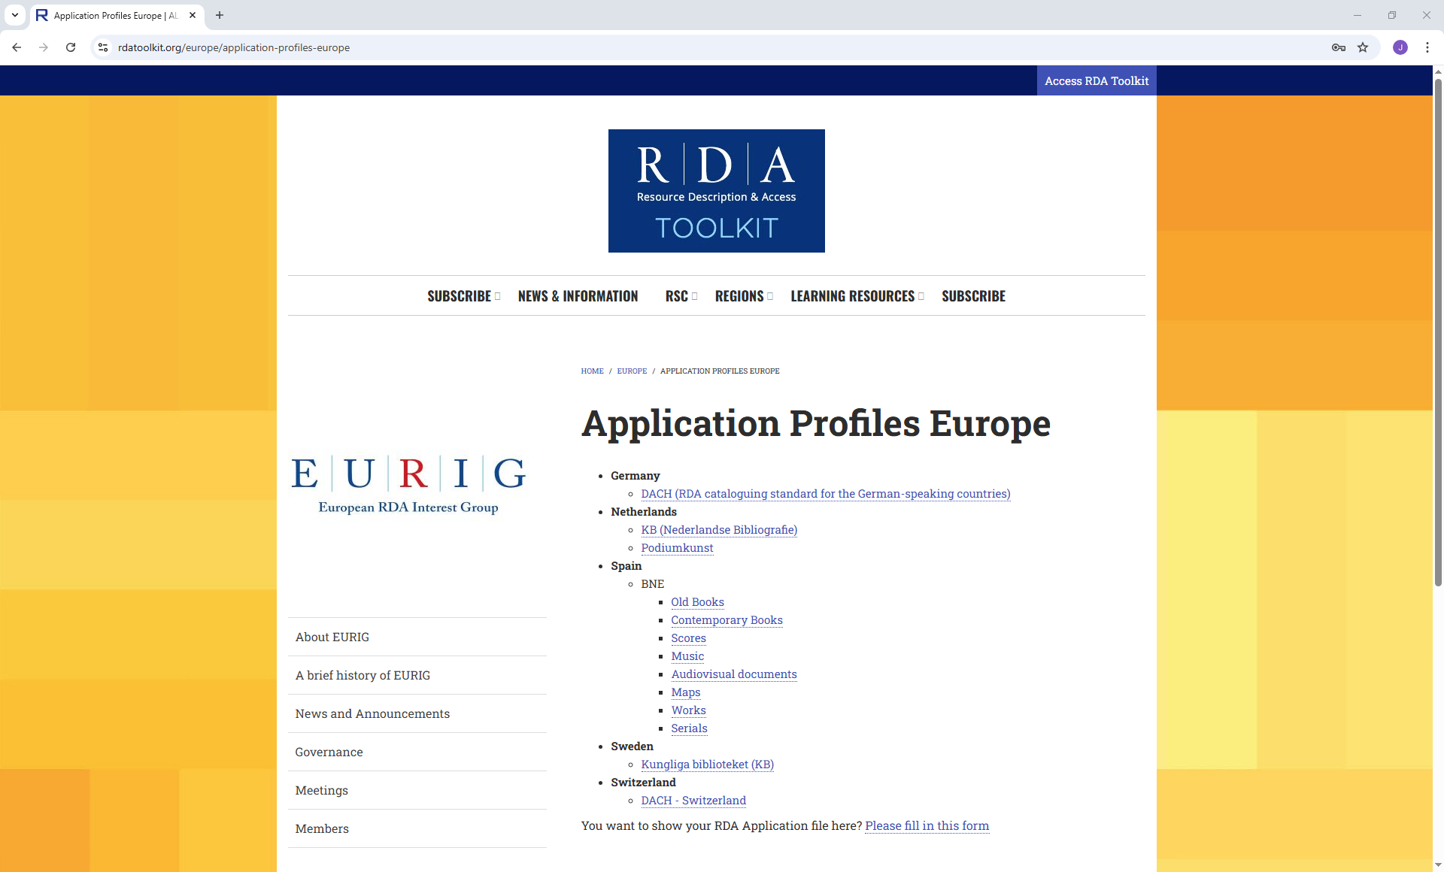
Notes:
As more of us make the move from original RDA to the official RDA, and bearing in mind there’s now an end date for original RDA being available, which is May 2027, the sharing of good practice and resources will continue to be vital. The Executive hope that sharing of Application Profiles will be beneficial, and we’ve mocked up a Webpage to show you what that could be.
Bearing in mind that external documents cannot ignore RDA copyright by unfairly copying large parts of the Toolkit, any organisation wanting to share their AP must honor the RDA permissions policy and respect the copyright, we hope that many EURIG members will see this as beneficial and share their APs.
Can I have a show of hands approving this plan?

Slide 4
Notes:
While I am using word clouds, I want to repeat that EURIG exists to promote the interests of current and potential users of RDA in Europe, and to provide a forum for discussion and co-operation, where we can communicate and benefit from each others’ experiences. If you have any ideas of ways in which EURIG could help its members more, the Executive Committee would love to hear from you

Slide 5
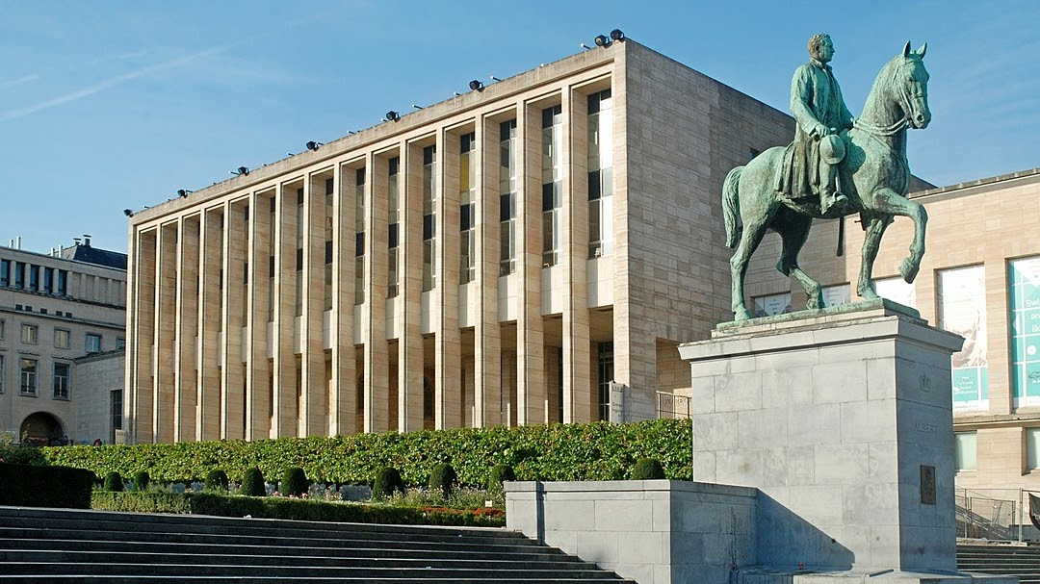
2026
Notes:
A principal task of the Executive is to make sure we have an annual meeting. I’m delighted to report that a member institution has offered to host us next year, and that is the Royal Library of Belgium, so I look forward to seeing you in Brussels next year.

Slide 6
Notes:
I’m not completely finished with my duties as Chair, but the final Chair Report at the end of my 2 year tenure seems the best place to Thank you, and especially my colleagues on the Executive committee – you’ve made my job very easy. Huge thanks also to Liv and Katerina and their team hosting us here at the National Library of Sweden, it is much appreciated.

