Slide 1
The Danish RDA-implementation Hanne Hørl Hansen

Slide 2
Implementation in a Danish context
The Ministry of Culture and the Danish municipalities agreed (finally!) on financing a Danish implementation of RDA in the Danish union catalogue in March 2023.
The RDA implementation will affect the national bibliography and all public and research libraries in Denmark, who are obliged to contribute to the union catalogue.
The project is a huge technical project including all aspects of a new environment. The main part of all coding of the repository hosting the national union catalogue will be renewed.
Also included are a new Danish data model, a Danish RDA handbook and a new Danish format (danMARC3).
It will take 3 years to have all the documentation and the technical part of the project in order.

Slide 3
Datamodel and handbook – pragmatic approach
The opportunity to change the datamodel is seen as the main benefit of RDA
Implement the concepts and parts of RDA that make sense for now in a Danish context both in the union catalogue as well as in a local context
”If it isn’t broken – don’t fix it” – we don’t change things that works just to change
New terms: Receding competence in cataloguing (Cataloguing is not a skill new staff in Danish libraries have been taugth and the staff often only do cataloguing a few couple of hours a month. Danish data from the national bibliography are reused and foreign data are imported.)

Slide 4
Entities in the Danish RDA-model
RDA entities
Work
Persons
Corporate bodies
Special Danish enitities
Subgroup of work
Group of works
Series
Not included as unique entities in the Danish model
Expression
Manifestation
(Attributes concerning expression and manifestation are included in the bibliographic record)
Other enitties rarely used – use the original toolkit if needed
Example: Families
Notes:
Denne pragmatiske tilgang til implementeringen af RDAs regler og datamodel er resulteret i følgende dansk RDA-model. Af entiteter som er hentet direkte fra RDA er værker, personer og korporationer. Derudover har vi suppleret med særlige danske entiteter, som har været nødvendige for at vi kunne passe modellen til danske forhold og brugerbehov. De særlige danske entiteter er underværker, værkgrupper og serier. Udtryk, Manifestation og eksemplar indgår ikke i den danske model som en selvstændig entitet, men lagres i den bibliografiske post. Entiteter der er helt udeladt er fx nomen, udtryk og eksemplar.

Slide 5
Work - Danish specialities
Not all publications results in a work authority record – only if we expect to see the content again in another format, a new edition etc.
Movies: Actors and performers in a movie are considered also to be creators of the work together with director etc. included in the work authority record.
Popular music: If a popular album is centered around an artist or a group - even though the artist or group are not composer or responsible for the lyrics- the artist or group are also considered creator of the work.

Slide 6
Expression versus subgroup of work – user needs
Users don’t have the same needs:
The researcher might be indifferent to language barriers
An end user in a public library might only read one language and not be able to find a meaning in a Japanese work or expression title in a presentation - even in a latin script:

Slide 7
Expression versus subgroup of work – user needs
An end user often don’t have a particular expression in mind – they just want the work in a language they can read
Same work
English versions
Polish version
Danish versions – different translators

Slide 8
Work – subgroup – a level between works and expressions
Support the needs for group presentation in a Danish context:
Mainly language and a title in the relevant language - but for example also subgroups of work for large print or easy reader-versions
Work: The Great Gatsby
Subgroups of work
English: The great Gatsby
Polish: Wielki Gatsby
Danish: Den store Gatsby
(For music – subgroup of work for notated music and subgroup of work for a recording of the same work)

Slide 9
How does it look?
WORK record 130 00 *a Meter i sekundet 200 00 4 aut *6 <id for Stine Pilgaard>….
Record for Danish work subgroup 130 00 *6 <id for the work Meter i sekundet> 131 00 *a Meter i sekundet 377 00 *a dan
Record for English work subgroup 130 00 *6 <id for værket Meter i sekundet> 131 00 *a The land of short sentences 377 00 *a eng
Bibliographic record when produced and originally stored: 231 00 *6 <id for the English subgroup of work > 245 00 *a The land of short sentences …
Merged on the fly based on id for the subgroup 230 00 *a Meter i sekundet 231 00 *a The land of short sentences *6 <id for the English subgroup of work> 245 00 *a The land of short sentences …. 700 00 *1 v *a Pilgaard *h Stine * 4 aut *6 <id for Stine Pilgaard> ….

Slide 10
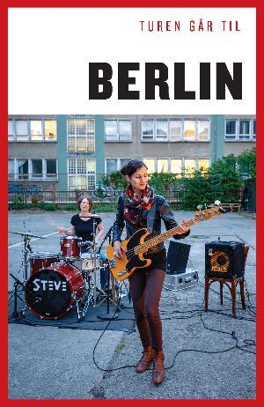
Entity: Group of works – works that are assumed to be the same work by users
Group of works
Turen går til Berlin
Work A Turen går til Berlin
Work B Turen går til Berlin
Work C Turen går til Berlin
Edition from 2004 by Kirstine Therkildsen & Henrik Vering
Edition from 2013 by
Henrik Vering
Edition from 2017 by Michelle Arrouas

Slide 11
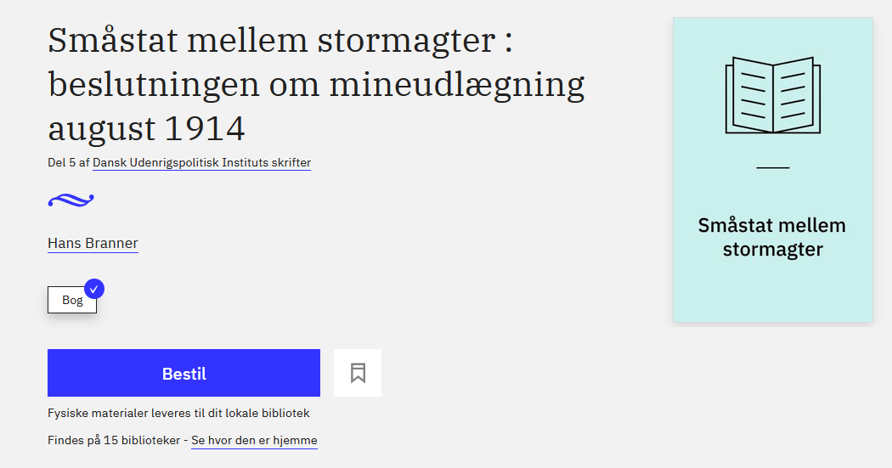
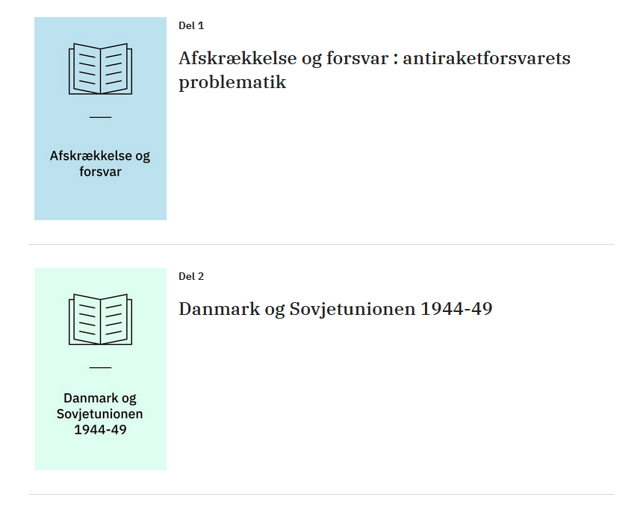
Series – another Danish entity
In RDA series are described as: manifestation series statement and only an unstructed description is possible.
Users often wants to see other parts of series.
An authoriy record is prefered rather than transcribing the material. The bibliographic record will include an id for this record along with the number. A click on the series statement enable you to see all the parts in series.

Slide 12
Aggregates are not introduced as terminology
Aggregate - Collections will be treated like other works!
Work: Margaret Atwood: Old babes in the wood (15 original short stories)
Subgroup of work – English Subgroup of work – Danish
Bibliographic record Bibliographic record
Physical book E-book

Slide 13
Structure of the handbook:
Works Rules for different types of works and who is considered creators of work Description of works – elements Relationships between works
Subgroups of works (when and how)
Group of works (when and how)
Series (when and how)
Persons (Choice, language etc., elements, relationships between persons and to other entities)
Corporate bodies (choice etc., elements and relationships)
Bibliographic records (elements from expressions and manifestations served in order of old ISBD and our format: title, edition, publication etc. : general rules and specific rules for type of materials relevant in a Danish context – relations between manifestations)
Appendixes
The intention is not to be exhaustive – use RDA Toolkit if you miss information in the handbook.

Slide 14
Thanks for your attention
… and when all this is over….

