Slide 1
RDA DACH and the
STA documentation platform
1
Michaela Edelmann

Slide 2
Table of content
2
RDA DACH and STA documentation platform
– current status
Plans for the (near) future
  Documentation for authority data
  French translation
  Instructions for subject headings

Slide 3
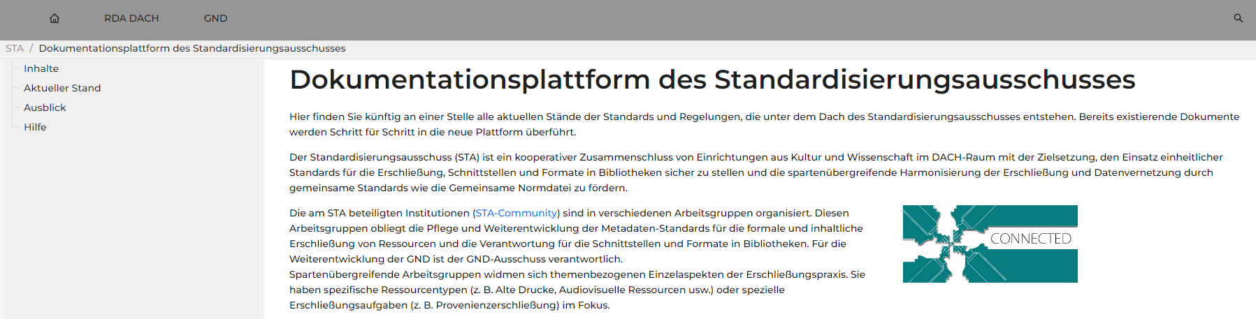
STA documentation platform
3
STA = abbreviation for Standardisierungsausschuss
(Committee for Library Standards)

Slide 4


Standardisierungsausschuss (STA)
Committee for Library Standards
4
A collaborative alliance of cultural and academic organisations and institutions in Germany, Austria and Switzerland (DACH region). Its aim is
  to ensure the use of common standards for cataloguing, interfaces and
  formats in libraries
  to promote the interdisciplinary harmonization of cataloguing and data networking

Slide 5
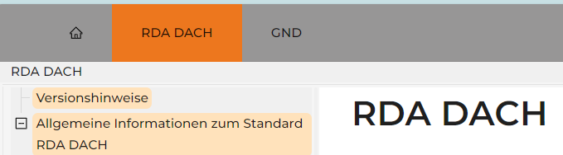
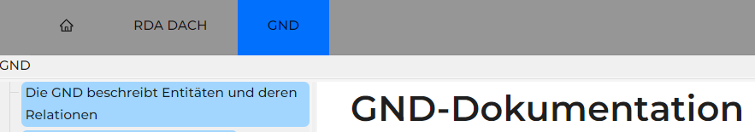
STA documentation platform
5
freely accessible: https://sta.dnb.de/doc
central access point for all standards, recommendations and agreements of the working groups of the STA (DACH region)
currently containing RDA DACH and some information about GND

Slide 6
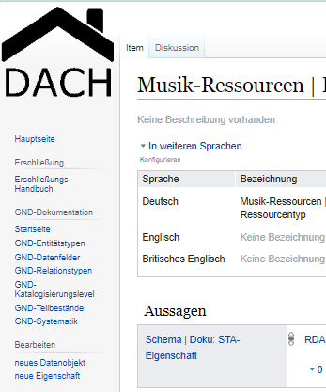
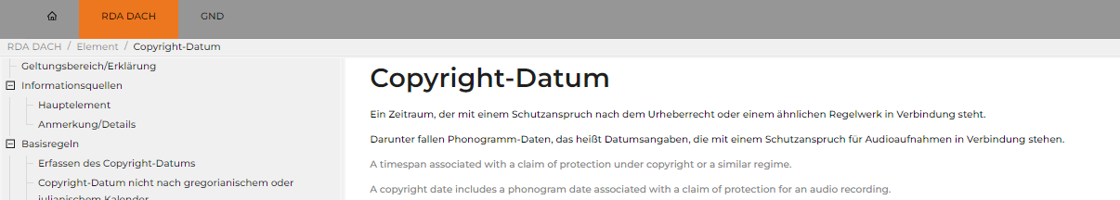
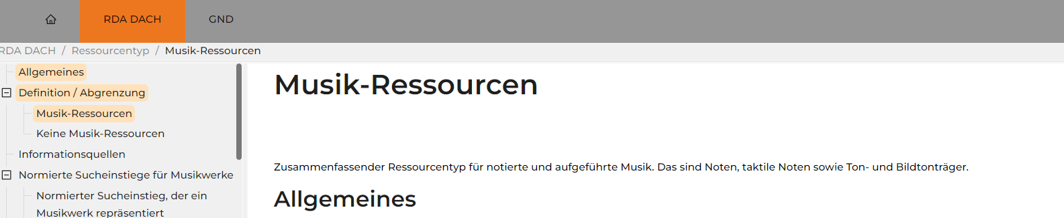
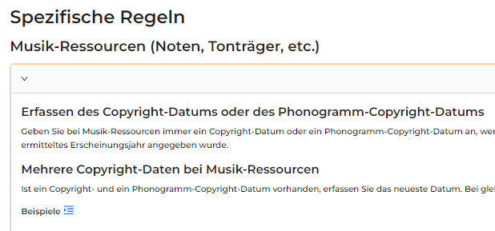
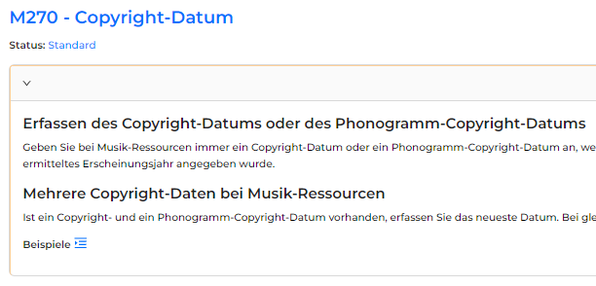
STA documentation platform
6
is based on Wikibase as database environment
enables displaying a single paragraph in multiple
places and different contexts on the platform

Slide 7
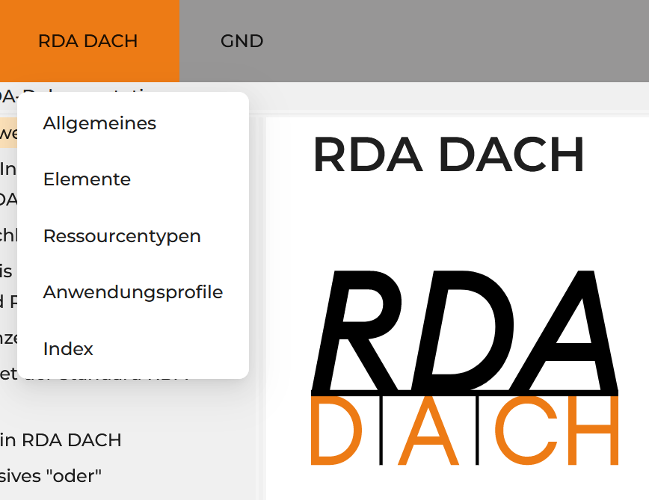
RDA DACH
7
RDA DACH is the RDA-based cataloguing
standard for the DACH region
it is the result of the STA project "3R for libraries
in the German-speaking countries"
changes for cataloguers should be as minimal
as possible, texts are based on the German translation of the original RDA, structure and terminology of the official RDA were widely adapted

Slide 8
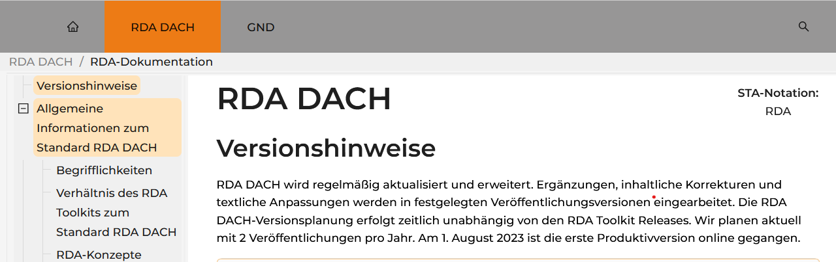
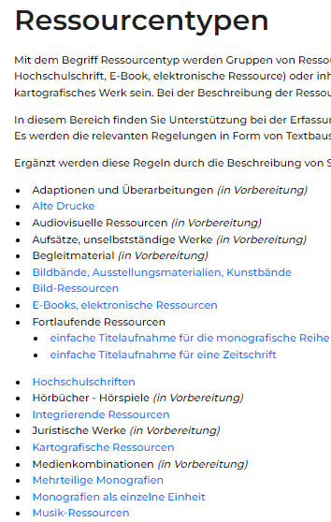
RDA DACH
8
is part of the
STA documentation platform
first version in summer 2023
two releases in 2024 (semi-annual)
more resource type descriptions, guidelines,
instructions and application profiles in further
releases (next: July 2025)

Slide 9
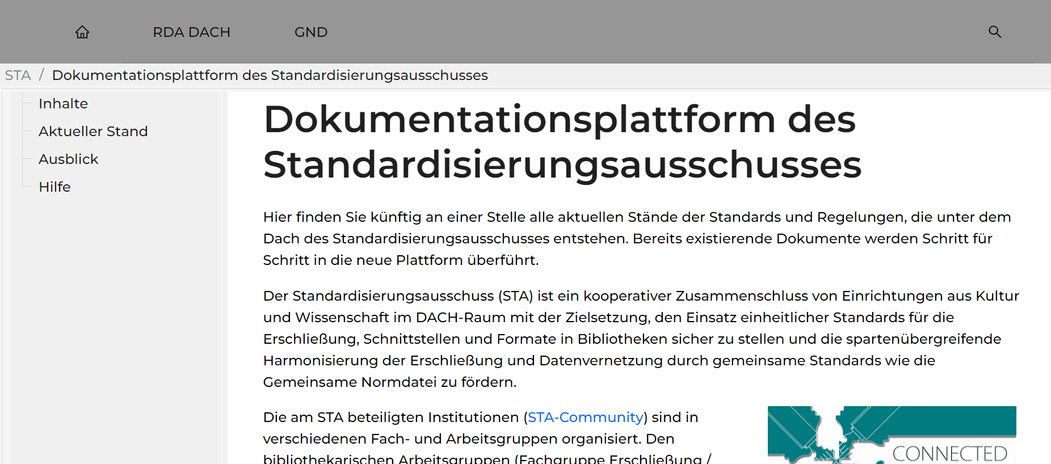
Plans for the (near) future
9
Authority data
French translation
Subject headings
Other communities

Slide 10
Documentation for authority data
10
Gemeinsame Normdatei (GND) = Integrated Authority File
  persons, families, corporate bodies, conferences, places, other subjects
  until now the instructions were documented in pdf files
  in future the instructions will be documented on the STA platform
  the documentation will include data format information for different library systems

Slide 11
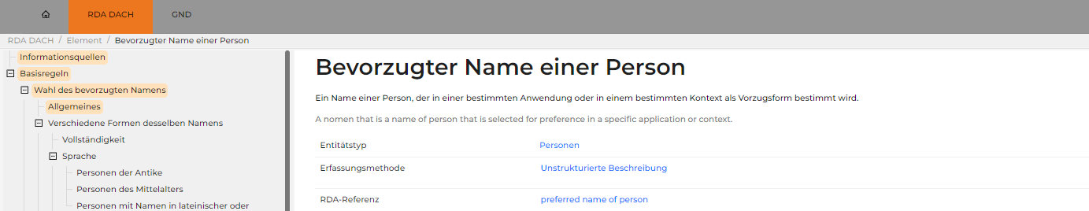
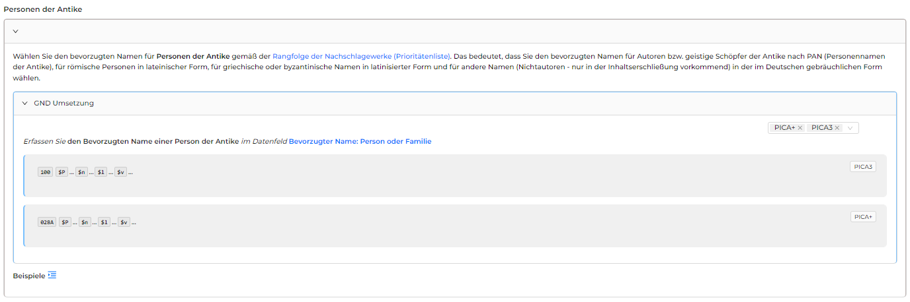
Documentation for authority data
11
information how
authority data should be
recorded will be integrated
in different
formats

Slide 12
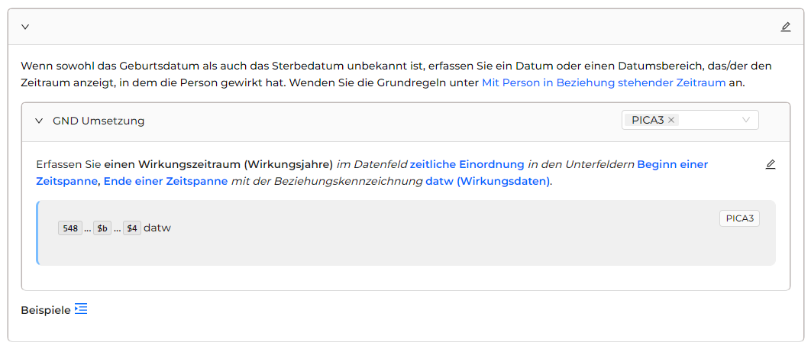
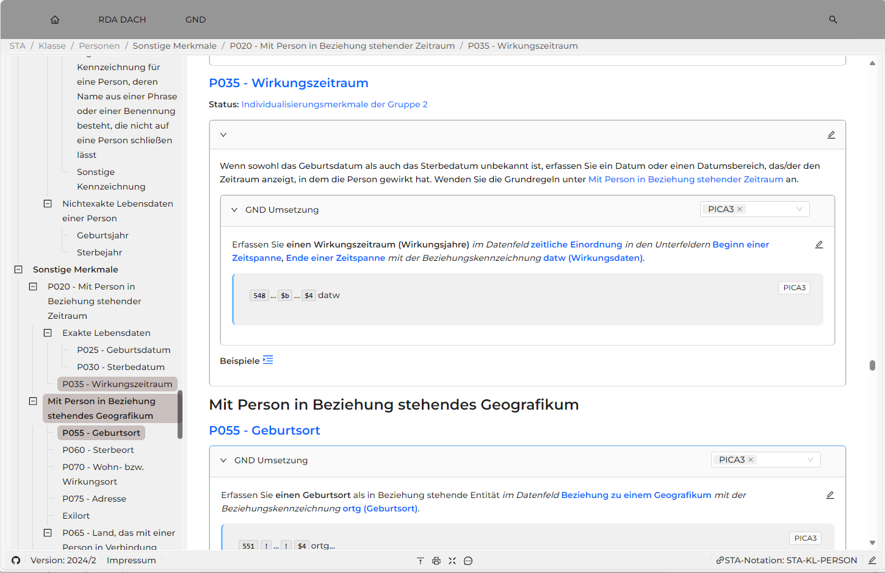
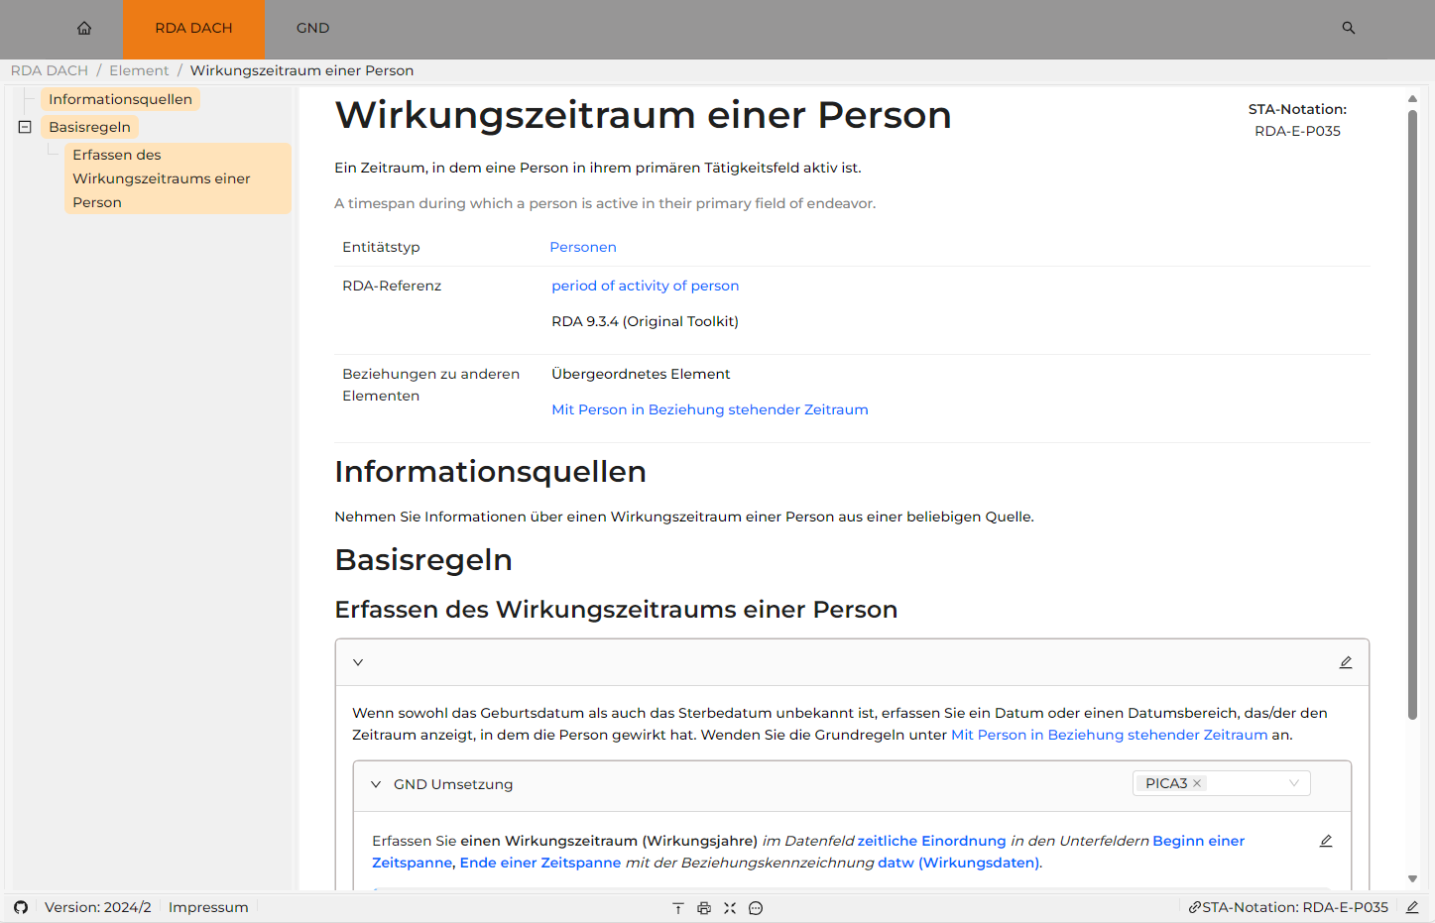
12
entity description
element description

Slide 13
Documentation for authority data
13
partial publication on the STA documentation platform in late summer 2025
more content will be added successively until December 2025
from 2026 on further additions will be made by using a release process as for RDA DACH

Slide 14
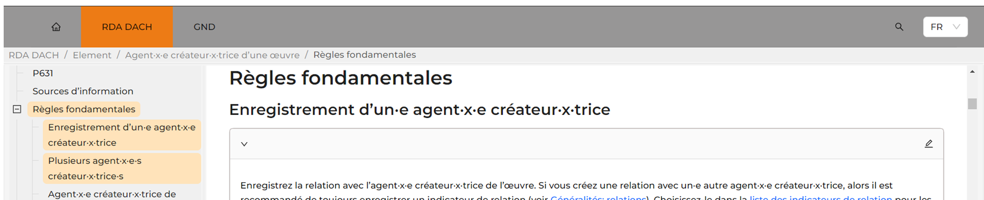
French version of RDA DACH
14
RDA DACH in a French version for Switzerland (translation under the responsibility of SLSP)

Slide 15
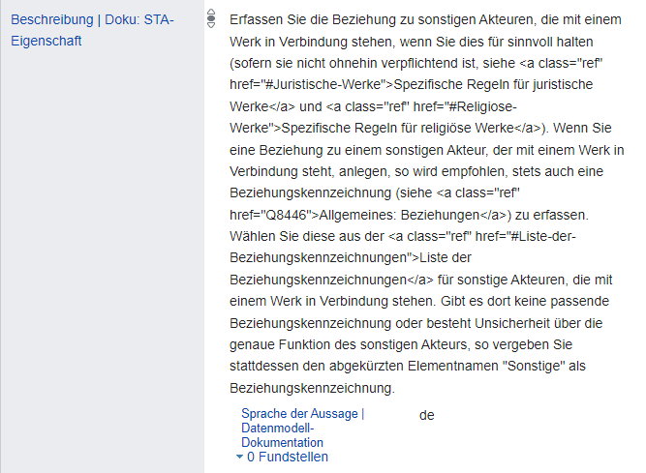
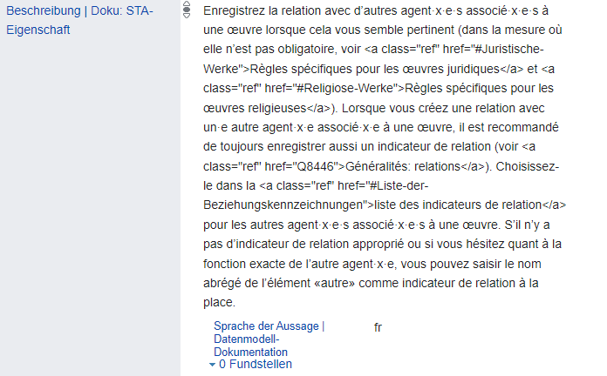
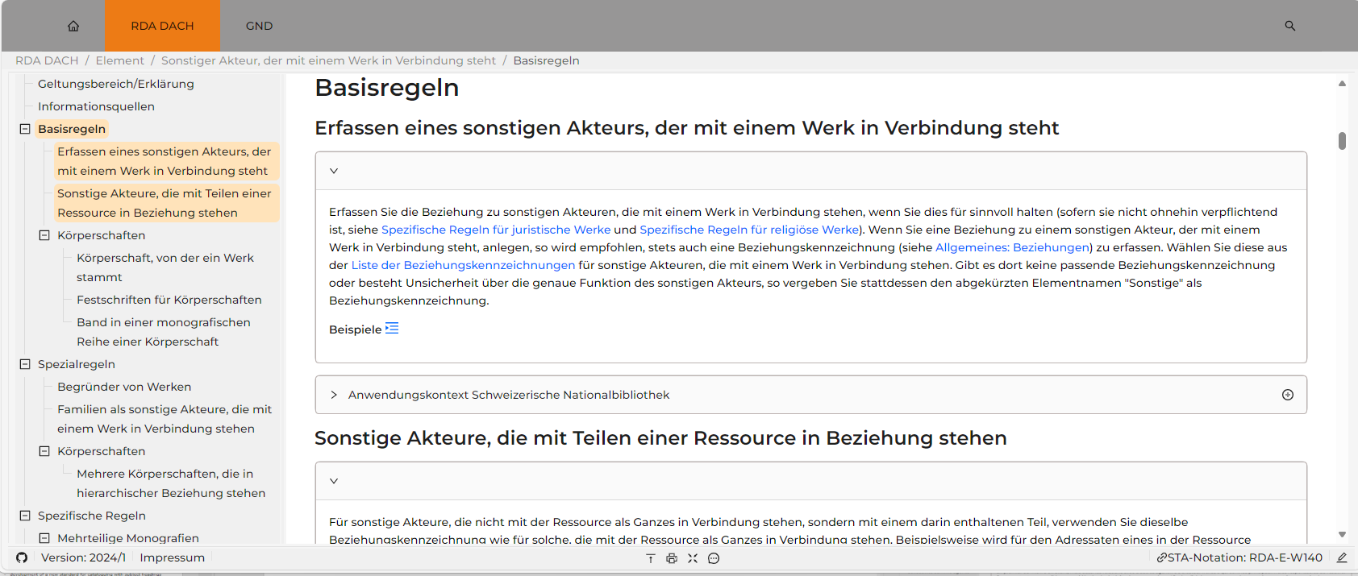
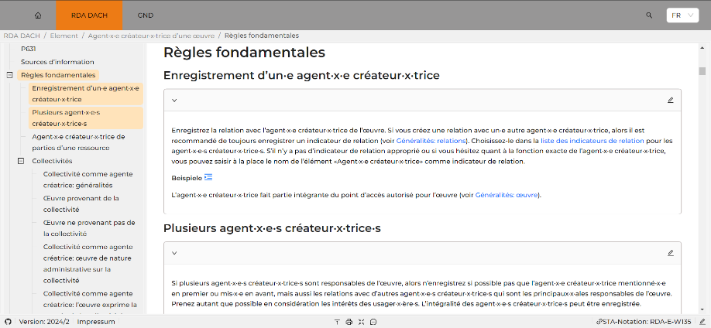
15
wikibase
platform
Language of the statement = de
Language of the statement = fr

Slide 16
Subject headings
16
STA Working Group for Subject Cataloguing:
  development of a new standard for the recording of subject headings based on RSWK
  partial publication at the end of 2025
  more additions will be made in 2026

Slide 17
What is planned for the future?
17
instructions for special interests (e.g. provenance cataloguing)
instructions for other communities (e.g. archives)
training materials for RDA DACH beginners
…

Slide 18
Thank you very much
18
Michaela Edelmann (m.edelmann@dnb.de)
or
Office for Library Standards at the German National Library (afs@dnb.de)

