Slide 1
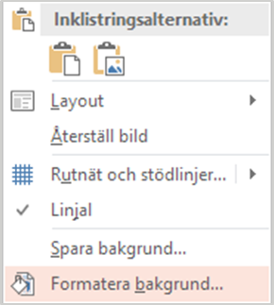
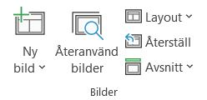
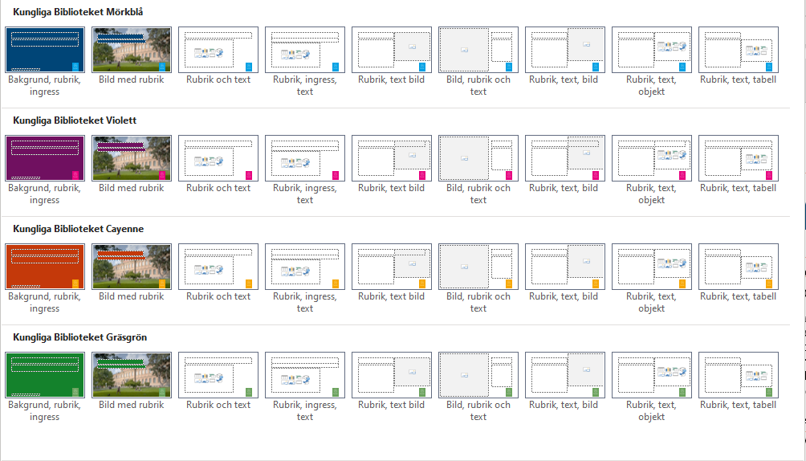
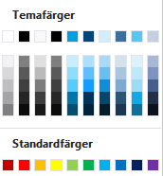
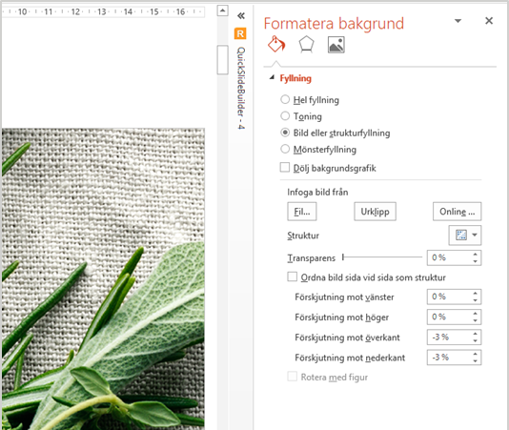
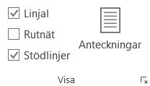
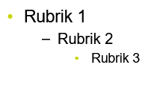
Instruktioner Dold sida, visas inte vid utskrift
Mallsidor
Layout
Temafärger
Byta bild i bildbakgrund (helsidesbild)
Stödlinjer
1. Ny bild visar samtliga layoutsidor.
Presentationen är uppbyggd på fyra färger. Behåll samma färg genom-gående i hela presentationen.
Objekt färgsätts med de inringade färgerna som följer vår grafiska profil. Använd enbart de färger som är markerade nedan.
För att få jämna marginaler på alla sidor, använd gärna stödlinjer. För att visa marginaler och stödlinjer, klicka på Visa och kryssa i rutan Stödlinjer (eller tryck Alt + F9).
Ladda ner önskad bild från bildbanken. Högerklicka på bakgrundsbilden. Välj alternativet Formatera bakgrund. Gå till alternativet Bild eller strukturfyllning och klicka på knappen Fil.
När du valt en ny bild lägger den sig i bakgrunden på din PowerPoint-sida.
Använd inte de inbyggda standardfärgerna.
Färg på presentationen
Bilder
Punktlista
För att byta färg på presentationen gå till fliken Design och välj en av de fyra första.
För att infoga en bild från KB:s bildbank, markera rutan där du vill ha bilden, gå till Infoga och välj Infoga bild Bildbank.
De olika formatnivåerna som finns i mallen.
Använd inte office teman

Slide 2
Sweden, with its rich library tradition and status as the first country to introduce a legal deposit law in 1661, has long been at the forefront of cataloging innovation. Today, the national library catalog, LIBRIS, encompasses around ten million titles and relies on collaboration among public, academic, research, and specialized libraries. The LIBRIS Collective recognized the need for a new approach to cataloging multilingual and non-Latin script materials to meet the principles of RDA, which emphasize describing resources as they appear while also supporting catalogers who may not have proficiency in all languages.
To address this, a project was initiated to develop a tool enabling automated romanization while preserving original scripts in metadata. This tool simplifies cataloging by offering language-specific schemes, such as ALA and ISO standards, and ensures that resources are described both in their original form and with a romanized version for easier handling by librarians. This dual approach balances the needs of catalogers, who require clarity and accessibility, with the principles of detailed and accurate resource description.
Initial efforts focused on automating romanization for key metadata fields like titles, authorship, and publication details. Particular challenges, such as handling Chinese word aggregation and accommodating multiple Yiddish romanization schemes, highlight the complexity of the task. Nevertheless, the tool has already improved accessibility for users and streamlined workflows for librarians, making it easier to manage Sweden’s multilingual collections.
Looking ahead, the project envisions further development of the tool to enable the generation of original scripts from existing romanized metadata. This functionality would be particularly beneficial for older collections where only romanized descriptions exist, ensuring that these materials can be enriched with their original script. Such advancements would not only support catalogers but also enhance the discoverability and representation of historical resources, furthering the accessibility and inclusivity of Sweden’s national library collections.

Slide 3
Automated Romanization in the Libris cataloguing interface
Fatima Klanco Al Mulki, Multilingual Coordinator
Olov Ylinenpää, System developer
National Library of Sweden
Notes:
Good day everyone, and thank you for being here today.
My name is Fatima Klanco Al Mulki and I’m the Multilingual coordinator of the National Library of Sweden.
Together with my colleague Olov Ylinenpää, who is a software developer, we are excited to share with you our project on automated romanization and the possibility of including original scripts in our cataloguing process.
I'll be guiding you through the background and context of the project, while Olov will demonstrate the more technical aspects of our work.
But before we dive in, I'd like to start by telling you a little bit about our history.
.

Slide 4
The National Library of Sweden
Swedish legal deposit law, 1661
Collecting and describing resources
Libris
Libris collective
Fatima Klanco Al Mulki
Notes:
As the National Library of Sweden, we are proud to say that Sweden was the first country in the world to introduce a legal deposit law. KLICK
Even though other nations tried to control what was printed and published, Sweden was the first to make it law.
In 1661, the Chancellery Ordinance introduced the legal deposit system in Sweden.
At the time, our king – Karl the Eleventh – was only five years old. So the country was governed by a regency council, acting in his name.
It was this council that issued the ordinance – making Sweden the first countrie to implement such a law.
The purpose of the law wasn’t about preserving books for their own sake. It wasn’t bibliophilic in nature.
Instead, it was a way for the authorities to monitor and control what was being printed throughout the kingdom.
By requiring publishers to submit copies of everything they printed, the government could gain insight into public opinion – and keep a closer eye on the spread of ideas.
This made Sweden not just an early adopter, but the first country in the world to legislate legal deposit – a system that still exists today, though with a very different purpose.
Thanks to this law, we now have a unique and extensive library collection – one that stretches far back in time.
It tells the story of Sweden through centuries of printed words – what was said, what was thought, and what mattered to people at different moments in history.
KLICK
Today in Sweden, books are published in over 100 different languages, in addition to Swedish and English.
This reflects the diversity of the society we live in – and the richness of voices that contribute to our national narrative.
As the national library, our task is not only to collect everything published in the country – but also to describe it.
We make it possible for future generations to access, understand, and explore the cultural and intellectual life of Sweden – as it was, as it is, and as it evolves.
KLICK
And we do this in our union catalogue called Libris.
Libris contains more than 15 million titles, ranging from books and magazines to films and audio recordings
Libris started in the 1970s and is now a shared catalogue built on collaboration among various types of libraries:
Public, university, research and specialized libraries –
which together contribute to as complete a catalog as possible.
KLICK
We refer to ourselves as the "Libris collective".
.

Slide 5
Project background
MARC21 and the transition to BIBFRAME
Inconsistency & unpredictability in romanization practices
Fatima Klanco Al Mulki
Notes:
We’ve been working on developing our own cataloguing tool,
KLICK
based on BIBFRAME and linked data, with the vision of eventually leaving MARC21 behind us.
We were pioneers.
But in 2018, when we decided to fully transition to the new system, we faced a challenge: handling metadata in multiple scripts was not yet implemented.
Data from the old 880 fields in MARC21 – which contain original script text in catalog records – could be imported and exported, but not edited in the new system.
That meant: KLICK
any errors in original script data could not be corrected – which risked the loss of vital metadata.
It became clear: the format needed to evolve to better meet the needs of both users and cataloguers.
In the initial phase, we found a temporary workaround: we entered the main title in its original script as a Variant Title, while the romanized title was placed in the Main Title field.
We performed the romanization manually, using several schemas – a surprisingly analog process, in today's highly digital world.
But in order to truly follow the core principles of RDA, which state that we should “record elements in the language and script in which they appear on the sources from which they are taken,”
— it is essential that we, within the Libris Collective, include the original script in bibliographic data.
Because any romanization changes the original language. It introduces interpretation, and it can lead to inconsistent records.
Inconsistency in romanization can result in unpredictable metadata –
and that directly affects data retrieval and the searchability of resources.
Searchability is significantly improved when users can search for information as it appears on the source – in its original script –
and when romanization is consistent and automated.
That’s not just a technical requirement –
it’s a matter of access, accuracy, and respect for linguistic integrity.

Slide 6
Vision
Romanization of non-Latin scripts while
allowing metadata exchange
Improving searchability
Target groups
1. Cataloguers & librarians
2. Our users
Fatima Klanco Al Mulki
Notes:
Our vision was clear: to create a powerful tool for our cataloguers.
A tool that would make romanization of non-Latin scripts possible, while still supporting easy metadata exchange with other libraries.
The ultimate goal was to improve both searchability and data availability through automated romanization
and the inclusion of the original script.
We also wanted to give our users the ability to search in the original script – so they could find publications more easily,
in the language and script they know best.
To turn that vision into reality, I formed a dedicated working group.
It included cataloguers from different types of libraries, metadata specialists, and developers.
By bringing together our diverse skills and perspectives, we were able to lay the foundation for the project –
a project driven by collaboration, expertise,
and a shared commitment to access and precision.
KLICK
As the project took shape, we identified two main target groups.
First – cataloguers and librarians who needed a simplified, reliable way to romanize non-Latin scripts
without compromising data quality or workflow.
Second – our users. Readers, researchers, and students who wanted to search in the original script
to more easily find the materials they were looking for.
These two groups had different needs – but they shared the same goal:
better access to information, and a more inclusive, accurate cataloguing system.

Slide 7
First Phase
Manifestation/Instance
Romanization schemes
Fatima Klanco Al Mulki
Notes:
We began our work process by focusing on a key question: How should the Manifestation /Instance – be presented in our records?
And Romanisation schems

Slide 8
Manifestation/Instance
- Title
- Authorship
- Edition
- Publication
- Series information
Fatima Klanco Al Mulki
Notes:
In the initial phase of the project, we identified key fields where automated romanization would have the most impact, based on RDA guide lines.
These included:
– the title, – authorship, – edition, – publication, and – series information.
By targeting these core areas, we focused on the parts of the bibliographic record that are most visible to users – and essential for searchability, discovery, and accurate referencing.

Slide 9
First Phase
Romanization schemes
Fatima Klanco Al Mulki
Notes:
Within the collective we use,
different Romanization schemes, for exempel.
For Slavic languages, there were two main approaches: public libraries often preferred transcription,
while research and university libraries leaned toward transliteration according to the ISO standard – that’s the International Organization for Standardization.
For Modern and Ancient Greek, two different Romanization systems were also applied
And for most other languages, we followed the ALA romanization tables,
We ere aware that different Romanization needs might appear in the future,
so we included flexibility in the tool.
That way,
the system could adapt – not only to existing practices, but also to the evolving needs of our cataloguers and users.

Slide 10
1
Fatima Klanco Al Mulki
Notes:
I won't get into the technical details of the tool; Olov, who has worked on and developed it, will explain it better.
But to exemplify how it works we can look at the title:
1) The cataloguer enters the title in the original script into the tool.

Slide 11
2
Fatima Klanco Al Mulki
Notes:
Then, manually tag the text string with the language.

Slide 12
3
Fatima Klanco Al Mulki
Notes:
Clicking the romanization button initiates the process.

Slide 13
4
Fatima Klanco Al Mulki
Notes:
The result is a title that has been romanized according to the scheme KLICK that aligns with our practice.

Slide 14
Development challenges
Fatima Klanco Al Mulki
Notes:
As it stands today, we’ve had the least trouble with the automation of Slavic languages.
The tool handles Cyrillic to Latin conversion smoothly – it’s efficient and accurate.
But we do face challenges with certain other languages that require specialized linguistic expertise – even though romanization is automated.
One clear example is Chinese – as you can see here KLICK on the screen.
The automated romanization tool breaks apart Chinese words into syllables,

Slide 15
Fatima Klanco Al Mulki
Notes:
Therefore, a language expert is needed to aggregate KLICK syllables
Into words and to place capitalization correctly.
So while automation takes us far, human language expertise is still essential to ensure that the data remains both usable and faithful to the source.

Slide 16
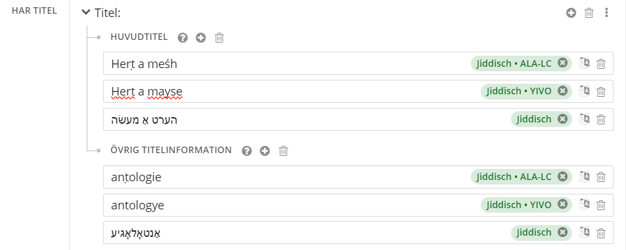
Fatima Klanco Al Mulki
Notes:
For some languages, such as Yiddish, KLICK
we have two romanization tables that we use.
In this case, when you click the button to romanize the text,
it appears in both variants.
KLICK
The result will display on two rows of romanized text.
One row follows the American Library Association ALA romanization table,
and the other row follows the Yidisher Visnshaftlekher Institut YIVO romanization table.
Why?
Yiddish holds a special status in Sweden as it is classified as a minority language.
The Jewish community has expressed its desire to use the YIVO romanization table to describe resources in Yiddish.
Since we typically follow the ALA romanization table for Yiddish,
we have reached a compromise by allowing both romanizations to appear in the post,
but the preferred title will be displayed romanized according to the ALA table.
We're facing some challenges in getting this right for Yiddish.
It requires language expertise and manual adjustments.

Slide 17
Today
The transliteration/romanization tool is integrated in the Libris cataloguing interface
Further developing and improvmensts
Notes:
The transliteration and romanization tool is integrated into the Libris cataloguing interface.
And it has already made a significant difference – both for our cataloguers and for our users.
Through this project, we have truly elevated the cataloguing of materials written in non-Latin alphabets to a new level.
And we’re not done yet. KLICK We continue to develop and improve the tool – to ensure that our bibliographic data becomes even more inclusive, accurate, and searchable for everyone.

Slide 18
Project's Future
Wishlist of languages
Wishlist to be developed
Arabic
Bengali
Hebrew
Japanese
Pashto
Persian
Urdu
Generate original script from the romanized records
Fatima Klanco Al Mulki
Notes:
We’re truly enthusiastic about the next steps in this journey. Our aim is to expand the tool to support more languages,
KLICK
as well as Works and Expressions.
1, KLICK - urdu
The goal is to make the handling of material in non-Latin scripts even easier – to reduce the need for manual adjustments, and to support more fonts for fully automated romanization.
But moving forward, our ambition is to go even further:
KLICK
to equip the tool to generate original script from older, romanized records.
KLICK
This would be especially valuable for legacy collections that currently only include romanized descriptions – allowing them to finally include their original script as well.
These improvements wouldn’t just support cataloguers – they would make historical resources easier to find, use, and trust.
And ultimately, they would increase the accessibility and inclusivity of Sweden’s national library collections.

Slide 19
Thank You
☺
fatima.klanco.almulki@kb.se
olov.ylinenpaa@kb.se
Notes:
Thank you KLICK very much for your time!
I now hand over to Olov, who will demonstrate how the tool actually works and share more about the technical challenges.

