Slide 1
Review of RDA Concepts
Notes:
Good morning, my name is Trina Soderquist, and I am a Cataloging Policy Specialist in the Policy, Training, and Cooperative Programs division at the Library of Congress. Today I am here in my capacity as one of the Library’s two representatives on the North American RDA Committee. My colleague and co-presenter for this session is Melanie Polutta.

Slide 2
Understand how IFLA’s Library Reference Model provides a foundation for the official RDA Toolkit
Identify and define entities, elements, and relationships
Learn about aggregates
Identify and describe the components of a metadata description set
Notes:
During this session, we will cover the following learning objectives. Participants will learn how IFLA’s Library Reference Model provides the intellectual underpinning to the official RDA Toolkit. You will understand how entities, elements, and relationships are some of the fundamental building blocks of RDA. You will be introduced to aggregates, and finally, you will be able to identify and describe the components of a metadata description set. All of this will enable you to begin to create a bibliographic record using the official RDA Toolkit.

Slide 3
IFLA Library Reference Model
Notes:
I’d like to begin by talking briefly about the Library Reference Model (or LRM) developed by the International Federation of Library Associations and Institutions (better known as IFLA).

Slide 4
IFLA LRM (2017)
Consolidation of three IFLA bibliographic conceptual models
  FRBR Functional Requirements for Bibliographic Records (1998)
  FRAD Functional Requirements for Authority Data (2009)
  FRSAD Functional Requirements for Subject Authority Data (2010)
Work/Expression/Manifestation/Item
Notes:
The LRM was first published in 2017 and is intended to consolidate and repair discrepancies among the three earlier IFLA bibliographic conceptual models: the Functional Requirements for Bibliographic Records, Authority Data, and Subject Authority Data.
FRBR really emphasized the Work/Expression/Manifestation/Item (or WEMI) structure, which was carried through into original RDA. WEMI continues to provide the backbone to LRM and official RDA.
So, if you didn’t quite understand the WEMI structure the first time around, now’s your chance.

Slide 5
From LRM to RDA
Hierarchical structure
  Superclass and subclass (or supertypes and subtypes and superelements and subelements in official RDA)
  Disjointedness
Three elements of entity-relationship models
  Entities
  Attributes (or elements in official RDA)
  Relationships
Aggregates and Nomens
Notes:
For the purposes of this session, here are some of the significant concepts from LRM that were adopted in official RDA. The first is the hierarchical structure, helping you stay oriented in the official RDA Toolkit and providing patterns for applying the different description options.
Along with the hierarchical structure comes the concepts of super- and subclasses and disjointedness, which I will cover shortly.
Next we have key elements of entity-relationship models like LRM: entities, attributes (or elements in official RDA), and relationships. Finally, I included two of the most confusing concepts to come out of LRM: aggregates and nomen.

Slide 6
Elements, Entities, and Relationships
Notes:
Let’s begin by looking at definitions of entities, attributes, elements, and relationships in the glossaries of the LRM and official RDA.

Slide 7
Definitions
 | LRM | RDA
Entity | Entities are the key objects of interest to users of library catalogs. | An abstract class of physical or conceptual thing in the universe of human discourse.
Attribute (LRM) Element (RDA) | Attributes characterize specific instances of an entity. | A specific aspect, characteristic, attribute, or relationship used to describe an RDA entity.
Relationship | Relationships connect instances of entities and provide context for them. | A specific association between two entities.
Notes:
You might find the LRM definition more accessible because the LRM was specifically written for libraries. RDA, on the other hand, is intended to be used by libraries and other cultural heritage institutions, and therefore its definitions are more abstract.
Entities are the bibliographic things we are interested in. Relationships connect entities to each other, providing context for those entities. And attributes or elements are used to describe entities.

Slide 8
Entities

Slide 9
RDA Entities
RDA entity
  Work
  Expression
  Manifestation
  Item
  Agent
    Person
    Collective agent
      Corporate body
      Family
  Nomen
  Place
  Timespan
Notes:
There are thirteen RDA entities, here shown at different hierarchical levels. RDA entity is at the top level of the hierarchy, and it has eight entity subtypes. These eight include the four resource entities that may be familiar from FRBR and original RDA: Work, Expression, Manifestation, and Item; and the other entities Agent, Nomen, Place, and Timespan.
Agent has two entity subtypes: Person and Collective agent. In turn, Collective agent has two entity subtypes: Corporate body and Family.

Slide 10
RDA Entities
RDA entity
  Work
  Expression
  Manifestation
  Item
  Agent
    Person
    Collective agent
      Corporate body
      Family
  Nomen
  Place
  Timespan
Entity boundary
  A set of criteria that is applied by an agent who creates metadata to determine if a new entity is being described. (RDA Glossary)
Disjointedness
  The entities at each level of hierarchy are disjoint. This means that any thing can be described as an instance of only one type of entity at that level, to ensure consistency and coherency. (Guidance > Introduction to RDA > Data elements)
Notes:
At each level of hierarchy, the entities are disjoint. Corporate body and Family are disjoint. In other words, some thing cannot be both a corporate body and a family. However, a thing can be a family, a collective agent, an agent, and an RDA entity at the same time because all these entities are in the same hierarchy.
How do we know that Corporate bodies and Families, or even Expressions and Manifestations, are disjoint? Because of entity boundaries.

Slide 11
Recognizing Entity Boundaries
Work
  Significant difference in subject
  Significant difference in related agent
Expression
  Significant difference in one or more of the following: aspect ratio, content type, duration, extent, scale, script, etc.
Manifestation
  Significant difference in carrier
Item
  Significant difference in modification of item
Notes:
Entity boundaries are sets of criteria applied by catalogers (or agents) that determine when a new entity is being described. These criteria can be outlined in an application profile developed by the PCC or by your library consortium. Or you can rely on or adapt existing criteria like OCLC’s “When to Input a New Record.”

Slide 12
The RDA Entity Match Game
Agent
Place
Timespan
Nomen
A finite period of time.
A given extent of space.
A label for any RDA entity except a nomen. It includes a name, title, access point, or identifier.
An entity who is capable of deliberate actions, of being granted rights, and of being held accountable for its actions.
Notes:
Let’s continue our look at entities with a little match game.

Slide 13
The RDA Entity Match Game
Agent
Place
Timespan
Nomen
A finite period of time.
A given extent of space.
A label for any RDA entity except a nomen. It includes a name, title, access point, or identifier.
An entity who is capable of deliberate actions, of being granted rights, and of being held accountable for its actions.
Notes:
Which definition describes an agent? You can verbalize your answer or even just hold up the appropriate number of fingers.

Slide 14
The RDA Entity Match Game
Agent
Place
Timespan
Nomen
A finite period of time.
A given extent of space.
A label for any RDA entity except a nomen. It includes a name, title, access point, or identifier.
An entity who is capable of deliberate actions, of being granted rights, and of being held accountable for its actions.
Notes:
Yes, an agent is #4, an entity who is capable of deliberate actions, of being granted rights, and of being held accountable for its actions. Agents include Persons and Collective agents like Corporate bodies and Families.
What is missing from this definition? Hint: it has to do with Fiona the hippo, Kermit the Frog, and Geronimo Stilton.
RDA does not consider any of those fictitious characters or real, non-human entities to be agents.

Slide 15
The RDA Entity Match Game
Agent
Place
Timespan
Nomen
A finite period of time.
A given extent of space.
A label for any RDA entity except a nomen. It includes a name, title, access point, or identifier.
An entity who is capable of deliberate actions, of being granted rights, and of being held accountable for its actions.
MGD:
Fictitious and Non-Human Entities
Notes:
Thankfully, the Program for Cooperative Cataloging (PCC) has a solution. There’s a metadata guidance document covering situations where fictitious characters and real, non-human entities act as agents like authors.

Slide 16
The RDA Entity Match Game
Agent
Place
Timespan
Nomen
A finite period of time.
A given extent of space.
A label for any RDA entity except a nomen. It includes a name, title, access point, or identifier.
An entity who is capable of deliberate actions, of being granted rights, and of being held accountable for its actions.
Notes:
Which definition describes a place?

Slide 17
The RDA Entity Match Game
Agent
Place
Timespan
Nomen
A finite period of time.
A given extent of space.
A label for any RDA entity except a nomen. It includes a name, title, access point, or identifier.
An entity who is capable of deliberate actions, of being granted rights, and of being held accountable for its actions.
Notes:
Yes, a place is #2, a given extent of space.

Slide 18
The RDA Entity Match Game
Agent
Place
Timespan
Nomen
A finite period of time.
A given extent of space.
A label for any RDA entity except a nomen. It includes a name, title, access point, or identifier.
An entity who is capable of deliberate actions, of being granted rights, and of being held accountable for its actions.
Notes:
Which RDA glossary definition describes a timespan?

Slide 19
The RDA Entity Match Game
Agent
Place
Timespan
Nomen
A finite period of time.
A given extent of space.
A label for any RDA entity except a nomen. It includes a name, title, access point, or identifier.
An entity who is capable of deliberate actions, of being granted rights, and of being held accountable for its actions.
Notes:
A timespan is #1, a finite period of time.

Slide 20
The RDA Entity Match Game
Agent
Place
Timespan
Nomen
A finite period of time.
A given extent of space.
A label for any RDA entity except a nomen. It includes a name, title, access point, or identifier.
An entity who is capable of deliberate actions, of being granted rights, and of being held accountable for its actions.
Notes:
And finally, what is a nomen?

Slide 21
The RDA Entity Match Game
Agent
Place
Timespan
Nomen
A finite period of time.
A given extent of space.
A label for any RDA entity except a nomen. It includes a name, title, access point, or identifier.
An entity who is capable of deliberate actions, of being granted rights, and of being held accountable for its actions.
Notes:
Number 3. Unfortunately, we don’t have the time or bandwidth to go through the nuances of this definition. Instead, I suggest we follow the advice that Melanie recently gave me, and “think of nomen as a label.” Specifically, I like to think of it like one of those sticky labels that you use to identify yourself. I’m a person called Trina. This is a place called Philadelphia. This expression is called War and Peace.
But all kidding aside, I find it more helpful to focus on how nomens function in RDA, and nomen, like timespan and place, got promoted and became RDA entities in the official Toolkit, which in turn transformed several attribute elements into relationship elements.

Slide 22
Elements and Relationships

Slide 23
Elements
Relationship Elements | Attribute Elements
An element that relates two RDA entities. Use for: relationship designator. | An element that is an inherent or external imputed characteristic of an RDA entity.
2,738 relationship elements in the RDA Toolkit | 286 attribute elements in the RDA Toolkit
Relationship elements have a domain and a range | Attribute elements have a domain but not a range
Notes:
There are over 3,000 elements in official RDA. That means there are over 3,000 ways to bring out different aspects, characteristics, attributes, and relationships to describe an RDA entity. It isn’t necessary to use all these elements to adequately describe a resource. Which elements you use will be determined by your cataloging community of practice and its application profile.
To better understand the difference between relationship and attribute elements, we will need to talk about domain and range.

Slide 24
Definitions
 | LRM | RDA
Domain | The source entity, or departure point, for a relationship. | The RDA entity that is described by an element.
Range | The target entity, or arrival point, for a relationship. | The RDA entity that is the value of a relationship element.
Domain
Range
Relationship
Notes:
When you are describing a relationship, the domain is your starting point. It’s the RDA entity you are trying to contextualize and describe. The range is your end point. If you prefer to think in linked data triples, the domain is the subject, the range is the object, and the relationship is the predicate.

Slide 25
Relationship Elements
Domain | Relationship Element | Range
Work | preferred title of work | Nomen
Manifestation | contributor person of still image | Person
Manifestation | place of publication | Place
Person | date of birth | Timespan
Notes:
Here is an example of how relationship elements create links between RDA entities. If our manifestation is illustrated, we can connect our manifestation to its illustrator with the element contributor person of still image.
You can also see that because they are RDA entities, Nomen, Place, and Timespan can be the range in a relationship. It might seem like a silly distinction to make because you’re still recording the same information you would if Nomen, Place, and Timespan were just attributes. But for data use in the future, it’s more powerful to structure a bibliographic description in terms of relationships.

Slide 26
Evolving Relationships
MARC Code List for Relators | id.loc.gov/vocabulary/relators | author [aut] illustrator [ill]
Relationship Designators | Original RDA Appendices I-M | author illustrator
Relationship Elements | Official RDA Toolkit | author person contributor person of still image
Relationship Labels | MGD | author illustrator
Notes:
There are many ways to express these relationships while cataloging. Second indicator 2 in MARC field 700 defines the name-title entry as an analytical entry. That relationship can be made human-readable by including relationship information in subfield $i.
Historically, catalogers have used the MARC Code List for Relators in subfields $e and $4 of 1XX and 7XX fields to label the relationship between the entity and the manifestation. Under original RDA, we used relationship designators from the appendices. In official RDA, we are recording relationship elements like author person and contributor person of still image. Instead of using the names of these elements as our relationship designators, the PCC has a list—documented in the MGDs--of much friendlier relationship labels that can be used.

Slide 27
Attribute Elements
Domain | Attribute Element | Value
Manifestation | carrier type | RDA Carrier Type Vocabulary Encoding Scheme
Expression | language of expression | MARC Code List for Languages ISO 639-3 Code Tables
Manifestation | statement of responsibility | Transcription
Notes:
Like relationship elements, attribute elements also have domains, but because attribute elements do not establish relationships between RDA entities, they do not have ranges. Attribute elements identify characteristics of entities. To do this, we sometimes record values that are transcribed—like statements of responsibility—and sometimes we record values that come from vocabulary encoding schemes like the RDA carrier types, the MARC Code List for Languages, and the ISO 639-3 Code Tables.

Slide 28
Aggregates

Slide 29
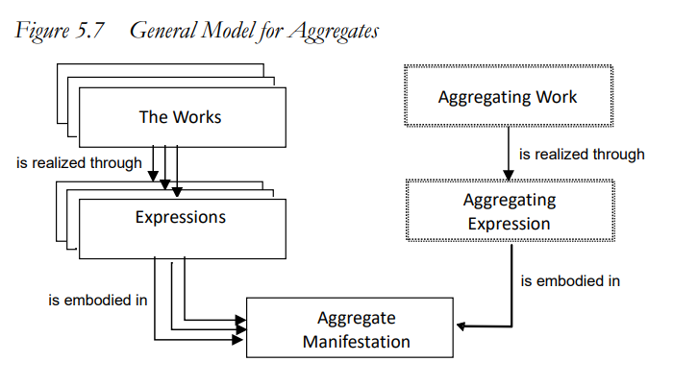
Aggregates in the LRM
Aggregated
works
The content
Aggregated
expressions
The plan
Notes:
For our discussion of aggregates, I’d like to start at the bottom of this diagram, which is actually figure 5.7 from the LRM, with annotations by Charlotte Christensen from the National Library of New Zealand.
An aggregate is a manifestation that embodies multiple expressions. First, it embodies one or more aggregated expressions that represent the content of the aggregate. Second, it embodies a single aggregating expression that represents the plan for the aggregate.
Continuing to work up our diagram, on the left, representing the content of the aggregate, the aggregated expressions are the realization of one or more aggregated works. On the right, representing the plan of the aggregate, the aggregating expression is the realization of a single aggregating work.

Slide 30
Types of Aggregates
Collection aggregate | An aggregate that embodies expressions of two or more independent works. | A collection of short stories
Augmentation aggregate | An aggregate that embodies expressions of two or more works, where expressions of one or more works are supplemented by expressions of one or more other works. | An authoritative edition of a novel with critical essays A DVD of a motion picture with bonus features A treatise with bibliographical references and index An illustrated book for children
Parallel aggregate | An aggregate that embodies expressions of a single work. | A bilingual government document
Notes:
There are three different types of aggregate manifestations. A collection aggregate is a manifestation that embodies expressions of two or more independent works. Examples include compilations of short stories.
An augmentation aggregate is a manifestation that embodies two or more expressions of two or more works, where one is supplemented by one or more other works. In this case, you have a “main” manifestation and other manifestations that supplement it, perhaps with illustrations, a foreword, bibliographical references, or bonus features.
A parallel aggregate is a manifestation that embodies two or more expressions of a single work. Examples include bilingual government documents.
As with many things in official RDA, aggregates seem intimidating at first, until you realize that our practice isn’t changing significantly. We will still use 7XX analytical entries, contents notes, and other MARC fields to indicate that a resource has significant component parts. It’s just that the intellectual modeling that underpins our cataloging is more sophisticated.

Slide 31
Metadata about Metadata

Slide 32
Outline
Metadata work
  Metadata statement
  Metadata description set
Recording methods
Value
Vocabulary encoding scheme (VES)
String encoding scheme (SES)
Data provenance

Slide 33
Metadata Statement
RDA Glossary
A metadata work that is a piece of metadata that assigns a value to an RDA element that describes an individual instance of an RDA entity.

Slide 34
Example of a Metadata Statement: Attribute
Domain (Entity) | Attribute Element | Value
Manifestation | has extent of manifestation | measurement and type of unit
Accountability and opportunity in higher education | 300 $a | 218 pages

Slide 35
Example of a Metadata Statement: Relationship
Domain (Entity) | Relationship Element | Range (Entity)
Manifestation | has expression manifested | Expression
Goodall and Hinde on commercial leases | 7XX $i Expression manifested: OR $4 http://rdaregistry.info/ Elements/m/P30139 | Goodall, Jason. Goodall and Hinde on commercial leases. English

Slide 36

Metadata Statement Exercise
Domain (Entity) | Element | Range (Entity) or Value
Manifestation | has title proper | Unfamiliar streets
Manifestation | has other title information | the photographs of Richard Avedon, Charles Moore, Martha Rosler, and Philip-Lorca DiCorcia
Manifestation | has statement of responsibility relating to title proper | Katherine A. Bussard

Slide 37
Metadata Statement Exercise
Domain (Entity) | Element | Range (Entity) or Value
Manifestation | has title proper | Unfamiliar streets
Manifestation | has other title information | the photographs of Richard Avedon, Charles Moore, Martha Rosler, and Philip-Lorca DiCorcia
Manifestation | has statement of responsibility relating to title proper | Katherine A. Bussard

Slide 38
Metadata Statement Exercise
Domain (Entity) | Element | Range (Entity) or Value
Manifestation | has title proper | Unfamiliar streets
Manifestation | has other title information | the photographs of Richard Avedon, Charles Moore, Martha Rosler, and Philip-Lorca DiCorcia
Manifestation | has statement of responsibility relating to title proper | Katherine A. Bussard

Slide 39
Metadata Statement Exercise
Domain (Entity) | Element | Range (Entity) or Value
Manifestation | has title proper | Unfamiliar streets
Manifestation | has other title information | the photographs of Richard Avedon, Charles Moore, Martha Rosler, and Philip-Lorca DiCorcia
Manifestation | has statement of responsibility relating to title proper | Katherine A. Bussard

Slide 40
Metadata Description Set
RDA Glossary
A metadata work that is an aggregating work that is a plan to select and arrange one or more expressions of one or more metadata statements that describe one or more individual instances of RDA entities and embody them in an aggregate. The plan may be part of an application profile.

Slide 41
Metadata Description Set and Metadata Work
Metadata Description Set | Metadata Work
A metadata work that is an aggregating work that is a plan to select and arrange one or more expressions of one or more metadata statements that describe one or more individual instances of RDA entities and embody them in an aggregate. The plan may be part of an application profile. (RDA Glossary) | A work that is a metadata statement or a metadata description set. OR A single metadata statement (a single piece of metadata describing an entity) or a plan to bring together metadata statements describing one or more entities (a metadata description set; e.g., bibliographic records and authority records). (RDA Glossary)

Slide 42
A Metadata Description Set
Contains Many Metadata Statements
Manifestation | Person
Manifestation has title proper Nancy Caroline's emergency care in the streets Manifestation has statement of responsibility AAOS Manifestation has variant title of manifestation Emergency care in the streets | Person has name of person Nancy L. Caroline Person has preferred name of person Nancy L. Caroline Person has variant name of person Nancy Lee Caroline Person has authorized access point for person Caroline, Nancy L.

Slide 43
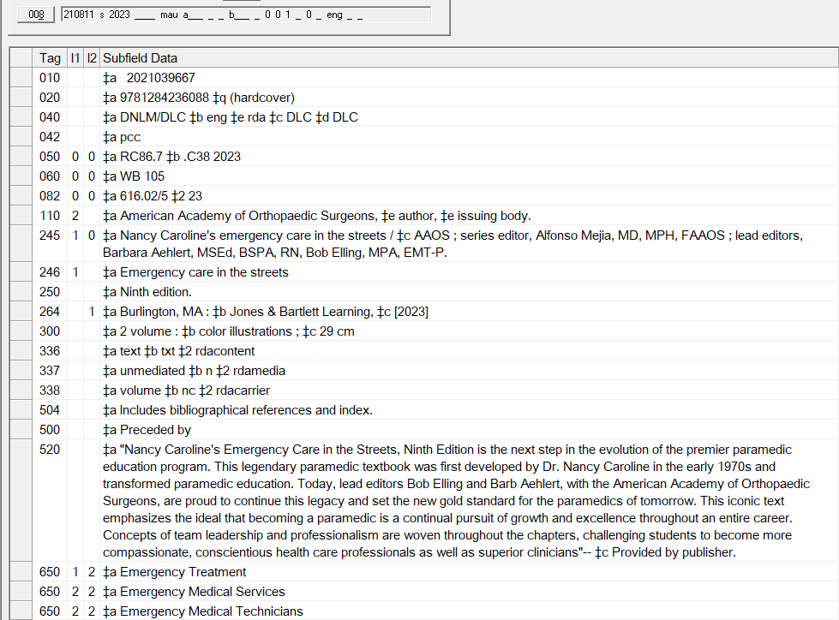
A Bibliographic Record
Is a Metadata Description Set

Slide 44
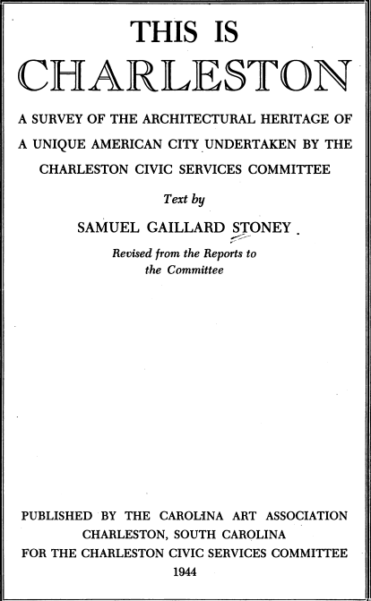
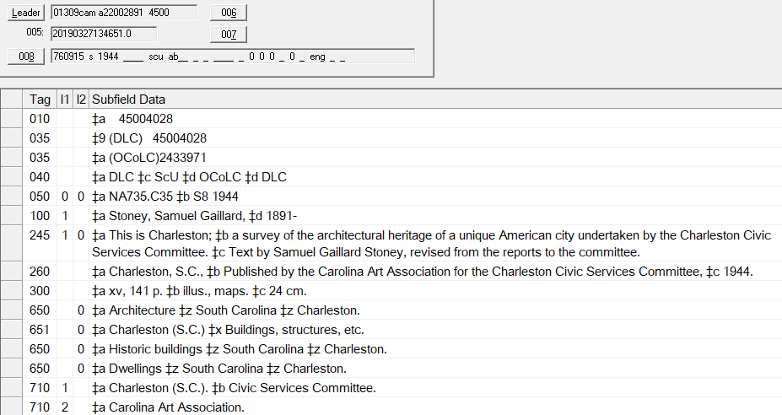
Identify Five Metadata Description Statements
https://lccn.loc.gov/45004028

Slide 45
Four Recording Methods
Unstructured | Structured | Identifier | IRI (Internationalized Resource Identifier)
A human-readable string that is an uncontrolled full or partial description of an entity or an uncontrolled term describing an aspect of an entity. | A human-readable string that is a full or partial description of an entity that is based on a string encoding scheme, or is a controlled term that describes an aspect of an entity. | A machine-readable string that is assigned to an entity in order to differentiate the entity from other entities within a local domain, or a notation for a term from a controlled vocabulary that is assigned to an aspect of the entity. | A machine-readable string that is assigned to an entity in order to differentiate the entity from other entities, or to an aspect of an entity, within the global domain of the semantic web and open linked data.

Slide 46
Four Recording Methods
Unstructured | Structured | Identifier | IRI (Internationalized Resource Identifier)
Includes a note, a transcription, a name or title as it appears in a source of information, and an uncontrolled term. Includes bibliographical references. | Includes an access point or a controlled term taken from a vocabulary encoding scheme. 700 1# $a Reynolds, Jonathan T. | Includes an identifier or notation taken from a vocabulary encoding scheme. LCCN: 2015487953 | http://id.loc.gov/vocabulary/issuance/mono

Slide 47
The Recording Methods Match Game
Unstructured
Structured
Identifier
IRI
Relationship: editor (hint: http://id.loc.gov/vocabulary/relators/edt)
edited by Shameemul Haque and Shashi Kant Singh
volume
Hershey, PA
Notes:
Hershey, PA – structured description
edited by Shameemul Haque and Shashi Kant Singh. – unstructured description
Volume – structured description
Relationship: editor – structured description
NOTE: Did not do identifier or IRI because fairly obvious

Slide 48
The Recording Methods Match Game
Unstructured
Structured
Identifier
IRI
Relationship: editor (hint: http://id.loc.gov/vocabulary/relators/edt)
edited by Shameemul Haque and Shashi Kant Singh
volume
Hershey, PA
Notes:
Hershey, PA – structured description
edited by Shameemul Haque and Shashi Kant Singh. – unstructured description
Volume – structured description
Relationship: editor – structured description
NOTE: Did not do identifier or IRI because fairly obvious

Slide 49
The Recording Methods Match Game
Unstructured
Structured
Identifier
IRI
Relationship: editor (hint: http://id.loc.gov/vocabulary/relators/edt)
edited by Shameemul Haque and Shashi Kant Singh
volume
Hershey, PA
Notes:
Hershey, PA – structured description
edited by Shameemul Haque and Shashi Kant Singh. – unstructured description
Volume – structured description
Relationship: editor – structured description
NOTE: Did not do identifier or IRI because fairly obvious

Slide 50
The Recording Methods Match Game
Unstructured
Structured
Identifier
IRI
Relationship: editor (hint: http://id.loc.gov/vocabulary/relators/edt)
edited by Shameemul Haque and Shashi Kant Singh
volume
Hershey, PA
Notes:
Hershey, PA – structured description
edited by Shameemul Haque and Shashi Kant Singh. – unstructured description
Volume – structured description
Relationship: editor – structured description
NOTE: Did not do identifier or IRI because fairly obvious

Slide 51
The Recording Methods Match Game
Unstructured
Structured
Identifier
IRI
Relationship: editor (hint: http://id.loc.gov/vocabulary/relators/edt)
edited by Shameemul Haque and Shashi Kant Singh
volume
Hershey, PA
Notes:
Hershey, PA – structured description
edited by Shameemul Haque and Shashi Kant Singh. – unstructured description
Volume – structured description
Relationship: editor – structured description
NOTE: Did not do identifier or IRI because fairly obvious

Slide 52
The Recording Methods Match Game
Unstructured
Structured
Identifier
IRI
Relationship: editor (hint: http://id.loc.gov/vocabulary/relators/edt)
edited by Shameemul Haque and Shashi Kant Singh
volume
Hershey, PA
Notes:
Hershey, PA – structured description
edited by Shameemul Haque and Shashi Kant Singh. – unstructured description
Volume – structured description
Relationship: editor – structured description
NOTE: Did not do identifier or IRI because fairly obvious

Slide 53
The Recording Methods Match Game
Unstructured
Structured
Identifier
IRI
Relationship: editor (hint: http://id.loc.gov/vocabulary/relators/edt)
edited by Shameemul Haque and Shashi Kant Singh
volume
Hershey, PA
Notes:
Hershey, PA – structured description
edited by Shameemul Haque and Shashi Kant Singh. – unstructured description
Volume – structured description
Relationship: editor – structured description
NOTE: Did not do identifier or IRI because fairly obvious

Slide 54
Recording Methods
Are you limited to one recording method?
NO
Are there elements that do not use all four recording methods?
YES
Notes:
Now, go back to your five metadata statements that we did for the “This is Charleston” resource. Which recording method is appropriate for each value that you recorded?

Slide 55
Recording Methods
Are you limited to one recording method?
NO
Are there elements that do not use all four recording methods?
YES
Notes:
Now, go back to your five metadata statements that we did for the “This is Charleston” resource. Which recording method is appropriate for each value that you recorded?

Slide 56
Recording Methods
Are you limited to one recording method?
NO
Are there elements that do not use all four recording methods?
YES
Notes:
Now, go back to your five metadata statements that we did for the “This is Charleston” resource. Which recording method is appropriate for each value that you recorded?

Slide 57
Recording Methods
Are you limited to one recording method?
NO
Are there elements that do not use all four recording methods?
YES
Notes:
Now, go back to your five metadata statements that we did for the “This is Charleston” resource. Which recording method is appropriate for each value that you recorded?

Slide 58
Value: A Piece of Data
Who is the speaker for this session? | Who = Person Name of person | Melanie Polutta
What conference are we attending? | What = Corporate body Name of corporate body | American Library Association Annual Meeting 2025
What is today’s date? | When = Timespan Beginning, ending, name of timespan, etc. | June 27, 2025
What room are we in? | Where = Place Name of place, coordinates, etc. | Pennsylvania Convention Center, Room 124
Notes:
Values are pieces of data. For descriptive cataloging, we are asking who, what, when, where questions, including relationships. We don’t ask how or why questions.
Note: Not defined in RDA. Used as shorthand for “data value.”
value vocabulary
A category of linked data work that contains concepts that are used as values for properties in a dataset.
OED: Worth or quality as measured by a standard of equivalence.

Slide 59
Value: Types of Data and How to Record Them
Literal Data | Controlled Data
Transcription (unstructured) Measurement and/or label (structured or unstructured) | Preferred label (structured description) Notation (ID) IRI
Notes:
Example of identifier for timestamp
Epoch Converter - Unix Timestamp Converter
Epoch timestamp: 1751047200
Timestamp in milliseconds: 1751047200000
Date and time (GMT): Friday, June 27, 2025 6:00:00 PM
Date and time (your time zone): Friday, June 27, 2025 2:00:00 PM GMT-04:00

Slide 60
Vocabulary Encoding Scheme (VES)
RDA Glossary
A named structured list of representations of controlled values for elements. A vocabulary encoding scheme includes an RDA list of terms or their corresponding value vocabularies in the RDA Registry, an ISO code list, a standard terminology, an authority control system, etc. Simple keyword indexes are excluded.

Slide 61
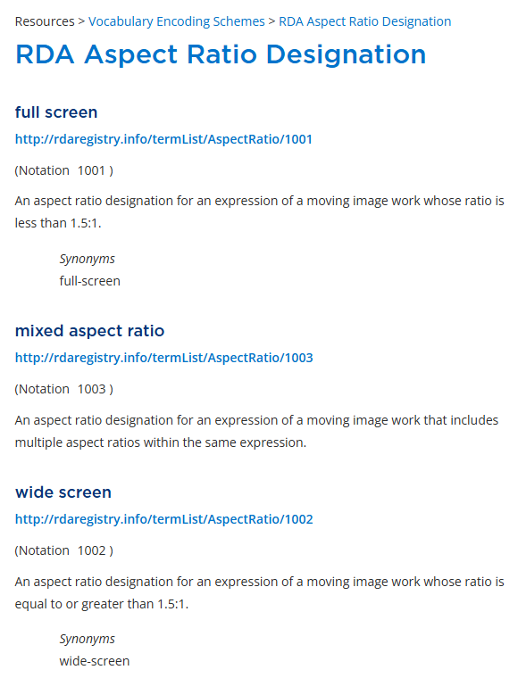
Example RDA VES
Unstructured | ?
Structured | ?
Identifier | ?
IRI | ?

Slide 62
Example RDA VES
Unstructured | Fullscreen (1.33:1)
Structured | ?
Identifier | ?
IRI | ?

Slide 63
Example RDA VES
Unstructured | Fullscreen (1.33:1)
Structured | full screen
Identifier | ?
IRI | ?

Slide 64
Example RDA VES
Unstructured | Fullscreen (1.33:1)
Structured | full screen
Identifier | Aspect Ratio Designation: Notation: 1001
IRI | ?

Slide 65
Example RDA VES
Unstructured | Fullscreen (1.33:1)
Structured | full screen
Identifier | Aspect Ratio Designation: Notation: 1001
IRI | http://rdaregistry.info/termList/AspectRatio/1001

Slide 66
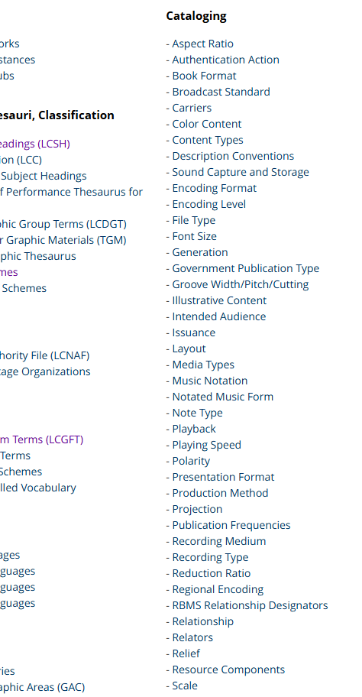
VES: What Are the Choices?
Where do we find them?
VES Vocabularies Library of Congress Linked Data Service Others? Yes. Any controlled vocabulary is a VES
Notes:
RDA Toolkit > Resources > VES Vocabularies
RDA Carrier Type
RDA Illustrative Content
Library of Congress > Linked Data Service
LCSH
LCGFT
MARC List for Languages
Other controlled vocabularies
Getty Art & Architecture Thesaurus
Homosaurus
MeSH
RBMS Controlled Vocabularies
etc.

Slide 67
String Encoding Scheme (SES)
RDA Glossary
A set of string values and an associated set of rules that describe a mapping between that set of strings and a value of an element.

Slide 68
Applying an SES
String Encoding Schemes and Nomens
  Constructing authorized access points for structured descriptions
  Other examples: Identifiers and name/title of X elements
String Encoding Schemes and Transcribed Elements
  Examples: Publication statement, edition statement
SES Instructions in the MGDs
  Example: MG: SES: Access Point for Person

Slide 69
SES Instructions
Apply to what? Nomen strings
  Examples: Access points, identifiers, name of/title of X elements
Other things that get SES Instructions
  Transcribed elements such as publisher statement, edition statement, etc.
Where? In the Metadata Guidance documentation
  MG: SES: Access Point for Person

Slide 70
String Encoding Schemes and Persons
Name of person | Nancy L. Caroline (unstructured)
Variant name of person | Nancy Lee Caroline (unstructured)
Authorized access point for person | Caroline, Nancy L.
Variant access point for person | Caroline, Nancy Lee

Slide 71

String Encoding Schemes and Publication Statements
Place of publication | New York (as found on resource)
Name of publisher | Doubleday, Page & Company (as found on resource)
Date of publication | 1907 (as found on resource)
Publication statement | New York [N.Y.] : Doubleday, Page & Company, 1907. (recorded using SES)

Slide 72
Data Provenance
RDA Glossary
Information about the metadata recorded in an element or set of elements. Metadata about metadata, or metametadata.

Slide 73
Data Provenance for Title Proper
Manifestation has title proper Fingerprints and archaeology
Metadata work has recording source title page
OR
Title proper has source of information title page

Slide 74
Data Provenance for the Metadata Description Set
LC/PCC Policy Statement | MARC Coding
The manifestation in hand is the default resource unless otherwise stated. | 042 ## $a pcc

Slide 75
Data Provenance for the Metadata Description Set
LC/PCC Policy Statement | MARC Coding
The manifestation in hand is the default resource unless otherwise stated. | 042 ## $a pcc

Slide 76
Data Provenance for Title Proper (Revisited)
Manifestation has title proper Fingerprints and archaeology
Metadata work has recording source title page
OR
Title proper has source of information title page
Notes:
In agreement, so no note needed.

Slide 77
Data Provenance for Title Proper (Revisited)
Manifestation has title proper 10-year plan to upgrade and maintain Minnesota's on-site (ISTS) treatment systems
Metadata work has recording source title page?
OR
Title proper has source of information Title from cover.

Slide 78
Data Provenance for the Metadata Statement
520 ## $a “Summary…” -- $c Provided by Publisher.

Slide 79
Questions?

