Slide 1
Recording Unstructured Descriptions
Notes:
Welcome to the preconference workshop! We’re going to begin the work of the workshop by talking about, and creating, something called unstructured descriptions. The first part of my section here will be a very heavily abridged version of fuller training that will be published later this year by the PCC Standing Committee on Training’s RDA Training Task Group: Monographs. This fuller training will go well beyond what we have time to talk about in this workshop.

Slide 2
RDA Copyright
©2010-2026 - American Library Association, Canadian Federation of Library Associations, and CILIP: Chartered Institute of Library and Information Professionals.
Screen images from the RDA Toolkit (www.rdatoolkit.org) used by permission of the Copyright Holders for RDA (American Library Association, Canadian Federation of Library Associations, and CILIP: Chartered Institute of Library and Information Professionals).

Slide 3
Learning Outcomes
At the end of this part, you will be able to:
Define an unstructured description
Identify source of information for elements recorded using unstructured description
Identify RDA transcription data elements
Record an element following unstructured description guidelines

Slide 4
Log in to RDA
Please open your instance of RDA, either using
  Username: DREvent
  Password: ALA2026
Or your own institutional login
Or your own Username and Password (from your profile)
When we look at a guideline, make sure in the “select policy statement set” dropdown box you have chosen LC-PCC PS

Slide 5
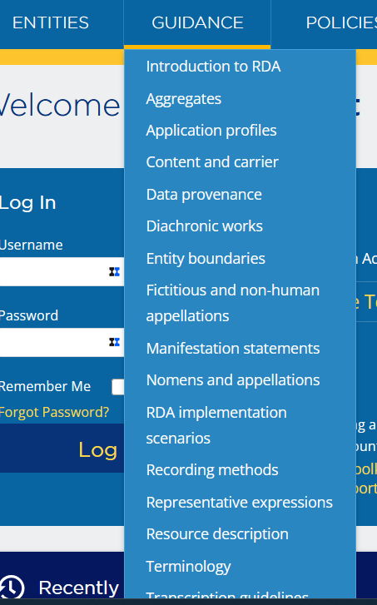
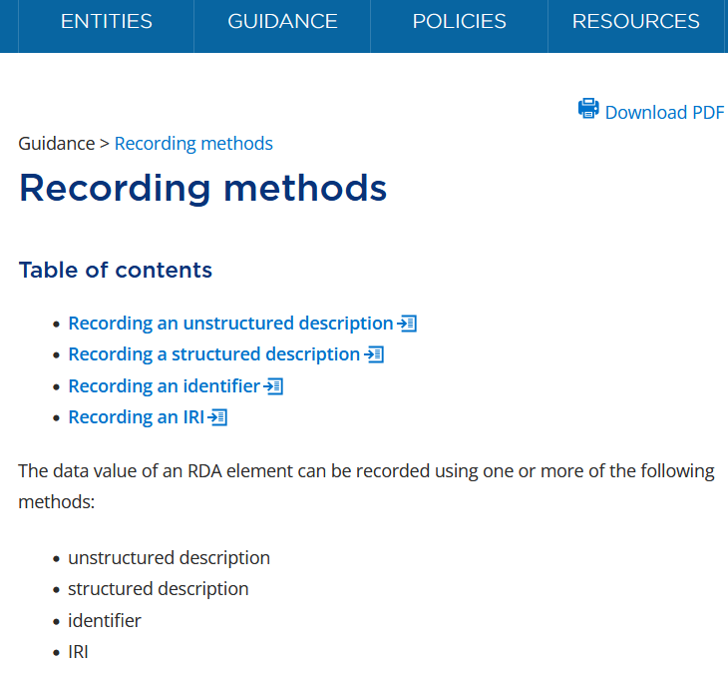
Recording Methods
Notes:
Once everybody’s there:
Click on Guidance from the menu in the lighter blue banner, and click on “Recording methods”. You will see four recording methods listed. (This is where you choose the policy statement set you want to see—you should only need to do this once, the Toolkit will “remember“ your choice as long as you stay logged in.)
In official RDA, recording techniques for data elements are standardized into four methods and presented in a separate “Recording methods” chapter under “Guidance”. The four methods are:
Unstructured description
Structured description
Identifier
IRI
The instructions for each element list all four recording methods, with instructions for each, although the instruction may be as brief as “This recording method is not applicable to this element.” We will be covering the first three recording methods in various segments of this workshop. We will not be covering the IRI recording method.

Slide 6
Recording Method: Unstructured Description
Data have no structure or extrinsic relationship to a vocabulary encoding scheme.
  RDA Glossary: vocabulary encoding scheme = A named structured list of representations of controlled values for elements.
  Also known as “controlled vocabulary”, e.g. the LC/NACO Authority File, LCSH
Supports the user task identify within a different area of application
Notes:
Please scroll down to Recording an unstructured description. We first see some examples where unstructured descriptions are used. Looking a few paragraphs down, we see that values using this recording method have “no structure” or relationship to a vocabulary encoding scheme. What is a vocabulary encoding scheme? [read from slide]
So an unstructured description is a type of description that has no structure or no extrinsic relationship to a controlled vocabulary, although the instructions point out that unstructured values may in certain cases be identical to structured values. Data entered using this recording method are either transcribed or supplied by catalogers not following any structure. They are mostly helpful for users to “Identify” resources.

Slide 7
Unstructured Description and Examples (1/2)
a manifestation statement (information transcribed from a manifestation)
  To kill a mockingbird by Harper Lee
  Second edition
an unstructured note
  Includes bibliographical references and index
  "Preface" signed: Charles Lee Lewes.
Notes:
Here are some examples of unstructured descriptions.
The first type of element is a manifestation statement that is transcribed from a manifestation. For example, a title proper and the statement of responsibility (To kill a mockingbird by Harper Lee), or an edition statement (Second edition). The data are recorded, transcribed, exactly as they appears in the source.
The next type is an unstructured note supplied by a cataloger such as: Includes bibliographic references and index or … Note that even though the phrase “Includes bibliographical references and index” does follow a structure that most everybody in North American cataloging practice writes out verbatim, this is still considered an unstructured description as far as RDA is concerned—nothing in RDA prescribes this wording or combining notes about bibliographies and indexes in this way. The second example is clearly free text supplied by the cataloger.

Slide 8
Unstructured Description and Examples (2/2)
a name or title in direct order, as it appears in sources of information
  Harper Lee
  edited by Tom Schuller and Richard Taylor
an uncontrolled term for a concept
  Children’s fiction
Notes:
The next type of data is a name or title in direct order as shown on the slide.
An uncontrolled term representing a concept is considered unstructured description. For example, Children’s fiction is a genre term supplied by a cataloger that is not drawn from a controlled vocabulary.

Slide 9
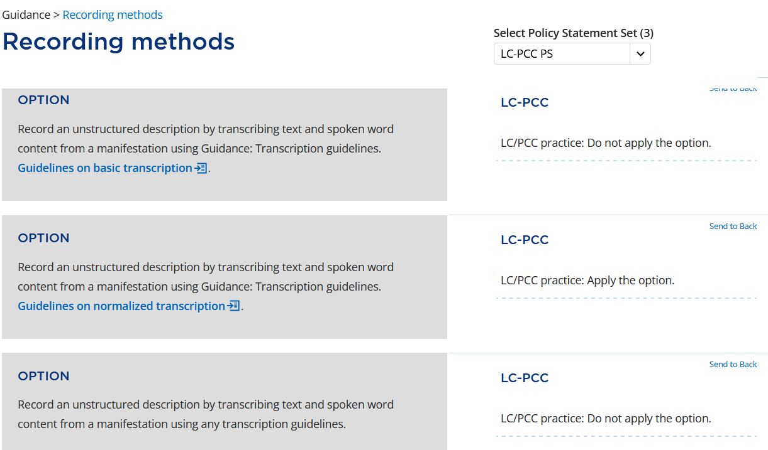
Transcription Options – LC/PCC practice: Normalized Transcription
RDA [03.41.60.16]
Notes:
Continuing down in the recording methods guideline we are presented with a series of options for how to record (or transcribe) the data in unstructured descriptions. The policy statement next to the option about basic transcription says not to apply it, so we’re going to ignore it for this workshop. To the contrary, the PS says to apply the option to transcribe following the Guidelines on normalized transcription. We will be looking at the guidelines on normalized transcription detail in the demonstrations in a few minutes, you’ll become quite familiar with it.
If you continue to scroll down you will see some other options having to do with transcription, including use of scripts, and transliterations. These are not pertinent to this workshop and so we won’t linger here.

Slide 10
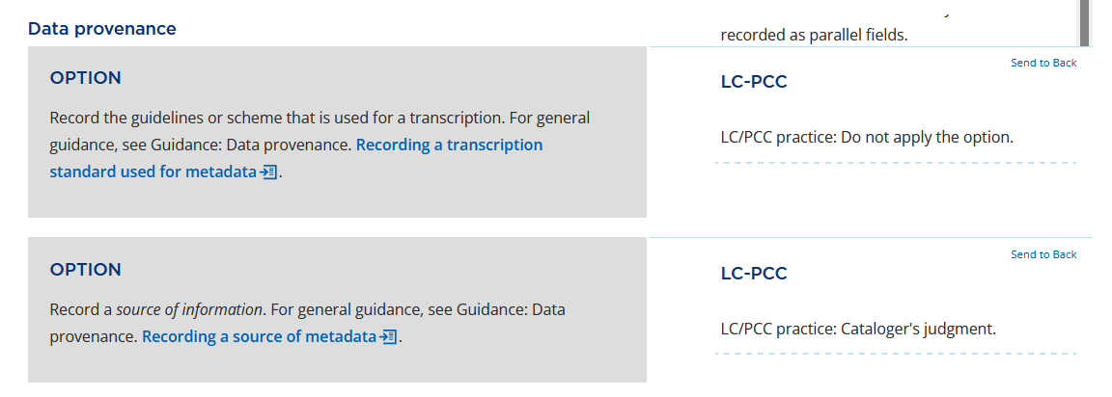
Data provenance
Notes:
Continuing to scroll down we see two options, still under unstructured description, having to do with data provenance. Data provenance is “information about the metadata” you’ve recorded for an element or set of elements (from glossary). Similar options appear with every element that permits unstructured description. RDA thinks it’s important to describe data provenance with unstructured descriptions, and if I’m not mistaken, the data provenance options ONLY appear with unstructured description elements, not the three other recording methods.
We’ll discuss this in greater detail in the demo, but we’ll pause here to look at some general information.
First, note that under LC-PCC practice we won’t apply the first option, to record the scheme used for transcription. It is assumed we are using normalized transcription, so we don’t need to explicitly say that.
Also note that for the second option, recording a source of metadata, we are told here to apply cataloger’s judgment. Source of metadata means what it sounds like—where did we find the information we’ve recorded as a value for an element? There are more explicit instructions with some of the elements, and we’ll have a look at some of these later on in the demonstration. Meanwhile, click on “recording a source of metadata” and we’ll briefly look at some of the guidance there.

Slide 11
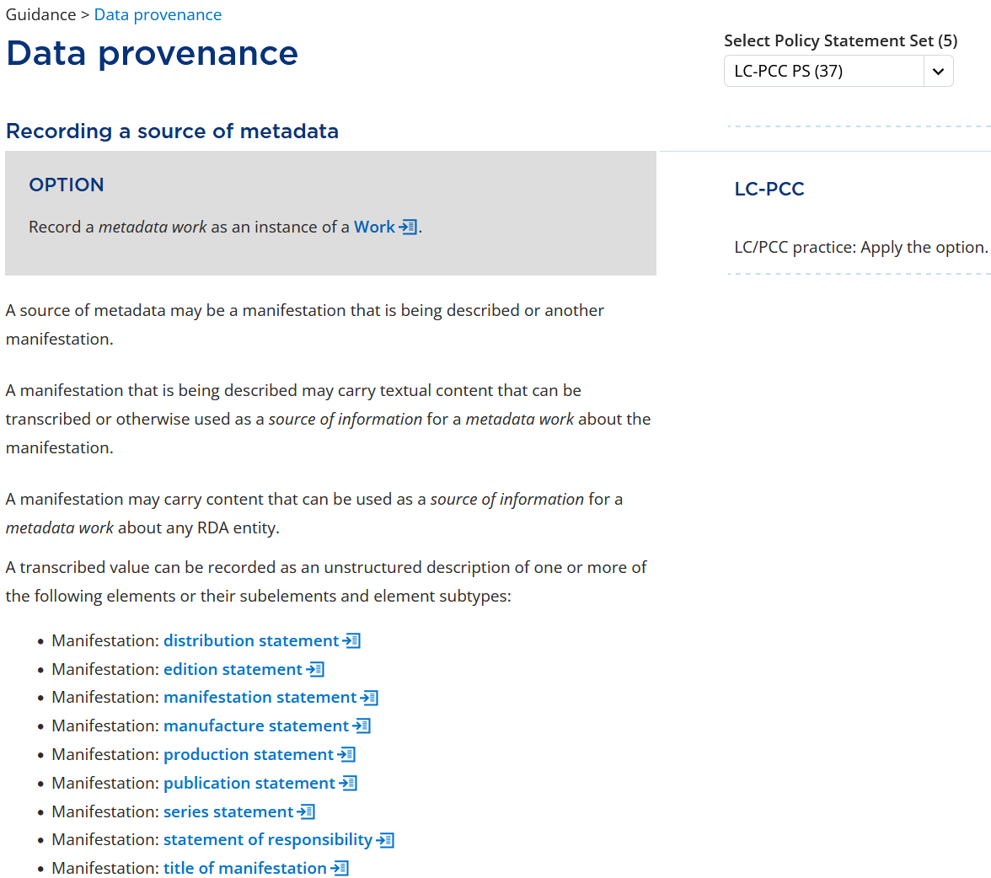
Source of metadata
RDA [76.95.49.73]
Notes:
In this section, we will see all relevant information about source of metadata which we will discuss in the following demonstration, so we won’t linger here, but do note the list of manifestation elements where source of metadata is most relevant. We will return to recording source of metadata when we discuss the title proper, place of publication, and name of person elements.
Let’s pause moment with the wording of the option at the top of this slide: Record a metadata work as an instance of a work”, which the PS tells us to do. What is a metadata work?

Slide 12
Metadata work: RDA Glossary
Metadata work: A work that is a metadata statement or a metadata description set.
Metadata statement: A metadata work that is a piece of metadata that assigns a value to an RDA element that describes an individual instance of an RDA entity.
Metadata description set: A metadata work that is an aggregating work that is a plan to select and arrange one or more expressions of one or more metadata statements that describe one or more individual instances of RDA entities and embody them in an aggregate.

Slide 13
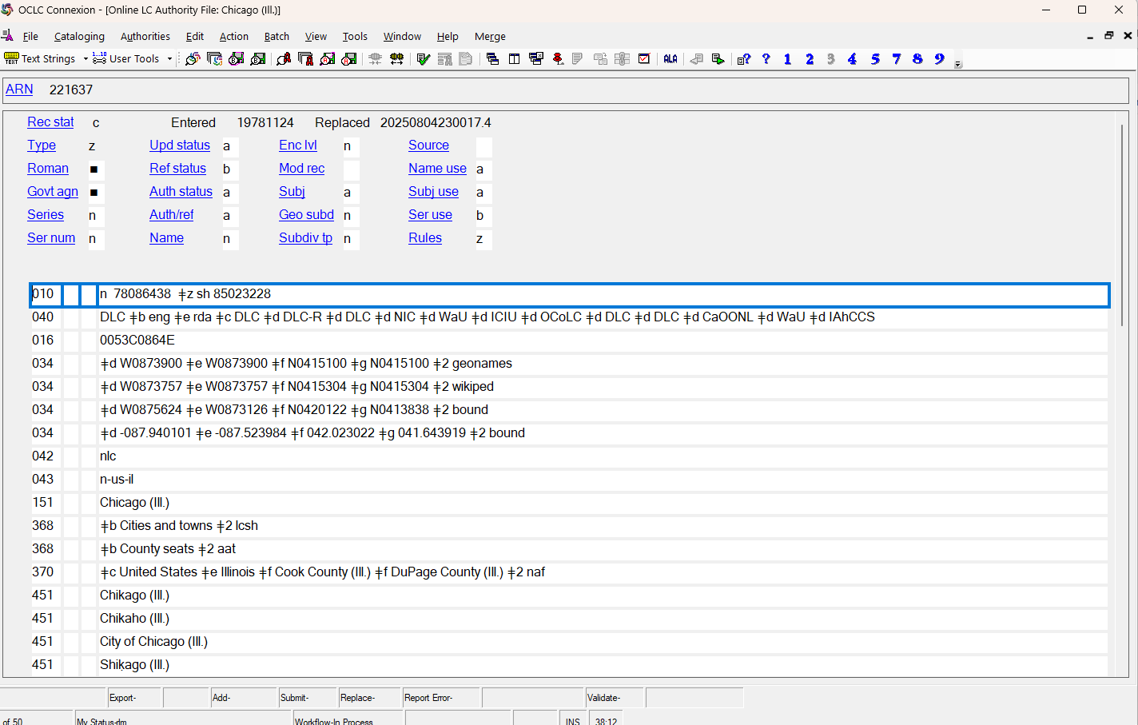
Metadata work: example
Notes:
An authority record is a familiar kind of metadata work. This is in fact a metadata description set, a description of an individual entity (Chicago) comprising one or more metadata statements, for example, statements about various names of the place, statements about latitude and longitude, etc.

Slide 14
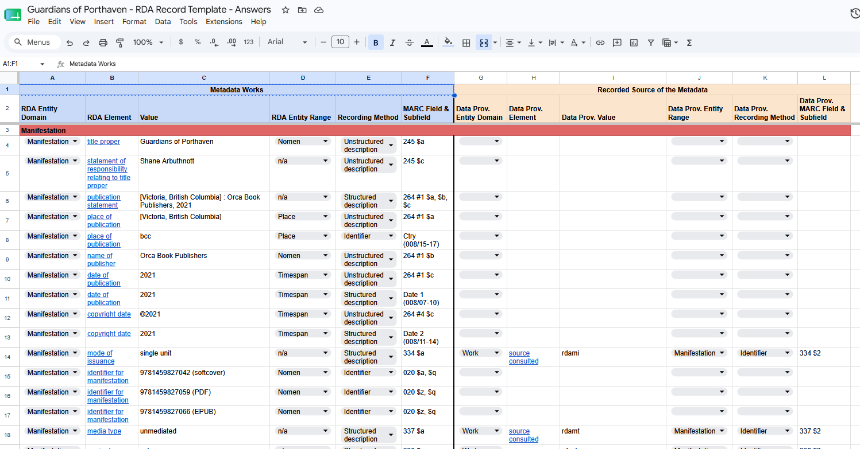
Metadata work: example
Notes:
The descriptions we will be creating in this session are examples of metadata description sets. For example, in a moment we will start describing a manifestation called Guardians of Porthaven by Shane Arbuthnott. This is a metadata description set, combining various metadata statements into a single metadata work, for example, recording vales for title proper, statement of responsibility relating to title proper, place of publication, etc.
An important point to keep in mind is that, for RDA, a metadata work is just the same as any other kind of work, it’s a work created by a cataloger (or a succession of catalogers) that can have all the attributes and relationships that other kinds of works can have.

Slide 15
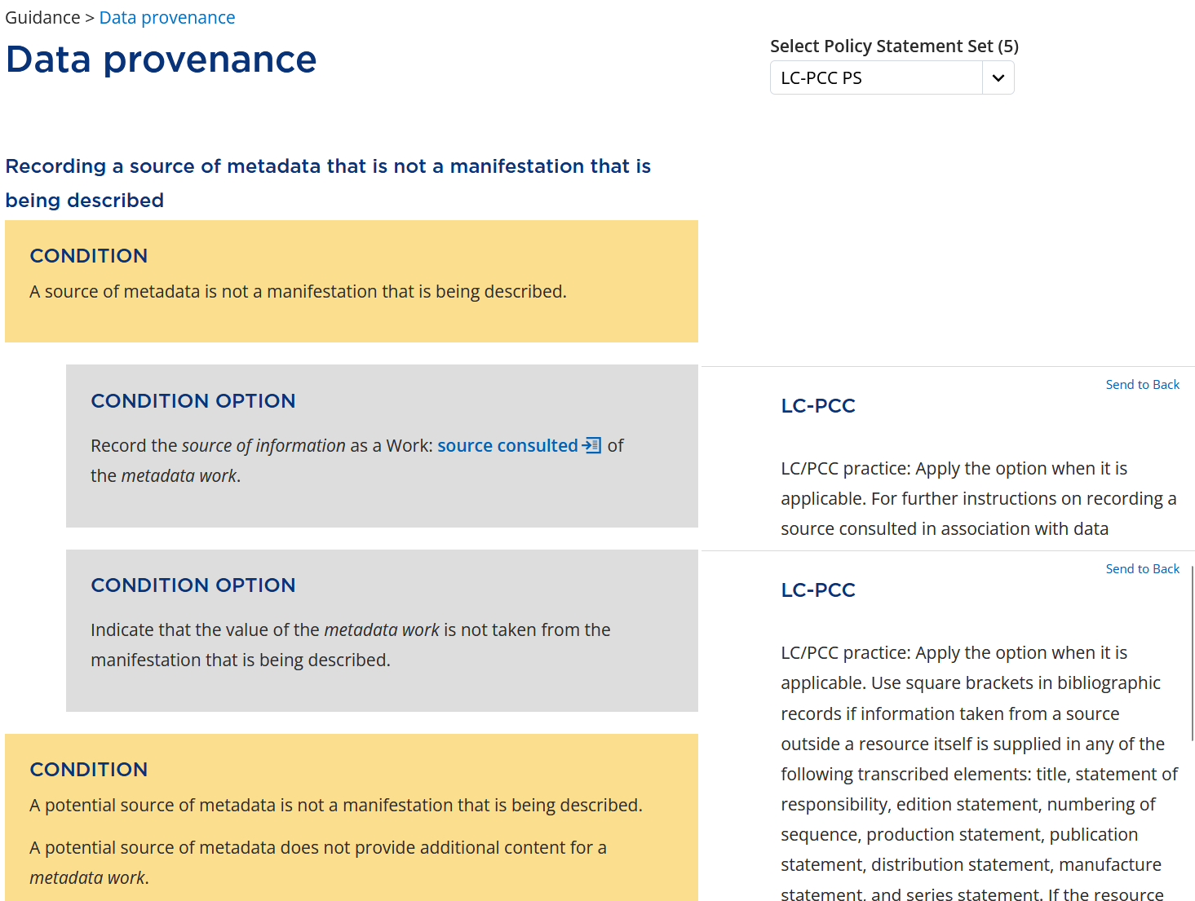
Source of Information – Not a manifestation being described
RDA [48.95.04.68]
Notes:
As I said, we will be looking at pertinent Data provenance provisions in the demonstration of specific elements, but please for a moment scroll down to “Recording a source of metadata that is not a manifestation that is being described.
The first condition option says to record the source consulted element. The PS tells us to apply it when it is applicable. One example of where it is applicable is in NACO practice, where we record source consulted in 670 fields to justify data used in the record.
The second condition option tells us what to do if we are recording a value for information that is not taken from the manifestation we’re describing. The option simply says to “indicate” this, and doesn’t tell us how. The PS clarifies that in PCC practice we indicate this by surrounding the data with square brackets, and then the PS tells us specifically which elements we need to do this for.

Slide 16
Source of Information – Not a manifestation being described – transcription elements examples
[VCH shorts]
Series title from publisher's website.
[The DMV].
[United Kingdom] : [Gareth Fuller], [2025]
[Purposeful wanderings]
Title, publisher, and series information from publisher's website.
Notes:
Here are some examples where values of elements are taken from outside the manifestation being described (with brackets) and a note specifying their source of information.

Slide 17
Unstructured description demonstration
We will now move on to a demonstration of applying official RDA instructions to discover and record unstructured values for six elements:
  Title proper
  Statement of responsibility
  Place of publication
  Name of publisher
  Date of publication
  Name of person

Slide 18
Unstructured Description
Demonstration
Notes:
The purpose of this demonstration is to get you familiar with using the Official RDA Toolkit, so make sure you’re logged in, I hope you will be following along as I show you. We will only look at a few elements; the same procedures will apply to other elements you may need for the exercises. We will (very!) briefly look at many aspects of the elements to allow us to record a value for them.
NOTE TO SPEAKER: if possible present most of this “live.”

Slide 19
BIBCO Standard Record
Please open the BIBCO Standard Record (BSR) for Official RDA and keep it handy
  https://bit.ly/Beta-BSR
For more information to consult later, see the BSR Introduction
Please note that both of these documents are in draft form

Slide 20
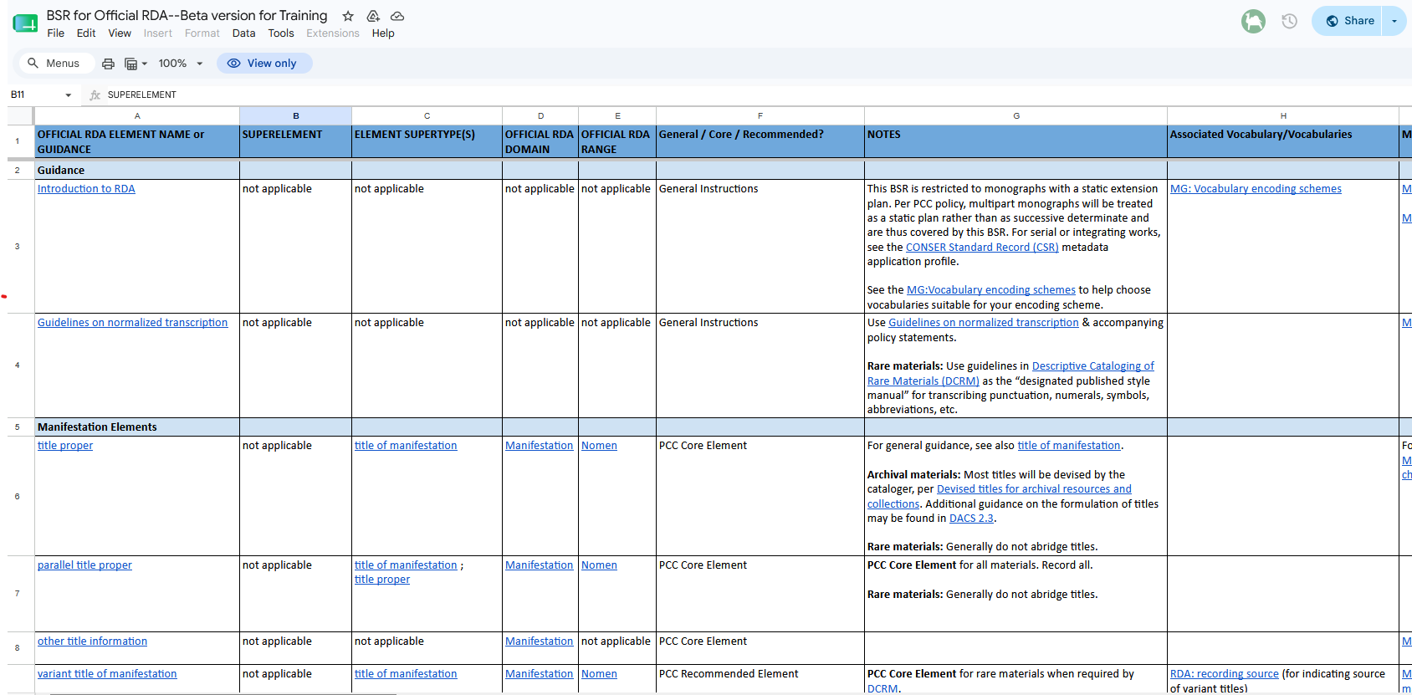
BIBCO Standard Record - https://bit.ly/Beta-BSR
Notes:
We will not be consulting the BSR heavily in this demonstration, but it is a handy list of the official RDA elements that you can use to identify which ones might be useful for you to consider recording values for in this workshop and later; and perhaps more important, what the names of the elements are, which, we shall see, is helpful to us when searching for the element instructions in official RDA.
Note: Column A gives the names of the elements; Column F tells us which elements are PCC core (e.g. title proper) -- in fact, nearly all of the elements listed are core -- ; and which are PCC recommended (e.g. variant title of manifestation). I’m not sure if the links from the BSR to RDA work—they didn’t when I was preparing last week.
The demonstrations we will give this morning will only show a few elements that you’ll need to do the workshop exercises—the purpose of the demonstration is to show you how to read and interpret official RDA, not to go over all the details of all the elements—so the BSR is a document you can consult to see what other elements you might want to use for the exercises you choose to do today. More important, it will be a useful document to consult later when you need to catalog things in real life, without the prepared templates we’ll be using in this workshop.

Slide 21
title proper

Slide 22
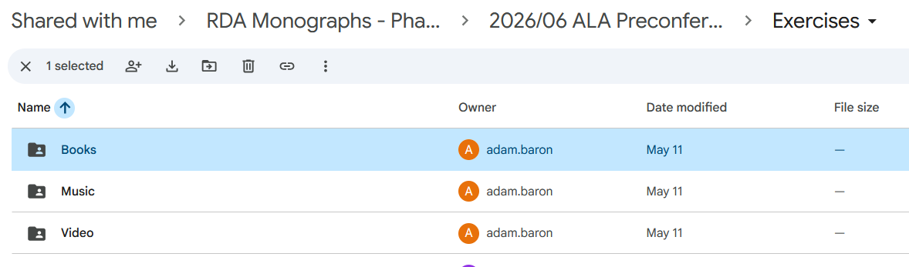
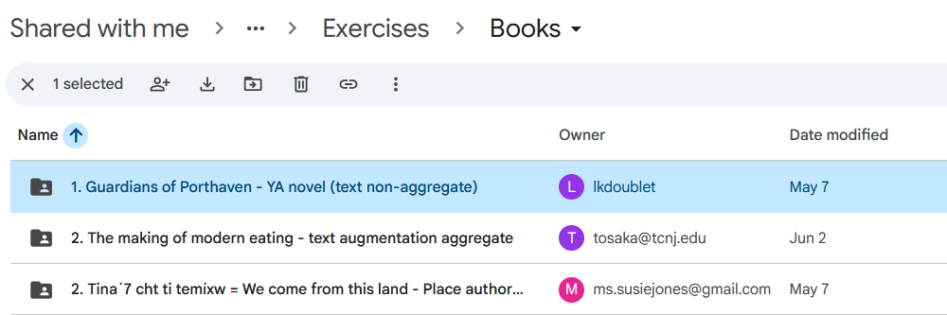
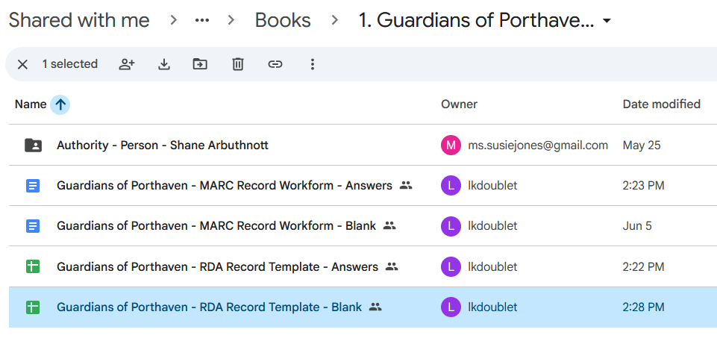
Recording title proper
Please go to the Exercises folder, choose “Books”
Open 1. Guardians of Porthaven
Open RDA Record Template – Blank (save it to your own computer)
We will be recording a value for Title proper

Slide 23
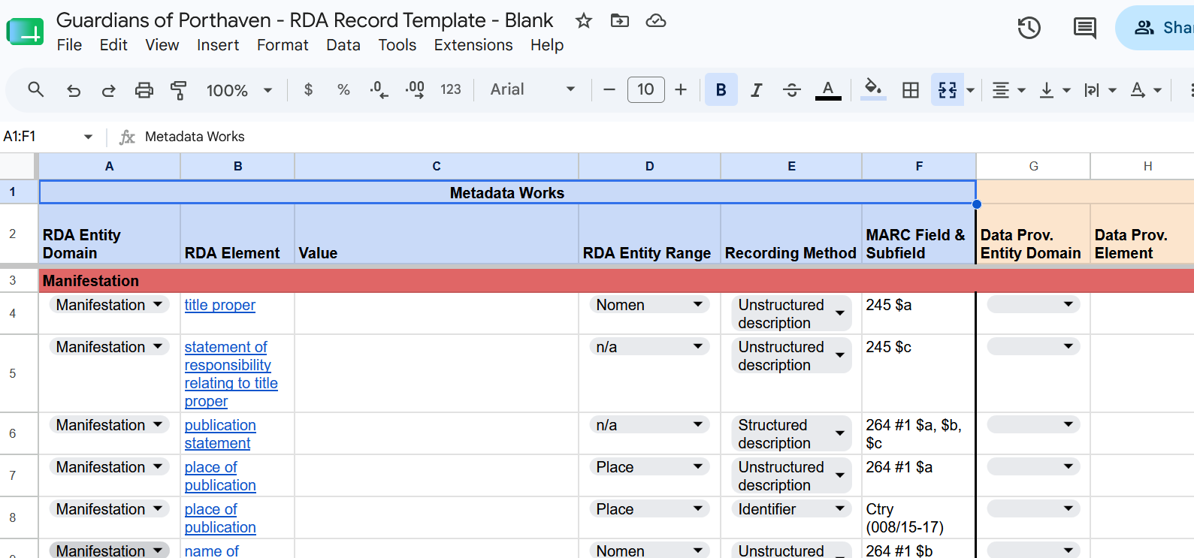
Recording title proper
Notes:
Make sure everyone is here, and has saved it to their own computer.

Slide 24
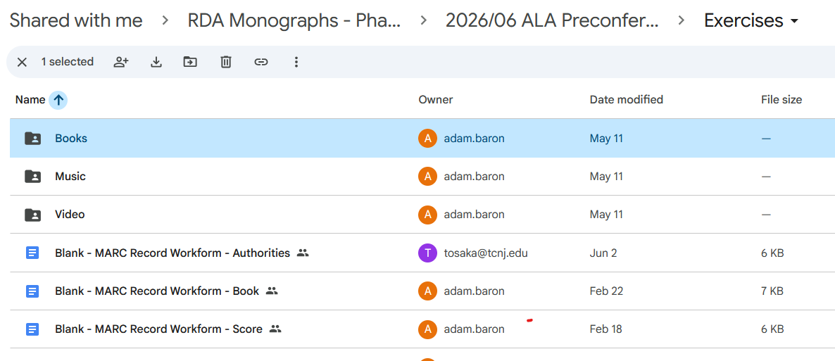
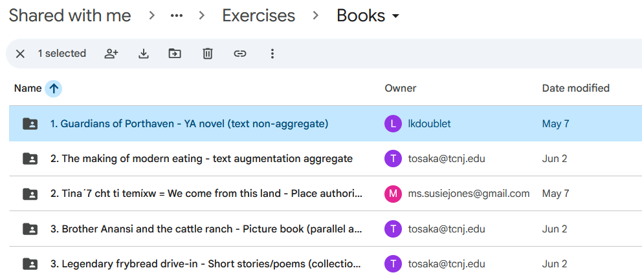
Recording title proper
Please go back to the Exercises folder and open the Books subfolder; open
1. Guardians of Porthaven

Slide 25
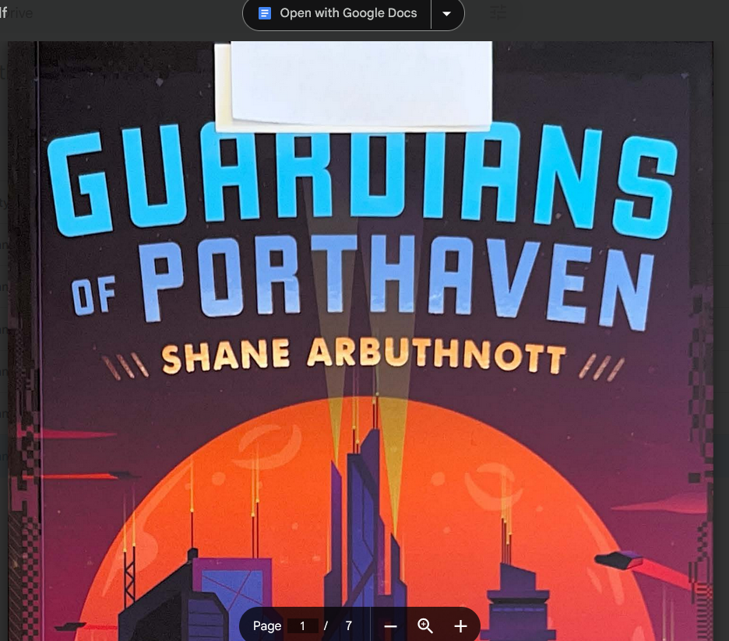
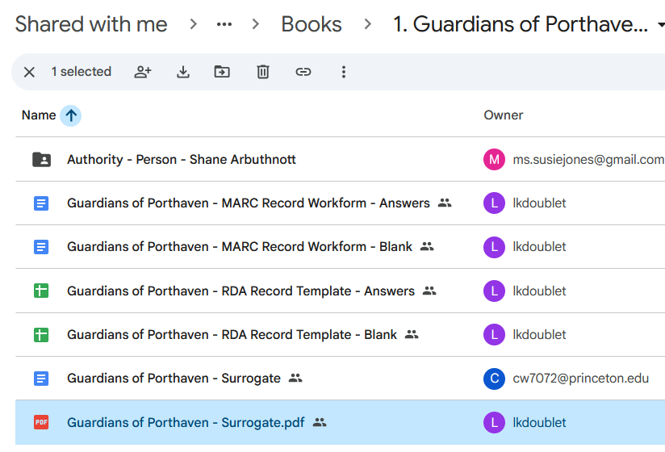
Recording title proper
Open the surrogate PDF

Slide 26
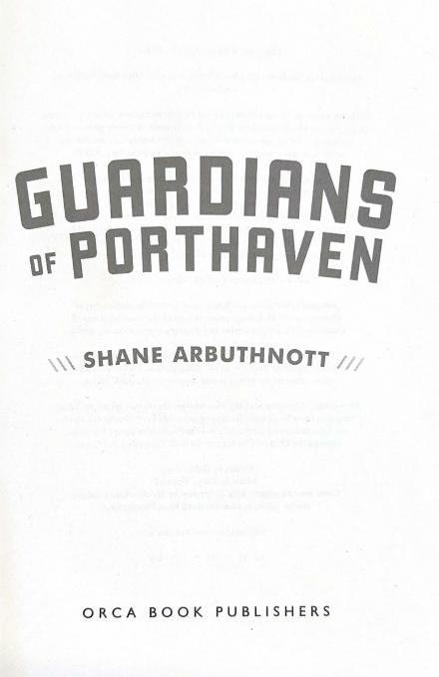
Recording title proper
Scroll down in the surrogate to the title page

Slide 27
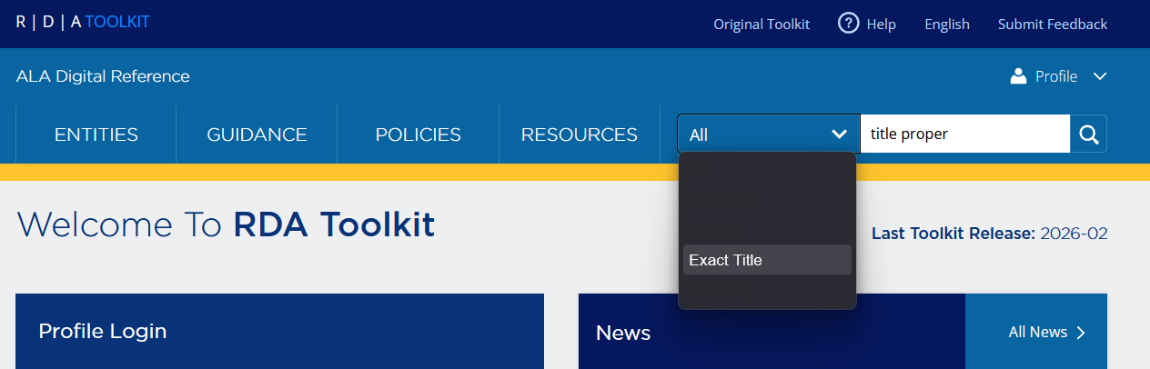
Recording title proper
Open your instance of the RDA Toolkit.
Find the Title proper element
  Choose “exact title” in the dropdown menu to the left of the search box
  Type “title proper” in the search box

Slide 28
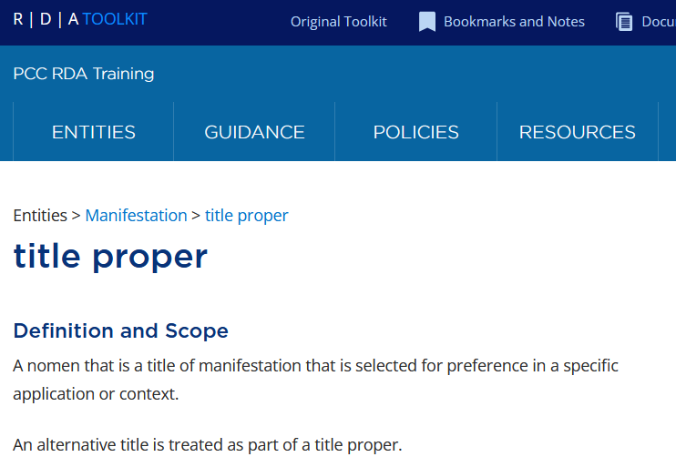
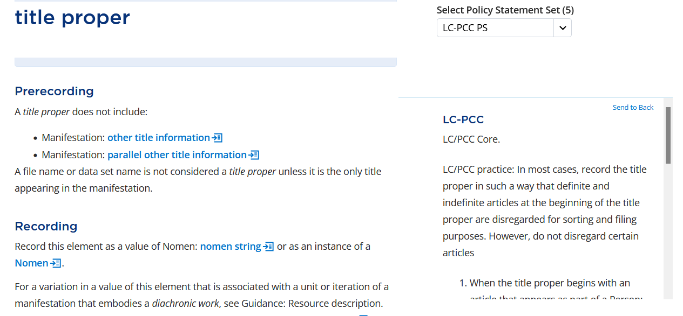
Recording title proper
Select LC/PCC-PS from the dropdown menu
Scroll down to prerecording
We learn that title proper is LC/PCC Core, that is, required
We also learn that we are to record a value of a “nomen string”
Click on the icon next to “nomen string.” This handy icon looks at the glossary
Notes:
MAKE SURE THE POLICY STATEMENTS ARE SHOWING – CHOOSE LC-PCC PS under “Select Policy Statement Set”.

Slide 29
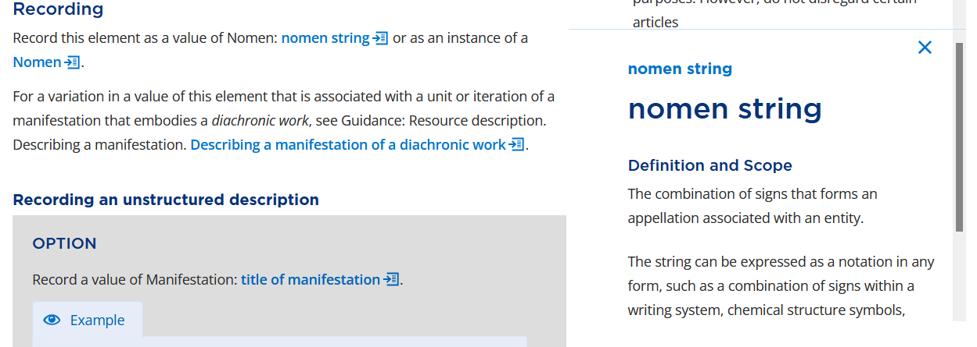
Recording title proper
The definition of nomen string appears in a box to the right
Notes:
“Nomen string” is a combination of signs that form an appellation (that is, a name) for the entity. It is composed of “notation”, that is, a combination of signs within a writing system. Translation: text. So that’s how a value of title proper is supposed to be recorded.
Close the box by clicking on the X to the upper right corner.

Slide 30
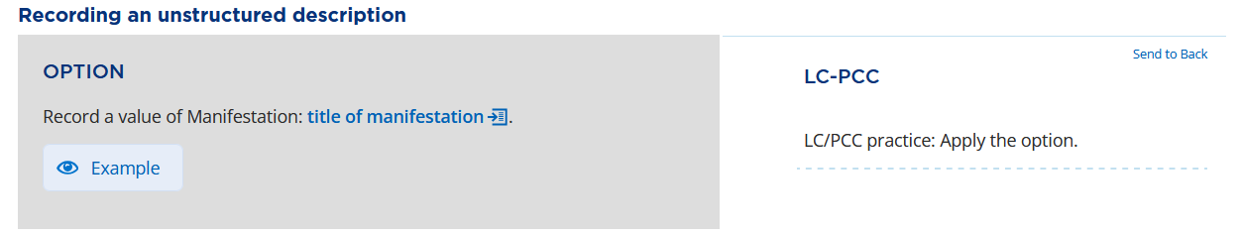
Recording title proper
Scroll down to Recording an unstructured description
Notes:
We are given the option to record, for Title proper, a value following the instructions for another element, Title of manifestation, and the PS says to do this, so we’d better go have a look. Click on “title of manifestation.”

Slide 31
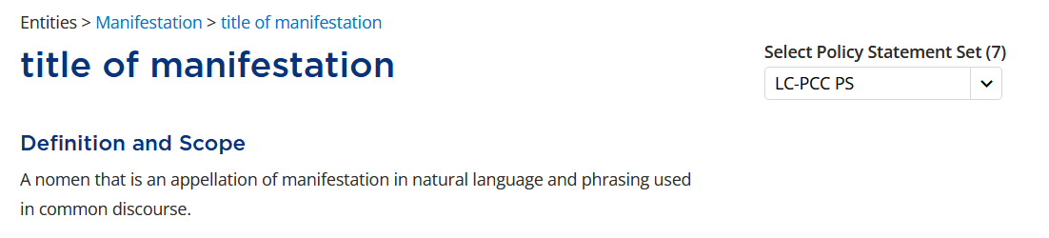
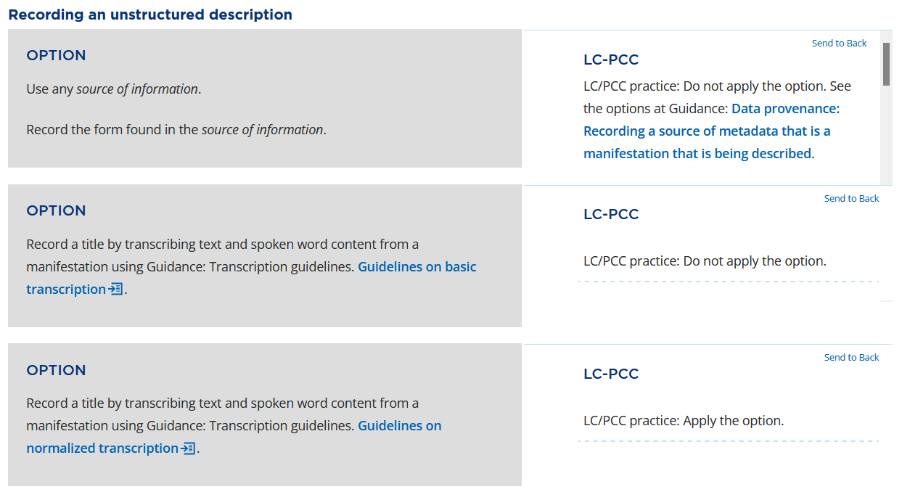
Recording title proper: Title of manifestation
Notes:
There’s a fair amount to unpack here, but let’s just look at Recording an unstructured description (scroll down). Look at the first and third options.
The PS for the first option says not to apply it. This is talking about the part that says “use any source of information”—we’re not to record the title proper from just anywhere. We’ll see what to do instead in a second. But the second sentence of the option is important, even though the PS applies to the option as a whole, I think we do want to apply the second sentence: Record the form found in the source of information. The only question is what source of information. Click on the link in the PS to Data provenance to find the answer to this question.

Slide 32
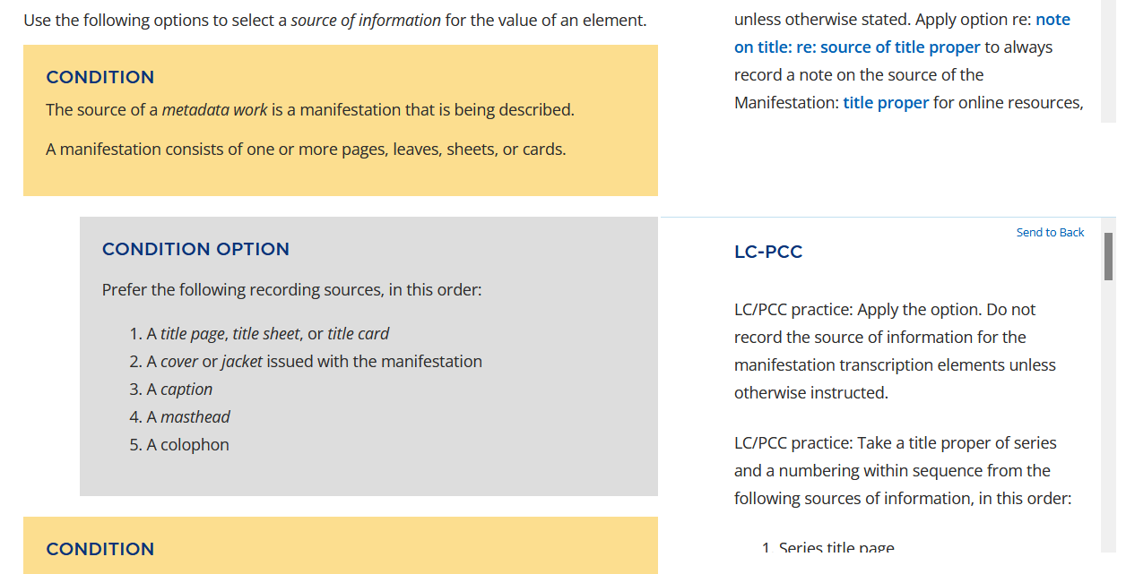
Recording title proper: Data Provenance
Notes:
You should be here, in the section under Guidance called “Data Provenance”. The PS is to apply this condition option if we have a book (a manifestation consists of one or more pages, leaves, sheets, or cards”. We have been explicitly told to apply this option when recording a Title of manifestation element. So what is the source of information for Title proper, which follows the same rules as Title of manifestation? In our case, the title page. We’ll look back at the surrogate in a moment.
Note: in the second sentence of the PS we are told “Do not record the source of information for the manifestation transcription elements unless otherwise instructed.” There are no “otherwise instructed” instructions for our situation, so when transcribing a value of the title proper element from a title page, we do not need to specify in the record where we got the information. It is assumed to have come from a title page.
Go back to the Title of manifestation element by clicking on the back button.

Slide 33
Recording title proper: Title of manifestation
Notes:
We are given, in the third option, the option to transcribe text using the Guidelines on normalized transcription, and the PS tells us to apply the option, so we’d better go have a look.

Slide 34
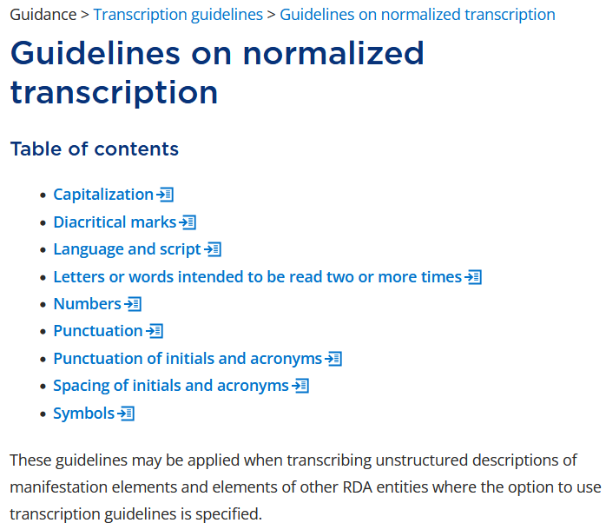
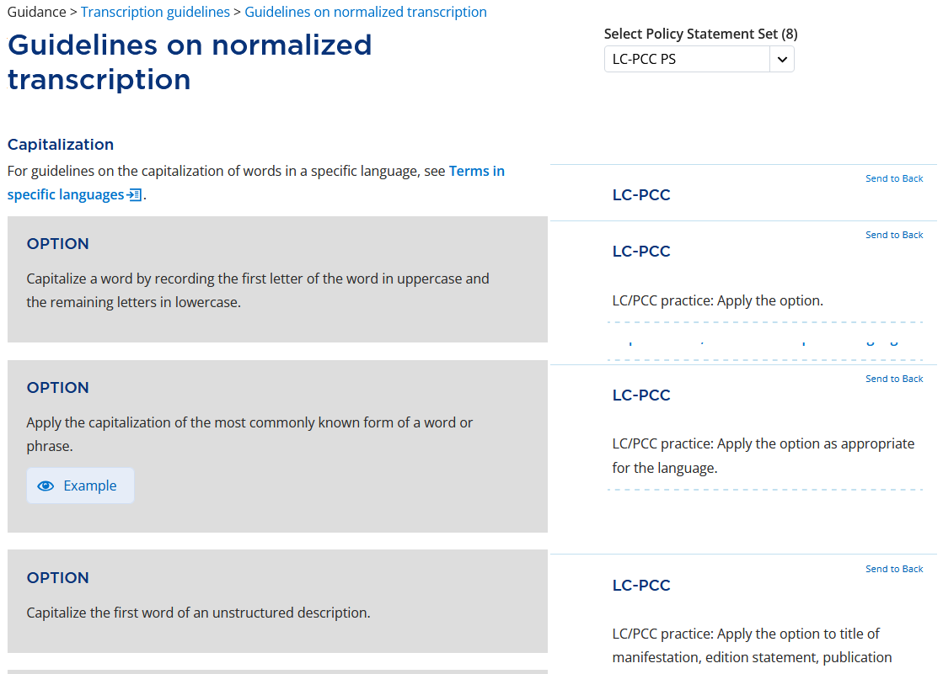
Recording title proper: Guidelines on normalized transcription
Notes:
Take note of the paragraph below the table of contents. Thes guidelines are for transcribing unstructured descriptions of manifestation elements. This is exactly what we want to do.
There are several sections, but the only one that really applies to Guardians of Porthaven is the capitalization section, so click on that word.

Slide 35
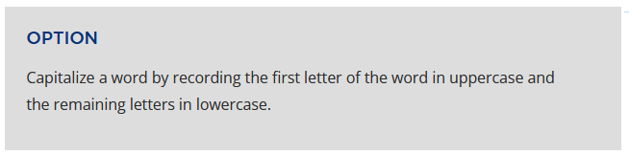
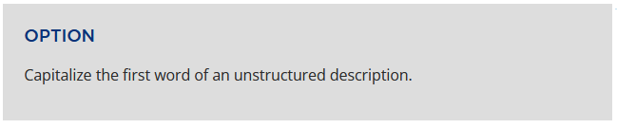
Recording title proper: Guidelines on normalized transcription
GUARDIANS = Guardians
Guardians …
Notes:
Applying the first option, we get: Guardians. Applying the third option, we’re going to capitalize the first word, “Guardians”. But what about the rest?

Slide 36
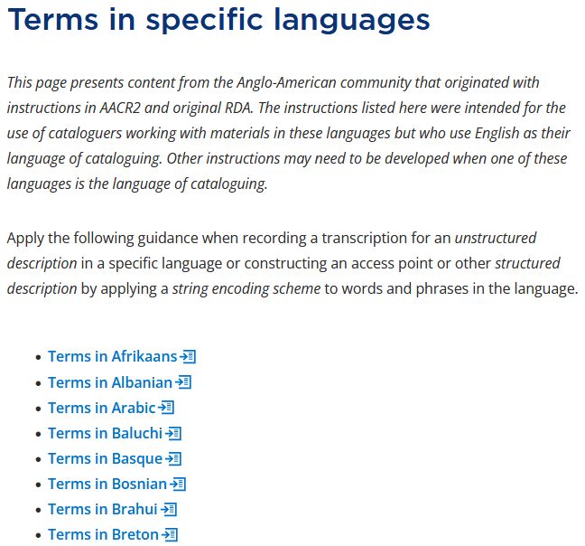
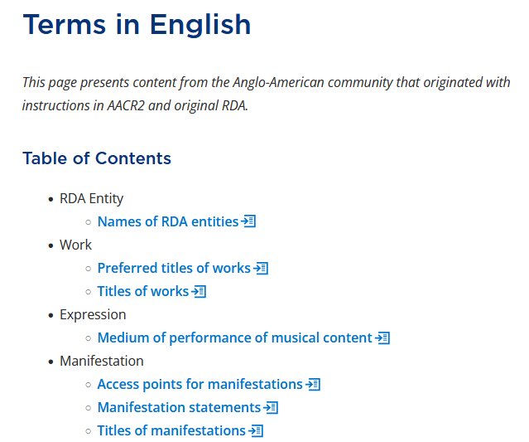
Recording title proper: Guidelines on normalized transcription
Notes:
We need to see what the Terms in specific languages says. Click there. Scroll down and click on “terms in English”. Click on Titles of manifestations

Slide 37
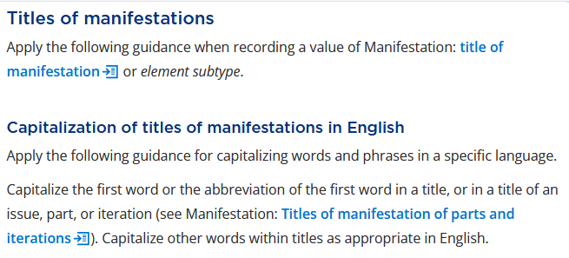
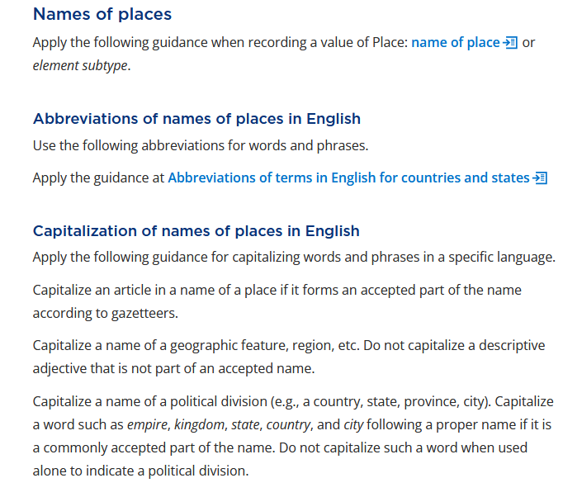
Recording title proper: Guidelines on normalized transcription
Notes:
We are told to apply this when recording a title of manifestation element—or an element subtype. Title proper is a subtype of Title of manifestation.
The second paragraph of the second section says: Capitalize the first word. Capitalize other words “as appropriate in English.” Well, what is appropriate? Scroll down most of the way in the page to Names of places. We are told to Capitalize the name of a geographic feature, region, etc., or a political division. Porthaven is such a name.

Slide 38
Recording title proper
Review:
Record a nomen string
Source = the title page
Use normalized transcription
Capitalize first word
Capitalize the name of a political entity
GUARDIANS OF PORTHAVEN
becomes
Guardians of Porthaven

Slide 39
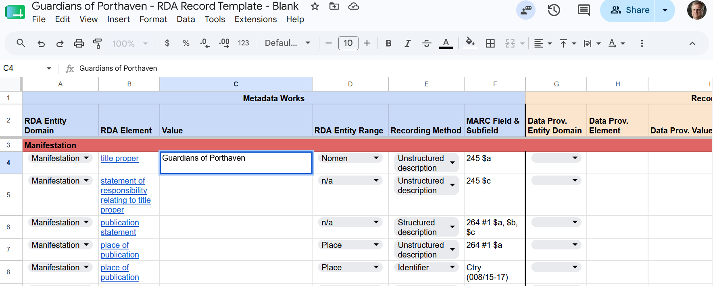
Recording title proper
Notes:
Record this value for title proper in the RDA Record Template for Guardians of Porthaven.
No need to record a data provenance value because the element value comes from the title page (as we saw earlier when discussing data provenance), and a book is not one of the types of resource we are required to record data provenance for this element.

Slide 40
statement of responsibility

Slide 41
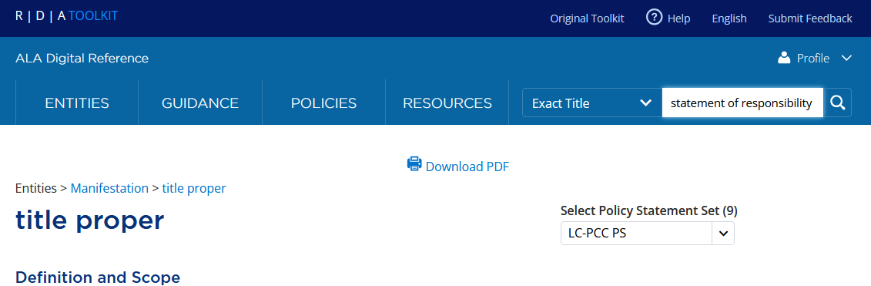
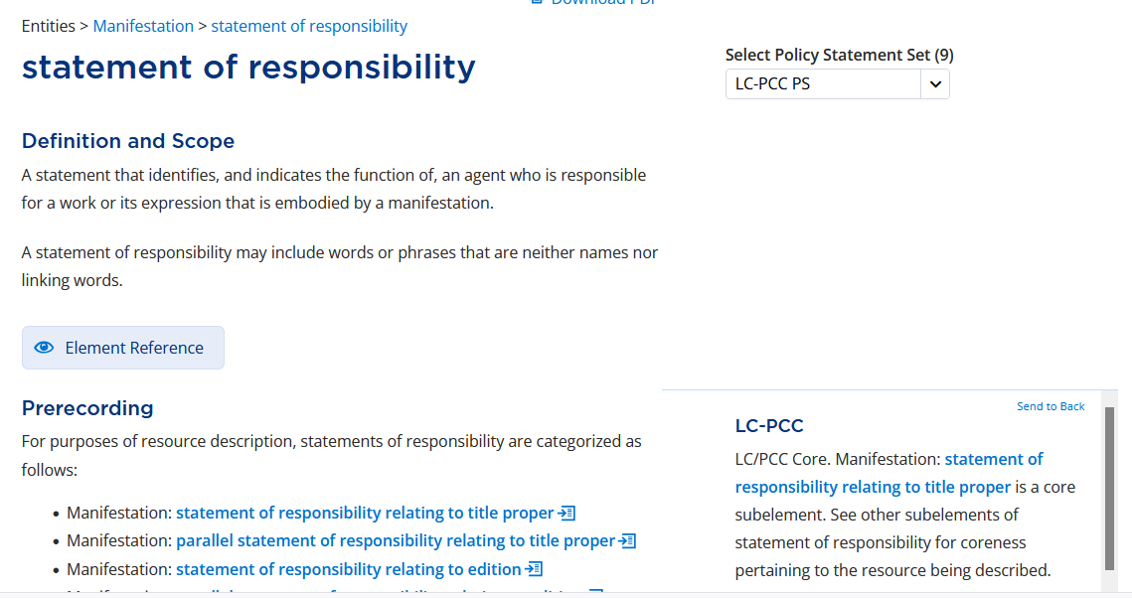
Recording statement of responsibility
Notes:
We’re done recording our first element of Manifestation. Now we will turn to statement of responsibility. This will go faster, because we’ve already touched on a lot of what we need to know for this new element. Find the statement of responsibility element by putting “statement of responsibility” in the search box, making sure that “Exact title” is chosen from the dropdown to the left.
As usual we get a definition, “A statement that identifies, and indicates the function of, an agent who is responsible for a work or its expression that is embodied by a manifestation.” We might not have defined it that way ourselves, but I think this is a familiar concept.
Under Prerecording, as usual, is the core statement. We learn that the first statement of responsibility relating to title proper element is core. So we need to record a value for it.
This is a lengthy section with a lengthy table of contents, but the statement of responsibility we’re interested in is the one relating to title proper, so click there.

Slide 42
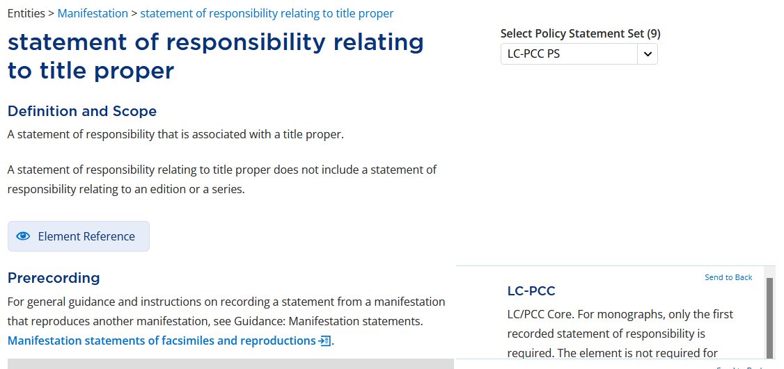
Recording statement of responsibility
Notes:
We are now in a new element of the manifestation description. Statement of responsibility relating to title proper is a subelement of Statement of responsibility.
We are reminded under Prerecording that the first instance of this element is core, that is, required, for monographs.
Scroll down to Recording.

Slide 43
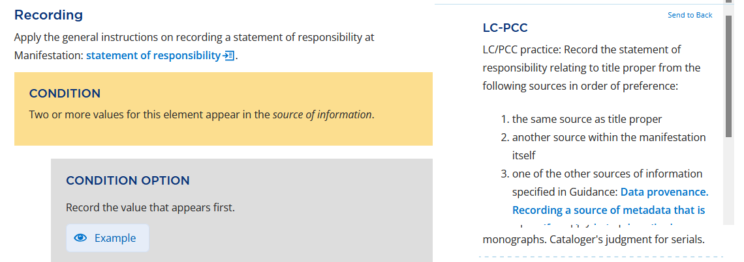
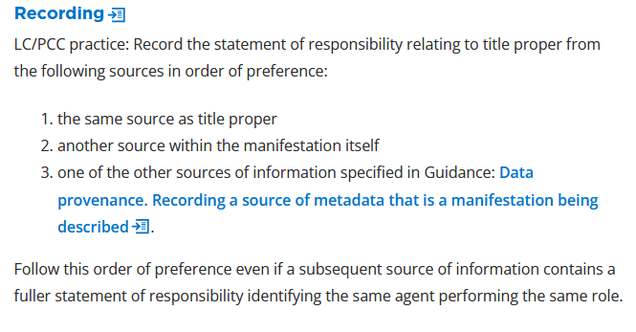
Recording statement of responsibility
Notes:
The PS here is too large to see in the box all at once. Click on “LC-PCC” to see the full policy statement. As in original RDA, the first preference is to take this statement of responsibility from the same source as the title proper; if there is no statement of responsibility there, we can go to another source within the manifestation. We can also record a value for this element from someplace else, but if we do we need to follow the instructions in data provenance, which tell us to indicate somehow that the value came from outside the manifestation; in North American practice we do this by bracketing.
Also, in this same section back in RDA itself, we are told to “Apply the general instructions on recording a statement of responsibility at “Manifestation: statement of responsibility” – which is where we started today … So use the back button to get back to the general “statement of responsibility” or click on the blue words under “Recording”.

Slide 44
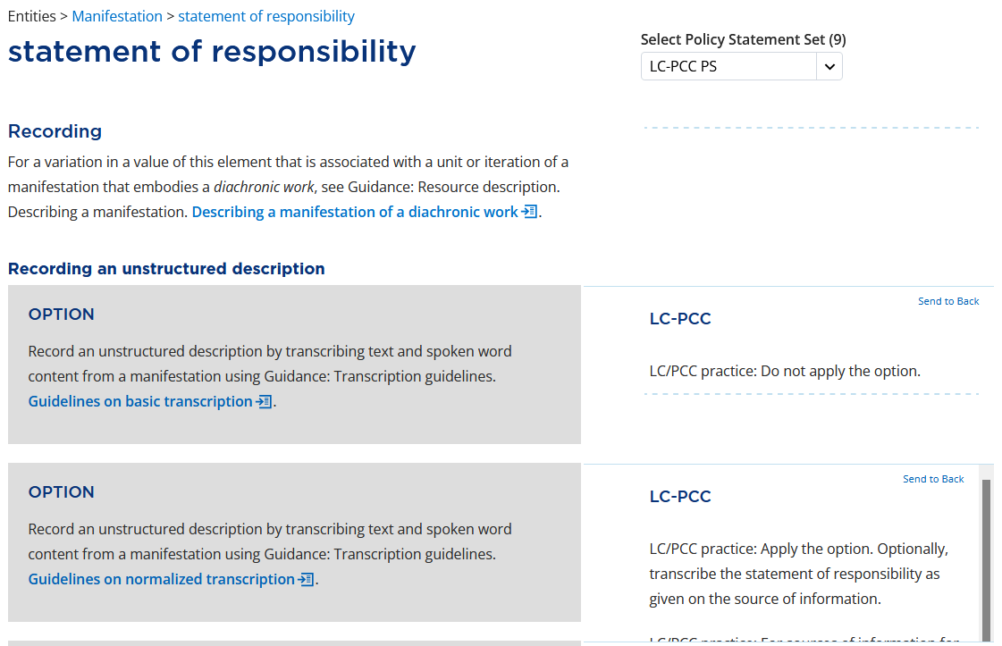
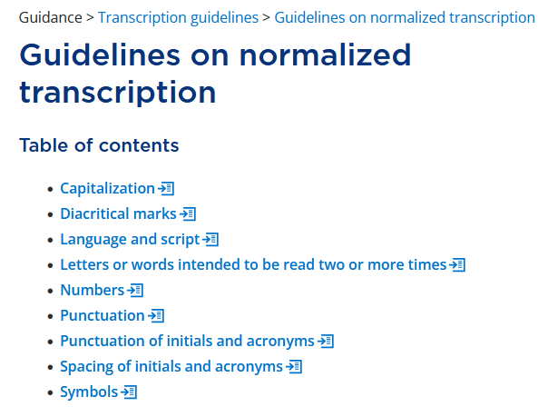
Recording statement of responsibility
Notes:
Scoll down to Recording an unstructured description. The second grey box is an option to apply the Guidelines on normalized transcription, and the PS says to apply this option. We do not need to linger here, everything is pretty much the same as we just saw for normalized transcription for title proper except for one thing, so let’s briefly click on “Guidelines on normalized transcription” and again, go to the capitalization rules

Slide 45
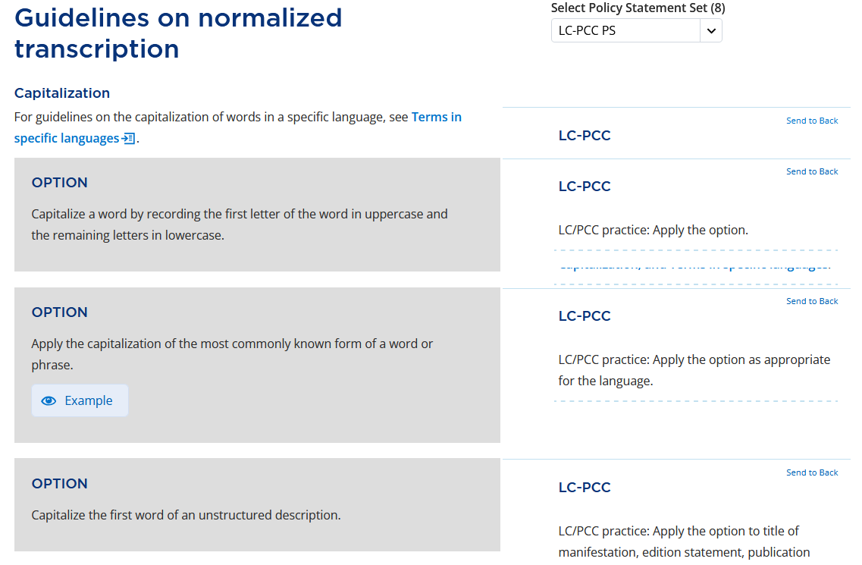
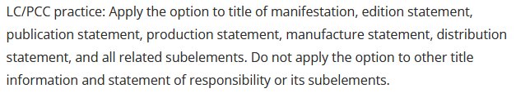
Recording statement of responsibility
Notes:
The third option, as we have seen, says to capitalize the first word of an unstructured description. We are recording Statement of responsibility as an unstructured description, so you might think this applies to this element, but think again. Let’s have a look at the full PS. “Do not apply the option to … statement of responsibility.” So unless there is another reason to capitalize, we won’t. Is there another reason?
Click on Terms in specific languages, …

Slide 46
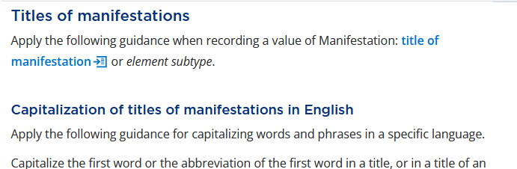
Recording statement of responsibility
Notes:
Then “terms in English”, then “Titles of manifestations” (which includes statement of responsibility). We’ve already seen this so we don’t need to linger, but scroll down to “Names of persons”.

Slide 47
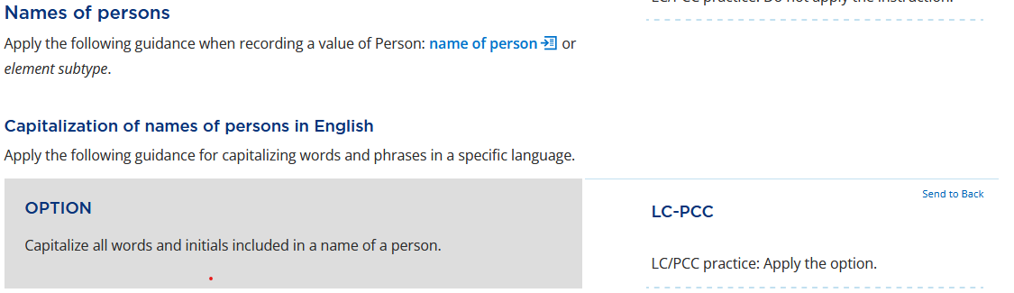
Recording statement of responsibility
SHANE ARBUTHNOTT = Shane Arbuthnott
Notes:
We are instructed to capitalize all words and initials included in a name of a person, and so there is another reason to capitalize the first word of this statement.

Slide 48
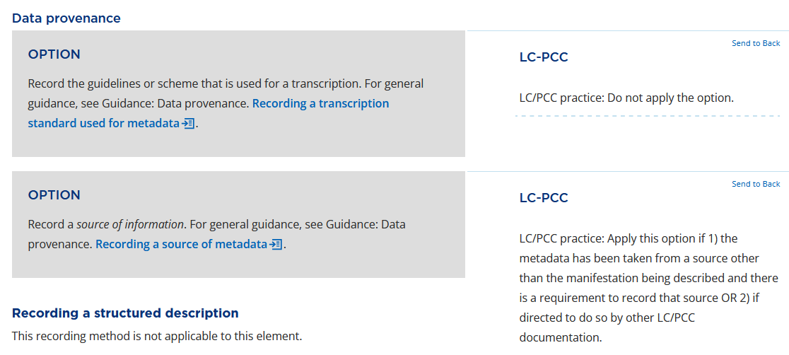
Recording statement of responsibility
SHANE ARBUTHNOTT = Shane Arbuthnott
Notes:
Backtrack to Statement of responsibility. There are no other pertinent options, so we’re ready to record our value, but for just a second scroll down and pause at Data provenance. Do we need to record the source of our statement of responsibility? The PS says no—our metadata is not taken from a source other than the manifestation being described and there is no requirement to record the source.

Slide 49
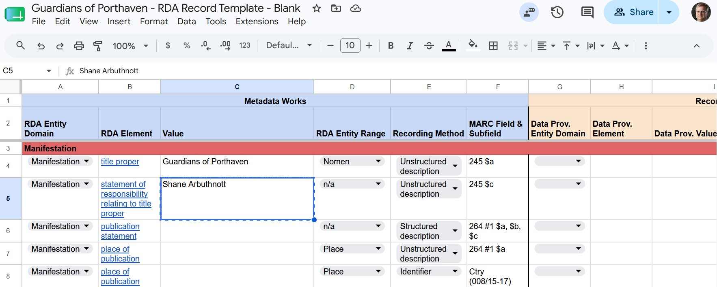
Recording statement of responsibility

Slide 50
place of publication

Slide 51
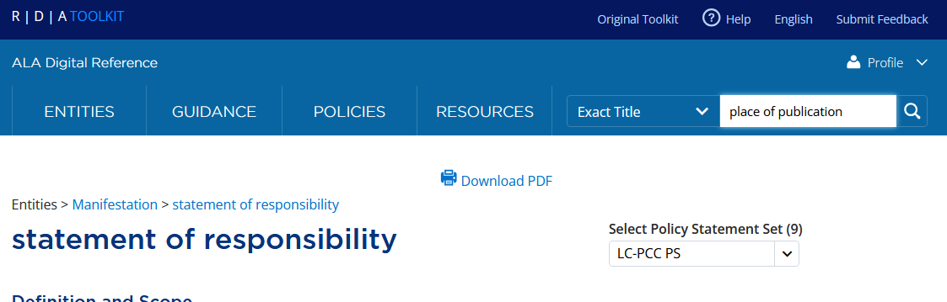
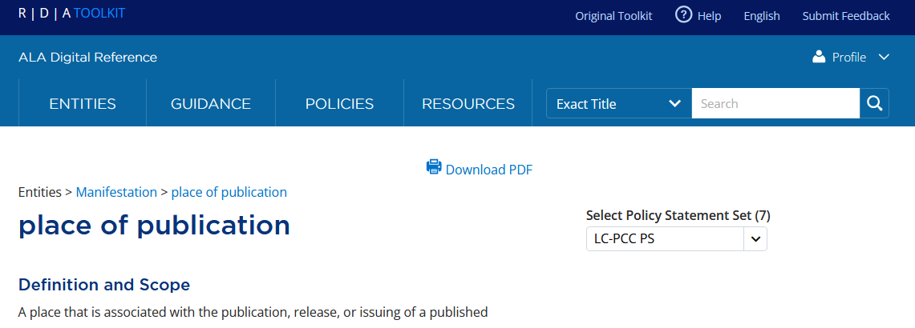
Recording place of publication
Notes:
Now let’s have a look at the place of publication element. Enter “place of publication” in the search box at the top, make sure “Exact title” is in the dropdown; and hit enter or click on the magnifying glass.

Slide 52

Recording place of publication
Notes:
The definition tells us it’s a place associated with the publication of a manifestation. That is, it will at least in theory be associated with a publisher, the entity responsible for a publication.
We learn that place of publication is a subelement of publication statement. Susie will be talking about the publication statement element, because it is recorded using a structured description. But to prepare for that we need to talk about the subelements, which are recorded as unstructured descriptions.
We also learn from the PS that this element is core, that is, required, so we need to pay attention.

Slide 53


Recording place of publication
Notes:
Scrolling down to “recording” we learn that we are to record a value of “appellation of place”—what is that? Click on the little icon to the right of the words and the glossary definition will appear. It’s a nomen (we’ve already encountered this word) that refers to a place. In other words, the name of a place. OK, fine. We can do that.
The first option tells us to record the value that appears first if there are more than one. The PS tells us to do this. The sequencing of this option may seem strange—we don’t have a situation where there are two or more values; we don’t even have a single value as we shall see, but we can deal with this.

Slide 54




Recording place of publication
Notes:
Let’s pause and see what evidence we do have for an appellation of place (return to the surrogates that you have open).
No place is named on the title page. Other than “Canada and the United States” no place is named on the verso of the title page. According to the evidence in the surrogates, no specific place for Orca Book Publishers is named in the manifestation. Can we do better than this? The back cover gives a URL for the publisher, orcabook.com. Let’s see what we find there. Under “About” we learn that Orca Book Publishers is located in Victora, British Columbia. Note, however, that this information is not in the manifestation.

Slide 55

Recording place of publication
Notes:
Back to RDA, scroll down in the place of publication element to “Recording and unstructured description.” We’ve seen identical language to this in the other two elements we’ve examined, and the PS is the same—we’re to record a value for this element using normalized transcription. And we’ve already seen exactly what to do—remember under Title proper we had a look at the guidelines for English and discovered that the names of places are capitalized.

Slide 56

Recording place of publication
Notes:
Continuing to scroll down we are given a couple of options about local and larger place names.
The first option says what to do if we have a value for a local place name. The PS says to record that as the value for the element.
The second option says what to do if we have a value for a larger place. The PS says to record that if no local place name is present on the manifestation.
So what do we have here? There is no local place name in the manifestation, so you might think we’re just to apply the second option and record “Canada” or maybe both “Canada” and “United States.”
However, we do happen to have a value for a local place name—the first option doesn’t say the value has to come from the manifestation, and we know because we did a teeny bit of research that the local place name is Victoria, British Columbia. So we can apply the first option.
Further, there is another option that applies—scroll down to “Place names not found.”

Slide 57

Recording place of publication
Place known from a source of information outside the manifestation: Victoria, British Columbia. Record in square brackets:
[Victoria, British Columbia]
Notes:
If there is no place of publication—here we’ll interpret to say a specific place of publication, not just Canada or United States—there is a condition option that allows us to record a value from another source. The PS says to supply a value if known. We do know the value, Victoria, British Columbia. Please notice that this is exactly the form found on the source (the publisher’s website). RDA calls for transcribing information exactly as found, even if it’s from a source outside the manifestation itself, so don’t abbreviate British Columbia to B.C.
The PS further says to supply the value in square brackets. This is a convenient reminder, although we could have figured that out by reading the “data provenance” section as well. We are now ready to record a value for this element in the worksheet template.

Slide 58

Recording place of publication
Notes:
Skip the publication statement row, we’ll come back to that later. But notice it’s listed as using the structured description recording method.

Slide 59
name of publisher

Slide 60


Recording name of publisher
Notes:
Next element: name of publisher. Put “name of publisher” in the search box, make sure the dropdown says “Exact title” and hit enter.
The definition tells us it’s a nomen that is the name of an agent responsible for publishing a manifestation. We also learn it is a shortcut element. We won’t go into that in detail, but it just means it actually represents a chain of relationships.
We learn that place of publication is a subelement of publication statement. Again, Susie will be talking about the publication statement element, because it is recorded using a structured description. But to prepare for that we need to talk about the subelements, which are recorded as unstructured descriptions.
We also learn from the PS that this element is core, that is, required.

Slide 61

Recording name of publisher
Notes:
Scroll down to Recording. We are told to record the element as a value of a nomen string. We’ve already seen this under Title proper, and we concluded there that that means we are to record text.
Looking down a bit, we learn we are to record a value of this element that appears first

Slide 62

Recording name of publisher
Notes:
Continue to scroll down to Recording an unstructured description. This should look very familiar by now and you will not be surprised to learn that the PS tells us to record the name following the Guidelines on normalized transcription.
Let’s click on that to see if there are any instructions we haven’t yet seen for capitalization of corporate bodies. Just as we have done two or three times now, click on Guidelines on normalized transcription; then Capitalization, then terms in specific languages, then terms in English. I won’t show all the steps on the slide.

Slide 63

Recording name of publisher
Notes:
We find there is a section on capitalization of corporate bodies.

Slide 64

Recording name of publisher
ORCA BOOK PUBLISHERS
=
Orca Book Publishers
Notes:
You will not be surprised to learn, scrolling down, that we are instructed to capitalize the name of an institution (etc.). Remember “capitalize” means record the first letter of a word using a capital letter; the rest of the word will be lower-case, if we are normalizing, however it is presented on the source. Looking at our surrogate title page we do have a presentation of the name of the publisher. Following the guidelines, the nomen string will be recorded as shown here. We are now ready to record a value for this element in our worksheet.

Slide 65

Recording name of publisher
Notes:
Moving on, let’s have a look at the date of publication element.

Slide 66
date of publication

Slide 67


Recording date of publication
Notes:
Next element: date of publication. Type “date of publication” in the search box, make sure the dropdown says “Exact title” and hit enter.
We learn that date of publication is a timespan during which the publication occurred. We also learn from the PS under Prerecording that the element is core, so we need to record it. Since Timespan is a new concept, we’re going to look at it very briefly, just two slides.

Slide 68

Timespan
Notes:
Timespan is an entity in Official RDA, which is a major change from Original RDA, where dates (aka timespans) were attributes of various entites.

Slide 69

Timespan
Notes:
The only thing we’re going to look at here is the definition: a finite period of time. A finite period of time might seem short, but this isn’t necessarily so. The only limit is it has a beginning and an end. So a nanosecond is a timespan; and the age of the universe is a timespan. A date of publication is a timespan. Our evidence for the date of publication is usually a year we find recorded on a manifestation, so even though the timespan is probably shorter than a year (it might be a single day), our evidence makes us record a year, which is standard practice even if we happen to see a shorter timespan (we would record 2026 even if the manifestation said April 26, 2026). This is just our cultural cataloging practice for general cataloging.
One last point, however: since timespan is an entity, and manifestation is an entity, that means when we record the place of publication element we are actually recording a relationship between a manifestation and a timespan. Theoretically we could create descriptions, aka authority records for timespans. If we did this we could record the date of publication element using a linking field between the manifestation and the timespan description. We aren’t doing that (yet!), so for the moment we will continue recording timespans such as date of publication as attributes of other entities rather than relationships. But being aware of the change in the underlying model is important, and may lead to changes in practice in the future.
OK, now go back to Date of publication by clicking on the back button or typing the name of the element in the search box again.

Slide 70


Recording date of publication
Notes:
Scroll down to Recording. We are to record this timespan as an “appellation of timespan” or as an IRI. We aren’t currently using IRIs (if we were we would have to use the IRI to point at a separate description of the timespan, which I already noted we aren’t creating now), so we’re left with appellation of timespan. We saw earlier in this presentation that appellation simply means a name, that is, text, which we’re all used to doing.
There is a PS but it isn’t pertinent, it’s about CIP cataloging, which we aren’t doing.
Let’s take stock for a moment of what information we already have about date of publication. Look in the surrogate at the verso of the title page. The statement starts with a copyright statement, but, hurrah!, the very next sentence tells us quite positively when this manifestation was published, 2021. Publishers are not always so considerate of catalogers. “2021” is an appellation of the timespan.

Slide 71

Recording date of publication
Notes:
Returning to RDA, scrolling down after “Recording” we see a bunch of conditions that do not apply to our book. The date is not represented in different calendars; only one value appears; an exact date IS known; this is not a diachronic work (one that exists over time), whether incomplete or complete; so we can skip right to the guidelines for recording an unstructured description.
First we are told to record this as a name of timespan. Technically they’re not the same thing, but we don’t have time to go into all the ins and outs of appellation, name, and nomen, so let’s just say we can think of this as the same thing as appellation of timespan that we saw earlier.
We’ve seen this exact set of options several times now. And it is no surprise that the PS instructs us the apply the guidelines on normalized transcription. Let’s just go there to see if there is anything about normalized transcription for timespan. Click on Guidelines on normalized transcription

Slide 72

Recording date of publication
Notes:
I don’t see anything here about timespan, but as a matter of fact, our method of writing a year is to use a number, and there is something about that. Let’s click on it.

Slide 73

Recording date of publication
Notes:
There are quite a few options, but the first one is the most basic: Transcribe a number as it appears, and the PS instructs us to apply the option except when recording numbers in certain non-Latin scripts, which isn’t the case with our book. So I think our case is pretty straightforward. Note, however, the PS to “apply the option” means transcribing Roman numerals as they appear, as Roman numerals. If that happens, we would then go to option number 3, “Transcribe a numeral as it appears and in an equivalent form preferred by an agent who creates the metadata.” The PS doesn’t say this here, but the equivalent form preferred by our agency is Arabic, which we would record in square brackets following the numeral as it appears. That might be the case with some of your exercises today. But it isn’t the case with Guardians of Porthaven so let’s just file that piece of information away for the moment.

Slide 74
Recording date of publication
Review:
Record an appellation of timespan / name of timespan
Use normalized transcription
Transcribe a number as it appears
If it’s not an Arabic numeral, give an equivalent Arabic numeral
2021
Notes:
We’re ready to record our value in the worksheet

Slide 75

Recording date of publication

Slide 76
name of person

Slide 77

Recording name of person
Notes:
While we’re at it thinking about unstructured descriptions, we’re going to jump momentarily from the description of a manifestation (which we’re used to thinking of as a bibliographic record) to the description of a person (which we’re used to thinking of as an authority record). There are several elements in the description of a person entity that are unstructured, but we’re only going to look at one, name of person, since there is a person related to Guardians of Porthaven that needs describing.
We’re moving to a new entity, so click on the Entities menu, click on “person” and let the Toolkit go there.

Slide 78

Recording name of person
Notes:
Before we continue, we need to open a template where we will build a description of this person, and where we can record a value for name of person. To back to the Google drive, the folder for Guardians of Porthaven. Open “Authority – Person – Shane Arbuthnott”.

Slide 79

Recording name of person
Notes:
Open Copy of blank.

Slide 80

Recording name of person
Notes:
PLEASE SAVE THIS FORM TO OUR OWN COMPUTER. DO NOT FILL OUT THE FORM IN THE DRIVE WE’RE ALL SHARING.

Slide 81

Recording name of person
Notes:
The person entity is defined as “An agent who is an individual human being who lives or is assumed to have lived.” This is a change from original to official RDA. According to the authors of Official RDA, a “person” has to be a “real” human being. You will remember that in Original RDA, fictitious and non-human entities such as named animals could be described as person entities. Many of us thought this was a leap forward from AACR2 which didn’t allow us to describe, for instance, animal actors such as Keiko the whale in name authority records because previously they were not considered persons. So many were disappointed with this development in Official RDA. Those of you who feel that way will be relieved to see the PS, therefore, under Prerecording “LC/PCC practice: A person entity may also be a fictitious entity or a non-human entity.” So we will be continuing the same practice in NACO that we have been for the last ten years. But that doesn’t actually apply to the person related to Guardians of Porthaven, so I just point it out for your information.

Slide 82

Recording name of person
Notes:
So as a reminder, we do have a person related to this work, Shane Arbuthnott, who is named on the title page as well as on an author bio page which shows us a photograph and gives other information. We want to create a description of this person. I am going to demonstrate one element only of this description, name of person.

Slide 83

Recording name of person
Notes:
You should all be on the Person entity page. Go to the very bottom and, under Elements, you will see a list of all possible elements that can be used to describe a person scroll through the list until you find name of person. Click on it.

Slide 84

Recording name of person
Notes:
This element is defined as “A nomen that is an appellation of person in natural language and phrasing used in common discourse.” We’ve already talked about “nomen” and “appellation”—it pretty much means “name”—but the important language here is “natural language … used in common discourse.” Name of person is an appellation, as we shall see, that has not been manipulated in any way. People call me Robert Maxwell, not “Maxwell, Robert.” “Robert Maxwell” is natural language used in common discourse. That’s what name of person is.
We also see that RDA recognizes many different kinds of names, including a real name, a pseudonym, a nickname, initials, and so on. We will skip over all these details today, sorry … Instead, let’s scroll down to Recording and Recording an unstructured description.

Slide 85

Recording name of person
SHANE ARBUTHNOTT = Shane Arbuthnott
Notes:
First of all, we are instructed to record this as a value of nomen string. You all know what this means now. What is a nomen string? A combination of signs, such as letters of the alphabet. I think we can manage this.
Next, under unstructured description, we see the now familiar options, and we are going to follow the third option, to follow the guidelines on normalized transcription. We don’t need to review these, we already learned everything we need to know when we were looking at the statement of responsibility element: Capitalize the words in a name. So we will record “name of person” by transcribing text from a manifestation. We happen to have text to transcribe on the title page. This will be the value we will record for name of person in this person’s description.

Slide 86

Recording name of person
Notes:
In a MARC record this value is recorded in a 670 field, usually subfield $b. There is no specific place in the MARC authority record to record the “name of person” element.

Slide 87

Recording name of person – data provenance
Notes:
We’re not quite done yet, though. Scroll down in the Name of person element to Data provenance. The second option says to record a source of information, and the PS says to apply the option if the metadata has been taken from a source other than the manifestation being described (not the case here), or if directed to do so by other LC/PCC documentation. You may remember that in NACO practice we are required to record the source of information for the manifestation we’re cataloging that caused us to create the authority record. The second part of the PS applies. Let’s briefly examine this further in Official RDA. Click on “recording a source of metadata.”

Slide 88


Recording name of person – data provenance
Notes:
We are taken to the general guidance on Data Provenance, a section called “Recording a source of metadata”. This starts by talking about a manifestation being described. We’re not actually describing a manifestation here, we’re describing a person. Let’s see what we find by scrolling down. You will pass quite a few options, some of which we’ve already looked at, and come to a section called “Recording a source of metadata that is not a manifestation being described. That’s what we want to do. The first option looks promising, “Record the source of information as a Work: source consulted of the metadata work.” And the PS further zeroes in: “Apply the option when it is applicable. For further instructions on recording a source consulted in association with data identifying agents or in association with relationships between agents, works, expressions, manifestations, or items, see Work: source consulted.” We are recording a source associated with an agent. But back to the option, what is a “metadata work”? It’s simply a work that records metadata. An authority record is an example of a metadata work; the descriptions we’re creating today in the workshop are metadata works. All the elements that apply to the main “work” entity potentially could apply to a metadata work. So now you know the secret.
SO, we want to see what the source consulted element has to tell us. Click there.

Slide 89

Recording name of person – data provenance
Notes:
The source consulted element is defined as “a manifestation in which there is evidence for a metadata work.” Notice in the breadcrumbs that we are now in the Work entity, no longer in the person entity. That is because this element is used in the description of a metadata work. What is our metadata work? It is our description of the person Shane Arbuthnott. And what is the manifestation in which there is evidence for this metadata work, the description of Mr Arbuthnott? Why, the novel Guardians of Porthaven, which has evidence for his name on the title page. So we’re definitely in the right place.
We’re instructed to record this as an appellation of manifestation—both in the basic guideline and in the associated PS. The PS tells us what that appellation is, the title proper.

Slide 90

Recording name of person – data provenance
Notes:
But let’s click through to appellation of manifestation. Here we’re told to record an appellation of manifestation as a nomen string—we know what that is, right?? (ask audience for response). And we are instructed under unstructured description to record a value of “title of manifestation.” This confirms what the PS said on the previous slide—title proper is a subelement of title of manifestation.
We can do this much in our worksheet:

Slide 91

Recording name of person – data provenance
Notes:
You can see that in a MARC record (look at the MARC field column) this is recorded in 670. We’ve now followed the RDA instruction and recorded an appellation of manifestation as the value for this element. You may say now, “wait a minute, that isn’t all that’s in a 670 field!” and you’d be right. Go back to the source consulted element (if you’re still on appellation of manifestation, hit the back button).

Slide 92

Recording name of person – data provenance
Notes:
Scroll down in the PS. It says “See the Metadata Guidance documentation: Works.” OK, click there.

Slide 93


Recording name of person – data provenance
Notes:
We are now in the MGD for works. Remember we’re creating a metadata work when we create a description of a person, aka an authority record, so this MGD applies. Scroll down the table of contents a couple of pages through dozens of work-related elements until you come to the very last one, source consulted. Click there.

Slide 94

Recording name of person – data provenance
Notes:
We are given MARC-oriented instructions for recording a value for source consulted. For our worksheet we can ignore the parts about subfields, but otherwise we’ll follow these instructions, and when you translate all this into the MARC record do pay attention to the subfields.
This is for use in authority records (e.g. our description of a person)
In the MARC record it will be recorded in 670 or 675
Fourth bullet point: record title of manifestation, and date of publication. How about that, we’ve already recorded both these values earlier in this presentation: Guardians of Porthaven and 2021.
Record the location within the manifestation, then statements of the information found. Nothing given here about punctuation, so I’ll just tell you the traditional punctuation.

Slide 95
Recording name of person – data provenance
Value for source consulted, following the MGD for works
Traditional punctuation
  comma after title proper;
  colon after date of publication if a location is given;
  location;
  within parentheses the data found
In RDA worksheet:
Guardians of Porthaven, 2021: title page (Shane Arbuthnott) about the author (lives in Regina, Saskatchewan)
In MARC:
670 ## $a Guardians of Porthaven, 2021: $b title page (Shane Arbuthnott) about the author (lives in Regina, Saskatchewan)
Notes:
We have a little more data from the surrogates—the about the author page tells where he lives, which you’ll be using later on in the workshop if you decide to finish this person description this afternoon, so record it here.

Slide 96

Recording name of person – data provenance
Notes:
You probably like this version of the value for source consulted a little better than the one a few slides ago.
We’re almost finished with unstructured description! Just one more thing.

Slide 97
preferred name of person

Slide 98


Recording name of person (preferred name)
Notes:
Return to Name of person by typing name of person in the search box, with the dropdown set to exact title. Scroll down until just before the first option box: A name may be categorized as … You can see the element “name of person” is divided into two types: preferred name and variant name. Click on preferred name of person.

Slide 99

Recording name of person (preferred name)
Notes:
There are three things to note here. First, perhaps most important, it is core, so we are required to record this element.
It is defined as a nomen –you know that that is, now--that is selected for preference in a specific application or context—our context is the NACO authority file.
And it is recorded as a nomen string (=??)

Slide 100

Recording name of person (preferred name)
Notes:
Scrolling down we discover that we are to record it as an unstructured description, and we are to record a value of name of person—hurrah, we’ve already recorded a value of name of person! Our work is nearly done. In fact our work is done, because we only recorded one value for name of person, so we don’t have any choice, that’s the one we’re going to record as preferred name of person. But let’s briefly look at one condition and option which are pretty common and that you’ll need to apply today with other examples. Scroll to Persons with two or more names.

Slide 101


Recording name of person (preferred name)
Notes:
The first three policy statements mostly say to apply cataloger’s judgment, but I’m going to go out on a limb and say the first condition option is the most important. If we have recorded values for more than one name of person, we are to choose, for the preferred name, a value that appears most frequently. The fourth condition does have a PS that says to apply the option, to record the value that appears most frequently in manifestations. I personally find this a bit of a distinction without a difference since I have trouble imagining a source of information that is not also a manifestation.
Again, in our case there is only one choice, so that’s the value we’ll record in our worksheet for this element.

Slide 102

Recording name of person (preferred name)
Notes:
Notice that the value we’ve recorded for “preferred name of person” is identical to that for “name of person”, because we derived it from the value we recorded for “name of person.” Also note that we’ve recorded the same information in “source consulted”. As a matter of fact there is no place in the MARC record to record specifically the name of person element or the preferred name of person element. I really wish there were. But we can’t. So this information, in the MARC authority record, is simply recorded as part of the source consulted element, in 670. There isn’t even a way to designate that a particular form is the preferred form, all we can do is record this information as part of source consulted.
Also note that the value for preferred name of person is NOT the same as the authorized access point for the person, which we’ll be getting to later on when we’re talking about structured description.

Slide 103
Review: unstructured description recording method
Start with the entity you want to describe, e.g. “Person”
Look through the elements at the bottom of the entity page for the one you want to record, e.g., “name of person”
Start by reading the definition and scope and the prerecording section:
  Is this in fact the element you want?
  Is this element LC-PCC Core?
  Is there other information you need to know to record the element?
Look at the recording instructions;
  If there is unfamiliar vocabulary, click on the links
  If other elements are mentioned (e.g. “preferred name of person”), click on them to read their instructions
Look at the recording an unstructured description instructions; choose from the various options
  Decide based on your needs and the situation
  Decide based on LC-PCC practice instructions in the Policy Statements
Determine if there are any data provenance requirements
Notes:
This is what we’ve been doing for each element we’ve examined for this part of the presentation.

