Slide 1
Practice Cataloging Using Official RDA
Workshop materials:
https://bit.ly/RDA-ALA-26
Notes:
Logistics:
Wifi
Restrooms
Good morning and welcome to the RDA preconference workshop “Practice Cataloging Using Official RDA.” Today’s workshop has been developed by the PCC Standing Committee on Training RDA Training Task Groups for Monographs and Name Authorities, as well as the North American RDA Committee (NARDAC).

Slide 2
Presenters and Helpers
Michael Babinec Northwestern University | Robert L. Maxwell Brigham Young University | Yuji Tosaka The College of New Jersey
Adam Baron University of California, Berkeley | Oksana Osborne U.S. Government Publishing Office | Cathy Weng Princeton University
Laura Doublet University of Victoria | Adam L. Schiff University of Washington
Susie Jones Vancouver Public Library | Trina Soderquist Library of Congress
Notes:
I am Adam Baron and I am here with Michael Babinec, Laura Doublet, Susie Jones, Bob Maxwell, Oksana Osborne, Adam Schiff, Trina Soderquist, Yuji Tosaka, and Cathy Weng.

Slide 3
Acknowledgements
Kaylin Blount University of Pennsylvania | Hong Cui Library and Archives Canada
Bradley Carrington New Mexico State Library | Tricia Mackenzie Library of Congress
Notes:
I also want to acknowledge those people who helped develop content for the workshop but were unable to be here today: Kaylin Blount, Bradley Carrington, Hong Cui, and Tricia Mackenzie.

Slide 4
Learning Outcomes
At the end of the workshop, you will be able to:
Understand and apply official RDA instructions and PCC practices for describing monographs and other resources in MARC 21 bibliographic records
Understand and apply official RDA instructions and PCC practices for creating name authority records in MARC 21
Understand and apply the BIBCO Standard Record (BSR) Official RDA Metadata Application Profile
Apply appropriate guidance in LC-PCC Policy Statements and RDA Metadata Guidance Documentation
Notes:
By the end of the workshop, we hope you will be able to:
Understand and apply official RDA instructions and PCC practices for describing monographs and other resources in MARC 21 bibliographic records
Understand and apply official RDA instructions and PCC practices for creating name authority records in MARC 21
Understand and apply the BIBCO Standard Record (BSR) Official RDA Metadata Application Profile
Apply appropriate guidance in LC-PCC Policy Statements and RDA Metadata Guidance Documentation

Slide 5
Overview
Briefly introduce and explain how to use the RDA Toolkit and PCC documentation while cataloging or creating a name authority record
Demonstrate the basic process for cataloging or creating a name authority record using the official RDA Toolkit and PCC documentation and then coding the values in MARC 21
Provide plenty of opportunities for hands-on practice cataloging and creating name authority records using the official RDA Toolkit and PCC documentation
Help catalogers feel more comfortable and confident with official RDA
Notes:
As suggested by the title of today’s workshop, Practice Cataloging Using Official RDA, our goal is to provide plenty of time for hands-on practice using the official RDA Toolkit and PCC documentation to catalog various resources and create name authority records. As a result, we will only provide a very brief introduction to the RDA Toolkit and PCC documentation.
We will focus our presentations on the basics of recording unstructured descriptions, structured descriptions, identifiers, and data provenance. To exemplify these basic principles, each presentation will be followed by demonstrations that show how to use the RDA Toolkit and PCC documentation to obtain values for selected RDA elements and then code the values in MARC 21. Our hope is that these demonstrations provide a foundation for you to complete the exercises on your own or in small groups, with experts available to answer your questions.
Ultimately, we want you to feel more comfortable and confident with official RDA, regardless of how many exercises you complete.

Slide 6
Workshop Schedule
8:00 AM Introduction
Presenter: Adam Baron
8:20 AM Recording unstructured descriptions
Presenter: Robert L. Maxwell
9:20 AM Recording structured descriptions
Presenters: Susie Jones, Oksana Osborne
10:00 AM Break (15 minutes)
10:15 AM Recording identifiers; Recording data provenance
Presenter: Trina Soderquist
10:45 AM Q & A
Notes:
In the workshop schedule, the times are approximate and subject to change based on the time needed to cover the content. For the introduction, my goal is to get you set up for the first exercise, which will be used for the demonstrations.
Bob Maxwell will cover recording unstructured descriptions, and Susie Jones and Oksana Osborne will cover recording structured descriptions.
We will take a 15-minute break around 10:00, after which Trina Soderquist will cover recording identifiers and recording data provenance.
There will be a brief Q & A session after all presentations and demonstrations.

Slide 7
Workshop Schedule
11:00 AM Exercises
12:00 PM Lunch (1 hour)
1:00 PM Exercises
2:15 PM Break (15 minutes)
2:30 PM Exercises
3:45 PM Q & A / Wrap-up
4:00 PM Finish
Notes:
We are aiming for you to start working on the exercises independently or in small groups around 11:00.
Lunch will be on your own from approximately 12-1. Since you will be working on exercises before and after lunch, feel free to flex your lunch break.
There will be an afternoon break around 2:15, with the final Q & A and wrap-up at 3:45. As part of the wrap-up, we will ask you to complete a survey about your experience. Your feedback will be important as we work on training for PCC’s implementation of official RDA.

Slide 8
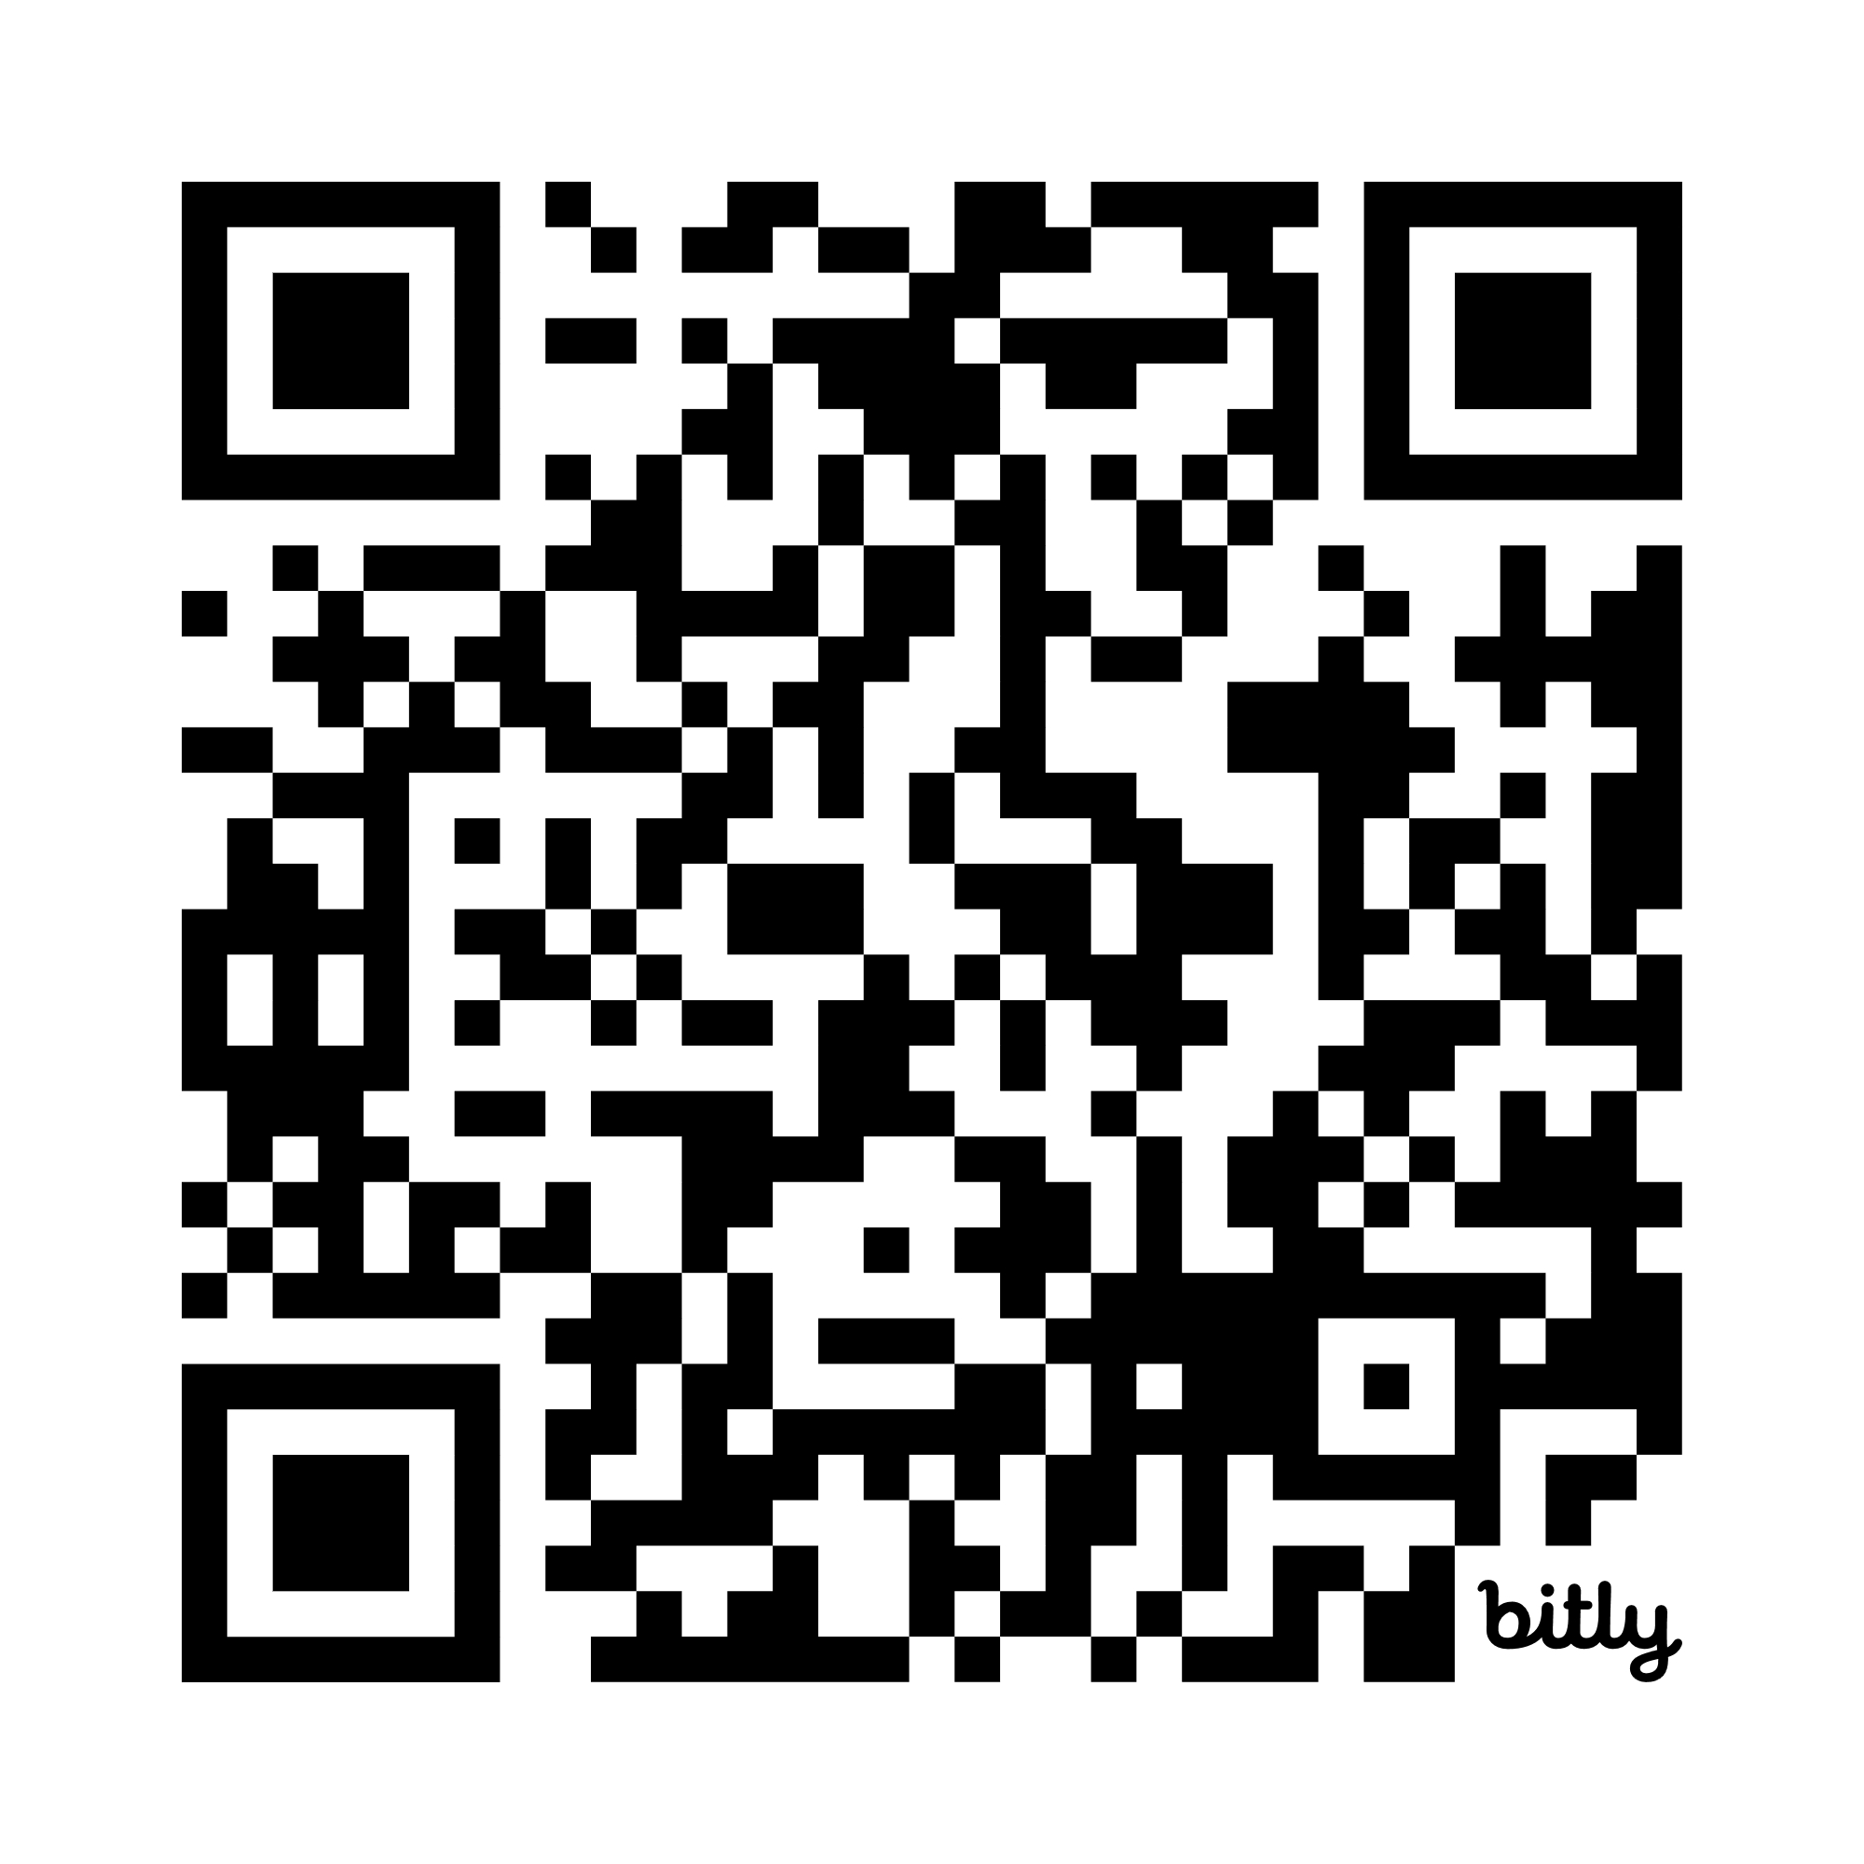
Workshop Materials
All workshop materials are available in a Google Drive folder
https://bit.ly/RDA-ALA-26
Notes:
All materials need for today’s workshop are available in a Google Drive folder available at bit.ly/RDA-ALA-26.
The Schedule and Resources document includes links to everything you will need for today.

Slide 9
Documents Needed
Documentation
  BIBCO Standard Record (BSR) Official RDA Metadata Application Profile
  RDA Toolkit
  LC-PCC Policy Statements (LC-PCC PSs)
  Metadata Guidance Documentation (MGDs)
Resource to catalog – Guardians of Porthaven
  1. Guardians of Porthaven - Surrogate.pdf
Copies of blank record templates and workforms
  2. Guardians of Porthaven - RDA Record Template - Blank
  3. Guardians of Porthaven - MARC Record Workform - Blank
  2. Shane Arbuthnott - RDA Record Template - Blank
  3. Shane Arbuthnott - MARC Record Workform - Blank
Notes:
To get started, you want to have access to the following documents:
The beta BSR for official RDA
RDA Toolkit
LC-PCC Policy Statements
Metadata Guidance Documentation
The surrogate of the book Guardians of Porthaven
Copies of blank RDA record templates and MARC record workforms for Guardians of Porthaven and Shane Arbuthnott

Slide 10
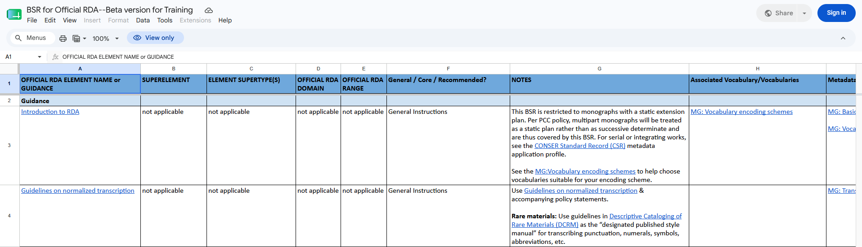
BIBCO Standard Record (BSR) Official RDA Metadata Application Profile
Provides PCC guidelines for Core and recommended elements applicable for describing monographic resources
Notes:
The BIBCO Standard Record (BSR) Official RDA Metadata Application Profile provides PCC guidelines for Core and recommended elements applicable for describing monographic resources.

Slide 11
Accessing BSR for Official RDA
Introduction
Beta version for training
https://bit.ly/Beta-BSR
Notes:
You can access the beta version of the BSR from the Schedule and Resources document or at bit.ly/Beta-BSR.

Slide 12

Accessing RDA Toolkit
Links in the BIBCO Standard Record (BSR) Official RDA Metadata Application Profile
https://access.rdatoolkit.org/
From RDA Toolkit homepage (https://www.rdatoolkit.org/)
Notes:
There are three ways to access the RDA Toolkit:
Clicking on direct links in the BSR to specific elements in the RDA Toolkit.
To go directly to the RDA Toolkit, type “access.rdatoolkit.org” into your web browser.
From the RDA Toolkit homepage at “rdatoolkit.org” and clicking on the “Access RDA Toolkit” button.

Slide 13
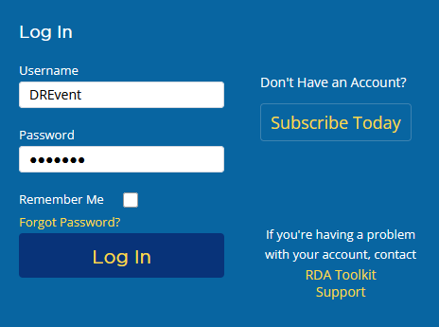
Logging In Using Institution Login
Enter the username:
DREvent
Enter the password:
ALA2026
Click Log In.
1
2
3
Notes:
If you do not have access to the RDA Toolkit through your institution, we have provided complimentary access using an institution login from ALA Digital Reference.
To login to the toolkit, enter the username DREvent, the password ALA2026, and then click “Log In”.

Slide 14
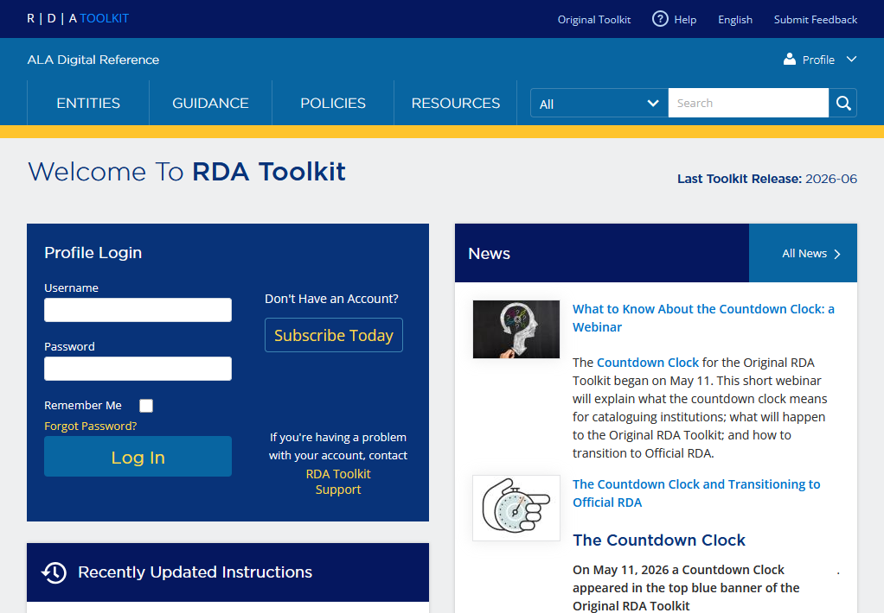
Successful Log In
Institution Login
ALA Digital Reference in the left portion of blue banner, under RDA Toolkit logo
Dark blue login box labelled “Profile Login”, under “Welcome to RDA Toolkit”
“Profile” icon in the right portion of blue banner
1
3
2
Notes:
You will know you have successfully logged in to the complimentary account because:
ALA Digital Reference appears in the left portion of the blue banner, under the RDA Toolkit logo;
A dark blue login box labelled “Profile Login” appears under the words “Welcome to RDA Toolkit”; and
A “Profile” icon appears in the right portion of the blue banner.

Slide 15
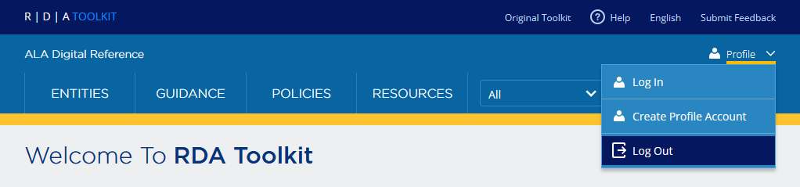
Logging Out
Time out after 30 minutes of inactivity
Close the browser
Log out button
Notes:
And because it will likely happen during the workshop, you will be automatically logged out after 30 minutes if you close the browser window or your session is inactive. If you have multiple browser windows open, you will be logged out when one of the windows is inactive for 30 minutes. This means that you could be actively working in one window and then logged out without warning because another window was inactive. When this happens, log in again, find the page you wanted to view, and select your policy statement set.

Slide 16
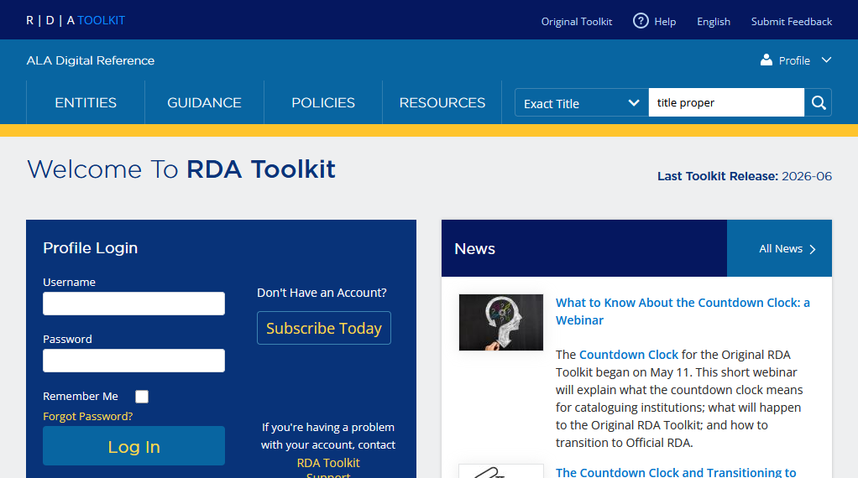
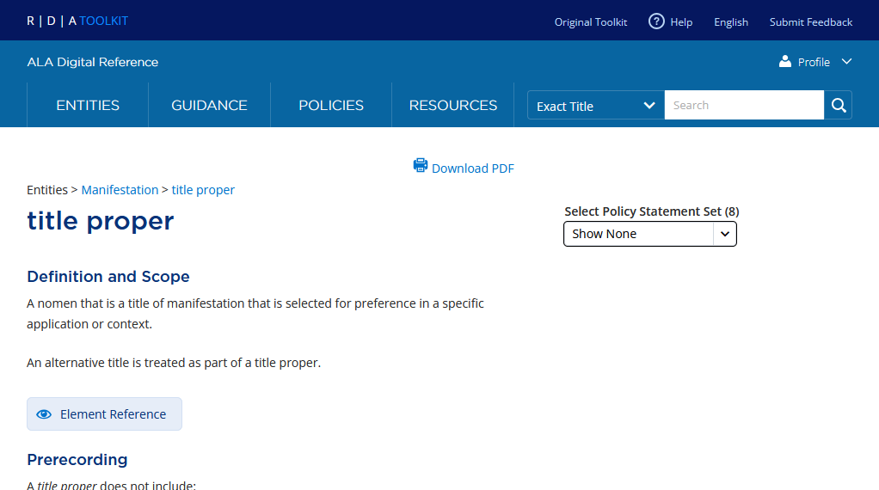
Searching by Exact Title
Use to search by the exact name of an entity, element, or other page to go directly to that page and skip the results page.
Do not use quotation marks.
If no page exists that exactly matches the search term, the search defaults to an All search and a results page displays.
Notes:
For the exercises, we have provided the element names. The easiest way to search for these elements in the RDA Toolkit is to use the drop-down menu to the left of the search box and select “Exact Title”.
In the search box, enter the exact title of the element without quotation marks. For example, an Exact Title search for title proper …
ELEMENT PAGE APPEARS ON CLICK
… goes directly to the element page with the title “title proper”.
If no page exists that exactly matches the search term, the search defaults to an All search and a results page displays.

Slide 17
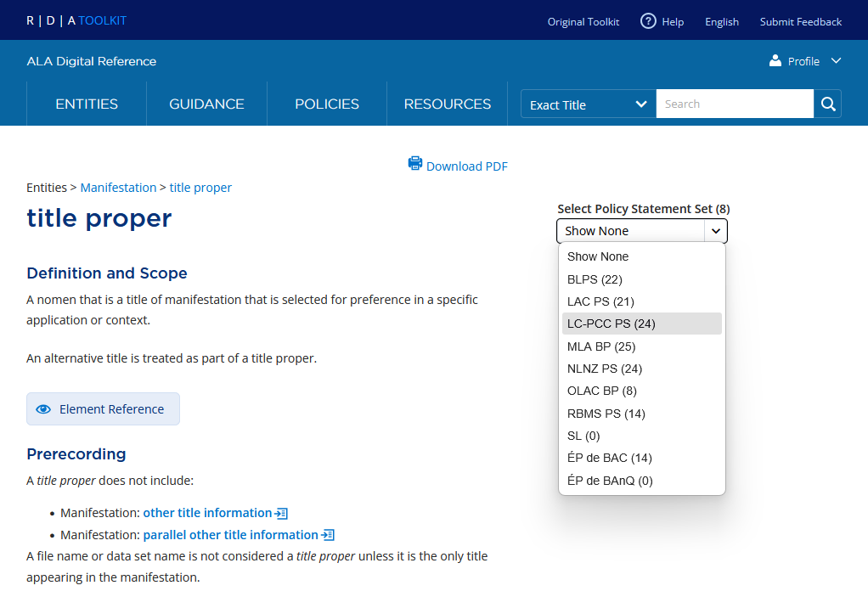
Viewing Policy Statements
Selecting Policy Statement Set
To view LC-PCC PSs, select LC-PCC PS from the Select Policy Statement Set drop-down menu
Only one set of policy statements can be viewed at a time
Notes:
Once on an element, entity, guidance, or resource page, you can select a policy statement set to view. To view the LC-PCC Policy Statements, select “LC-PCC PS” from the Select Policy Statement Set drop-down menu. You can also select to view the MLA and OLAC Best Practices; however, you can only view one set of policy statements at a time.

Slide 18
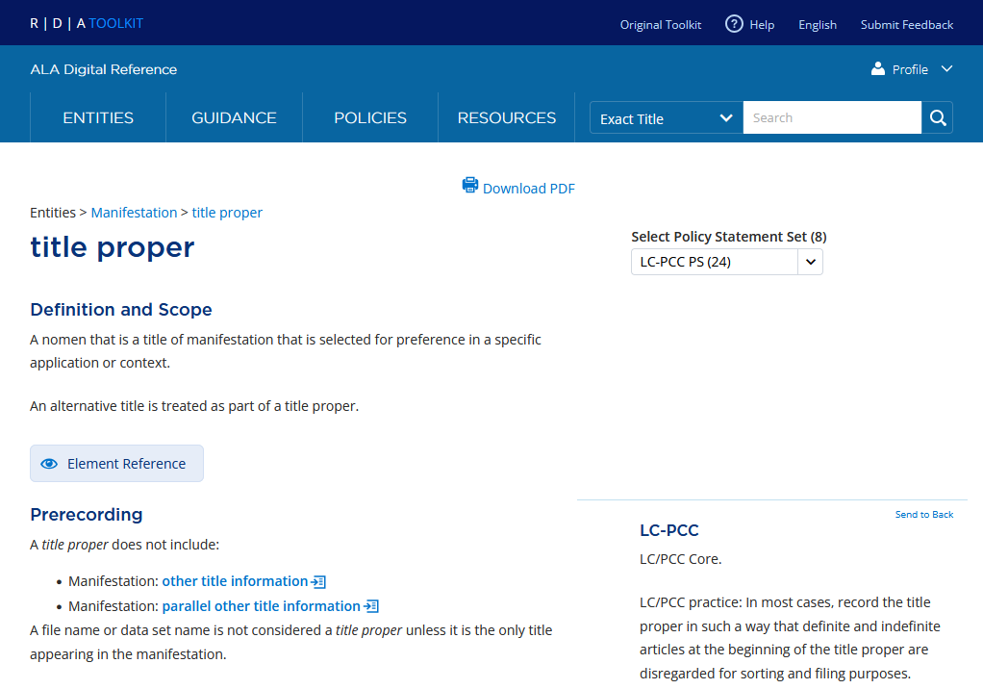
LC-PCC Policy Statements (LC-PCC PSs)
Prerecording: Core Elements
For Core elements:
The core statement always appears at the Prerecording level
Almost always the very first policy statement to appear on a page
Indicates the element is required if applicable and readily ascertainable
Notes:
A couple points about the LC-PCC PSs:
For Core elements, the core statement always appears at the Prerecording level and is almost always the first policy statement on the page. It may say “LC/PCC Core”, indicating the element is required if applicable and readily ascertainable for both LC and PCC.

Slide 19
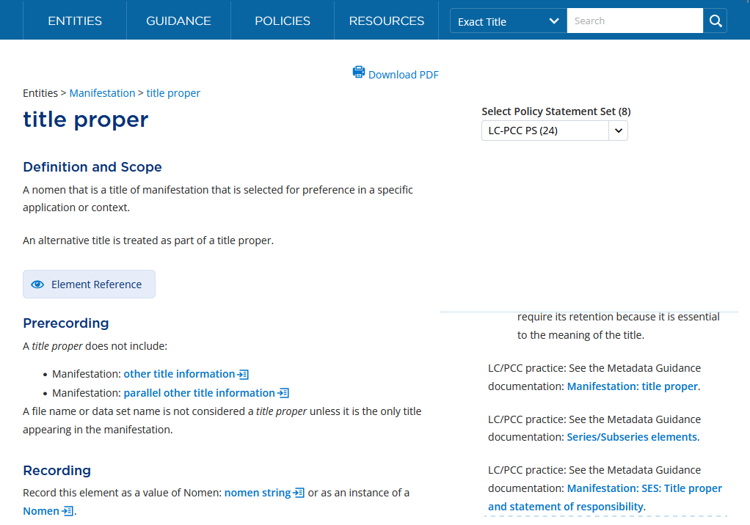
LC-PCC Policy Statements (LC-PCC PSs)
Links to Metadata Guidance Documentation
Always appear as the last LC-PCC PSs
May be linked at the Prerecording level or wherever the content of the MGD seems relevant to the section, option, or instruction
Notes:
If you scroll down within a policy statement, you may see links to Metadata Guidance Documentation (MGDs). MGDs are PDF documents that provide additional guidance and examples that could not be included in the policy statements.
Links to MGDs always appear last in the LC-PCC Policy Statements.
The most common location to find links to MGDs is at the Prerecording level; however, they may be linked wherever the content of the MGD seems relevant to the section, option, or instruction.

Slide 20
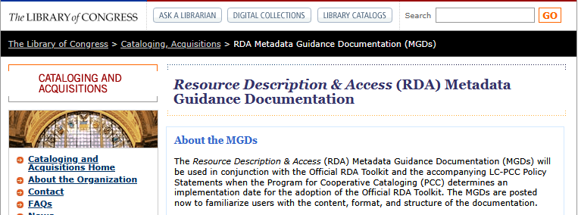
Accessing MGDs
LC website at https://loc.gov/aba/rda/mgd/
Notes:
The MGDs are also available on the LC website at loc.gov/aba/rda/mgd.

Slide 21
Accessing the Exercise Materials
Access the workshop materials at: https://bit.ly/RDA-ALA-26
Open Exercises > Books > 1. Guardians of Porthaven.
Notes:
To begin working on an exercise, access the workshop materials and select Exercises > Books > 1. Guardians of Porthaven.
This will be the exercise that we will start working on together.

Slide 22
Overview of Exercises
Each exercise has its own folder with the following files:
  Surrogates
    Copies of applicable resources for cataloging or creating name authority records
  RDA Record Template - Blank
    A template listing RDA elements, recording methods, and MARC 21 fields specific to the bibliographic or authority record being created
  MARC Record Workform - Blank
    Values from the RDA Record Template will be copied into the MARC Record Workform
  RDA Record Template - Answers
    Possible answers for completing the RDA Record Template
  MARC Record Workform - Answers
    Corresponding MARC record based on the RDA Record Template - Answers
Notes:
Each exercise has its own folder with the following files:
Surrogates: contains copies of applicable resources for cataloging or creating name authority records
RDA Record Template - Blank: a template listing RDA elements, recording methods, and MARC 21 fields specific to the bibliographic or authority record being created
MARC Record Workform - Blank: values from the RDA Record Template will be copied into the MARC Record Workform
RDA Record Template - Answers: possible answers for completing the RDA Record Template
MARC Record Workform - Answers: Corresponding MARC record based on the RDA Record Template - Answers

Slide 23
Creating Copies of Blank Templates
If you have a Google account:
Sign into your Google account.
Open 2. Guardians of Porthaven - RDA Record Template - Blank.
Select File > Make a copy.
In the Copy document window, change the Folder where the copy will be created.
Repeat with 3. Guardians of Porthaven - MARC Record Workform - Blank.
If you do not have a Google account:
Open 2. Guardians of Porthaven - RDA Record Template - Blank.
Select File > Download > Microsoft Excel (.xlsx).
Repeat with 3. Guardians of Porthaven - MARC Record Workform - Blank.
Also create copies of the blank authority record RDA Record Template and MARC Record Workform.
Notes:
To start, create copies of the blank RDA Record Template and MARC Record Workform.
If you have a Google account:
Sign into your Google account.
Open 2. Guardians of Porthaven - RDA Record Template - Blank.
Select File > Make a copy.
In the Copy document window, change the Folder where the copy will be created.
Repeat with 3. Guardians of Porthaven - MARC Record Workform - Blank.
If you do not have a Google account:
Open 2. Guardians of Porthaven - RDA Record Template - Blank.
Select File > Download > Microsoft Excel (.xlsx).
Repeat with 3. Guardians of Porthaven - MARC Record Workform - Blank.
Since we will also be working on the authority record, also create copies of the blank authority record RDA Record Template and MARC Record Workform.
Once you create a copy, you can close the original.

Slide 24
Summary
At this point, you should have the following open:
Documentation
  BIBCO Standard Record (BSR) Official RDA Metadata Application Profile
  Official RDA Toolkit
  (Optionally) Metadata Guidance Documentation website
Copies of blank record templates and workforms
  2. Guardians of Porthaven - RDA Record Template - Blank
  3. Guardians of Porthaven - MARC Record Workform - Blank
  2. Shane Arbuthnott - RDA Record Template - Blank
  3. Shane Arbuthnott - MARC Record Workform - Blank
Notes:
For the first exercises, you should have the following open:
Documentation
BIBCO Standard Record (BSR) Official RDA Metadata Application Profile
Official RDA Toolkit
(Optionally) Metadata Guidance Documentation website
Copies of blank record templates and workforms
2. Guardians of Porthaven - RDA Record Template - Blank
3. Guardians of Porthaven - MARC Record Workform - Blank
2. Shane Arbuthnott - RDA Record Template - Blank
3. Shane Arbuthnott - MARC Record Workform - Blank

Slide 25
Scenario for Exercises
Imagine each resource requires original cataloging
If creating an authority record, imagine it has not already been established in the LC/NACO Authority File (NAF)
  If searching NAF, disregard the authority record for the entity
  The authorized access point you create may differ from that in NAF
  Use the authorized access point from your authority record in your bib record
If not creating an authority record, use the authorized access point that has been established in NAF
Notes:
As you are working on the exercises, imagine that each resource requires original cataloging.
If creating an authority record, imagine it has not already been established in the LC/NACO Authority File (NAF). If search NAF, disregard the authority record for the entity. The authorized access point that you create may differ from that in NAF. Use the authorized access point from your authority record in your bib record.
If not creating an authority record, use the authorized access point that has been established in NAF.

Slide 26
Overview of the Process
Identify elements to record.
Review relevant RDA instructions and PCC documentation.
Determine the value to record.
Record the value in RDA Record Template.
Record the value in MARC Record Template.
Notes:
As we go through the cataloging or creating a name authority record, we will do the following for each element:
Identify elements to record.
Review relevant RDA instructions and PCC documentation.
Determine the value to record.
Record the value in the RDA Record Template.
Record the value in the MARC Record Template.
In this process, we focus on using RDA and the PCC documentation to determine the value to record and then we encode that value in MARC.
I will now pass things over to Bob Maxwell who will walk us through recording unstructured descriptions and the first few elements.

