Slide 1
Documentation used by
PCC catalogers
Notes:
To start, we are going to review the documentation for official RDA used by PCC catalogers.

Slide 2
RDA Copyright
©2010-2025 - American Library Association, Canadian Federation of Library Associations, and CILIP: Chartered Institute of Library and Information Professionals.
Screen images from the RDA Toolkit (www.rdatoolkit.org) used by permission of the Copyright Holders for RDA (American Library Association, Canadian Federation of Library Associations, and CILIP: Chartered Institute of Library and Information Professionals).

Slide 3
Identify and access documentation used by PCC catalogers
Understand significant changes in documentation for official RDA
Recognize how documentation is organized
Define Core elements and interpret core statements
Understand how to apply options and determine how to record values for RDA elements
Explain how the documentation interact with each other
Notes:
At the end of this section, you will be able to:
Identify and access documentation used by PCC catalogers
Understand significant changes in documentation for official RDA
Recognize how documentation is organized
Define Core elements and interpret core statements
Understand how to apply options and determine how to record values for RDA elements
Explain how the documentation interact with each other

Slide 4
Outline
RDA Toolkit
LC-PCC Policy Statements (LC-PCC PS)
Metadata Guidance Documentation (MGDs)
BIBCO Standard Record (BSR) Metadata Application Profile
Using documentation while cataloging
Notes:
There are four primary documents for official RDA that PCC catalogers use when cataloging: the RDA Toolkit, LC-PCC Policy Statements, Metadata Guidance Documentation, and the BIBCO Standard Record Metadata Application Profile. After reviewing the documentation, we will discuss how to use the documentation while cataloging.

Slide 5
RDA Toolkit
https://access.rdatoolkit.org/

Slide 6
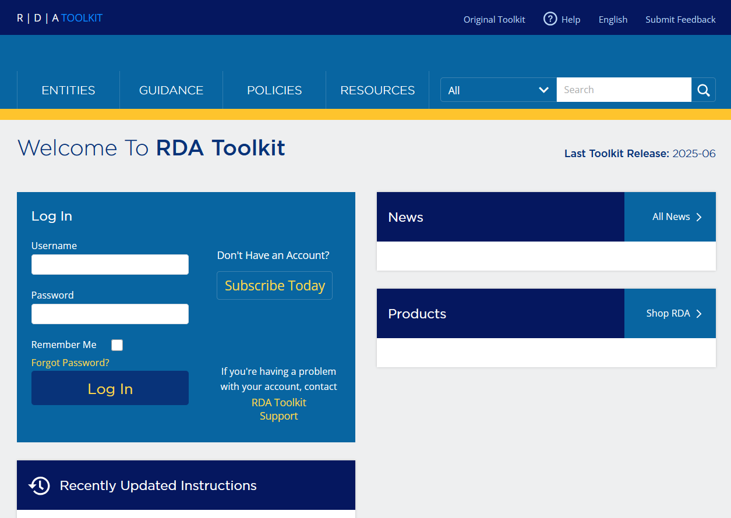
RDA Toolkit
RDA Toolkit includes:
  RDA instructions that are searchable and browsable
  Mappings of RDA elements to MARC 21
  Library of Congress-Program for Cooperative Cataloging Policy Statements (LC-PCC PS)
Notes:
The RDA Toolkit is an integrated, browser-based, online product that allows users to interact with a collection of cataloging-related documents and resources, including RDA: Resource Description and Access. The RDA Toolkit includes RDA instructions that are searchable and browsable, mappings of RDA elements to different schemas including MARC 21, Library of Congress-Program for Cooperative Cataloging Policy Statements (LC-PCC PS), and so much more.

Slide 7


Accessing RDA Toolkit
https://access.rdatoolkit.org/
From RDA Toolkit homepage (https://www.rdatoolkit.org/)
From original RDA Toolkit (https://original.rdatoolkit.org/)
Notes:
There are three ways to access the RDA Toolkit:
To go directly to the RDA Toolkit, type “access.rdatoolkit.org” into your web browser.
From the RDA Toolkit homepage at “rdatoolkit.org”, click on the “Access RDA Toolkit” button.
From the original RDA Toolkit at “original.rdatoolkit.org”, click on the “Return to the Official RDA Toolkit” link in the top banner.

Slide 8
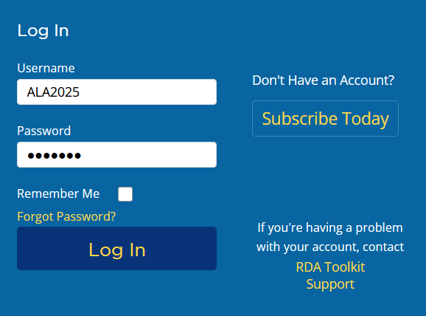
Logging In Using Profile Login
Enter the profile username: ALA2025
Enter the profile password: ALA2025
Click Log In.
1
2
3
Notes:
For the workshop today, we have created a profile that you can use. To login to the toolkit using this profile, enter the username ALA2025, the password ALA2025, and then click “Log In”.

Slide 9
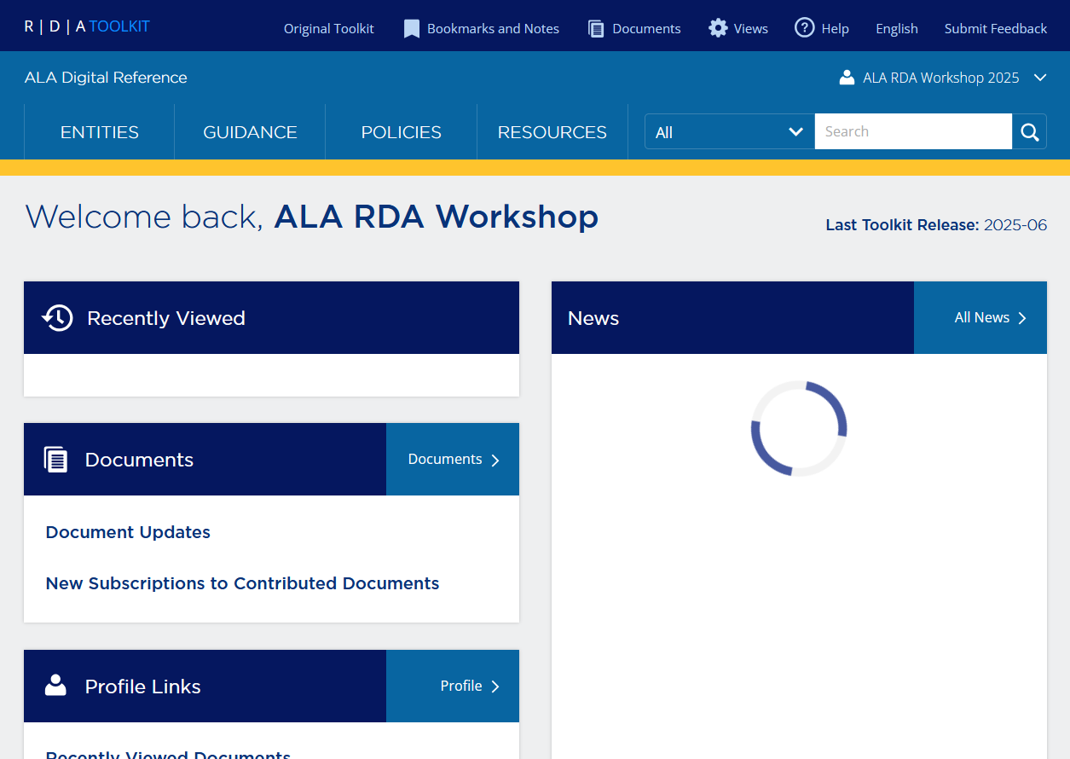
Successful Login
Profile Login
“Welcome back,” message
“Recently Viewed” box
Profile name in the right portion of blue banner
Institution name in the left portion of blue banner
4
3
1
2
Notes:
You will know you have successfully logged in because under the blue banner appears a “Welcome back” message, under the welcome message appears a box titled “Recently Viewed”, the name supplied in the profile appears in the right portion of the blue banner, and the institution’s name appears in the left portion of the blue banner.

Slide 10
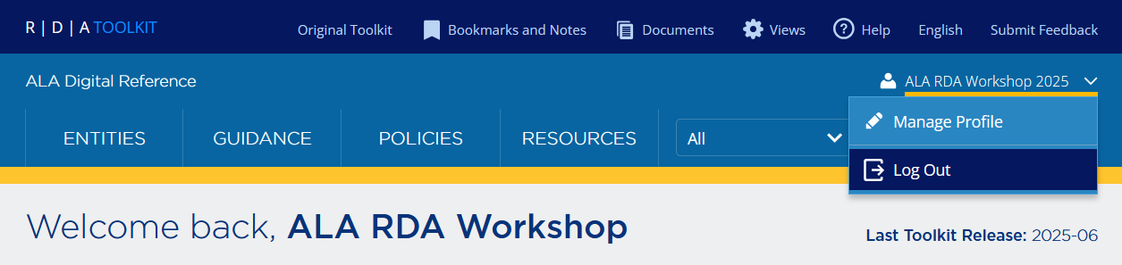
Logging Out
Time out after 30 minutes of inactivity
Close the browser
Log out button
Notes:
And because it will likely happen during the workshop, you will be automatically logged out after 30 minutes if you close the browser window or your session is inactive. If you have multiple browser windows open, you will be logged out when one of the windows is inactive for 30 minutes. This means that you could be actively working in one window and then logged out without warning because another window was inactive. When this happens, log in again and continue where you left off.

Slide 11
RDA: Resource Description and Access
A package of data elements, guidelines, and instructions for creating library and cultural heritage metadata that is well-formed according to international models
This metadata is intended to support the discovery and identification of resources in library and other cultural heritage collections
RDA is structured around the RDA entities and their elements
Notes:
Once logged into the RDA Toolkit, you can access RDA. RDA: Resource Description and Access is a package of data elements, guidelines, and instructions for creating library and cultural heritage metadata that is well-formed according to international models. This metadata is intended to support the discovery and identification of resources in library and other cultural heritage collections.
RDA is structured around the RDA entities and their elements.

Slide 12
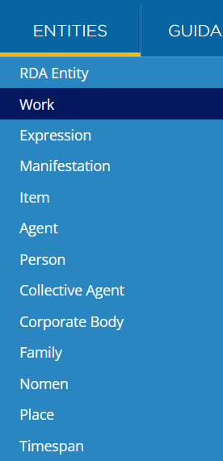
Entity Pages
Structure of Entity Pages
Definition and Scope
Prerecording
  Minimum description
  Effective description
  Entity boundary
Recording
  Recording an unstructured description
  Recording a structured description
  Recording an identifier
  Recording an IRI
Elements
Notes:
There are 13 RDA entities. Each entity has its own page that can be accessed from the Entities tab in the RDA Toolkit. Each entity page provides a definition and scope of the entity, instructions for creating a minimum and effective description of an instance of the entity, and guidance on entity boundaries for determining when a new description is needed. Each entity page also includes a list of the elements for describing the entity.

Slide 13
Element Pages
Structure of Element Pages
Definition and Scope
Element Reference
Prerecording
Recording
  Recording an unstructured description
  Recording a structured description
  Recording an identifier
  Recording an IRI
Related Elements
Notes:
When describing an RDA entity, we record values of RDA elements. All elements have their own page in the RDA Toolkit.

Slide 14
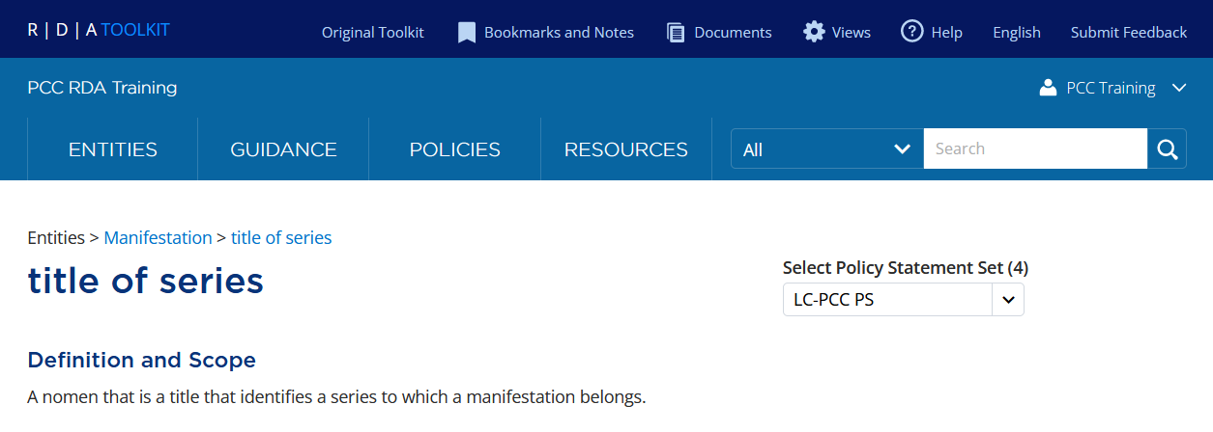
Element Pages
Definition and Scope
The Glossary definition for the element
Notes:
Using the element title of series as our example, each element page begins with the name of the element followed by the Definition and Scope, which contains the Glossary definition for the element.

Slide 15
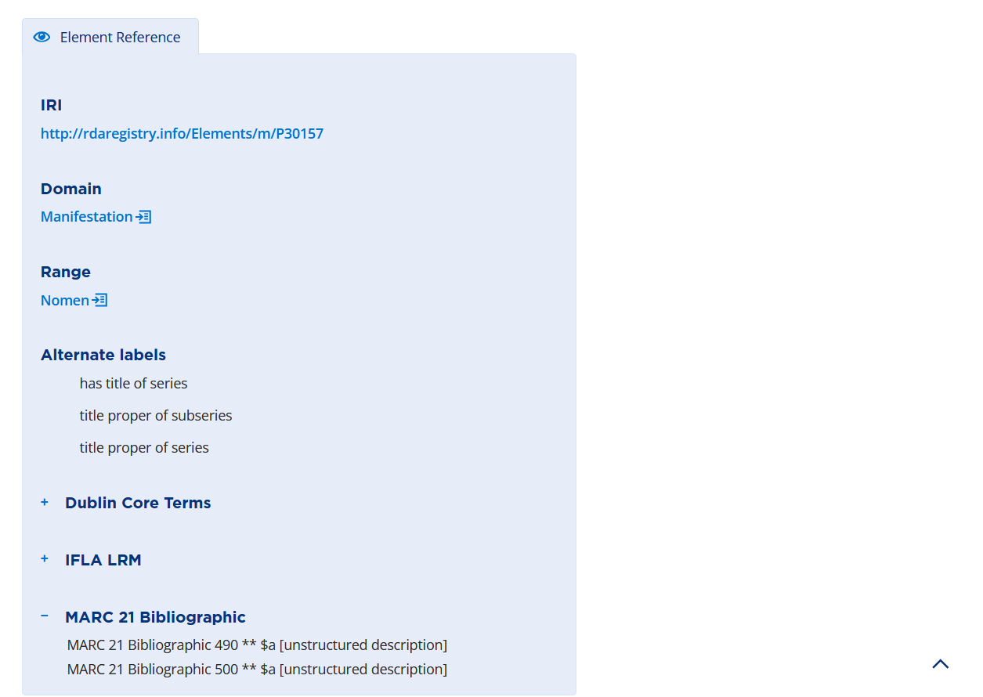
Element Pages
Element Reference
Additional information about the element
  Domain
    The RDA entity that is described by the element
  Range
    The RDA entity that is the value of the relationship element
  Alternate labels
  Alignments to MARC 21
Notes:
The Element Reference box includes additional information about the element, including its domain, range for relationship elements, alternate labels, and alignments to MARC 21.

Slide 16
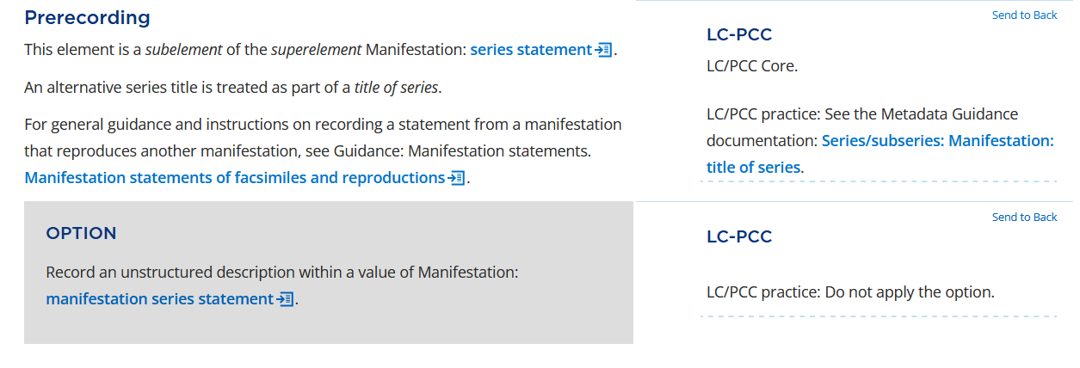
Element Pages
Prerecording
Provides information to decide if:
  The element is appropriate
  Another element could or should be used instead
LC-PCC PS
  Indicates if element is Core for LC/PCC
  May include links to relevant Metadata Guidance Documentation
Notes:
The Prerecording section provides information so we can decide if the element is appropriate, or if another element could or should be used instead. The LC-PCC Policy Statement for Prerecording indicates if the element is Core for LC/PCC and may include links to relevant Metadata Guidance Documentation.

Slide 17
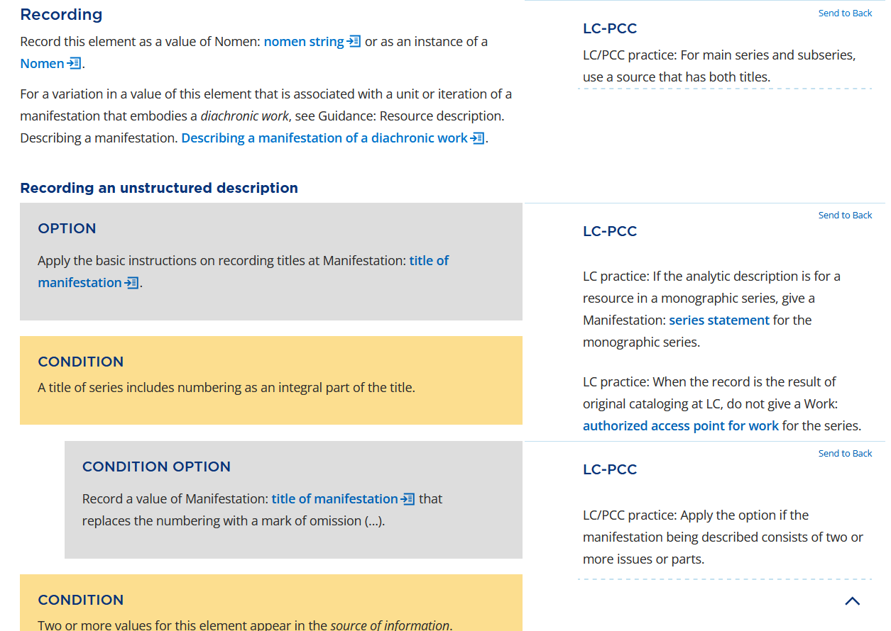
Element Pages
Recording
Provides information on how to record a value for the element
General instructions are followed by sections for recording:
  An unstructured description
  A structured description
  An identifier
  An IRI
Notes:
The Recording section provides information on how to record a value for the element. If applicable, general instructions for selecting one or more values are given first. This is followed by specific instructions for each of the four recording methods: an unstructured description (e.g., a note), a structured description (e.g., an access point), an identifier (e.g., a code), and an IRI.

Slide 18
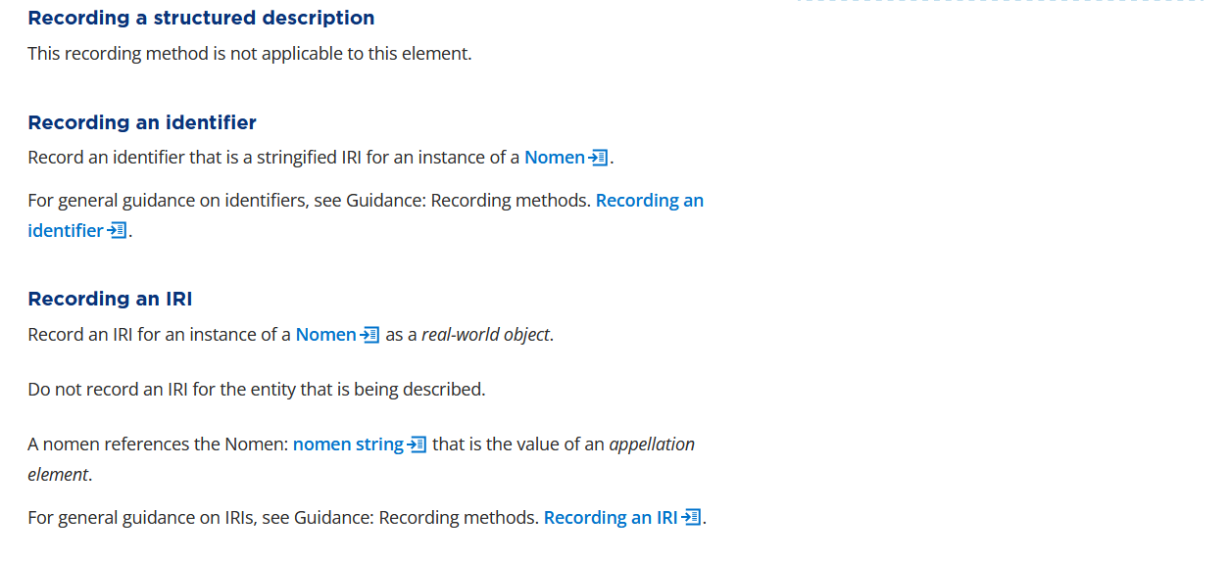
Element Pages
Recording
Instructions specifically indicate if a recording method is not applicable
For more information, see Guidance: Recording methods
Notes:
If a recording method is not applicable for the element, the instruction will say “This recording method is not applicable to this element.” The guidance chapter “Recording methods” includes additional information.

Slide 19
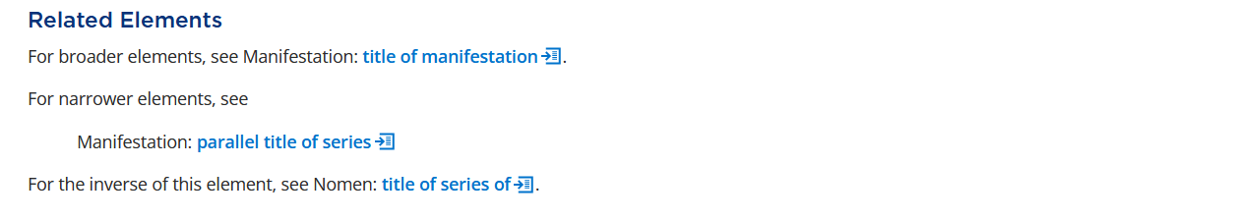
Element Pages
Related Elements
Broader element
Elements that are one level above the element
Narrower element
Elements that are one level below the element
Inverse element
The inverse if the element is a relationship element
Notes:
RDA elements are arranged in a hierarchy. If applicable, the Related Elements section lists elements that are broader or narrower. Broader elements are one level above the element and narrower elements are one level below in the element hierarchy. All relationship elements give their inverse element in this section.

Slide 20
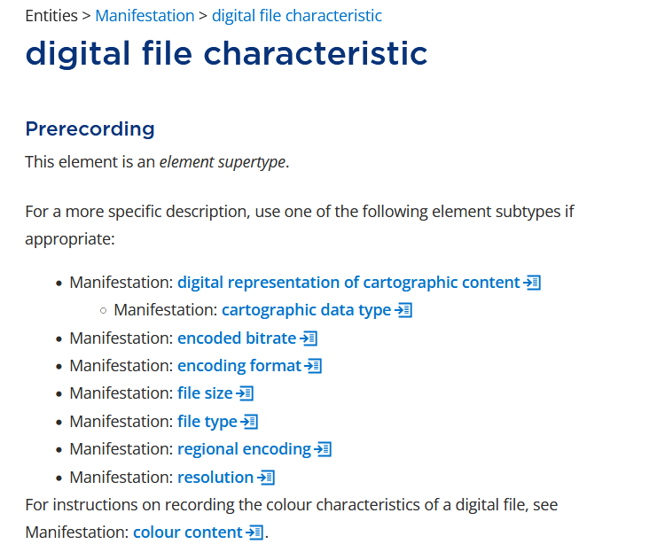
Element Supertype & Element Subtype
Element supertype
A broader element
Element subtype
A narrower element
Notes:
In the RDA instructions, you will come across the terms “element supertype” and “element subtype”. These are just different ways of referring to a broader element or a narrower element, respectively.

Slide 21
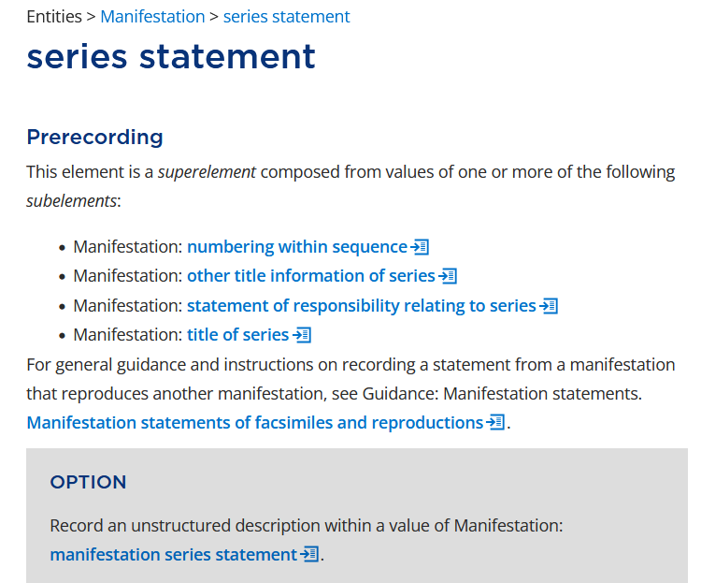
Superelement & Subelement
Superelement
Aggregates data values of one or more subelements
Subelement
A component of a larger element that aggregates data values from different elements
Notes:
An element supertype should not be confused with a superelement. A superelement aggregates data values from one or more subelements. For example, a series statement may be composed of values of title of series and numbering within sequence.

Slide 22
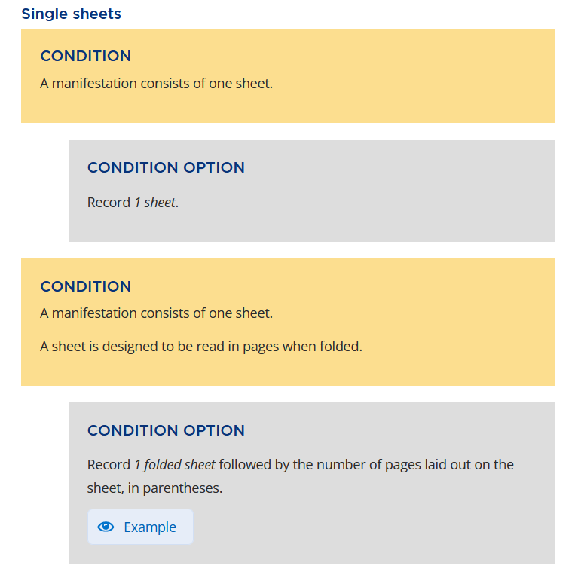
Conditions
Displayed in yellow boxes with caption CONDITION
Specify circumstances when a CONDITION OPTION applies
All conditions must be satisfied to apply a CONDITION OPTION
Notes:
When it comes to the actual RDA instructions, some are conditional. A condition is displayed in a yellow box with the caption CONDITION. The Condition box specifies the circumstances under which the Condition Options that follow can be applied. If a Condition box contains more than one condition, all conditions must be satisfied to apply any of the Condition Options that follow. For example, there are two conditions in the second Condition box. It can be read with an implied “and” between the two conditions, that is, “A manifestation consists of one sheet.” AND “A sheet is designed to be read in pages when folded.”
----------
Example from: Manifestation: extent of manifestation

Slide 23
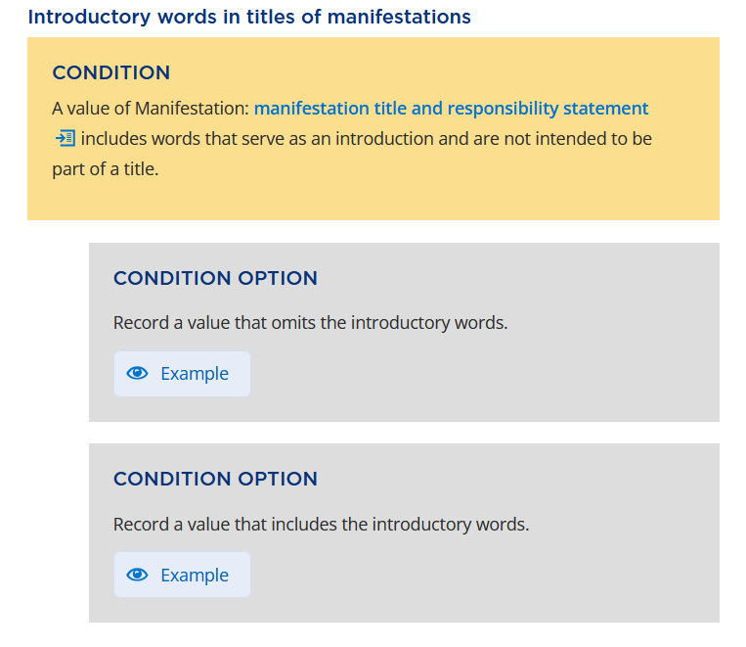
Condition Options
Follow a yellow CONDITION box
Displayed in indented grey boxes with the caption CONDITION OPTION
Can only be applied if the preceding conditions are met
Notes:
Some RDA instructions are optional. In the RDA Toolkit, there are two types of options: Condition Options and Options. A Condition Option follows a yellow Condition box and is displayed in an indented grey box with the caption CONDITION OPTION. A Condition Option can only be applied if the preceding conditions are met.
----------
Example from: Manifestation: title of manifestation

Slide 24
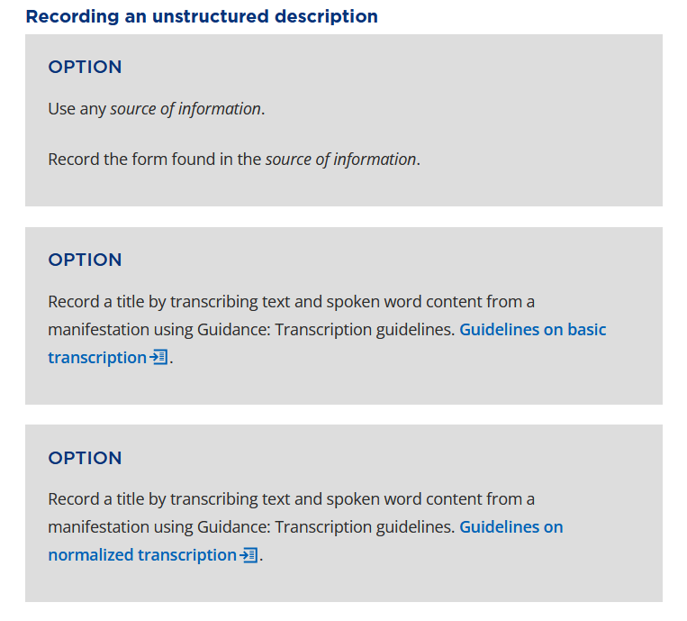
Options
Independent of conditions
Displayed in grey boxes without indentation and with the caption OPTION
Notes:
An Option is independent of conditions. It is displayed in a grey box without indentation and with the caption OPTION.
----------
Example from: Manifestation: title of manifestation

Slide 25

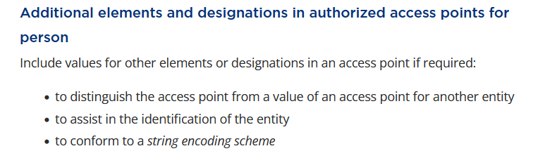
RDA Instructions
Not all RDA instructions are optional
RDA instructions also appear as regular text
Notes:
Note that not all RDA instructions are options. RDA instructions that are not optional appear as regular text (that is, black text on a white background) in the Toolkit and should not be overlooked.
----------
Examples from: Person: authorized access point for person

Slide 26
LC-PCC Policy Statements
https://access.rdatoolkit.org/

Slide 27
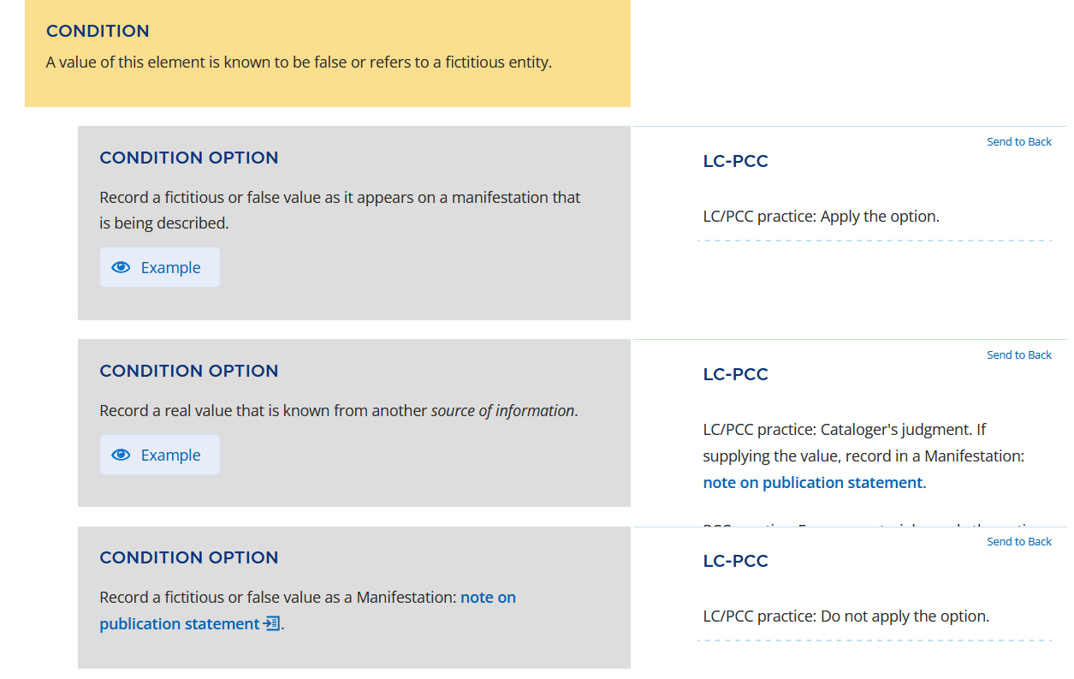
LC-PCC Policy Statements (LC-PCC PSs)
Identify the options in the RDA Toolkit that LC and PCC have decided to apply or not apply
Appear in the right column alongside RDA instructions
LC-PCC PSs
Notes:
Optional instructions in RDA provide choices for creating well-formed RDA data that supports the needs of a local application or cataloging community. To help you decide which options to apply, you need to consult the Library of Congress-Program for Cooperative Cataloging Policy Statements. The LC-PCC PSs provide information about the options in the RDA Toolkit that LC and PCC have decided to apply or not apply.

Slide 28
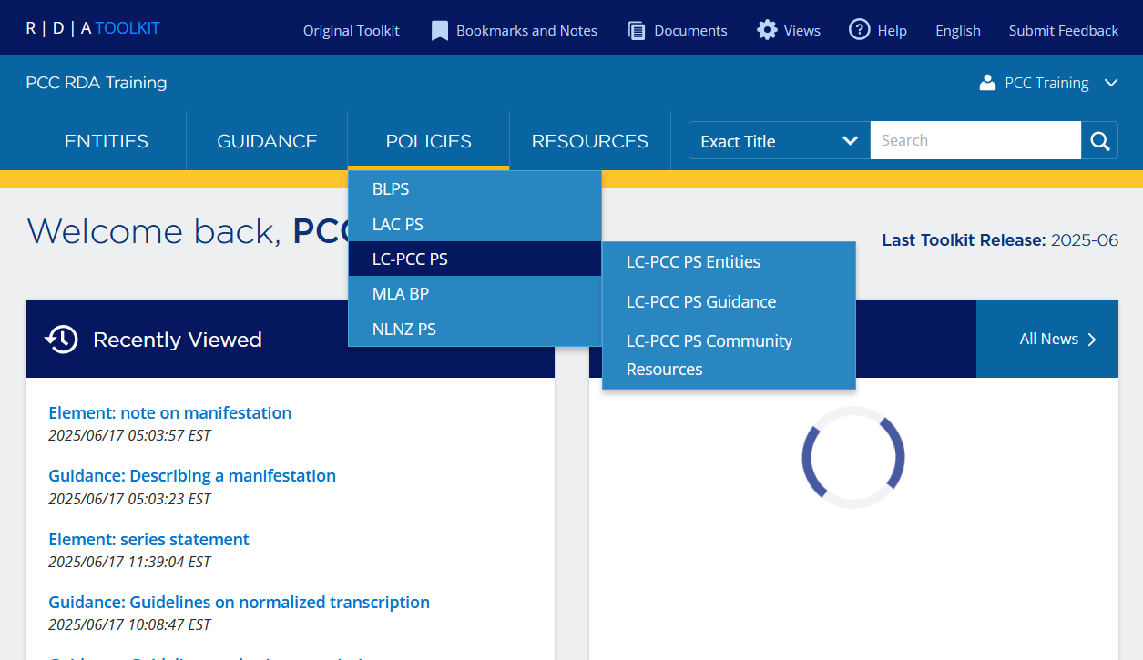
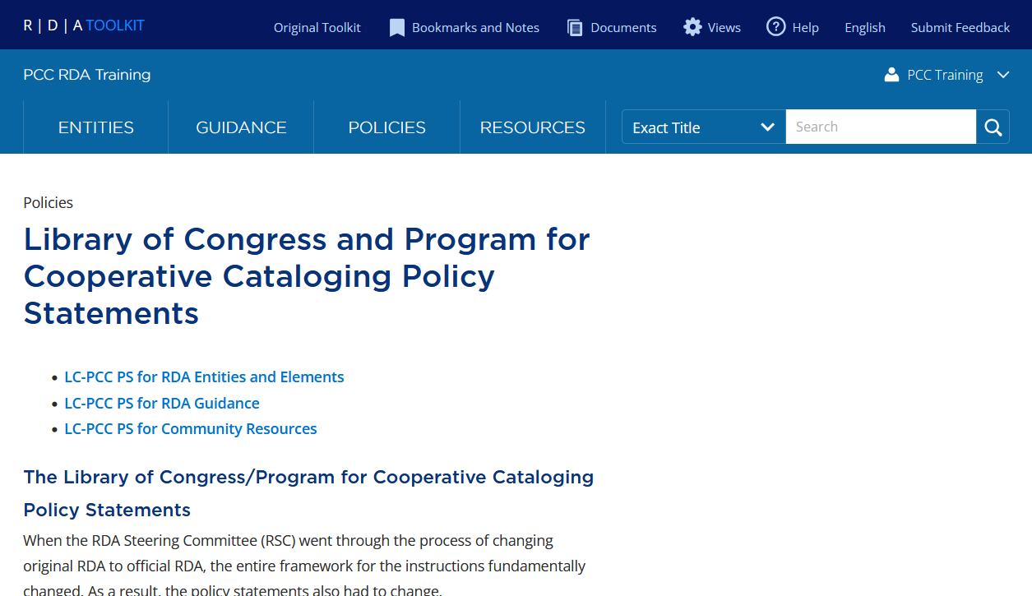
Introduction to the LC-PCC Policy Statements
To view the introduction, select Policies > LC-PCC PS
Notes:
An introduction to the LC-PCC Policy Statements is available in the RDA Toolkit by clicking on Policies and then LC-PCC PS.

Slide 29
Policy Statement Changes
Changing from original RDA to official RDA resulted in necessary changes to the LC-PCC Policy Statements to adhere to the new framework
Four significant changes from original RDA to official RDA resulted in changes to the policy statements:
  Transition from instructions in original RDA to options in official RDA
  Elimination of core elements of original RDA in official RDA
  Layout of the RDA Toolkit
  Use of new format to encode policy statements
Notes:
Changing from original RDA to official RDA resulted in necessary changes to the LC-PCC Policy Statements to adhere to the new framework. There are four significant changes that impacted the policy statements, namely the transition from instructions to options, the elimination of core elements, a new layout, and a new format for encoding policy statements.

Slide 30
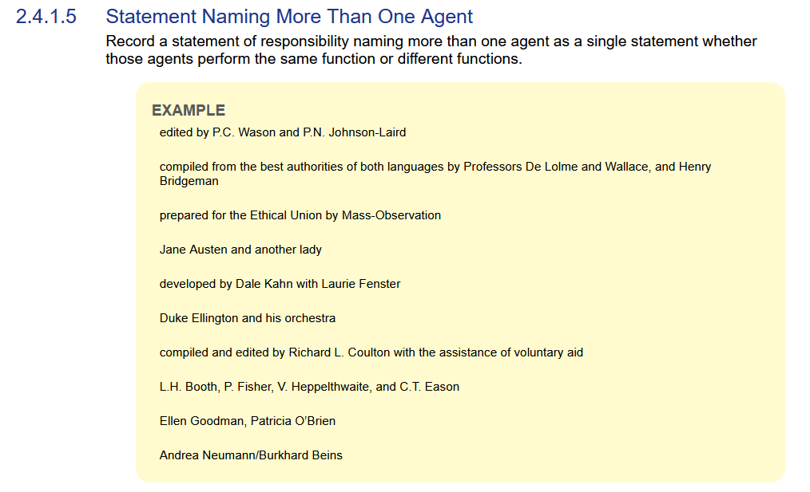
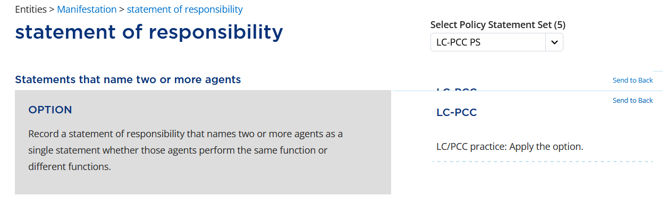
Policy Statement Changes
Transition from instructions to options
Original RDA provides instructions.
Official RDA provides options.
Each option requires a policy statement to indicate:
Whether an LC/PCC cataloger should apply the option or not
If an LC/PCC cataloger can use their own judgment to make a decision
Notes:
One of the most significant changes was that instructions in original RDA became options in official RDA. This changed the purpose of the policy statements because each option required a policy statement to indicate whether an LC/PCC cataloger should apply it or not, or if they could exercise judgment to make the decision.

Slide 31
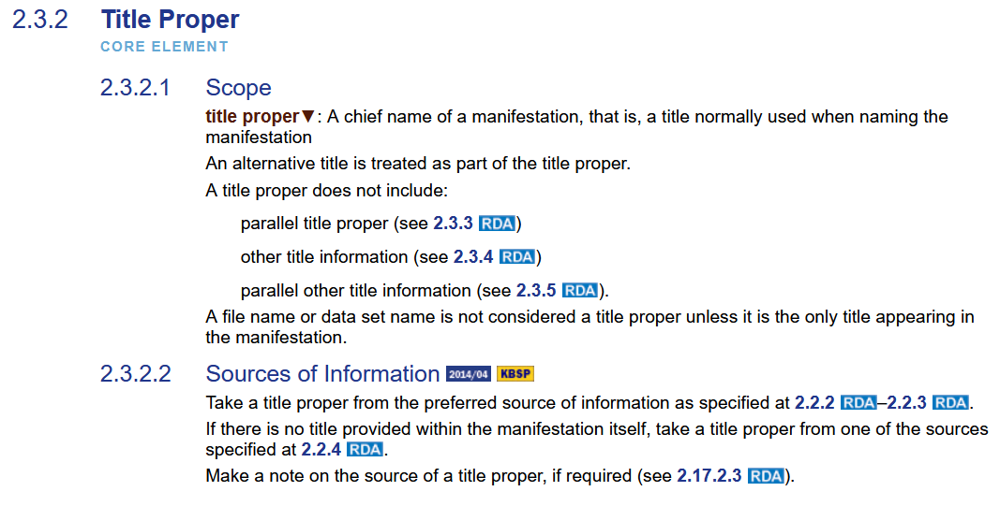
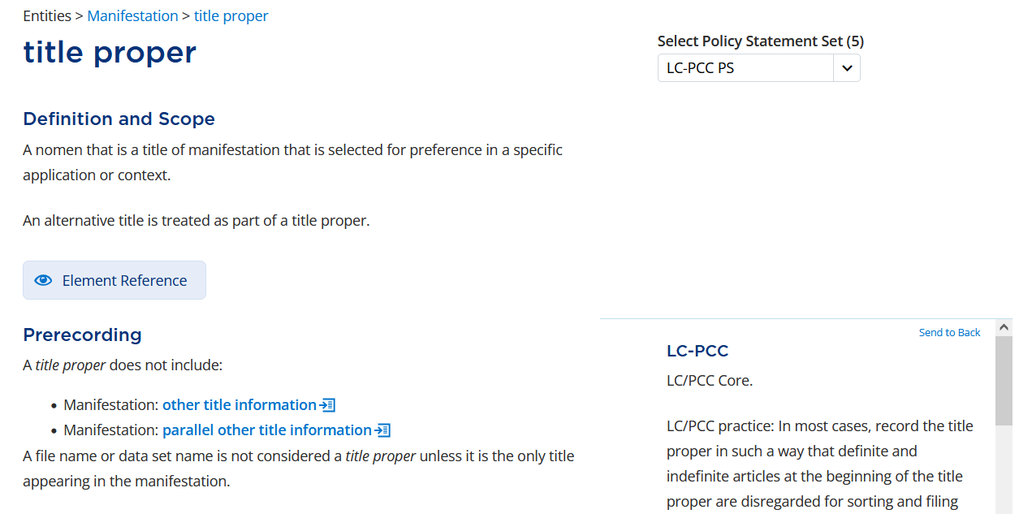
Policy Statement Changes
Elimination of core elements
Original RDA defines core elements.
Official RDA defines a basic minimum description for each RDA entity. Policy statements state what LC/PCC consider to be core elements.
Notes:
The second significant change was that the core elements of original RDA were eliminated in official RDA. Instead, official RDA defines a very basic minimum description for each RDA entity. The policy statements are, therefore, essential for stating what LC/PCC consider core elements.

Slide 32
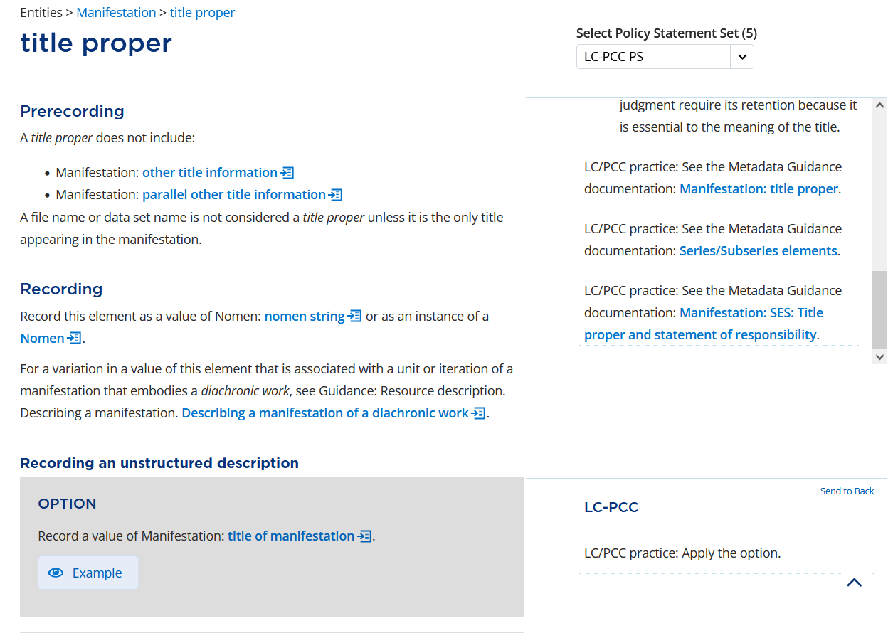
Policy Statement Changes
Layout of the RDA Toolkit
The original RDA Toolkit layout allows for long policy statements and examples.
The official RDA Toolkit layout does not allow for this. Examples have been removed from policy statements and placed in Metadata Guidance Documentation (MGDs). Most policy statements are brief.
Notes:
The third significant change was the layout of the RDA Toolkit, which no longer allowed for lengthy policy statements and examples. LC/PCC decided to take all the examples out of the policy statements and place them in external documentation, known as Metadata Guidance Documentation (MGDs). Consequently, the policy statements are relatively brief, with some being longer.

Slide 33
Policy Statement Changes
Encoding of policy statements
In official RDA, policy statements are encoded using the DITA (Darwin Information Typing Architecture) format
DITA is an XML standard that allows the use of “boilerplate,” which is text that can be recorded in one file and used repeatedly in many different locations
Policy statements have been written to take advantage of “boilerplate” so that they can apply to many different elements, meaning that they may be very general
Changes to boilerplate text will affect a variety of elements, so must be carefully considered
Notes:
The fourth and final significant change was the use of the DITA (Darwin Information Typing Architecture) format to encode the policy statements. DITA is an XML standard that allows the use of “boilerplate,” which is text that can be recorded in one file and used repeatedly in many different locations. The policy statements were written to take advantage of this capability, resulting in policy statements that were written to apply to many different elements and may, therefore, be very general. Moreover, changes to boilerplate text must be considered very carefully because of the variety of elements affected.

Slide 34
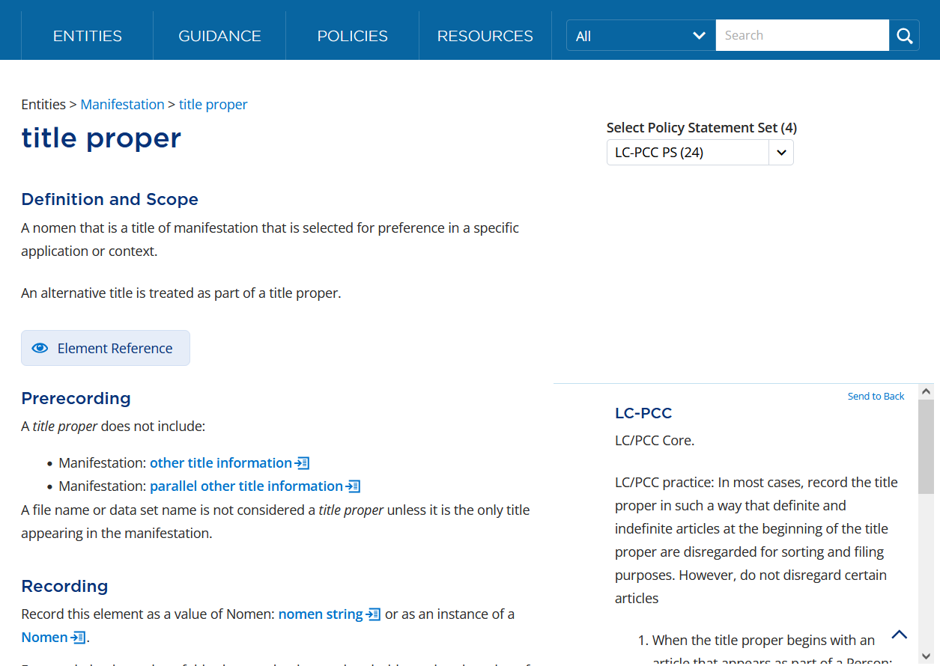
Viewing Policy Statements
Policy statements appear in the right column alongside RDA instructions
LC-PCC PS
Notes:
The policy statements appear in the right column, or the right rail as it is frequently called. This allows you to view the policy statements alongside the RDA instructions.

Slide 35
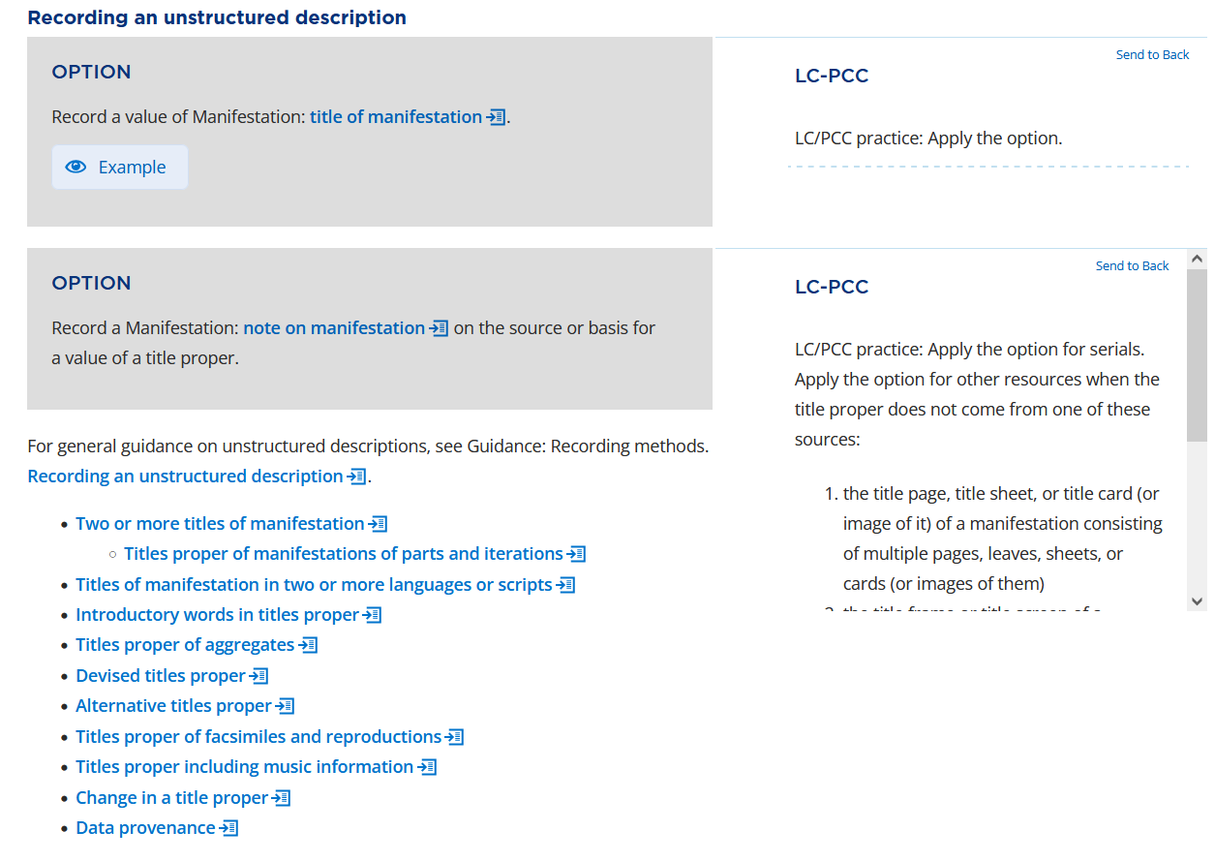
Viewing Policy Statements
Solid line ( ) extends to the RDA instruction and indicates the passage or option to which the policy statement applies
Dashed line ( ) indicates the end of a policy statement
Notes:
A solid, thin line at the top of the policy statement …
SOLID LINES APPEAR ON CLICK
… extends to the RDA instruction and indicates the passage or option to which the policy statement applies.
A short, dashed line …
DASHED LINE APPEARS ON CLICK
… indicates the end of a policy statement.

Slide 36
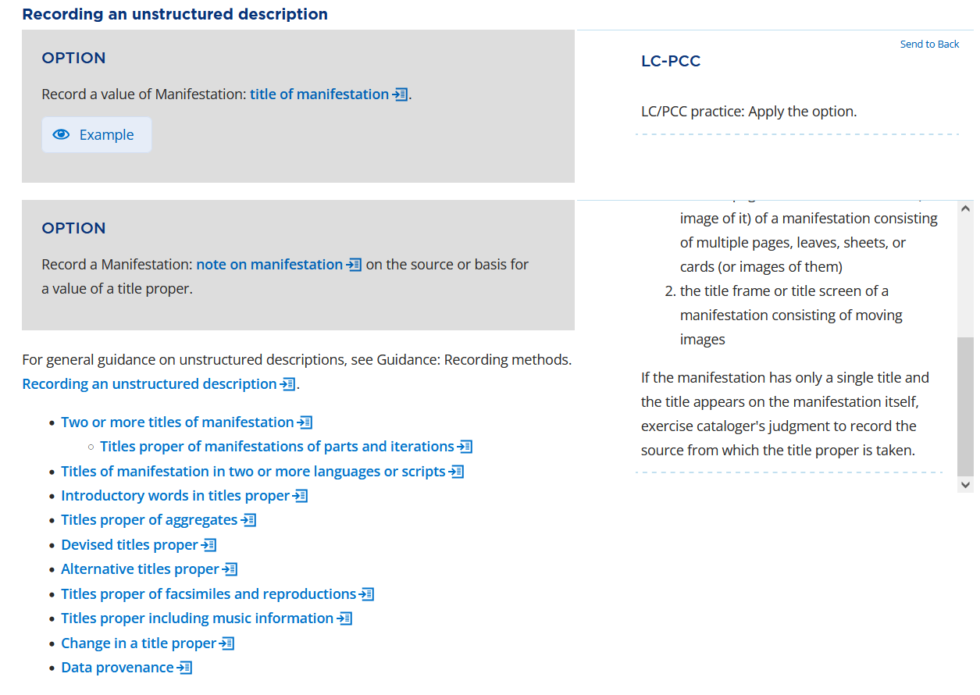
Viewing Policy Statements
Longer policy statements have a scroll bar
Always look for the dashed line to indicate the end of the policy statement
Notes:
Longer policy statements have a scroll bar.
END OF POLICY STATEMENT APPEARS ON CLICK
Scroll down to read the entire policy statement. Always look for the dashed line …
DASHED LINE APPEARS ON CLICK
… to indicate the end of the policy statement.

Slide 37

Viewing Policy Statements
To view long policy statements in the main pane, click LC-PCC at the top of the policy statement
Notes:
Particularly long policy statements may be difficult to read in the right column, even with scrolling. To view the complete policy statement in the main pane of the Toolkit, click the “LC-PCC” link at the top of the policy statement.

Slide 38
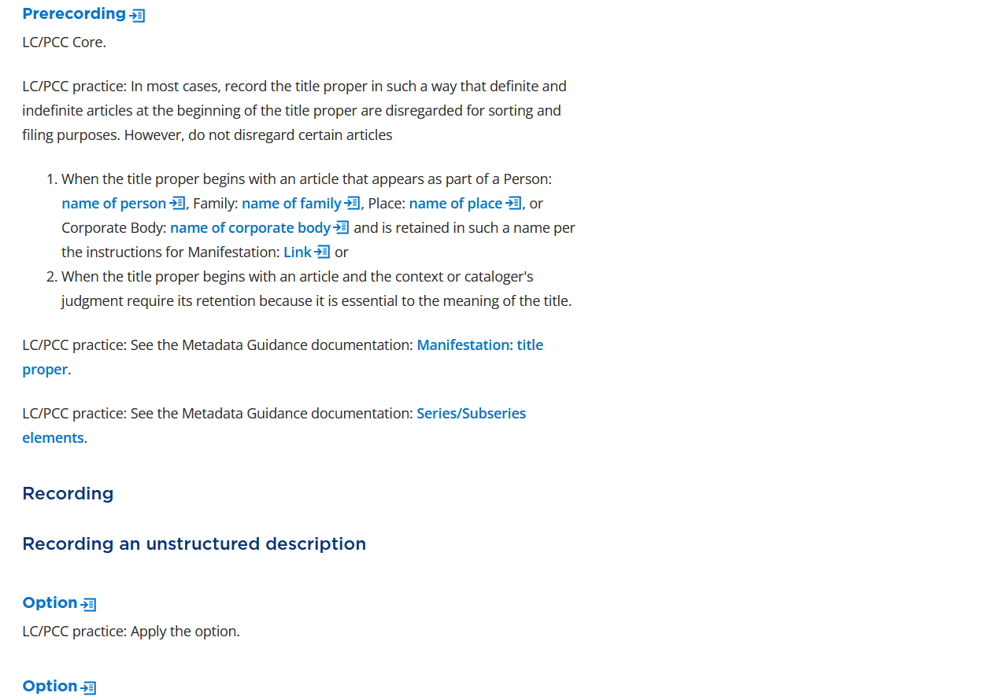
Viewing Policy Statements
To view the RDA instruction to which the policy statement applies, click the link at the top of the policy statement
Notes:
The policy set page provides the full text of the policy statement in the main pane of the Toolkit. To view the RDA instruction to which the policy statement applies, …
RED BOX APPEARS ON CLICK
… click the link at the top of the policy statement.

Slide 39
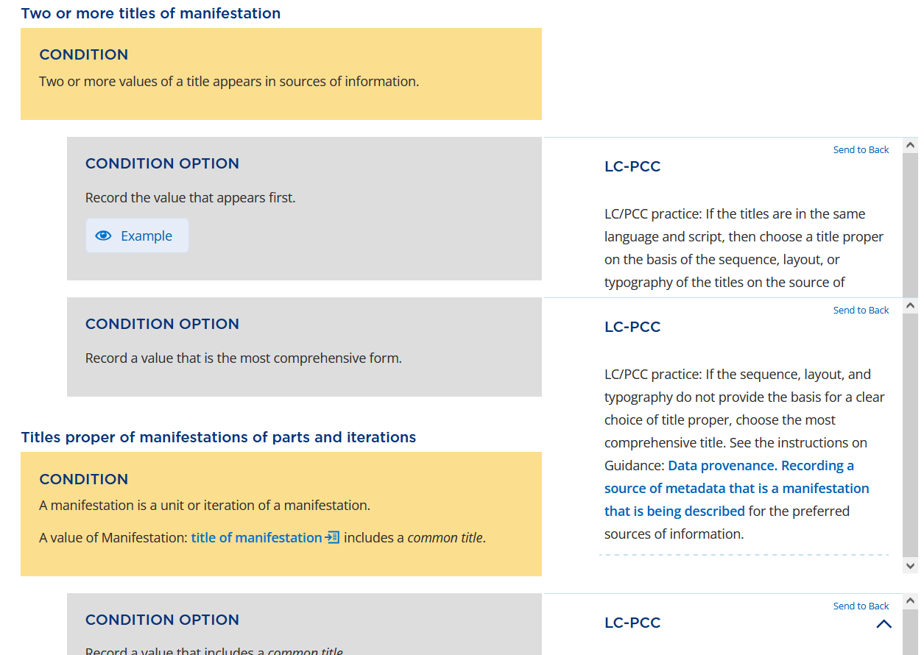
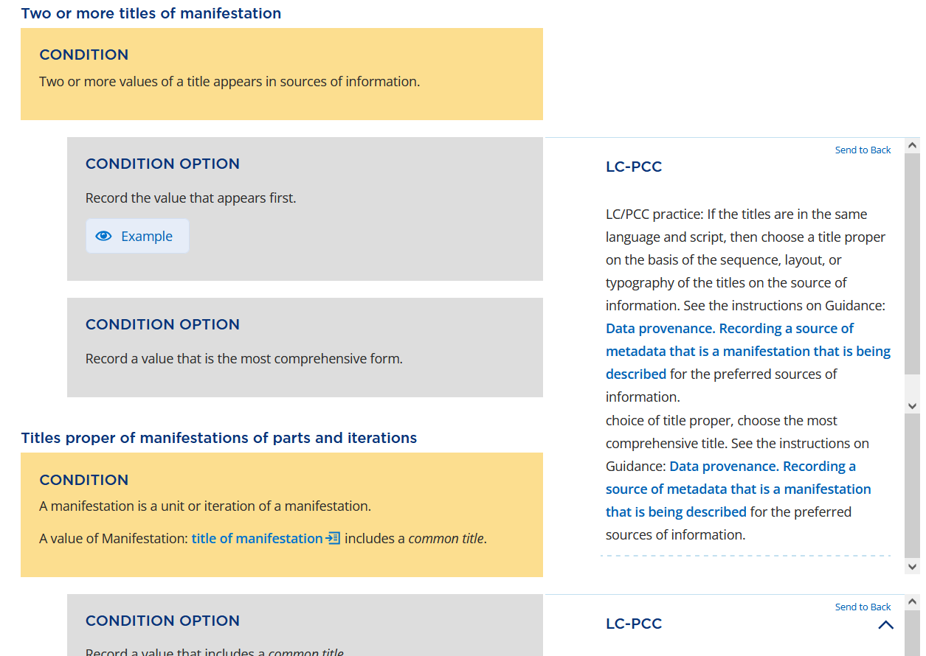
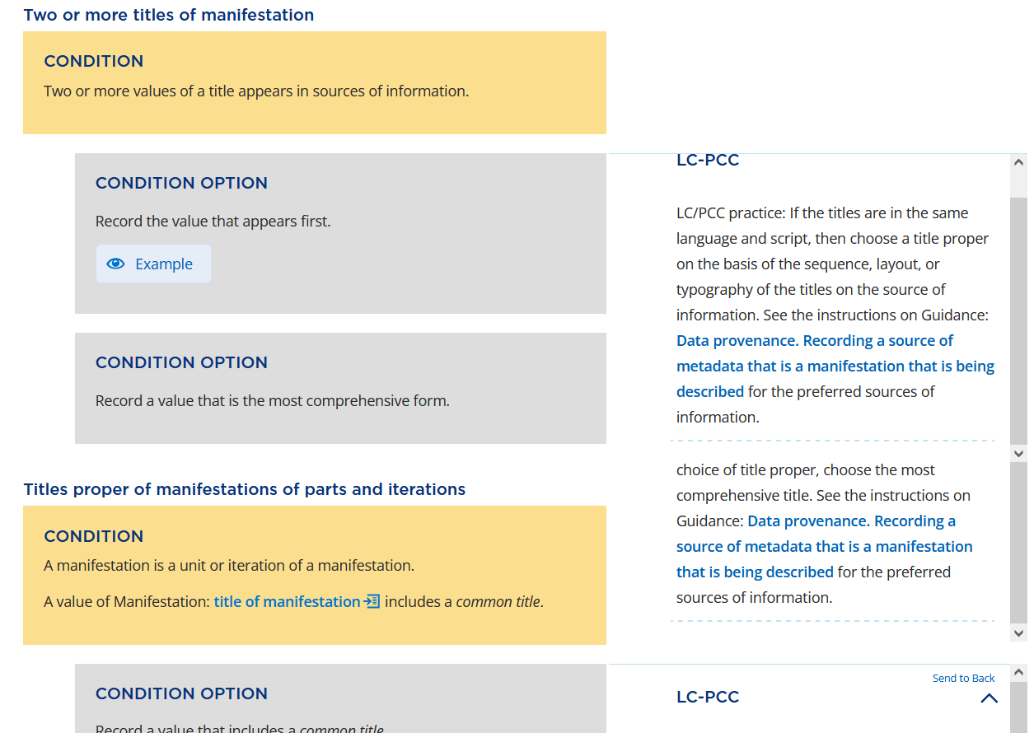
Viewing Policy Statements
Policy statements may cover up other policy statements
Always look for the dashed line to indicate the end of the policy statement
To view a complete policy statement, click Send to Back in the policy that is covering up another policy
Notes:
When policy statements are close together, they may appear on top of each other. Again, always look for the dashed line to indicate the end of the policy statement. If you don’t see the dashed line before you see the solid line of another policy statement, …
SOLID LINES APPEAR ON CLICK
… click “Send to Back” …
RED BOX APPEARS ON CLICK
… in the top right corner of the following policy statement.
FULL POLICY STATEMENT APPEARS ON CLICK
After clicking “Send to Back”, you can now see more of the policy statement. If necessary, scroll down …
END OF POLICY STATEMENT APPEARS ON CLICK
… to view the end of the policy statement. Remember to always look for the dashed line …
DASHED LINE APPEARS ON CLICK
… that indicates the end of the policy statement.
When you send a following policy statement to the back, the preceding policy statement will cover up that policy statement. If you see the end of a policy statement before you see the beginning, …
BEGINNING OF POLICY STATEMENT AND RED BOX APPEAR ON CLICK
… click “Send to Back” in the preceding policy statement to view the following policy statement.
FOLLOWING POLICY STATEMENT APPEARS ON CLICK
In summary, look for the solid line that indicates the beginning of the policy statement and the dashed line that indicates the end of the policy statement. If necessary, send to back the policy statement that is covering up another policy statement, whether it is above or below.

Slide 40
Organization of Presentation
Policy statements follow a consistent presentation of information on each element page, with different types of statements appearing in the following order:
  Core statements
  General practice statements
  Metadata Guidance Documentation (MGD) statements
Notes:
The policy statements follow a consistent presentation of information on each element page: Core statements, general practice statements, and Metadata Guidance Documentation statements.

Slide 41
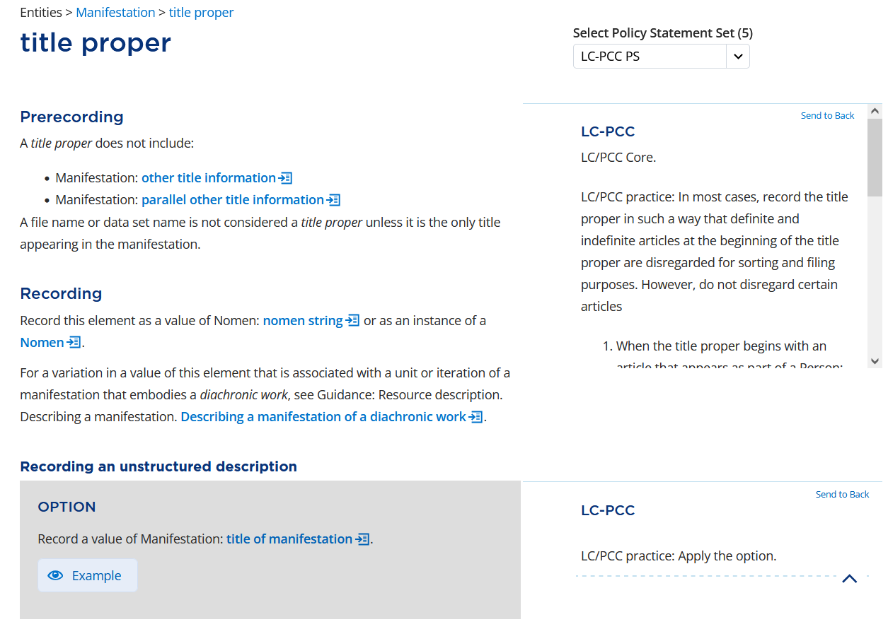
Organization of Presentation
Core statements
For Core elements, the core statement always appears at the Prerecording level
The core statement is almost always the first policy statement on the element page
Notes:
For Core elements, the core statement always appears at the Prerecording level and is almost always the very first policy statement to appear on a page.

Slide 42
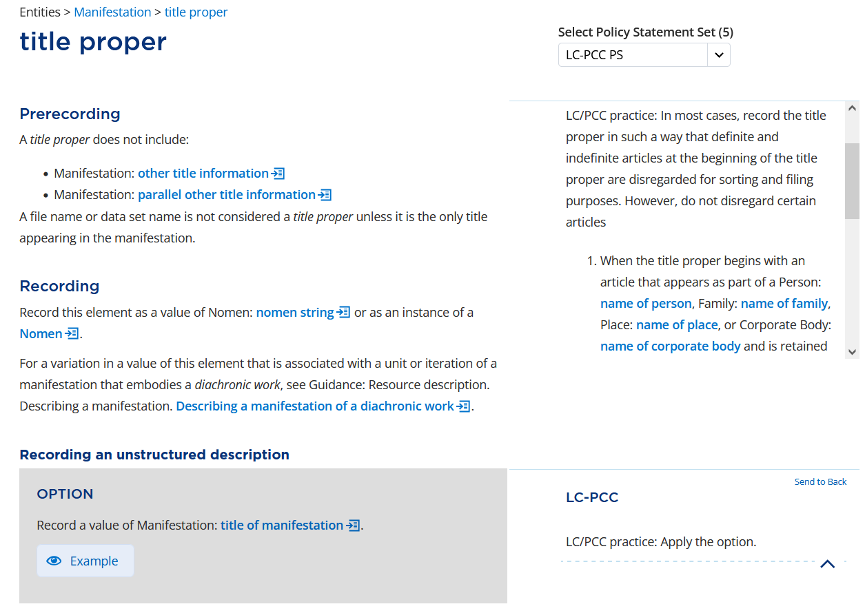
Organization of Presentation
General practice statements
General policy statements appear after core statements
General policy statements may be attached to:
  A section title
  An instruction in a paragraph of text
  An option
  A condition (rarely)
Notes:
General policy statements appear next. They may be attached to a section title (e.g., Recording an unstructured description), to an instruction in a paragraph of text, or to options. They rarely appear next to a condition. If a policy statement is attached to a section title or to a condition, it is related to all the options or instructions under that section or grouping of options.

Slide 43
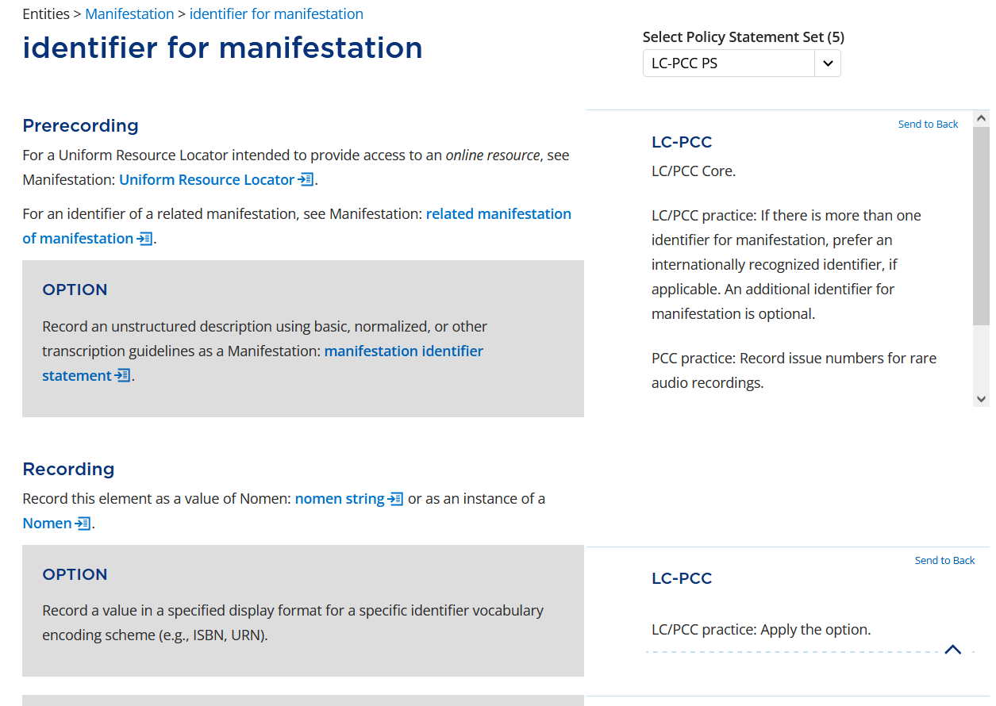
Organization of Presentation
General practice statements
General policy statements always appear in the following order:
  LC/PCC practice
  LC practice
  PCC practice
Notes:
General policy statements always appear in the order of LC/PCC practice, LC practice, then PCC practice. Not all policy statements have all three phrases, but when there are different practices that require separate statements, they appear in this order.

Slide 44
Organization of Presentation
General practice statements
The three most common policy statements are:
  Apply the option
  Cataloger’s judgment
  Do not apply the option
Policy statements may also include:
  Conditions
  Contingent instructions
  Links to other elements or relevant options
Notes:
The three most common policy statements are: Apply the option, Do not apply the option, or Cataloger’s judgment.
Other additions to policy statements may include conditions, contingent instructions, and links to other elements or relevant options.

Slide 45
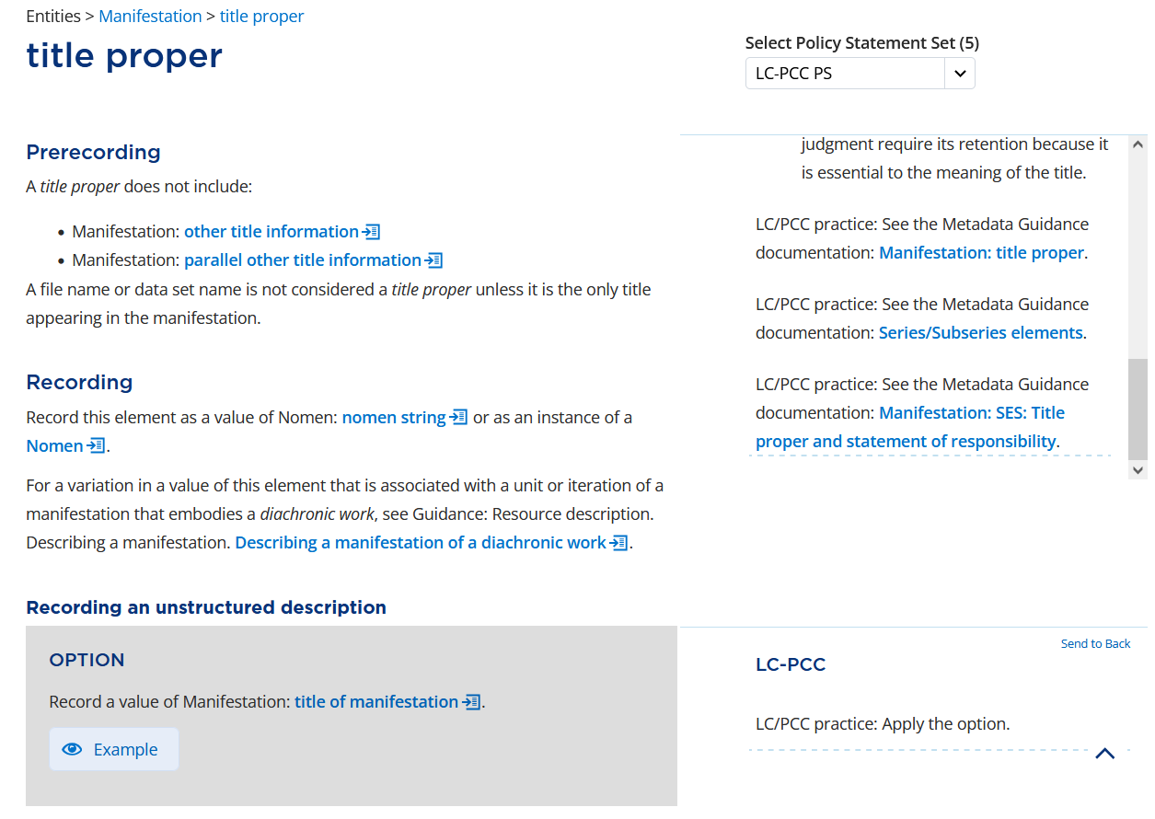
Organization of Presentation
Metadata Guidance Documentation (MGDs)
Links to MGDs always appear as policy statements
Links to MGDs always appear last in the order of policy statements
Notes:
Links to Metadata Guidance Documentation (MGDs) appear as policy statements. They always appear last in the order of policy statements. General narrative MGD links appear before specific one-to-one MGD links. The most common location to find links to MGDs is at the Prerecording level; however, they may be linked wherever the content of the MGD seems relevant to the section, option, or instruction.

Slide 46
Metadata Guidance Documentation
https://loc.gov/aba/rda/mgd/
Notes:
Let’s talk more about the Metadata Guidance Documentation.

Slide 47
Metadata Guidance Documentation (MGDs)
Part of the metadata application profile for LC and PCC catalogers to use with RDA
Provide additional guidance and examples
Must be used in conjunction with RDA Toolkit and LC-PCC PSs
Notes:
The Metadata Guidance Documentation, or MGDs, are part of the metadata application profile for LC and PCC catalogers to use with official RDA. They provide additional guidance and examples than what is possible to include in the policy statements. The MGDs are not standalone documents and must be used in conjunction with the RDA Toolkit and the LC-PCC PSs.

Slide 48
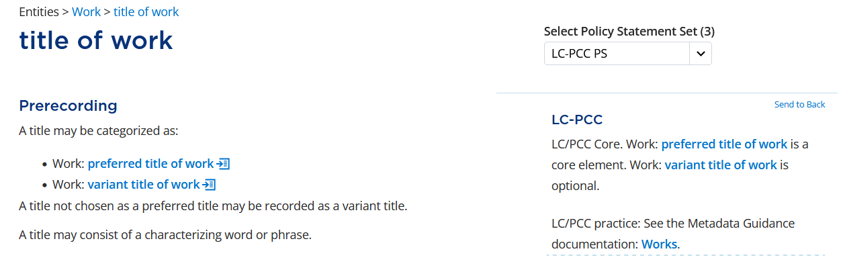
Accessing MGDs
Linked from LC-PCC PSs
Notes:
As we have already discussed, the main way to access the MGDs is through direct links from the LC-PCC PSs in the RDA Toolkit.

Slide 49
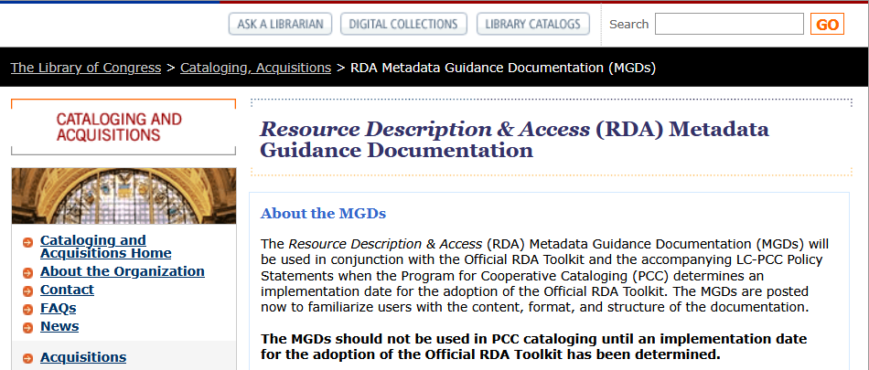
Accessing MGDs
LC website at https://loc.gov/aba/rda/mgd/
Notes:
However, the MGDs are also available on the LC website at loc.gov/aba/rda/mgd.

Slide 50
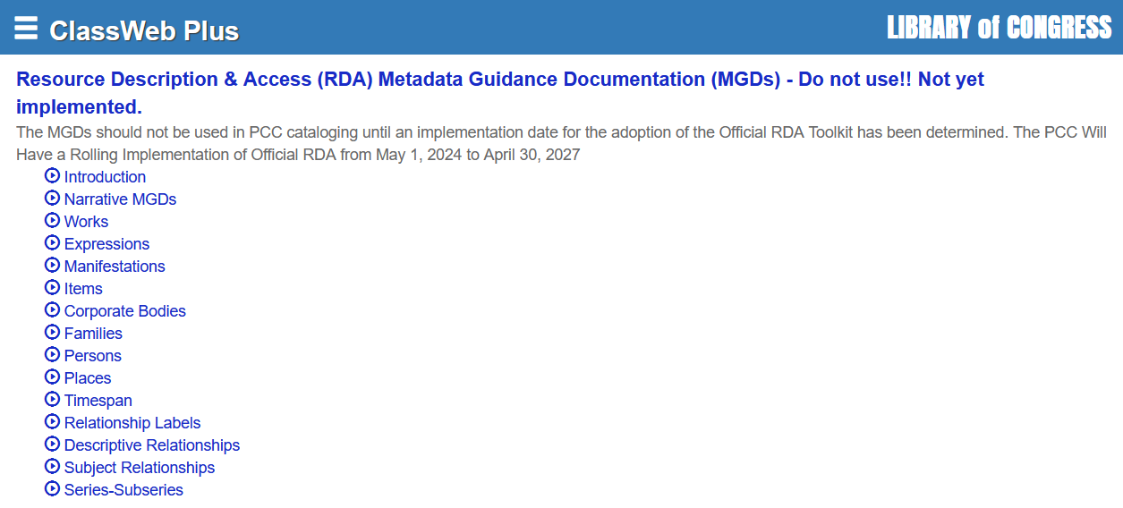
Accessing MGDs
ClassWeb Plus
Notes:
If your institution subscribes to ClassWeb Plus, the MGDs are included as part of the Cataloging Policy Documentation. ClassWeb Plus allows you to search across all or some of the MGDs.

Slide 51
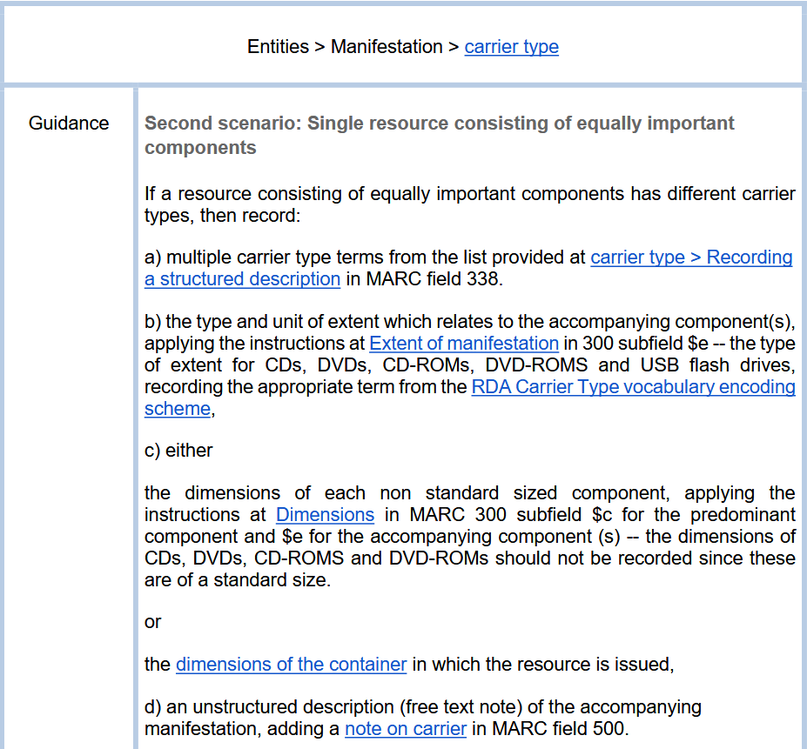
MGDs link to RDA
Notes:
Because the MGDs are used in conjunction with RDA, they link back to relevant sections of the RDA Toolkit.
----------
https://www.loc.gov/aba/rda/mgd/manifestation/mg-m-carrierType-01.pdf

Slide 52
Narrative MGDs and 1:1 MGDs
Narrative MGDs
1:1 MGDs
Instructions for describing a specific RDA entity
  e.g., MG: Works and MG: Places
Instructions for new entities and concepts
  e.g., MG: Timespan and MG: Aggregates
Instructions for policies, concepts, and practices used in PCC work but not addressed in the official RDA Toolkit
  e.g., MG: Basic Cataloging Decisions
Map to specific elements
Generally tied to a specific option or element subsection
Notes:
There are two main types of MGDs. Narrative MGDs provide instructions for describing a specific RDA entity; new entities and concepts; and policies, concepts, and practices used in PCC work but not addressed in the official RDA Toolkit. They tend to be more general in nature and describe higher-level decisions that need to be made and applied in cataloging. On the other hand, 1:1 MGDs map to specific elements and are generally tied to a specific option or element subsection in the RDA Toolkit.

Slide 53
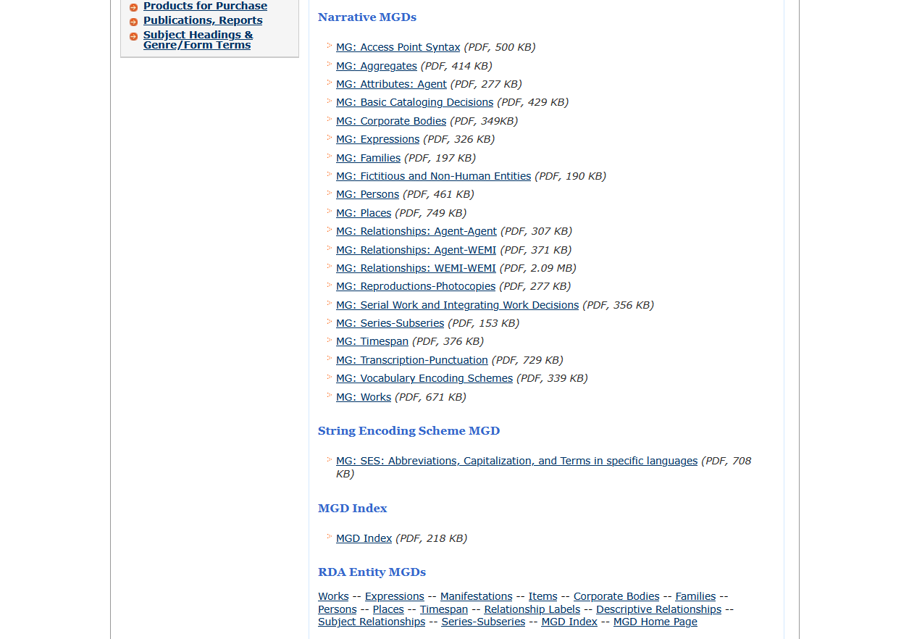
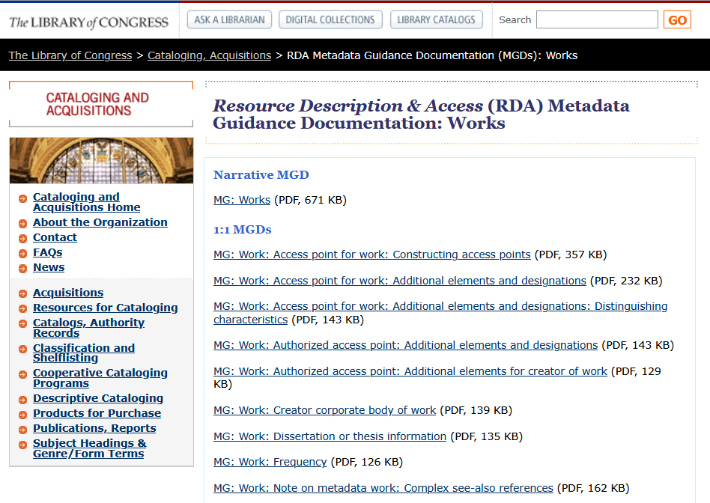
Narrative MGDs and 1:1 MGDs
MGD Home Page
MGD Page for Work Entity
All narrative MGDs
Narrative MGD
1:1 MGDs
Entity pages for 1:1 MGDs
Notes:
If you view the MGDs on the LC website, all the narrative MGDs are listed on the MGD home page, whereas 1:1 MGDs are listed on their respective entity page.

Slide 54
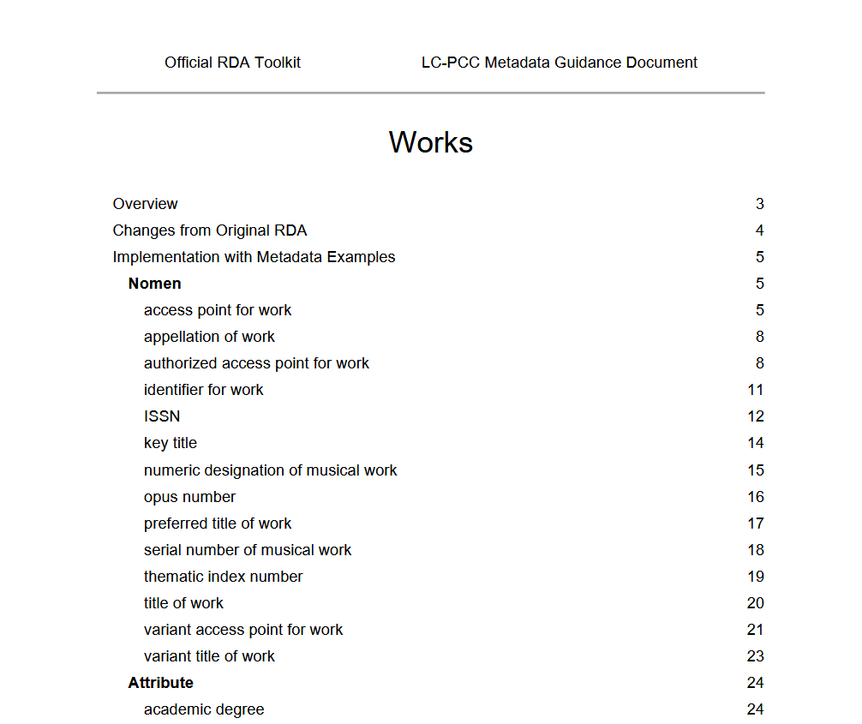
Narrative MGDs
Basic structure
  Overview
  Changes from Original RDA
  Implementation with Metadata Examples
    Guidance
    MARC Examples
    BIBFRAME Examples
  Cataloger Judgment Areas
Notes:
Narrative MGDs begin with a table of contents and have the following basic structure: Overview, Changes from Original RDA, Implementation with Metadata Examples, and Cataloger Judgment Areas. Elements are ordered based on the range of the element beginning with Nomen, attribute elements, and then all remaining relationship elements.

Slide 55
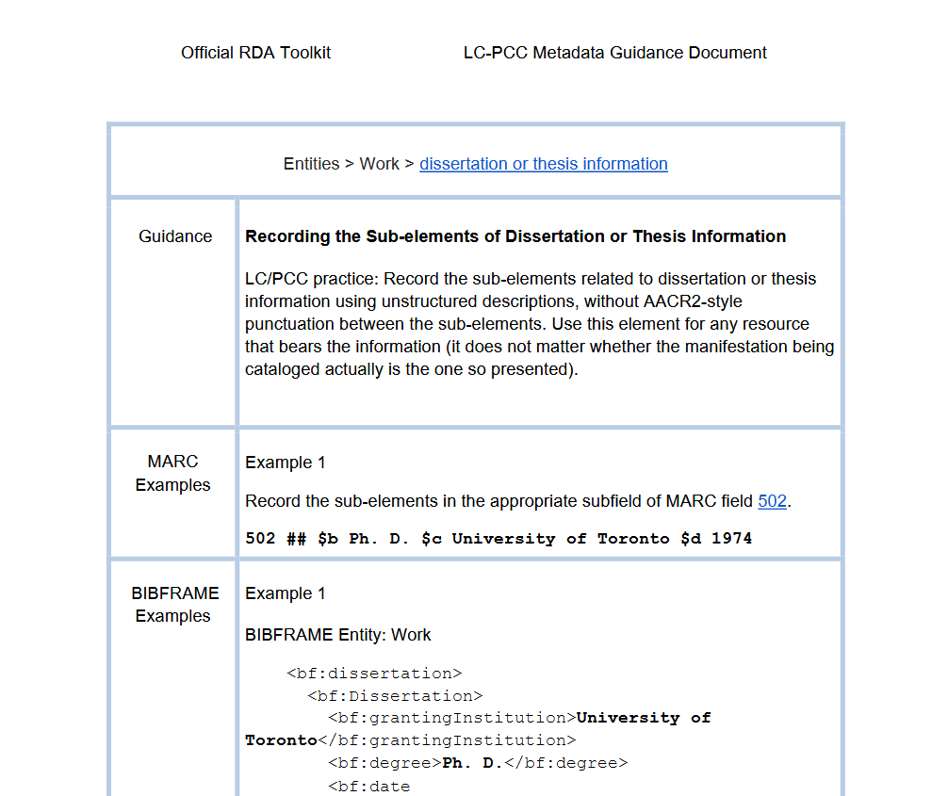
1:1 MGDs
Basic structure
  Header with link to RDA element
  Guidance
  MARC Examples
  BIBFRAME Examples
  Reference and Notes
  Update History
Notes:
In 1:1 MGDs, the information is presented in a table with the following sections: Guidance, MARC Examples, BIBFRAME Examples, Reference and Notes, Update History. These sections may be repeated when multiple topics are covered in the MGD. A header appears at the top of each page with a link to the corresponding RDA element.

Slide 56
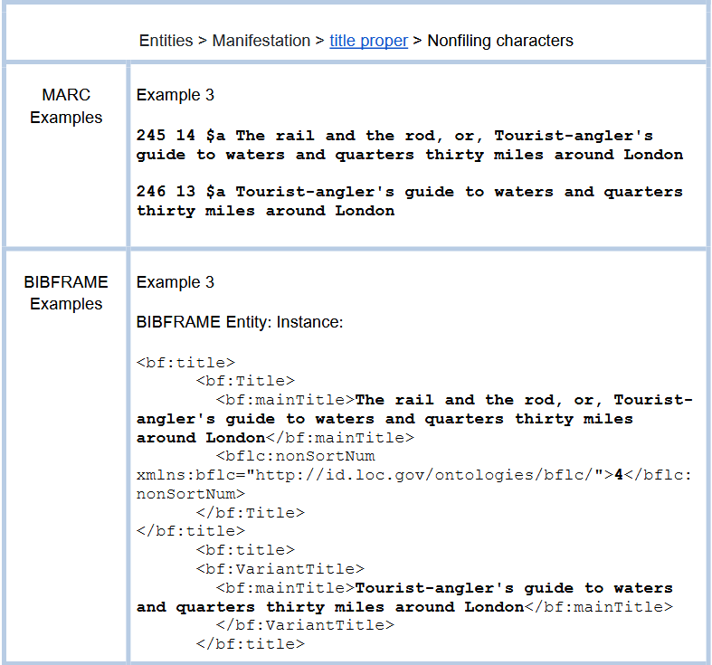
Examples
When appropriate, MGDs have examples in MARC and BIBFRAME
Examples may be:
  Made up
  Copied from actual descriptions
  Modified from actual descriptions
  Taken from LC-PCC PSs for the original RDA Toolkit
Notes:
When appropriate, MGDs have examples in MARC and in BIBFRAME. Some examples are made up, some are taken verbatim from bibliographic or authority descriptions, some are modified from bibliographic or authority descriptions to suit the example, and some are taken directly from LC-PCC PSs for the original RDA Toolkit.

Slide 57
BIBCO Standard Record (BSR) Metadata Application Profile
https://wiki.lyrasis.org/display/PFCCP/PCC+Working+Group+on+Metadata+
Application+Profiles
Notes:
The last document we need to highlight is the BIBCO Standard Record Metadata Application Profile.

Slide 58
What is a metadata application profile?
A specification of the metadata that is used in an application
A specification may include the entities, elements, and vocabulary encoding schemes that are used
(RDA Glossary)
Notes:
A metadata application profile is a specification of the metadata that is used in an application. It may include the entities, elements, and vocabulary encoding schemes that are used.

Slide 59
BIBCO Standard Record (BSR)
The BIBCO Standard Record (BSR) is a metadata application profile
A model for bibliographic monographic records using a single encoding level in a shared database environment
Catalogers satisfy BSR requirements when creating and/or modifying bibliographic records, and determine the fullness that best suits the resources in their collections and the needs of their users
Notes:
The BIBCO Standard Record, or BSR, is a metadata application profile. It is a model for bibliographic monographic records using a single encoding level in a shared database environment. Catalogers satisfy BSR requirements when creating and/or modifying bibliographic records, and determine the level of fullness that best suits the resources in their collections and the needs of their users.

Slide 60
BIBCO Standard Record (BSR) RDA Metadata Application Profile
Original RDA
Official RDA
April 26, 2024 revision
Word/PDF document
Combination of RDA “Core”, “PCC Core”, and “PCC Recommended” elements applicable to textual monographs and various other formats
Arranged in RDA element order
Use in conjunction with LC-PCC PSs
BSR for Official RDA (2025 draft)
Spreadsheet
Combination of “PCC Core” and “PCC Recommended” elements applicable to textual monographs and various other formats
A “map” to navigate official RDA
Use in conjunction with LC-PCC PSs and MGDs
Notes:
The BSR for original RDA has been updated for official RDA. One of the most significant changes is that the BSR for official RDA is a spreadsheet instead of a Word/PDF document. The BSR for official RDA includes a combination of “PCC Core” and “PCC Recommended” elements applicable for textual monographs and various other formats. Since the elements in official RDA are not arranged in any order, the BSR serves as a literal map to help navigate official RDA. The BSR is used in conjunction with the LC-PCC PSs and MGDs.

Slide 61
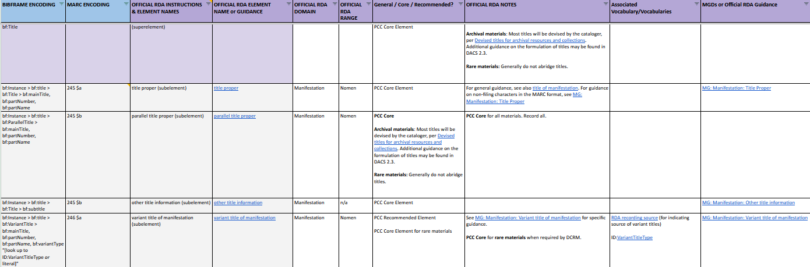
BIBCO Standard Record (BSR) RDA Metadata Application Profile for Official RDA
https://wiki.lyrasis.org/display/PFCCP/PCC+Working+Group+on+Metadata+
Application+Profiles
Notes:
The BSR for official RDA is still in draft form and is continuously being updated. Because of this, it is only available from the PCC Working Group on Metadata Application Profiles page on the PCC Wiki.
----------
From the PCC Wiki, select Standing Committee on Standards > PCC Working Group on Metadata Application Profiles.
https://wiki.lyrasis.org/display/PFCCP/PCC+Working+Group+on+Metadata+Application+Profiles
Direct link to the draft BSR:
https://docs.google.com/spreadsheets/d/14ooFZt8Fyy7DuF9a5X4wuxZO1dhS3pAX2fGWP5jFyfs/edit?gid=0#gid=0

Slide 62
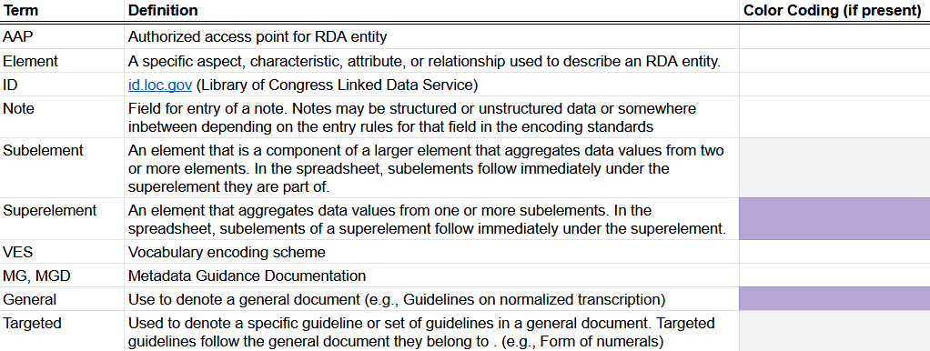
BSR for Official RDA
Abbreviations & Color Coding
Notes:
A key for the abbreviations and color coding used throughout the BSR is found on sheet 2. Of note is that superelements, element supertypes, and general instructions are shaded purple, while subelements, element subtypes, and targeted instructions are shaded grey.
----------
Direct link: https://docs.google.com/spreadsheets/d/14ooFZt8Fyy7DuF9a5X4wuxZO1dhS3pAX2fGWP5jFyfs/edit?gid=0#gid=0

Slide 63
BSR for Official RDA
PCC Core Elements
PCC Core Elements is sheet 1 of the BSR for Official RDA
Blue rows divide and organize list of elements:
  Identifying Manifestations & Items
  Describing Carriers
  Providing Acquisition & Access Information
  Identifying Works
  Identifying Expressions
  Agents
  Relationships Between Works and Subjects
  Related Works
  Related Expressions
  Related Manifestations
  Related Items
Notes:
PCC Core Elements are listed on sheet 1 of the BSR for official RDA. Blue rows divide and organize the list into the following sections, which largely correspond to the sections in original RDA:
Identifying Manifestations & Items
Describing Carriers
Providing Acquisition & Access Information
Identifying Works
Identifying Expressions
Agents (which includes sections for Agents Associated with a Work, Agents Associated with an Expression, and Agents Associated with a Manifestation)
Relationships Between Works and Subjects
Related Works
Related Expressions
Related Manifestations
Related Items

Slide 64
BSR for Official RDA
PCC Core Elements
Column | Example
BIBFRAME ENCODING | bf:Instance > bf:title > bf:Title > bf:mainTitle, bf:partNumber, bf:partName
MARC ENCODING | 245 $a
OFFICIAL RDA INSTRUCTIONS & ELEMENTS | title proper (subelement)
OFFICIAL RDA ELEMENT NAME or GUIDANCE | title proper
Notes:
Going from left to right in the PCC Core Elements sheet, there are columns for BIBFRAME and MARC encodings, a column for RDA instructions and elements, and then a link to the RDA element or guidance in the RDA Toolkit.

Slide 65
BSR for Official RDA
PCC Core Elements
Column | Example
OFFICIAL RDA DOMAIN | Manifestation
OFFICIAL RDA RANGE | Nomen
General / Core / Recommended? | PCC Core Element
Notes:
The domain and range of the element are given, followed by a column indicating if the element is PCC Core or PCC Recommended.

Slide 66
BSR for Official RDA
PCC Core Elements
Column | Example
OFFICIAL RDA NOTES | For general guidance, see also title of manifestation. For guidance on non-filing characters in the MARC format, see MG: Manifestation: Title Proper
Associated Vocabulary/Vocabularies
MGDs or Official RDA Guidance | MG: Manifestation: Title Proper
Notes:
Very basic guidance is included in the Notes column, which may include links to the RDA Toolkit or Metadata Guidance documents. If the value for the element can be recorded using a controlled term, the Associated Vocabularies are listed. Lastly, there is a column that includes links to selected MGDs or Official RDA Guidance.

Slide 67
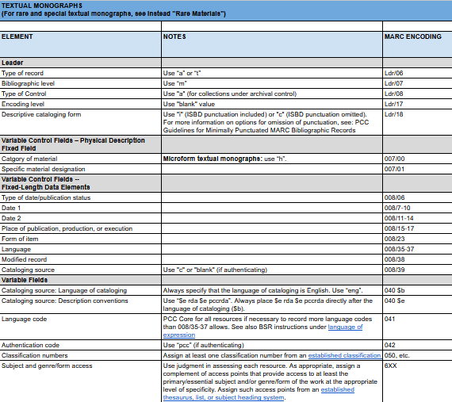
BSR for Official RDA
Required Non-RDA & MARC Data
Archival Materials
Audio Recordings
Cartographic Resources
Electronic Resources
Graphic Materials
Moving Images
Notated Music
Rare Materials
Textual Monographs
Supplemental Requirements for the Digital Aspects of Formats
Notes:
Sheet 3 is divided into formats and provides recommended non-RDA and MARC data for the Leader and variable control fields.
----------
Direct link: https://docs.google.com/spreadsheets/d/14ooFZt8Fyy7DuF9a5X4wuxZO1dhS3pAX2fGWP5jFyfs/edit?gid=0#gid=0

Slide 68
Using documentation while cataloging
Notes:
Now that we know what the documentation is, let’s look at how we can use it while cataloging.

Slide 69
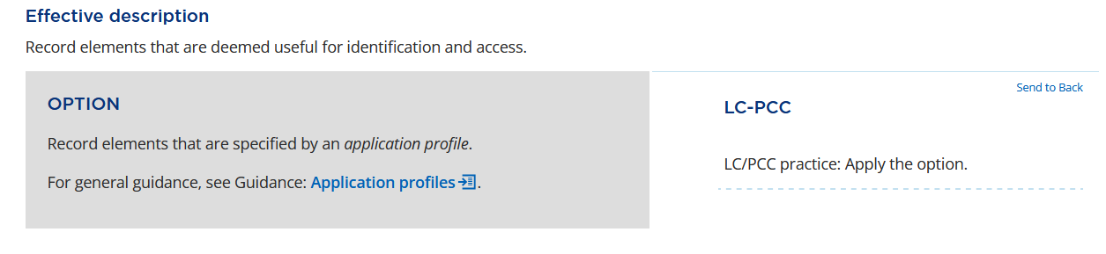
Determining which elements to record
The PCC BIBCO metadata application profile includes:
  BIBCO Standard Record (BSR) Official RDA Metadata Application Profile
  LC-PCC Policy Statements (LC-PCC PSs)
  Metadata Guidance Documentation (MGDs)
Notes:
Since RDA only specifies a very basic minimum description, we apply the option to record elements that are specified by an application profile and that are deemed useful for identification and access. The PCC BIBCO metadata application profile includes the BSR, the LC-PCC PSs, and the MGDs.

Slide 70
LC/PCC Core Elements
For a full-level record, all Core elements must be recorded if applicable and readily ascertainable
Types of core statements:
  Core: the element is required if applicable and readily ascertainable
  Core if: the element is required when specific conditions are met
  Core for: the element is required for specific formats
If there is no Core statement, then the element is optional for LC/PCC
Notes:
For an effective description of an entity, LC/PCC has designated certain elements as Core. For a full-level record, all Core elements must be recorded if applicable and readily ascertainable. Unless otherwise specified, only one instance of a Core element is required; subsequent instances are optional.
There are three types of core statements:
“Core” means that the element is required if applicable and readily ascertainable. Core does not mean it is mandatory.
“Core if” means that the element is required when specific conditions are met.
“Core for” means that the element is required for specific formats.
If there is no Core statement, then the element is optional for LC/PCC; however, you may be required to record the element according to institutional policy or best practices from a specialized cataloging community.

Slide 71
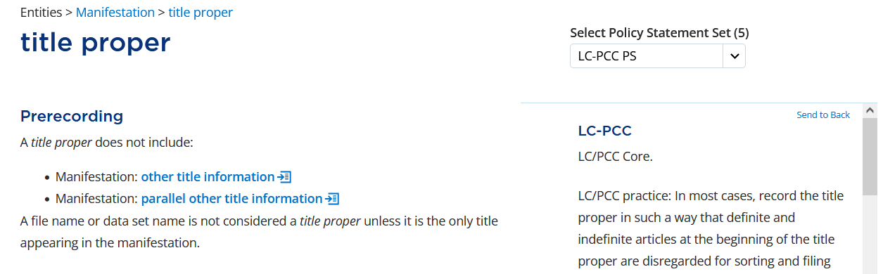
BSR → RDA Toolkit
Notes:
Because the BSR includes all PCC Core and PCC Recommended elements, it is a logical place to start. In addition to basic information about the element, it provides a link to view the element in the RDA Toolkit. Note that the element is identified as Core in the “General / Core / Recommended?” column in the BSR and in the LC-PCC PS for Prerecording.

Slide 72
Choice of Elements
Element Supertype vs. Element Subtype
Choose to use one or more element subtypes to create a more specific description
Choose to use the element supertype to create a more general description
  This generally includes recording the values of one or more element subtypes without using the subtypes themselves
Notes:
Because of the element hierarchy in RDA, you may be able to choose between using an element subtype to create a more specific description or using the element supertype to create a more general description. This is most common when recording a relationship and the specific relationship is not listed in the BSR.

Slide 73
Applying Options
After deciding to record an element, consider all options and related policy statements to determine how the value for the element should be recorded:
  Apply the option: the option should be applied if applicable and readily ascertainable
  Apply the option if/when: the option should be applied when specific conditions are met
  Cataloger’s judgment: the option can be applied according to the judgment of the cataloger
  Do not apply the option: the option should not be applied
Notes:
After deciding to record an element, consider all options and related policy statements to determine how the value for the element should be recorded.
“Apply the option” means that the option should be applied if applicable and readily ascertainable.
“Apply the option if/when” means that the option should be applied when specific conditions are met.
“Cataloger’s judgment” means that the option can be applied according to the judgment of the cataloger.
“Do not apply the option” means that the option should not be applied.

Slide 74
Applying Options
General Guidelines
Apply options where the policy statements say “Apply the option” if the option is applicable and readily ascertainable
If those options are not applicable or readily ascertainable, apply options where the statements say “Cataloger’s judgment”
(Optional) Apply options where statements say “Cataloger’s judgment” to add to the existing value or to record an additional value
Notes:
When considering which options to apply, consider the following general guidelines:
Apply options where the policy statements say to “Apply the option”. Apply only those options that are applicable and readily ascertainable, including those that meet the specified conditions.
If the options that should be applied are not applicable or readily ascertainable, apply options where the policy statements indicate “Cataloger’s judgment.”
Optionally, apply options where the policy statements indicate “Cataloger’s judgment” to add to the existing value or to record an additional value for the element.

Slide 75



Applying Options
Applying one or more options
Some options are meant to work together and be applied at the same time
Example: Manifestation: extent of manifestation
Notes:
The options in official RDA are written with different underlying assumptions that are not stated. Some options are meant to work together and be applied at the same time. For example, when recording the extent for a single volume with numbered pages, several options must be applied at the same time, including options to record the sequence used in the manifestation, to record the number of pages, to record each sequence, and to record the last numbered page of each sequence followed by the appropriate term. In this case, all these options work together to record a single value.

Slide 76

Applying Options
Applying one or more options
Some options are meant to work in contrast and cannot be applied at the same time
Example: Manifestation: title of manifestation
Notes:
Other options are meant to work in contrast and cannot be applied at the same time. For example, the element title of manifestation provides three options that begin with “Record a title by transcribing text and spoken word content from a manifestation using,” with each option giving a different standard to use: Guidelines on basic transcription, Guidelines on normalized transcription, and any transcription guidelines. Since only one set of transcription guidelines can be applied to a single value, the policy statements clearly state “Do not apply the option” on two of the options and “Apply the option” on the one that is desired.

Slide 77

Applying Options
Applying one or more options
Sometimes, options that should be applied separately appear to be applied together
“If” statements in LC-PCC PSs indicate preference
Example: Manifestation: title proper
Notes:
Sometimes, options that should be applied separately appear to be applied together. If the options result in the same value, only one of the options needs to be applied. If the values could be different, the policy statements try to take account of these differences. For example, when recording the element title proper, the condition “Two or more values of a title appears in sources of information” is followed by two options: “Record the value that appears first” and “Record a value that is the most comprehensive form.” Depending on the source, the value may be the same or it may be necessary to choose between two values. As a result, the policy statements have “if” statements to give preference to apply one of the two options depending on the situation.

Slide 78
Interpreting Conditions and Options
Conditions
Options
Describes the situation
  A manifestation is …
  A title includes …
  A value of [Domain]: [element] includes …
Tells you what to do
  Record a value …
  Record a value of [Domain]: [element] …
    Record a value of another element as a value for this element
  Record a [Domain]: [element] …
    Record another element instead of or in addition to this element
Notes:
When reviewing the options to apply, there are a few things to remember. A condition describes the situation and often begin with phrases like “A manifestation is …,” “A title includes …,” or “A value of [an element] includes …” The options tell you what to do when the conditions are met. Options often begin with “Record a value …,” “Record a value of [an element] …,” or “Record [an element] …” The last two can be a bit tricky, so let’s look at some examples.

Slide 79


Interpreting Conditions and Options
Interpretation
Record a title of work as a preferred title of work
You may need to determine a title of work if you have not already done so
Interpretation
Record a note to indicate the source of the title proper using the element note on manifestation
Notes:
For the element preferred title of work, there is an option to “Record a value of Work: title of work.” This means that we can record a title of work as a preferred title of work. If you have not already determined a title of work, you will need to determine a title of work before you can apply this option.
For the element title proper, there is an option to “Record a Manifestation: note on manifestation on the source or basis for a value of a title proper.” This tells us to record a note to indicate the source of the title proper using a different element, note on manifestation.

Slide 80
Cataloging using Official RDA
Consult the BSR and identify an applicable PCC Core or PCC Recommended element.
Consult the RDA Toolkit and confirm the element to record.
Consider all options and related policy statements for the element.
Consult any MGDs linked from the policy statements for further guidance and examples.
    Note: Linked MGDs are applicable for the element but not necessarily to your situation.
If applicable, consult additional documentation, such as those from specialized cataloging communities, even if not mentioned or linked in the policy statements.
Determine how to record the value for the element.
Record that value in your description.
Repeat for all applicable PCC Core and PCC Recommended elements.
Consider and record any additional elements beyond the PCC Core and PCC Recommended elements.
Notes:
When cataloging using official RDA, start by consulting the BSR and identifying an applicable PCC Core or PCC Recommended element.
Next, consult the RDA Toolkit and confirm the element to record. After consulting the element in the RDA Toolkit, you may decide that a broader or narrower element is more appropriate for your situation.
After deciding the element to record, consider all options and related policy statements for the element.
Consult any MGDs linked from the policy statements for further guidance and examples. Note that MGDs are linked because they are applicable to the element, section, or option and they may not be applicable to your situation.
If applicable, also consult additional documentation, such as those from specialized cataloging communities, even if they are not mentioned or linked in the policy statements.
After consulting all the documentation, determine how to record the value for the element and …
… record it in your description.
Repeat this process for all applicable PCC Core and PCC Recommended elements.
Lastly, consider and record any additional elements.

Slide 81
BIBCO Standard Record (BSR) Metadata Application Profile (2025 Draft)
  Core elements were eliminated in official RDA
  BSR includes PCC Core and PCC Recommended elements
RDA Toolkit
  RDA is structured around the RDA entities and their elements
  Instructions in original RDA are options in official RDA
  Each option requires a policy statement
LC-PCC Policy Statements (LC-PCC PSs)
  Identify LC/PCC Core elements
  Indicate whether an LC/PCC cataloger should or should not apply an option, or if they could exercise judgment to make the decision
Metadata Guidance Documentation (MGDs)
  Include further guidance and examples than what is possible to include in the LC-PCC Policy Statements
Notes:
In summary, the primary documentation used for official RDA are the BIBCO Standard Record Metadata Application Profile, the RDA Toolkit, the LC-PCC Policy Statements, and the Metadata Guidance Documentation. Since core elements were eliminated in official RDA, the BSR includes PCC Core and PCC Recommended elements for textual monographs and other resources. The RDA Toolkit is structured around the RDA entities and their elements. Instructions in original RDA are options in official RDA and each option requires a policy statement. The LC-PCC PSs identify LC/PCC Core elements and indicate whether an LC/PCC cataloger should or should not apply an option, or if they could exercise judgment to make the decision. The MGDs include further guidance and examples than what is possible to include in the LC-PCC PSs. All this documentation works together and is used in conjunction with each other.

Slide 82
Exercises

Slide 83
Exercise
What are the broader elements of Manifestation: title of manifestation?
What are the narrower elements of Manifestation: title of manifestation?
Notes:
Answer on next slide.

Slide 84

Answer
What are the broader elements of Manifestation: title of manifestation?
  Manifestation: appellation of manifestation
  RDA Entity: name of RDA entity
What are the narrower elements of Manifestation: title of manifestation?
  Manifestation: abbreviated title
  Manifestation: title of series
  Manifestation: title proper
  Manifestation: variant title of manifestation

Slide 85
Exercise
element supertype
element subtype
superelement
subelement
Expression: form of notation
Manifestation: place of publication
Manifestation: publication statement
Expression: script
Notes:
Exercise: Match the element type (1-4) with the appropriate element (A-D).
Answer on next slide.

Slide 86
Answer
element supertype
element subtype
superelement
subelement
Expression: form of notation
Expression: script
Manifestation: publication statement
Manifestation: place of publication
Notes:
The element Expression: form of notation is an element supertype and includes the element subtype Expression: script. The element Manifestation: publication statement is a superelement because it is composed of subelements such as Manifestation: place of publication.

Slide 87
Exercise
Identify if the following elements are PCC Core, PCC Recommended, or optional.
Manifestation: place of distribution
Manifestation: designation of edition
Manifestation: illustrative content
Expression: summarization of content
Notes:
Answer on next slide.

Slide 88
Answer
Identify if the following elements are PCC Core, PCC Recommended, or optional.
Manifestation: place of distribution
  PCC Core for rare materials when present in the manifestation.
Manifestation: designation of edition
  LC/PCC Core.
Manifestation: illustrative content
  Optional for PCC
Expression: summarization of content
  PCC Core for archival materials and a recommended element for other resource types when useful to support user tasks.

