Slide 1
A Joint Workshop with NARDAC and
PCC SCT RDA Training Task Group: Monographs
Workshop materials:
https://bit.ly/RDA-ALA-25
Notes:
Logistics:
Wifi
Restrooms
Today’s workshop has been developed by the PCC Standing Committee on Training RDA Training Task Group: Monographs and the North American RDA Committee (NARDAC).

Slide 2
SCT RDA Training Task Group: Monographs
Michael Babinec Northwestern University | Bradley Carrington New Mexico State Library | Robert L. Maxwell Brigham Young University
Adam Baron, chair University of California, Berkeley | Laura Doublet University of Victoria | Yuji Tosaka The College of New Jersey
Kaylin Blount University of Pennsylvania | Sarah Furger Joliet Public Library | Cathy Weng Princeton University
Notes:
Members of the SCT RDA Training Task Group: Monographs who helped develop content for today’s workshop include Michael Babinec, Adam Baron, Kaylin Blount, Bradley Carrington, Laura Doublet, Sarah Furger, Robert Maxwell, Yuji Tosaka, and Cathy Weng.

Slide 3
North American RDA Committee (NARDAC)
Hong Cui Canadian Committee on Cataloguing representative Library and Archives Canada | Melanie Polutta Library of Congress representative Policy, Training, and Cooperative Programs Division
Robert L. Maxwell American Library Association representative Brigham Young University | Adam L. Schiff American Library Association representative University of Washington Libraries
Shawne Miksa Library Science education representative University of North Texas | Trina Soderquist Library of Congress representative Policy, Training, and Cooperative Programs Division
Notes:
Members of NARDAC who helped develop content for the workshop include Hong Cui, Robert Maxwell, Shawne Miksa, Melanie Polutta, Adam Schiff, and Trina Soderquist.

Slide 4
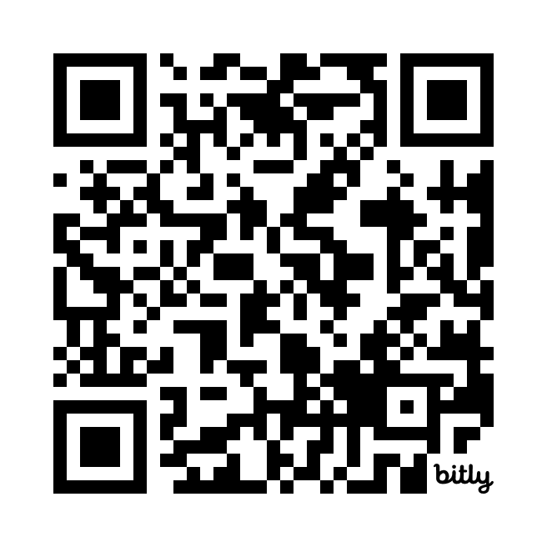
Workshop Materials
All workshop materials are available in a Google Drive folder
https://bit.ly/RDA-ALA-25
Notes:
All materials need for today’s workshop are available in a Google Drive folder available at bit.ly/RDA-ALA-25.

Slide 5
Understand and apply official RDA instructions and PCC practices for describing print and electronic monographs in MARC 21 format
Understand and apply the BIBCO Standard Record (BSR) Official RDA Metadata Application Profile
Apply appropriate guidance in LC-PCC Policy Statements and RDA Metadata Guidance Documentation
Notes:
At the end of the workshop, we hope you will be able to:
Understand and apply official RDA instructions and PCC practices for describing print and electronic monographs in MARC 21 format
Understand and apply the BIBCO Standard Record (BSR) Official RDA Metadata Application Profile
Apply appropriate guidance in LC-PCC Policy Statements and RDA Metadata Guidance Documentation

Slide 6
Overview
Introduce documentation used by PCC catalogers for official RDA
Explain how to use the RDA Toolkit and PCC documentation while cataloging
Demonstrate and explain how to catalog an ebook using official RDA and PCC documentation and then code the values in MARC 21
Provide opportunities for hands-on practice cataloging using official RDA and PCC documentation
Help catalogers feel more comfortable and confident with official RDA
Notes:
To help us achieve today’s learning outcomes, we will be introducing you to the documentation used by PCC catalogers for official RDA and explaining how to use the RDA Toolkit and PCC documentation while cataloging. We will spend much of the workshop demonstrating and explaining how to catalog an ebook using official RDA and PCC documentation and then coding our values in a MARC 21 bibliographic record. After cataloging an ebook together, we will provide you with an opportunity for hands-on practice cataloging other resources using official RDA and PCC documentation. Ultimately, we hope that at the end of the workshop you will feel more comfortable and confident with official RDA than you do right now.

Slide 7
Workshop Schedule
8:00 AM Introduction
8:10 AM Documentation used by PCC catalogers
Presenter: Adam Baron
9:00 AM Review of RDA concepts
Presenters: Trina Soderquist, Melanie Polutta
10:00 AM Break (15 minutes)
10:15 AM Cataloging an ebook: Describing the manifestation
Presenters: Robert L. Maxwell, Cathy Weng, Kaylin Blount, Laura Doublet, Michael Babinec
12:00 PM Lunch (1 hour)
Notes:
In the workshop schedule, the times are approximate and subject to change based on the time needed to cover the content. I will start shortly with the first session on documentation used by PCC catalogers and then Trina and Melanie will review some RDA concepts. We will take a 15 minute break around 10:00. The remainder of the morning will be spent describing the manifestation of our ebook presented by Bob Maxwell, Cathy Weng, Kaylin Blount, Laura Doublet, and Michael Babinec. We will break for a provided lunch from 12:00 to 1:00.

Slide 8
Workshop Schedule
1:00 PM Cataloging an ebook:
Describing the aggregating work & aggregating expression
Presenters: Yuji Tosaka, Adam Schiff
Describing an aggregated work & aggregated expression
Presenters: Robert L. Maxwell, Adam Schiff
Recording data provenance
Presenter: Adam Baron
2:15 PM Break (15 minutes)
2:30 PM Exercises
3:45 PM Q & A / Wrap-up
4:00 PM Finish
Notes:
Beginning at 1:00, we will finish cataloging our ebook. Yuji Tosaka and Adam Schiff will focus on describing the aggregating work and aggregating expression, then Bob Maxwell and Adam Schiff will describe an aggregating work and an aggregated expression. Lastly, I will conclude cataloging our ebook by recording data provenance information.
Our afternoon break will be from approximately 2:15 to 2:30. Hopefully, that will leave you with a little over an our to work on some of the exercises.
We will wrap things up at about 3:45. As part of the wrap-up, we will ask you to complete a survey about your experience. Your feedback will be important as we work on training for PCC’s implementation of official RDA.

Slide 9
Questions
Notes:
Are their any questions about the structure of the day before we get started?

